Slide 1

Peer Pressure
Fourth Grade Lesson 5

Slide 2

Personal Space
Be aware of your surroundings, respect others’ space, and stay in your own area.

Slide 3

Volume control
Use indoor voices, be mindful of noise levels.

Slide 4

Active Listening
Eyes and ears open! Ready to participate!

Slide 5

Sharp Minds
Be prepared to problem solve, ask questions, and contribute to the lesson.

Slide 6
What is peer pressure?

Slide 7

Peer pressure is when people your age try to influence you to do something, whether good or bad. Sometimes, it's tempting to do what everyone else does, even if it's wrong.

Slide 8
Examples of peer pressure:

Slide 9

Cheating on a test
Notes:
Imagine you're sitting in class, and your friends start passing notes, whispering, 'Hey, let's copy each other's answers on the test.' They keep nudging you, saying, 'Come on, everyone else is doing it. It's not a big deal.' This is an example of negative peer pressure because they're trying to influence you to cheat, which is not the right thing to do.

Slide 10
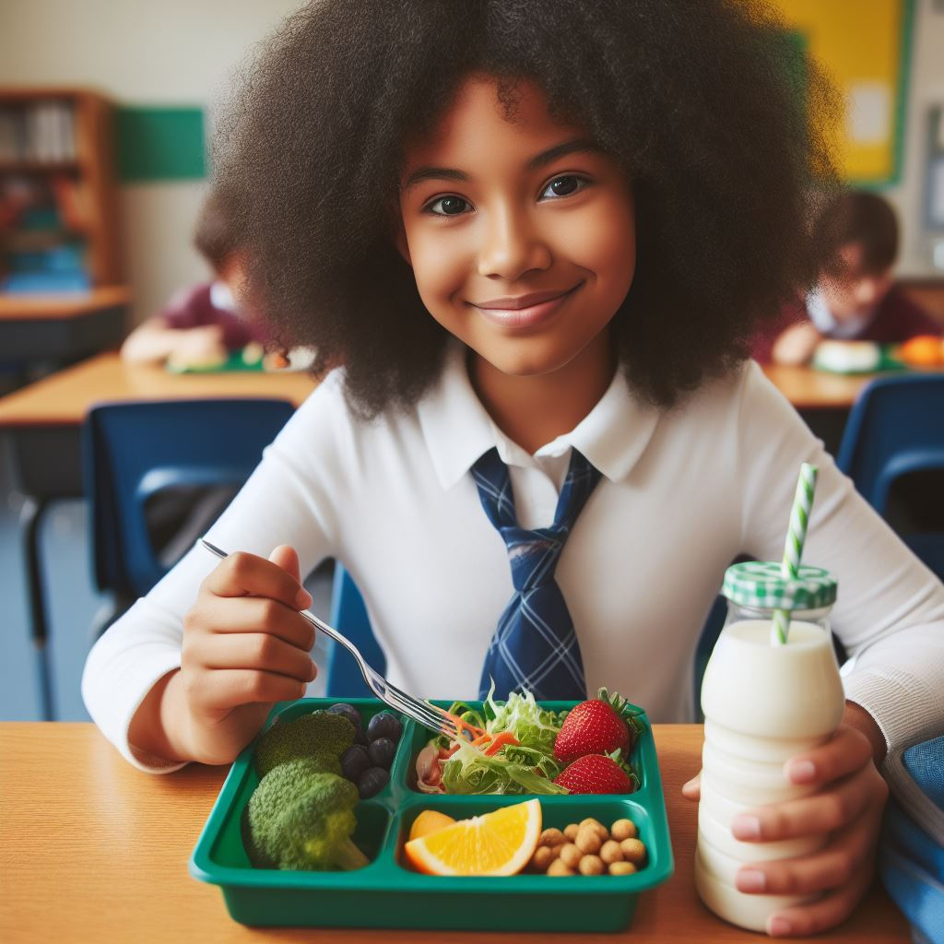
Encouraging healthy choices
Notes:
You're at lunch with your friends and bring a nutritious lunch from home. Your friends notice and say, 'Wow, that looks healthy! I should start bringing healthier lunches, too.' They encourage you to join the school's fitness club and eat more fruits and vegetables. This is a positive example of peer pressure because your friends influence you to make healthier choices, which is good. Now, think about a positive example. You're at lunch with your friends and bring a nutritious lunch from home. Your friends notice and say, 'Wow, that looks healthy! I should start bringing healthier lunches, too.' They encourage you to join the school's fitness club and eat more fruits and vegetables. This is a positive example of peer pressure because your friends influence you to make healthier choices, which is good.

Slide 11
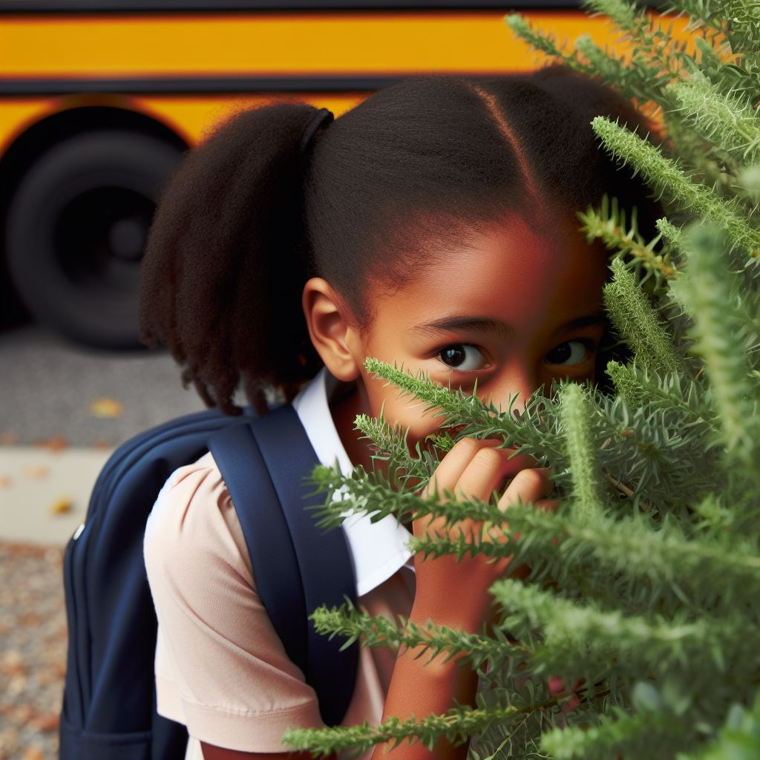
Skipping school
Notes:
Next, consider another negative example. You're excited about attending school because you have a project presentation today. But your friends approach you and say, 'Hey, let's skip school and go to the mall instead. It'll be way more fun!' They insist, saying, 'Don't worry, nobody will even notice we're gone.' This is an example of negative peer pressure because they're trying to persuade you to skip school, which is irresponsible behavior.

Slide 12
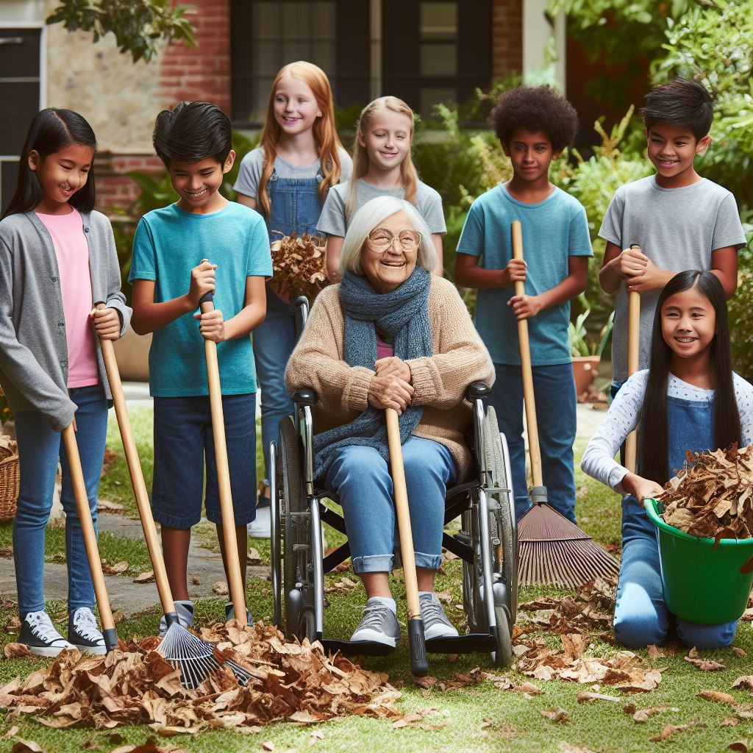
Volunteering for community service
Notes:
Let's consider a positive example of peer pressure. Your classmates are organizing a community service project to clean up the local park. They invite you to join them, saying, 'We're making a difference in our community. It would be awesome if you could help, too!' They encourage you to participate by explaining how much fun it will be and how good it will feel to help others. This is a positive example because they're influencing you to do something helpful and responsible for your community.

Slide 13
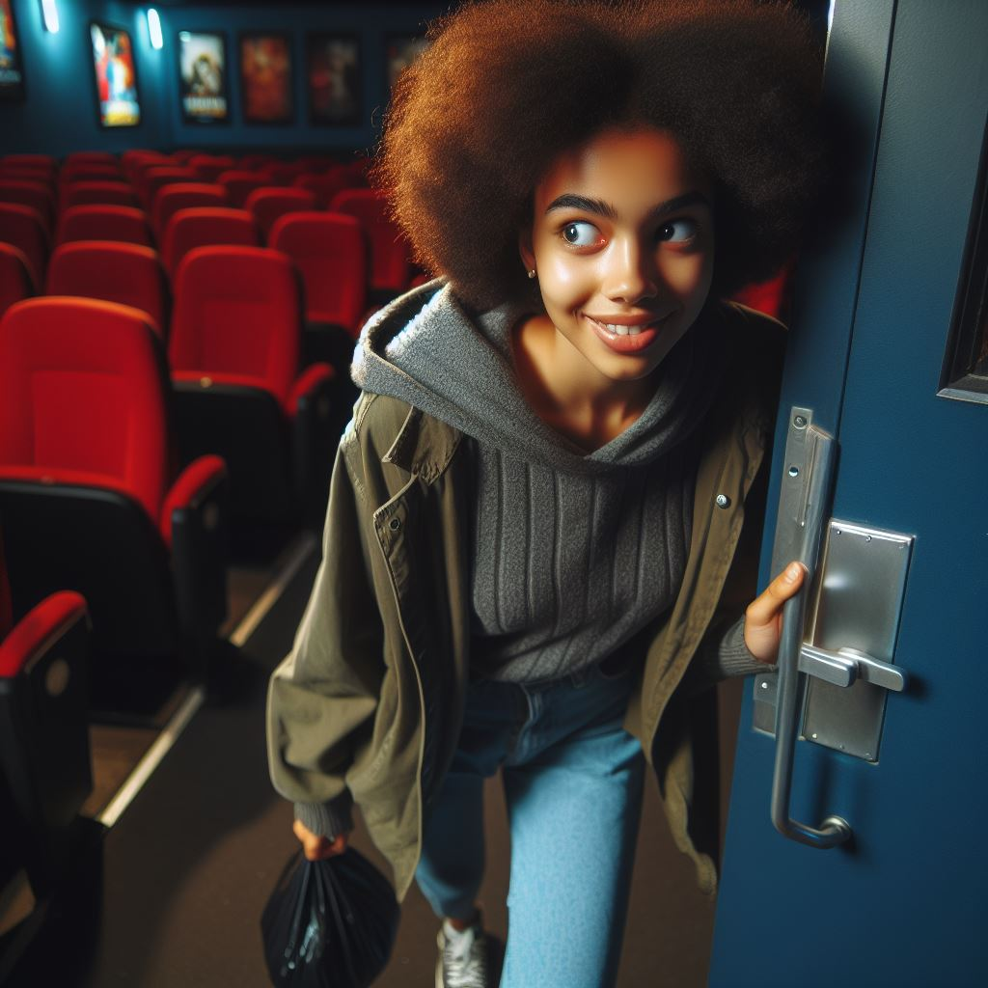
Scenario 1
Your friends want you to sneak into a movie theater without paying.

Slide 14
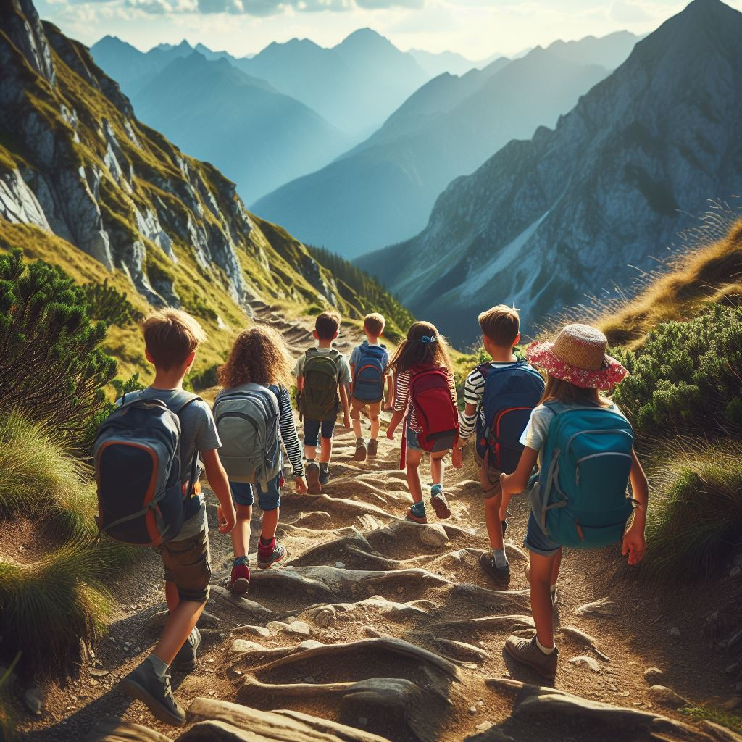
Scenario 2
Your friends suggest hiking instead of playing video games indoors.

Slide 15
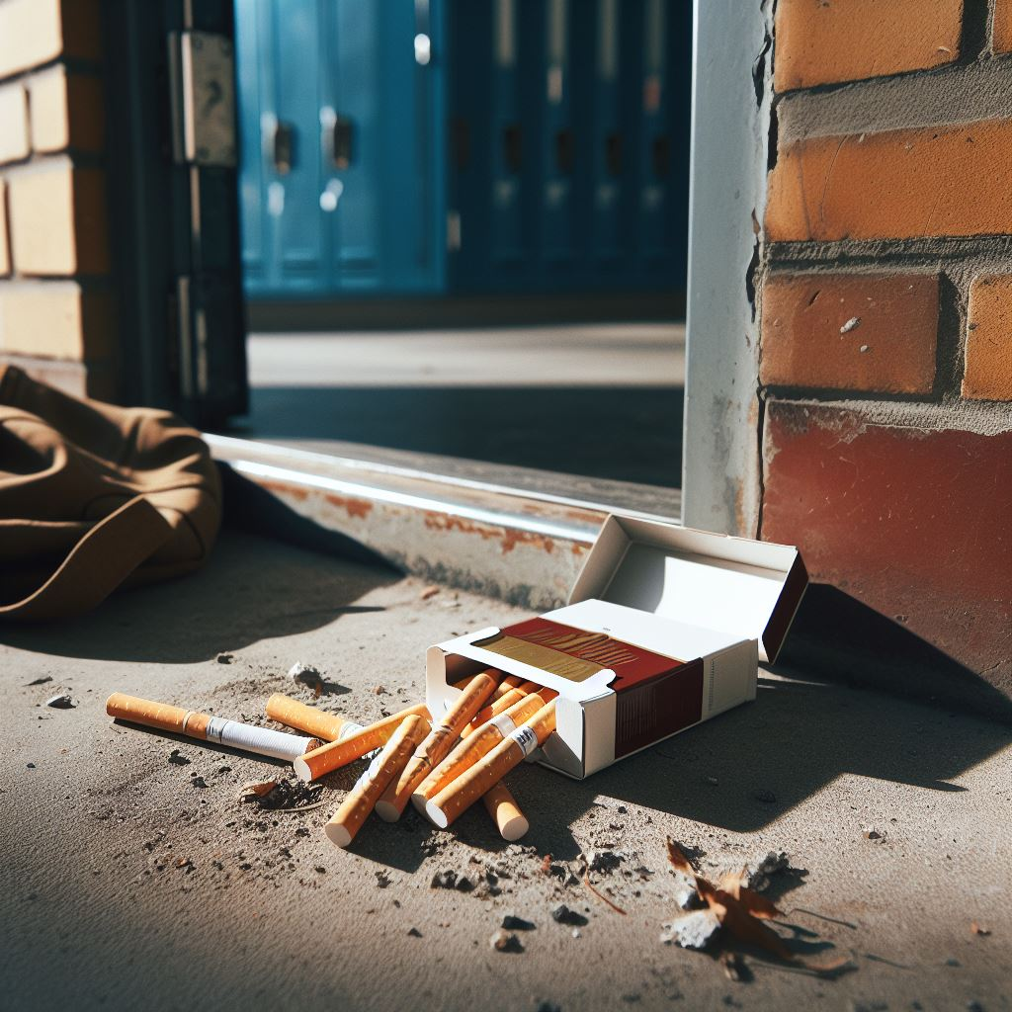
Scenario 3
Your friends urge you to try smoking cigarettes behind the school building.

Slide 16

Scenario 4
Your friends invite you to participate in a charity run to raise funds for a local animal shelter.

Slide 17
Brainstorming:
What are some things you can do when you feel pressured to do something you know is wrong?

Slide 18
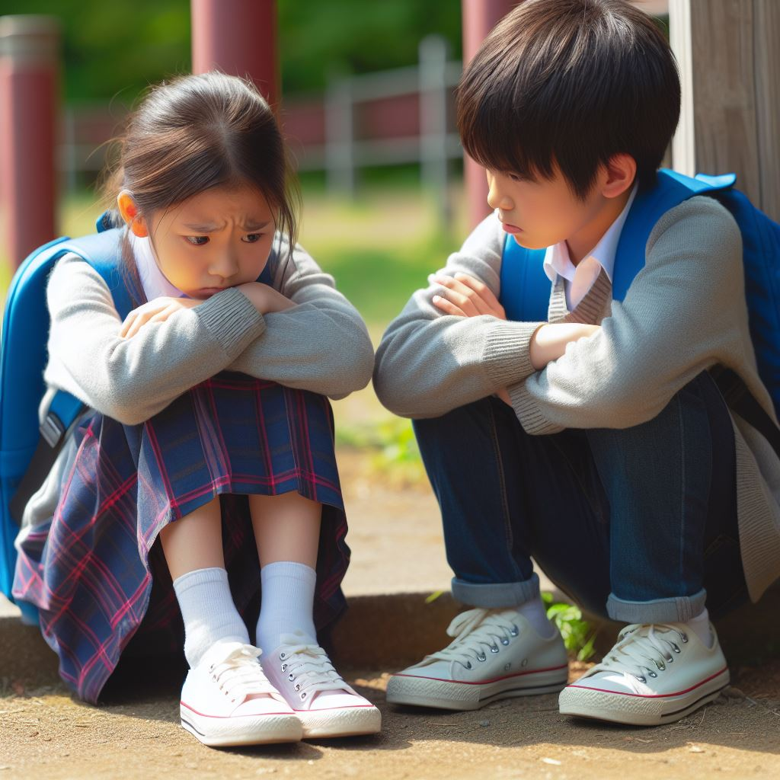
Handling mistakes by demonstrating responsibility and
remorse.

Slide 19
Important strategies to remember:

Slide 20

Strategy 1: Say no firmly.
Notes:
It's okay to say no if you're uncomfortable with something. It's important to stand up for what you believe in.

Slide 21

Strategy 2: Walk away.
Notes:
Sometimes, removing yourself from a tough situation is the best option. Taking a break can help you make better choices.

Slide 22

Strategy 3: Find new friends who support your decisions.
Notes:
Surround yourself with friends who respect your choices and help you do the right thing.

Slide 23

Strategy 4: Talk to a trusted adult.
Notes:
If you're unsure what to do, don't hesitate to talk to a grown-up you trust. They can provide guidance and support.

Slide 24

Strategy 5: Take responsibility for your actions.
Notes:
When you make a mistake, own up to it. Don't blame others. For example, if you break something, apologize sincerely.

Slide 25
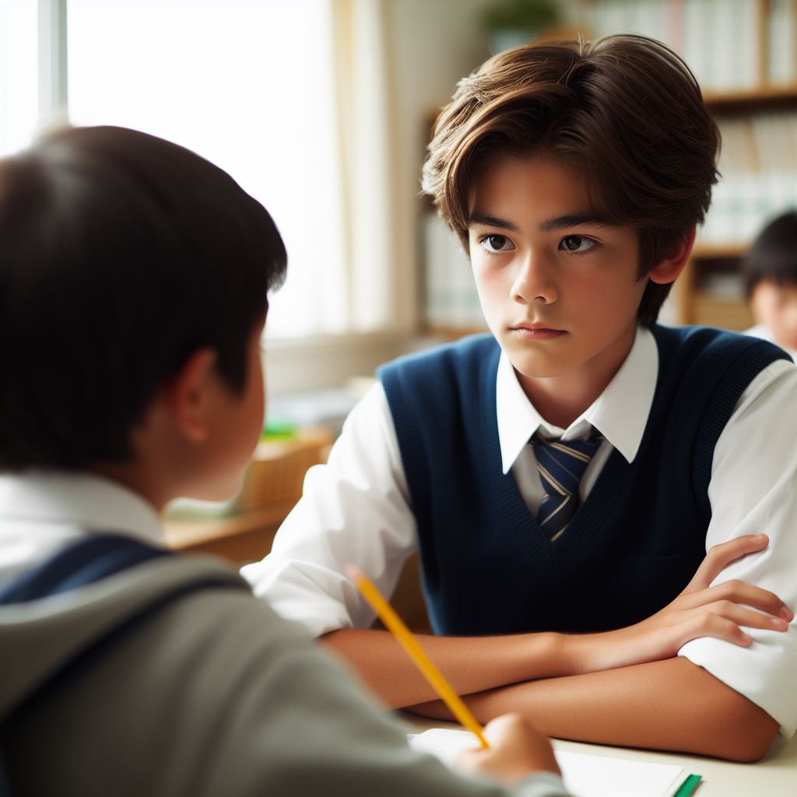
Strategy 6: Apologize sincerely if you make a mistake.
Notes:
If you hurt someone, apologize and mean it. It's important to acknowledge the impact of our actions.

Slide 26
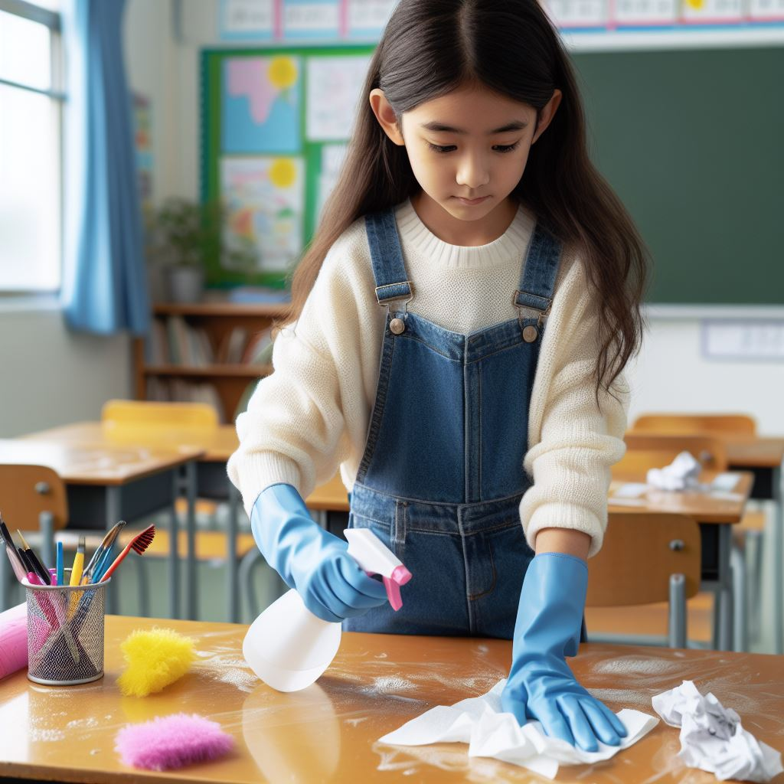
Strategy 7: Make amends to those you may have harmed.
Notes:
If you do something wrong, try to fix it. Offer help or replace what was damaged, if possible.

Slide 27

Strategy 8: Learn from your mistakes and strive to improve.
Notes:
Use your mistakes as opportunities for growth. Think about what you can do differently next time.

Slide 28
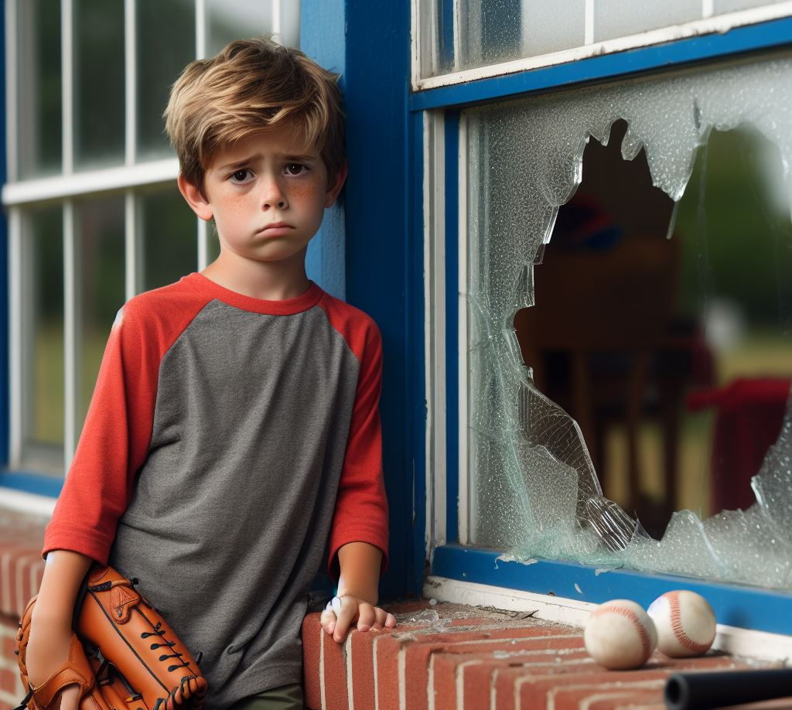
Strategy 9: Reflect on the consequences of your actions.
Notes:
If you do something wrong, try to fix it. Offer help or replace what was damaged, if possible.

Slide 29

Strategy 10: Seek guidance from positive role models.
Notes:
Seek out a positive influence for guidance.

Slide 30
Discussion
Take responsibility
Show remorse
Make amends
Notes:
Let's discuss how we can demonstrate responsibility and remorse for our behavior. When we make a mistake, it's important to take ownership of our actions and try to make things right. How do you think we can do that?
Show the powerpoint slides or read the scenarios and ask students what the forecast means

Slide 31
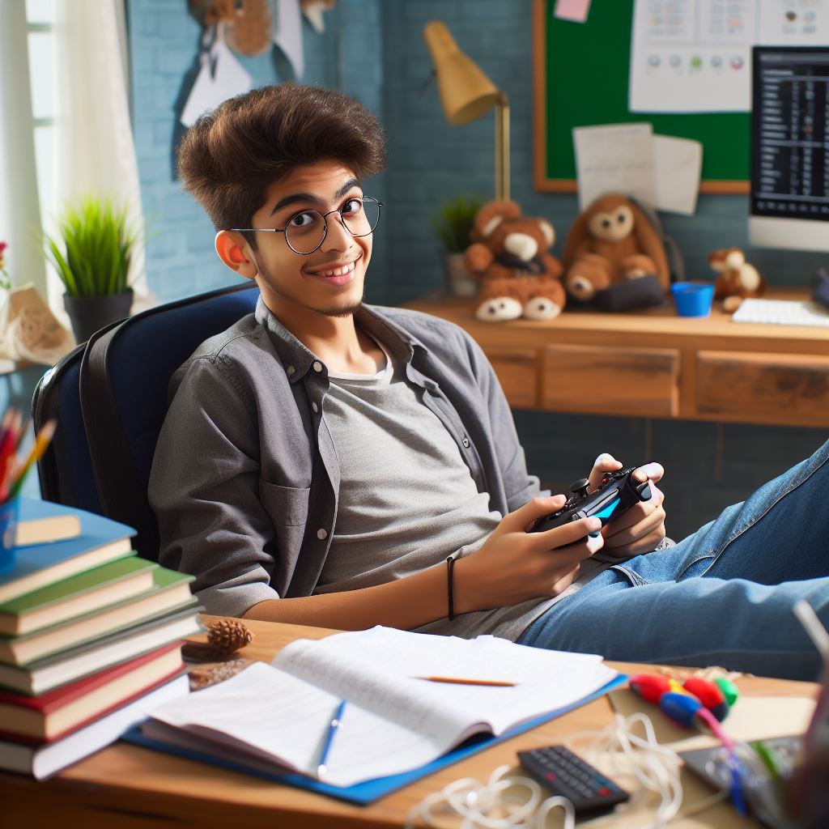
Scenario 1
Your friends want you to skip homework and play video games instead.
Notes:
Your friends want you to skip homework and play video games instead.

Slide 32
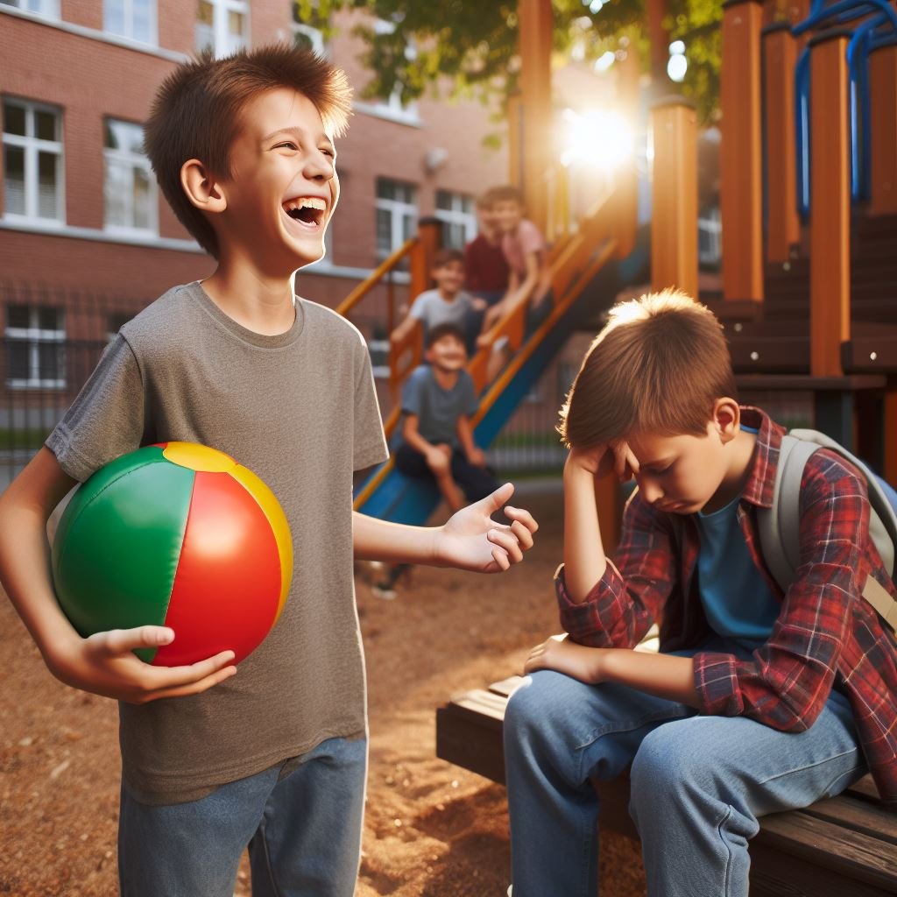
Scenario 2
Your classmates are teasing another student and want you to join in.
Notes:
Your classmates are teasing another student and want you to join in.

Slide 33
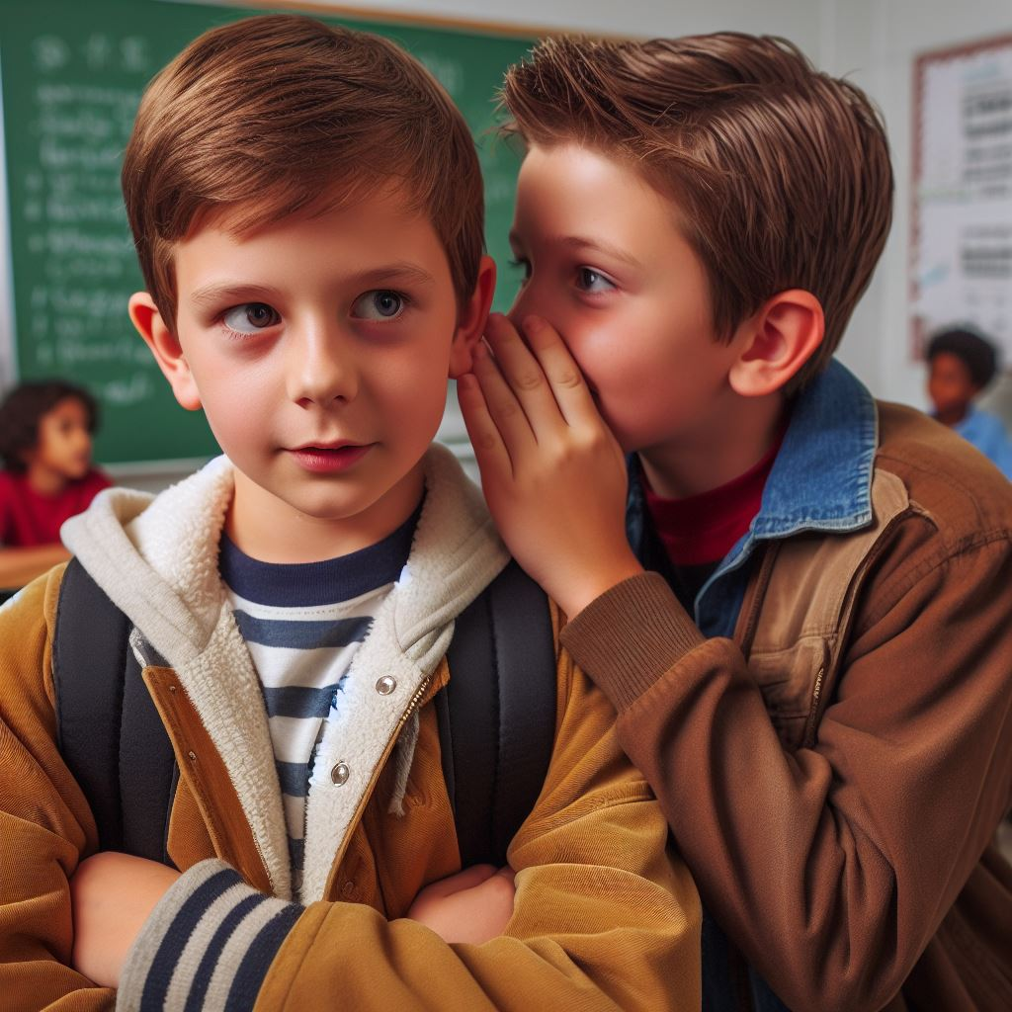
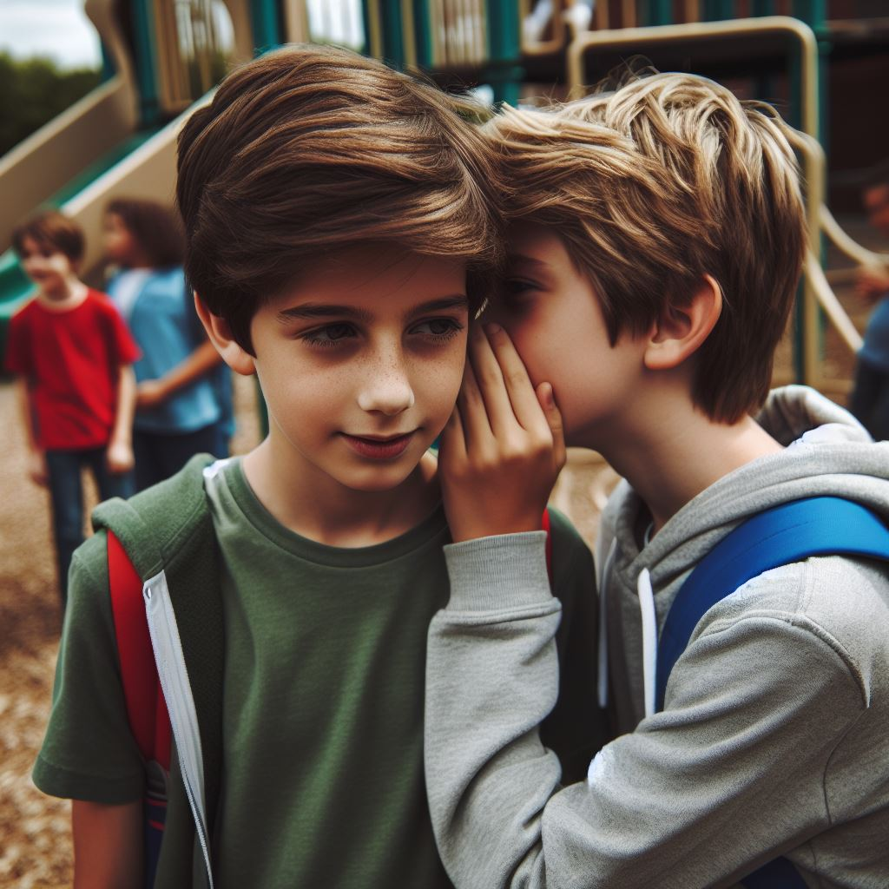
Scenario 3
Your friends are pressuring you to try vaping.
Notes:
Your friends are pressuring you to try vaping.

Slide 34

Scenario 4
Your friend asks you to cover for them while they break a school rule.
Notes:
Your friend asks you to cover up for them when they break a school rule.

Slide 35
All done, great job!
Notes:
Today, we discussed peer pressure and how it can affect our choices. Remember, doing what you know is right is important, even if others disagree. Let's make smart choices, but if we make mistakes, let's take responsibility for our actions and demonstrate remorse. You did a fantastic job today, class!

