Slide 1

School Bus and Pedestrian Safety Kindergarten Lesson 1

Slide 2
When we are learning we will:

Slide 3

Keep our bodies in our own place!

Slide 4

Use our quiet voices!

Slide 5

Keep our ears open!

Slide 6

Have our brains ready to learn!

Slide 7
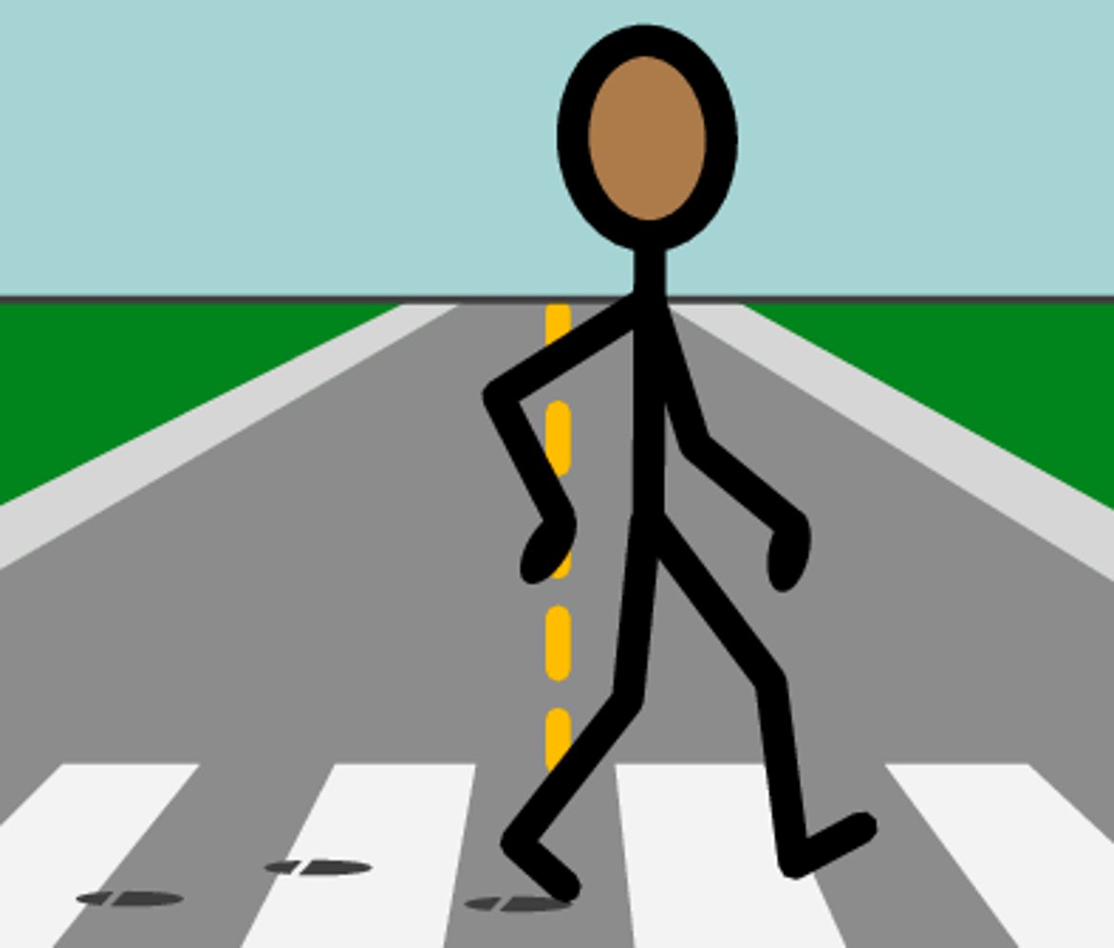
A pedestrian is a person who is walking, riding a scooter, or using a wheelchair to get around.
Notes:
Introduce and discuss the Vocabulary Word "Pedestrian” and discuss the difference between a bus rider or passenger and a pedestrian.

Slide 8



Activity: pedestrians or not a pedestrian?

Slide 9
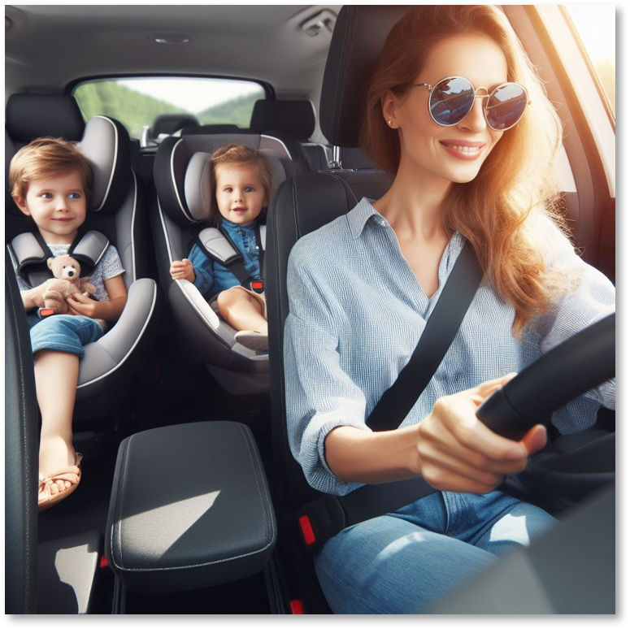
Are these pedestrians or not pedestrians?

Slide 10
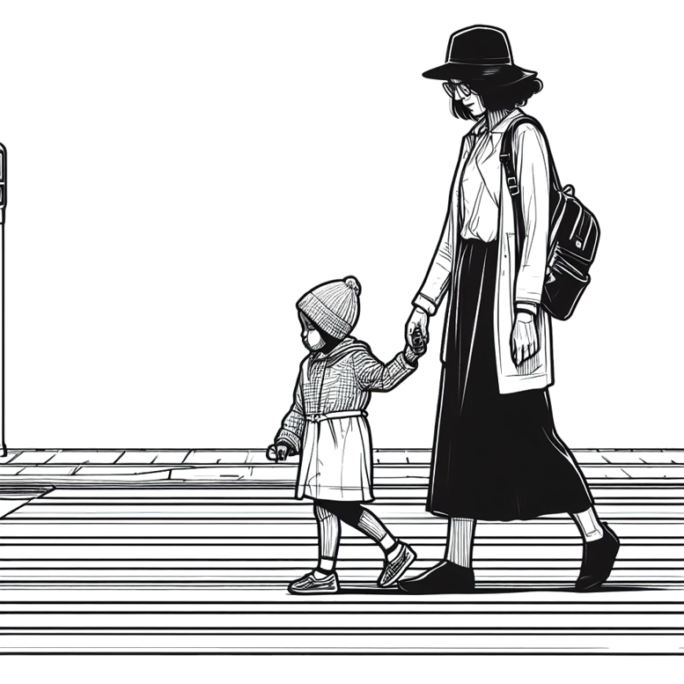
Are these pedestrians or not pedestrians?

Slide 11
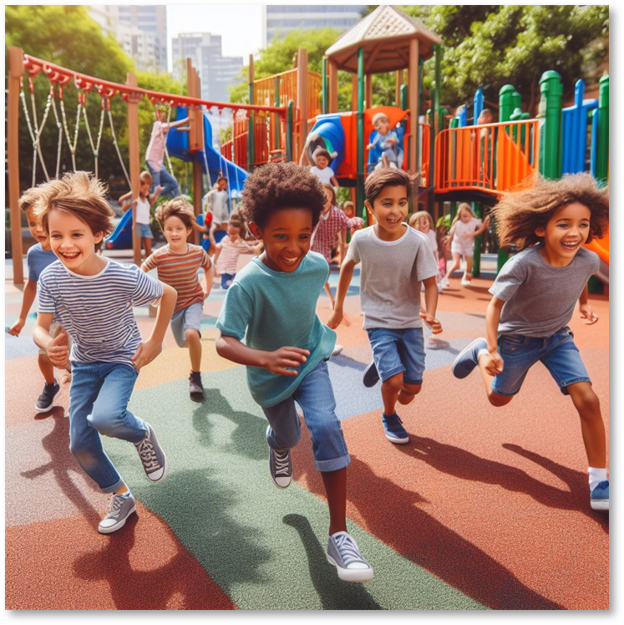
Are these pedestrians or not pedestrians?

Slide 12
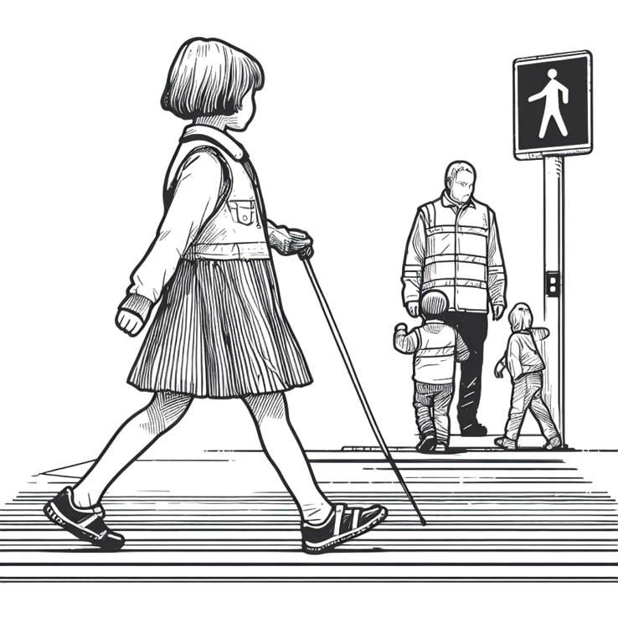
Are these pedestrians or not pedestrians?

Slide 13
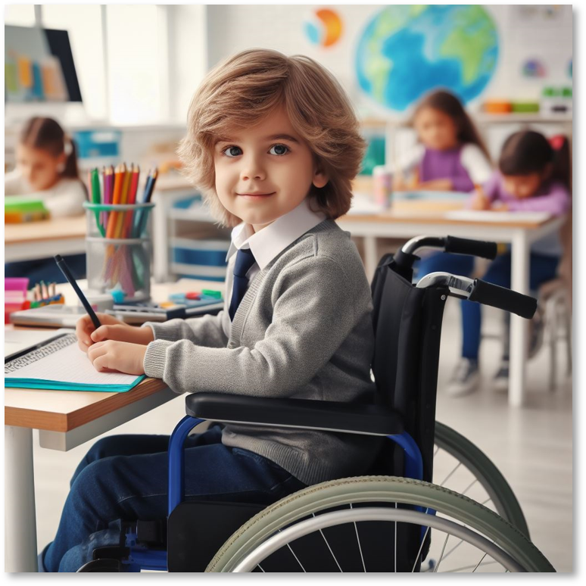
Is this a pedestrian or not a pedestrian?

Slide 14
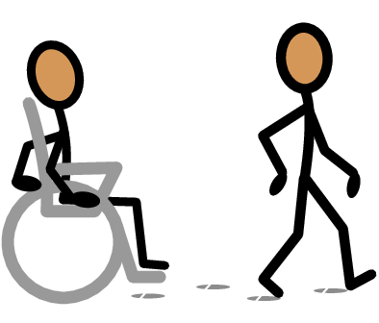
Are these pedestrians or not pedestrians?

Slide 15
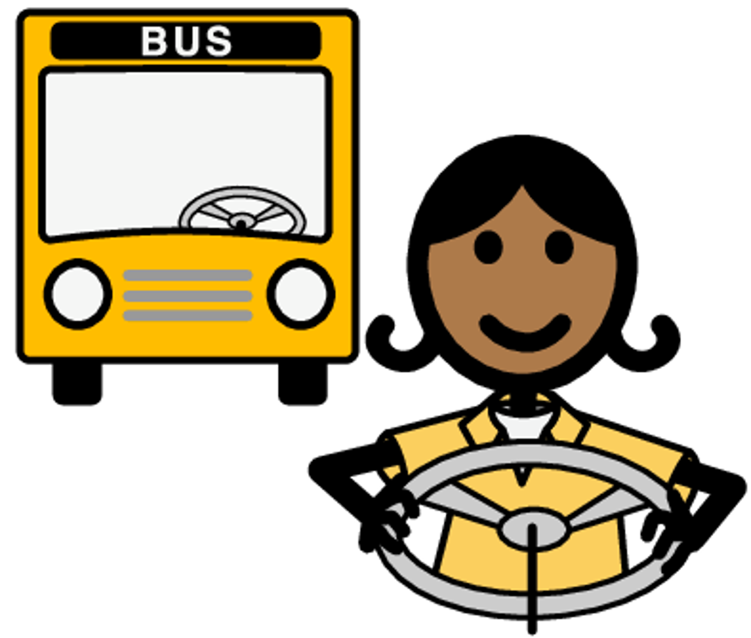
Bus Driver: A bus driver is the person responsible for driving the school bus and keeping us safe.
Notes:
Introduce the school bus,
describing why we ride the bus and define the job of a bus driver.

Slide 16
Activity: Is this a bus driver, a pedestrian, or neither?
Notes:
Introduce the school bus,
describing why we ride the bus and define the job of a bus driver.

Slide 17
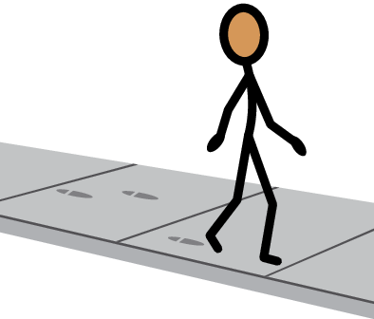
Is this person a pedestrian?

Slide 18

Is this person a bus driver?

Slide 19
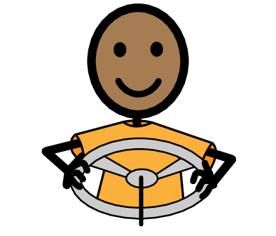
Is this person a pedestrian?

Slide 20
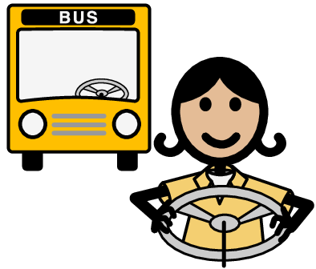
Is this person a bus driver?

Slide 21

School Bus Safety Song
The yellow bus is here, it's big and bright, Taking us to school, morning till night. But before we hop on, let’s learn today, Safety on the bus, every step of the way!
On the school bus, On the school bus, Sit down tight, safety is a must! Look left, look right, before we hop, Safety on the bus (yeah) we won't stop!
Big wheels turning, we’re on our way, Windows for looking, hands tucked away. The driver says “Hello!” as we step inside, With rules on the bus, we safely ride.
On the school bus, On the school bus, Sit down tight, safety is a must! Look left, look right, before we hop, Safety on the bus, (yeah) we won't stop!
The yellow bus slows, the red lights say STOP! Thank you, driver, for being on top! Hop off with a smile, it’s easy to see, safety on the bus, happy we will be!
Click symbol to play audio.

Slide 22
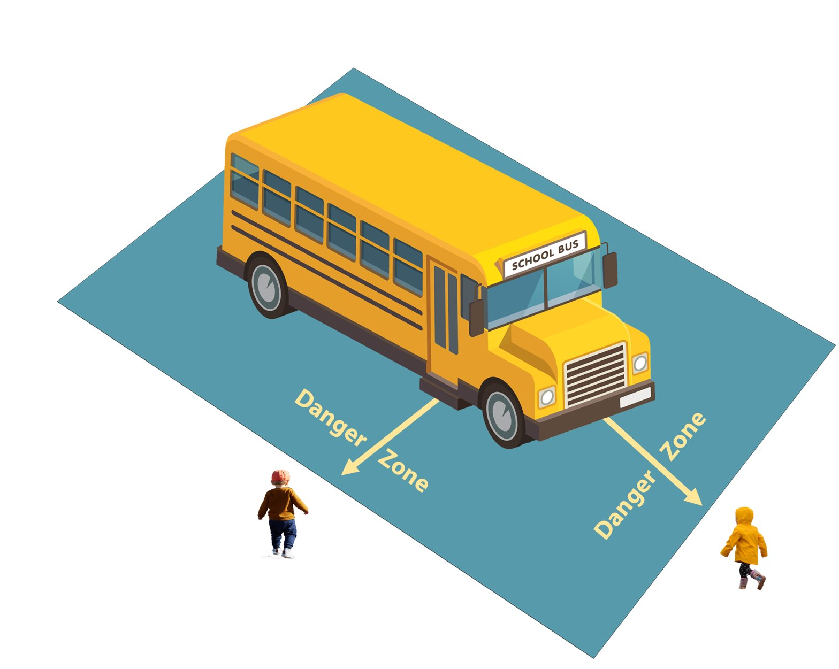
Practicing Bus Rules: Danger Zone
Notes:
Examine Safety rules for pedestrians and riding the bus.
Discuss and compare safe and unsafe behaviors in Danger zones.

Slide 23
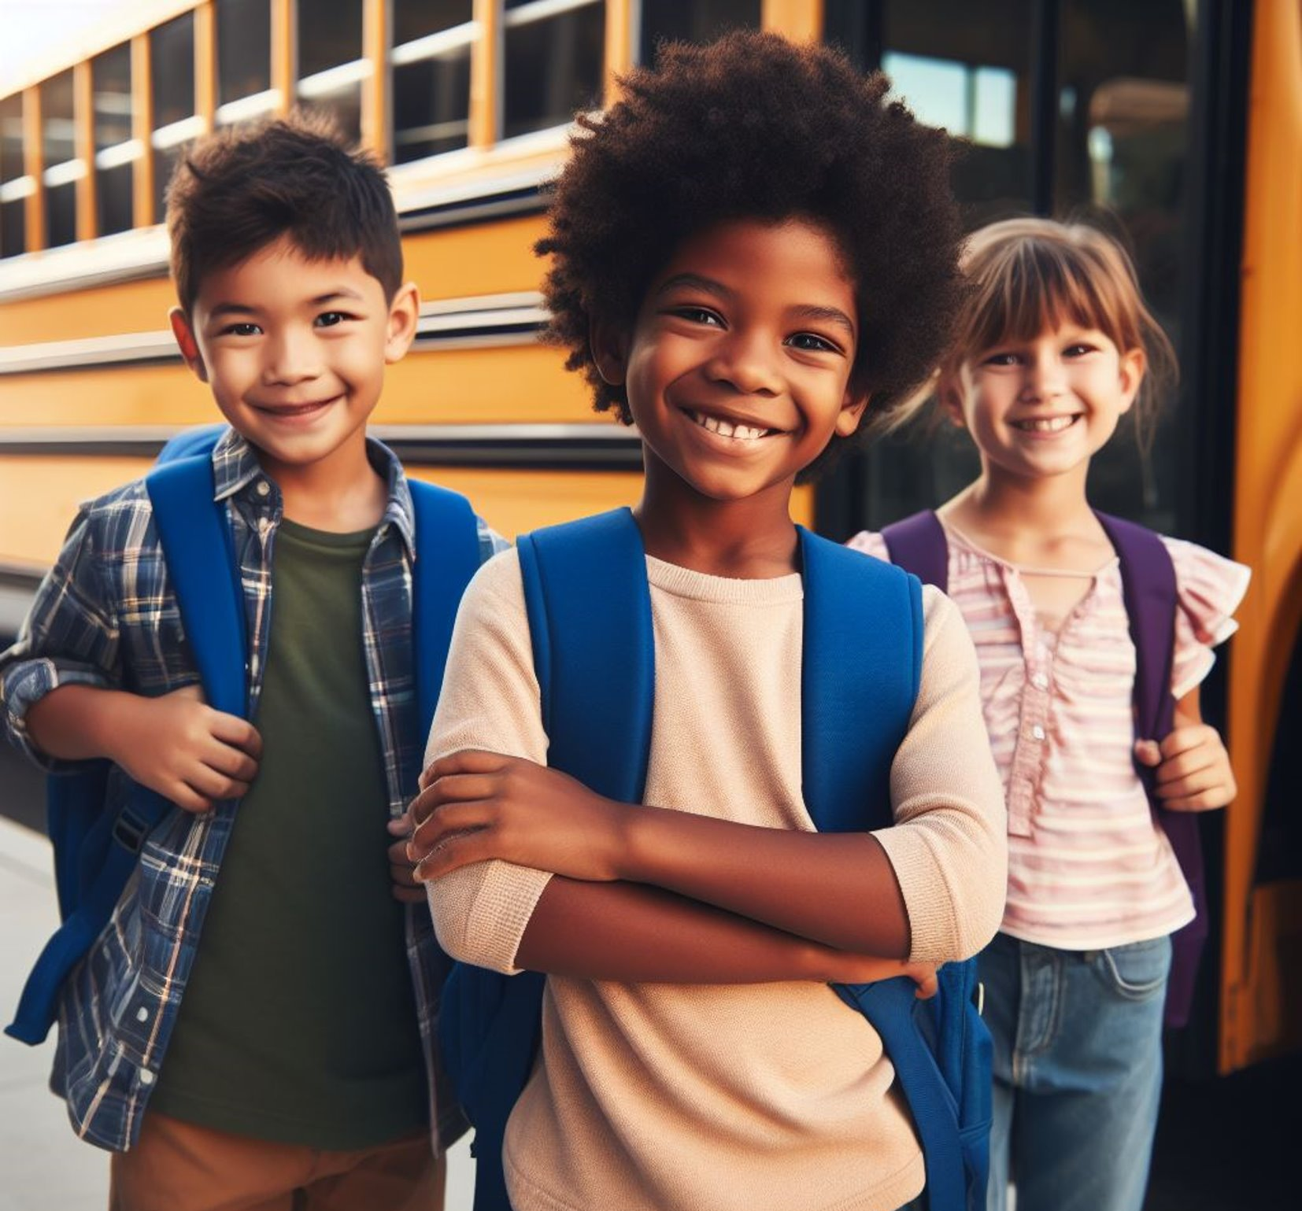
Three giant steps away from the side of the bus.

Slide 24

Five giant steps away from the front of the bus.

Slide 25
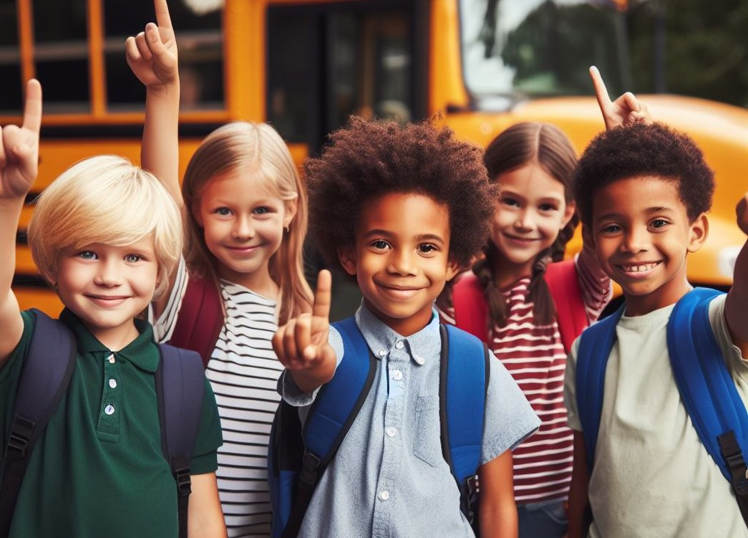
Never go behind the bus or near the wheels.

Slide 26
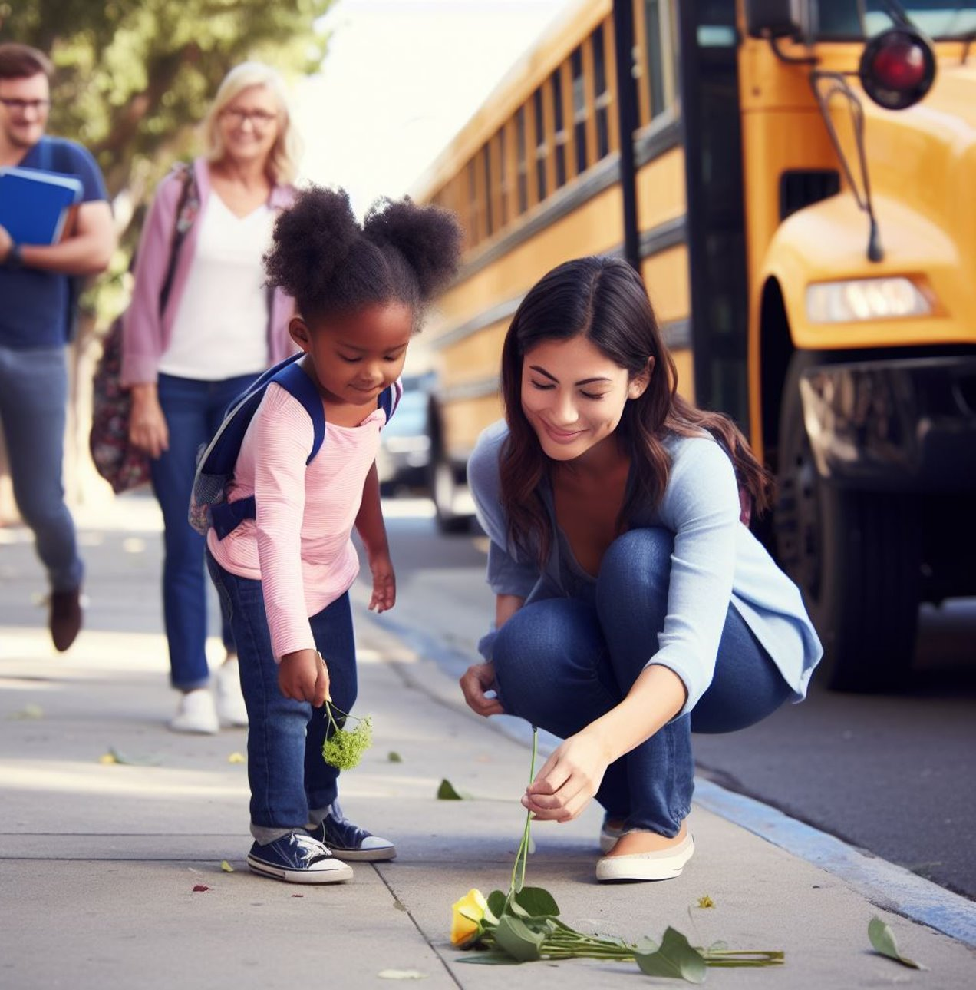
Practicing Bus Rules: Danger Zone
If you drop something near the bus, tell an adult and let them tell you what to do. Never pick it up without permission.

Slide 27
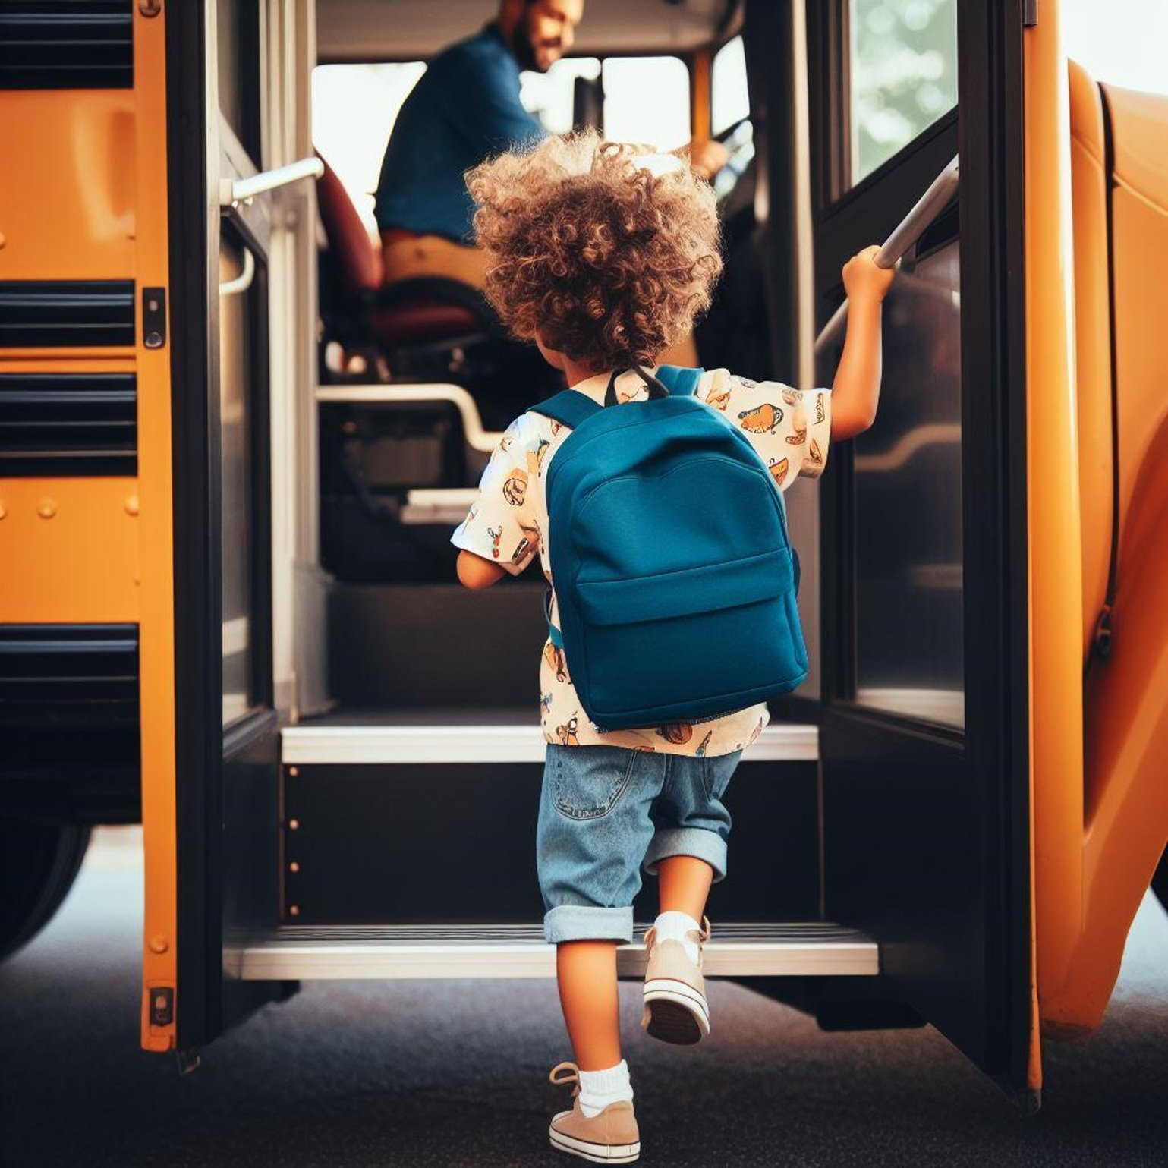
Practicing Bus Rules: Danger Zone
Use the handrail when boarding or getting off the bus.

Slide 28

We Can Ride the Bus to School!

Slide 29

Riding the bus to school is fun, but first, we must make sure our safety is number one!

Slide 30
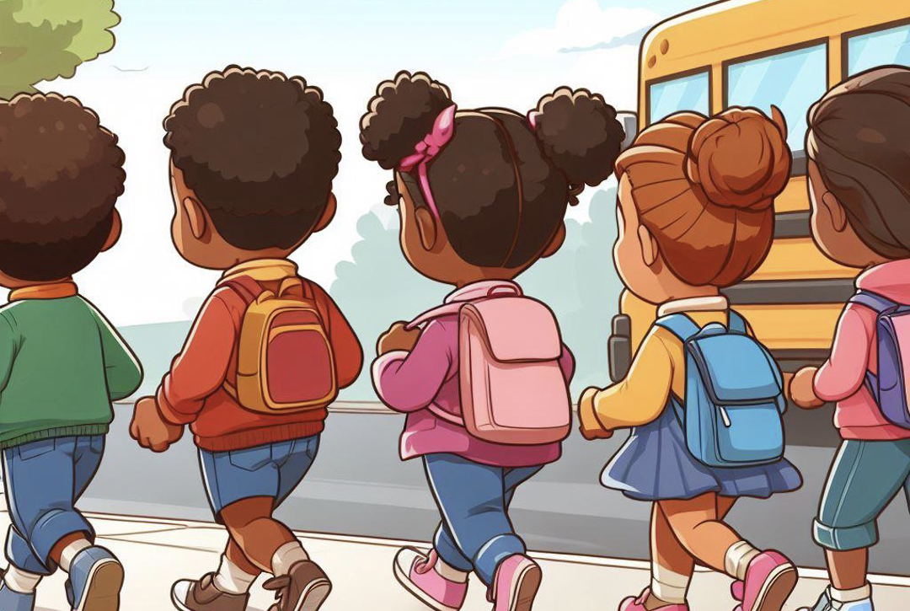
Walking to the bus stop is what we do, safety is the number one rule. We stay on the left facing cars and always keep a lookout for what is far. Our ears are open and alert. This way we won’t get hurt!

Slide 31
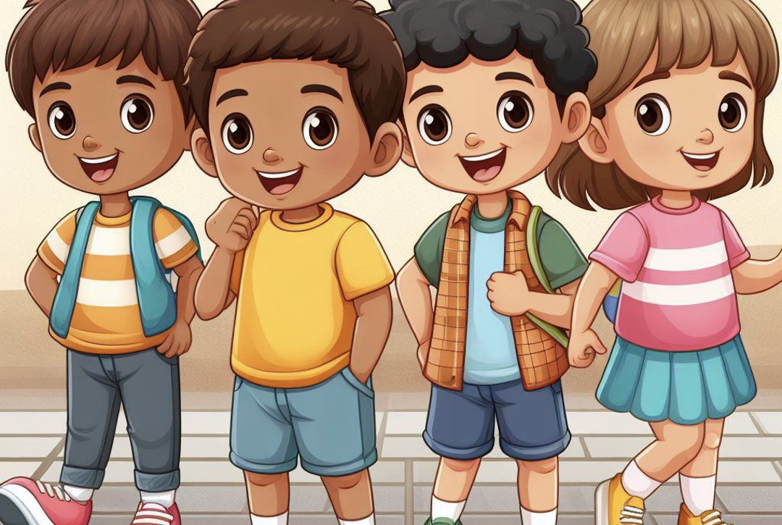
To cross the road, we stop and look. Left, right, left is by the book!

Slide 32
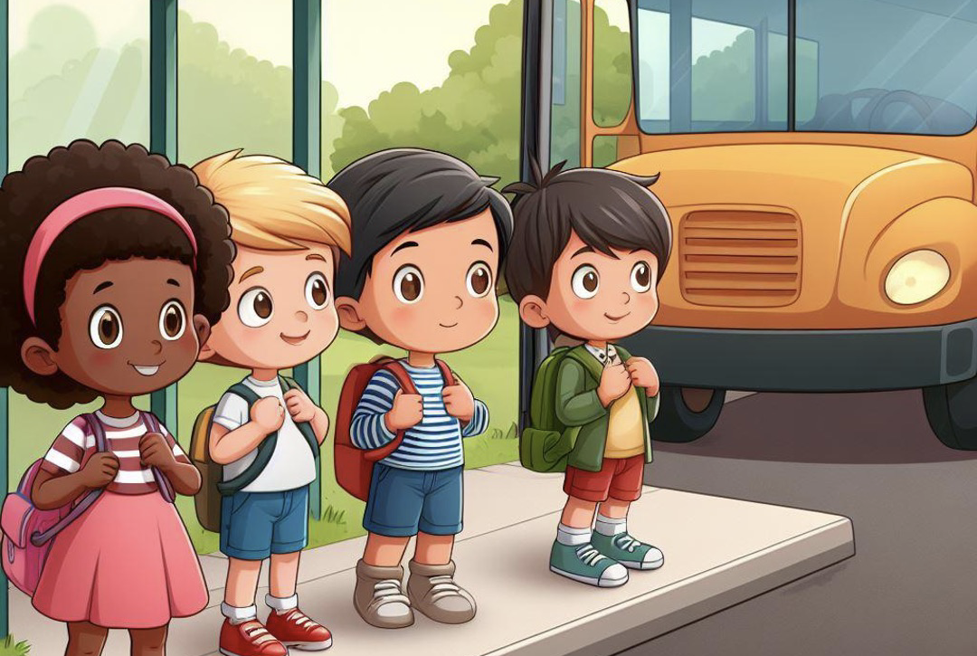
At the bus stop we stand and wait. We have calm bodies which is great!

Slide 33
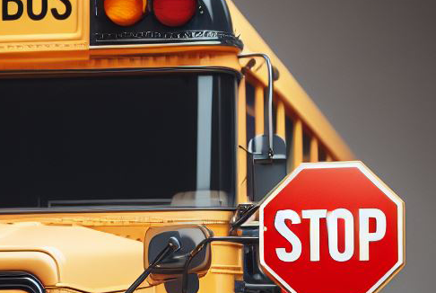
The bus here, we see the lights. The stop sign is shining bright!

Slide 34
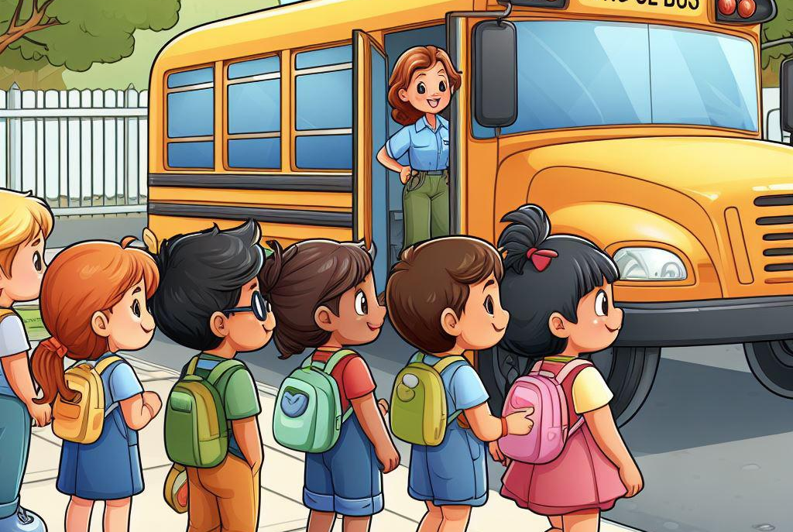
We stay back from the bus’s side. Three big steps used as our guide! Five steps from the front is cool! We give space to the driver and follow this rule!

Slide 35
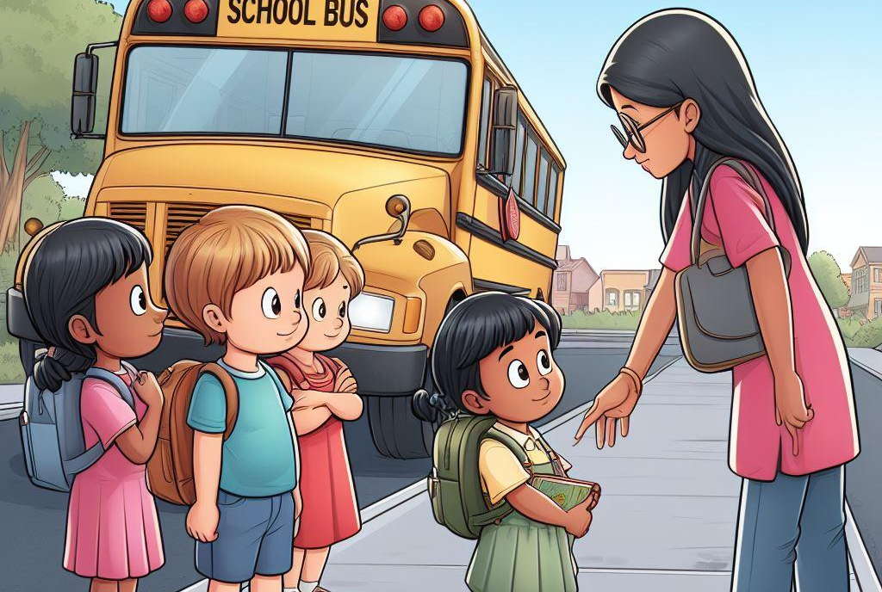
We keep our distance from wheels and the rear, safety is what we hold most dear. If we drop something near the bus, we don’t stress! We find an adult, they'll know best. We let them decide what to do, we never pick it up alone, that is true!

Slide 36
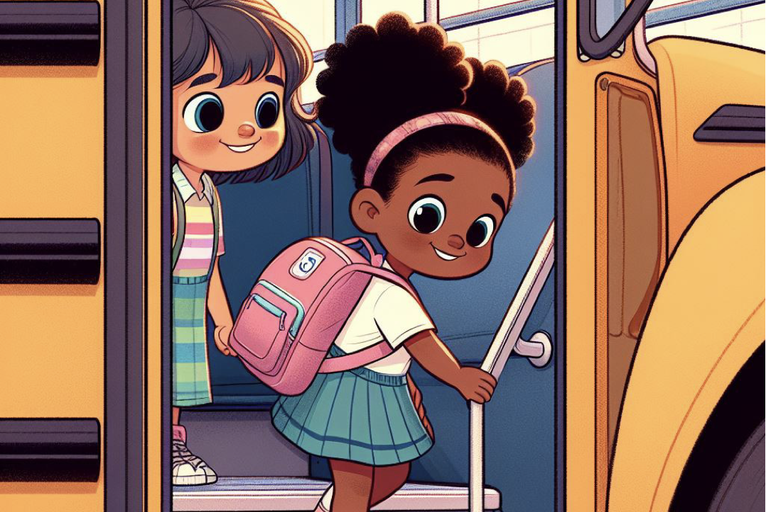
When getting on or off, we use the handrail, which is smart. Hold tight and steady we are doing our part!

Slide 37
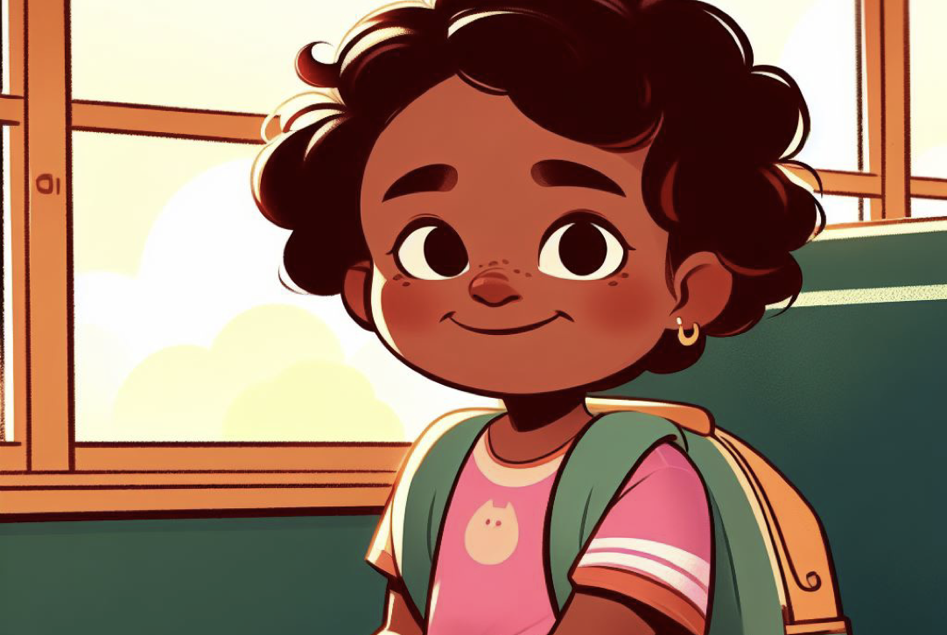
On the bus we find our seat, and make sure we keep the aisle neat!

Slide 38
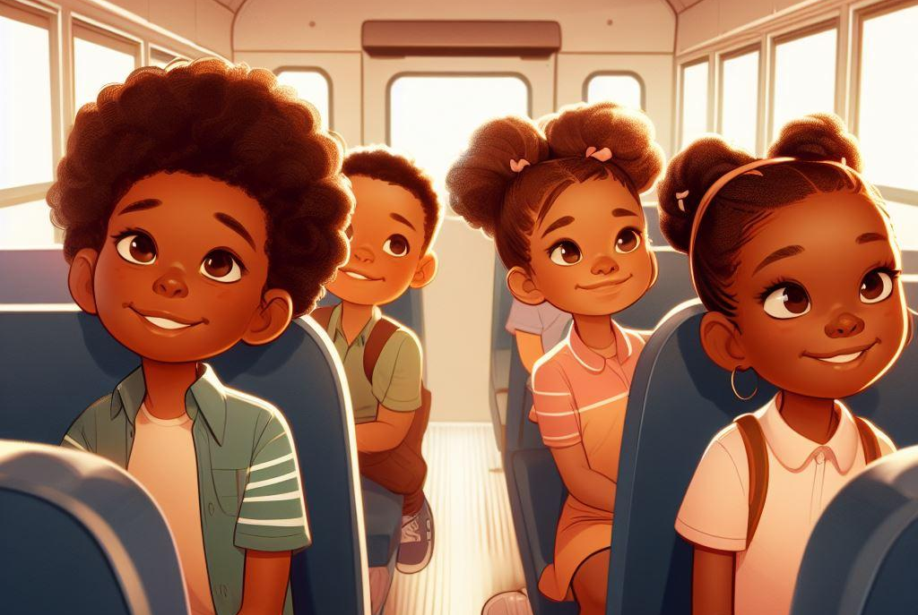
We sit on our bottom and face the front. Safety is our number one stunt!

Slide 39
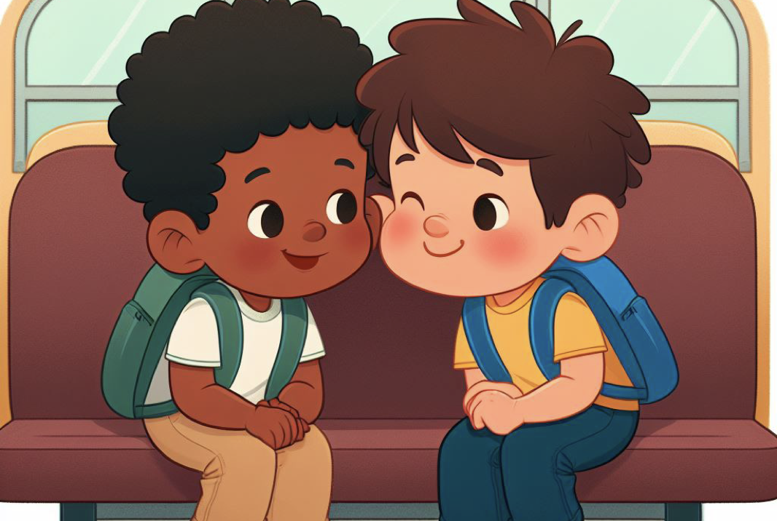
Talking to our seat partner is fine, but we use quiet voices the entire time.

Slide 40
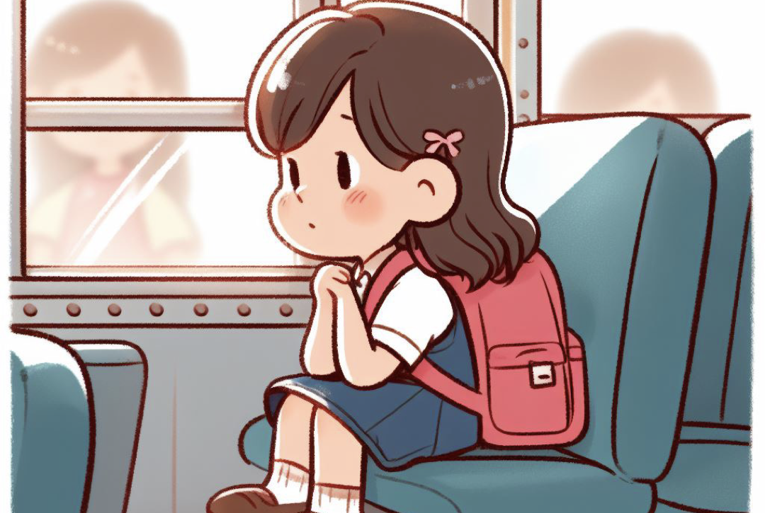
We keep our bodies in our own space. That puts a smile on our driver’s face! If the window is open, that is cool, we keep our arms and heads inside, that’s the rule!

Slide 41
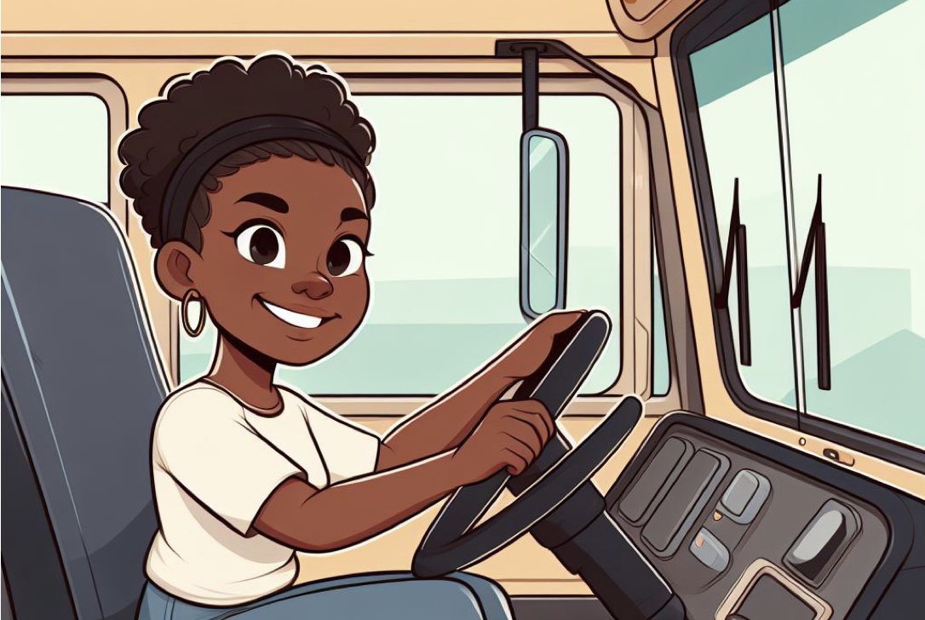
Listening to our driver is the key, our safety they will guarantee!

Slide 42
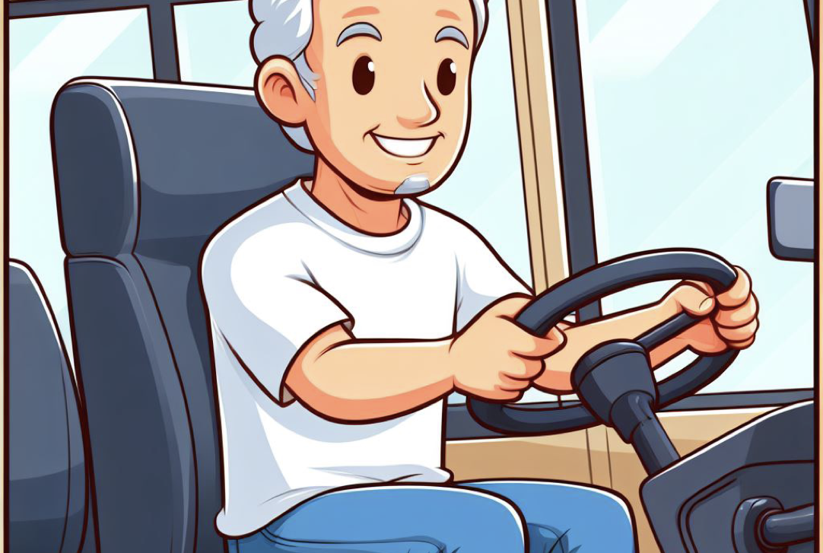
Following these rules is simple and fun. It helps our bus driver make a safe bus run!

Slide 43
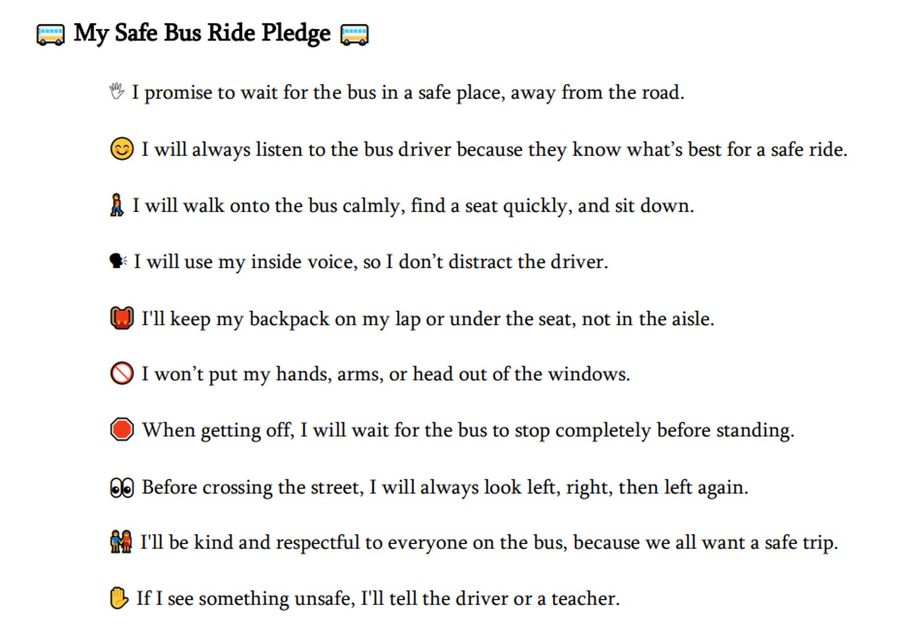
Activity: Bus Safety Pledge

Slide 44
All done, great job!

