Slide 1

Playground Safety Rules
Pre-Kindergarten Lesson 3

Slide 2
When we are learning we will:

Slide 3

Keep our bodies in our own place!

Slide 4

Use our quiet voices!

Slide 5

Keep our ears open!

Slide 6

Have our brains ready to learn!

Slide 7
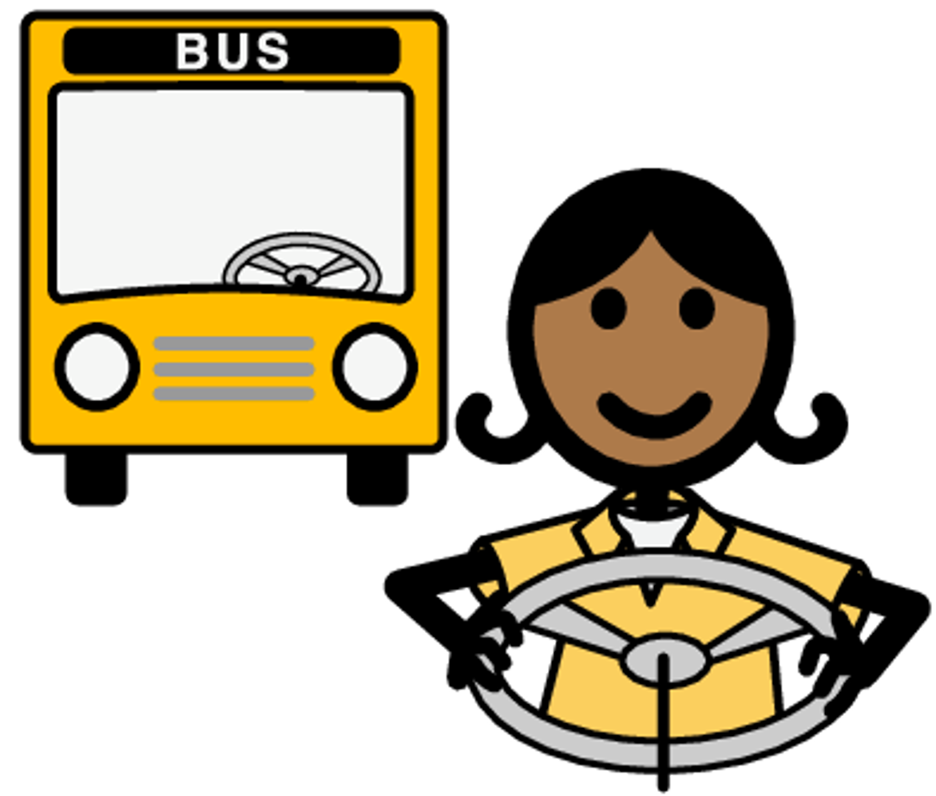
A bus driver is the person responsible for driving the school bus and keeping us safe.
Notes:
Introduce the school bus,
describing why we ride the bus and define the job of a bus driver.

Slide 8

We Can Ride the Bus to School!

Slide 9
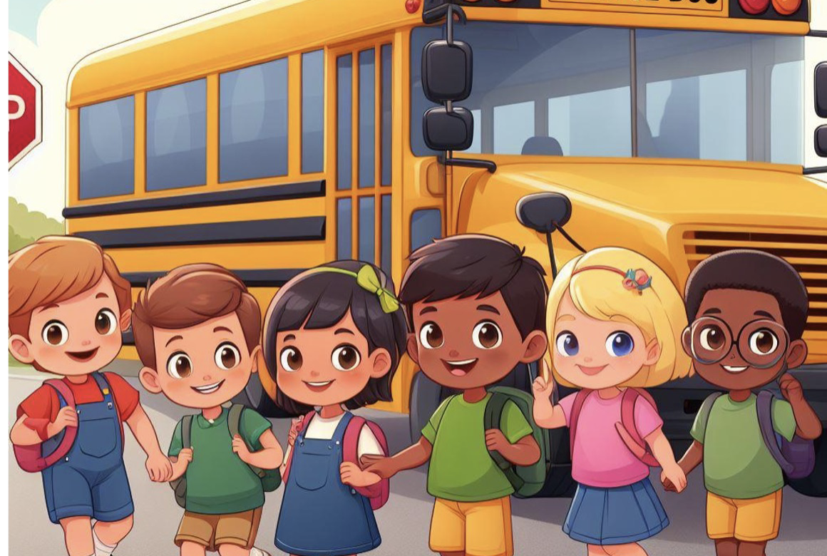
Riding the bus to school is fun, but first, we must make sure our safety is number one!

Slide 10
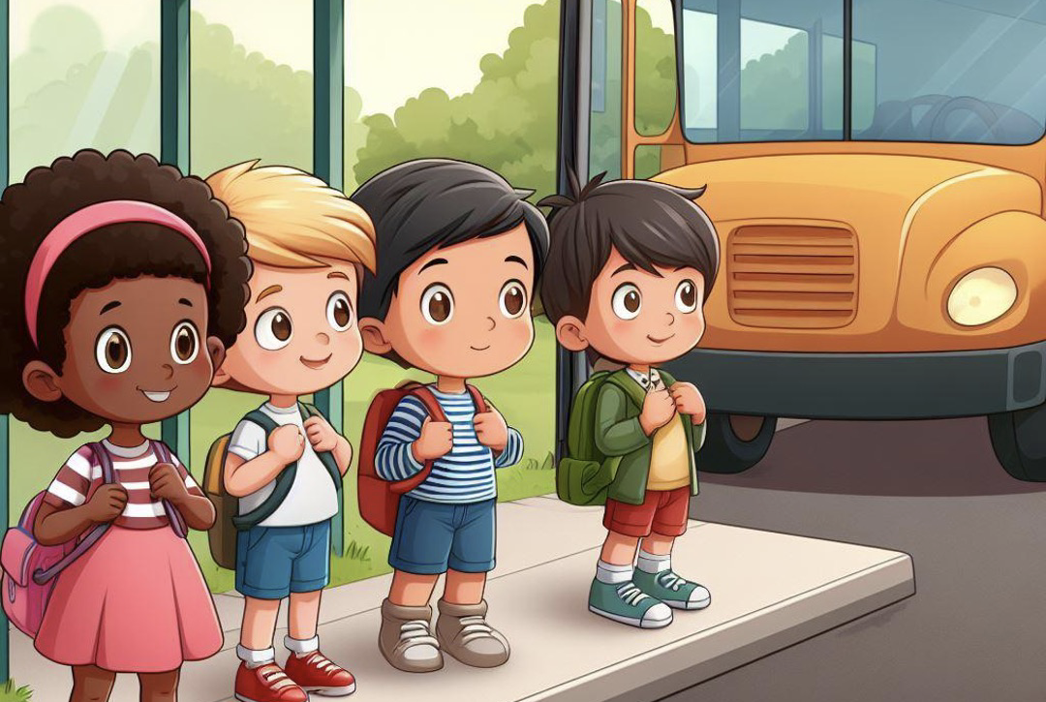
At the bus stop, we stand and wait. We have calm bodies which is great!

Slide 11
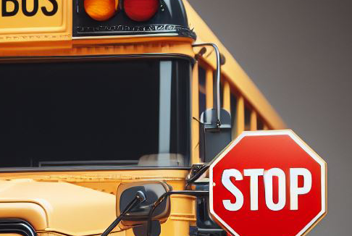
The bus here, we see the lights. The stop sign is shining bright!

Slide 12
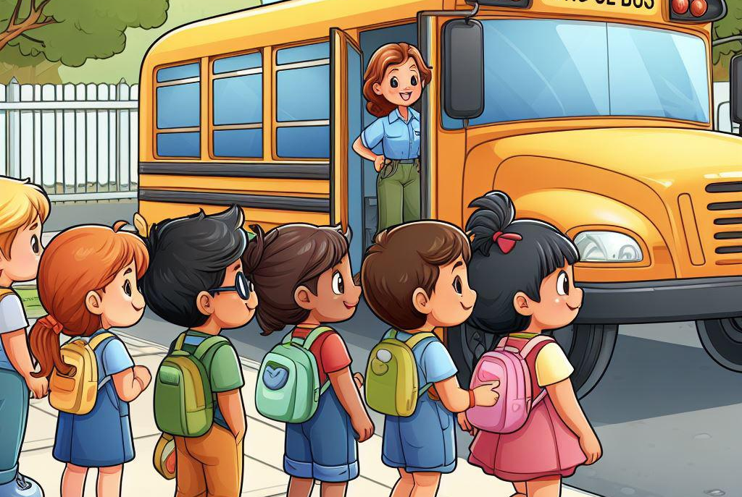
We stay back from the bus’s side. Three big steps are used as our guide!

Slide 13
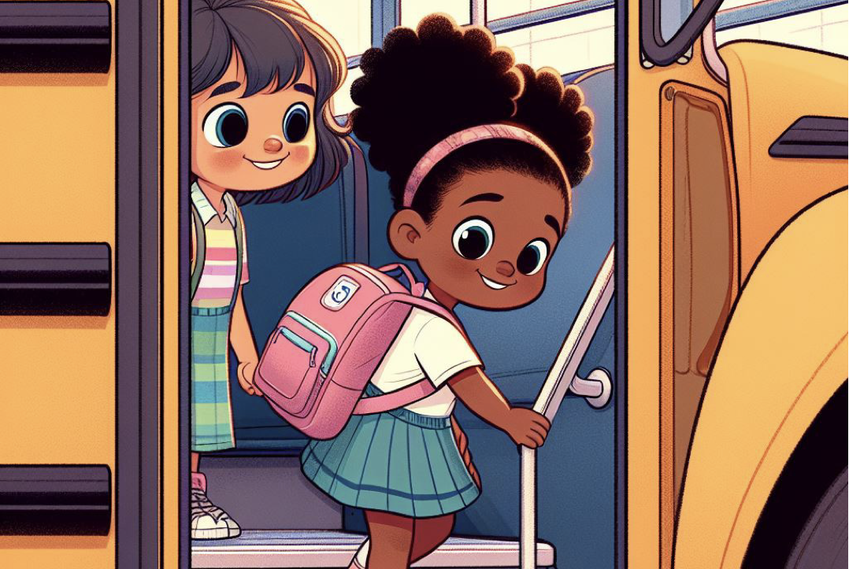
When getting on or off, we use the handrail, which is smart. Hold tight and steady, we are doing our part!

Slide 14
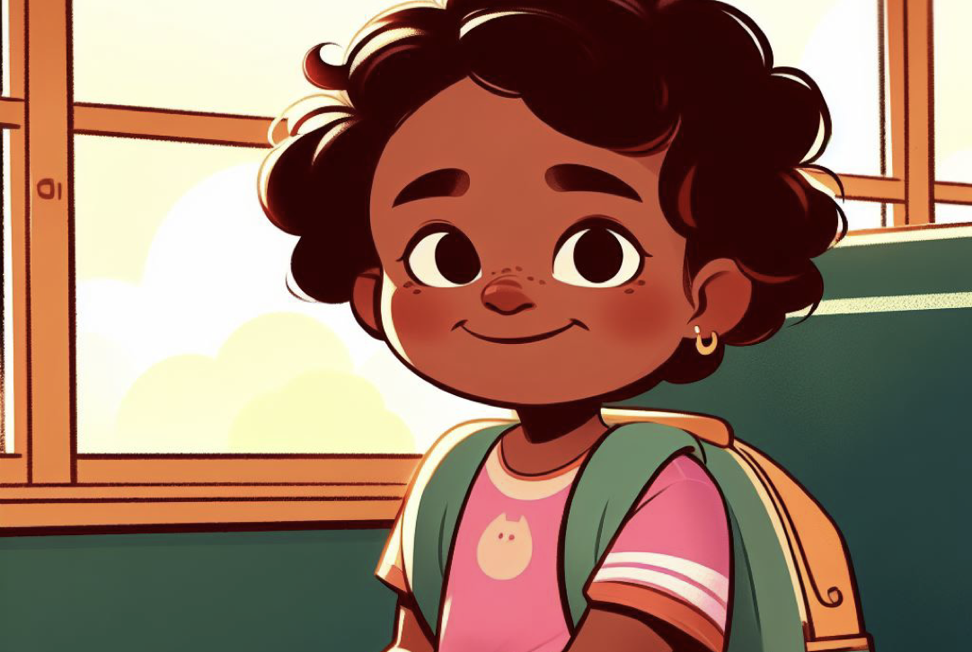
On the bus, we find our seats, and make sure we keep the aisle neat!

Slide 15
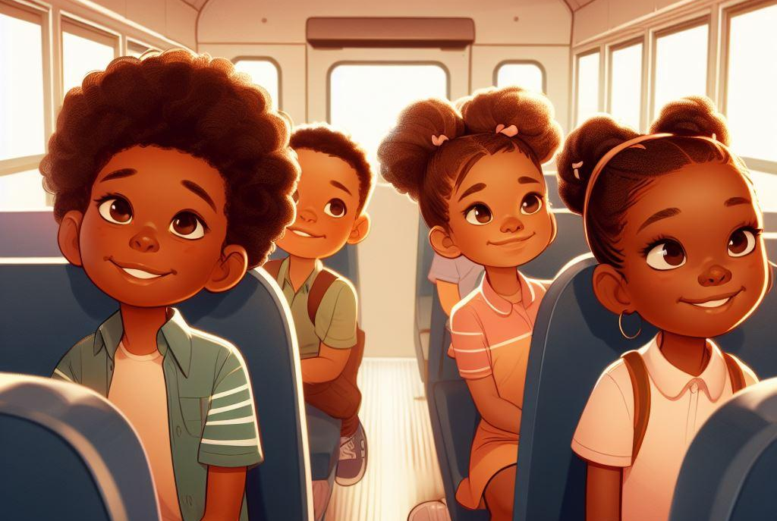
We sit on our bottom and face the front. Safety is our number one stunt!

Slide 16
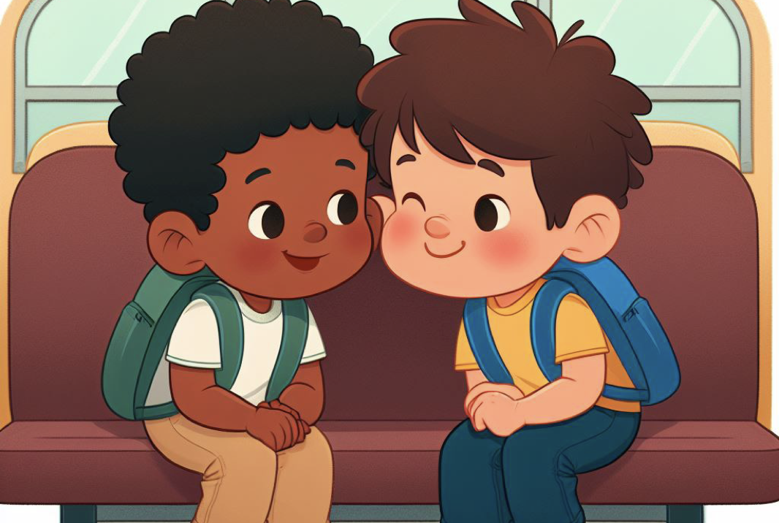
Talking to our seat partner is fine, but we use quiet voices the entire time.

Slide 17
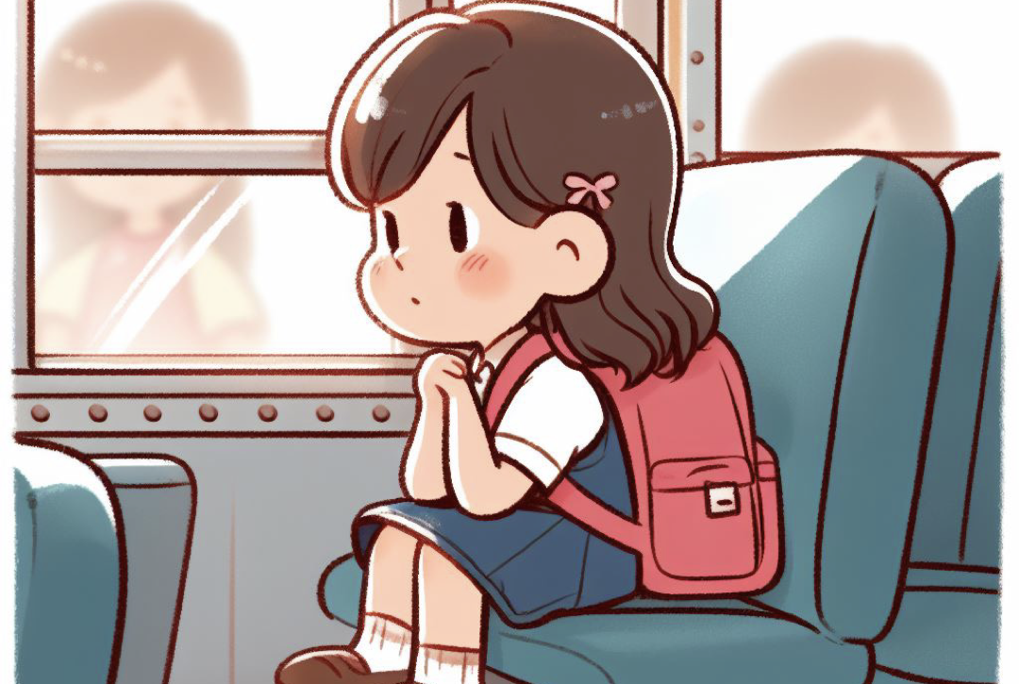
We keep our bodies in our own space. That puts a smile on our driver’s face!

Slide 18
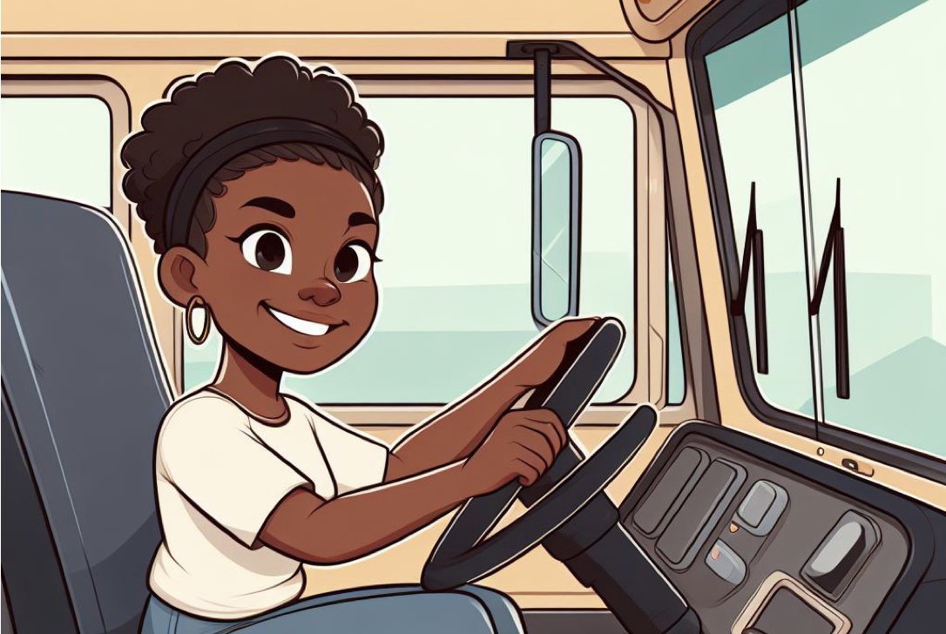
Listening to our driver is the key, our safety they will guarantee!

Slide 19
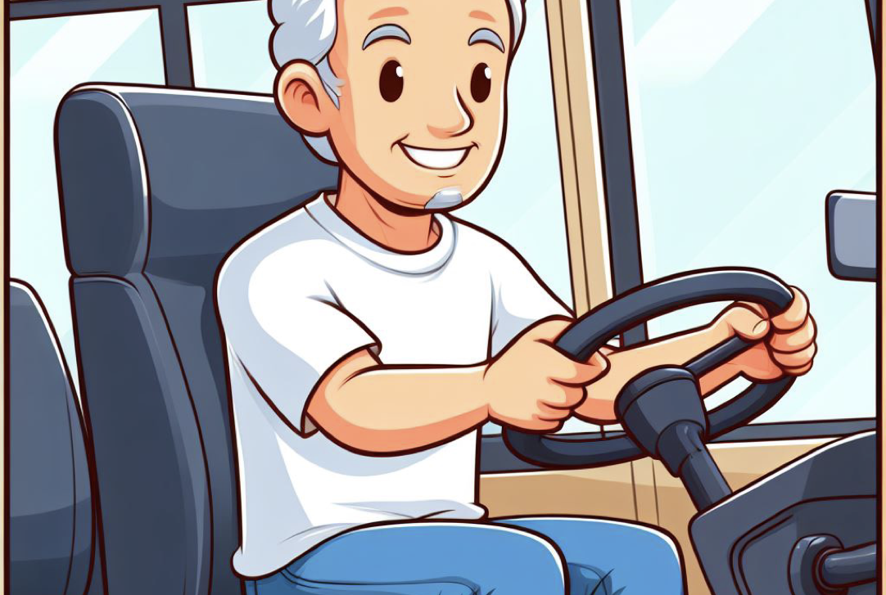
Following these rules is simple and fun. It helps our bus driver make a safe bus run!

Slide 20


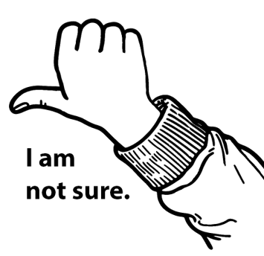
Activity:
Safe or not safe?

Slide 21
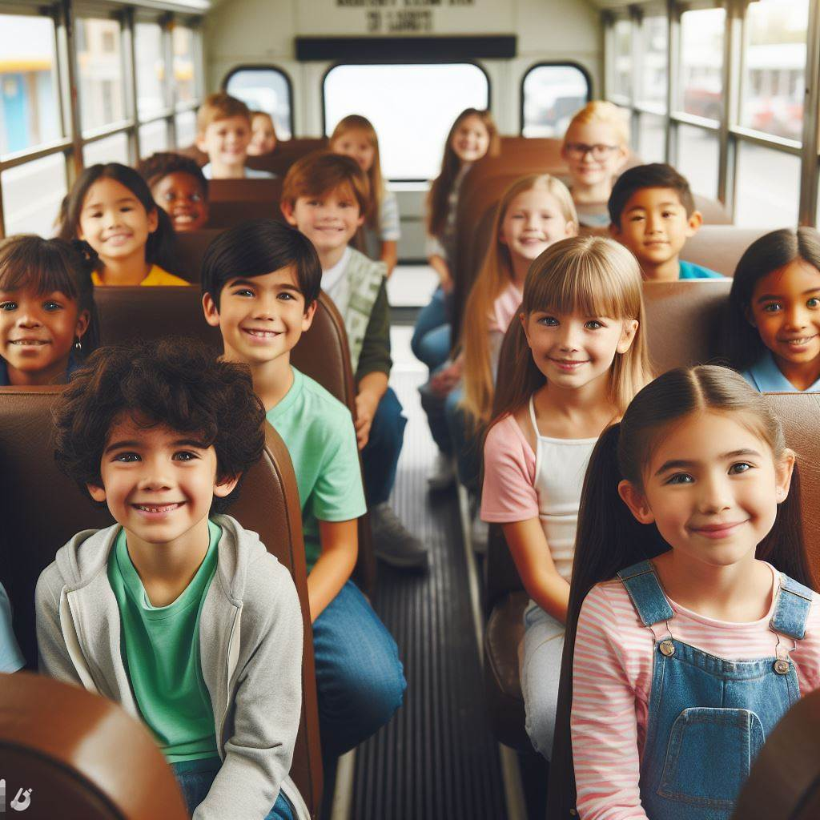
Safe or not safe?
Sitting on the bus

Slide 22
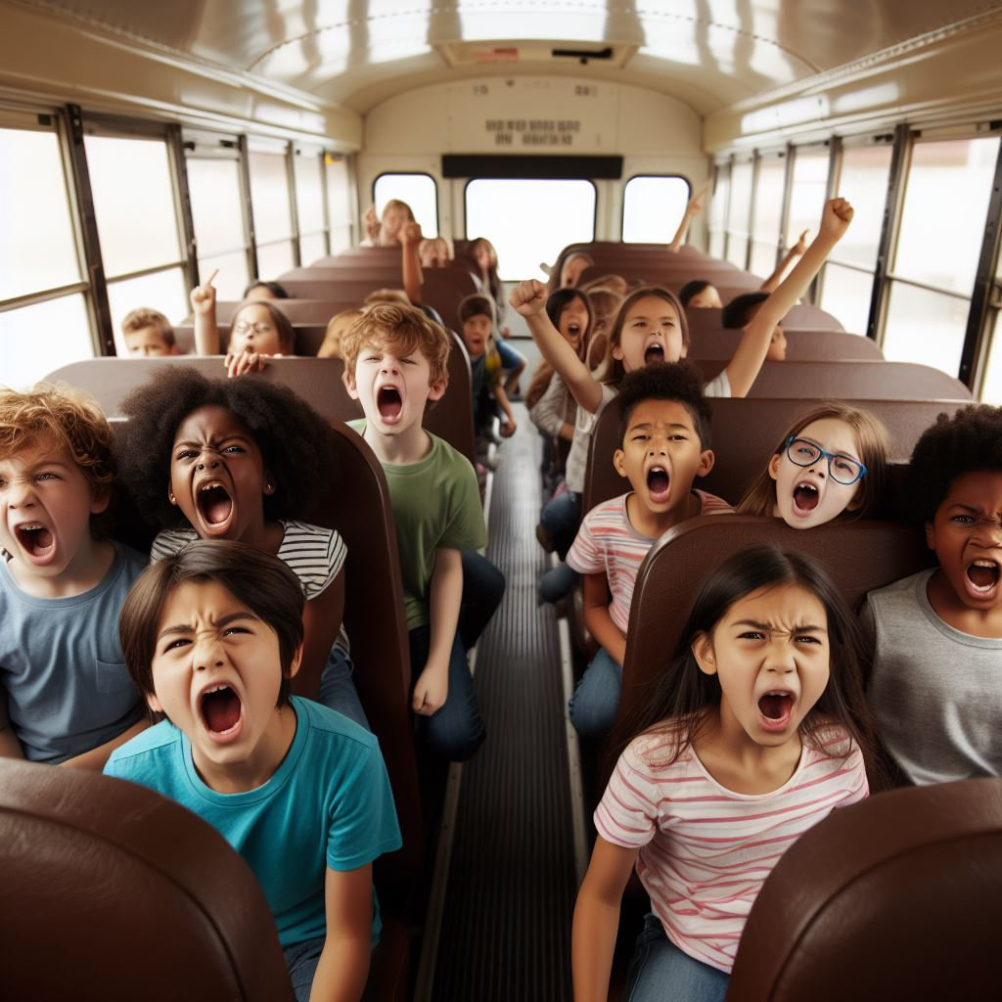
Safe or not safe?
Yelling on the bus

Slide 23
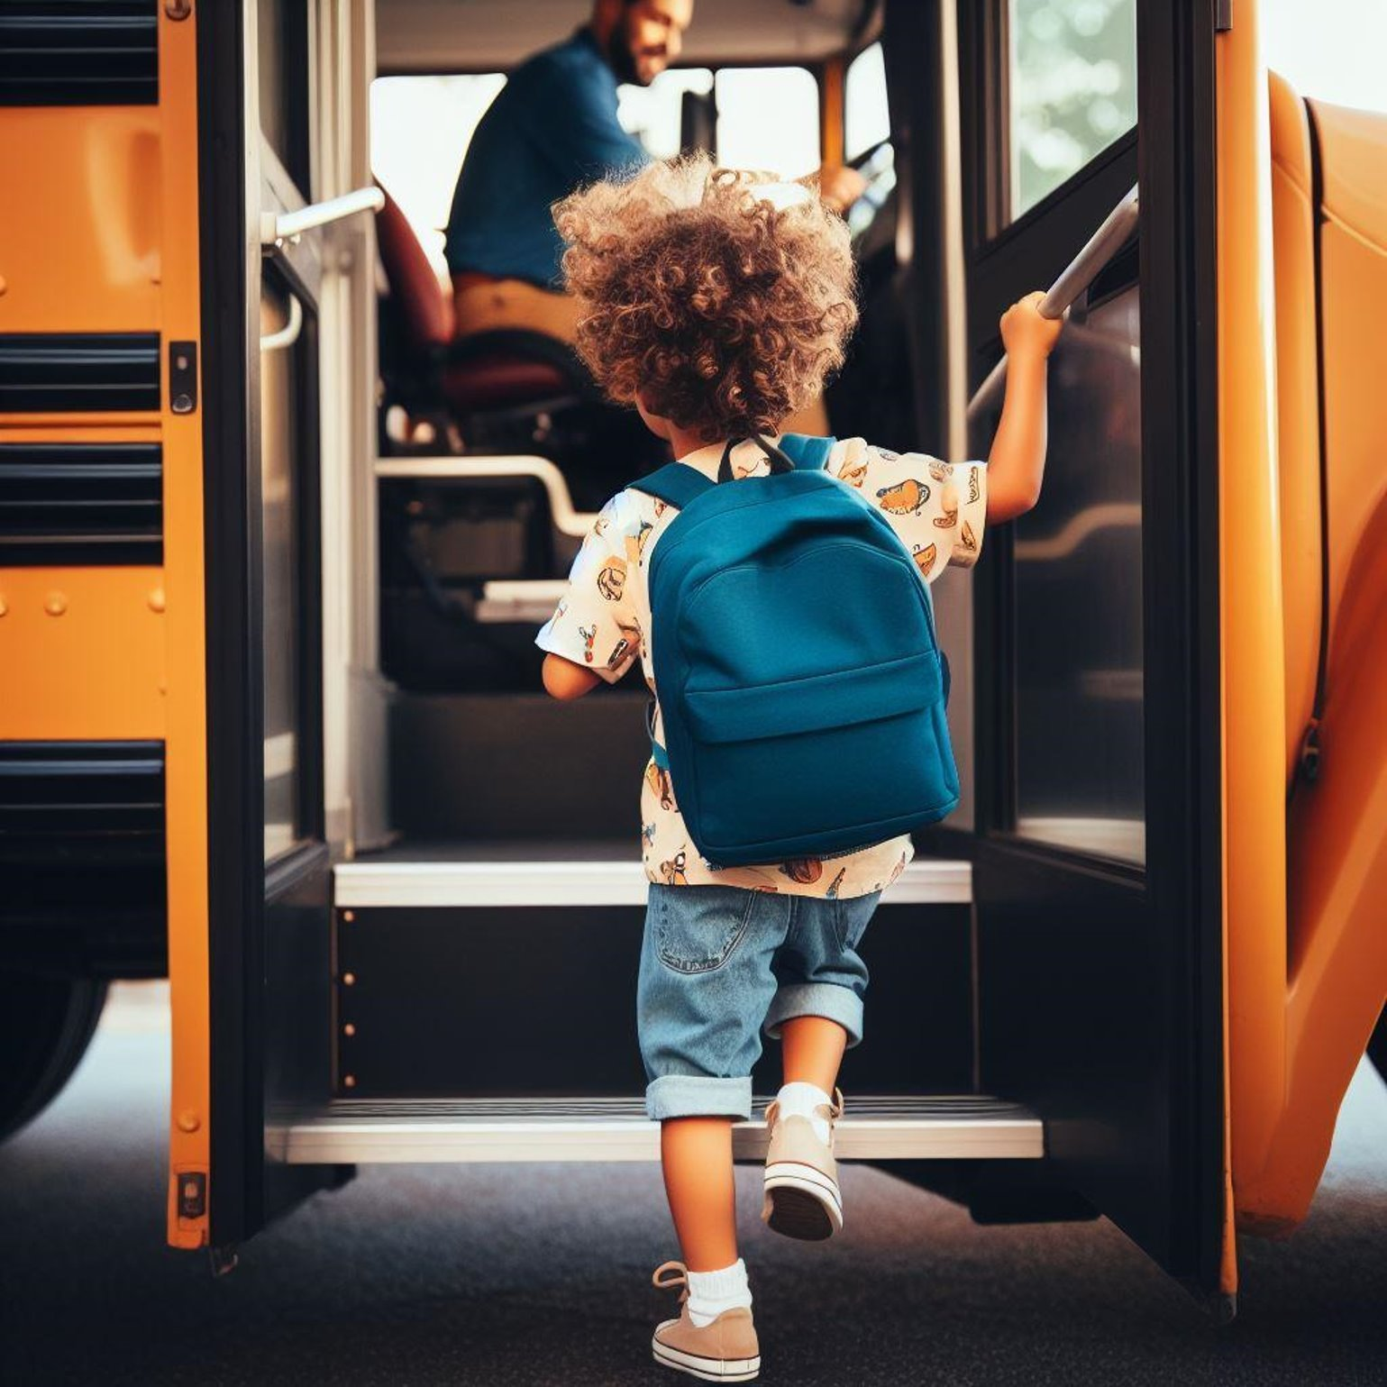
Safe or not safe?
Using the handrail on the bus

Slide 24
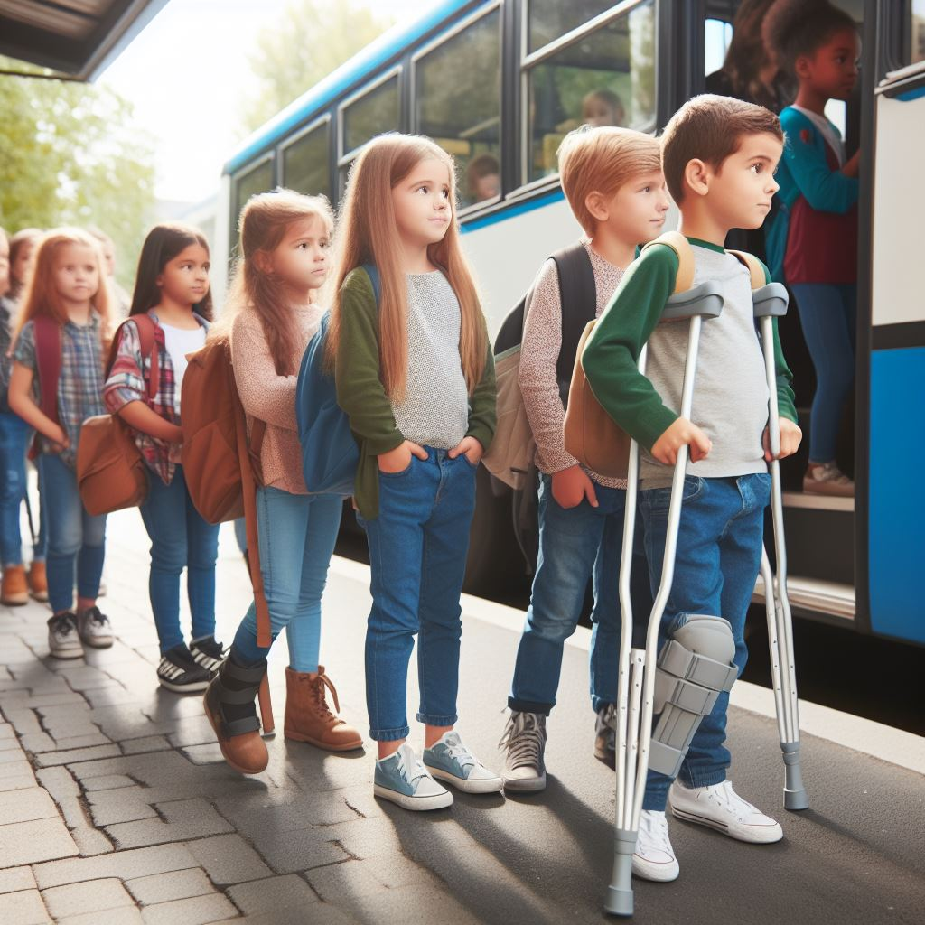
Safe or not safe?
Waiting in line to get on the bus

Slide 25
Activity: Bus safety

Slide 26

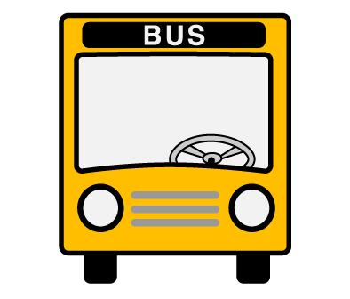
Hooray for bus safety!

Slide 27
All done, great job!

