Slide 1






Impact of Crime Victimization on Survivors
Legal Definition of a Victim
Crime victimization can impact a survivor’s physical and mental health. They may develop:
Disturbances in memory, sleep, and appetite
Compromised immune function
An increased risk for chronic health issues such as irritable bowel syndrome, chronic pain, depression, anxiety, and post-traumatic stress
According to Virginia’s Crime Victim and Witness Rights Act, a victim is someone who has suffered
“…physical, emotional, or financial harm as a direct result of a
felony or certain misdemeanors.”
This can include the spouses, parents, children, guardians, foster parents, and other caregivers of victims.
Crime in Virginia in 2023
363,437 total crime incidents were reported.
51.5% of violent crime incidents occurred at home.
There were 20,824 reported incidents of violence crime.
The total value of property lost through theft was $634,863,885.
Victims Services In Virginia
In 2023, Virginia’s sexual and domestic violence agencies:
Provided
241,641 nights of
emergency shelter
Responded to 72,831 hotline calls
Provided sexual violence advocacy services to 6,426 adults and children
Provided 251,999 hours of domestic violence and sexual assault
advocacy services

Slide 2
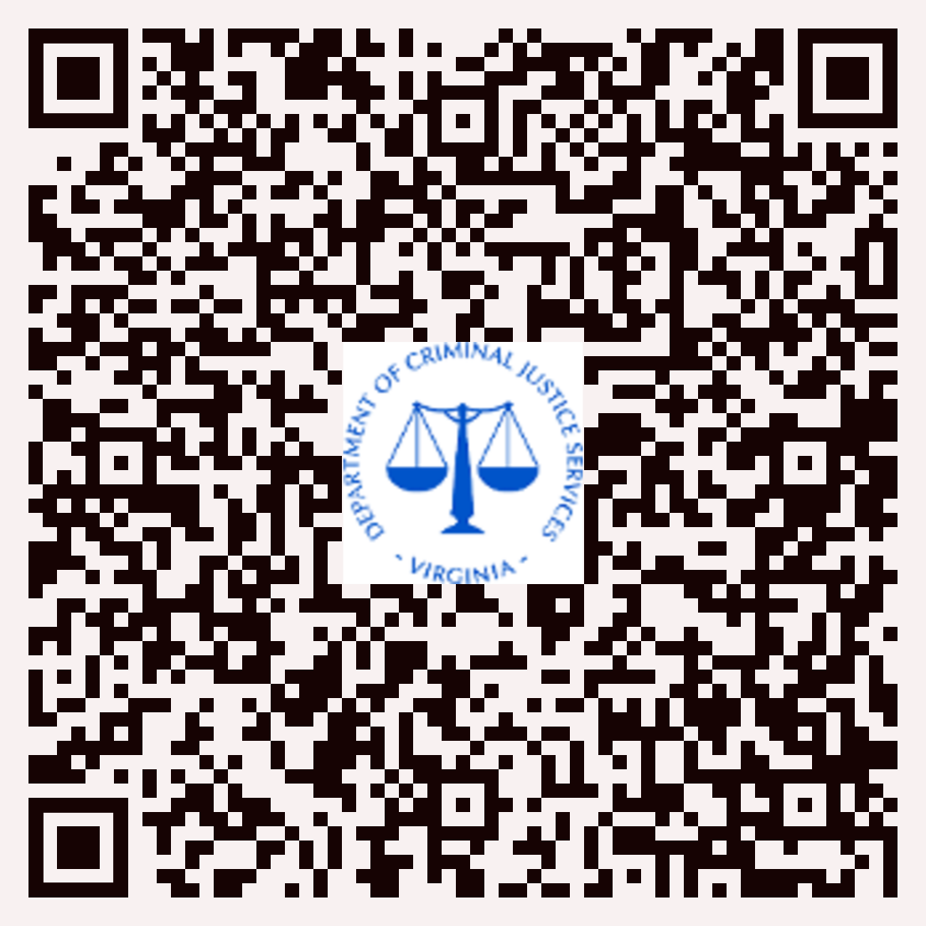


30th Anniversary of Virginia’s Crime Victim and Rights Act
Enacted in 1995, the Virginia Crime Victim and Rights Act is intended to ensure that crime victims:
Are treated with dignity, respect, and sensitivity, and that their privacy is protected;
Are informed of their rights;
Received authorized services, including possible financial assistance;
Have opportunities to make the courts aware of the full impact of crime; and,
Are heard at all critical stages of the criminal justice process.
Financial Cost Of Crime Victimization
For more information on victim and witness rights in Virginia,
It is estimated that the total costs related to
crime in the United States equal to approximately $2.6 trillion a year. This estimate includes expenses related to:
Criminal justice response
Victims services
Loss of wages
Medical expenses
Damaged or stolen goods
please scan this QR code with
your smart device
If you are a victim of crime, help is available:
Virginia Family Violence &
Sexual Assault Hotline
1-800-838-8238 (24-hours/day, toll-free)
www.vsdvalliance.org
Virginia Victim Assist Helpline
1-855-4-HELP-VA (855-443-5782
www.vanetwork.org)
SOURCES:
https://news.vanderbilt.edu/2021/02/05/new-research-examines-the-cost-of-crime-in-the-u-s-estimated-to-be-2-6-trillion-in-a-single-year/
Virginia Sexual and Domestic Violence Action Alliance (2024) “2023 Statewide Sexual Violence Report”
Virginia State Police (2024) “Crime in Virginia 2023”

