Slide 1

Digital Citizenship
Fifth Grade Lesson 1

Slide 2

Personal Space:
Be aware of your surroundings, respect others’ space, and stay in your own area.

Slide 3

Volume Control:
Use indoor voices, be mindful of noise levels.

Slide 4

Active Listening:
Eyes and ears open! Ready to participate!

Slide 5

Sharp Minds:
Be prepared to problem solve, ask questions, and contribute to the lesson.

Slide 6
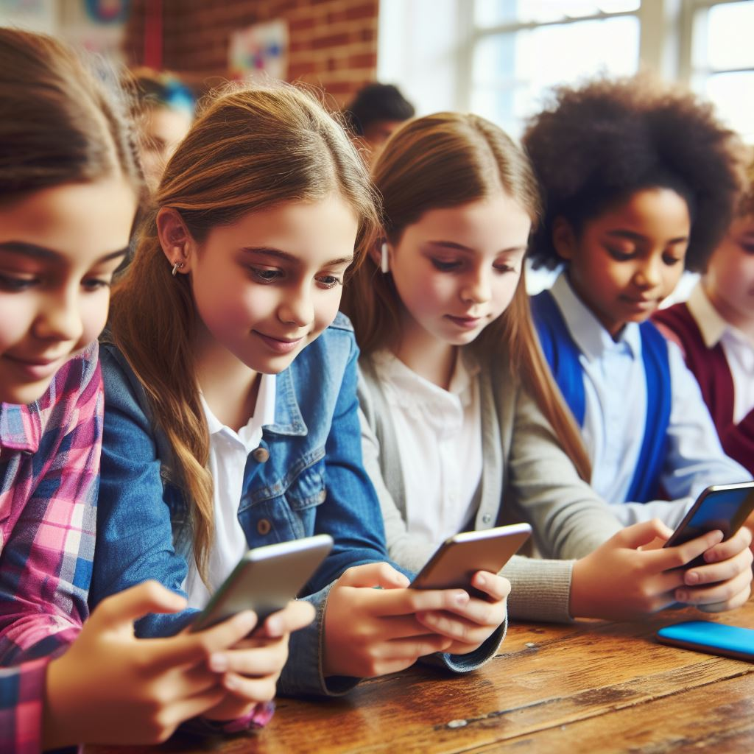
What does it mean to be a good digital citizen?
Notes:
Picture of children arguing

Slide 7
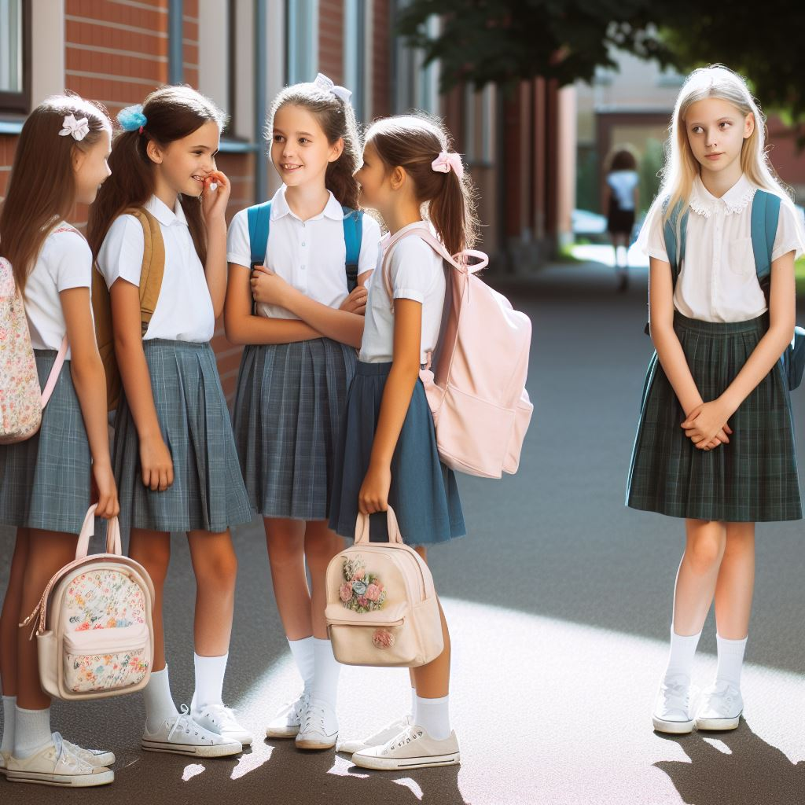
Be kind online: Just like you wouldn't bully someone at school, don't say mean things in comments, messages, or games. Remember, people have feelings even online!

Slide 8
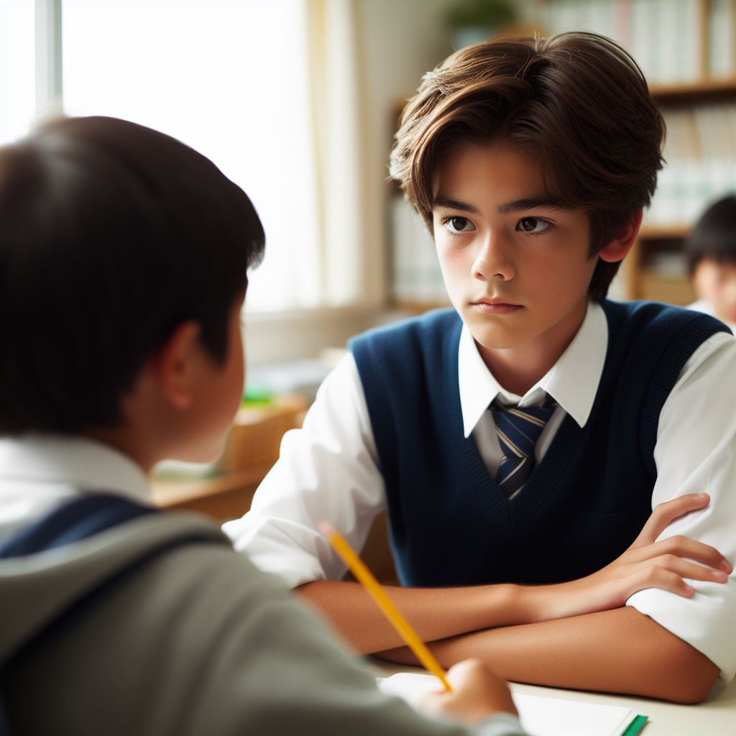
Think before you share: Would you share that picture or information if you were saying it out loud? Be careful about what you post about yourself and others.
Notes:
Picture of children arguing

Slide 9
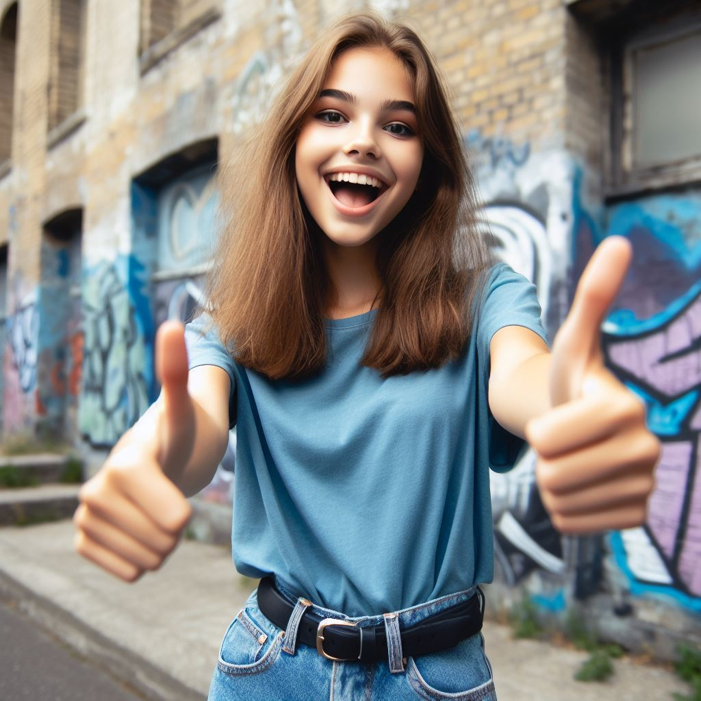
Make good choices: Even superheroes make mistakes, but they learn from them! If you make a bad choice, apologize and try to fix it. Being responsible means making choices that don't hurt yourself or others.
Notes:
Picture of children arguing

Slide 10
Rules for digital use and safety:

Slide 11

Rule 1
Protect your information:
Don't share your passwords or personal details with people you don't know online. It's like giving away your secret identity!

Slide 12

Rule 2
Be careful about clicking links: Not everything online is safe. Ask a grown-up before clicking on links or downloading anything, just like you ask before going to a friend's house.

Slide 13
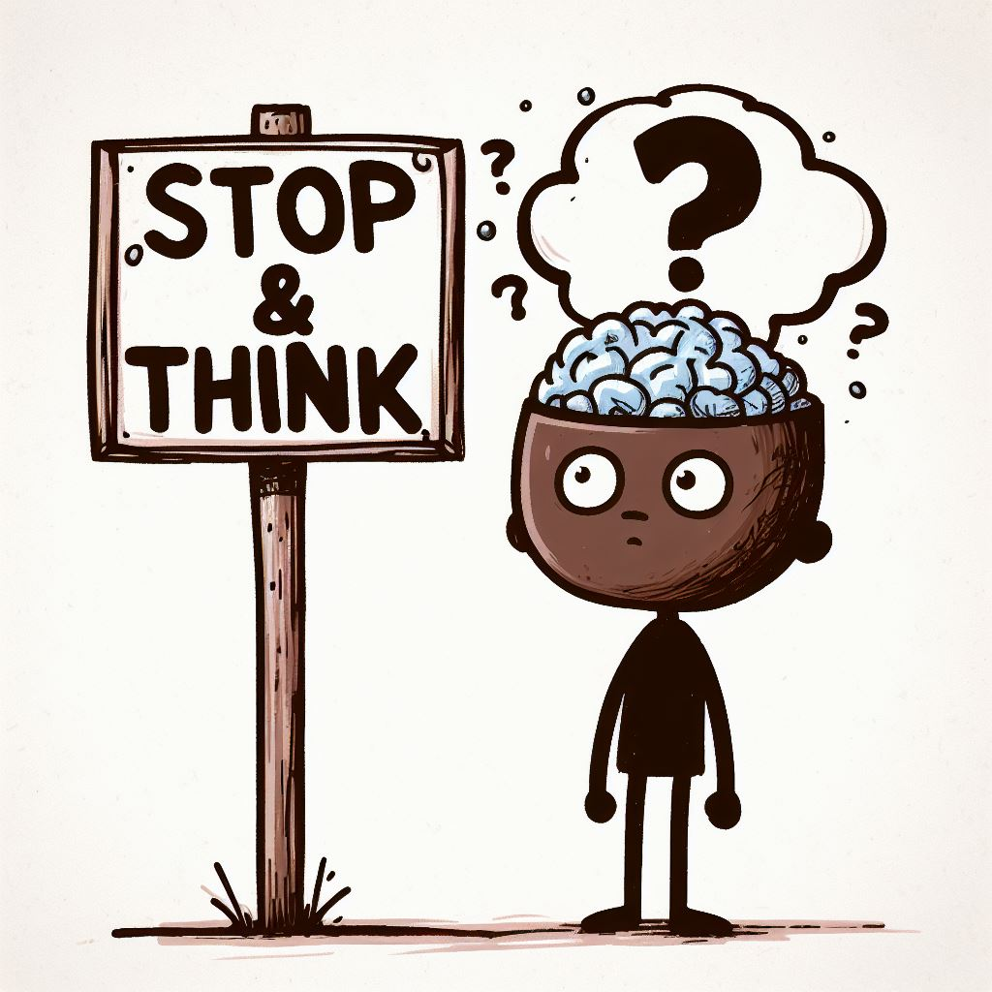
Rule 3
Think critically about what you see: Not everything you read online is true. Check with trusted sources like teachers, librarians, or websites you know before believing something.

Slide 14


Rule 4
Follow your media balance: It is easy to scroll through social media and stay on the computer all day. But we need to use media in a way that feels healthy and in balance with other life activities.

Slide 15
What’s cyberbullying?

Slide 16
Lizzie loves to spend time on social media, especially to connect with her friends after school. One day, Lizzie posts a photo of herself wearing her favorite outfit and feeling excited about it. She shares it with her friends, hoping they will like it too. However, when Lizzie logged back into her social media account later that day, she noticed something upsetting. Some of her classmates have left mean comments on her photo. They're saying things like, "Your outfit is so ugly," "You look ridiculous," and "Why do you even bother trying to look cool?" Lizzie feels hurt and embarrassed. She doesn't understand why her classmates are being so mean to her. She starts questioning her outfit choice and feels self-conscious about posting anything online.
Notes:
Picture of children arguing

Slide 17
Activity: Hurtful comments handout

Slide 18
All done, great job!

