Slide 1

Self-Discipline and Self Respect
Fifth Grade Lesson 2

Slide 2

Personal space:
Be aware of your surroundings, respect others’ space, and stay in your own area.

Slide 3

Volume control:
Use indoor voices, be mindful of noise levels.

Slide 4

Active listening:
Eyes and ears open! Ready to participate!

Slide 5

Sharp minds:
Be prepared to problem solve, ask questions, and contribute to the lesson.

Slide 6

Self-discipline is controlling your actions and emotions to achieve a goal, even if it's difficult.

Slide 7

Self-respect is treating yourself and others with kindness and dignity.

Slide 8
Why are self-discipline and self-respect essential for goal setting?

Slide 9


Provide examples of how self-discipline and self-respect contribute to setting and achieving goals

Slide 10
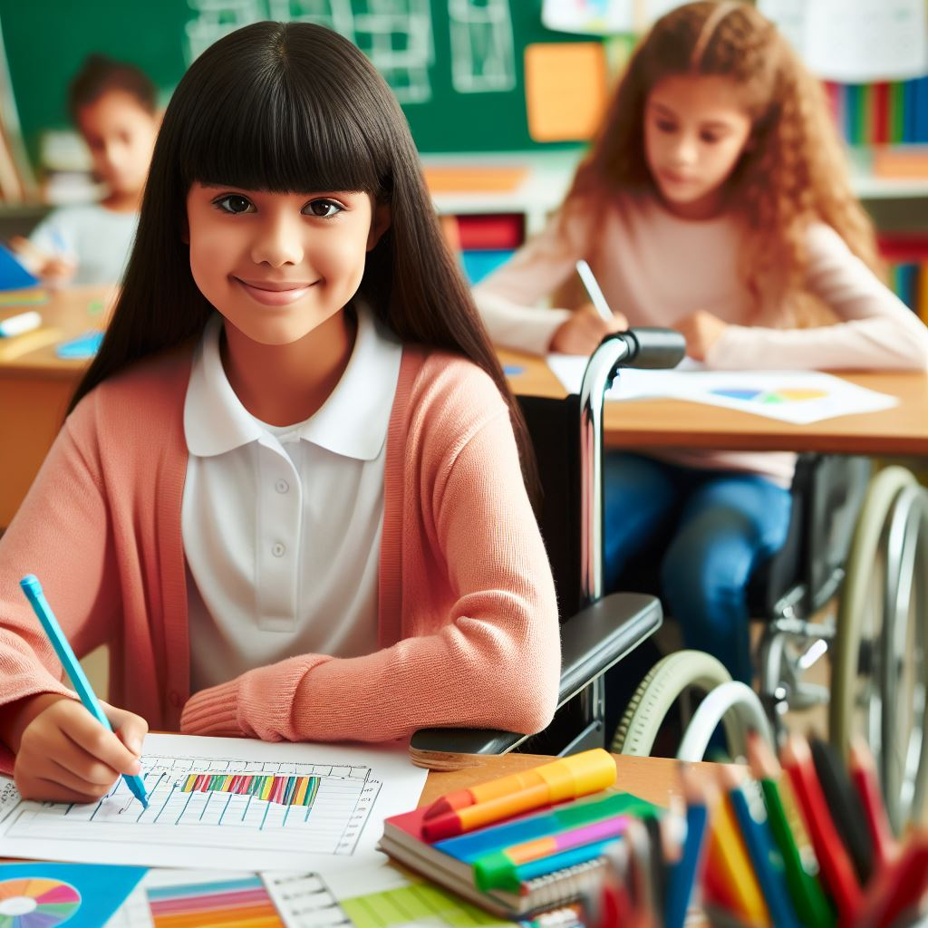
How can students show self-discipline by making and following a plan to reach a personal goal?

Slide 11
Brainstorm

Slide 12

Group Activity

Slide 13
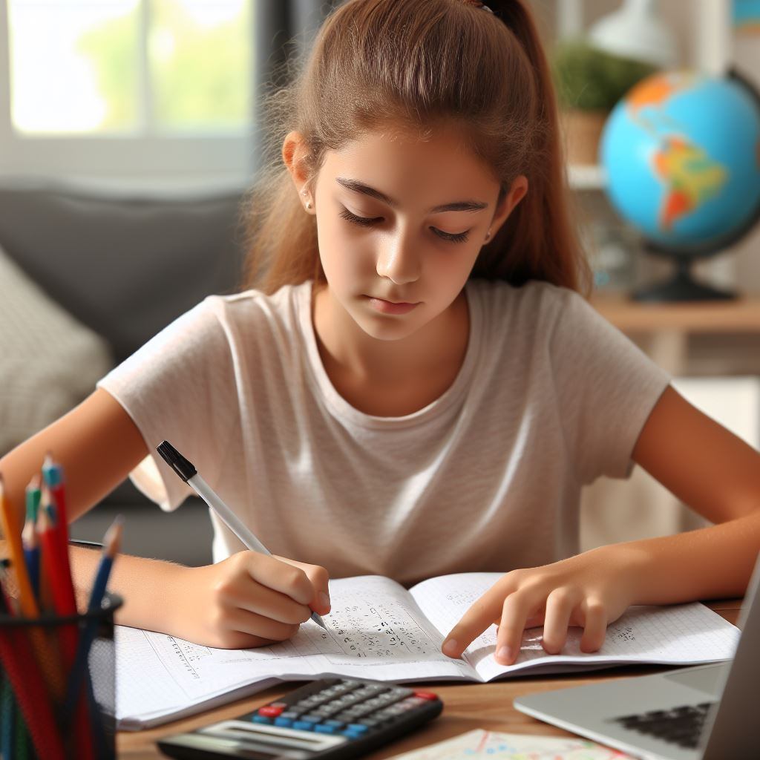
Scenario 1: Academic improvement
Notes:
Scenario 1: Academic Improvement
Sarah wants to improve her grades in math. She struggles with the subject but is determined to do better. How can Sarah apply self-discipline and self-respect to achieve her goal of improving her math grades?

Slide 14
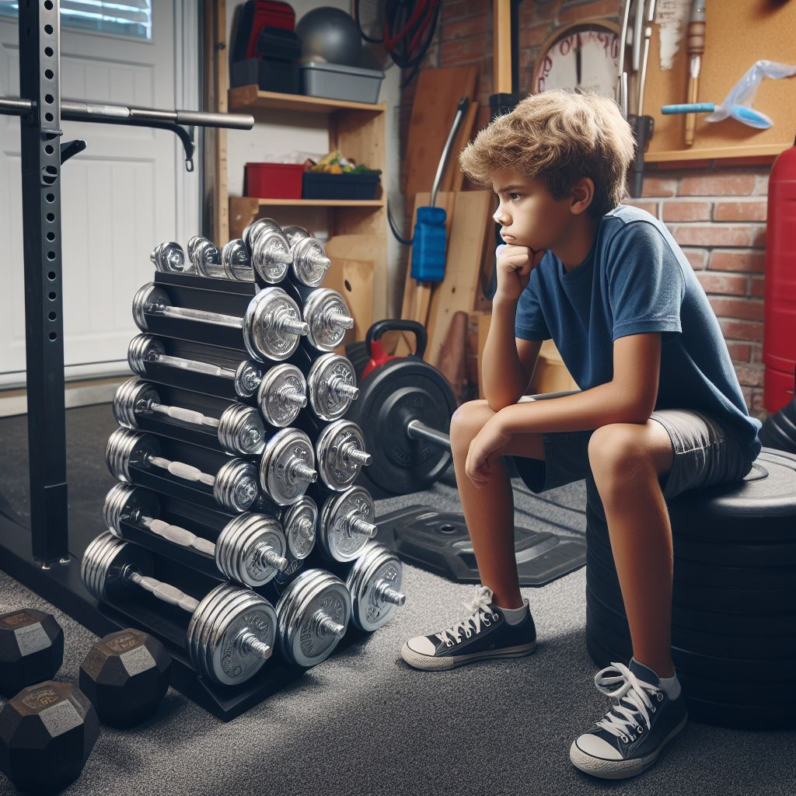
Scenario 2: Health and fitness
Notes:
Scenario 2: Health and Fitness
Jack wants to become more physically fit. He enjoys playing video games and spending time indoors but realizes the importance of being active for his overall health. How can Jack apply self-discipline and self-respect to establish a regular exercise routine and improve his fitness?

Slide 15

Scenario 3: Time management
Notes:
Scenario 3: Time Management
Emily often overwhelms herself with homework and extracurricular activities. She wants to manage her time more effectively to reduce stress and improve her academic performance. How can Emily apply self-discipline and self-respect to develop better time management skills and achieve a balance between her responsibilities and leisure activities?

Slide 16

Scenario 4: Personal development
Notes:
Scenario 4: Personal Development
Alex is interested in learning a new skill, such as playing a musical instrument or speaking a foreign language. He knows it will require dedication and practice but is excited about mastering something new. How can Alex apply self-discipline and self-respect to stay motivated and committed to acquiring this new skill?

Slide 17

Scenario 5: Social relationships
Notes:
Scenario 5: Social Relationships
Maria wants to strengthen her friendships and build deeper connections with her peers. She tends to be shy and reserved but recognizes the importance of nurturing her social relationships for her well-being. How Can Maria apply self-discipline and self-respect to step out of her comfort zone, initiate conversations, and actively engage with others to build stronger friendships?

Slide 18
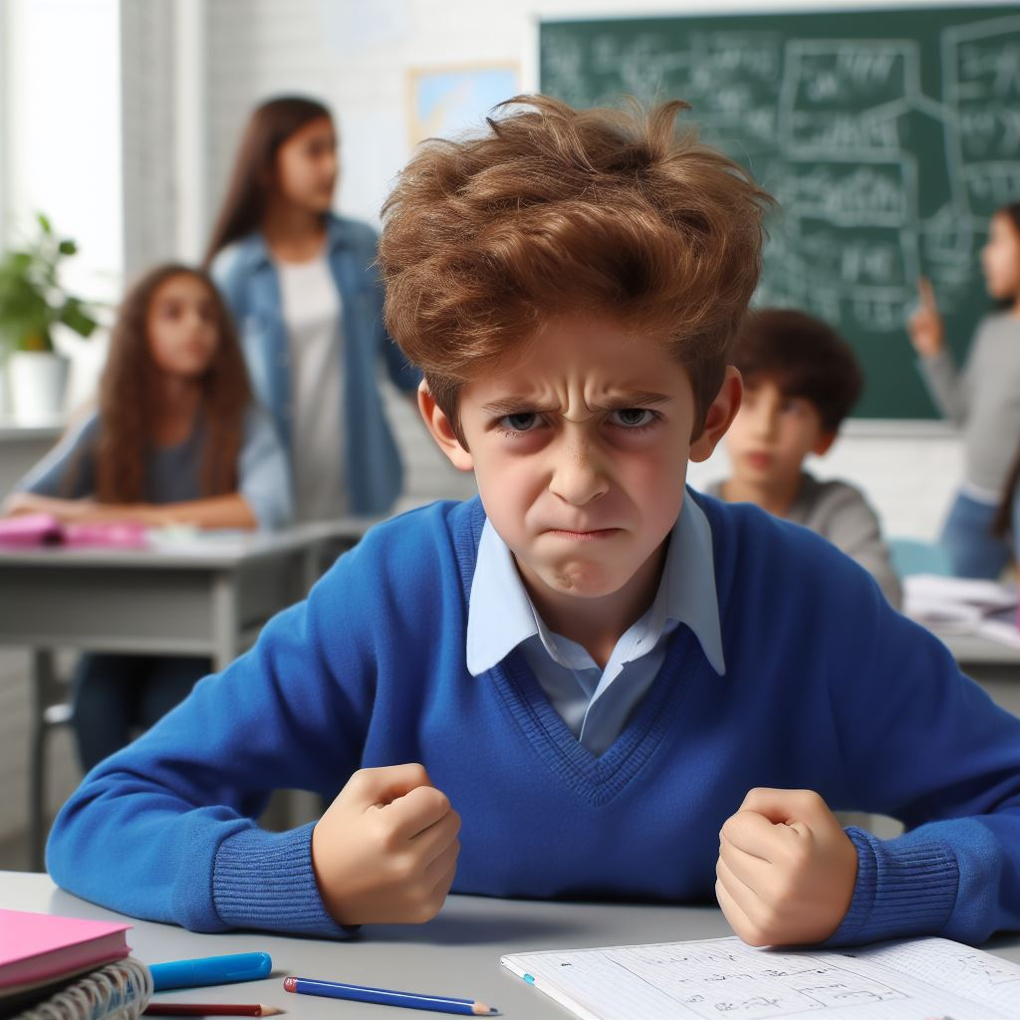
Scenario 6: Emotional tegulation
Notes:
Scenario 6: Emotional Regulation
Tom struggles with managing his anger and often reacts impulsively in frustrating situations. He wants to develop healthier coping mechanisms and control his emotions more. How can Tom apply self-discipline and self-respect to cultivate self-awareness, practice mindfulness, and constructively respond to challenging emotions to achieve his goal of emotional regulation?

Slide 19
Activity: Personal reflection and goal setting

Slide 20
All done, great job!

