Slide 1

Drug Awareness
Fifth Grade Lesson 4

Slide 2

Personal space:
Be aware of your surroundings, respect others’ space, and stay in your own area.

Slide 3

Volume control:
Use indoor voices, be mindful of noise levels.

Slide 4

Active listening:
Eyes and ears open! Ready to participate!

Slide 5

Sharp minds:
Be prepared to problem solve, ask questions, and contribute to the lesson.

Slide 6

What is a drug?

Slide 7
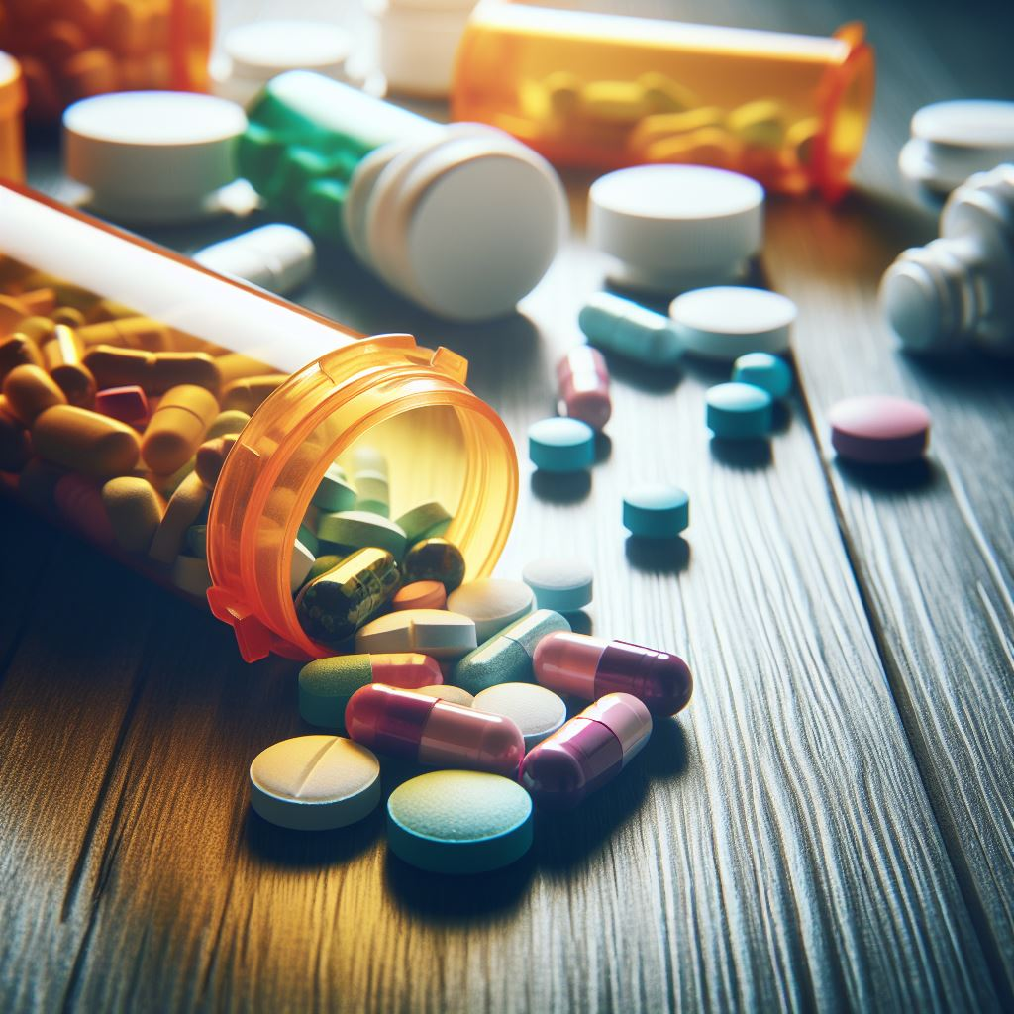
Where do drugs come from?
(Legal and illegal)

Slide 8
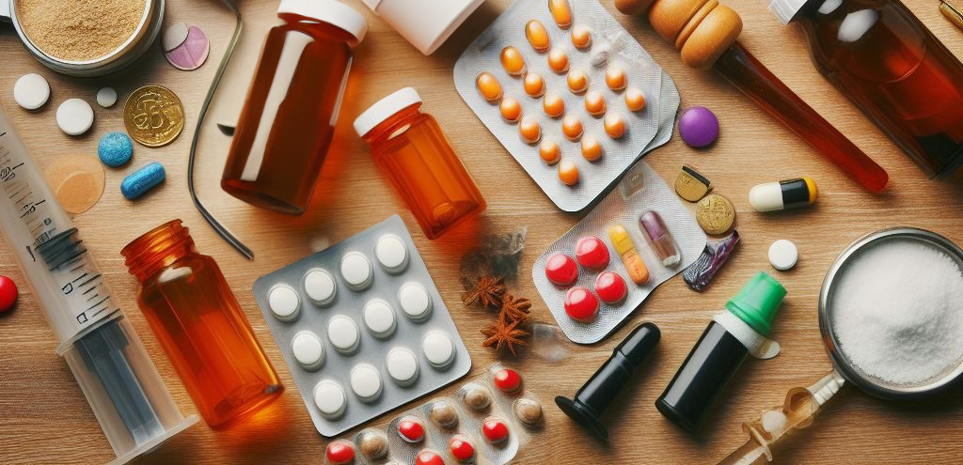
Why do people use drugs?
(Legal and illegal)

Slide 9
Can legal drugs be used in an illegal way?

Slide 10
Legal drugs
Illegal drugs

Slide 11
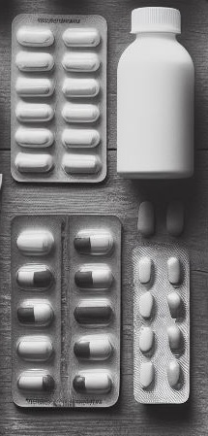

Drug forms and administration
Pills: ingest
Liquid: ingest, inject, inhale
Other solids (plants): ingest, inhale
Cream/patch: apply to skin
Gas: inhale

Slide 12

Medicines are meant to help us feel better and keep us healthy. If taken incorrectly, it can make us very sick.

Slide 13
Prescription abuse is just as dangerous as illegal drug abuse. Overdosing on these drugs can result in death, coma, or addiction. Other side effects may include impaired memory, nausea, and vomiting.

Slide 14
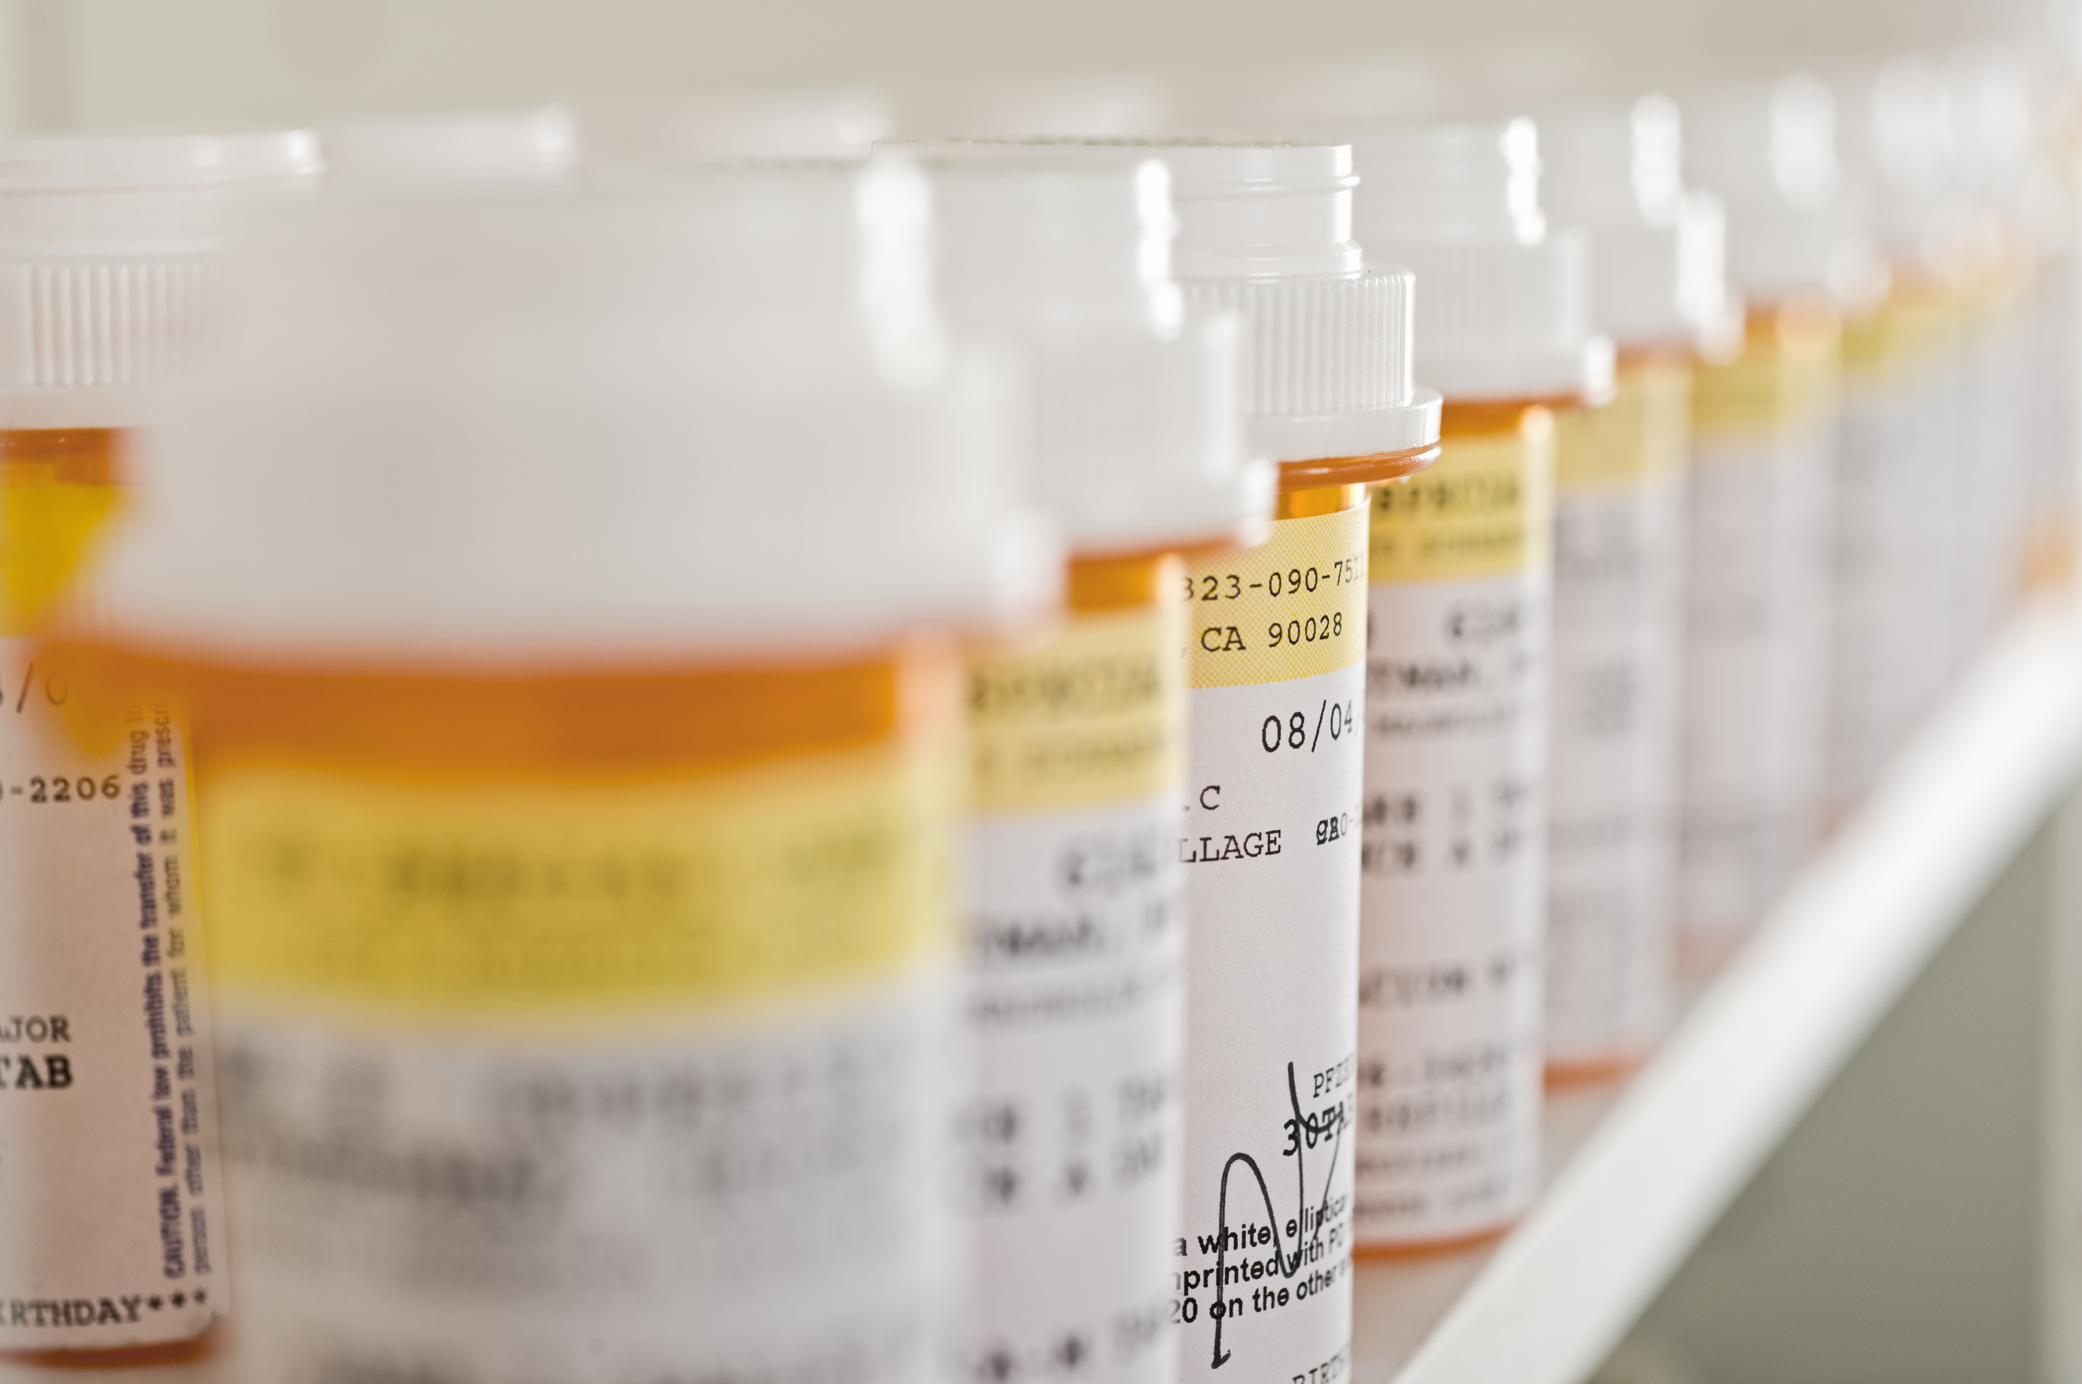
Addiction is considered a disease because substances like drugs and alcohol change the structure of the brain and how it works. It is an uncontrollable urge to do something despite harmful consequences.

Slide 15
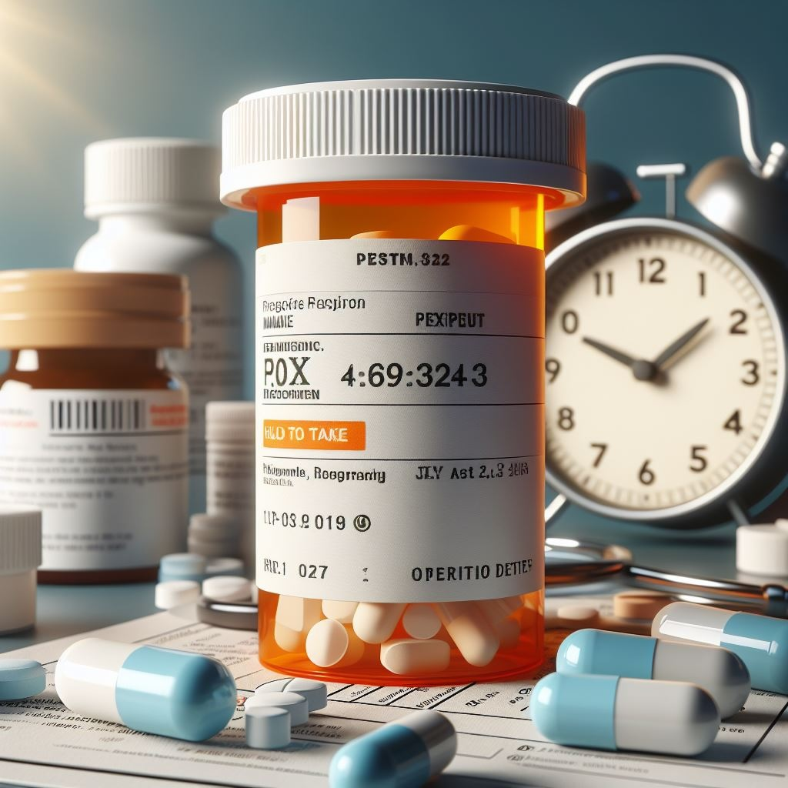
Prescription label information:
Patient name
Name of medicine and strength
Instructions on how and when to take the medication
Physical description of the medication
Expiration date
Number of pills in the bottle
Notes:
Taking prescription drugs in a way that has not been recommended by a doctor is more dangerous than some might think. It’s drug abuse. It’s illegal just like taking street drugs.

Slide 16

How can drugs negatively impact an individual?

Slide 17
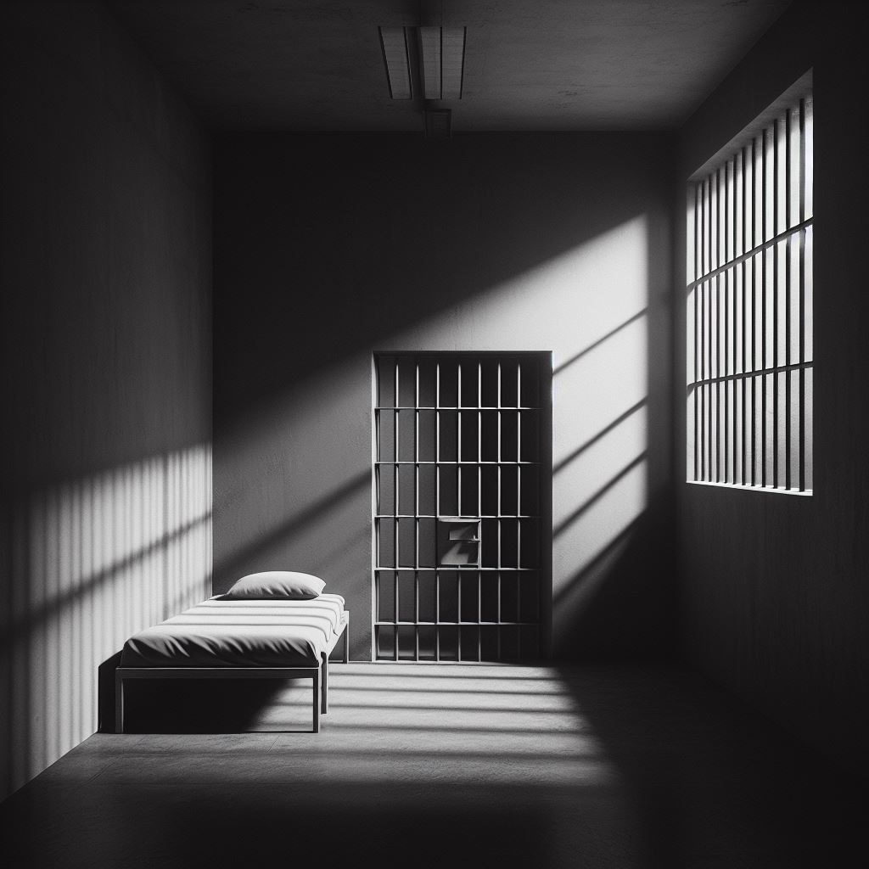
Legal consequences

Slide 18


Health hazards

Slide 19


Safe administration of legal drugs

Slide 20
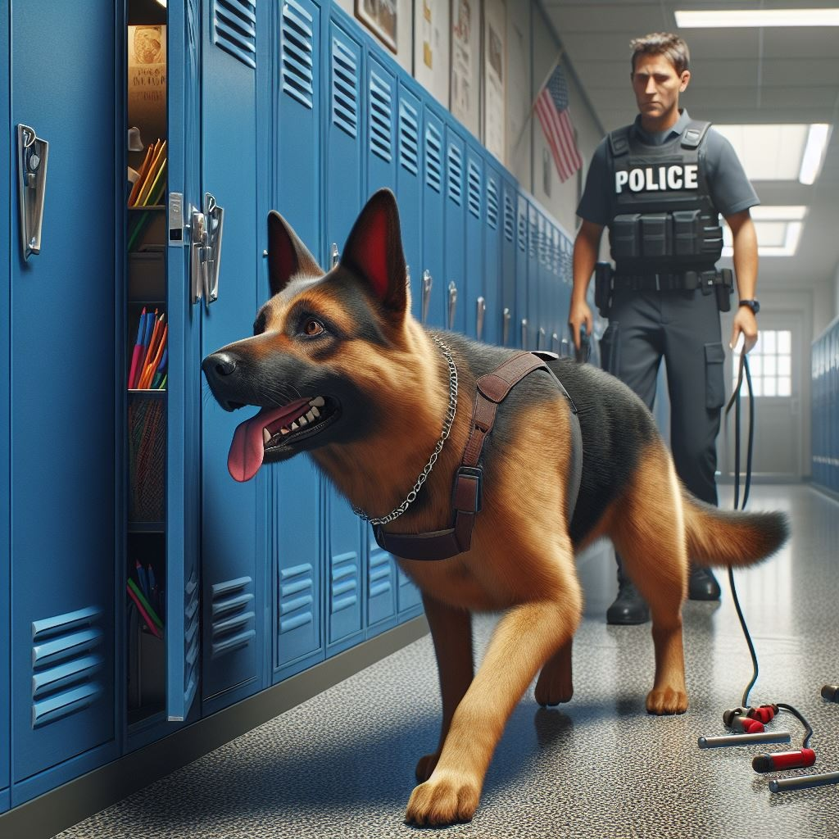
Stopping the distribution of drugs

Slide 21
If you suspect/know someone is guilty of using illegal drugs:
Stay clear - you can get in trouble if you are where drugs are being used even if you’re not using. You could also get hurt.
If a friend is using drugs, help them get help. Contact a trusted adult; parent, counselor, teacher, or pastor.

Slide 22
Cocaine
Aspirin
Marijuana
Heroin
Cough syrup
Ecstasy
Fentanyl
Opiod pills
Asthma inhaler
Vapes
Activity:
Illegal/Legal Drug Sort

Slide 23
In groups, answer questions and make decisions in different drug-related situations.
Answer the discussion questions on the handout. Be prepared to share your answers with the class!
Activity: Scenarios

Slide 24

Final reflection:
Share one key takeaway from one scenario with the class.

Slide 25
Every decision we make has the potential to impact us and our community.

Slide 26
All done, great job!

