Slide 1

Alcohol
Awareness
Fifth Grade Lesson 5

Slide 2

Personal space:
Be aware of your surroundings, respect others’ space, and stay in your own area.

Slide 3

Volume control:
Use indoor voices, be mindful of noise levels.

Slide 4

Active listening:
Eyes and ears open! Ready to participate!

Slide 5

Sharp minds:
Be prepared to problem solve, ask questions, and contribute to the lesson.

Slide 6
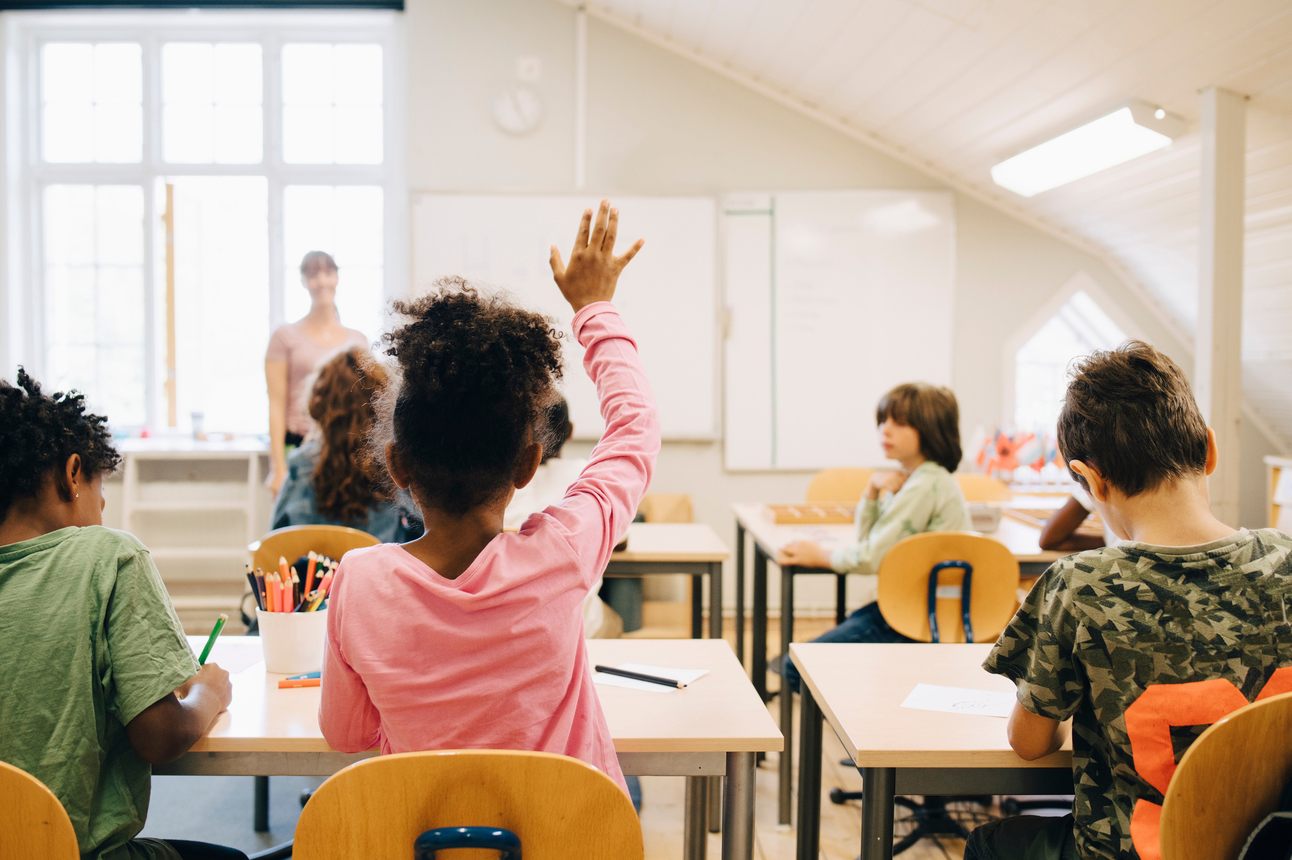
Why do you think people consume alcohol?

Slide 7
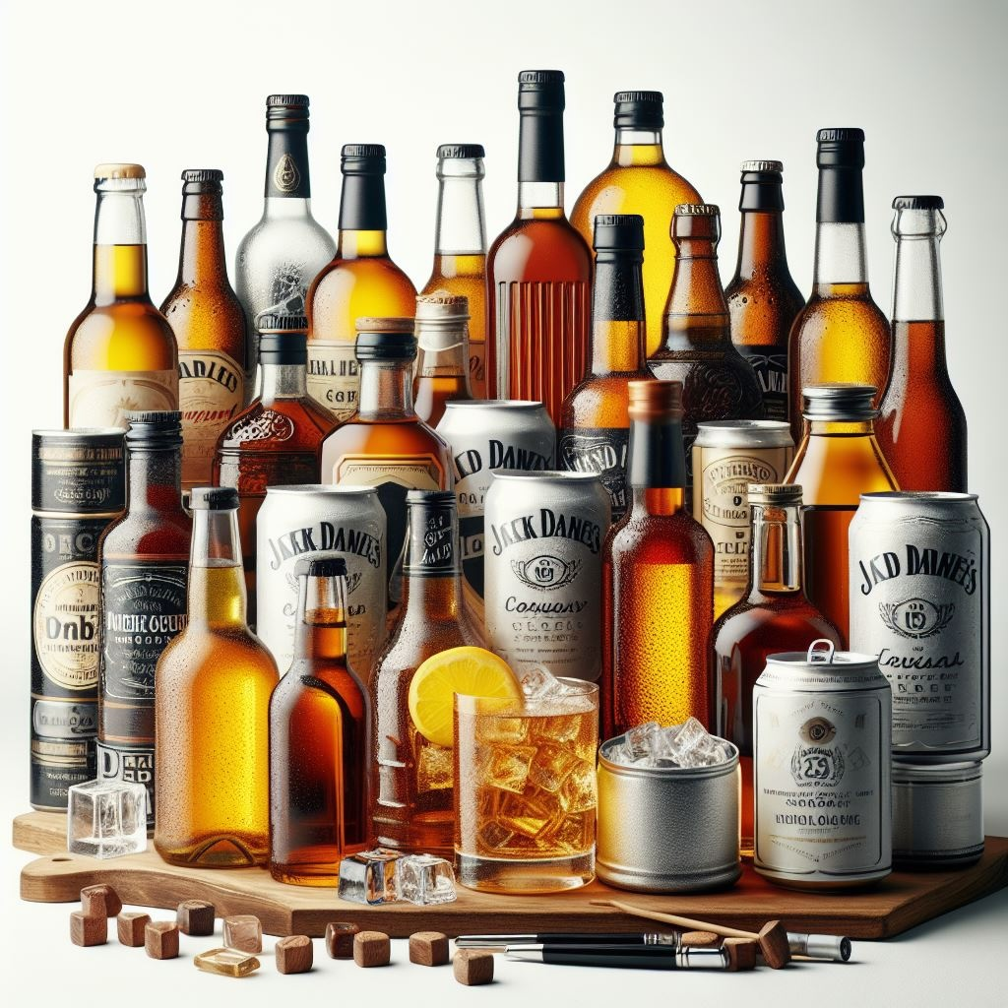
Facts about alcohol

Slide 8
Alcohol is the intoxicating ingredient in wine, beer, vodka, rum, cough medicines, some mouthwashes, etc.

Slide 9

Alcohol is a depressant drug that slows the body’s processes.

Slide 10

It is the oldest and most abused drug in the world.

Slide 11
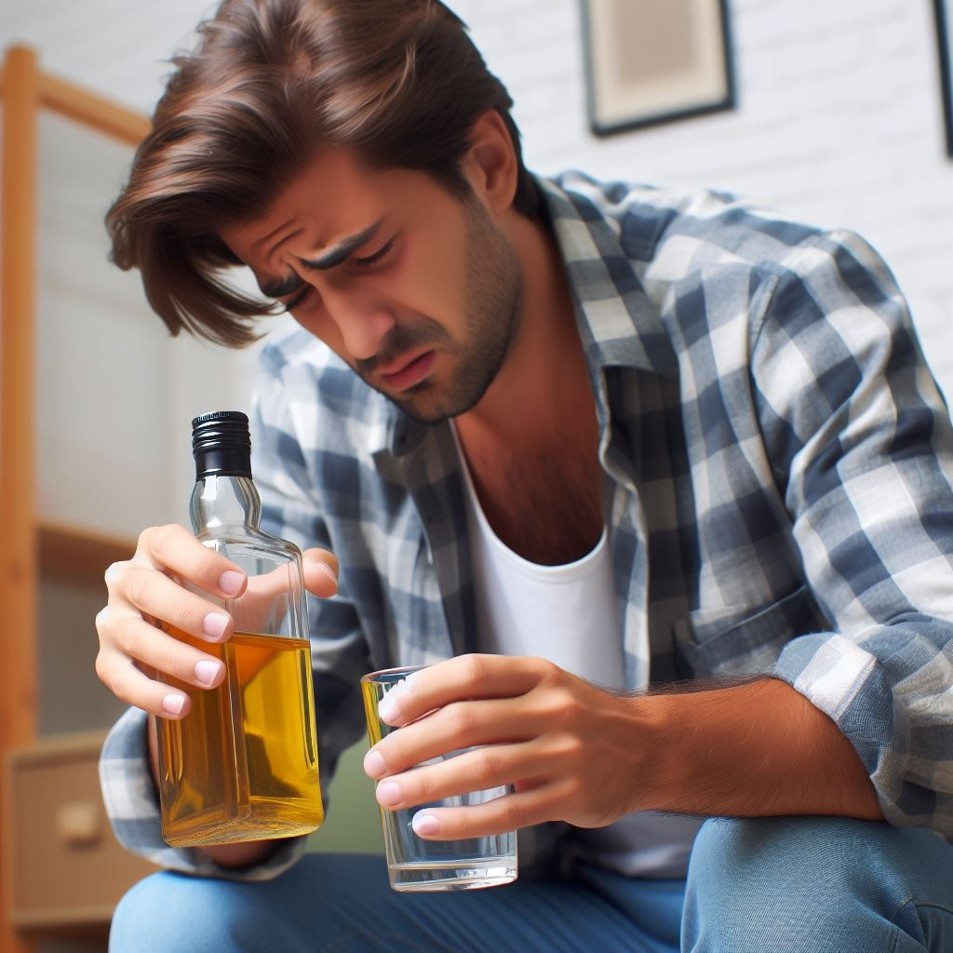
There are predictable, though varying, physical effects upon everyone who drinks alcohol.

Slide 12




Different factors influence the speed at which alcohol is absorbed and how it affects the person.
Notes:
Presence of food in the stomach
Use of carbonated beverages (increase the speed of absorption).
Concentration of alcohol
Amount of alcohol intake
Body weight
Age
Previous drinking experience
Presence of other drugs in the system
General health of the individual

Slide 13
Effects of alcohol on different organs

Slide 14
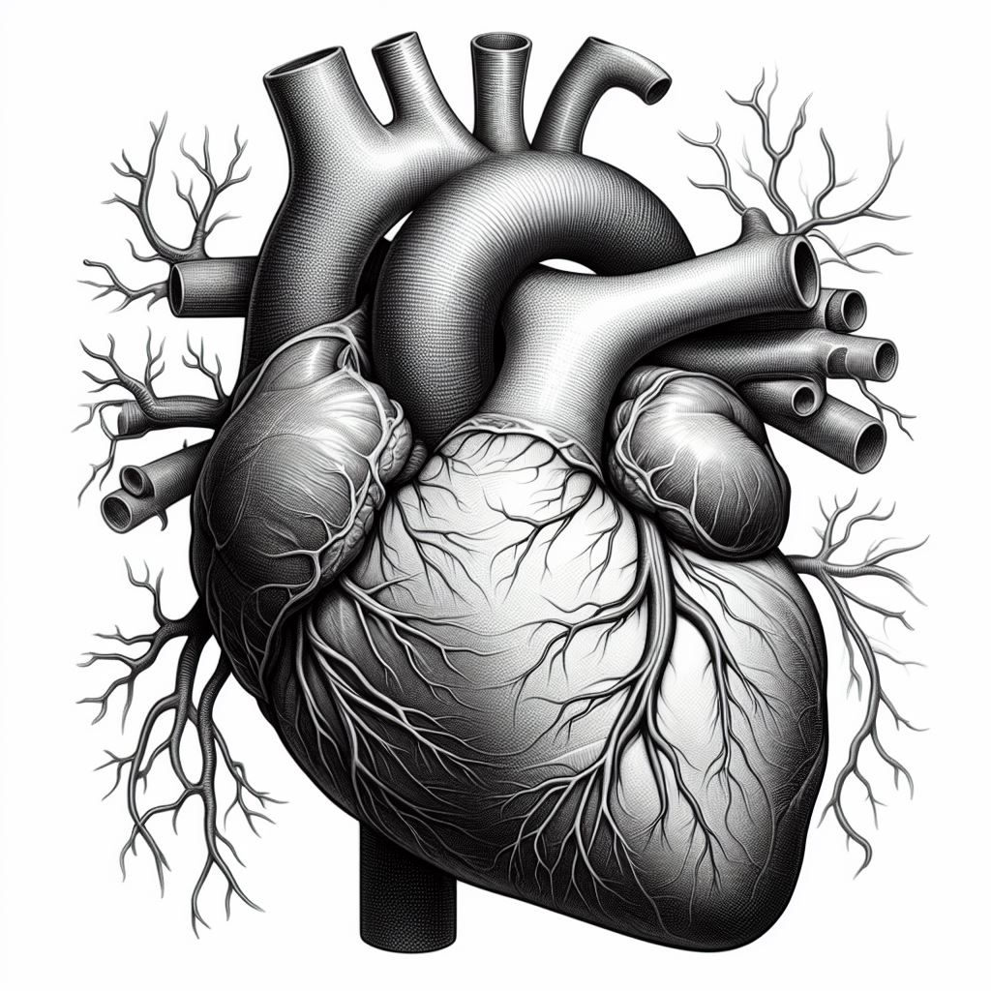
Heart

Slide 15
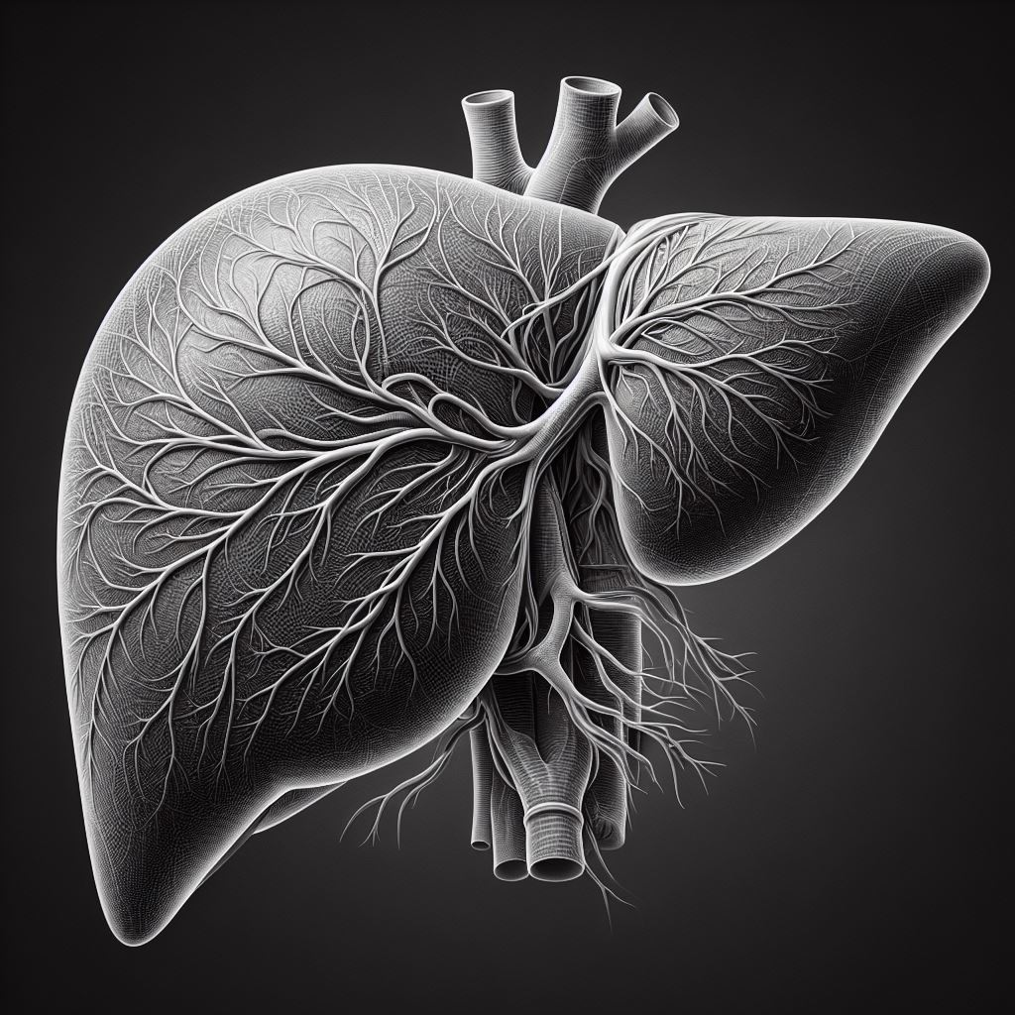
Liver

Slide 16
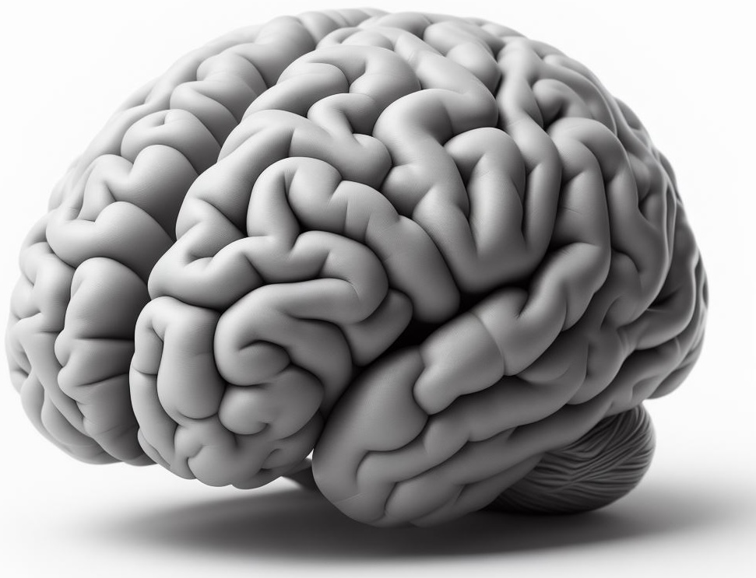
Brain

Slide 17

What are some consequences of using and/or buying alcohol underage?

Slide 18

Age restrictions
Under 21

Slide 19
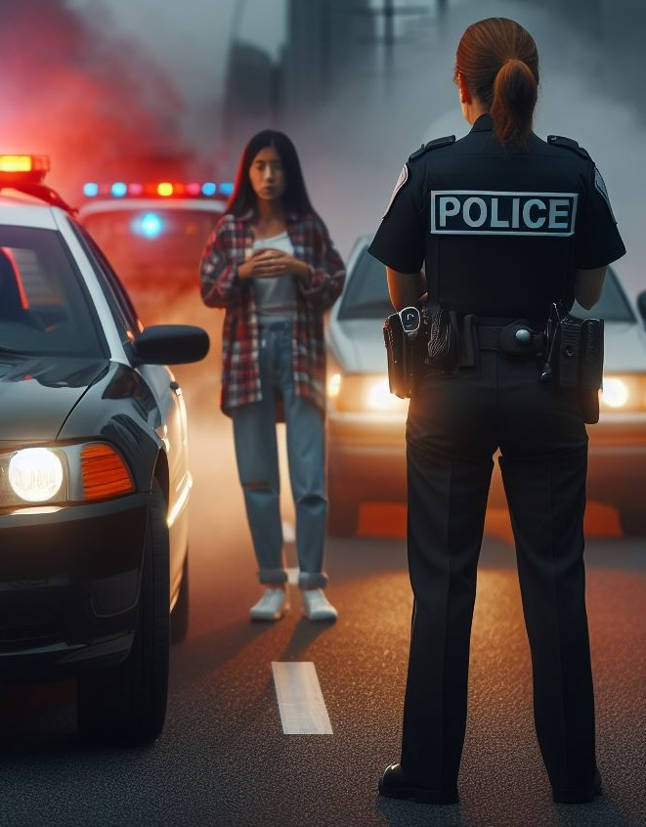
Driving Under the Influence (DUI)

Slide 20
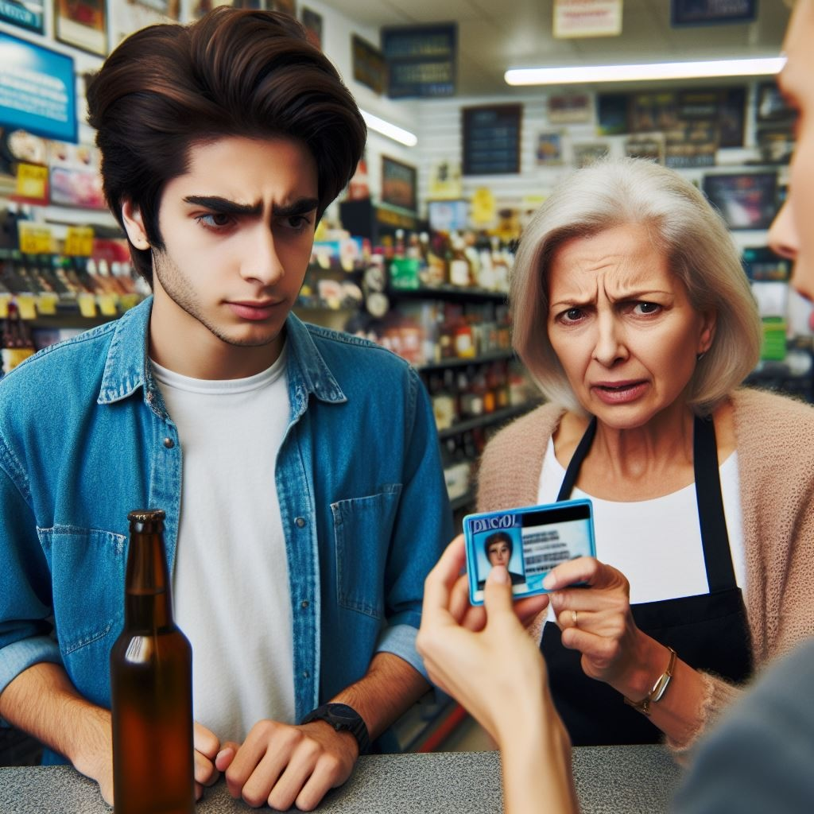
Possession and purchase

Slide 21
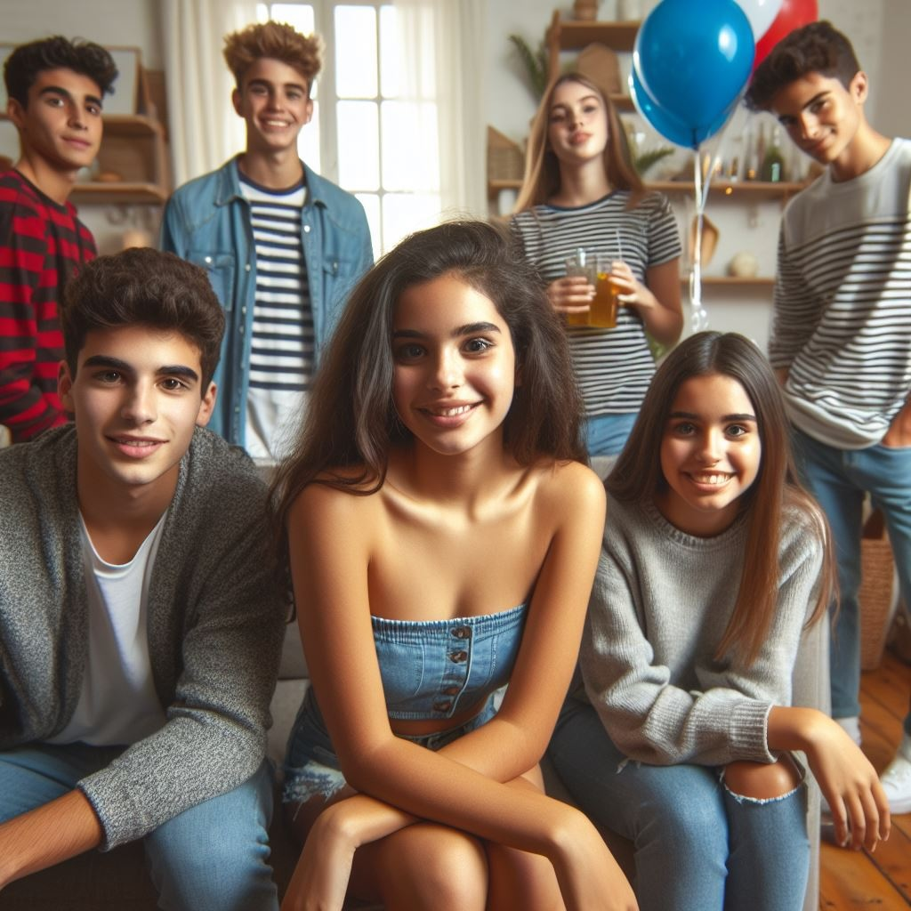
Social host liability

Slide 22
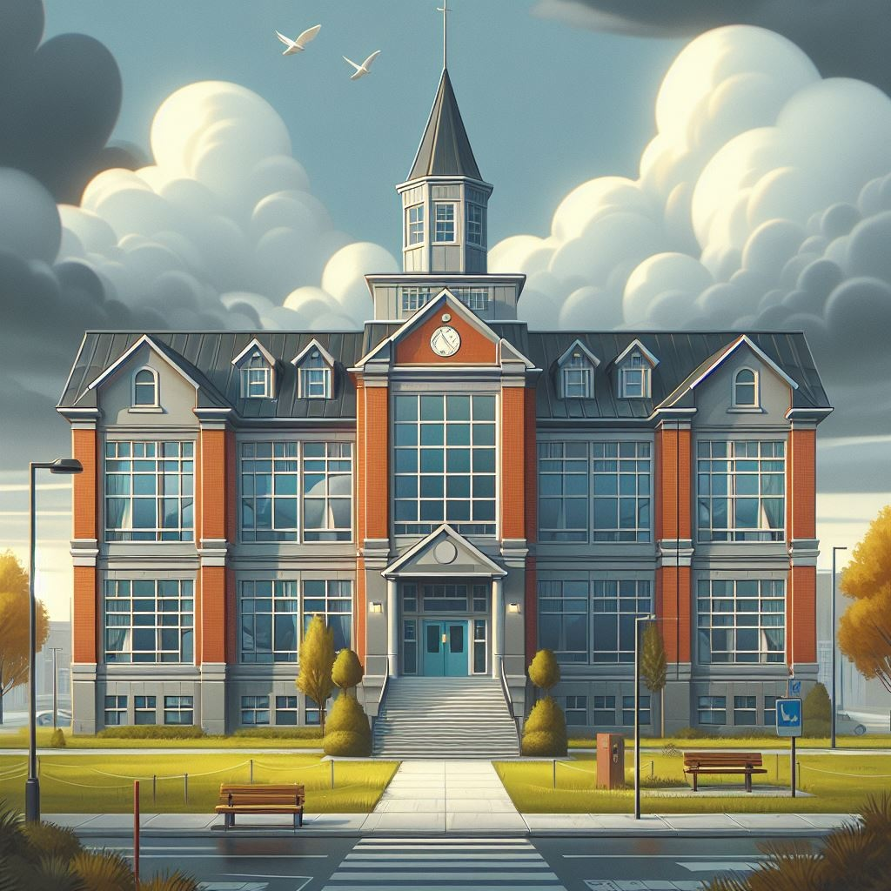
School consequences

Slide 23
Identify the potential negative effects and
consequences of underage drinking.
Categories: Physical, social, emotional, and legal.
Group Activity: Alcohol Consequences

Slide 24
Group Activity: Role-Play
Identify potential consequences and ways to prevent underage drinking.
Each group will present their findings to the class!

Slide 25

Final Reflection:
By yourself, what is one takeaway from your scenario that you can apply in your life today?

Slide 26
Every decision we make has the potential to impact ourselves and our community.

Slide 27
All done, great job!

