Slide 1

Nicotine Awareness
Fifth Grade Lesson 6

Slide 2

Personal space:
Be aware of your surroundings, respect others’ space, and stay in your own area.

Slide 3

Volume control:
Use indoor voices, be mindful of noise levels.

Slide 4

Active listening:
Eyes and ears open! Ready to participate!

Slide 5

Sharp minds:
Be prepared to problem solve, ask questions, and contribute to the lesson.

Slide 6


Smoked tobacco

Slide 7

Smokeless tobacco

Slide 8
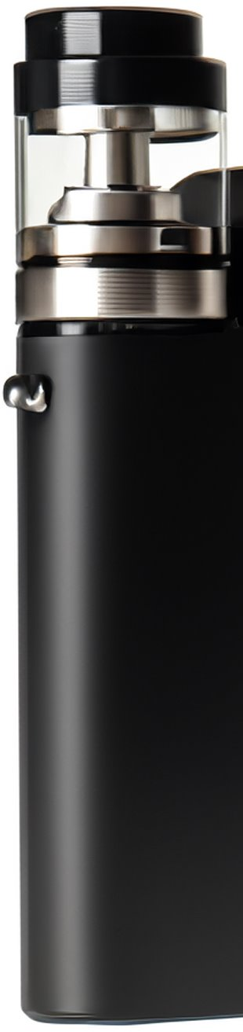
E-cigarettes

Slide 9
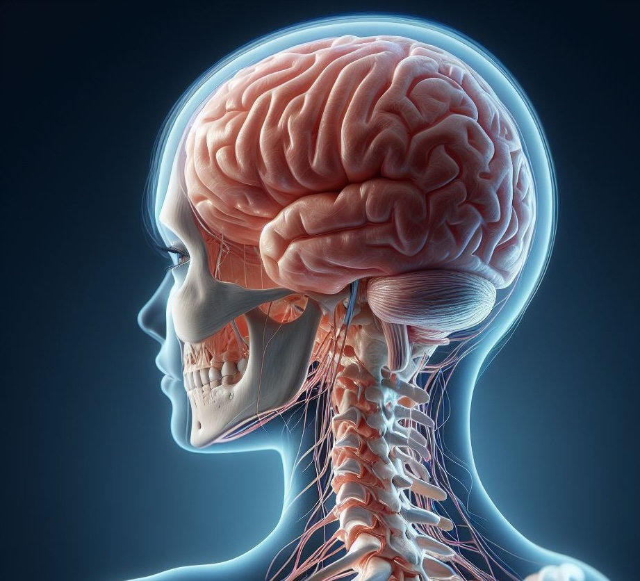
The central nervous system is like the control center of our body. It includes two important parts: the brain and the spinal cord.
Notes:
Brain: This is where we think, learn, feel, and remember things. It’s like our super-smart computer!
Spinal Cord: Imagine it as a long highway that carries messages between the brain and the rest of our body.

Slide 10

A stimulant is like a turbo boost for our body and brain. It speeds things up!
Notes:
Examples of stimulants include caffeine (found in coffee and some sodas) and sugar (like when we eat candy). They can make us feel more awake and energetic.

Slide 11

A depressant is like a calm-down potion. It slows things down!
Notes:
Doctors sometimes use depressants to help people relax their muscles or feel less anxious.
But if we take too much, it can make us feel sleepy, confused, and even stop us from breathing properly.

Slide 12
Facts about nicotine and addiction:
Addiction is an uncontrollable urge to do something despite harmful consequences.

Slide 13

Nicotine exposure during the teen years can limit brain growth and development leading to problems with attention, learning and cause vulnerability to addiction.

Slide 14
Narrows blood vessels, cutting down blood and oxygen flow. Raises blood pressure. This means that the heart has to work harder.

Slide 15
Burned tobacco and second-hand smoke contains more than 7,000 chemicals. Many are toxic and have been related to cancer.

Slide 16

What is in tobacco products?
Nicotine: This is the addictive drug.
Insecticide: Chemical used to kill insects.
Tar: Similar to road paving and roofing materials.
Methanol: Used in rocket fuel.
Acetone: Found in nail polish remover.
Ammonia: Found in household bathroom cleaners.
Carbon monoxide: Found in car exhaust fumes.
Arsenic: Found in rat poison.
Formaldehyde: Found in embalming fluid.

Slide 17
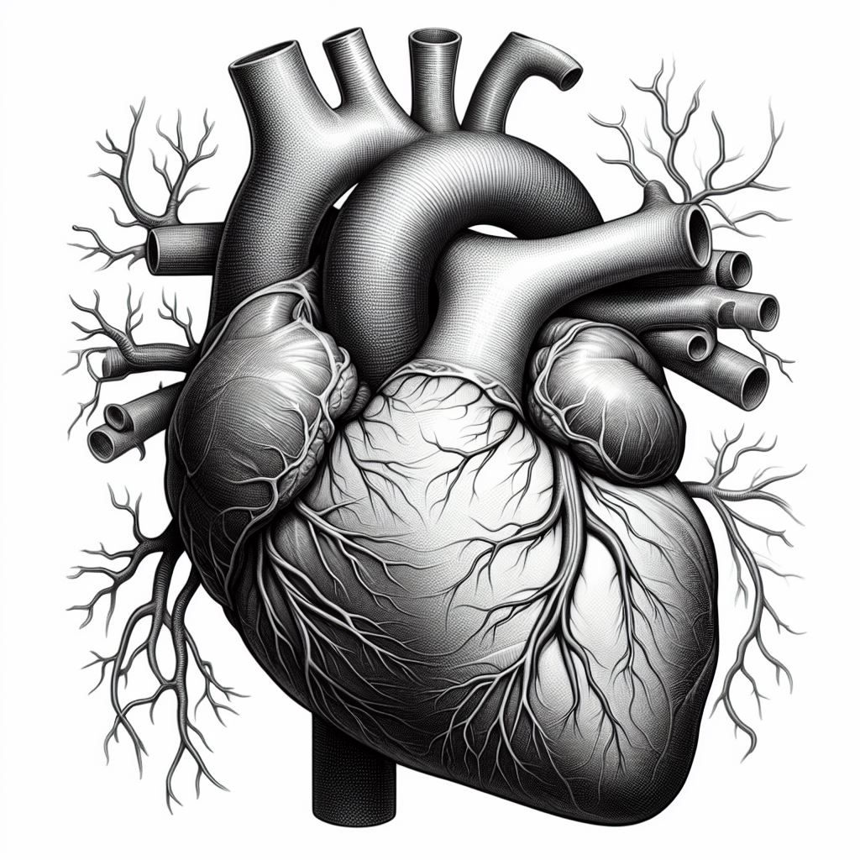
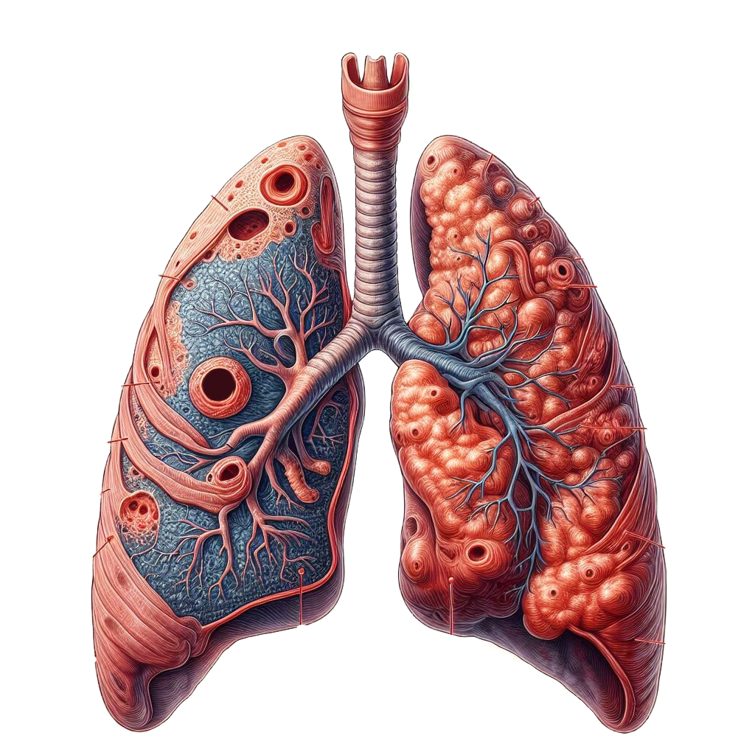
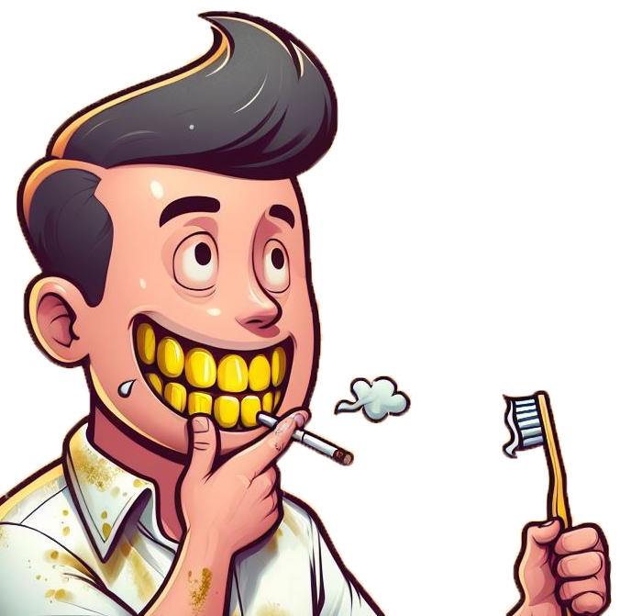
Health issues and diseases caused by tobacco:
Chronic bronchitis
Laryngitis
Emphysema
Heart Disease
Cancer
Stained teeth and skin
Wrinkled dry skin
Gum disease, tooth loss, and bad breath
Medication interactions
Impaired physical fitness

Slide 18
E-Cigarettes: produce an aerosol (not pure water vapor) by heating liquid nicotine, flavoring and other chemicals that combine to make the aerosol.
These liquids also contain:
Flavoring that causes lung disease and injury when inhaled
Ultra-fine particles that are inhaled deep into the lungs
Heavy metals and other chemicals that can permanently lodge in the users’ lungs
Notes:
These products are regulated by the FDA and are not considered safe.
Users inhale the aerosol into their lungs. Bystanders also inhale this aerosol when the user exhales into the air.
These products are not FDA approved as a quit smoking aid.

Slide 19
Health issues and diseases:
Lung Disease and/or injury
Respiratory problems- “Popcorn lung” (caused by the chemical diacetyl)
E-cig aerosol has metals and toxic chemicals known to cause cancer.
Skin exposure to or ingestion of “e-juice” can cause seizures, brain injury, or vomiting.

Slide 20

Legal consequences of tobacco use can include:
Fines
Community service
Tobacco education programs
Loss of driver’s license
Official records report

Slide 21
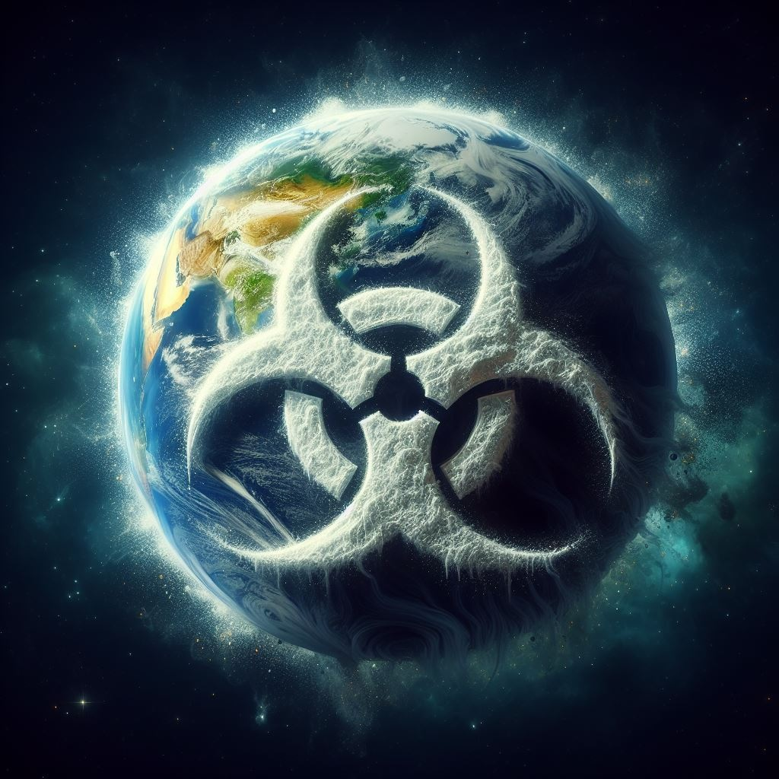
Environmental consequences:
All those toxic chemicals and heavy metals contaminate our water and wildlife. The toxic exposure can poison fish, as well as animals who eat cigarette butts. The cigarette filters, or butts, take years to biodegrade because they’re made of plastic fibers.
Some studies have shown that after 2 years, only 38% of a cigarette butt was decomposed.

Slide 22


Financial Consequences
The average cost of a pack of cigarettes is $6.36.
If someone smokes one pack of cigarettes a day,
How much does that cost per week? Month? Year?

Slide 23

With all of this knowledge, why do you think people start or continue to use nicotine and tobacco products?

Slide 24

What happens when someone stops smoking?
How do people stop smoking?

Slide 25

Activity: Impact on the body
Label different parts of the body that are impacted by the use of nicotine and tobacco products.

Slide 26
Now, after we have identified different areas of the body that are negatively affected by nicotine and tobacco use. Let’s expand to show our knowledge of how it can impact other elements of our lives.
Activity:
Impact outside the body

Slide 27
Create a public service announcement that will influence others to not use nicotine or tobacco products.
1. Develop a slogan (a catchy phrase or saying) for your PSA
2. Incorporate one negative impact and one positive impact of using nicotine or tobacco products
Activity:PSA

Slide 28

Let's share our PSA with the class.

Slide 29
All done, great job!

