Slide 1

Community Helpers
First Grade Lesson 1

Slide 2
When we are learning we will:

Slide 3

Keep our bodies in our own place!

Slide 4

Use our quiet voices!

Slide 5

Keep our ears open!

Slide 6

Have our brains ready to learn!

Slide 7
If you have an emergency:
Dial 9-1-1

Slide 8



Emergency or non-emergency: Put your thumb up if it is an emergency.

Slide 9
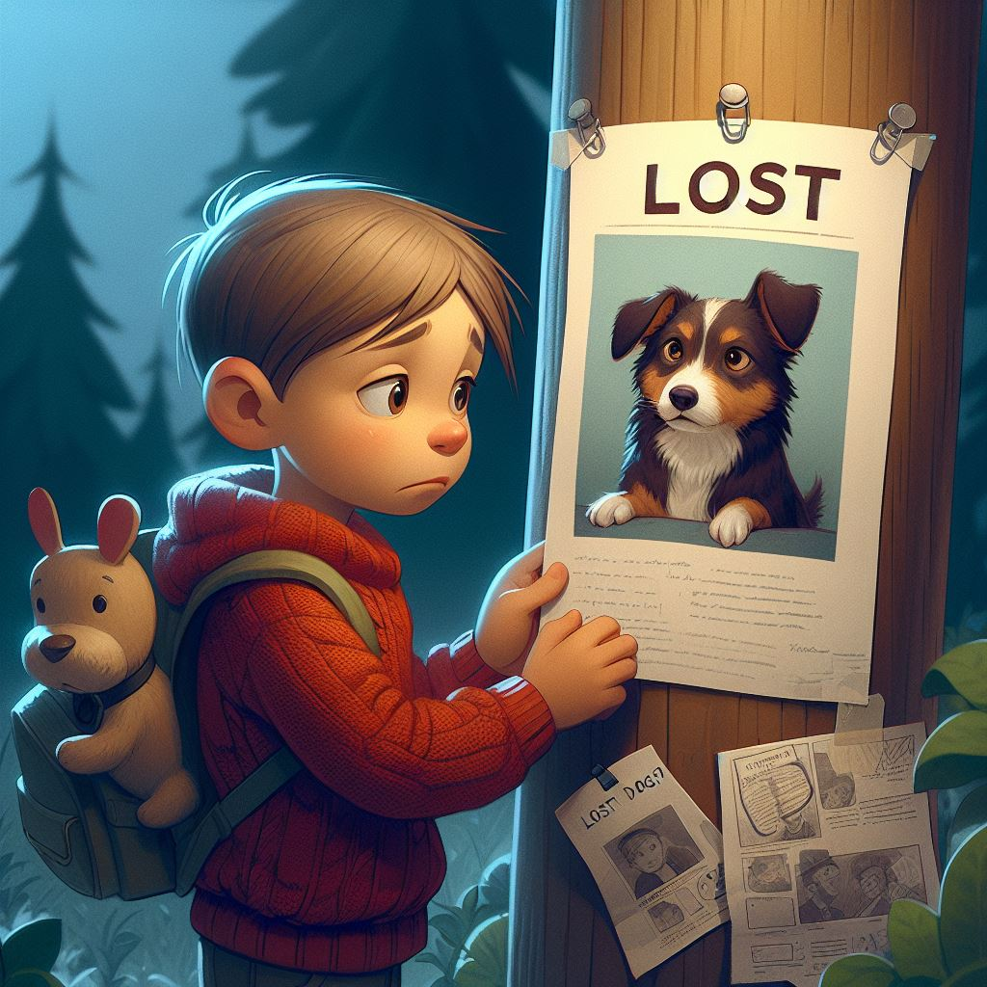
Emergency?
Your dog runs away.

Slide 10
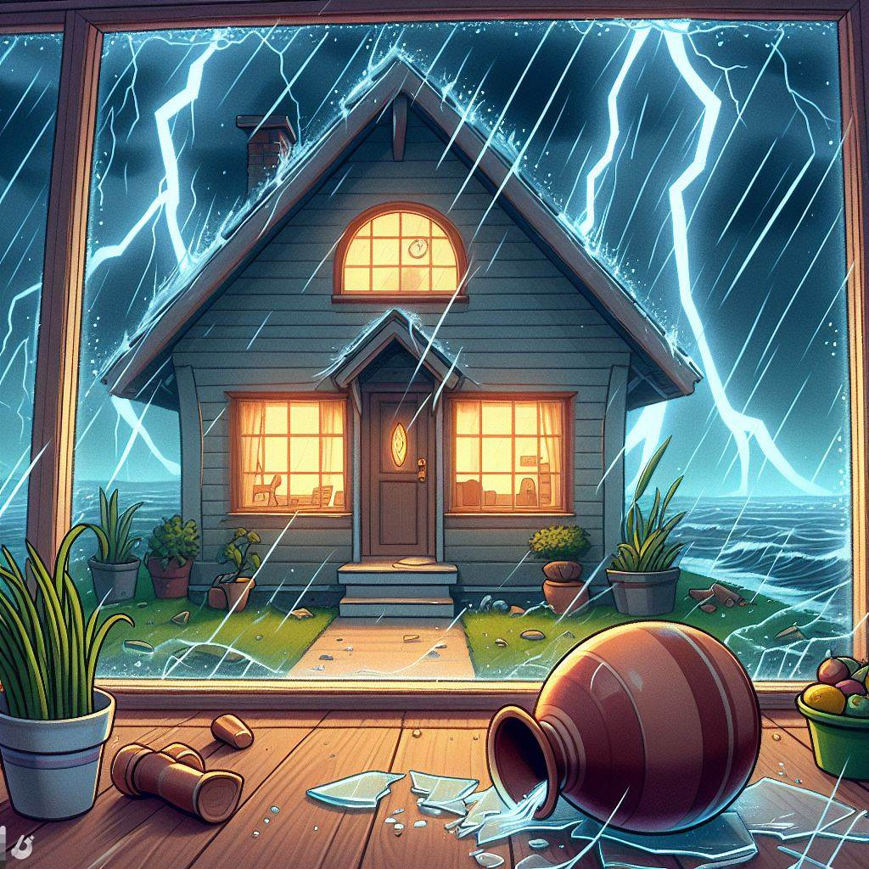
Emergency?
During a bad storm, the house is shaking, and things are breaking.

Slide 11

Emergency?
Your toilet overflows.

Slide 12
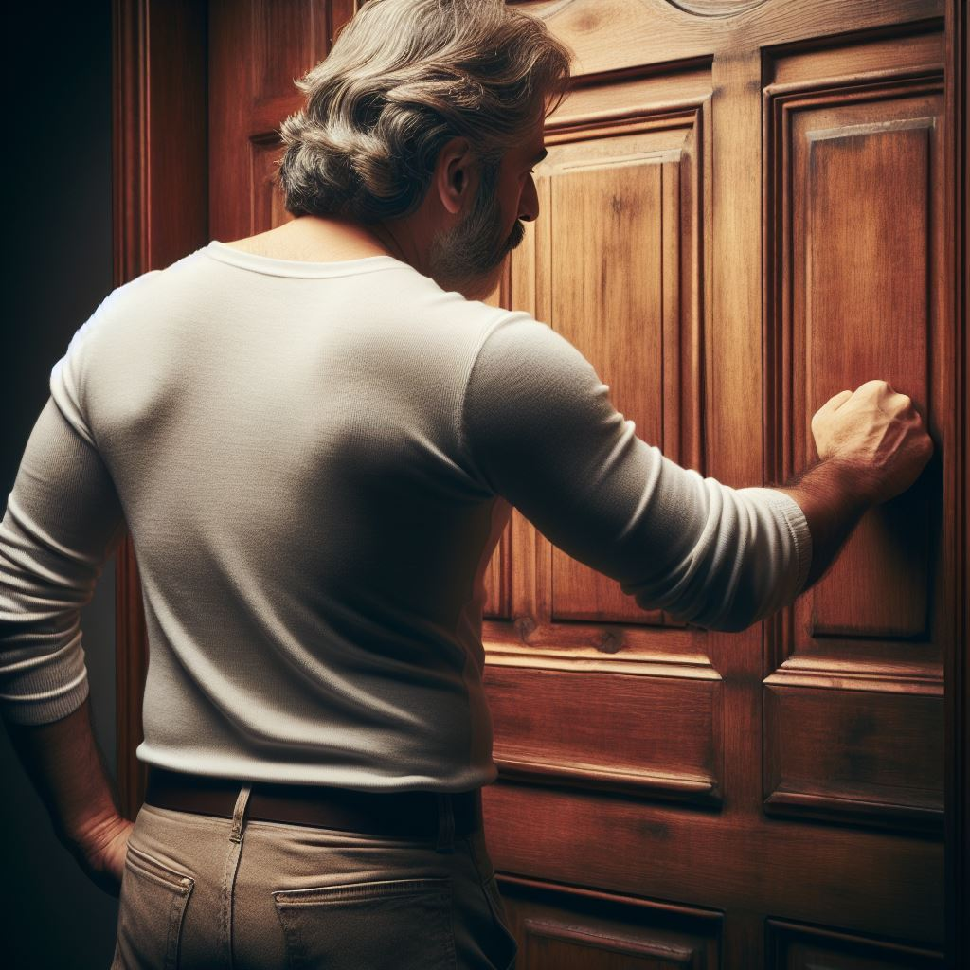
Emergency?
There is a stranger at the door that won’t go away.

Slide 13
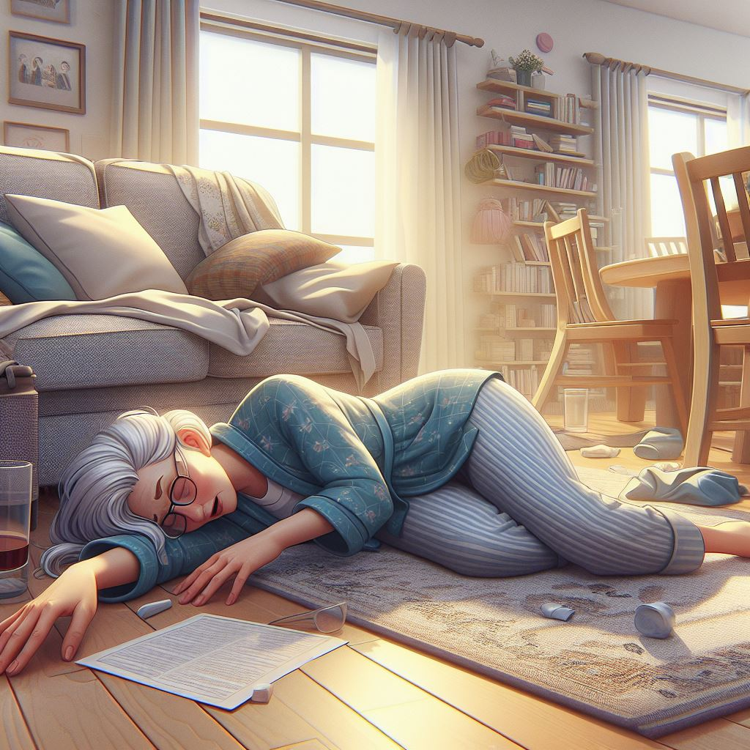
Emergency?
Your mom has fallen and won't answer or wake up.

Slide 14

Emergency?
You see a cat stuck up in a tree.

Slide 15
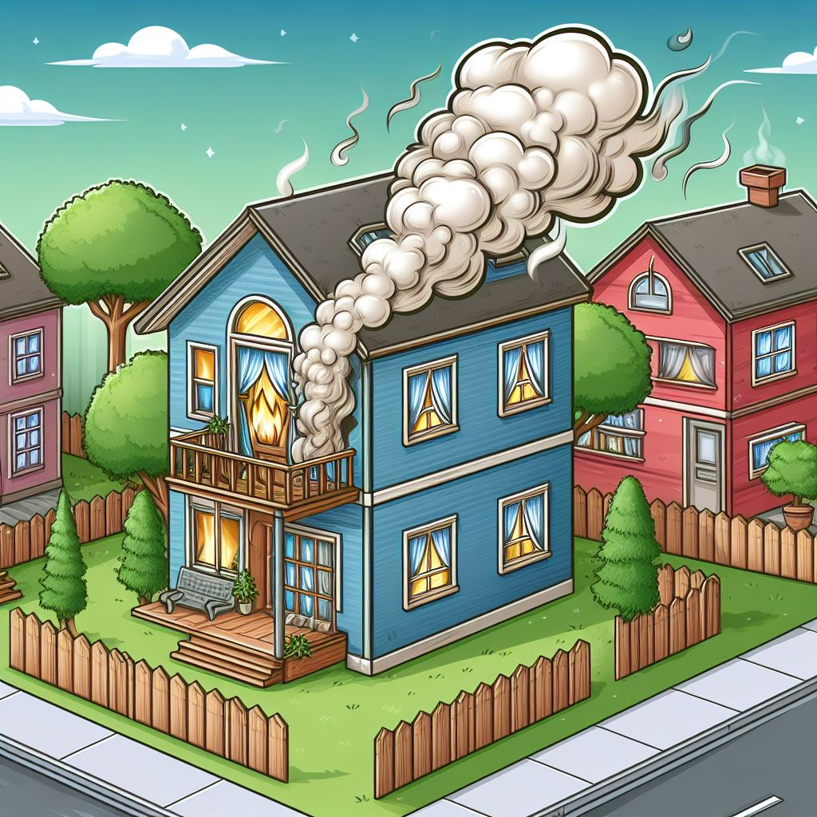
Emergency?
You smell smoke or see fire.

Slide 16

Emergency?
You get separated in a crowded place.

Slide 17
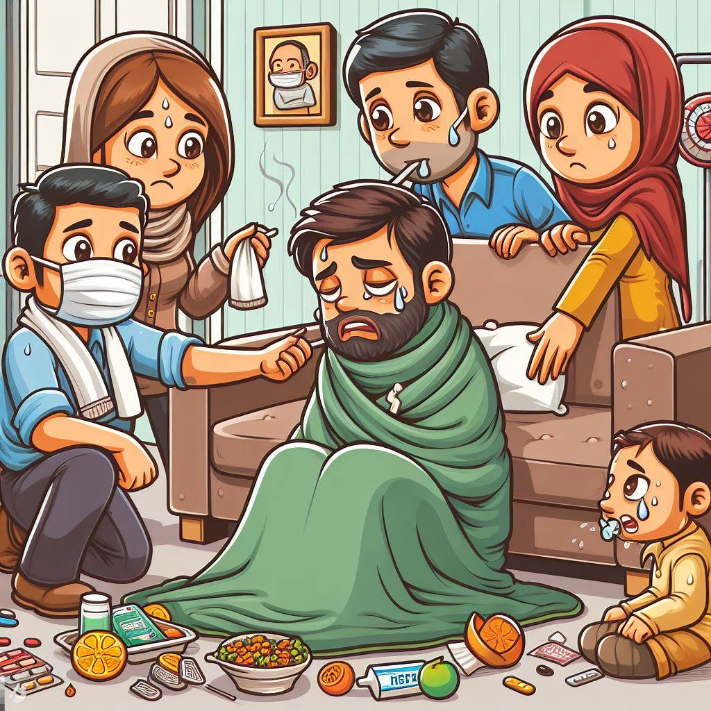
Emergency?
Someone in your family is very, very sick and needs special help.

Slide 18
Who responds to emergencies?

Slide 19
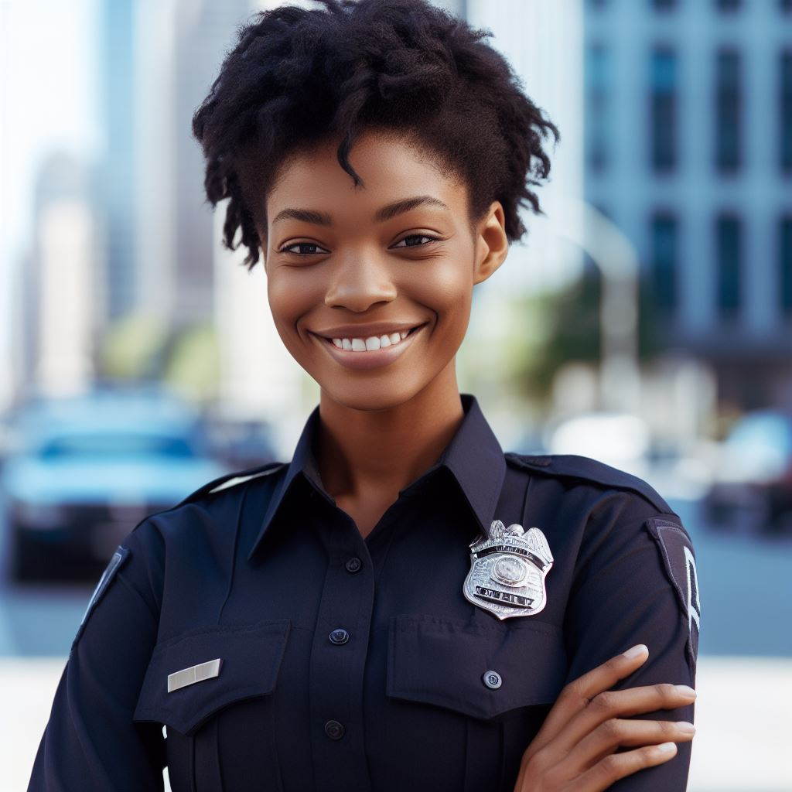
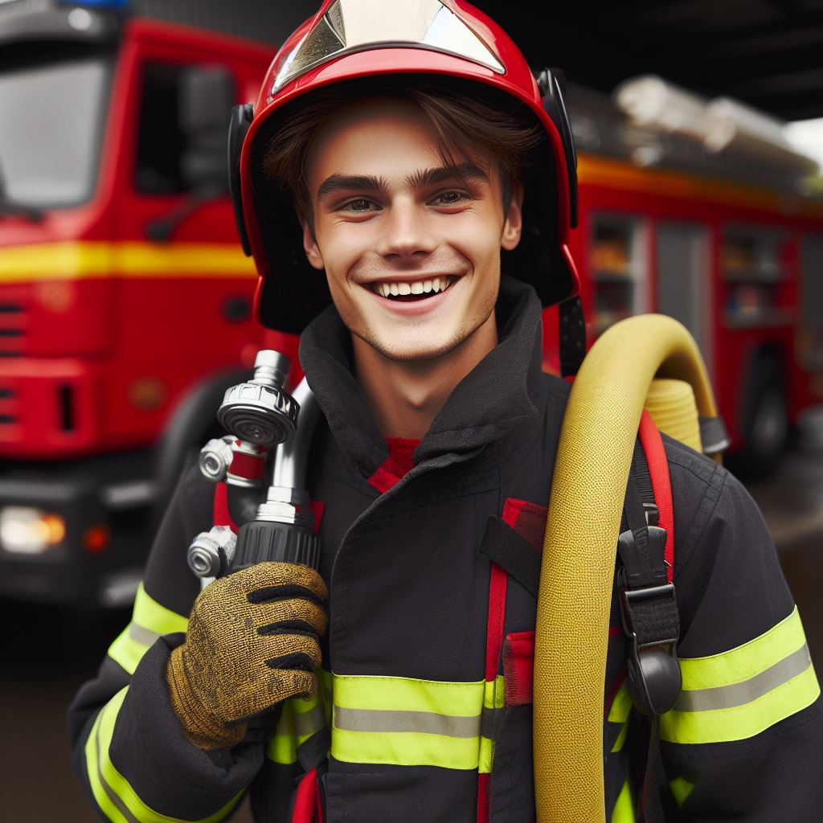
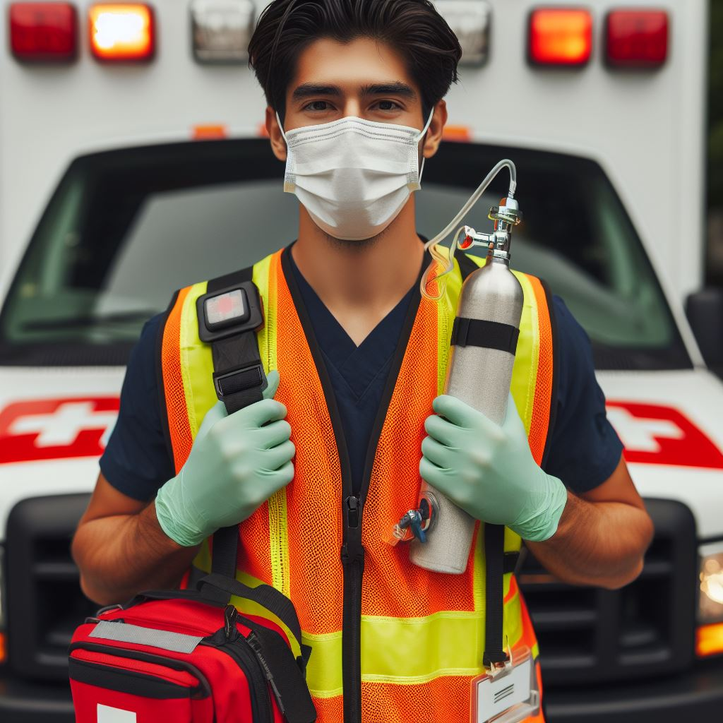
Police Officer
Firefighter
Paramedic

Slide 20
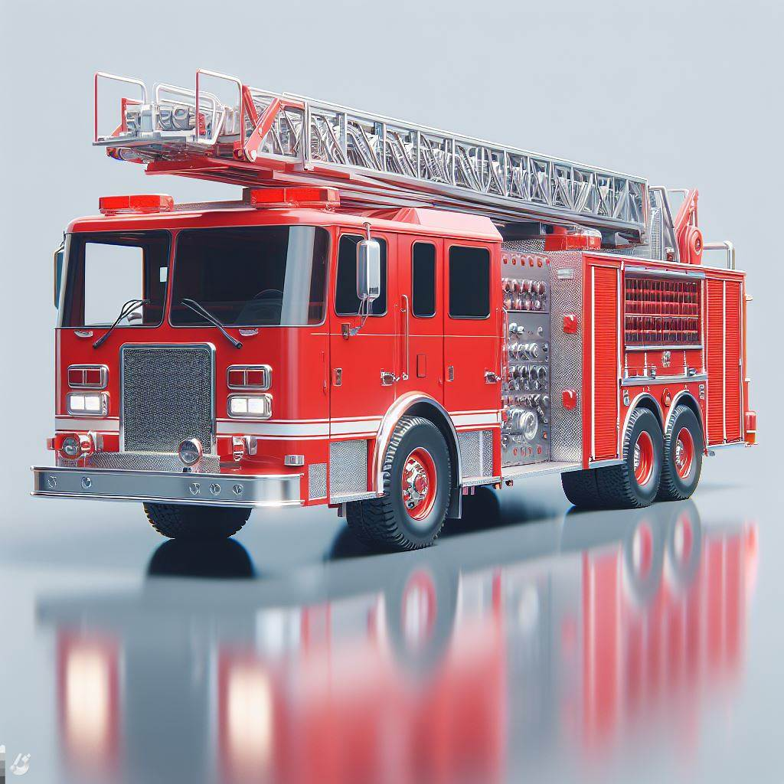
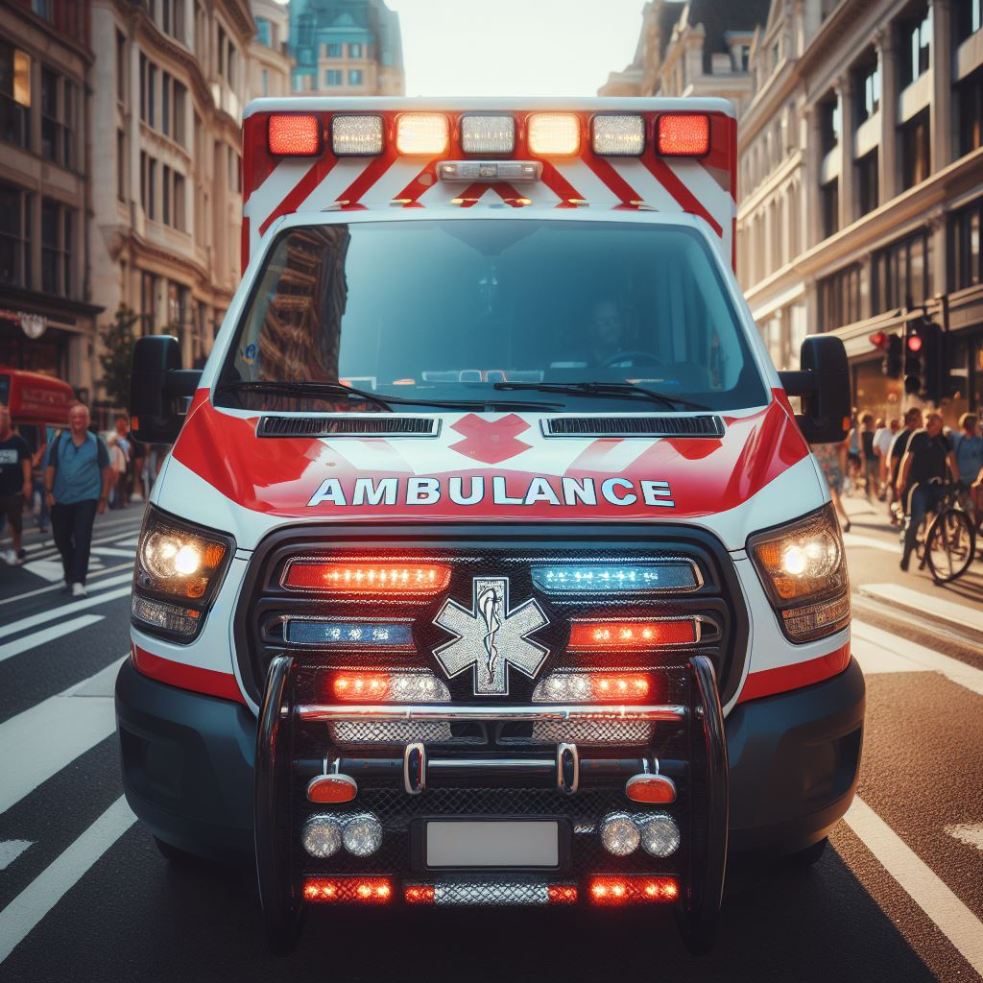
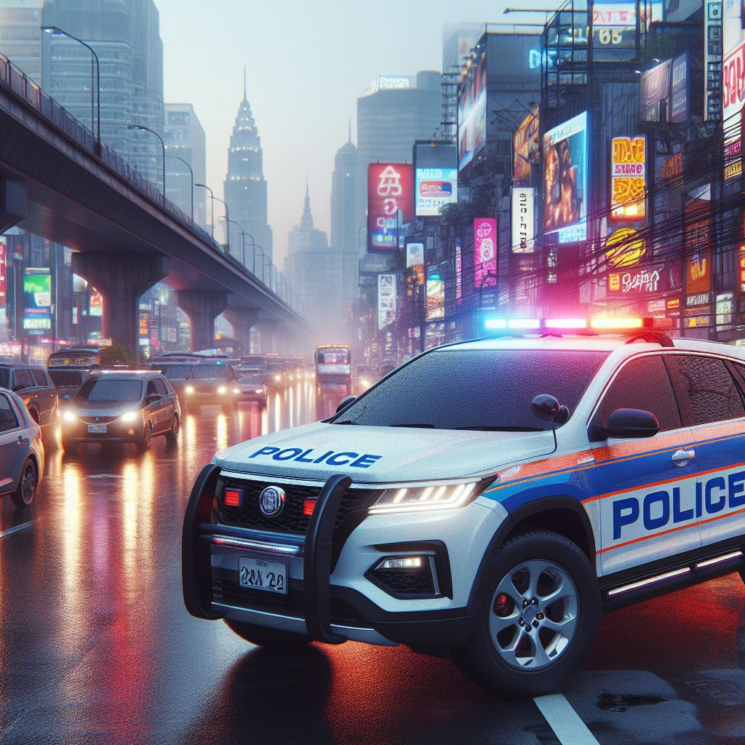
Which vehicle does a police officer use?

Slide 21
Which vehicle does a firefighter use?

Slide 22
Which vehicle does a paramedic use?

Slide 23
If you have an Emergency:
Dial 9-1-1

Slide 24
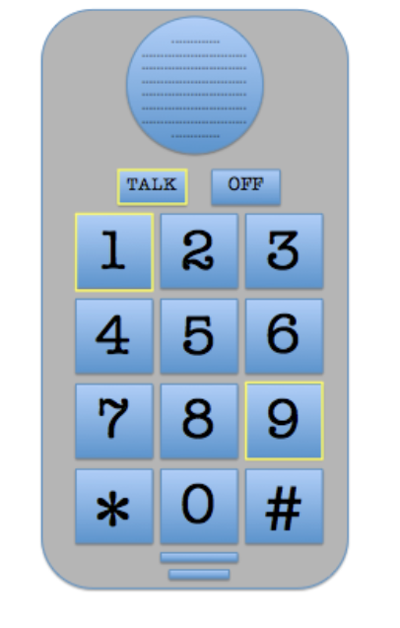
Practice Dialing 9-1-1

Slide 25
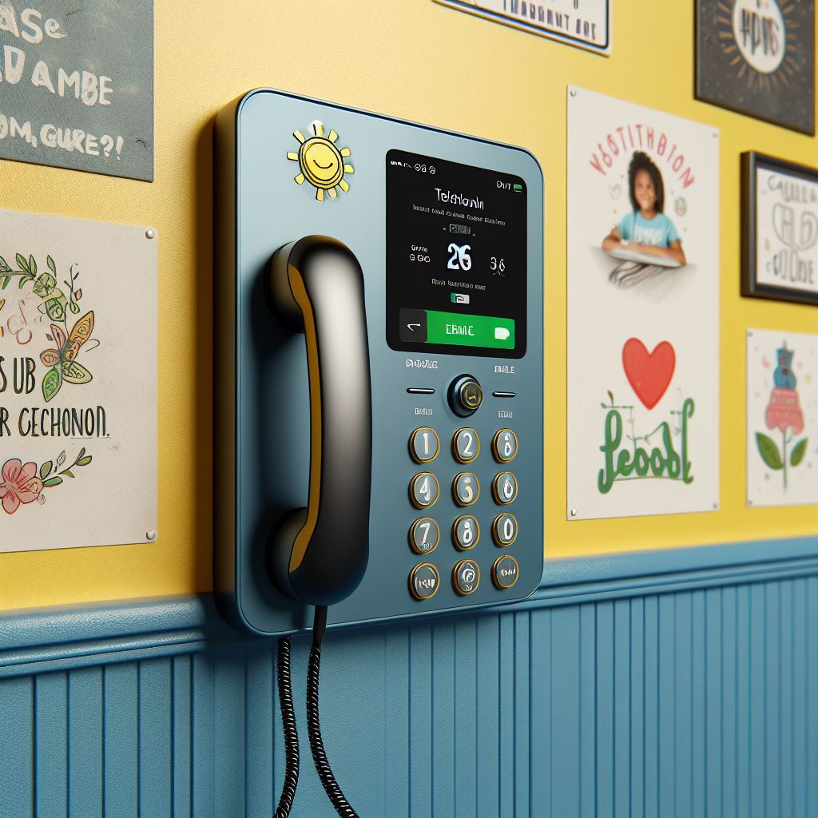

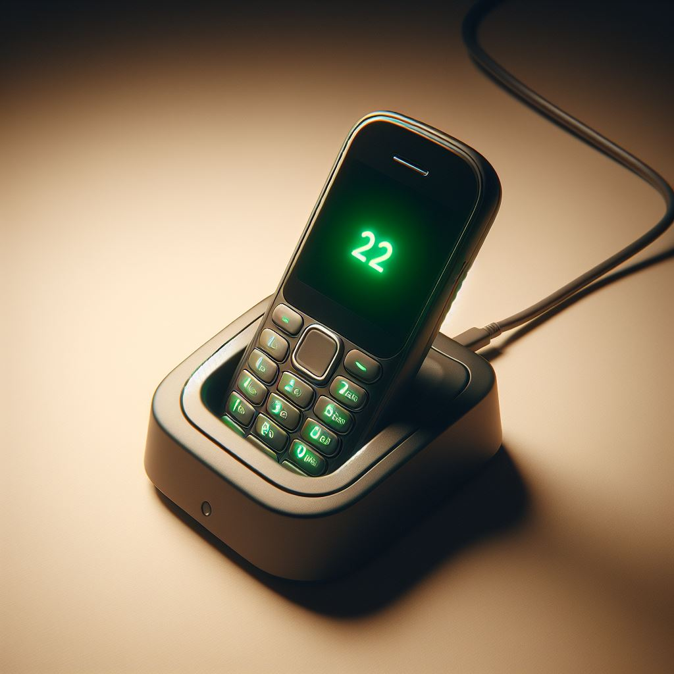
Let's learn about different types of phones that you might use to call 911.

Slide 26
Scenarios

Slide 27
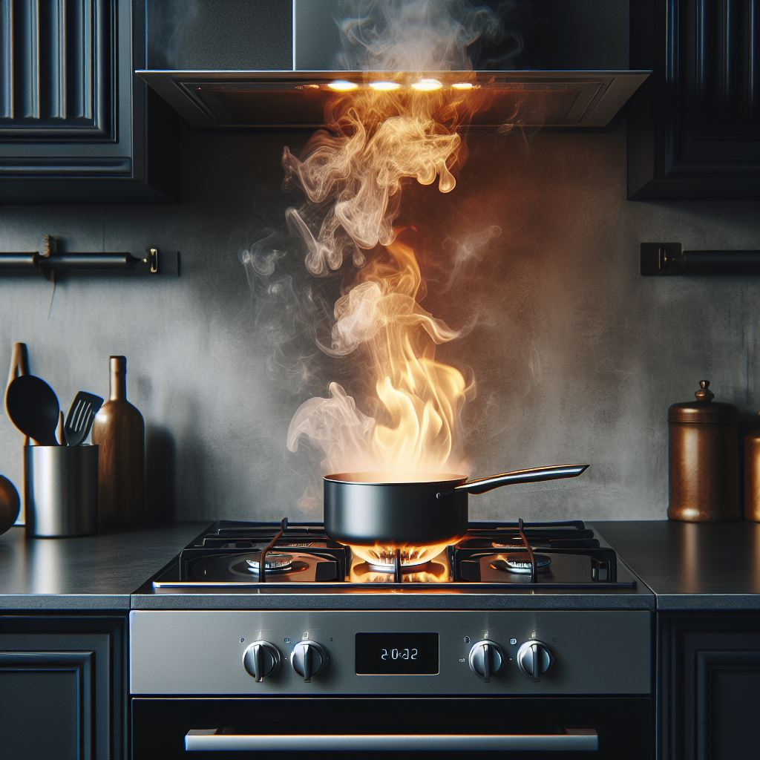
Fire on the stove

Slide 28
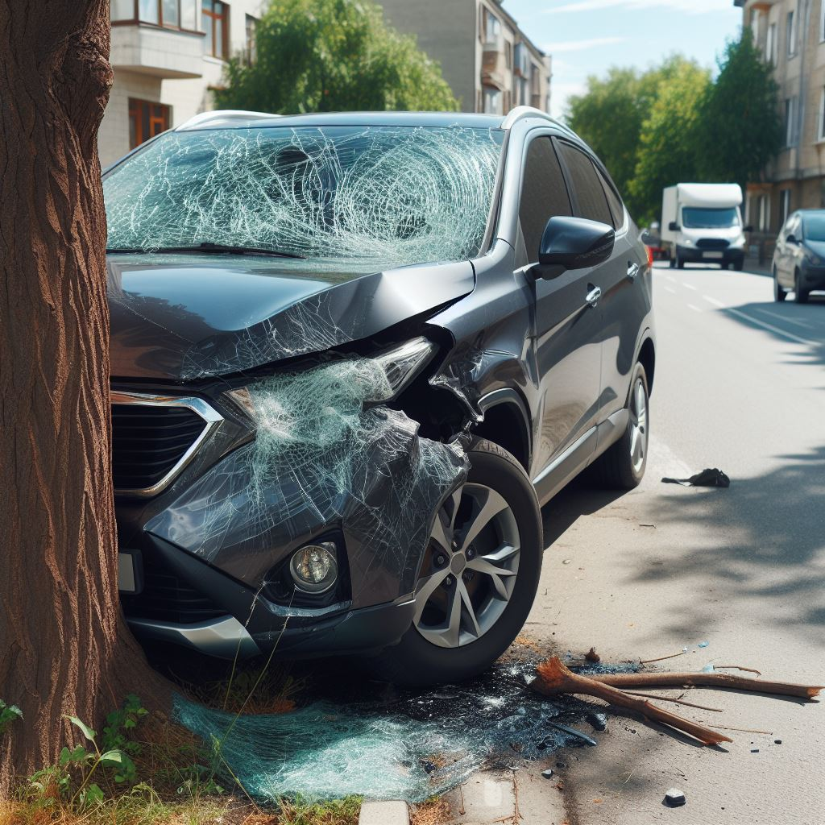
A car accident in front of your house

Slide 29
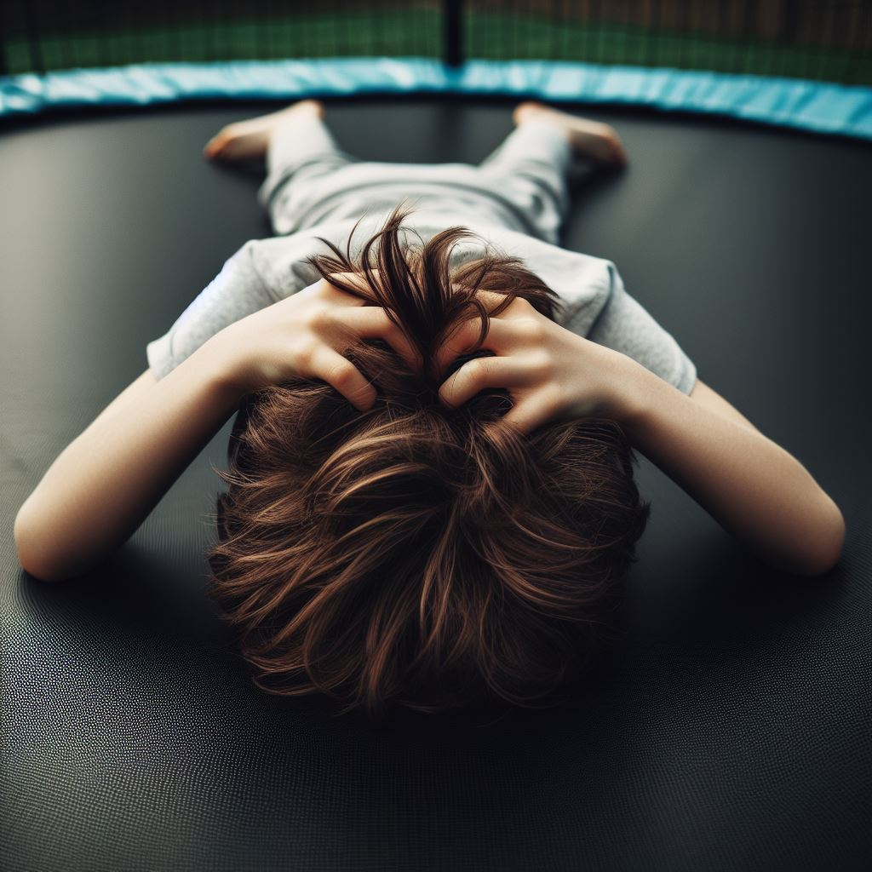
Injury on a trampoline

Slide 30
Role Play

Slide 31
Handout: Create your own emergency preparedness plan.
My Emergency Information:
Name:
Address:
Phone Number:

Slide 32
All done, great job!

