Slide 1

Digital Citizenship
First Grade Lesson 2

Slide 2
When we are learning we will:

Slide 3

Keep our bodies in our own place!

Slide 4

Use our quiet voices!

Slide 5

Keep our ears open!

Slide 6

Have our brains ready to learn!

Slide 7

Internet
The internet is a network that we use to communicate with others on computers, phones, iPads, and games.
I can be in my house and use my computer to send messages, emails, or call other people in other places.
We can use the internet to talk to other people, play games, learn new information, and create art.

Slide 8
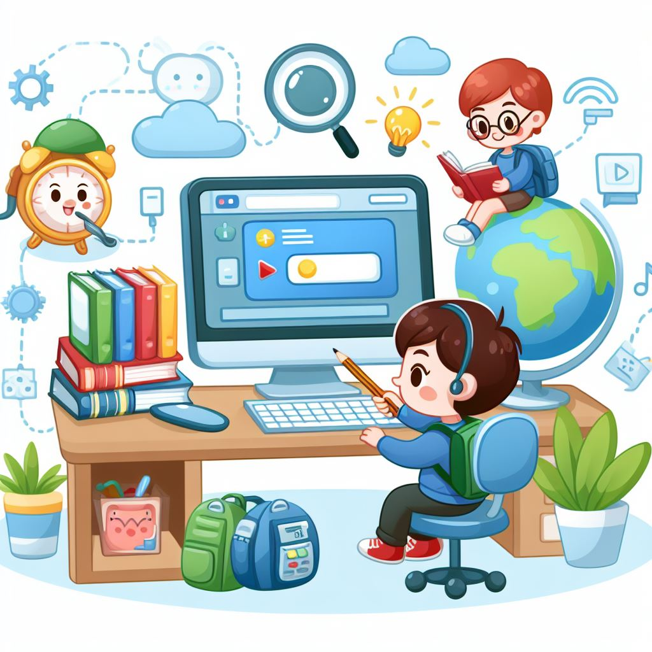
Online
When we get on the internet and use the network we are "online."

Slide 9
Rules for staying safe while using the internet:

Slide 10
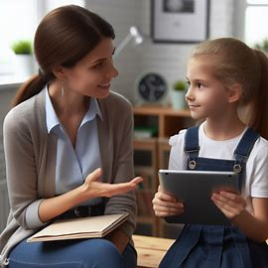
Always ask a trusted adult (parent, teacher, etc.) that is taking care of you if you can go online.

Slide 11
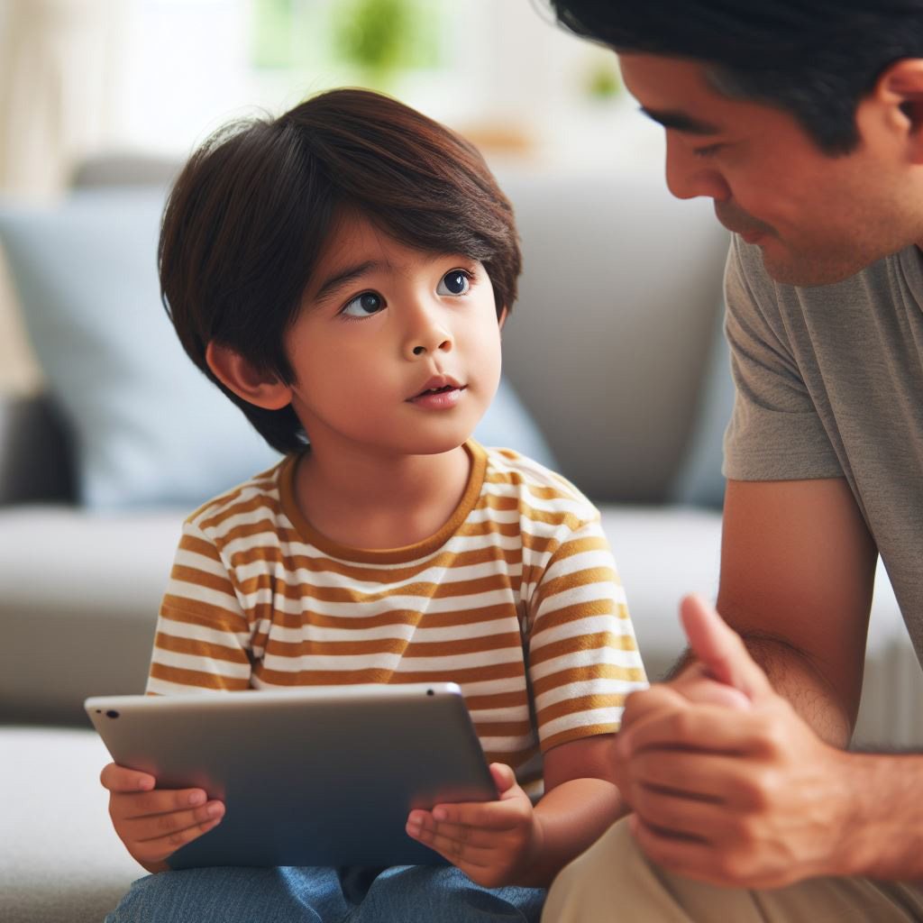
2. Do not talk to people you do not know in real life and immediately tell an adult if someone tries to talk to you on the internet.

Slide 12
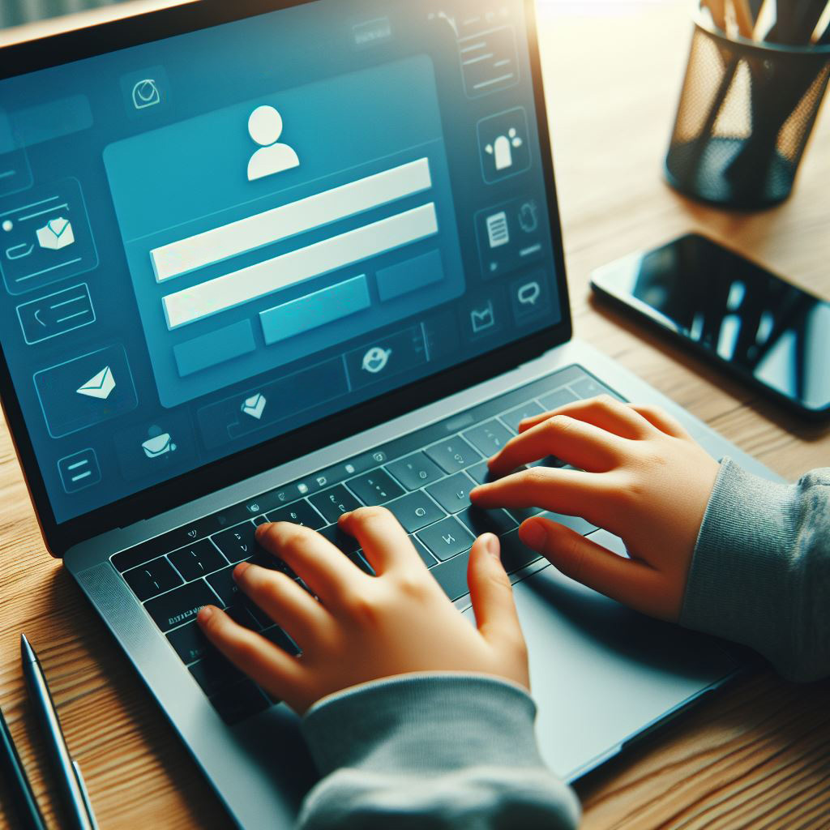
3. Never answer a question while online about your personal information.

Slide 13
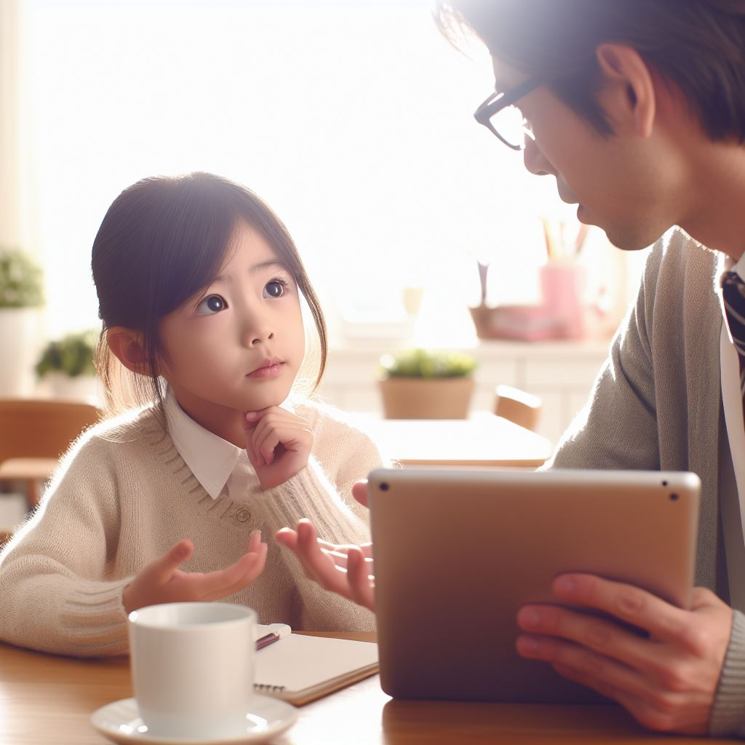
4. If someone keeps trying to contact you and you don't want them to, go right away to your adult.

Slide 14

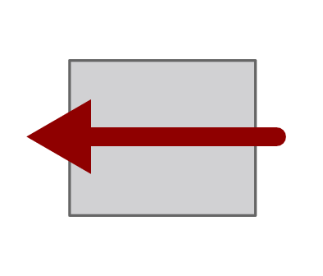

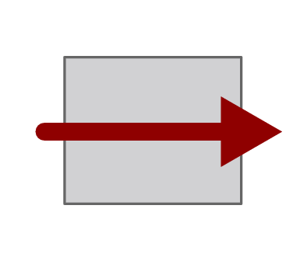
Let's practice making decisions about safety on the internet.
Activity
True False

Slide 15
Your name, address, and phone number are personal information.
True False

Slide 16
You should not give your personal information on websites.
True False

Slide 17
If you don't know what websites are safe, you should ask a trusted adult.
True False

Slide 18
A stranger is someone you don't know.
True False

Slide 19
Private information should be shared with anyone.
True False

Slide 20
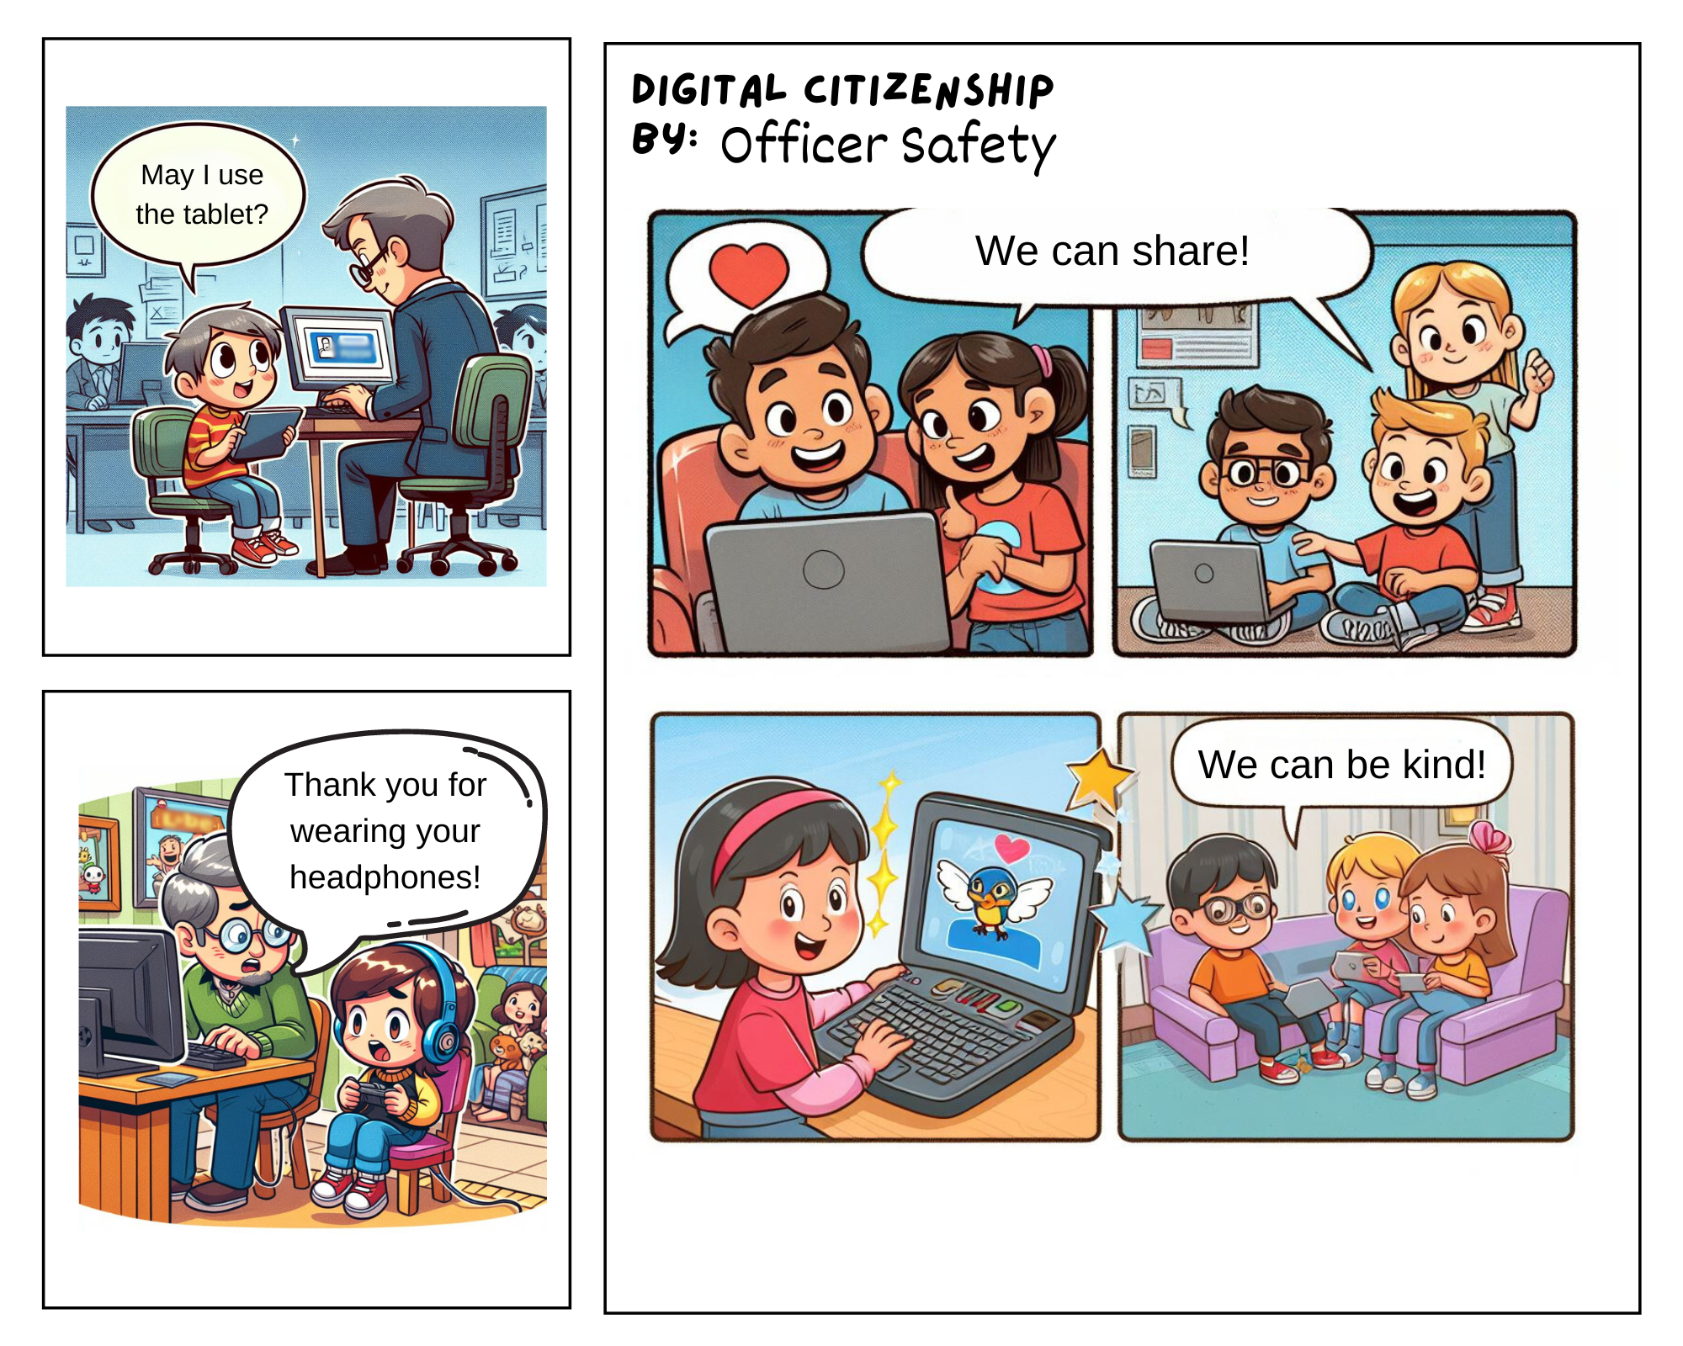
Comic Strip Activity

Slide 21
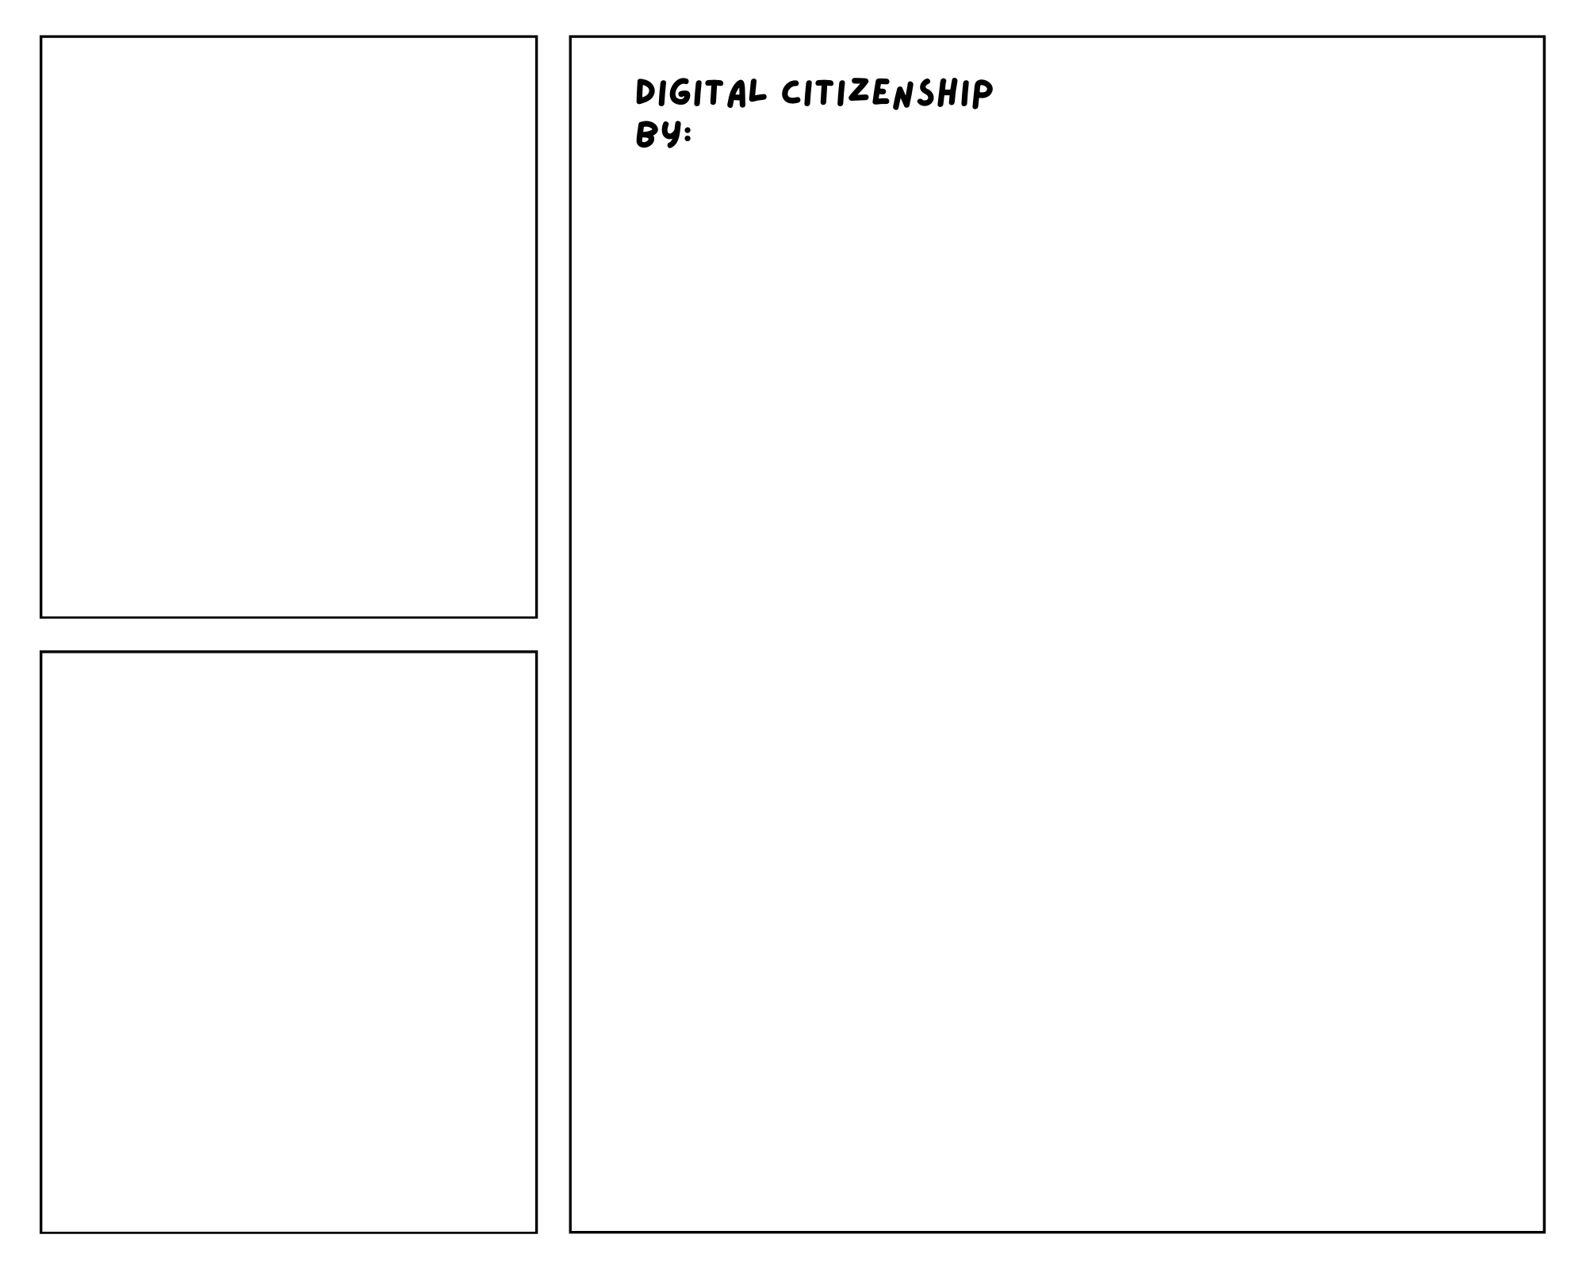
Create a comic that shows one way to be a good digital citizen:

Slide 22
All done, great job!

