Slide 1

Safety at Home
First Grade Lesson 3

Slide 2
When we are learning we will:

Slide 3

Keep our bodies in our own place!

Slide 4

Use our quiet voices!

Slide 5

Keep our ears open!

Slide 6

Have our brains ready to learn!

Slide 7

Home Safety Rules:

Slide 8
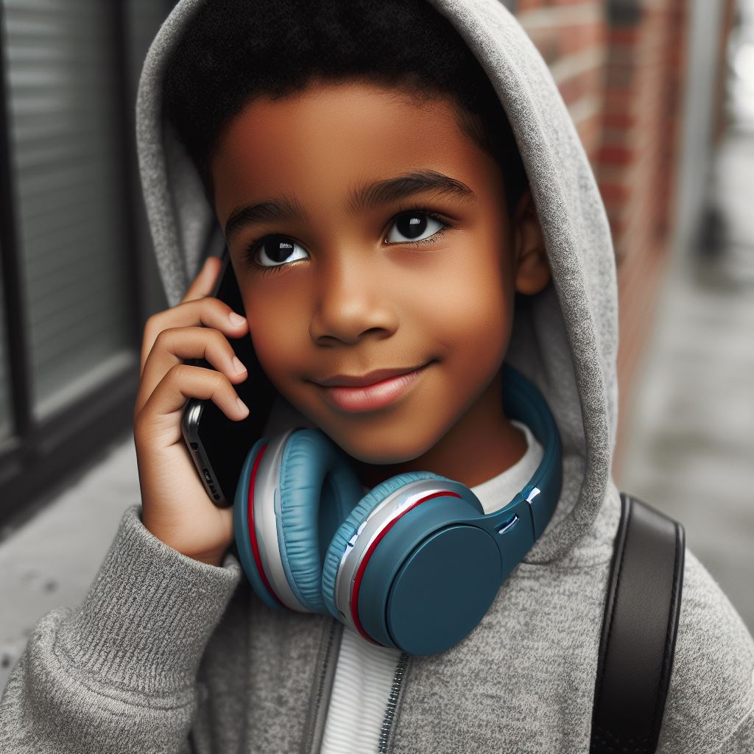
Phone safety

Slide 9
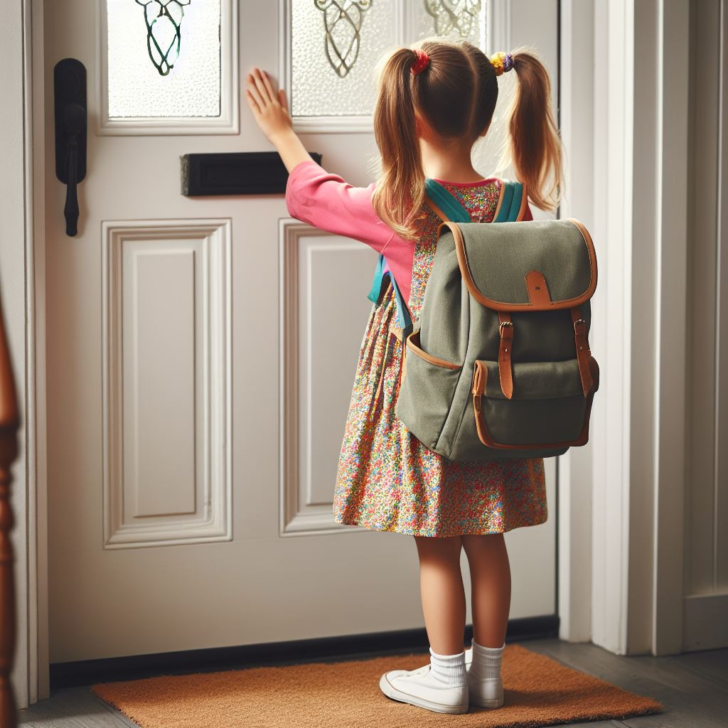
Door safety

Slide 10

Computer safety

Slide 11
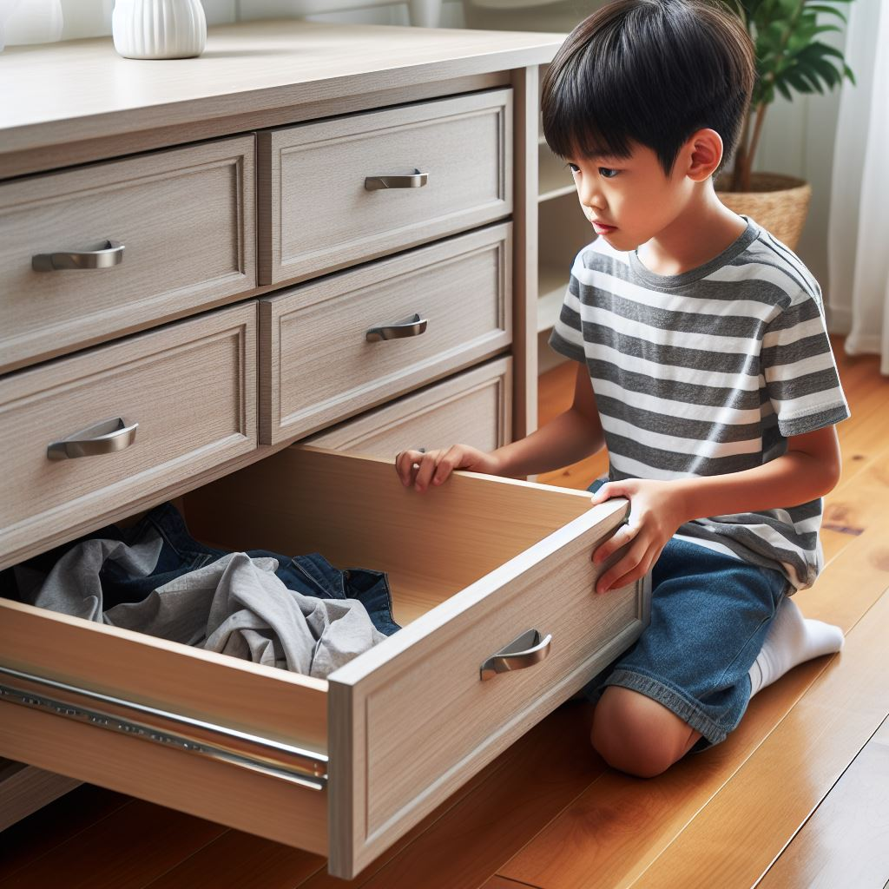

Gun safety

Slide 12
What do you do if you see a gun?

Slide 13

Stop!

Slide 14

Don’t touch!

Slide 15

Get away!

Slide 16

Tell an adult.

Slide 17


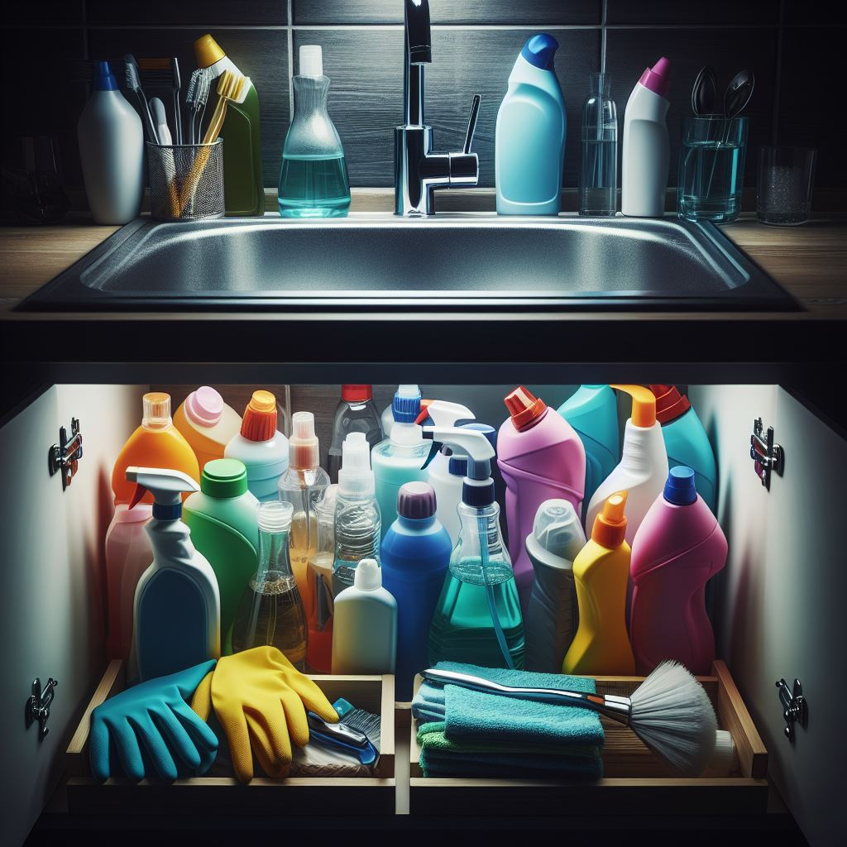
Prescription drugs, medicines, and household substances safety:

Slide 18
We learned important safety rules for being at home. Now, let's go deeper with a “think, pair, share” activity.

Slide 19
Activity: Think. Pair. Share.

Slide 20
Think about the safety rules we discussed for being home alone. What do you need to remember to stay safe at home?
Think:
Notes:
Allow a moment for students to think.

Slide 21
Turn to a partner. Share one safety rule you remember for being home alone. Listen to your partner's rule too.
Pair:
Notes:
Give students a moment to pair up and share.

Slide 22
Let's share as a group. Who wants to share the safety rule they discussed with their partner?
Share:
Notes:
Encourage students to share with the class.

Slide 23
Activity: Role Play

Slide 24

"You hear the doorbell ring, and when you check, you see a stranger outside. What should you do to stay safe?"

Slide 25

"You're home alone and receive a chat request from someone you don't know on an online game. They say they are seven years old, and they want to be your friend. What should you do?"

Slide 26
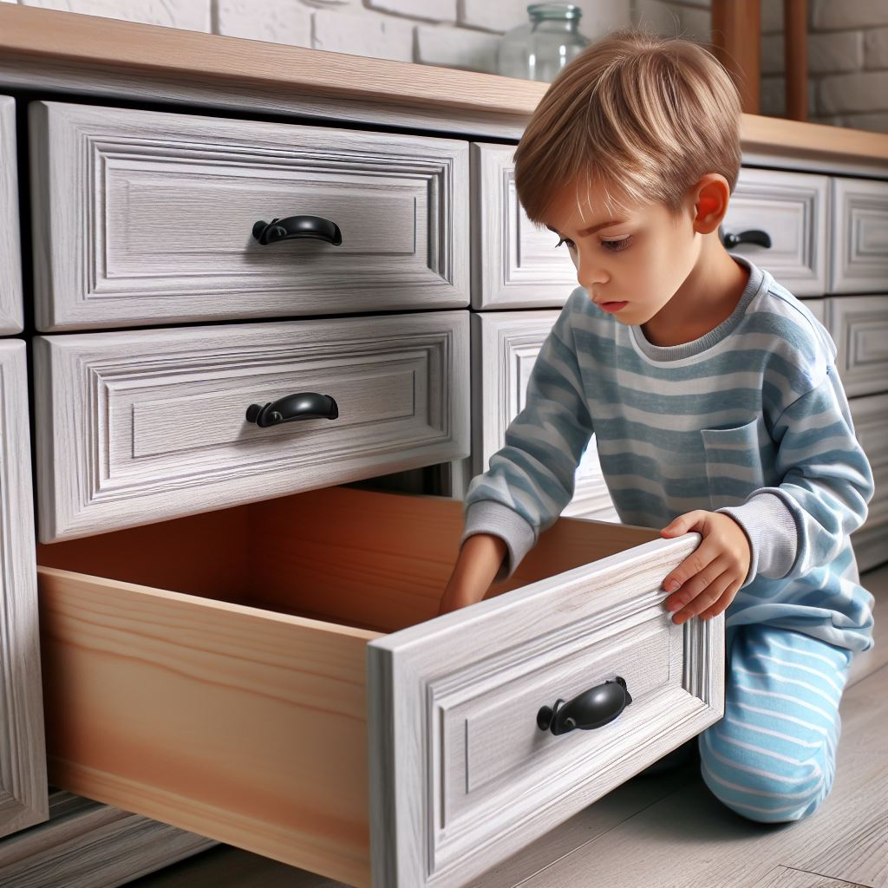
"You come across a gun in a place where it should not be, like a drawer in the living room. What should you do to stay safe?"

Slide 27

"You're at home alone, and you notice a bottle of pills that you don't recognize on the kitchen counter. What should you do to stay safe?"

Slide 28
Activity: Create a safety plan.

Slide 29
Activity: Share your safety plan.

Slide 30
All done, great job!

