Slide 1

Respect for Following Rules and Authority
First Grade Lesson 4

Slide 2
When we are learning we will:

Slide 3

Keep our bodies in our own place!

Slide 4

Use our quiet voices!

Slide 5

Keep our ears open!

Slide 6

Have our brains ready to learn!

Slide 7
Learning Objective:
Identifying rules and explaining their importance.

Slide 8
Let’s review our learning-ready rules!

Slide 9
Let’s talk about the importance of listening to people in authority.

Slide 10
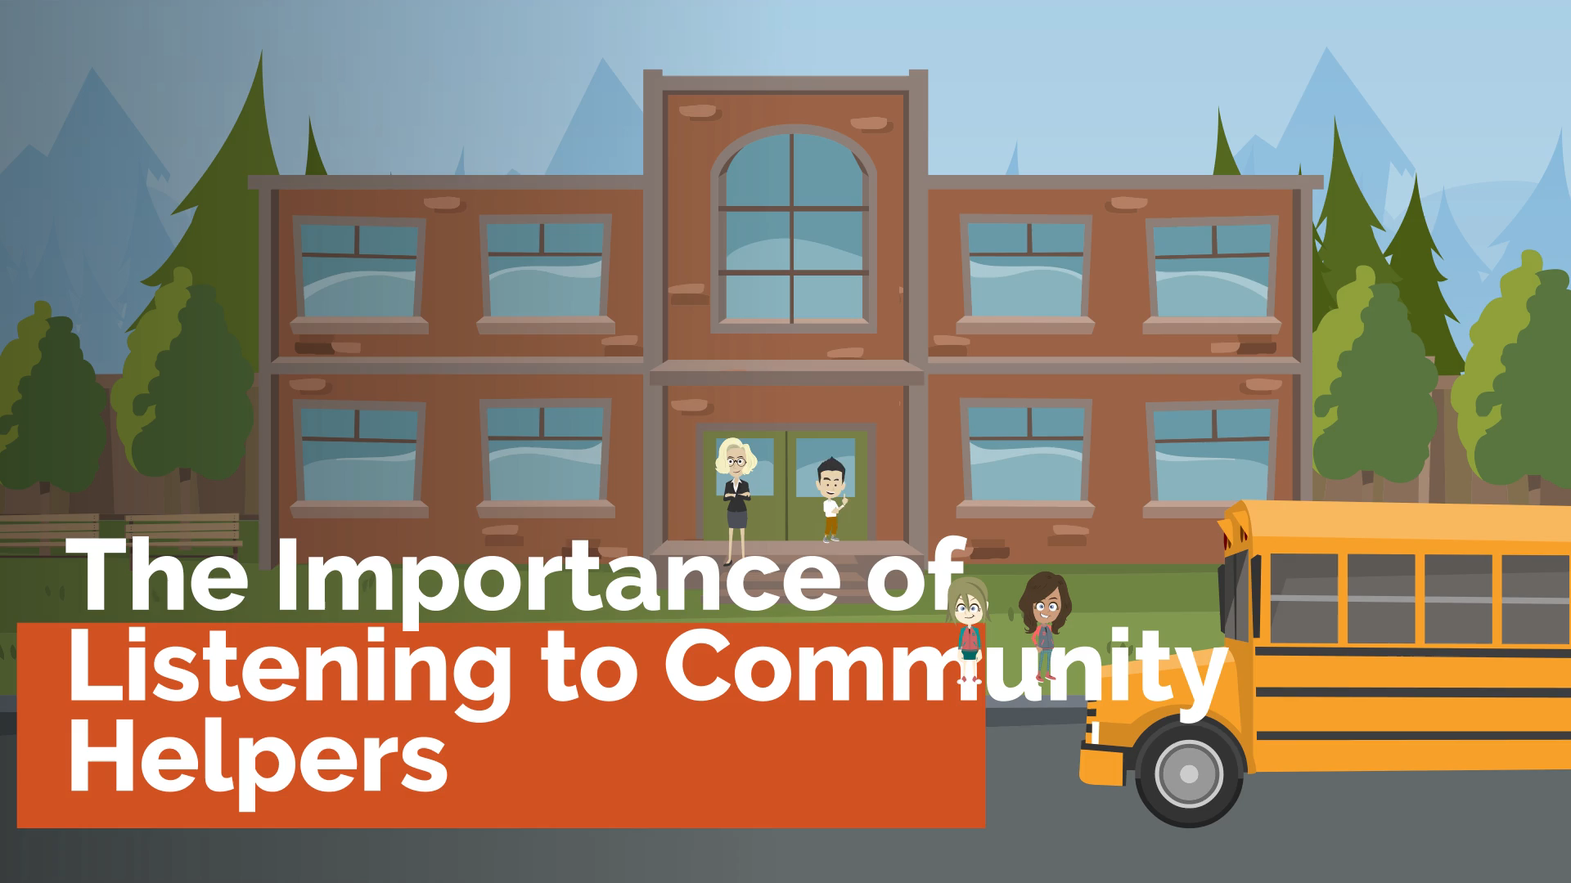

Slide 11
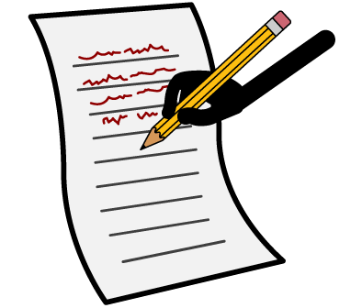
Activity:
List people who are in authority.

Slide 12



Activity:
Is this a person in authority or not in authority?

Slide 13

A teacher with students?

Slide 14
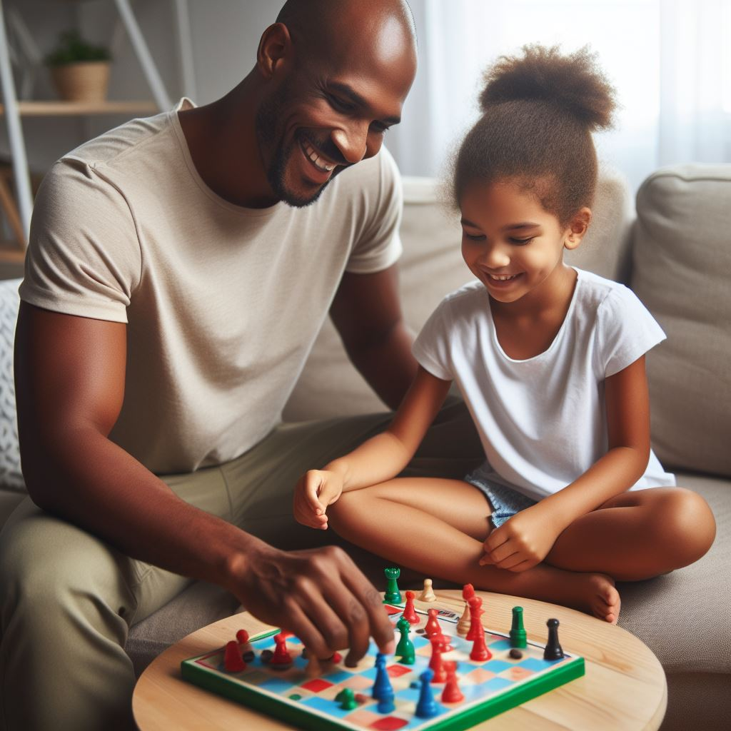
A parent playing with their child?

Slide 15
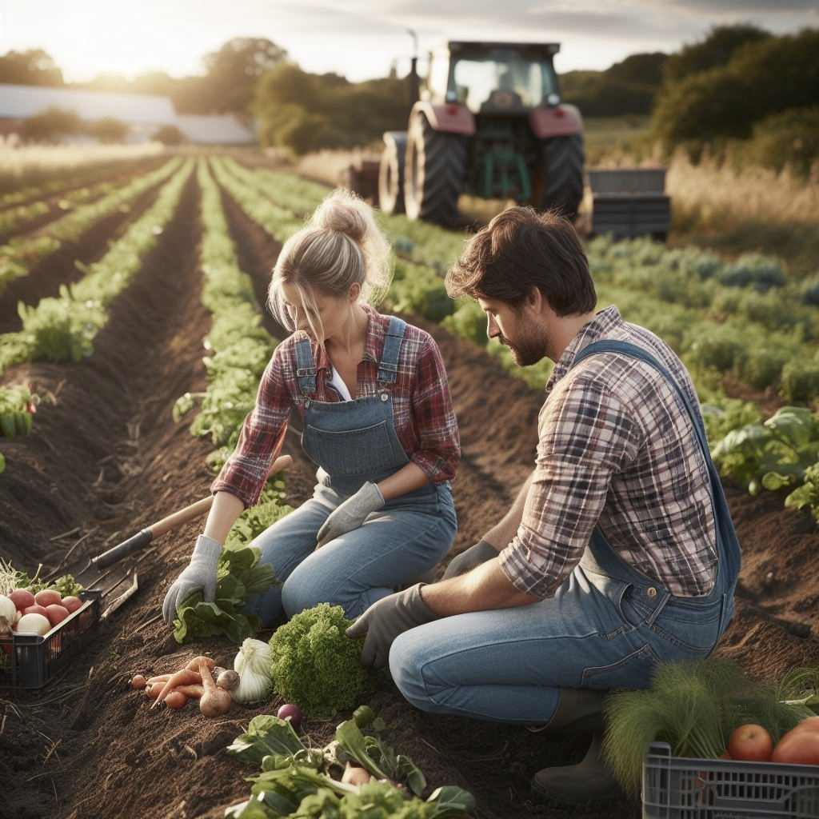
Farmers planting crops?

Slide 16
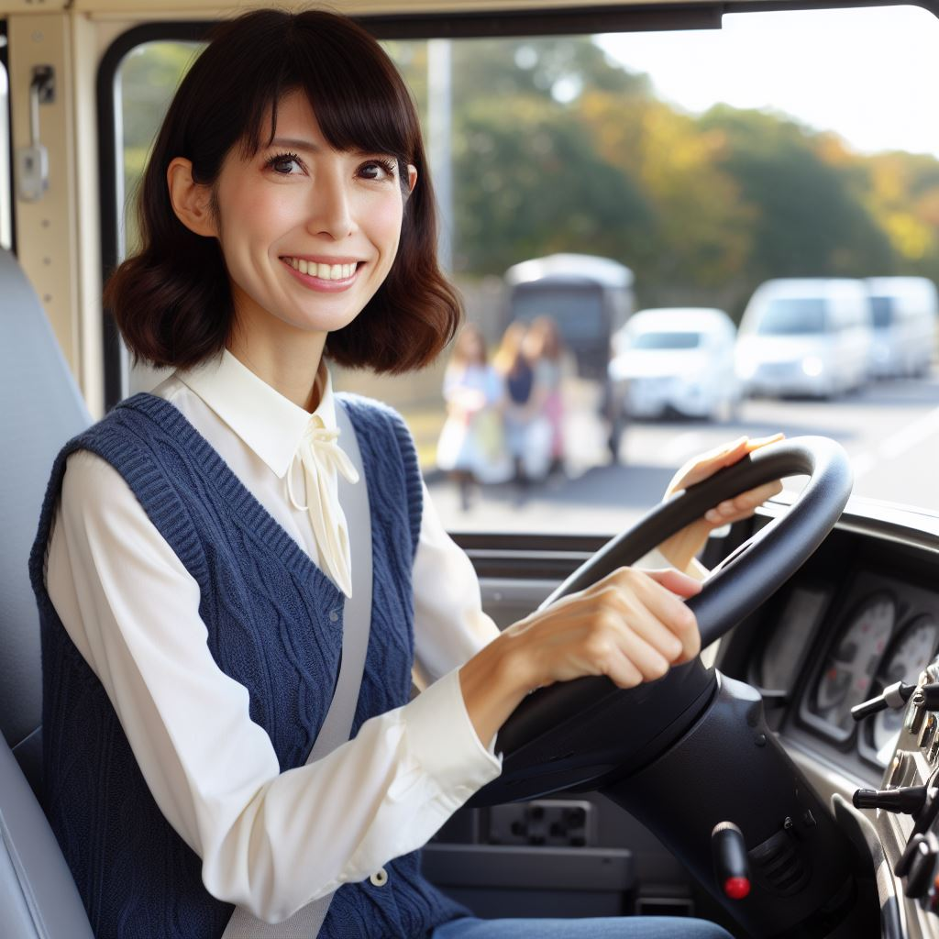
A person driving a school bus?

Slide 17

The cashier at the grocery store?

Slide 18

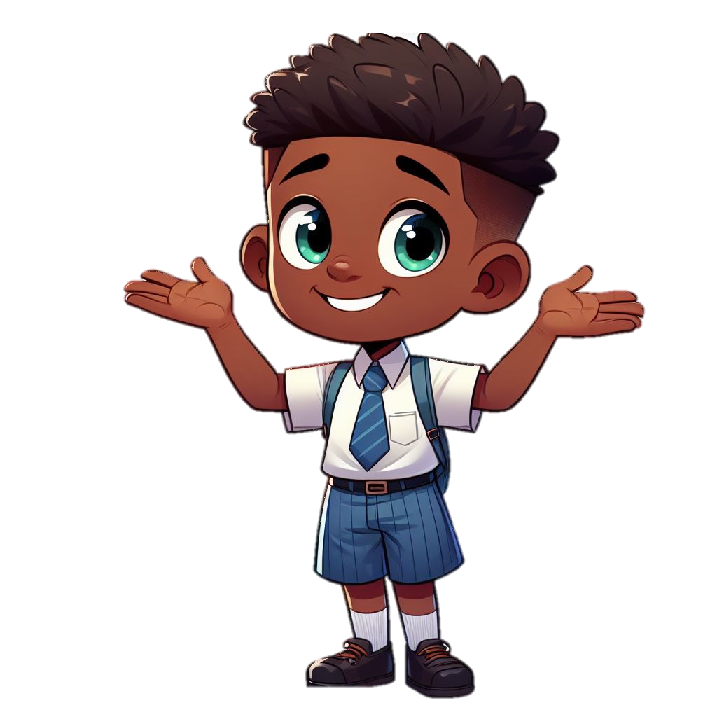

Activity:
Comparing home rules, school rules, and community rules.
Community Rules
School Rules
Home Rules

Slide 19

Community Rule
School Rule
Home Rule
Students listening to directions from the teacher?

Slide 20
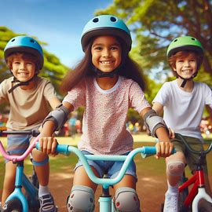
Community Rule
School Rule
Home Rule
Children wearing helmets?

Slide 21
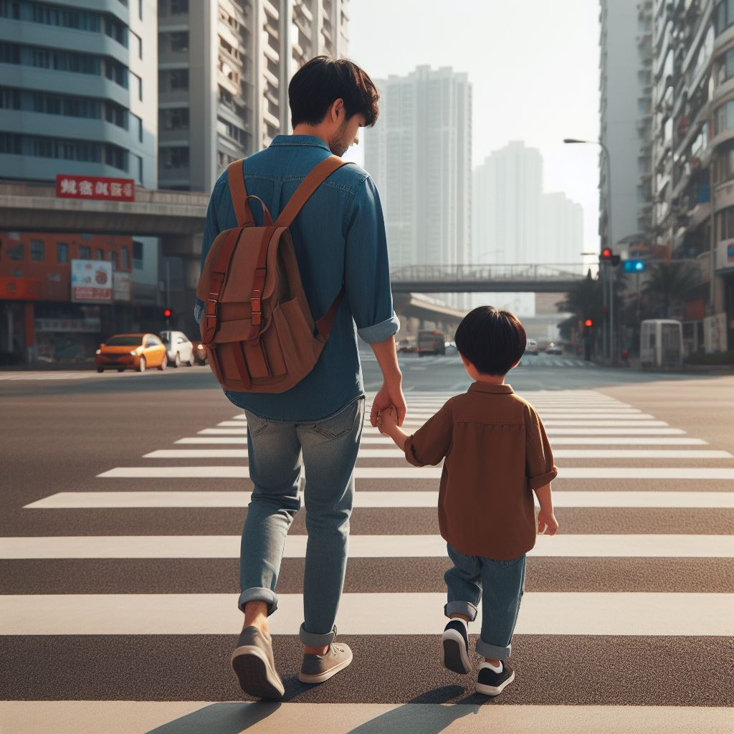
Community Rule
School Rule
Home Rule
People using a crosswalk to cross the street?

Slide 22
Activity: Define a law.

Slide 23
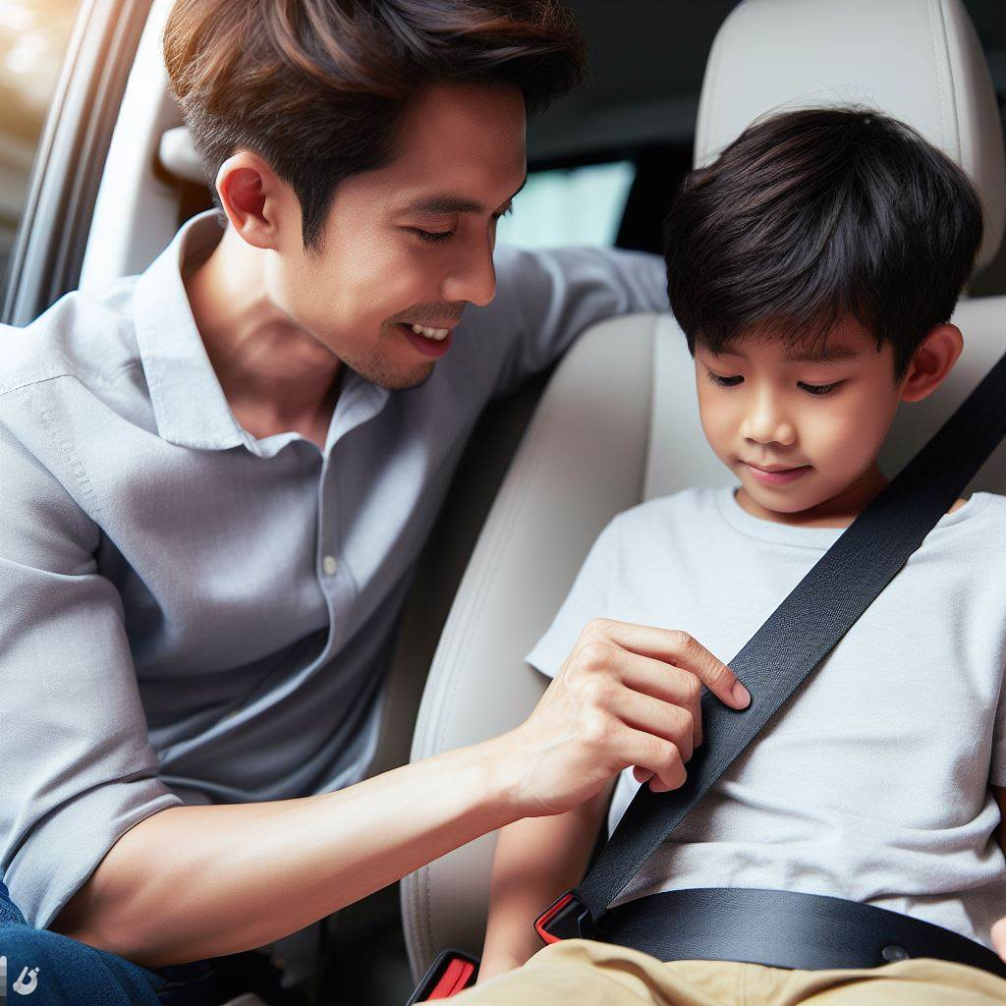
What is the law?

Slide 24

What is the law?

Slide 25

What is the law?

Slide 26
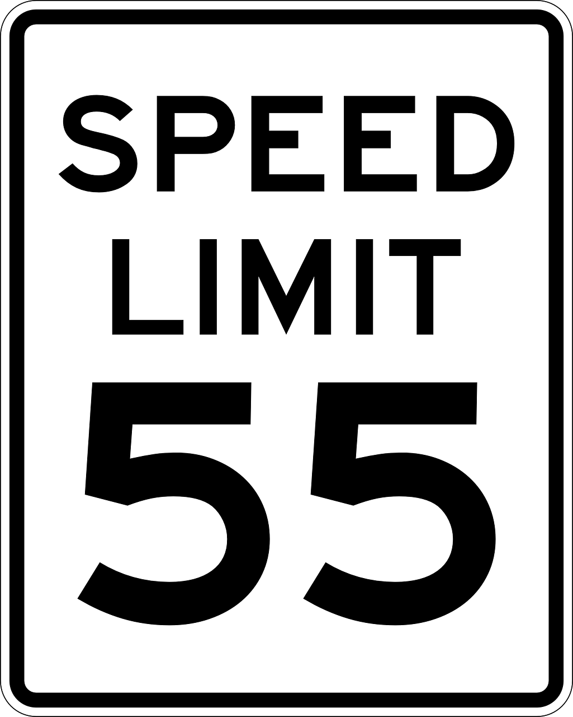
What is the law?

Slide 27

What is the law?

Slide 28

Read: What If Everyone Did That? by Ellen Javernick

Slide 29
Activity:
Write about the rule you like to follow the most.

Slide 30
All done, great job!

