Slide 1

Self-Control
First Grade Lesson 5

Slide 2
When we are learning we will:

Slide 3

Keep our bodies in our own place!

Slide 4
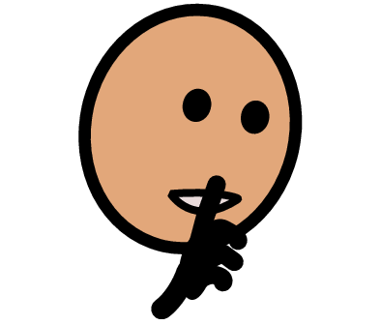
Use our quiet voices!

Slide 5

Keep our ears open!

Slide 6

Have our brains ready to learn!

Slide 7
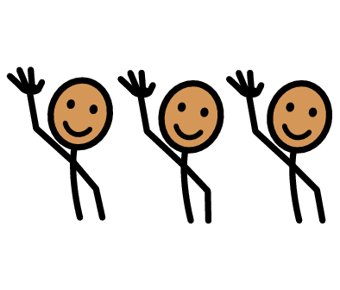
What is something you can do that you couldn’t do before or weren’t good at before?

Slide 8

What is something that you can’t do yet?

Slide 9
Self-control is being able to control your emotions and behaviors, especially in situations that are difficult or upsetting.

Slide 10




You have self-control right now.

Slide 11
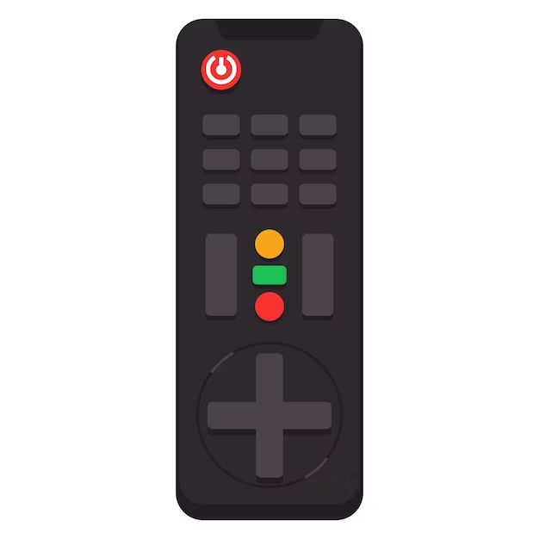




on
Notes:
Show students the remote.
Ask the student what they see in the picture
Let them call out (remote control)
Ask what the remote control does
Let them call out (controls the tv, etc)
Tell the students the remote control has several buttons that all have a job to control a part of the tv. Tell the students they also have buttons in their brains that have a job to help you have self control
Ask the students to raise their hand and name what buttons they see on the remote
Let them call out the buttons they see one at a time and address the purpose of each button and how the students have the same button in their brains to help them have self control.

Slide 12
Mute and volume
on
Notes:
Volume button (mute button)
Ask students how the volume and mute buttons control the tv: controls the volume
Tell the students they have to sometimes control their volume when their parents, teacher, or friends ask them to
Ask students to name when it is okay to be loud (outside, when singing), quiet (inside, when parents are on the phone), and silent (when someone is sleeping, during a test)

Slide 13
Play and pause
on
Notes:
Play button
Ask students how the play button controls the tv: it starts the video
When we are in play mode we are going and we are being safe.
Pause button
Ask students how the pause button controls the tv: stops the video
Tell the students sometimes they have to pause what they are doing to make a different decision, take a break, or do something else first
Tell the students sometimes when you need to use the pause button in your brain you like to take a deep breath before we press play again
Teach the students how to flower/ candle breath

Slide 14
On and off
or
Power
on
Notes:
Power button
Ask students how the power button controls the tv: turns the tv on and off
Tell the students sleeping is an important part of having the power to have self control because sleeping makes our brains stronger
Ask the students how they feel when they don’t get enough sleep

Slide 15
Record
on
Notes:
Record (to keep track of your things)
Ask students how the Record button controls the tv: records videos so you can watch them later
When we use the record button in our brains we are being responsible for the things we do and have done
When someone asks you what happened it is important to tell the truth. Sometimes telling the truth is scary if it means we will get in trouble. Telling the truth is a power of self control that helps keep everyone safe.

Slide 16
Rewind
on
Notes:
Rewind button
Ask students how the rewind button controls the tv: start a part of the video over
Tell the students when we miss something the first time or can’t do something YET we start over and try again
Tell the students sometimes you pause before you rewind so that you can take a deep breath before trying again and this helps you to have self control to not be angry.

Slide 17
Talk/ voice control
on
Notes:
alk button
Ask students how the talk button controls the tv: you can ask the tv to do something
Tell the students sometimes when we are using our powerful self control we just need to talk to someone: an adult, a parent, or a good friend
Ask the student who is someone they like to talk to when they need to have self control, tell them who you like to talk to (spouse, parent, friend)

Slide 18
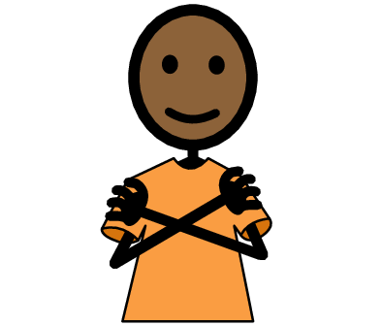
What happens when you use self-control?
Notes:
sk the students what happens when we use our self-control?
Tell the students when they use self control they keep themselves and others safe. When you use self control people trust and respect you. When you use self control you also respect others. The community is safe because it has citizens who respect the law.

Slide 19
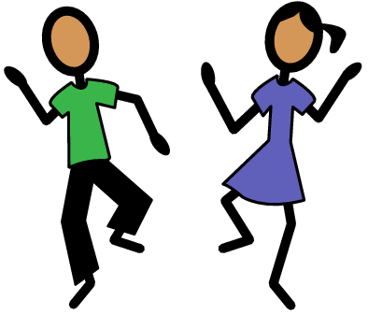
Time for a game!
Notes:
Tell the students now let’s practice having self control by playing one of my favorite games, freeze dance.
Ask the students if they know the rules to freeze dance
Let students answer
Tell the students you are going to play a song and the kids get to dance and be silly! But when the music stops they need to stop their bodies and stay super frozen until the music starts again
Play a few rounds of freeze dance

Slide 20
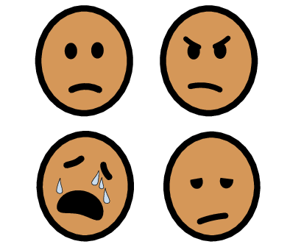
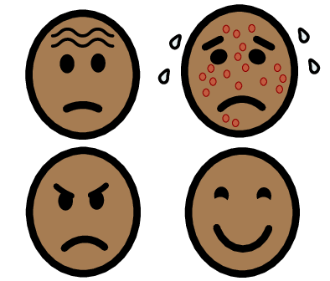
Nice work!
Notes:
: Tell the students, that was a lot of fun wasn’t it!
You all did so well freezing but sometimes we're so excited and having fun that we forgot to freeze when the music stopped
Tell the students we have feelings that cause us to forget to use our powerful self control like when we are super excited sometimes we forget to use self control.
Ask the students what other feelings can sometimes cause us to forget to use self control
Let the students answer: frustration, anger, sadness
Tell the students it is very important to have feelings but we need to know what to do when we have those feelings.

Slide 21
Pause, rewind, play!
on
Notes:
Tell student we are going to learn some skills to help remember how to use self control when we have feelings that make us not want to
Tell the students when we need to have self control with our feelings we can remember to pause, rewind, play, and sometimes talk
Pause: when we need to have self control we can pause what we are doing and take a deep breath. Let’s practice our deep breaths again.
Rewind: when we need to have self control we can start over and try again
Play: Once we take a deep breath and try again we can press play and keep going!
Last sometimes we need to talk to an adult or friend about our feelings to help us feel better

Slide 22
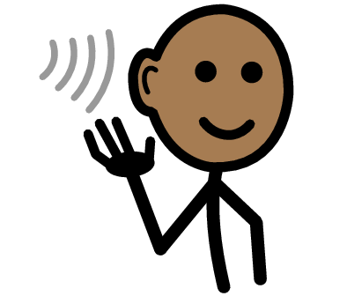
Pause, rewind, play!
Notes:
Practice saying “Pause, Rewind, Play!” out loud
Tell the student’s having self control leads us to respect and keep ourselves safe and those around us.

Slide 23
Let's try again with self-control!
Notes:
Tell the students, Now lets try freeze dance again using our powerful self control when it is time to freeze. This time when we freeze I want everyone to take a deep breath
Play freeze dance a few times again taking deep breaths when you free
Tell the students great job having self control

Slide 24
Sit down.

Slide 25
What is self-control?

Slide 26
Self-control is being able to control your emotions and behaviors, especially in situations that are difficult or upsetting.

Slide 27
All done, great job!

