Slide 1

Bullying and Upstanding
First Grade Lesson 6

Slide 2
When we are learning we will:

Slide 3

Keep our bodies in our own place!

Slide 4

Use our quiet voices!

Slide 5

Keep our ears open!

Slide 6

Have our brains ready to learn!

Slide 7
Today we are going to learn how to spot a bully and what to do when we see a bully.

Slide 8

What is a bully?

Slide 9

A bully is a person who has aggressive and unwanted behavior that is intended to harm, intimidate, or make fun of a target.

Slide 10
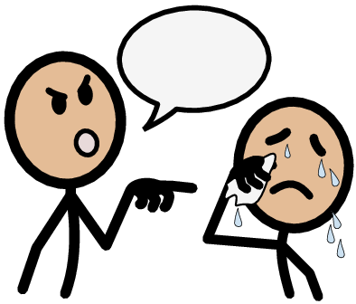
A target is a person being bullied.

Slide 11

A bystander is a person who watches and is aware but does not stop the bully or help the target.

Slide 12
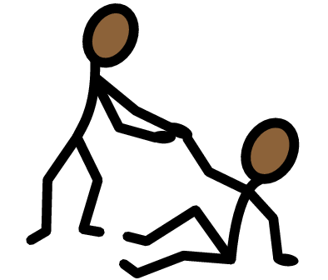

An upstander is a person who finds a way to help the target and stop the bully.

Slide 13
How does it make you feel when you are the target of bullying?

Slide 14

How do you think a bully feels? Why do they bully?

Slide 15
They want attention.
They are angry.
They want others to feel bad.
And more….
Notes:
Usually, people bully because they think acting that way gives them power; but really, they are being disrespectful and unsafe to others.

Slide 16
Being a bystander is also harmful. What can we do instead of watching?

Slide 17
Follow these three steps to be an upstander:

Slide 18
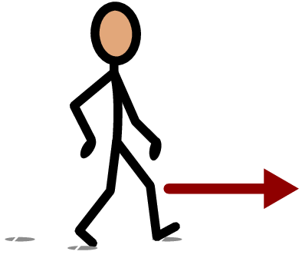
Approach

Slide 19
“Hey, what's going on here?”
“What can I do to help?”
“This isn't cool. I will get someone to help.”
Notes:
Never put yourself in danger- safety first! If it is safe to talk to the bully or target you can say:
When might it be safe to approach?

Slide 20


Intervene

Slide 21
Invite the target to walk away or play with you.
If the bully is saying rude things do not respond.
Notes:
Be a friend and let the target know they are not alone.

Slide 22
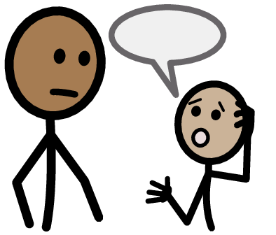
Follow up

Slide 23
Make sure adults know what happened.
If an adult is the bully, you can tell your teacher, parents, or another community helper.
Notes:
Remember you can also be a community helper by keeping your friends and neighbors safe by using your brain.

Slide 24


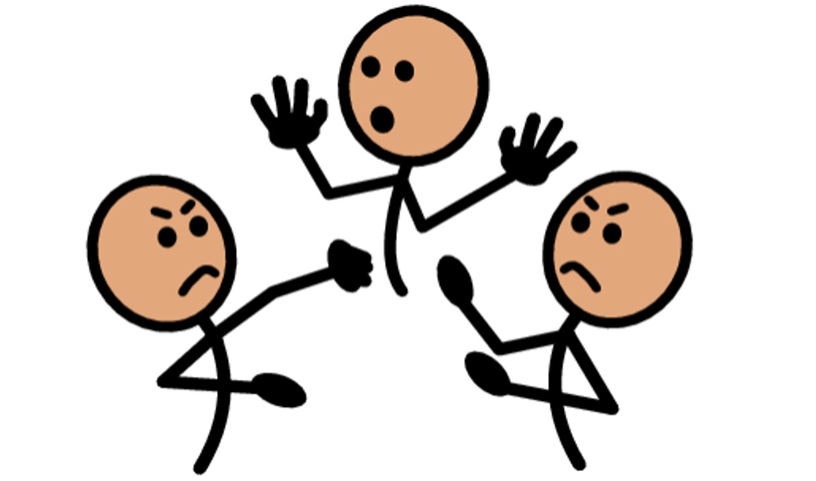

Activity: Bully, bystander, upstander, or target?

Slide 25
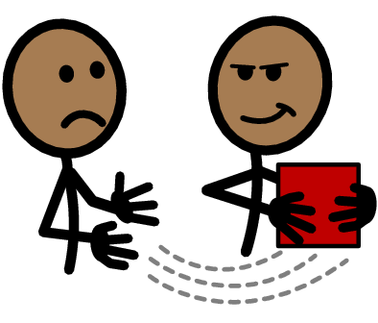
Brandon takes another student’s cookies at lunch without asking.
Brandon is a what?

Slide 26
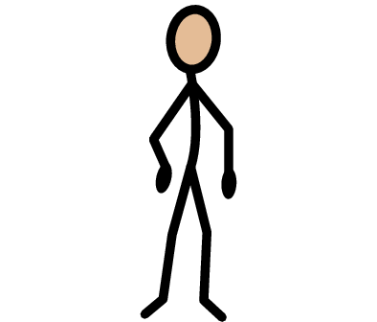

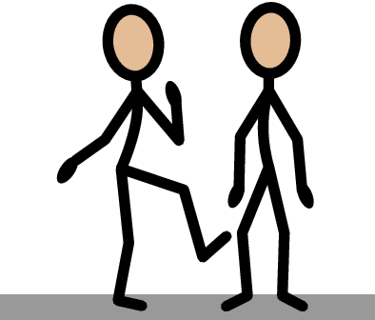
Cassidy watches as another student kicks someone on the playground. Cassidy does not tell anyone.
Cassidy is being a what?

Slide 27
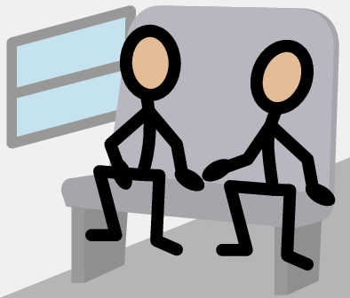
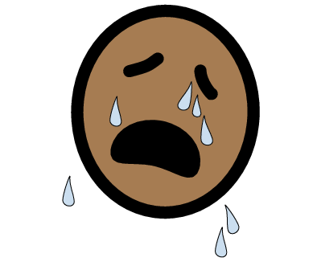
Jackson cries when the student on the bus calls him ugly.
Jackson is a what?

Slide 28
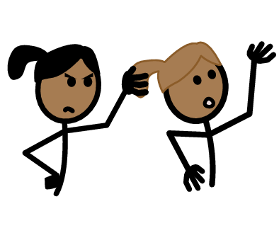
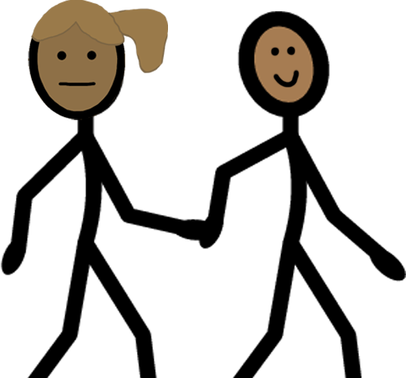
Eric helps a friend who got her hair pulled. Eric takes the friend to tell the teacher.
Eric is a what?

Slide 29



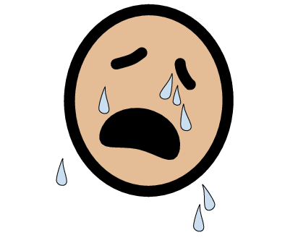
Robin takes the swings from a student on the playground and laughs.
Robin is a what?

Slide 30
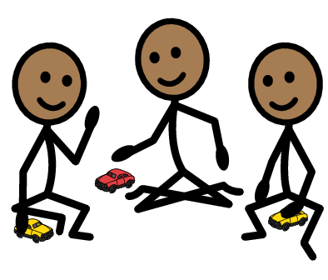


Monica was told she can’t play with the other girls because she is not wearing the color pink.
Monica is a what?

Slide 31
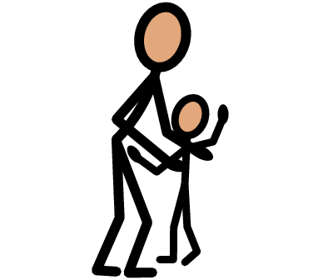
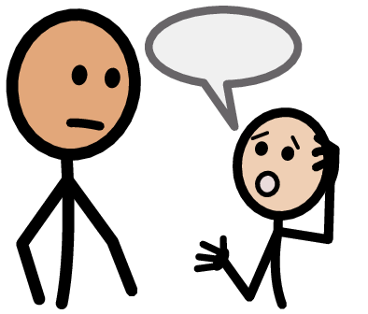
Charlie sees an adult hit a child. Charlie tells his teacher immediately.
Charlie is a what?

Slide 32
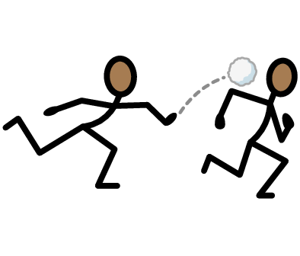
Nevaeh saw a boy throw rocks at another student. Nevaeh runs away and doesn’t tell anyone.
Nevaeh is a what?

Slide 33
Remember:
Be an upstander and walk proud!

Slide 34
All done, great job!

