Slide 1

Crime Prevention and Resistance
Fourth Grade Lesson 1

Slide 2

Personal space:
Be aware of your surroundings, respect others’ space, and stay in your own area.

Slide 3

Volume control:
Use indoor voices, and be mindful of noise levels.

Slide 4

Active listening:
Eyes and ears open! Ready to participate!

Slide 5

Sharp Minds
Be prepared to problem solve, ask questions, and contribute to the lesson.

Slide 6

What does crime mean?
Notes:
Tell the students “Today, we’re going to talk about something very important: crime prevention. But before we begin, can anyone tell me what they think crime means?”
Give students opportunities to respond.
Tell the students “crime is when someone breaks the law and harms people or property. Today, we’ll learn how to prevent crime, especially vandalism and shoplifting.”

Slide 7
Crime is when someone breaks the law and harms people or property. Today, we’ll learn how to prevent crime, especially vandalism and shoplifting.
Notes:
Tell the students “crime is when someone breaks the law and harms people or property. Today, we’ll learn how to prevent crime, especially vandalism and shoplifting.”

Slide 8
What is a victim?
Notes:
Tell the students “we are going to talk about ways to avoid becoming victims of crime. Who remembers what a victim is?”
Give students opportunities to respond.

Slide 9
A victim is someone who’s been affected by someone or something. Being a victim of crime is when someone breaks the law and it affects you in a bad way.
Notes:
Explain “A victim is someone who’s been affected in a bad way by someone or something. Being a victim to crime is when someone breaks the law and it affects you in a bad way.”

Slide 10
List of strategies:
Activity: List of ways to avoid victimization.
Notes:
Make a list with the student on strategies to avoid victimization. Direct students to saying these answers.
Stay with someone: Always stick with a friend or family member when you’re outside or in unfamiliar places. There is safety in numbers
Use your voice: If someone tries to make you uncomfortable or does something that seems wrong, don’t be afraid to speak up and tell them to stop or tell an adult.
Stay aware: Pay attention to what is happening around you. Notice if something doesn’t feel right or if you see something suspicious. Trust your instincts.
Know your safe places: Be familiar with safe places in your neighborhood, school, or in public. Know who your community helpers are (cops, teachers)
Keep your belongings safe: always keep track of your belongings so no one can take them

Slide 11
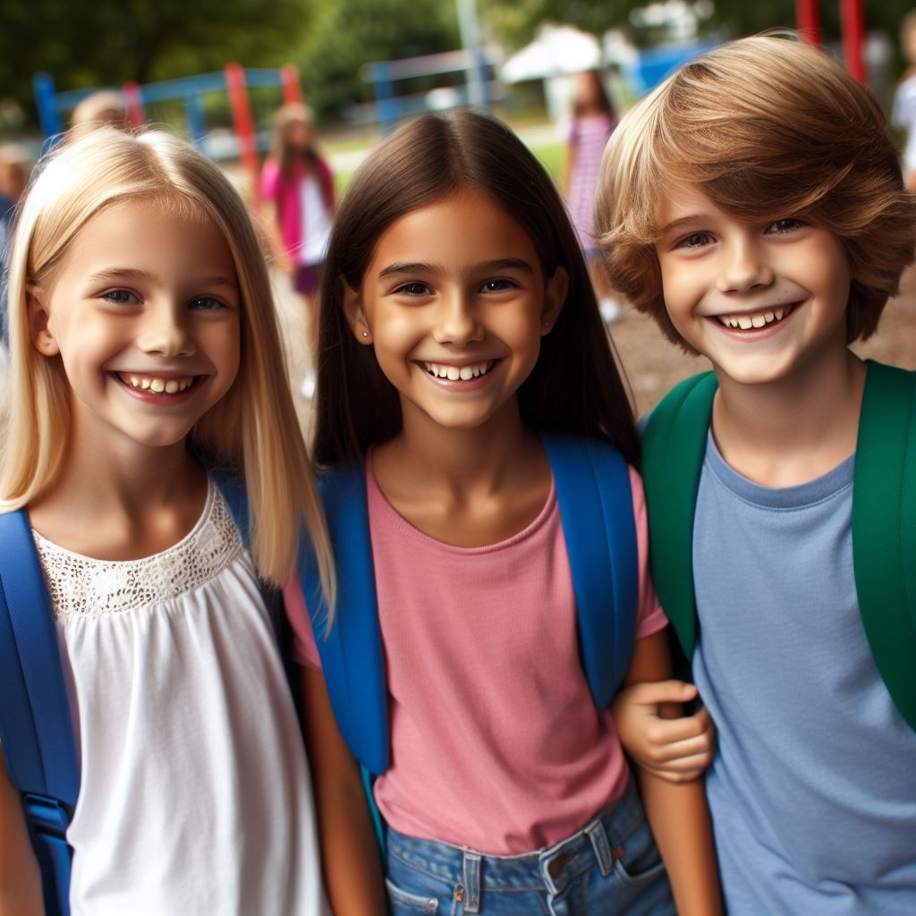
Stay with someone: Always stick with a friend or family member when you’re outside or in unfamiliar places.
Notes:
Stay with someone: Always stick with a friend or family member when you’re outside or in unfamiliar places. There is safety in numbers

Slide 12
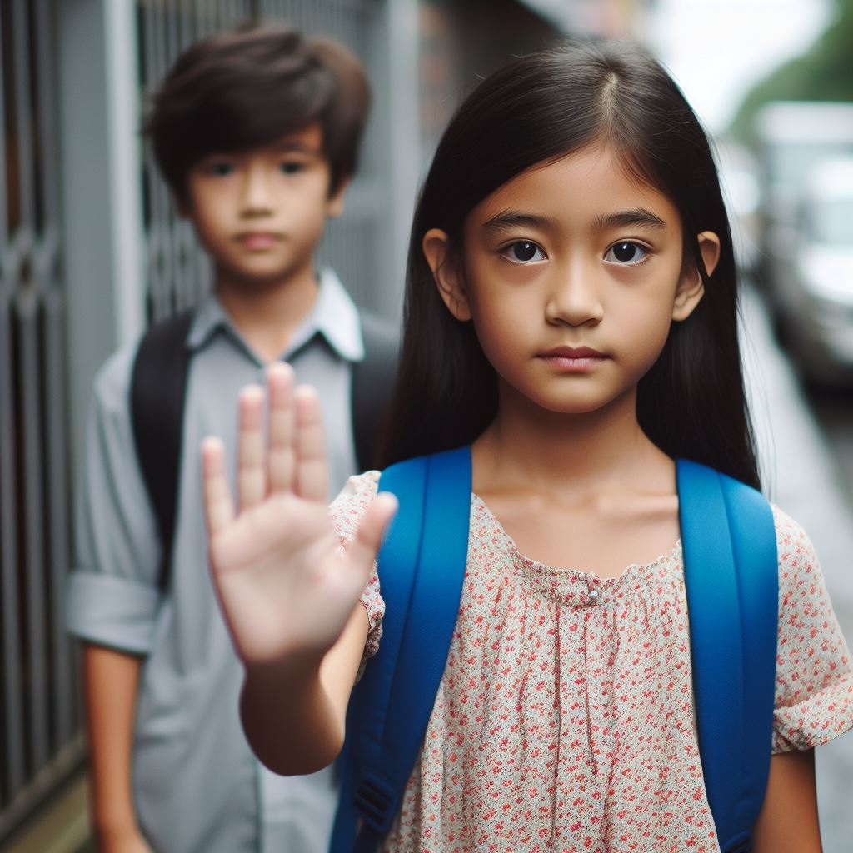
Use your voice: If someone does something that seems wrong speak up and tell them to stop or tell an adult.
Notes:
Use your voice: If someone tries to make you uncomfortable or does something that seems wrong, don’t be afraid to speak up and tell them to stop or tell an adult.

Slide 13
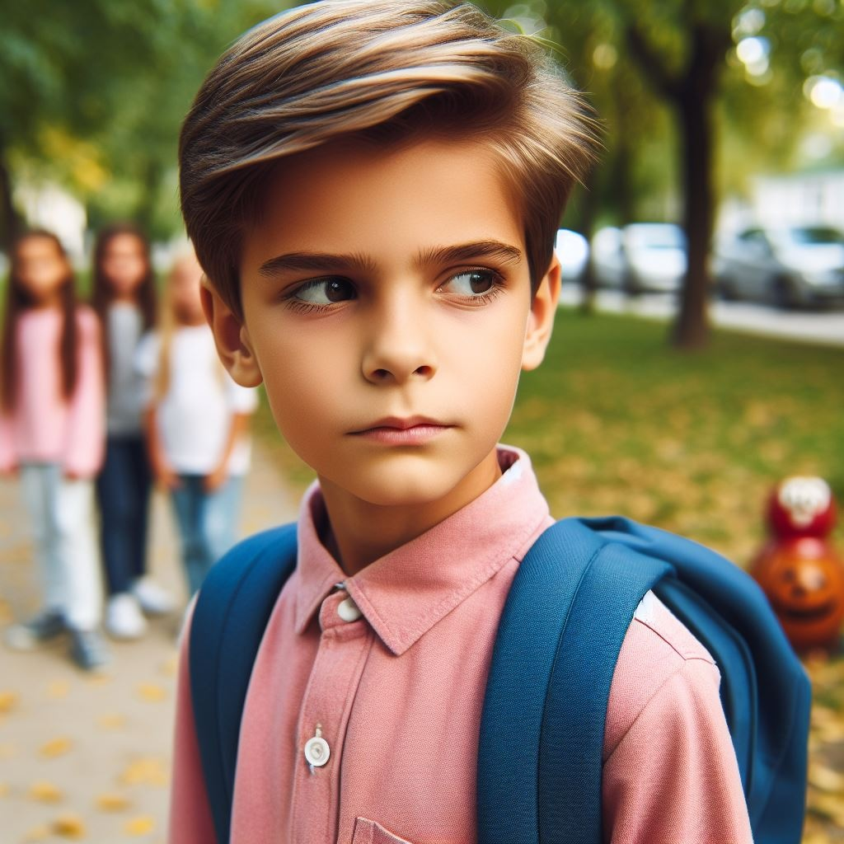
Stay aware: Pay attention to what is happening around you. Notice if something doesn’t feel right.
Notes:
Stay aware: Pay attention to what is happening around you. Notice if something doesn’t feel right or if you see something suspicious. Trust your instincts.

Slide 14

Know your safe places: in your neighborhood or in public. Know who your community helpers are.
Notes:
Know your safe places: Be familiar with safe places in your neighborhood, school, or in public. Know who your community helpers are (cops, teachers)

Slide 15
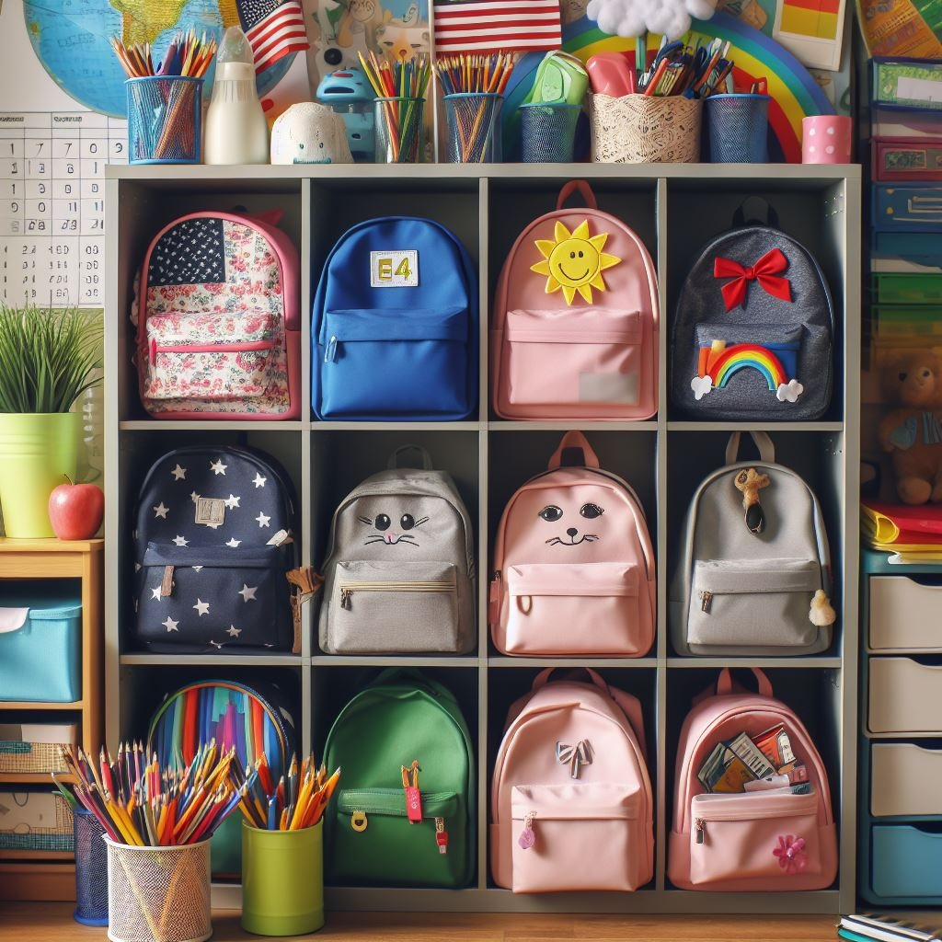
Keep your belongings safe: Always keep track of your belongings so no one can take them.
Notes:
Keep your belongings safe: always keep track of your belongings so no one can take them

Slide 16
What does prevention mean?
Notes:
Tell the students “those are strategies to avoid victimization. Now we are going to learn 3 assertive techniques that aid in crime prevention”

Slide 17
Prevention means stopping something bad from happening before it happens.
Notes:
“prevention means stopping something bad from happening before it happens”

Slide 18
1. Use strong body language.
2. Say “no” firmly.
3. Set boundaries.
Prevention strategies:
Notes:
Explain each point
Use strong body language: Stand up straight, look people in the eye, and use a confident tone of voice
This shows that you’re assertive and not an easy target for someone who might want to bother you.
Say “no” firmly: Practice saying “no” in a clear and firm voice when someone asks you to do something you’re not comfortable with or if they try to pressure you into doing something wrong.
Set Boundaries: It is important to know your limits and boundaries. If someone tries to cross those boundaries or makes you feel uncomfortable, don't be afraid to speak up and tell them to stop.

Slide 19

Use strong body language: point your chest up.
Notes:
Lets practice hand motions to remember these” First show the students, then have them repeat after you, and then do it together a few times.
Use strong body language: point your chest up

Slide 20
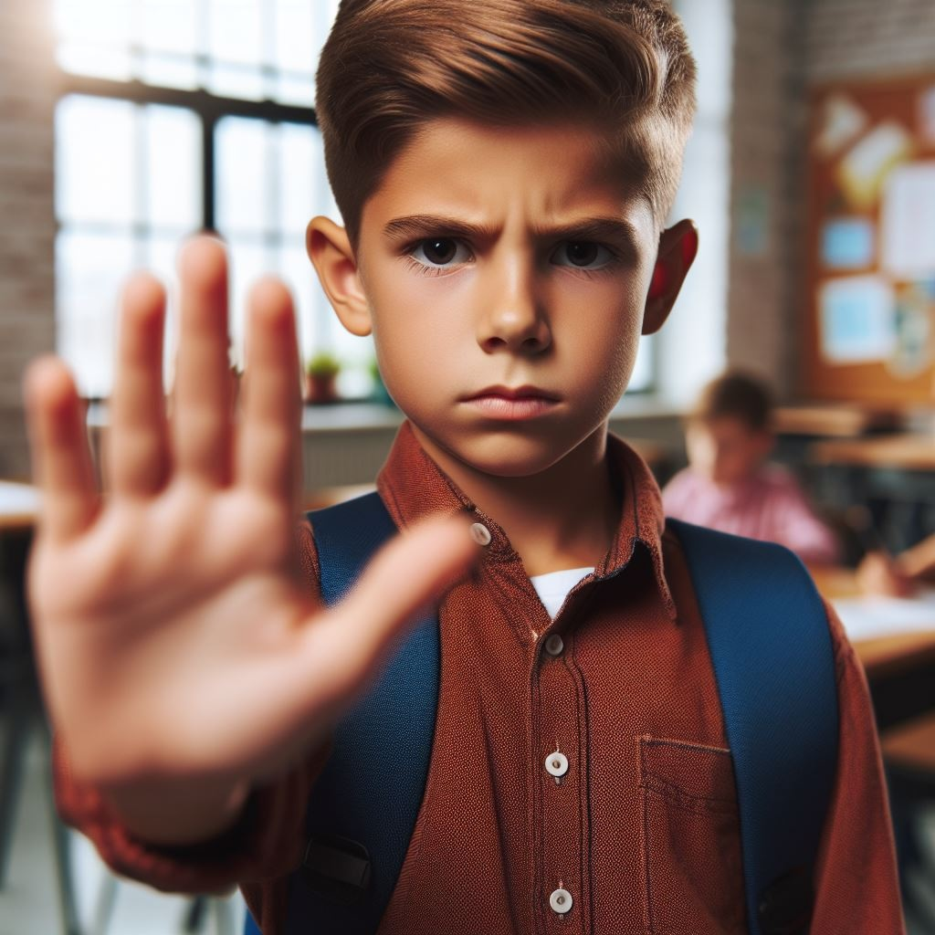
Say “no” firmly: raise your right hand out in front of you.
Notes:
Lets practice hand motions to remember these” First show the students, then have them repeat after you, and then do it together a few times.
Say “no” firmly: raise your right hand

Slide 21

Set boundaries: cross both arms over your chest making an x.
Notes:
Lets practice hand motions to remember these” First show the students, then have them repeat after you, and then do it together a few times.
Set Boundaries: cross both arms over your chest making an x

Slide 22
Review:
What is crime?
Notes:
Review by having students tell you what a crime is.
Explain a crime is when someone breaks the law and harms people or property. A crime also means breaking the law
Ask the students if they have ever heard the term vandalism and what it is.

Slide 23

Let's discuss vandalism and shoplifting.
Notes:
Review by having students tell you what a crime is.
Explain a crime is when someone breaks the law and harms people or property. A crime also means breaking the law
Ask the students if they have ever heard the term vandalism and what it is.

Slide 24
What is vandalism?
Notes:
Ask the students if they have ever heard the term vandalism and what it is.

Slide 25
Vandalism is when someone purposely damages or destroys property that doesn’t belong to them.
Notes:
Explain to the students that vandalism is when someone purposely damages or destroys property that doesn’t belong to them.

Slide 26
What is shoplifting?
Notes:
Ask the students if they have ever heard the term shoplifting and what it is.

Slide 27
Shoplifting can be explained as taking something from a store without paying for it.
Notes:
Explain to the students that shoplifting can be explained as taking something from a store without paying for it.

Slide 28
Consequences of vandalism:
Paying fines, doing community service, apologizing to the victim, or getting in trouble with your parents.
Consequences of shoplifting:
Paying fines, being banned from the store, getting in trouble with your parents.
Notes:
Tell the students “vandalism and shoplifting are both crimes”
Consequences of vandalism
Paying fines, doing community service, or apologizing to the victim
Consequences of shoplifting
Paying fines, being banned from the store, getting in trouble with the law

Slide 29

Activity: Scenarios
Notes:
“Now lets look at some scenarios of shoplifting and vandalism. We will talk about possible consequences and how these crimes could have been prevented.”

Slide 30
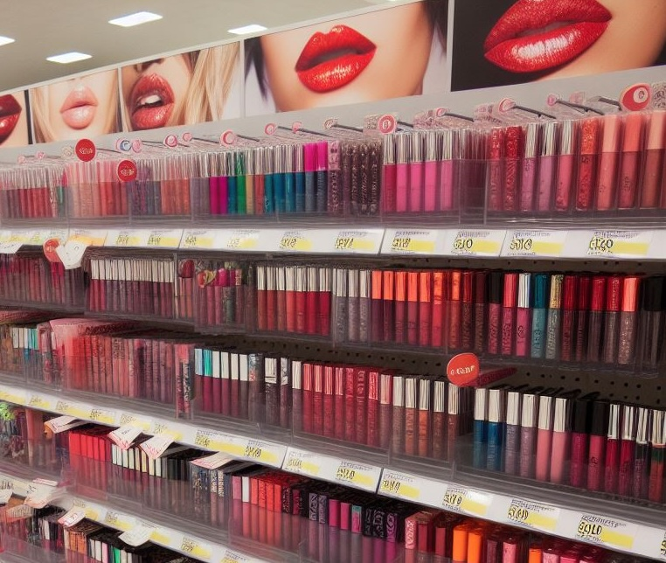
Emily goes to Target with her friends. She sees a lip gloss she really wants but realizes she doesn’t have enough money to buy it. She hides the lip gloss in her backpack and tries to leave the store without paying. She gets caught by the store clerk.
Notes:
Emily goes to Target with her friends. She sees a lipgloss she really wants but realizes she doesn’t have enough money to buy it. She hides the lip gloss in her backpack and tries to leave the store without paying. She gets caught by the store clerk.
What type of crime is this?
shoplifting
What is a possible consequence? (give students opportunities to answer)
She has to put it back
She has to call her parent and have them pick her up
Someone has to pay for her
What could have been done to prevent the crime? (give students opportunities to answer)
She could have asked her friend for more money
She could have come back later with more money

Slide 31
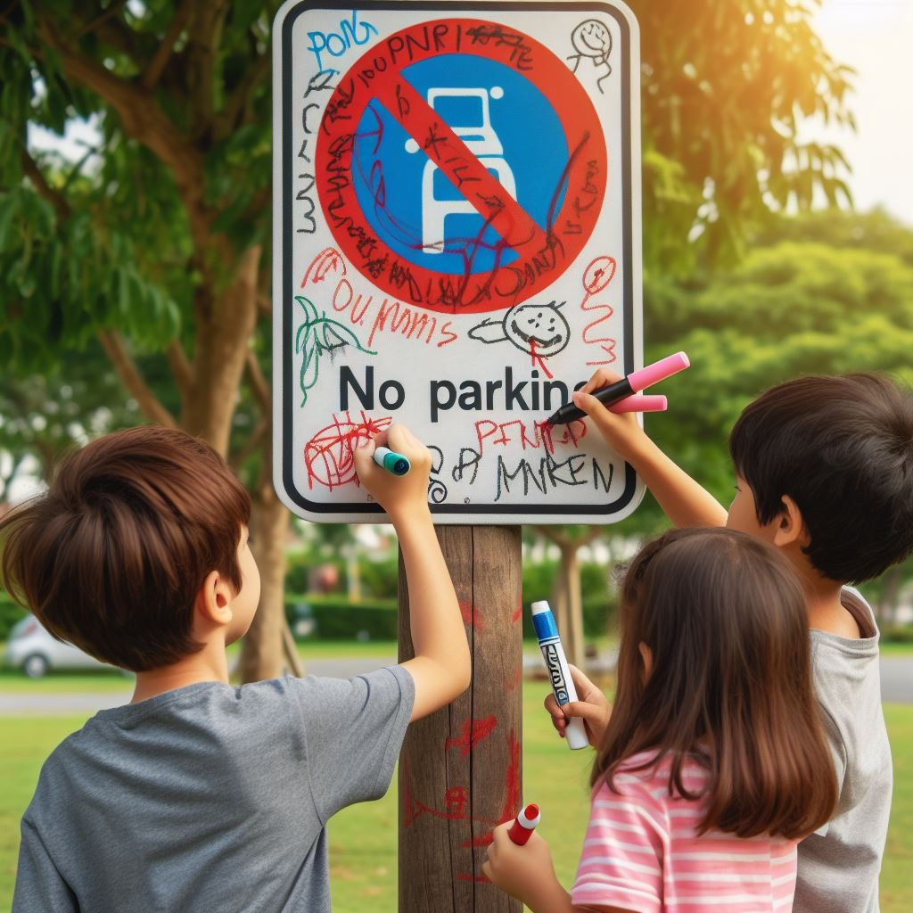
Tom and his friends are playing in the park when they see a signboard. They decide to throw rocks at it and scribble on it with markers, thinking it would be funny. They leave the signboard damaged and covered in graffiti.
Notes:
Tom and his friends are playing in the park when they see a signboard. They decide to throw rocks at it and scribble on it with markers, thinking it would be funny. They leave the signboard damaged and covered in graffiti
What type of crime is this?
Vandalism
What is a possible consequence? (give students opportunities to answer)
They get caught by the cops and have to clean it
They have to pay for a new one
Community service
What could have been done to prevent the crime? (give students opportunities to answer)
They could play somewhere else
Someone should have said “no

Slide 32

Sarah and her friends go to the candy store after school. Sarah sees a chocolate bar she wants and she is hungry. She quickly puts it in her pocket and leaves the store without paying.
Notes:
Sarah and her friends go to the candy store after school. While her friends are busy browsing, Sarah sees a chocolate bar she really wants. She quickly puts it in her pocket and leaves the store without paying.
What type of crime is this?
shoplifting
What is a possible consequence? (give students opportunities to answer)
She gets banned from the store
She has to call her parent and have them pick her up
Someone has to pay for her
What could have been done to prevent the crime? (give students opportunities to answer)
She could have asked her friend for more money
She could have come back later with more money

Slide 33
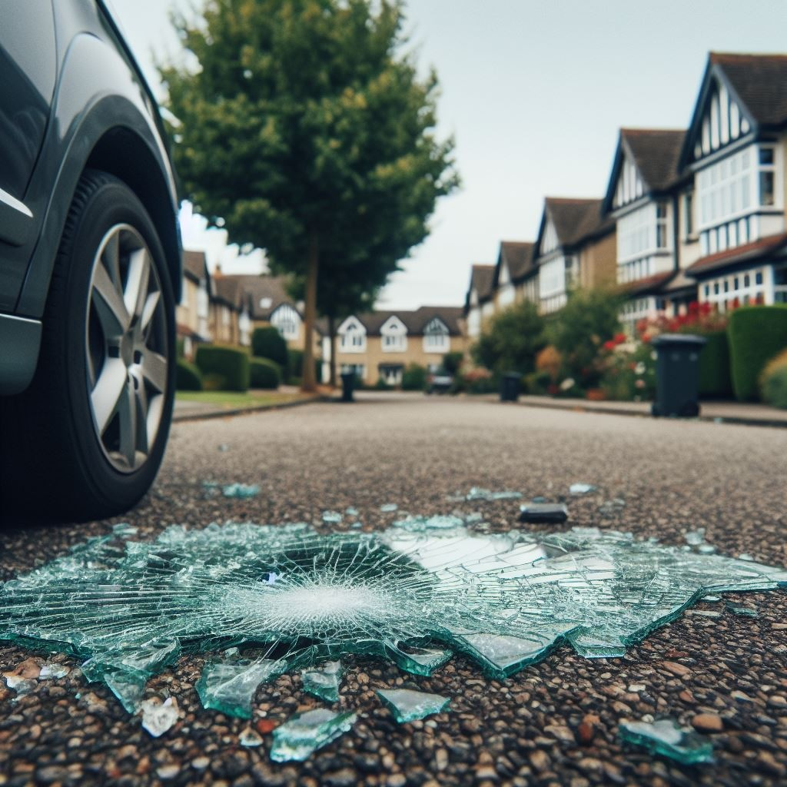
During the weekend, Jack and his friends break a window on their neighbor's car. They thought this was a funny prank.
Notes:
During the weekend Jack and his friends break a window on their neighbor's car. They thought this was a funny prank.
What type of crime is this?
Vandalism
What is a possible consequence? (give students opportunities to answer)
They have to pay for it
They have to do work/service for the neighbor
They get grounded
What could have been done to prevent the crime? (give students opportunities to answer)
Someone should have said “no”

Slide 34
Review:
What is crime?
Notes:
Remind the students “crime is when someone breaks the law and harms people or property. Today, we learned how to prevent crime, especially vandalism and shoplifting.”
Tell the students “we also learned about assertive ways to prevent crime. Who can tell me what those three ways were amd show me the motions we used to remember them?”
Use strong body language: point your chest up
Say “no” firmly: raise your right hand
Set Boundaries: cross both arms over your chest making an x

Slide 35
All done, great job!

