Slide 1

Digital Citizenship
Fourth Grade Lesson 2

Slide 2

Personal Space
Be aware of your surroundings, respect others’ space, and stay in your own area.

Slide 3

Volume control
Use indoor voices, be mindful of noise levels.

Slide 4

Active Listening
Eyes and ears open! Ready to participate!

Slide 5

Sharp Minds
Be prepared to problem solve, ask questions, and contribute to the lesson.

Slide 6

Use kind words and actions.

Slide 7
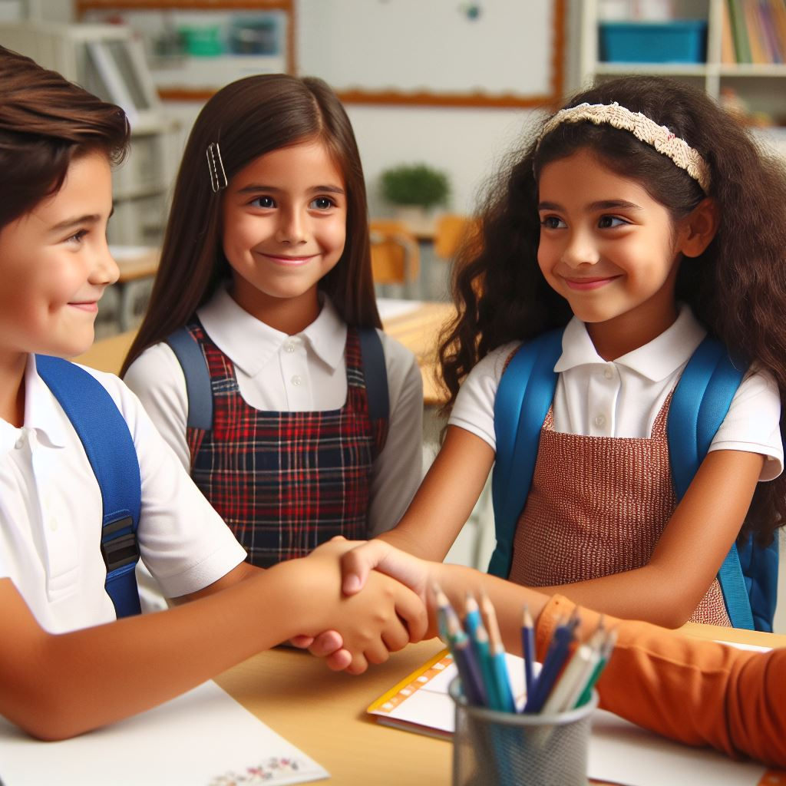
Treat others fairly.

Slide 8
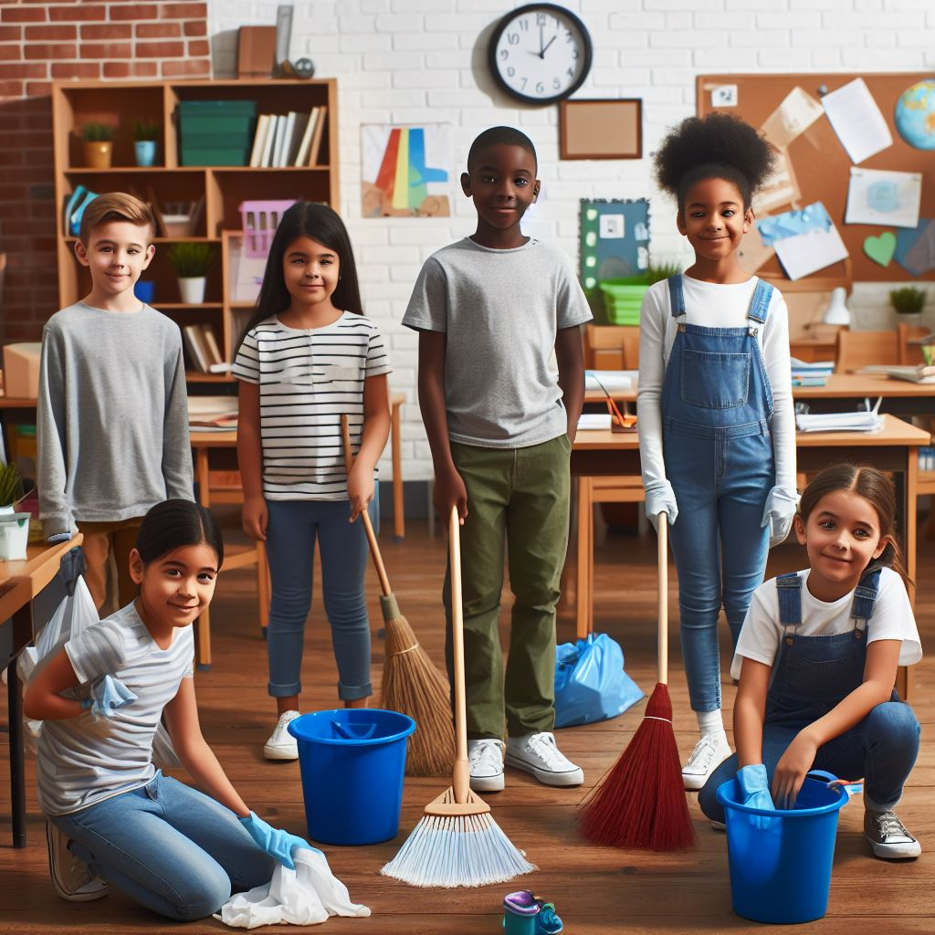
Take care of things.

Slide 9

Be kind online.

Slide 10

Think before you share.

Slide 11
Responsibility

Slide 12
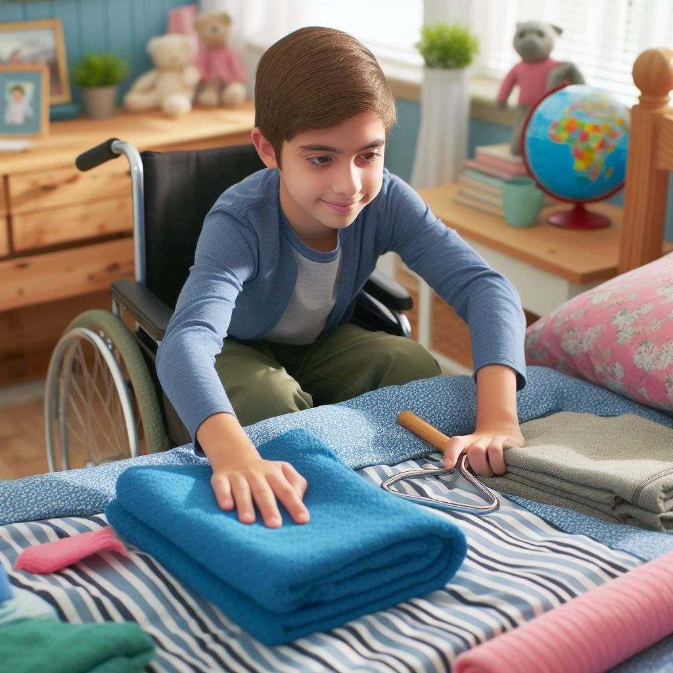
Do your part.

Slide 13
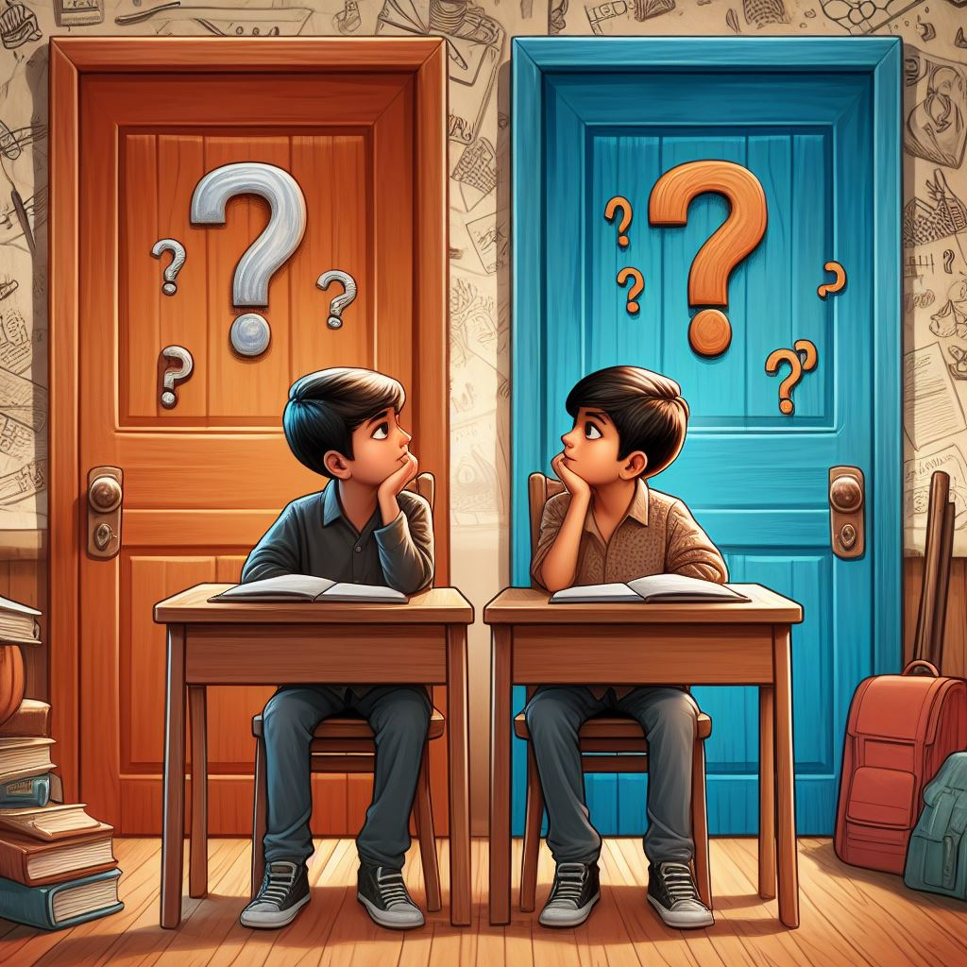
Make good choices.

Slide 14

Be accountable.

Slide 15

Protect your information.

Slide 16

Be careful about clicking links.

Slide 17

Think critically about what you see.

Slide 18
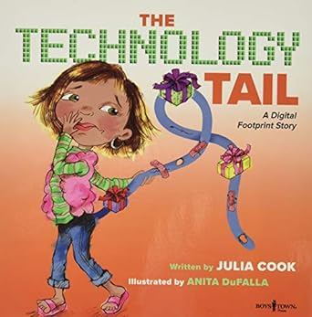
Read the book: The Technology Tail: A Digital Footprint Story
Author: Julia Cook

Slide 19
Discussion:
Digital Dilemma
Imagine you're playing a game online, and someone starts making fun of another player.
What could you do to be a responsible digital citizen?

Slide 20
Discussion:
Digital Dilemma
Now, picture yourself receiving a message from someone you don't know who wants to meet up offline.
Is that safe?
What responsible steps could you take?

Slide 21
Activity:
Create a digital superhero!

Slide 22


Activity:
Digital Superhero
What special powers would your superhero have to stop cyberbullying, spread kindness, and protect people's privacy?

Slide 23
Activity:
”Dear Future Me” letter

Slide 24

Activity:
“Dear Future Me…”
What are some good online habits you want to keep up? What are some potential risks you want to avoid?

Slide 25
All done, great job!

