Slide 1

Respect for Others
Fourth Grade Lesson 3

Slide 2

Personal Space
Be aware of your surroundings, respect others’ space, and stay in your own area.

Slide 3

Volume control
Use indoor voices, be mindful of noise levels.

Slide 4

Active Listening
Eyes and ears open! Ready to participate!

Slide 5

Sharp Minds
Be prepared to problem solve, ask questions, and contribute to the lesson.

Slide 6

Can anyone think of a situation where showing respect was important?

Slide 7
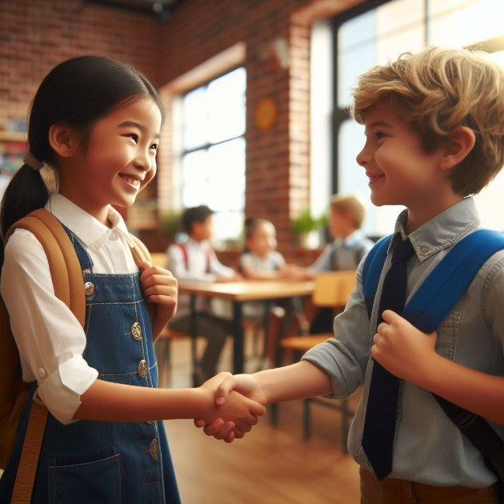
Respect and responsibility

Slide 8

Strengths and weaknesses

Slide 9
Strengths Weaknesses

Slide 10
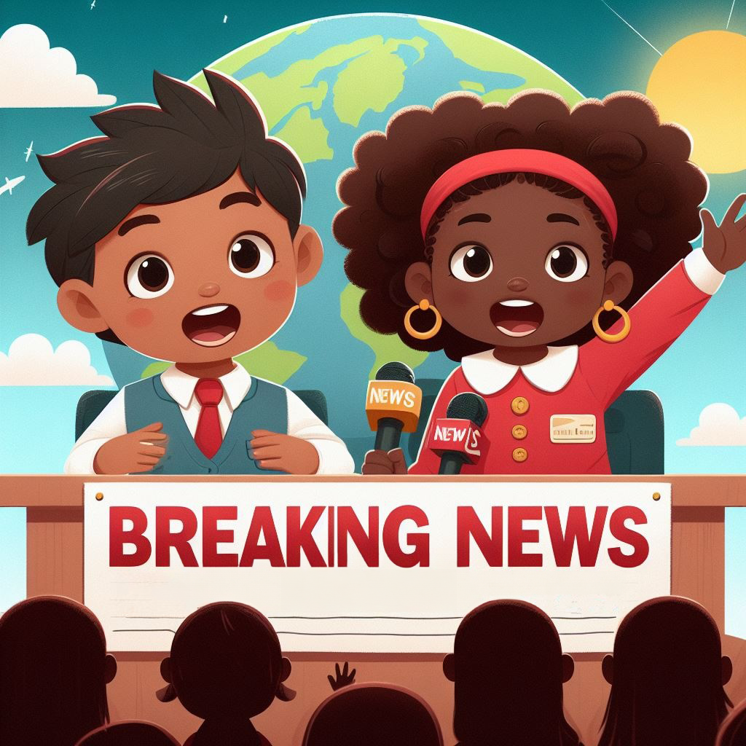
Everyone deserves respect.

Slide 11

When we treat people differently or unfairly based on who they are, that is called being prejudiced.
Notes:
You're at lunch with your friends and bring a nutritious lunch from home. Your friends notice and say, 'Wow, that looks healthy! I should start bringing healthier lunches, too.' They encourage you to join the school's fitness club and eat more fruits and vegetables. This is a positive example of peer pressure because your friends influence you to make healthier choices, which is good. Now, think about a positive example. You're at lunch with your friends and bring a nutritious lunch from home. Your friends notice and say, 'Wow, that looks healthy! I should start bringing healthier lunches, too.' They encourage you to join the school's fitness club and eat more fruits and vegetables. This is a positive example of peer pressure because your friends influence you to make healthier choices, which is good.

Slide 12
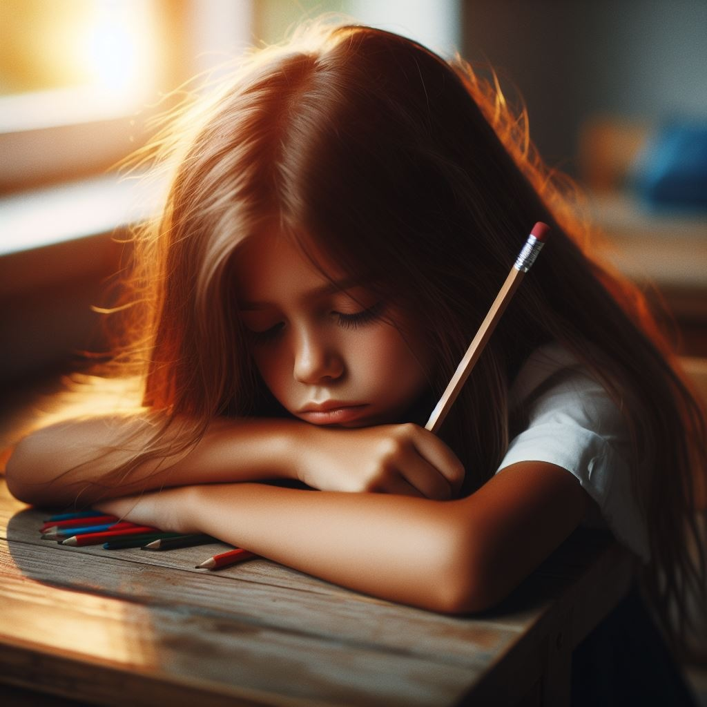
Treating someone unfairly
Notes:
Next, consider another negative example. You're excited about attending school because you have a project presentation today. But your friends approach you and say, 'Hey, let's skip school and go to the mall instead. It'll be way more fun!' They insist, saying, 'Don't worry, nobody will even notice we're gone.' This is an example of negative peer pressure because they're trying to persuade you to skip school, which is irresponsible behavior.

Slide 13
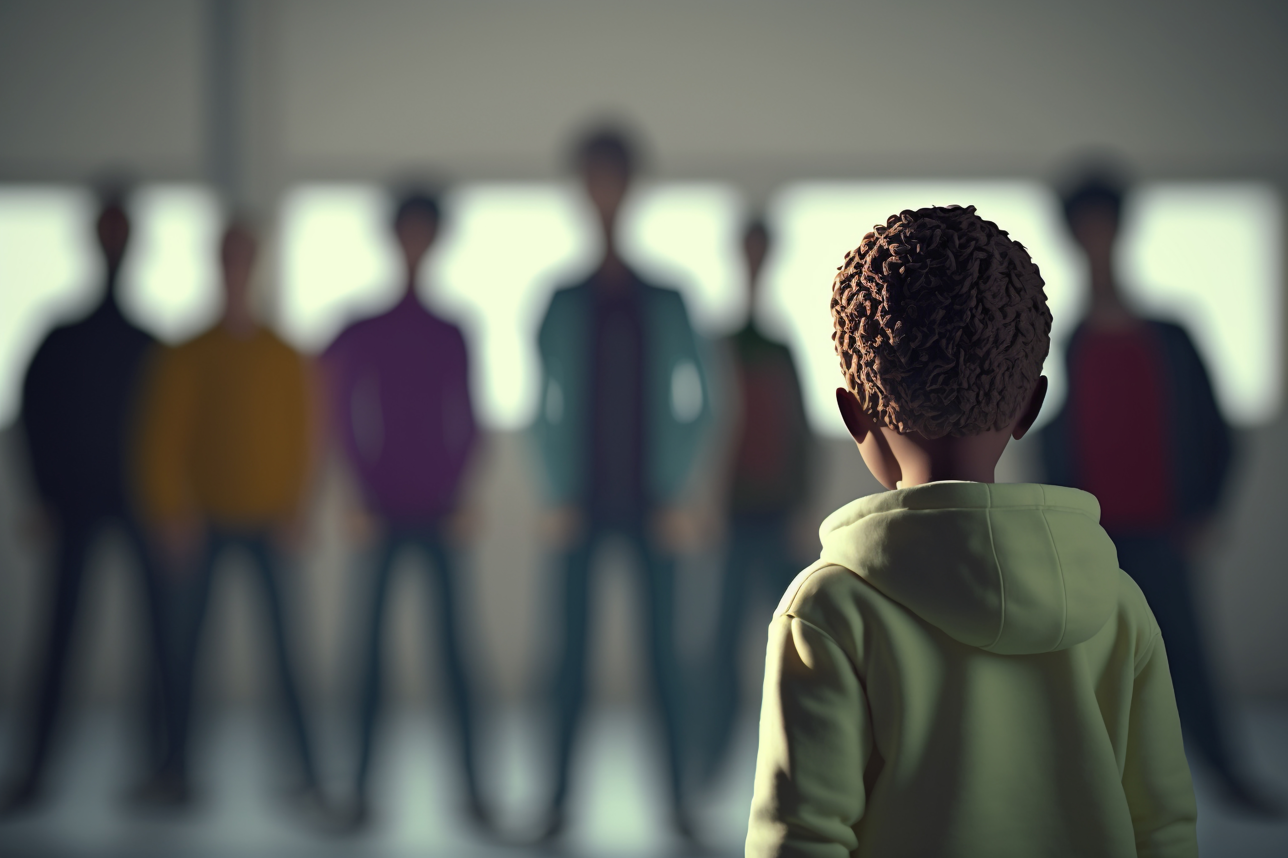
Treating someone differently because of who they are
Notes:
Next, consider another negative example. You're excited about attending school because you have a project presentation today. But your friends approach you and say, 'Hey, let's skip school and go to the mall instead. It'll be way more fun!' They insist, saying, 'Don't worry, nobody will even notice we're gone.' This is an example of negative peer pressure because they're trying to persuade you to skip school, which is irresponsible behavior.

Slide 14

Imagine everyone has a unique book inside them full of stories and adventures. Stereotypes are like judging a book by its cover without ever opening it!
Notes:
You're at lunch with your friends and bring a nutritious lunch from home. Your friends notice and say, 'Wow, that looks healthy! I should start bringing healthier lunches, too.' They encourage you to join the school's fitness club and eat more fruits and vegetables. This is a positive example of peer pressure because your friends influence you to make healthier choices, which is good. Now, think about a positive example. You're at lunch with your friends and bring a nutritious lunch from home. Your friends notice and say, 'Wow, that looks healthy! I should start bringing healthier lunches, too.' They encourage you to join the school's fitness club and eat more fruits and vegetables. This is a positive example of peer pressure because your friends influence you to make healthier choices, which is good.

Slide 15

Be a detective!
Notes:
Next, consider another negative example. You're excited about attending school because you have a project presentation today. But your friends approach you and say, 'Hey, let's skip school and go to the mall instead. It'll be way more fun!' They insist, saying, 'Don't worry, nobody will even notice we're gone.' This is an example of negative peer pressure because they're trying to persuade you to skip school, which is irresponsible behavior.

Slide 16

Challenge your detective skills!
Notes:
Next, consider another negative example. You're excited about attending school because you have a project presentation today. But your friends approach you and say, 'Hey, let's skip school and go to the mall instead. It'll be way more fun!' They insist, saying, 'Don't worry, nobody will even notice we're gone.' This is an example of negative peer pressure because they're trying to persuade you to skip school, which is irresponsible behavior.

Slide 17
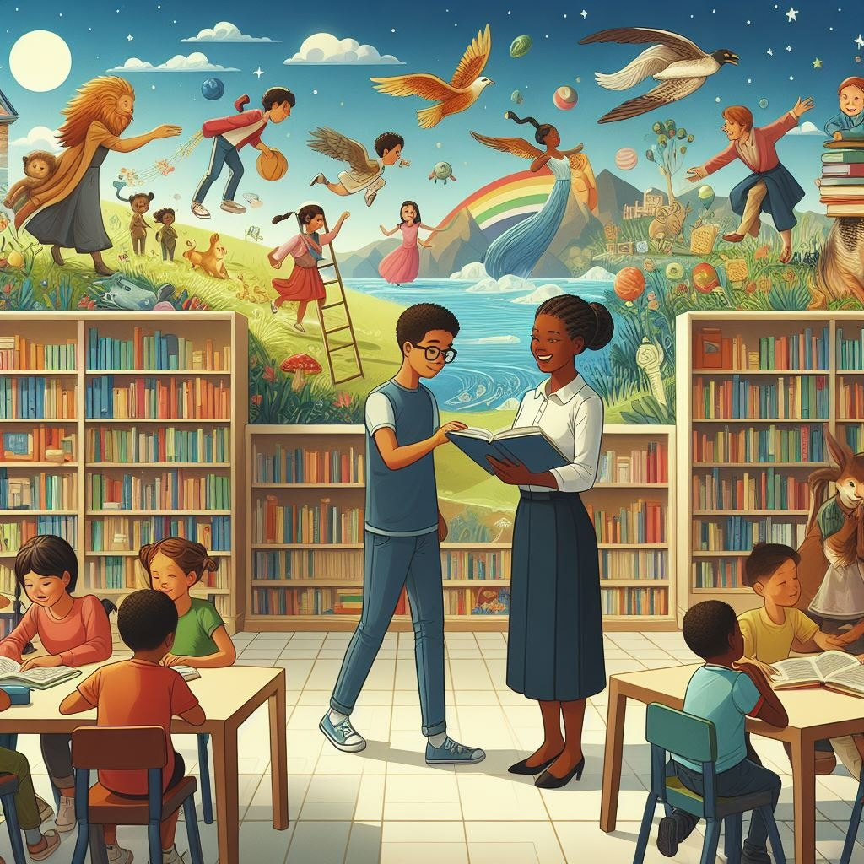
Celebrate the library!
Notes:
Next, consider another negative example. You're excited about attending school because you have a project presentation today. But your friends approach you and say, 'Hey, let's skip school and go to the mall instead. It'll be way more fun!' They insist, saying, 'Don't worry, nobody will even notice we're gone.' This is an example of negative peer pressure because they're trying to persuade you to skip school, which is irresponsible behavior.

Slide 18
In pairs, we will help each other make decisions about respect.
Activity:
Scenarios

Slide 19
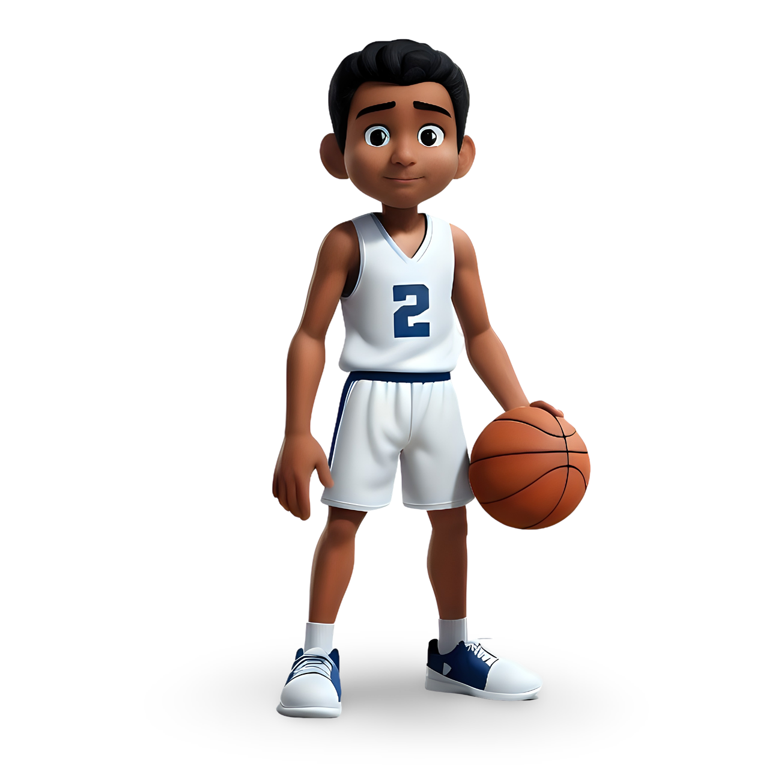
Sarah and Michael, are playing basketball at recess. A new student, David, arrives but hesitates to join.
Notes:
Why might David have felt hesitant to join?
How can we be welcoming to newcomers even if they seem different?
What can Sarah and Michael do to make David feel welcome?”

Slide 20
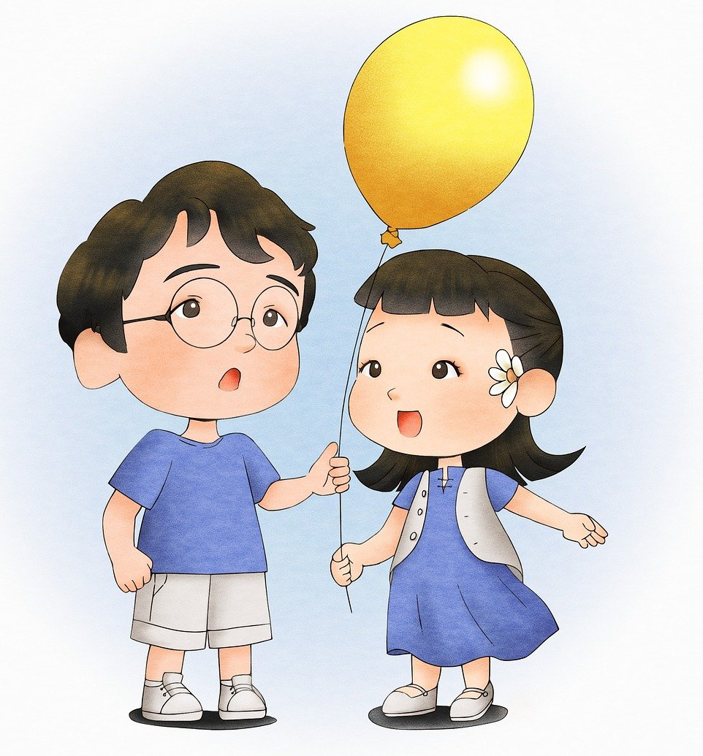
Maya and Leo, are interested in joining a new activity group. However, they notice the group leader making assumptions about their abilities based on their age and their cultural backgrounds.
Notes:
How might Maya and Leo feel when the group leader makes assumptions about them?
How can Maya and Leo politely challenge the assumptions and advocate for their abilities?
Why is it important to be open-minded and avoid making judgments based on stereotypes or appearances?”

Slide 21
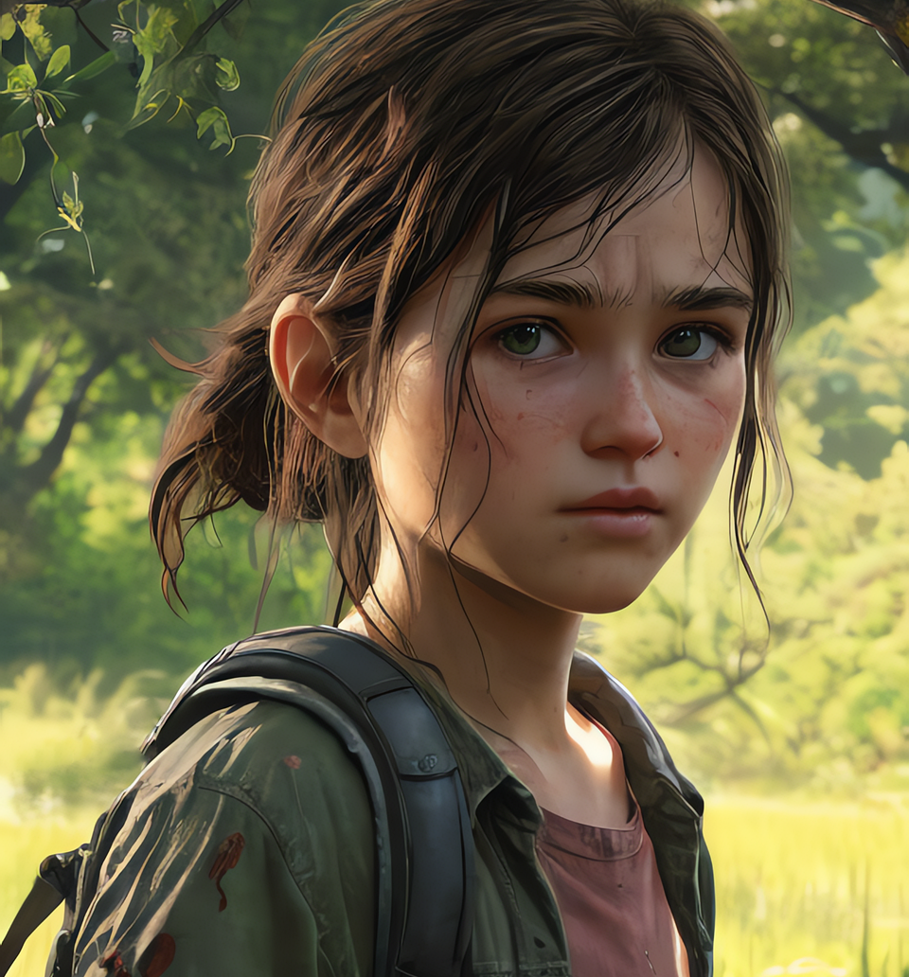
Emma, from a low-income family, arrives at the pool with her mom. Feeling self-conscious due to her worn belongings, she hesitates to join other children, one of whom, Liam, from a wealthier family, makes a mean remark about her outfit.
Notes:
How might Emma feel after being teased?
Why is it important to be respectful of others regardless of the situation?
How can individuals like Liam be more understanding of those from different socioeconomic backgrounds?
You are one of Liam’s friends. How can you help in this situation?”

Slide 22
Design a slogan or poster that inspires others to be respectful. What message do you want to share? Use words and visuals that will capture everyone's attention.
Activity:
Design a slogan or poster

Slide 23
How can we create a more inclusive environment for everyone?

Slide 24
Can you give an example of how diversity can be a strength in a group or community?

Slide 25
What is one thing we can do as a class today that will make everyone feel like this is a welcoming space?

Slide 26
All done, great job!

