Slide 1

Conflict Resolution
Fourth Grade Lesson 4

Slide 2

Personal Space
Be aware of your surroundings, respect others’ space, and stay in your own area.

Slide 3

Volume control
Use indoor voices, be mindful of noise levels.

Slide 4

Active Listening
Eyes and ears open! Ready to participate!

Slide 5

Sharp Minds
Be prepared to problem solve, ask questions, and contribute to the lesson.

Slide 6
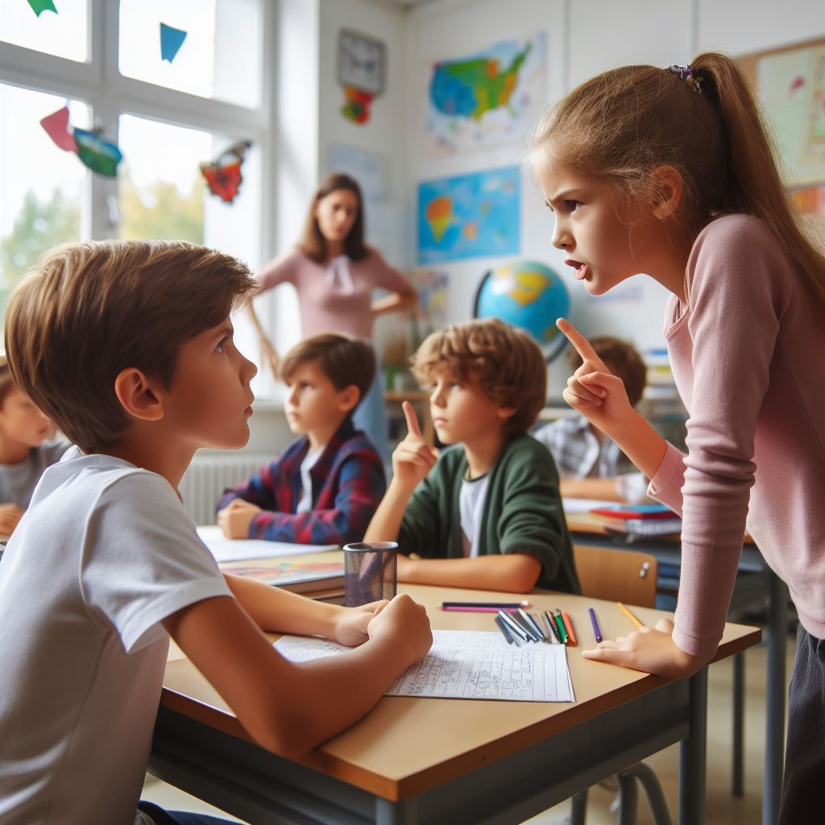
Conflict is when there's disagreement between people.
Notes:
Picture of children arguing

Slide 7

A trigger is something that starts a conflict.
Notes:
Picture of children arguing

Slide 8
Activity: Scenarios

Slide 9
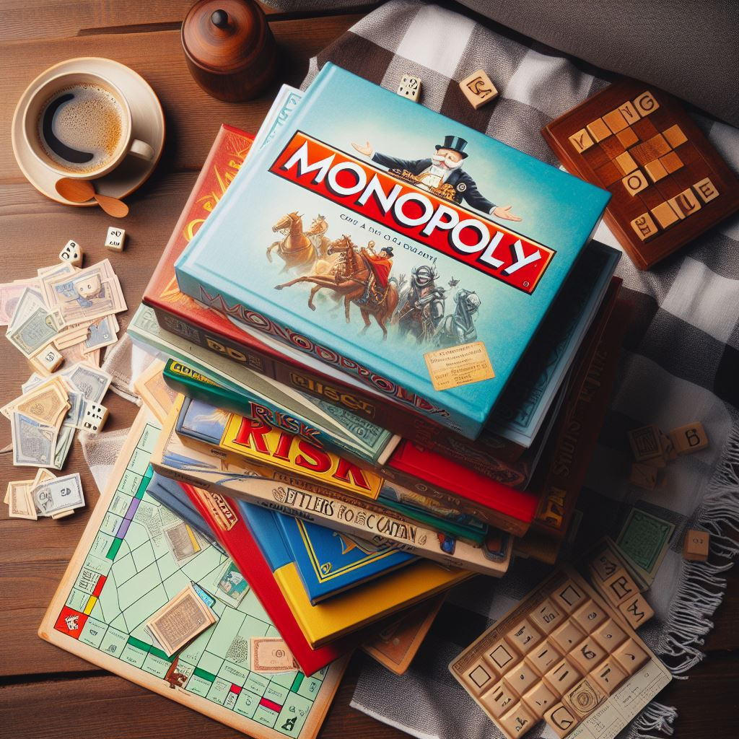
Scenario 1
You and your friend want to play a board game. Your friend wants to play Clue, but you want to play Monopoly and you argue about it.

Slide 10
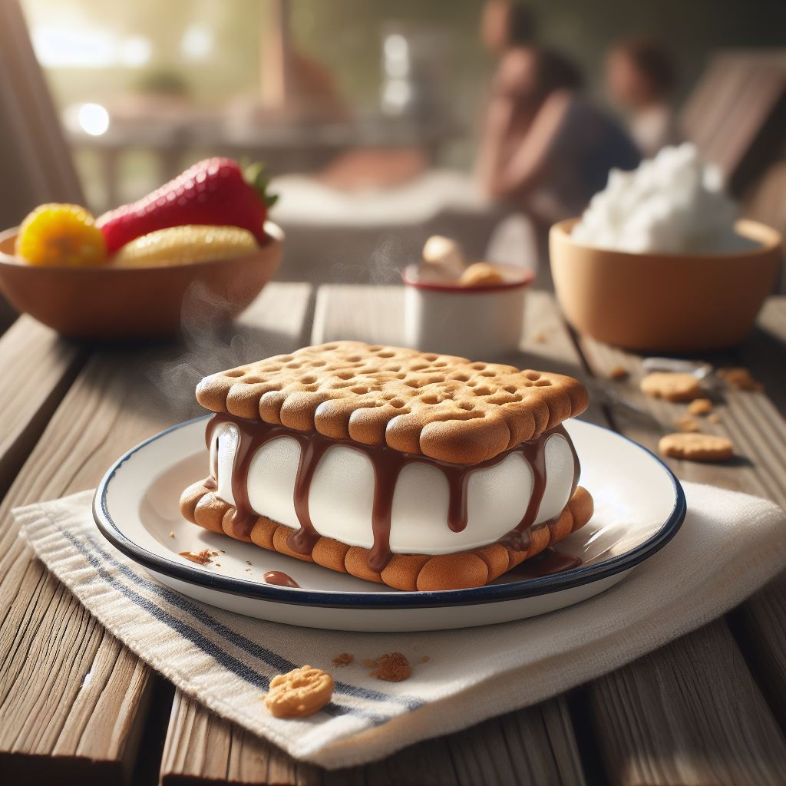
Scenario 2
You and your sibling both want an ice cream sandwich after dinner. When you go to the freezer, there is only one sandwich left. You both begin to cry.

Slide 11
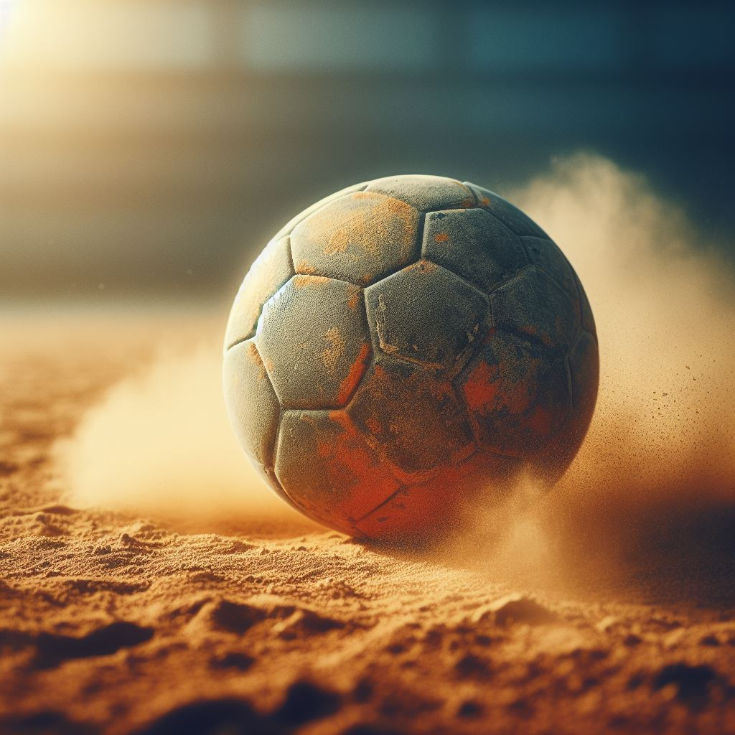
Scenario 3
You want to be the pitcher of the kickball game, but your class is last out to recess and someone else is already the pitcher. You are upset so you sit on the side, instead of playing.

Slide 12
Four steps to conflict resolution:

Slide 13
Step 1: Calm down
Use your calm-down strategy.

Slide 14
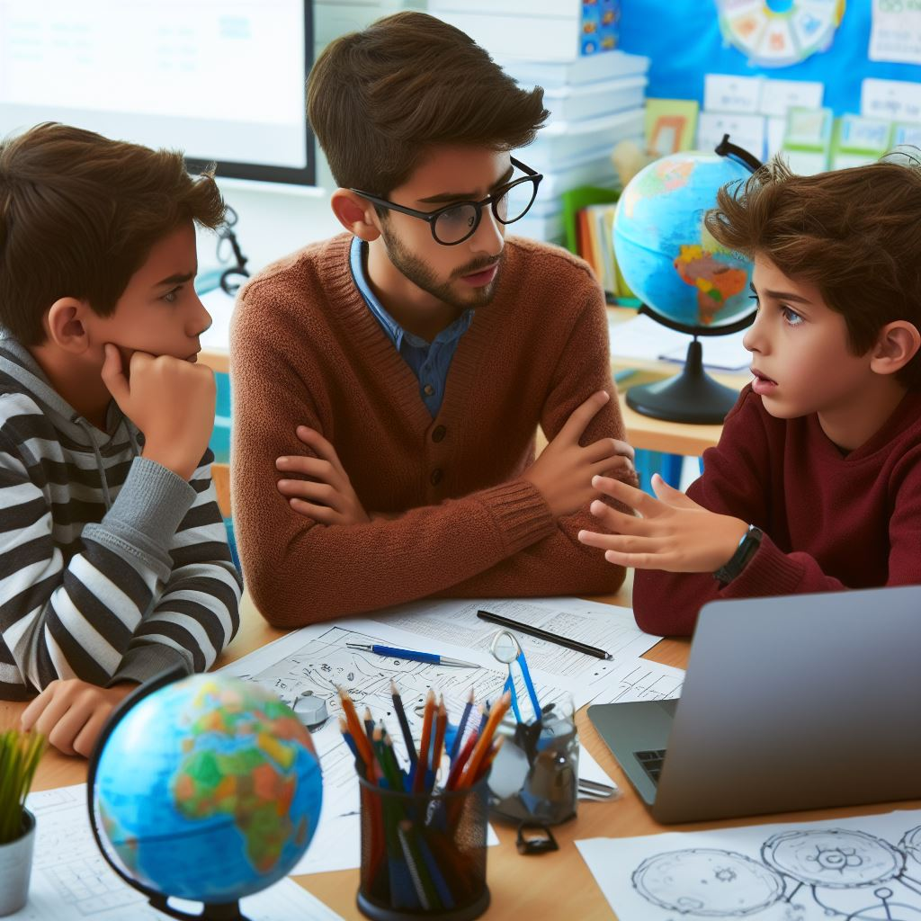
Step 2: Communicate
Kindly express how you are feeling.

Slide 15

Step 3: Listen carefully
Actively listen to what the other person is saying.

Slide 16

Step 4: Find a compromise
Figure out a solution that works for everyone.

Slide 17
Activity:
Let’s practice
Scenario 1
Sarah and Emily are working on a class project together. They disagree on which topic to choose. Sarah wants to do a project about animals, while Emily wants to do a project about space. They both feel strongly about their ideas and can't seem to agree.

Slide 18
Activity:
Let’s practice
Scenario 2
During recess, John accidentally kicks the soccer ball, and it hits Maria. Maria gets angry and starts yelling at John. John feels bad but doesn't know what to do.

Slide 19
Activity:
What is my calm-down strategy?

Slide 20
All done, great job!

