Slide 1

Community Helpers
Kindergarten Lesson 2

Slide 2
When we are learning we will:

Slide 3

Keep our bodies in our own place!

Slide 4

Use our quiet voices!

Slide 5

Keep our ears open!

Slide 6

Have our brains ready to learn!

Slide 7
Community helpers are people who have a job to help keep our friends and neighborhood safe in different ways.
Notes:
Identify helpers and their tools activity

Slide 8
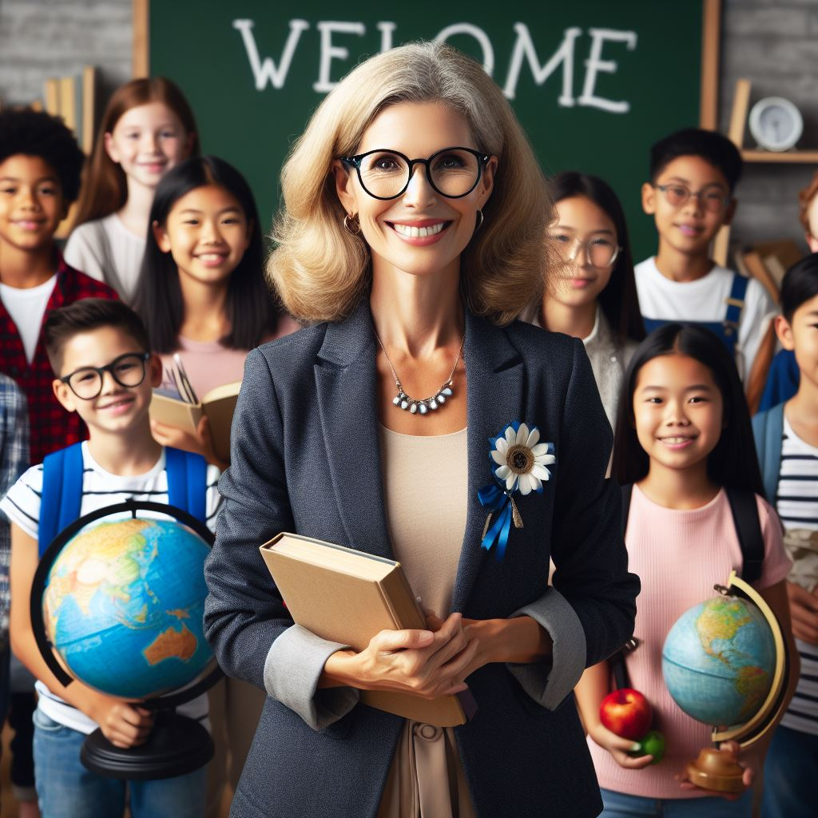
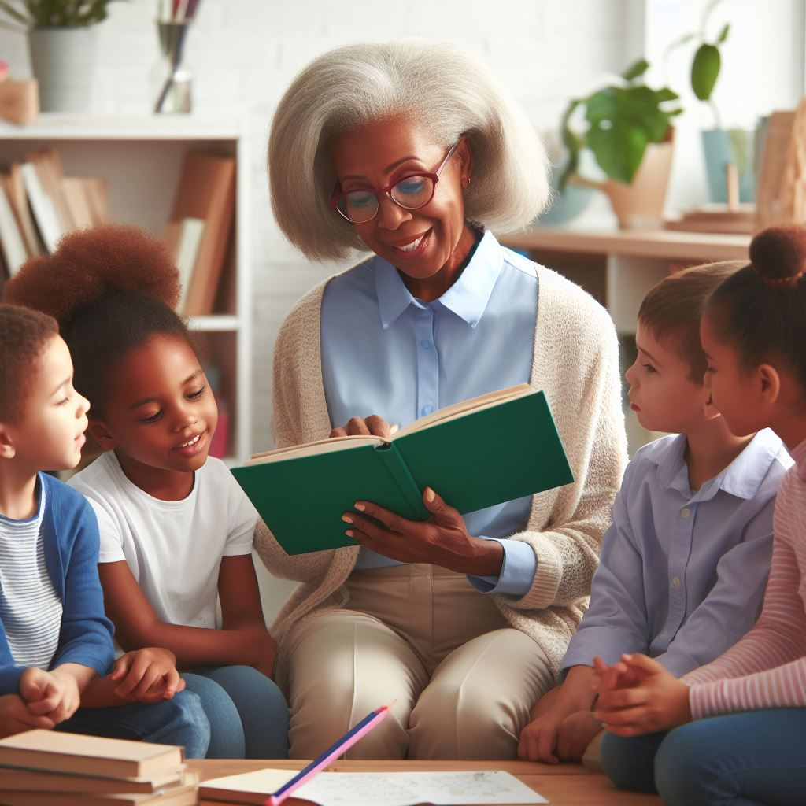
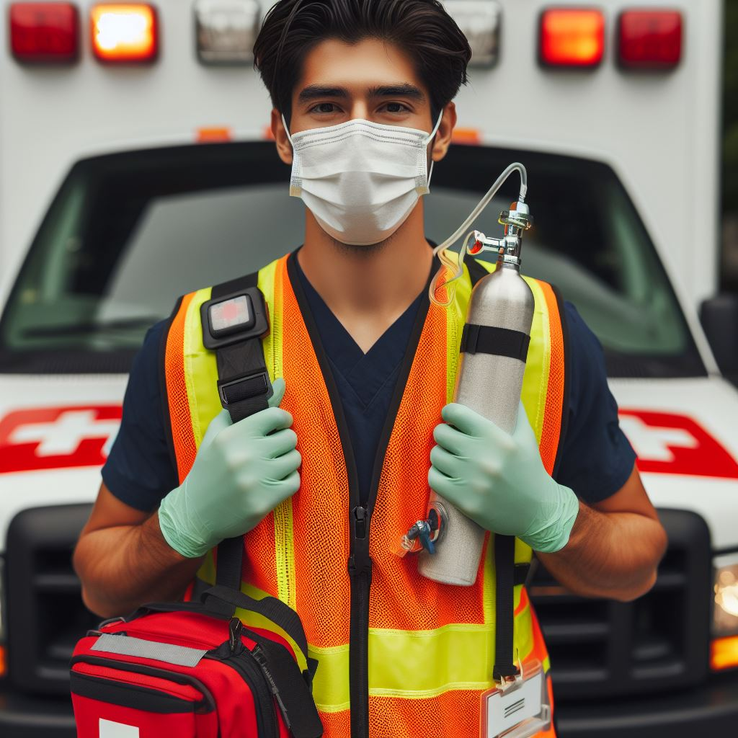
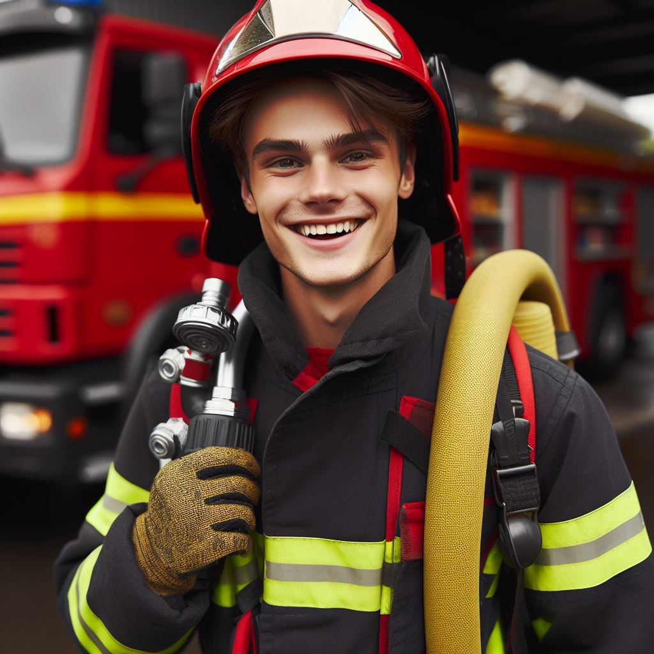
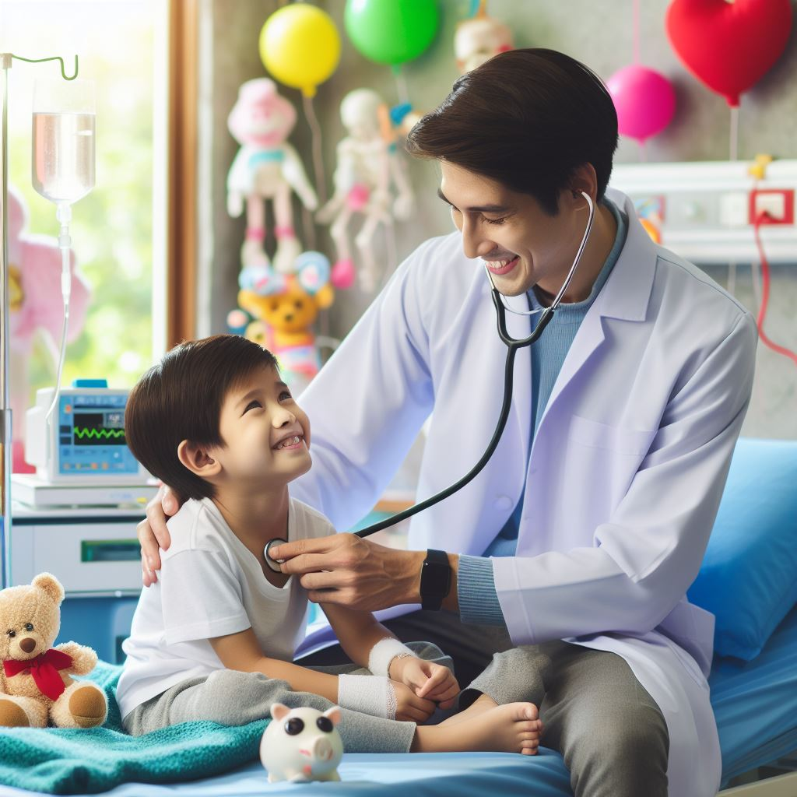
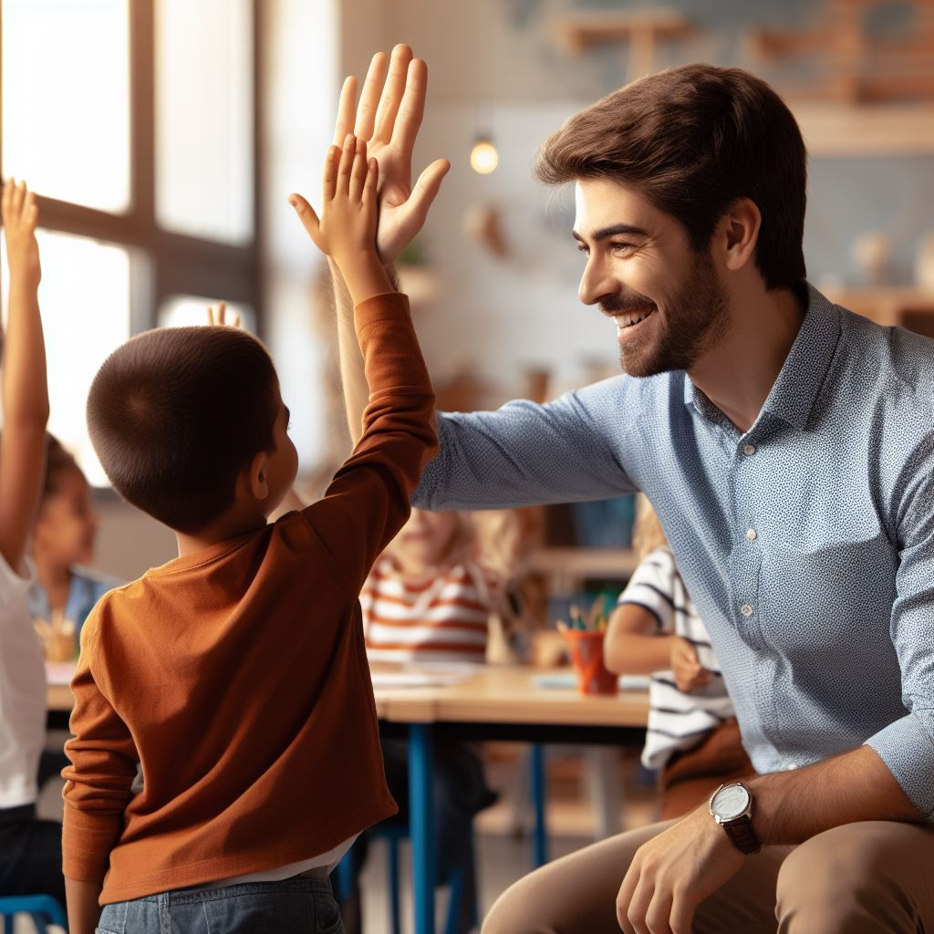
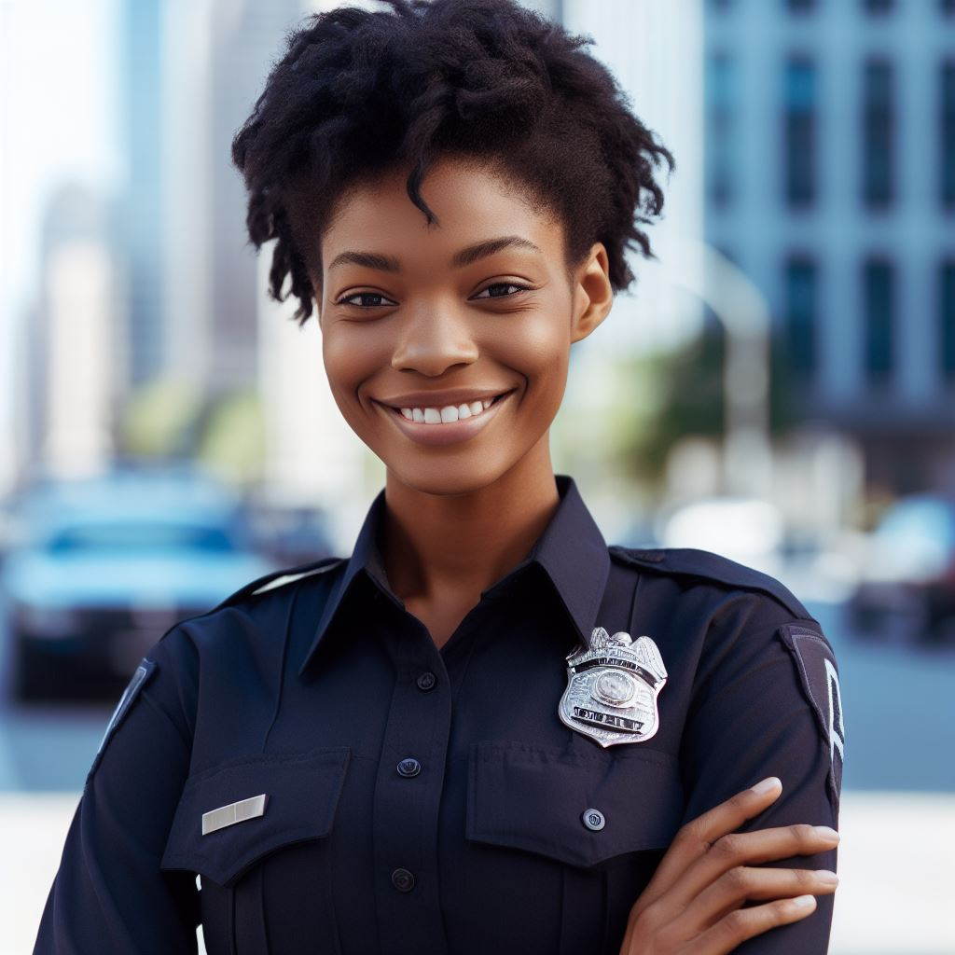
Community helpers have tools that help them to do their jobs.

Slide 9

Tools that help community helpers with their jobs.
A badge is a tool that symbolizes that the person is a true police officer and a safe person to ask for help.
Notes:
Identify helpers and their tools activity

Slide 10
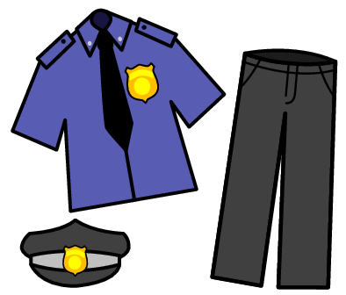
Tools that help community helpers with their jobs.
Uniform: Police officers wear blue, black, tan, and sometimes green or gray shirts and pants for their uniforms.
Notes:
Identify helpers and their tools activity

Slide 11

Tools that help community helpers with their jobs.
Whistle: Police officers use whistles to get people's attention like to direct traffic.
Notes:
Identify helpers and their tools activity

Slide 12
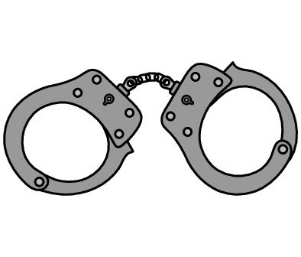
Tools that help community helpers with their jobs.
Handcuffs: we use handcuffs to secure people who break the law.
Notes:
Identify helpers and their tools activity

Slide 13
What do you do if you see a gun?

Slide 14

Stop!

Slide 15

Don’t touch!

Slide 16
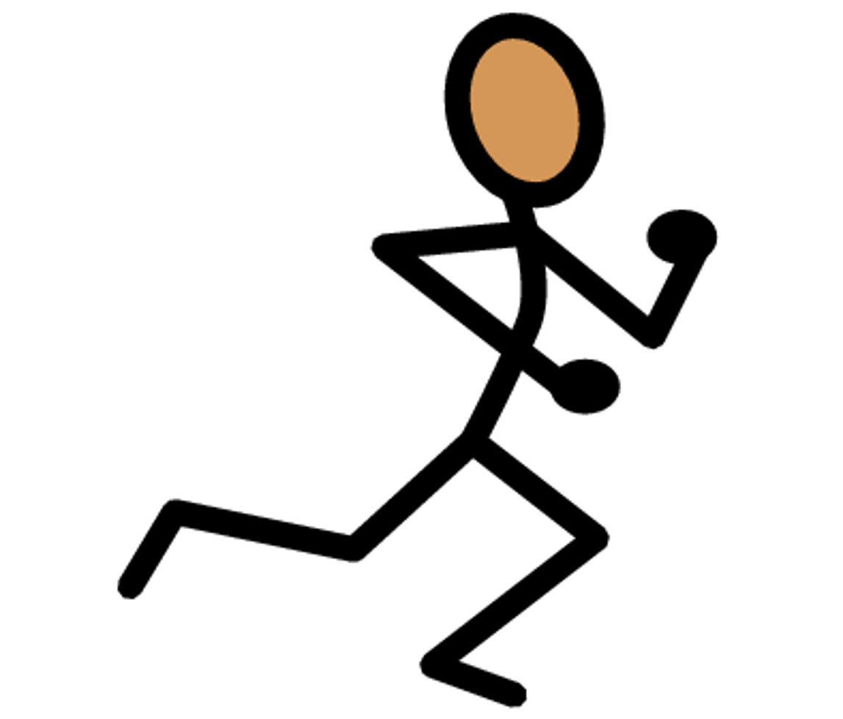
Get away!

Slide 17

Tell an adult.

Slide 18


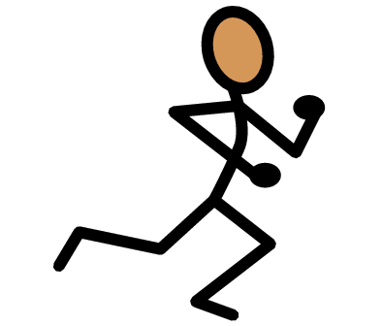

Activity: What do you do if you see a gun?

Slide 19
All done, great job!

