Slide 1

Digital Citizenship
Kindergarten Lesson 3

Slide 2
When we are learning we will:

Slide 3

Keep our bodies in our own place!

Slide 4

Use our quiet voices!

Slide 5

Keep our ears open!

Slide 6

Have our brains ready to learn!

Slide 7

Being a good citizen:

Slide 8
Being a good citizen means being kind and helpful to others.
Here are some rules for being a good citizen:

Slide 9
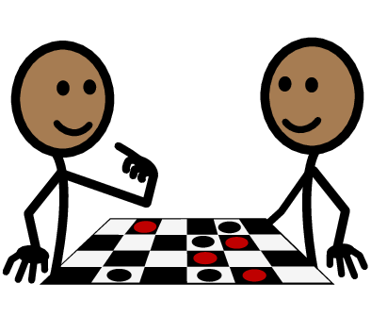
Taking turns

Slide 10
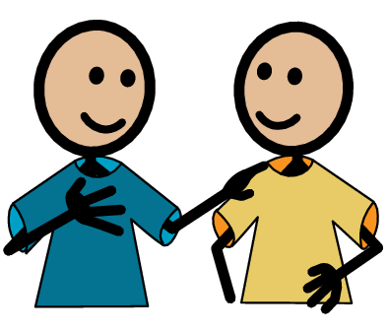
Using kind words

Slide 11
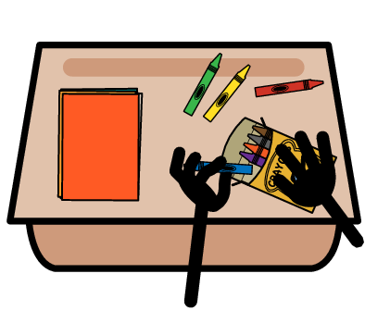
Helping clean up

Slide 12

Respecting personal space

Slide 13

Being a good friend

Slide 14

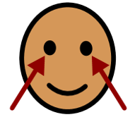

Following classroom rules

Slide 15

Respecting nature

Slide 16
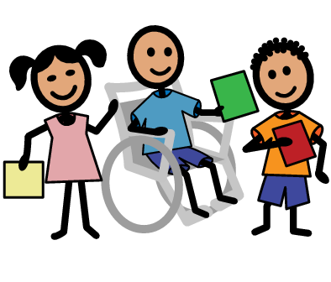
Being inclusive

Slide 17
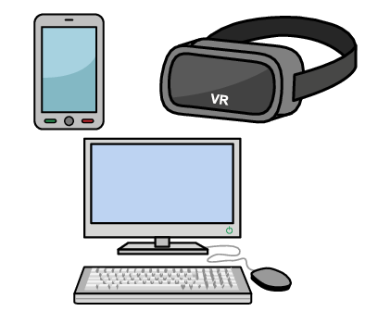
Computers help us to communicate, work together, have fun, and learn new information.

Slide 18

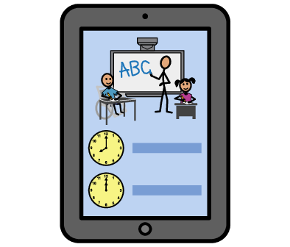
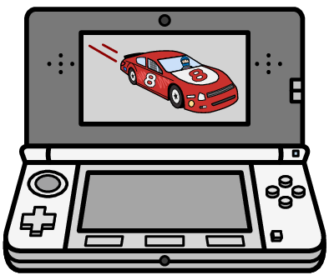
Good citizenship when using computers, tablets, or phones.
Good Digital Citizen​

Slide 19
Being a good digital citizen means using technology in a smart and responsible way. It's like being a good friend online. You should always be kind and respectful when talking to others, just like you would in person.

Slide 20
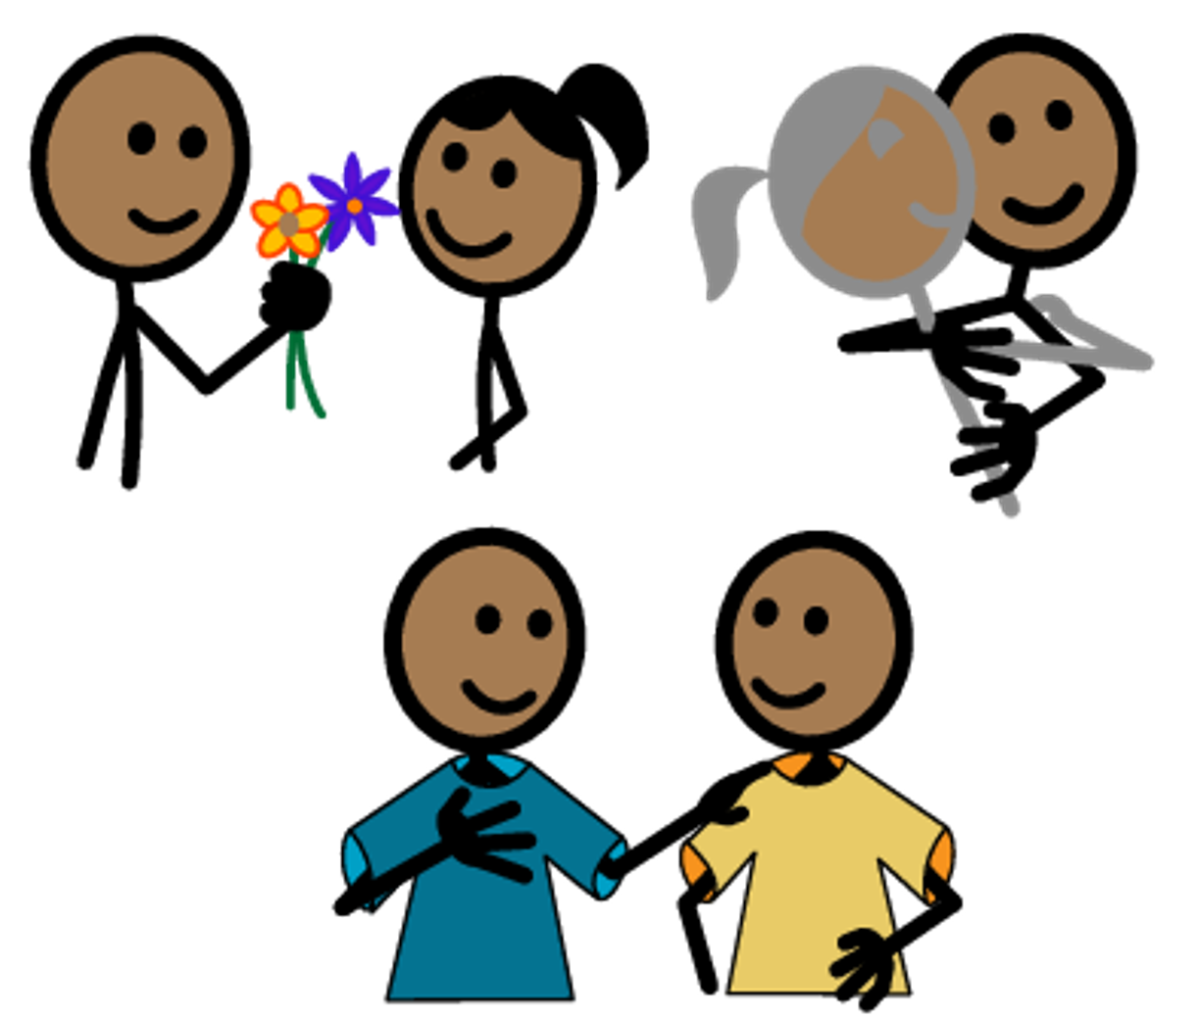
Be kind.

Slide 21
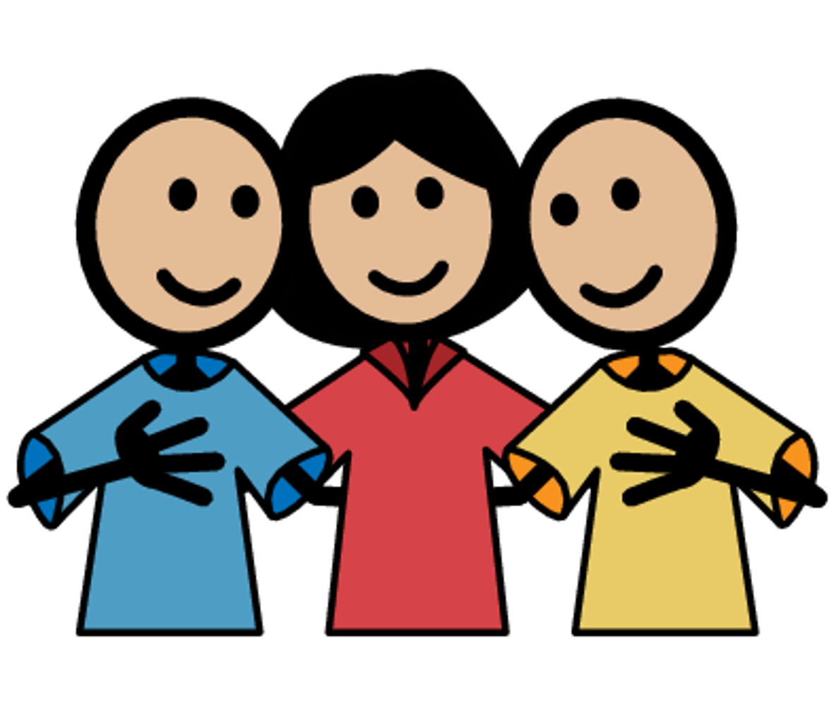
Respect others.

Slide 22

Share nicely.

Slide 23

Ask for permission.

Slide 24

Keep personal information private.

Slide 25
Let's learn more about good digital citizenship:

Slide 26



KEY VOCABULARY
Online
Using a device like a
computer, phone, or tablet to visit a website or app

Slide 27
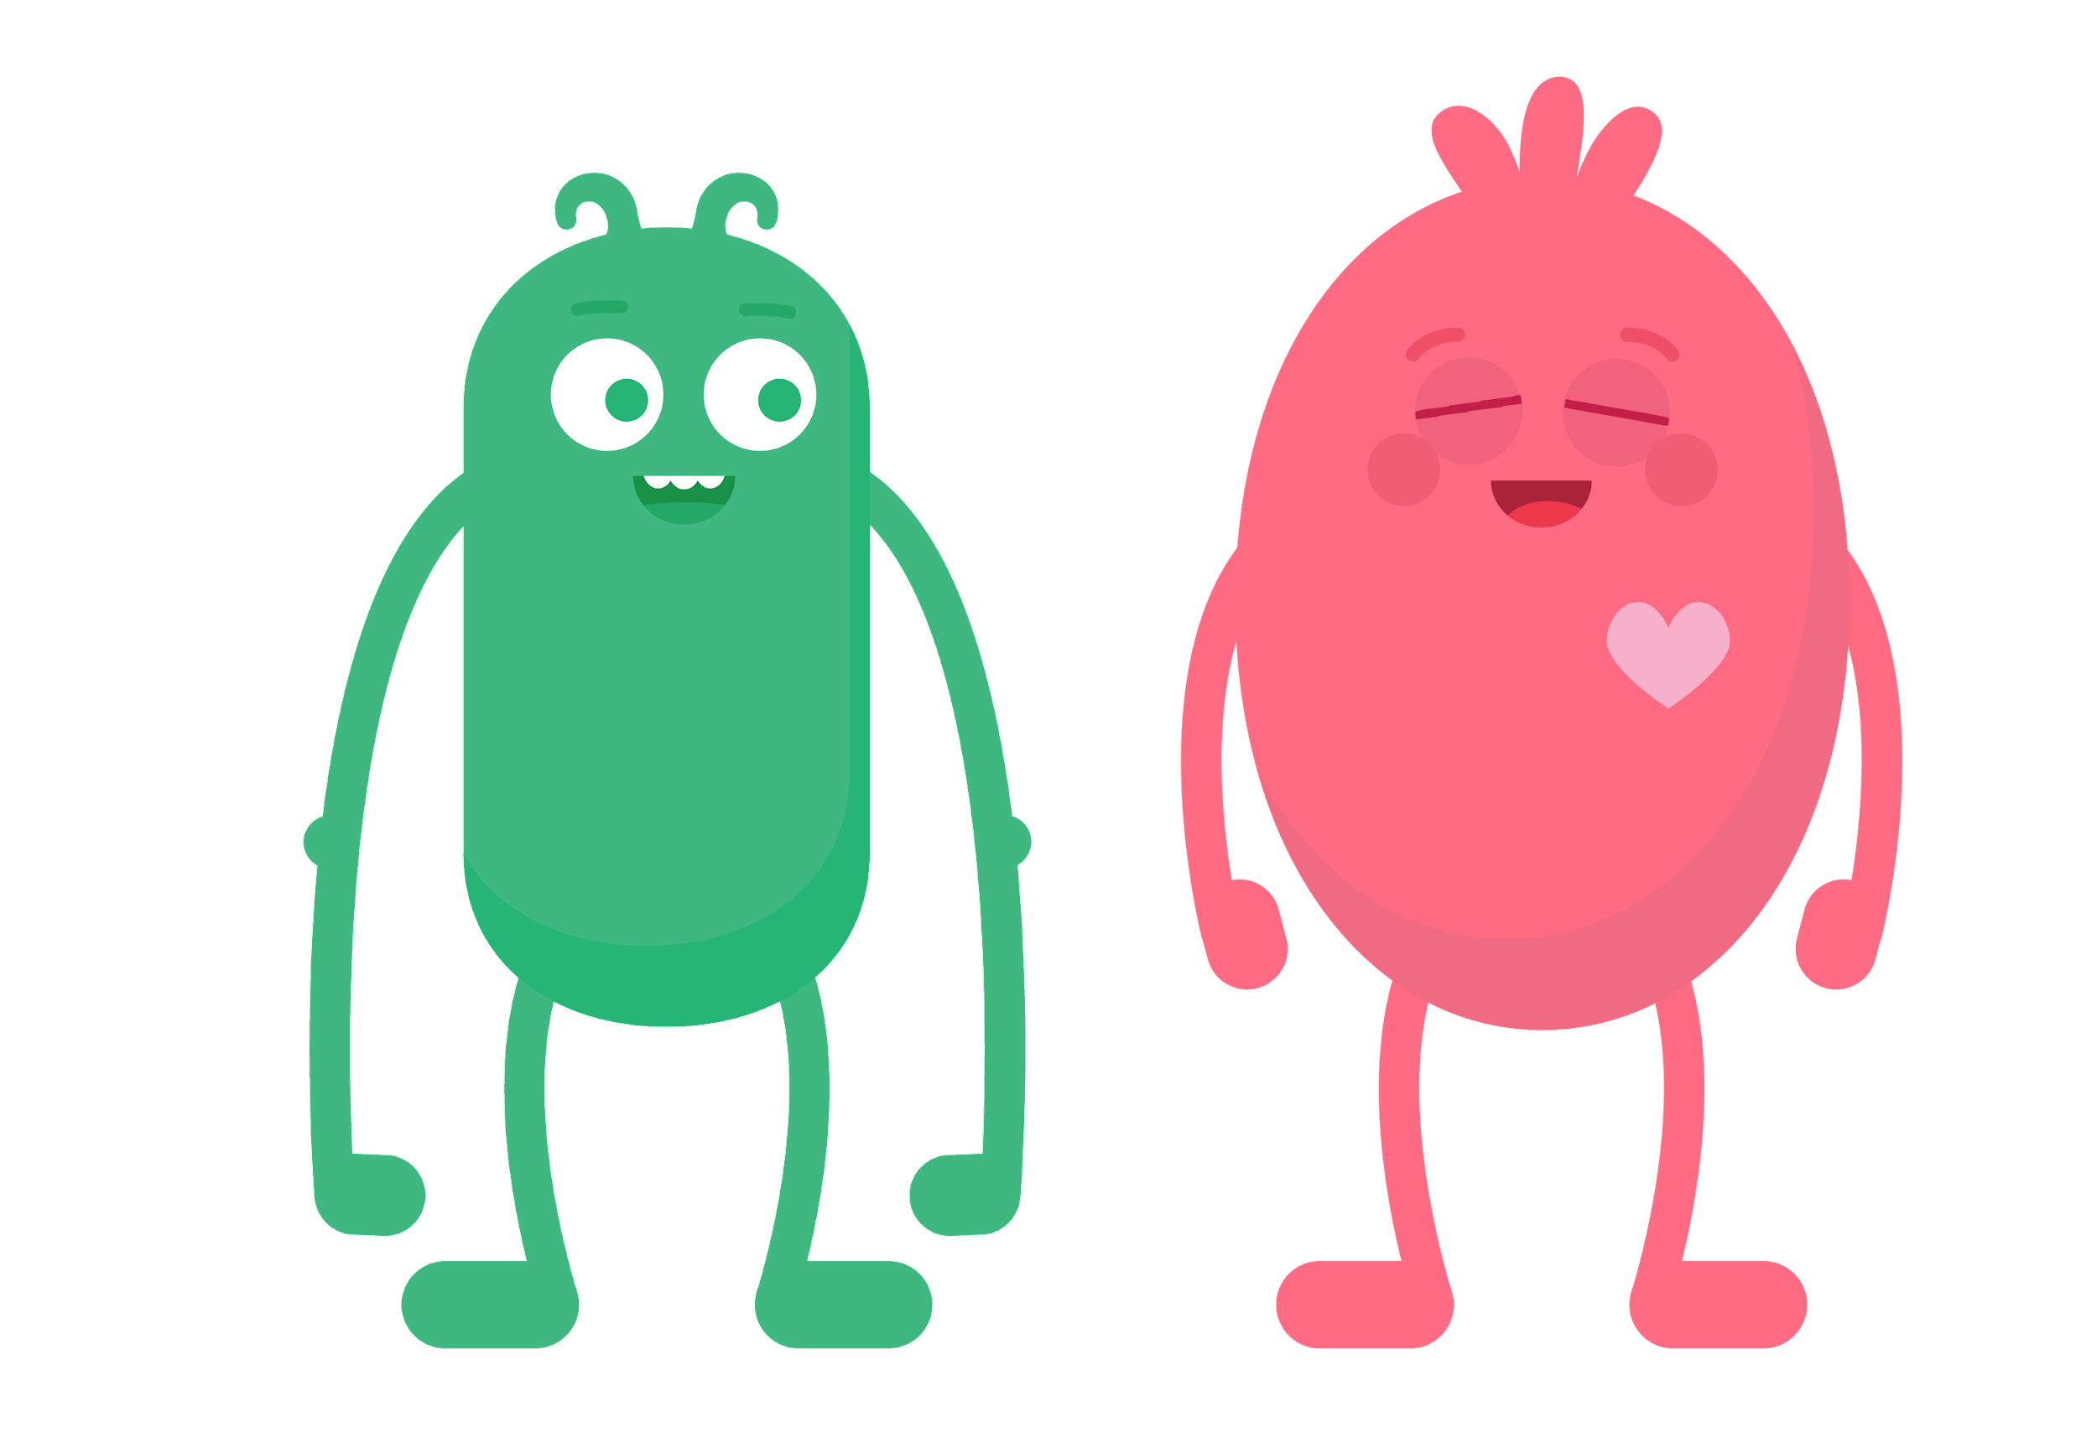
KEY VOCABULARY
Respect
Showing that you
appreciate someone

Slide 28
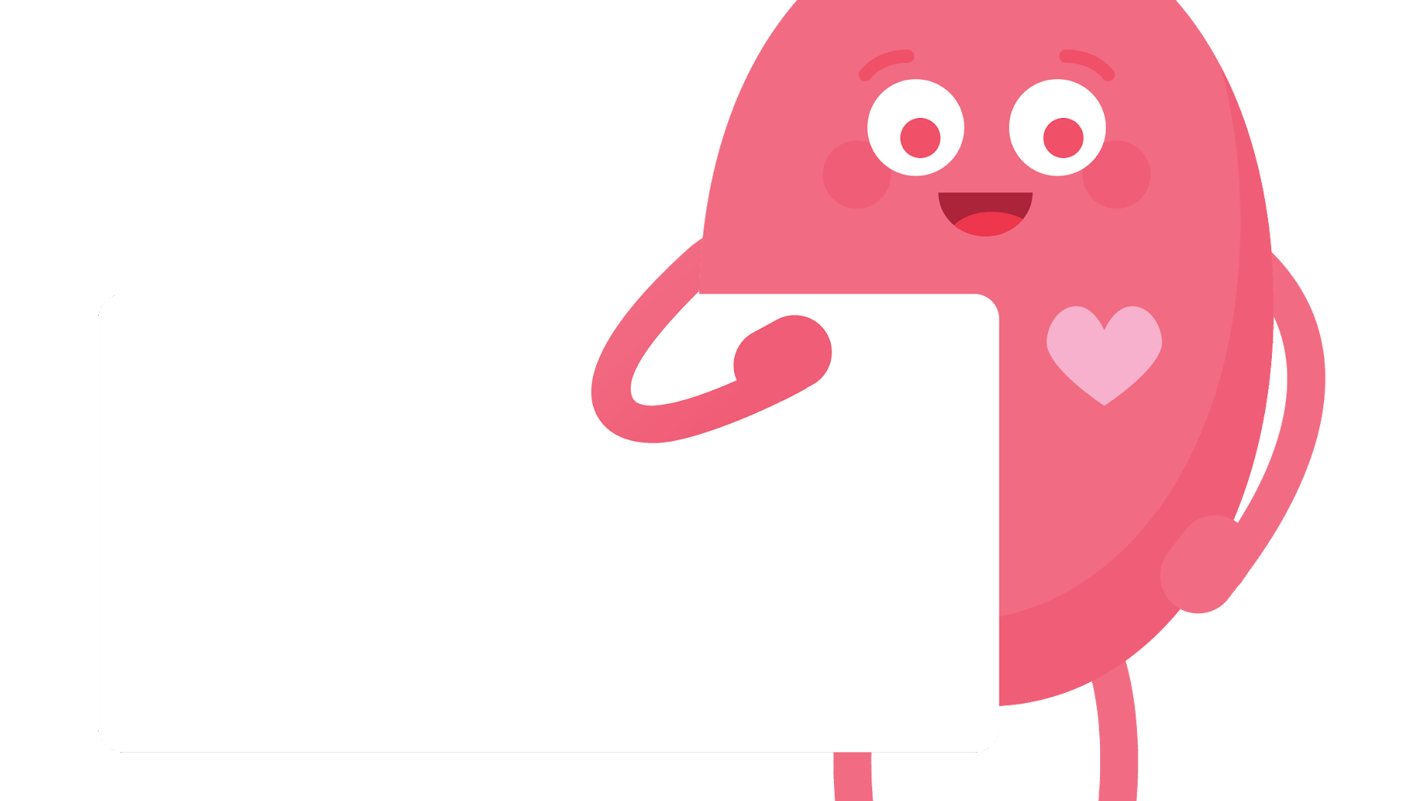


What are ways you can
be kind online?
DSN: Have monster holding up as sign with the EQ.

Slide 29

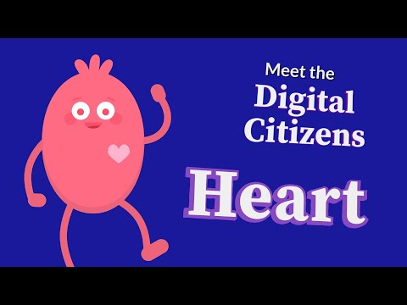
WATCH
To watch this video on the Common Sense Education site, click here.

Slide 30
Ways to be kind online

Slide 31

Help a friend with a computer problem.

Slide 32

Use headphones to keep the noise down.

Slide 33

Take turns with a computer or tablet.

Slide 34

Keep our hands to ourselves and do not touch anyone else's belongings.

Slide 35

Ask for permission before using someone else's device.

Slide 36
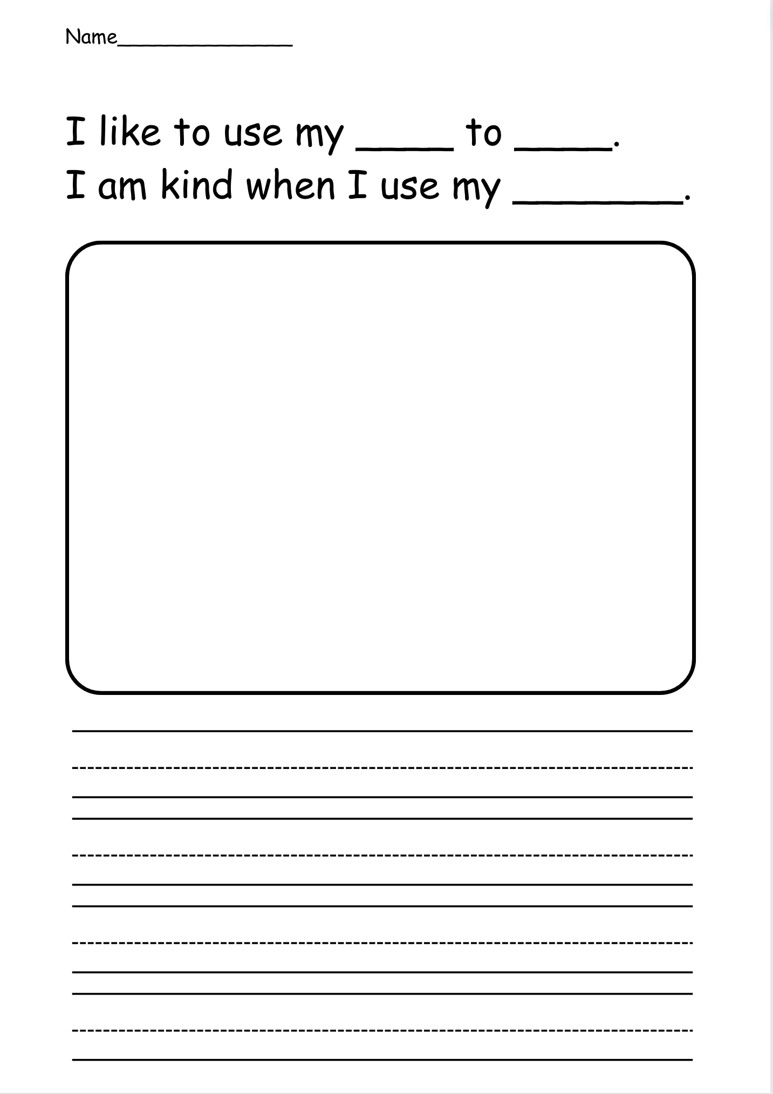
Activity

Slide 37
How can I be a good digital citizen?
Wrap up

Slide 38
All done, great job!

