Slide 1

Stranger Awareness
Kindergarten Lesson 4

Slide 2
When we are learning we will:

Slide 3

Keep our bodies in our own place!

Slide 4

Use our quiet voices!

Slide 5

Keep our ears open!

Slide 6

Have our brains ready to learn!

Slide 7
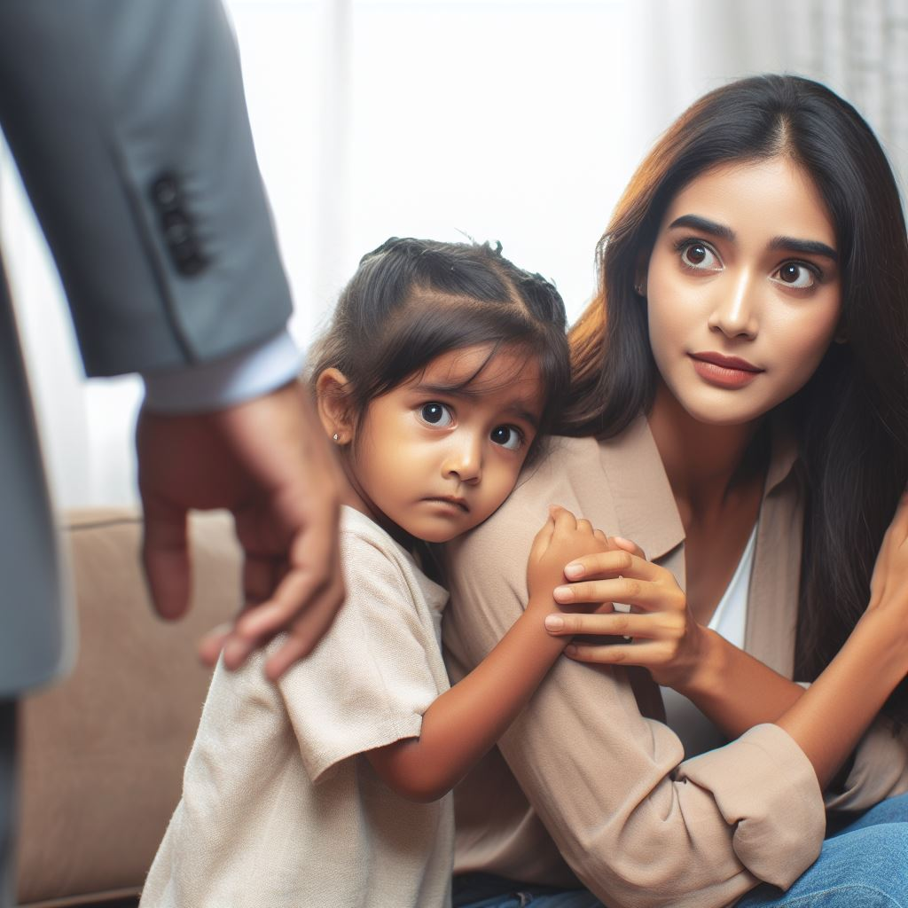
A stranger is anyone you do not know.
Notes:
Define the word "stranger" and then identify the characteristics of a stranger.

Slide 8
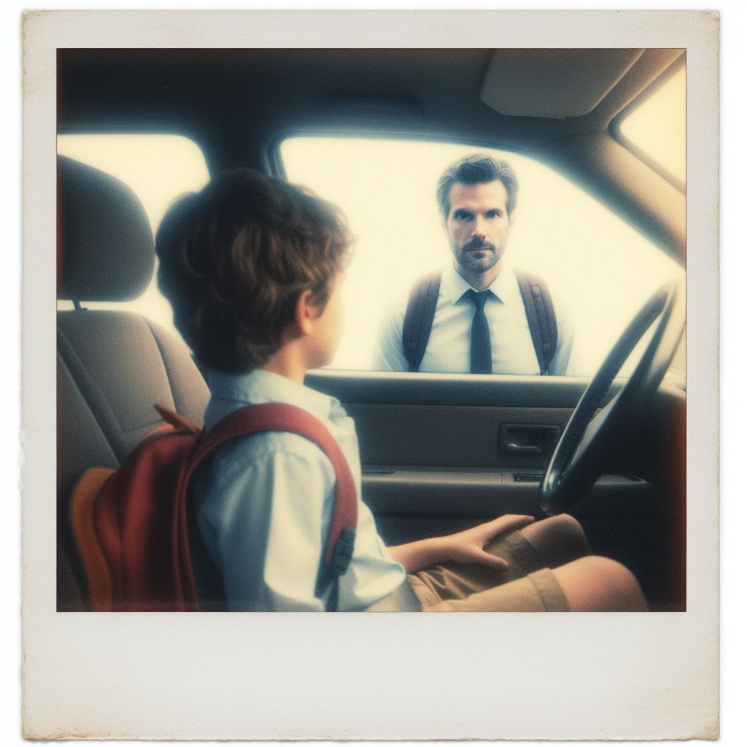
A stranger is anyone you do not know.

Slide 9
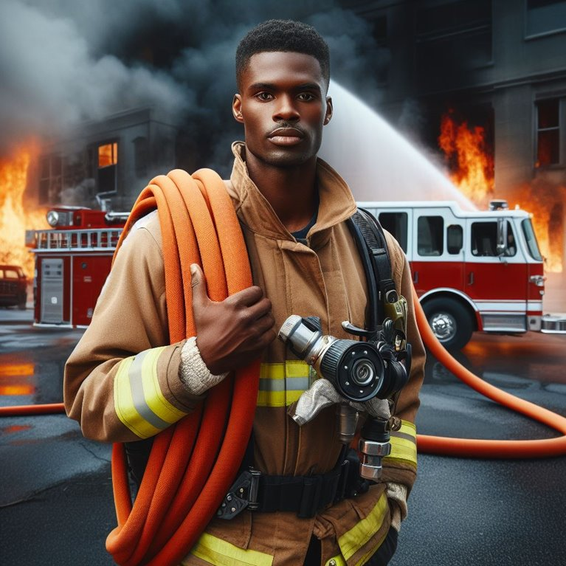
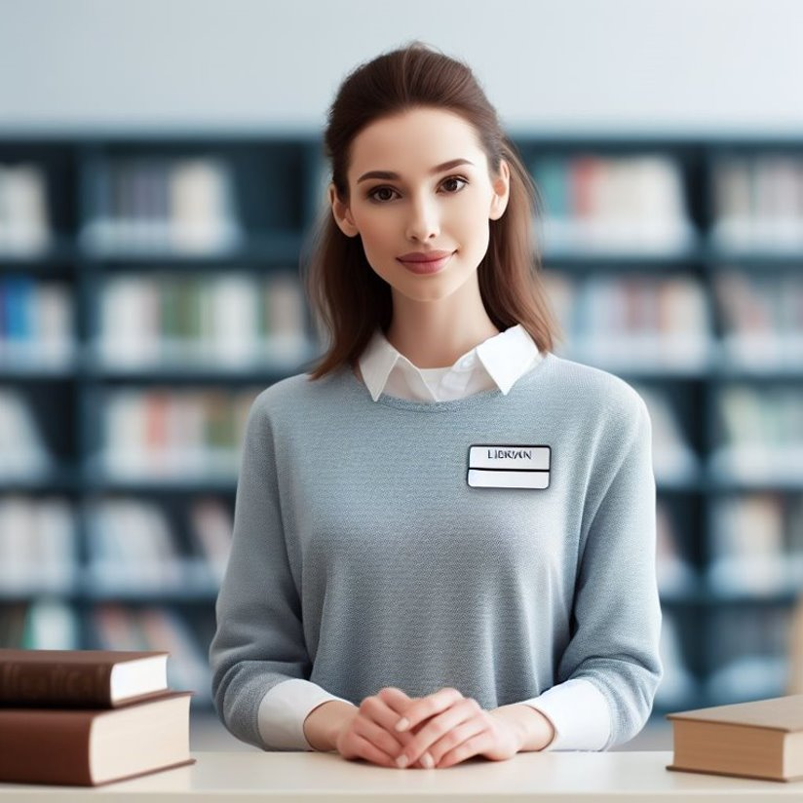
A safe stranger is a community helper who wears a uniform and often has a name tag and helps you when you need them to.

Slide 10
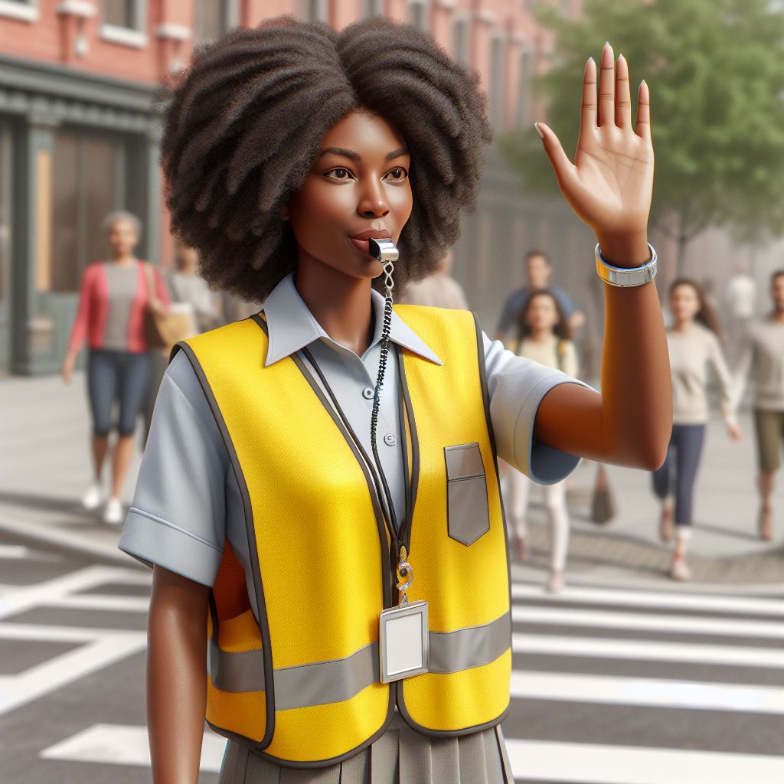
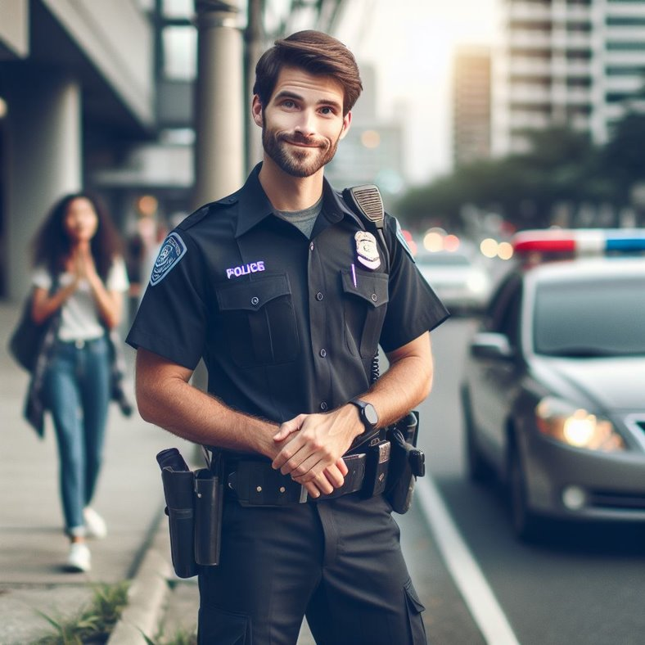
A safe stranger is a community helper who wears a uniform and often has a name tag and helps you when you need them to.

Slide 11
Rules to follow to keep us safe:
Notes:
Define stranger safety rules

Slide 12


Don't talk to strangers.
Notes:
Define stranger safety rules

Slide 13
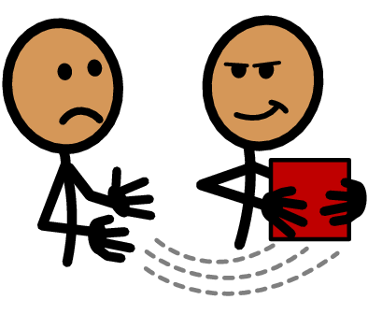
Don't take anything from a stranger.

Slide 14
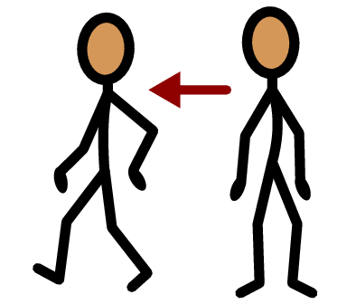
Don't go with a stranger.

Slide 15
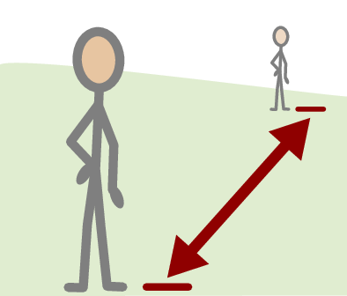
Keep a safe distance from a stranger.

Slide 16
Let’s practice: What would you do?
Notes:
Define stranger safety rules

Slide 17
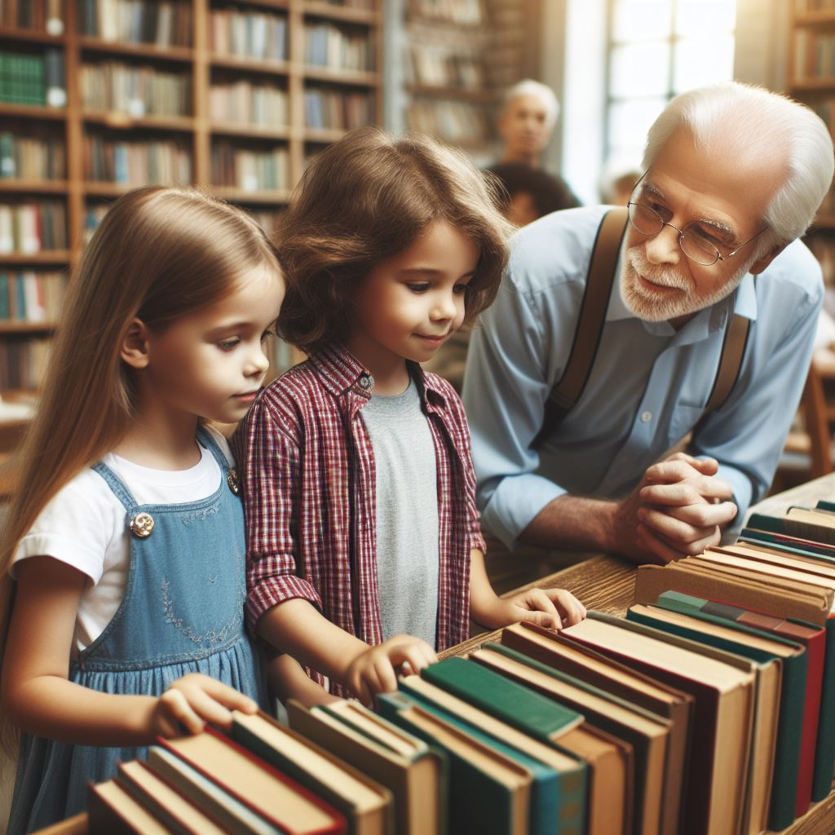
You are at the library, and your parent is in another section. An older person you don't know approaches you and asks for help finding a book. What do you do?
Notes:
Discuss scenarios and apply stranger safety rules that will help keep students safe, and students will explain how they are responsible for following stranger safety rules.
Activity: Read the Book – A Stranger in the Park
Watch Video: "Friendly City Video"

Slide 18
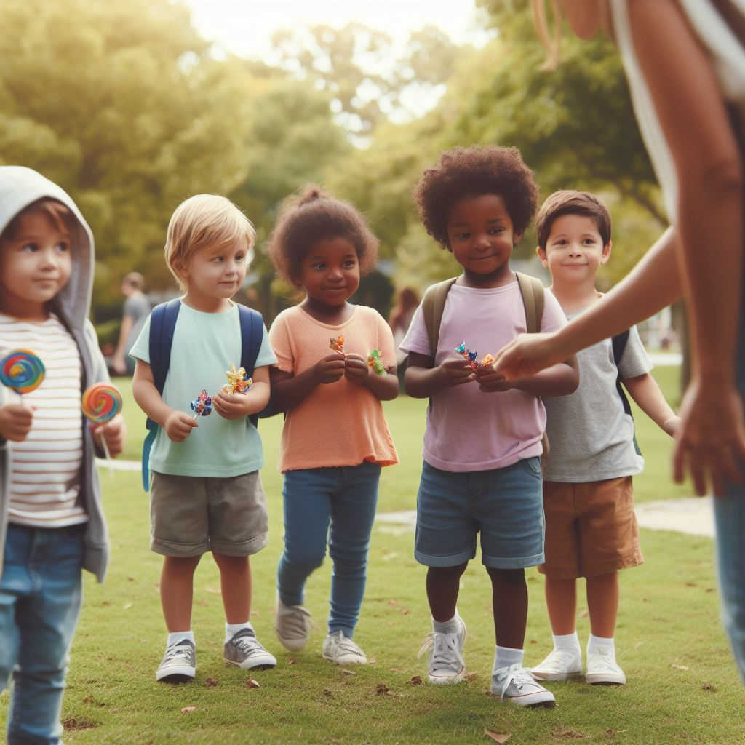
You're playing in the park with your friends, and a person you've never seen before offers you some candy. What should you do?

Slide 19
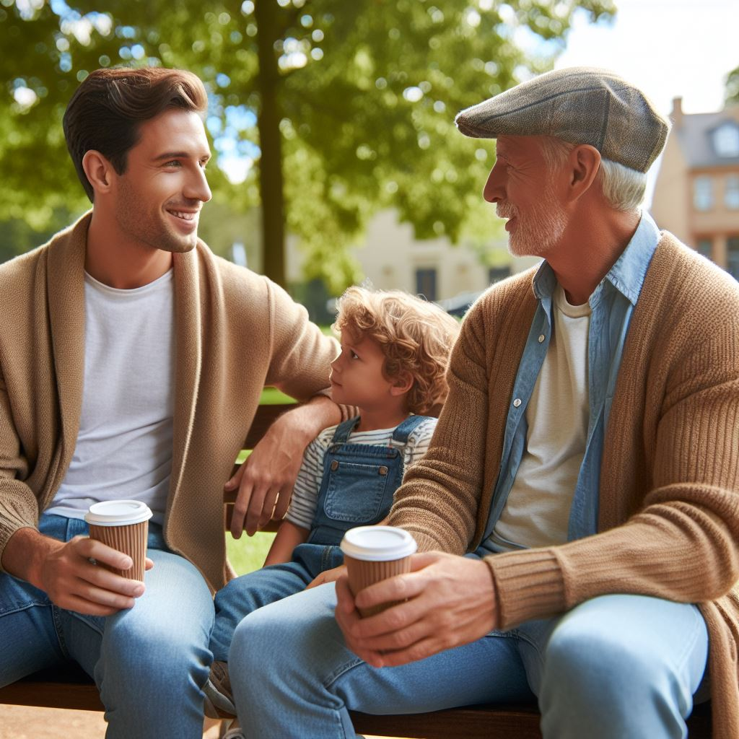
Your parent is talking with someone from work you don’t know and asks your name. Your parent says it’s okay to tell him since you are with him. What do you do?

Slide 20
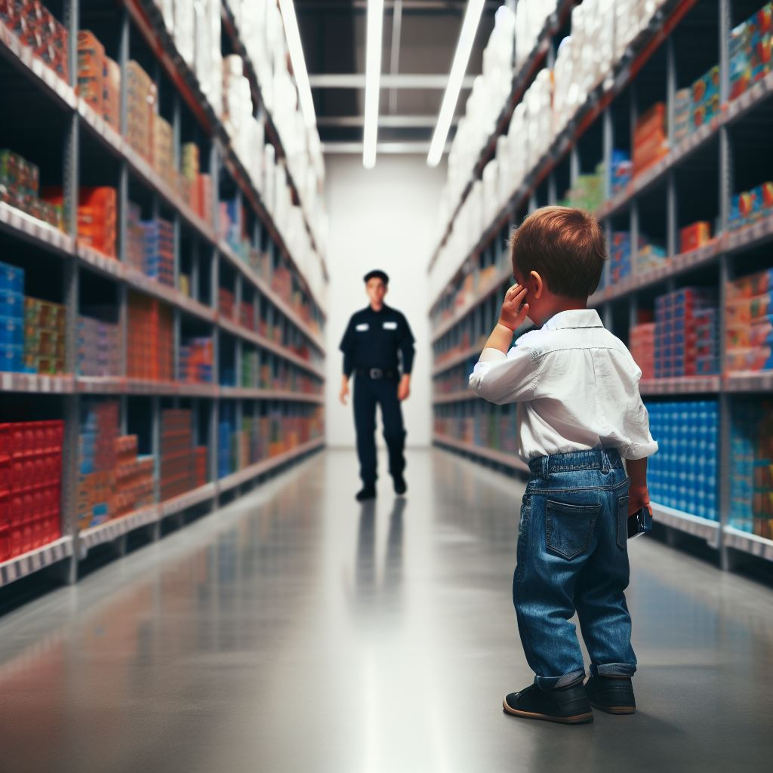
You get separated from your parent at the store and see a security officer. What do you do?

Slide 21
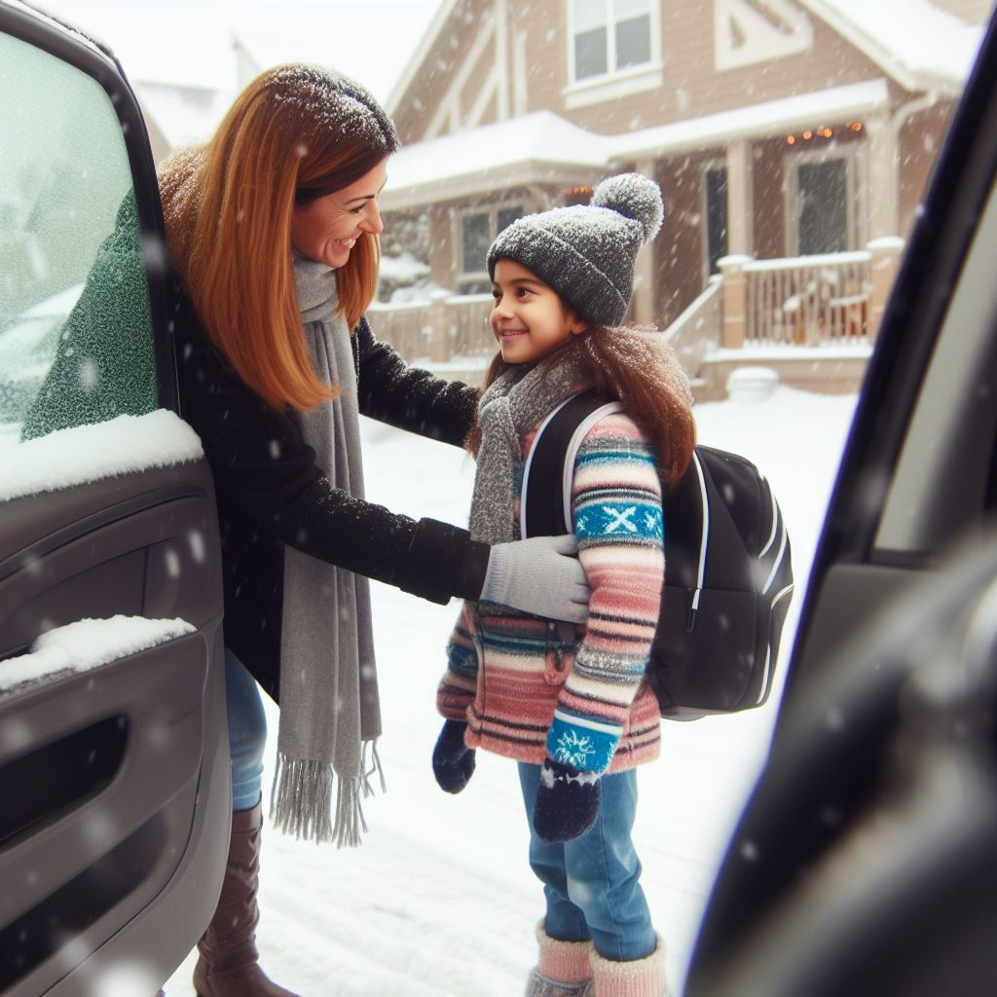
You're walking home from school, and a neighbor you don't know very well asks you to help them carry groceries into their house. What do you do?

Slide 22
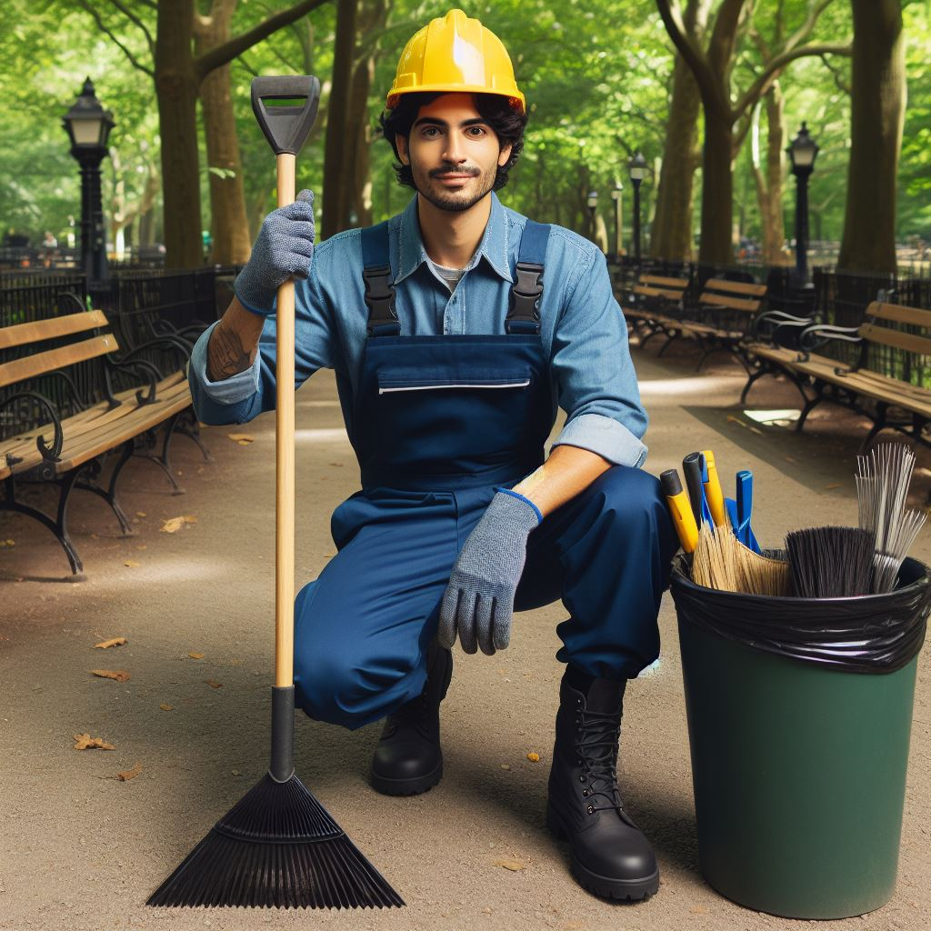
You're at the playground, and a person in a uniform (like a maintenance worker) asks you if you've seen a lost dog. What do you do?

Slide 23
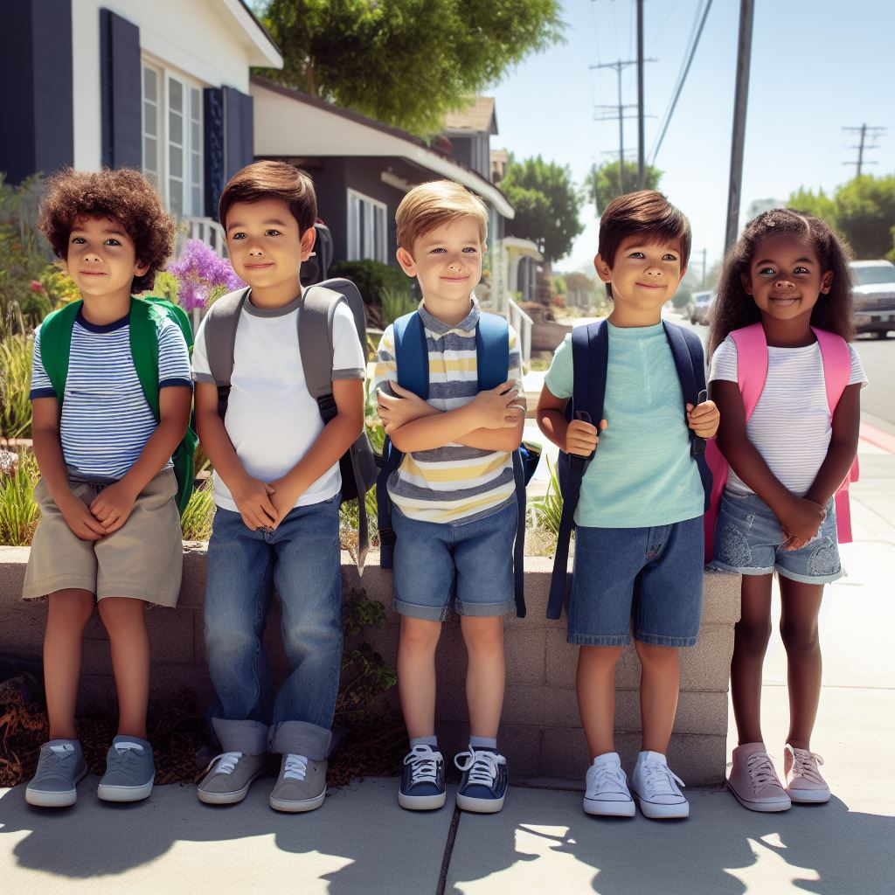
You're waiting at a bus stop, and a friendly-looking stranger starts a conversation with you. Your bus is late. What do you do?

Slide 24
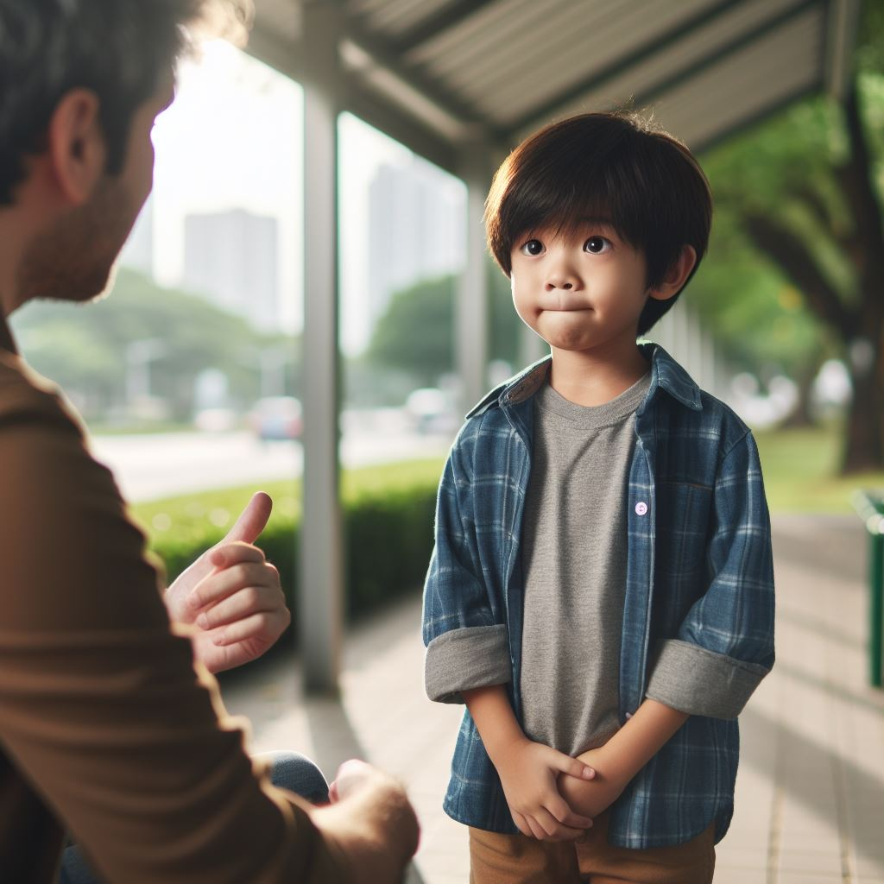
You're at a community event, and a person you haven't met before asks if you can help them find their son. What do you do?

Slide 25
Click to watch "A Friendly Stranger" Video

Slide 26

My Stranger Awareness Safety Pledge:
"I promise not to talk to strangers, take things, or go with them. I'll stay a safe distance away to be smart and safe every day."

Slide 27
All done, great job!

