Slide 1

Following Rules and Authority
Kindergarten Lesson 5

Slide 2
When we are learning we will:

Slide 3

Keep our bodies in our own place!

Slide 4

Use our quiet voices!

Slide 5

Keep our ears open!

Slide 6

Have our brains ready to learn!

Slide 7
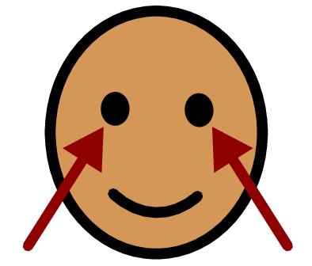


Rule: A rule describes something that we need to do.
Notes:
Define the word “Rules" and Discuss the role of rules and explain how they keep us and others safe. For example:
Use your quiet voice.
Use your listening ears.
Look at the teacher.

Slide 8

The importance of following rules:

Slide 9

Read the book: How Do Dinosaurs Stay Safe?
Author: Jane Yolen

Slide 10
Why is it important to follow the rules?

Slide 11
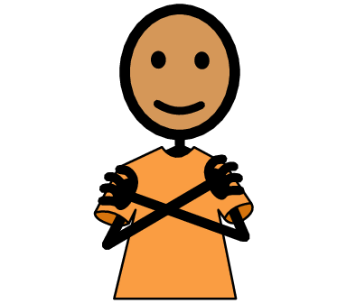
To keep us safe

Slide 12

To help us make good choices

Slide 13

To help us be responsible

Slide 14



Activity: Are they following a rule or not following a rule?

Slide 15
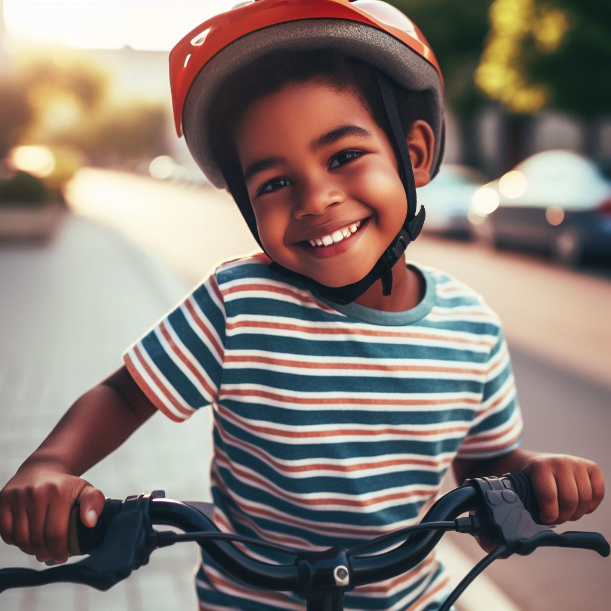
Wearing a helmet

Slide 16
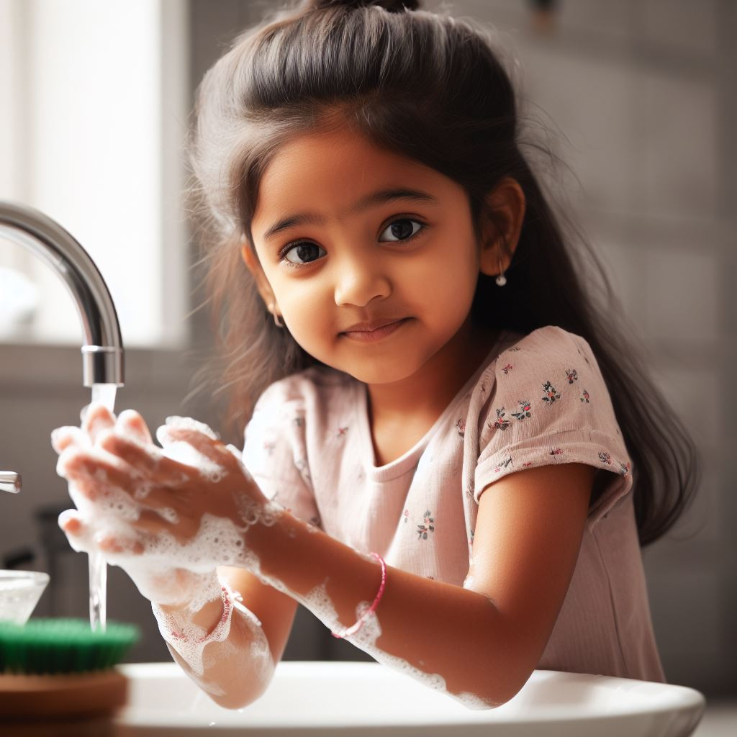
Washing her hands

Slide 17
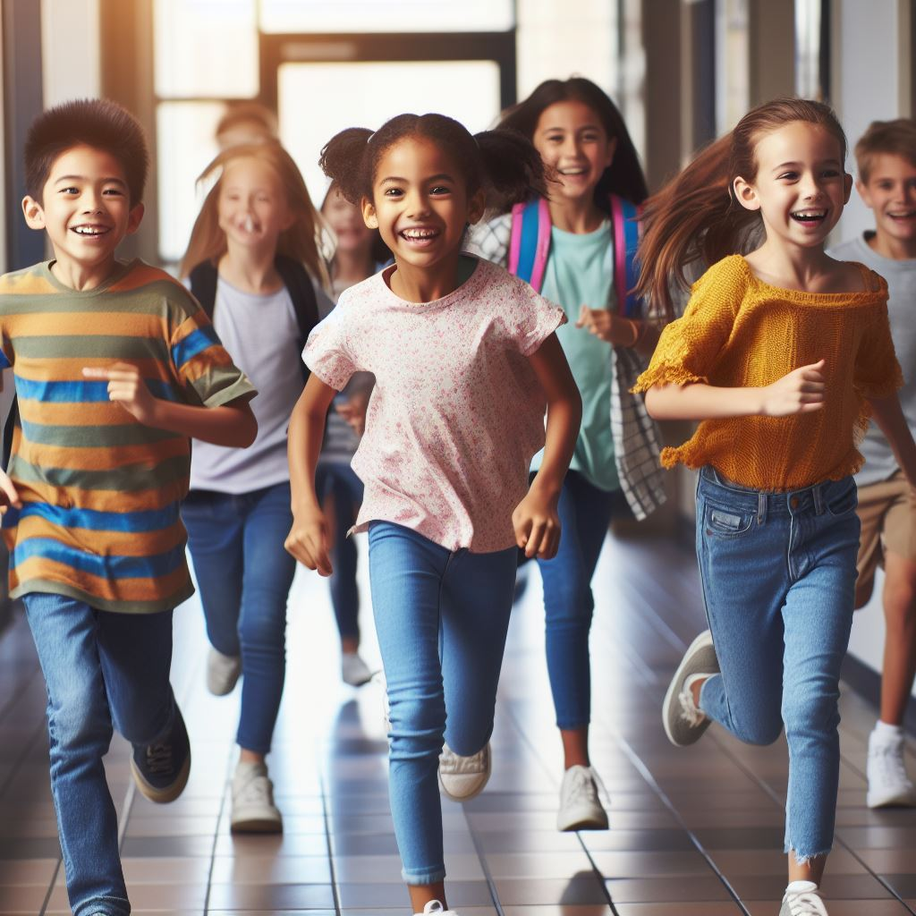
Running in the hallway

Slide 18
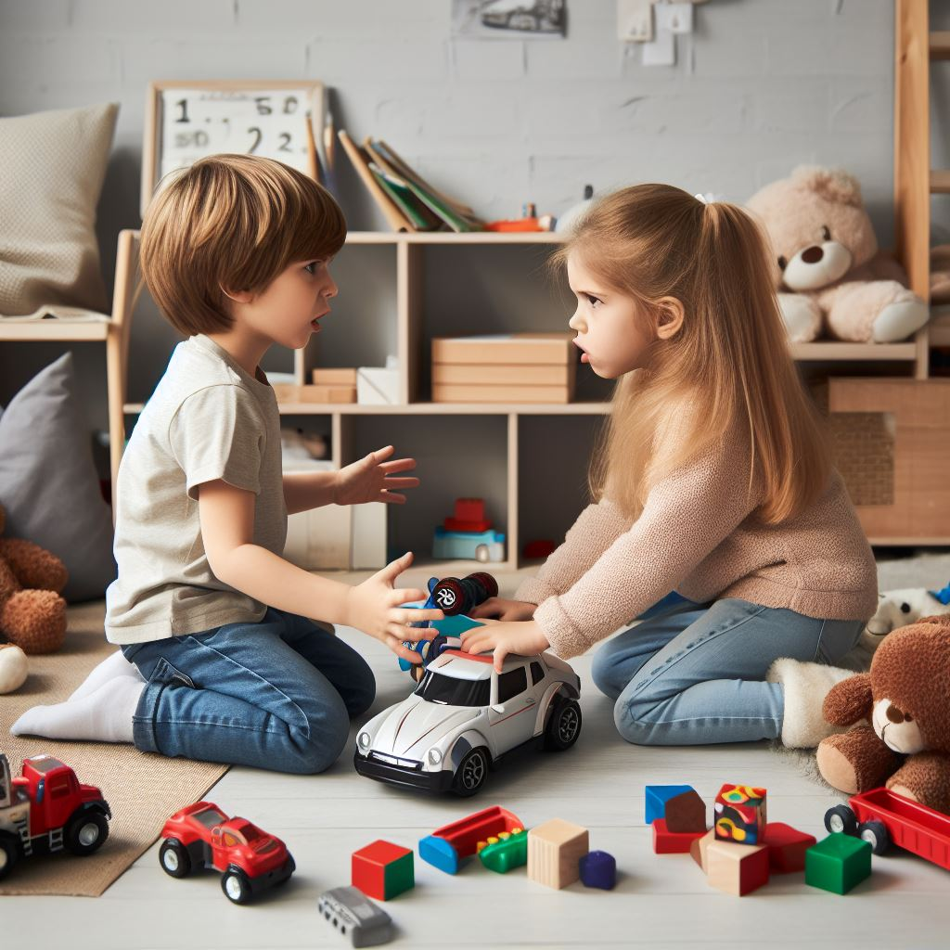
Not sharing her toys

Slide 19
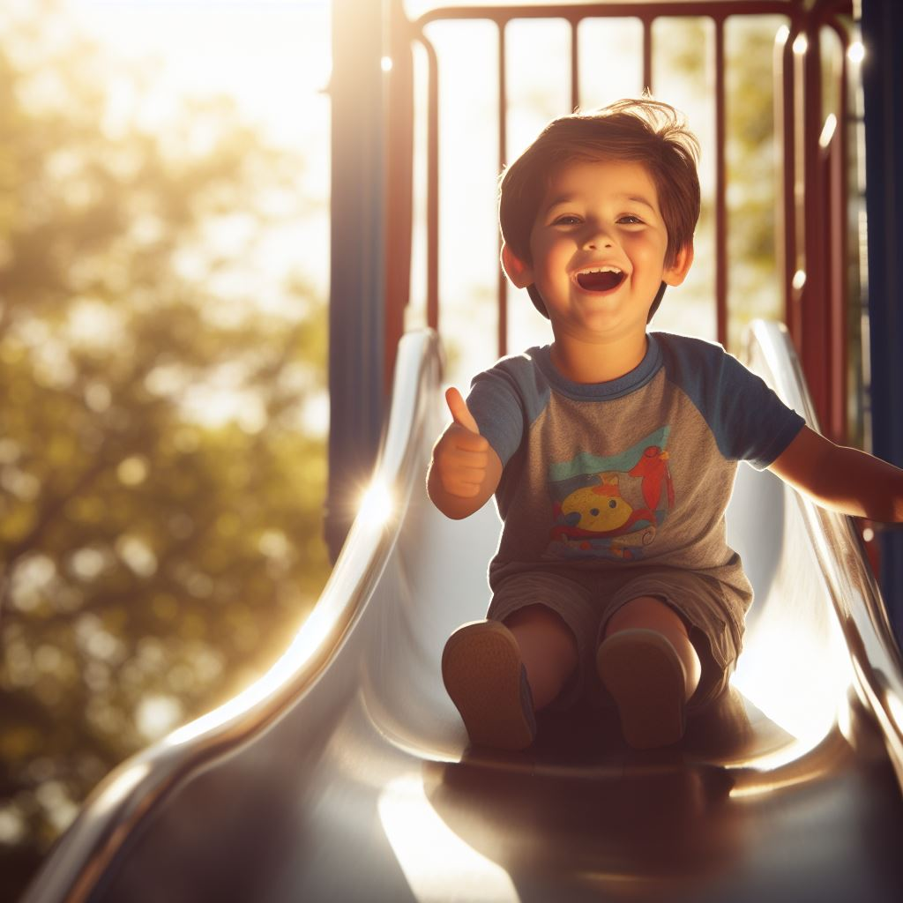
Going down the slide feet first

Slide 20

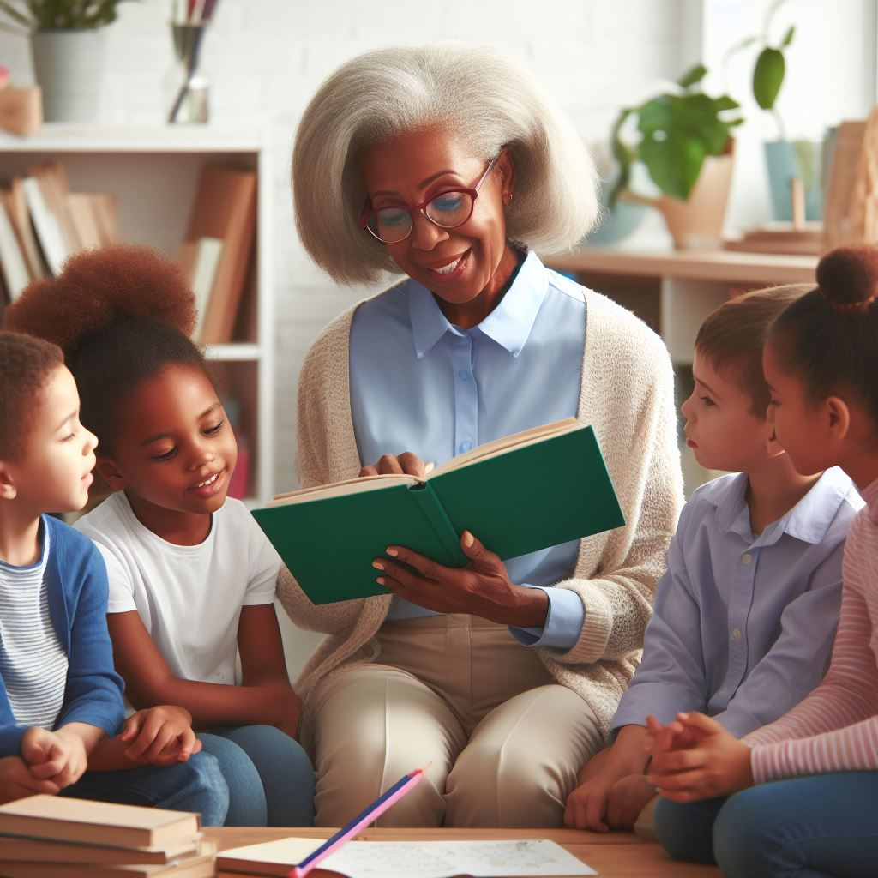
A person in authority is a person who is in charge and is responsible for keeping us safe.

Slide 21
Examples of people in authority:
Parent/guardian
Teacher
Principal
Firefighter
Police officer
Emergency Medical Technician (EMT)

Slide 22
Activity: Identify persons with authority and their responsibilities.

Slide 23
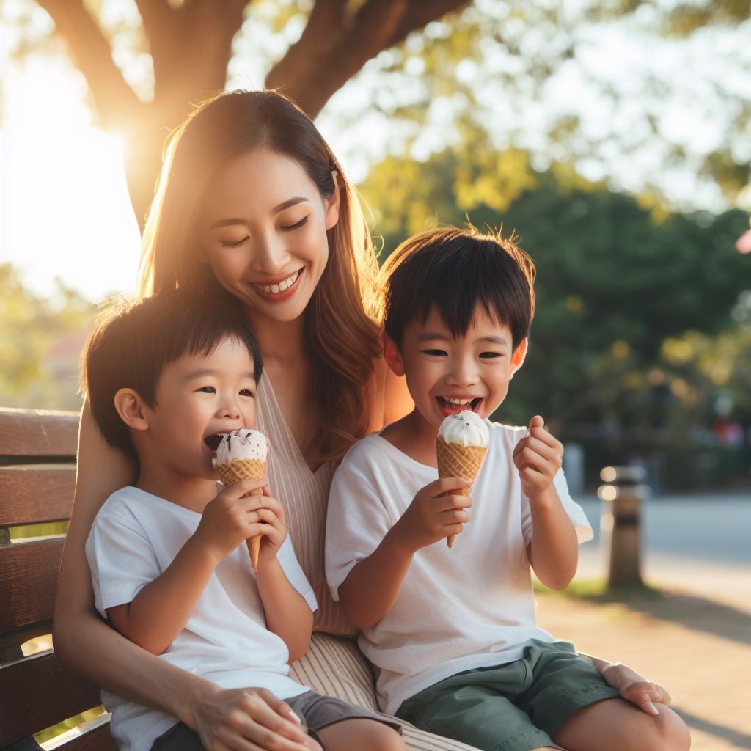
Examples of people in authority:
Parent/Grandparent/Guardian

Slide 24

Examples of people in authority:
Teachers

Slide 25
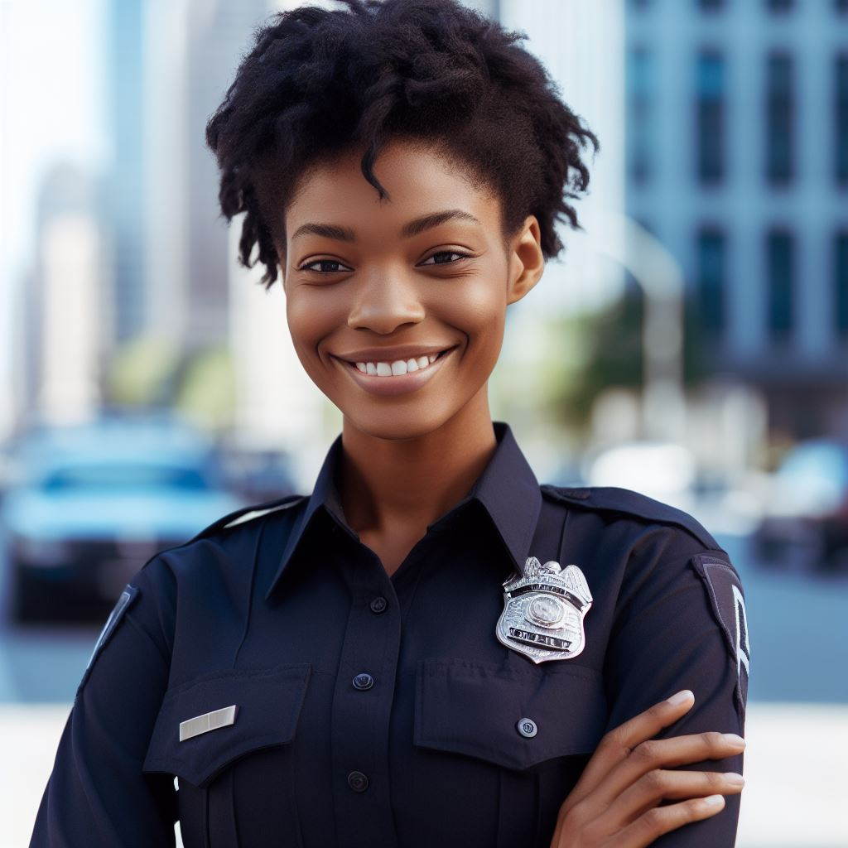
Examples of people in authority:
Police Officers

Slide 26
Why is it important to follow the rules?

Slide 27
To keep us safe

Slide 28
To help us make good choices

Slide 29
To help us be responsible

Slide 30
All done, great job!

