Slide 1

Seatbelt Safety
Kindergarten Lesson 6

Slide 2
When we are learning we will:

Slide 3

Keep our bodies in our own place!

Slide 4
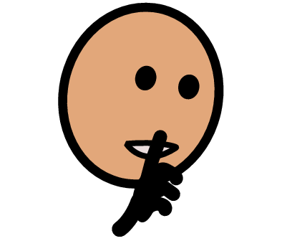
Use our quiet voices!

Slide 5

Keep our ears open!

Slide 6

Have our brains ready to learn!

Slide 7
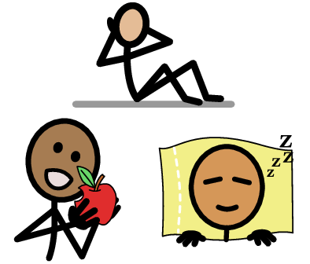
How do we stay safe and healthy?

Slide 8

We brush our teeth.

Slide 9
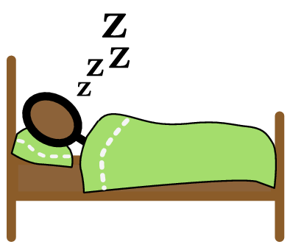
We get a good night's sleep.

Slide 10
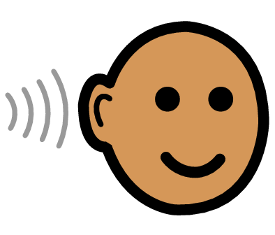
We listen to our teachers and parents.

Slide 11

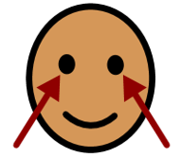
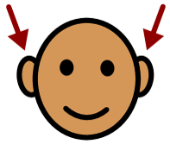
We follow the rules.

Slide 12
Let's use our brains to think about other places where we need to stay safe.

Slide 13
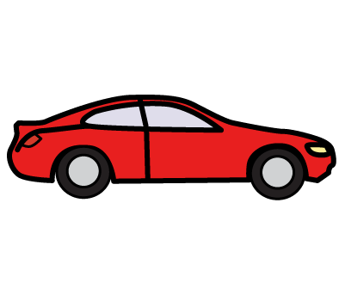
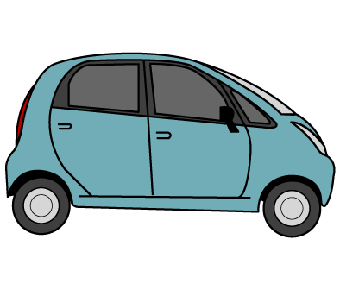
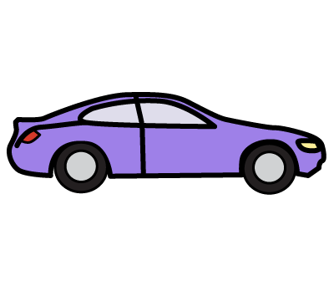
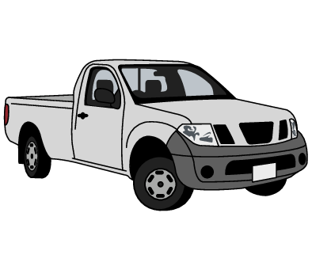
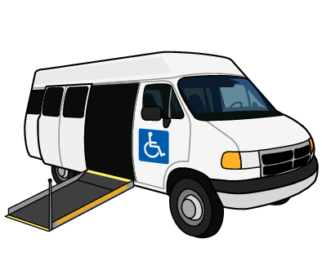
What rules do we follow in a vehicle that helps keep us safe?

Slide 14
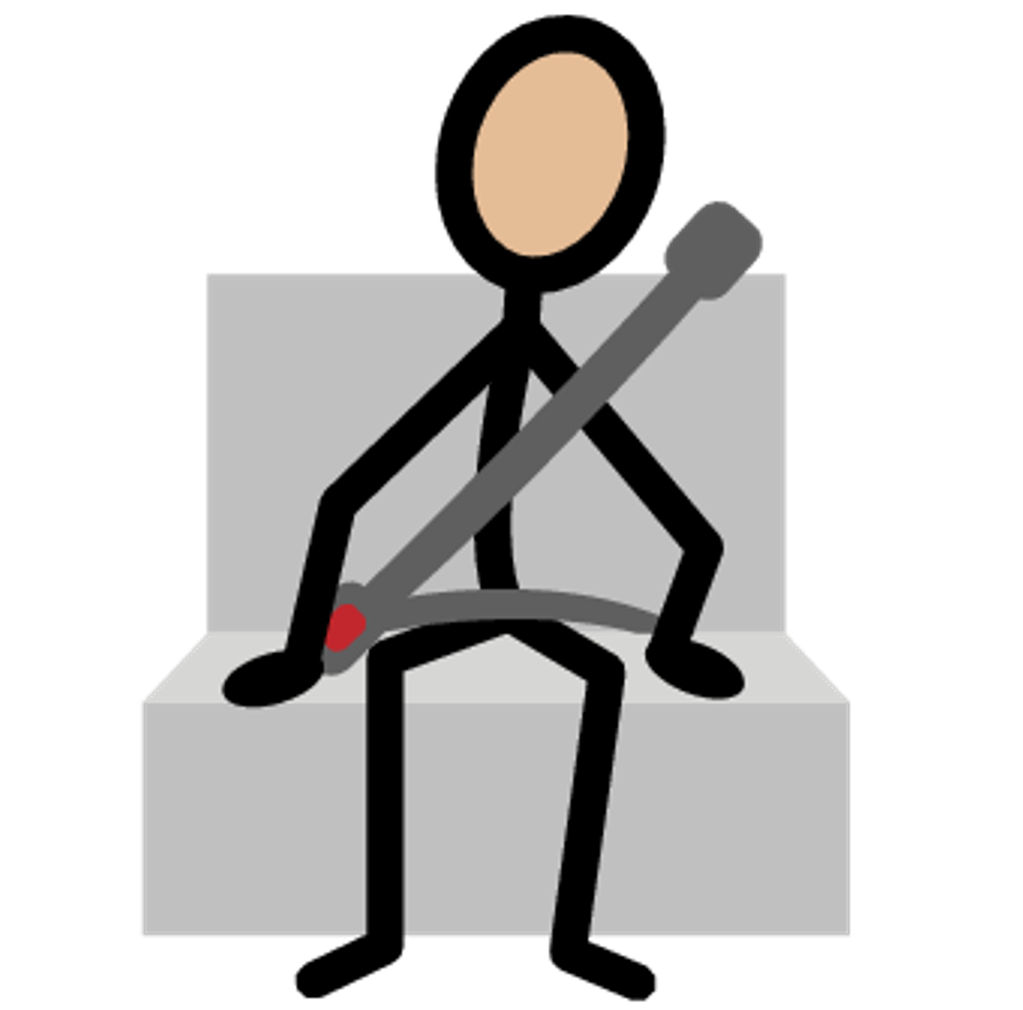
Always wear your seatbelt.

Slide 15
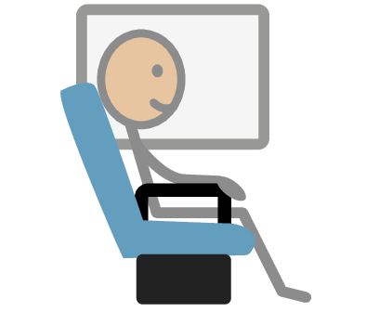
Stay in your seat.

Slide 16


Keep your hands and feet inside the car.

Slide 17

Do not play with the car controls.

Slide 18

Do not throw anything inside or outside of the car.

Slide 19
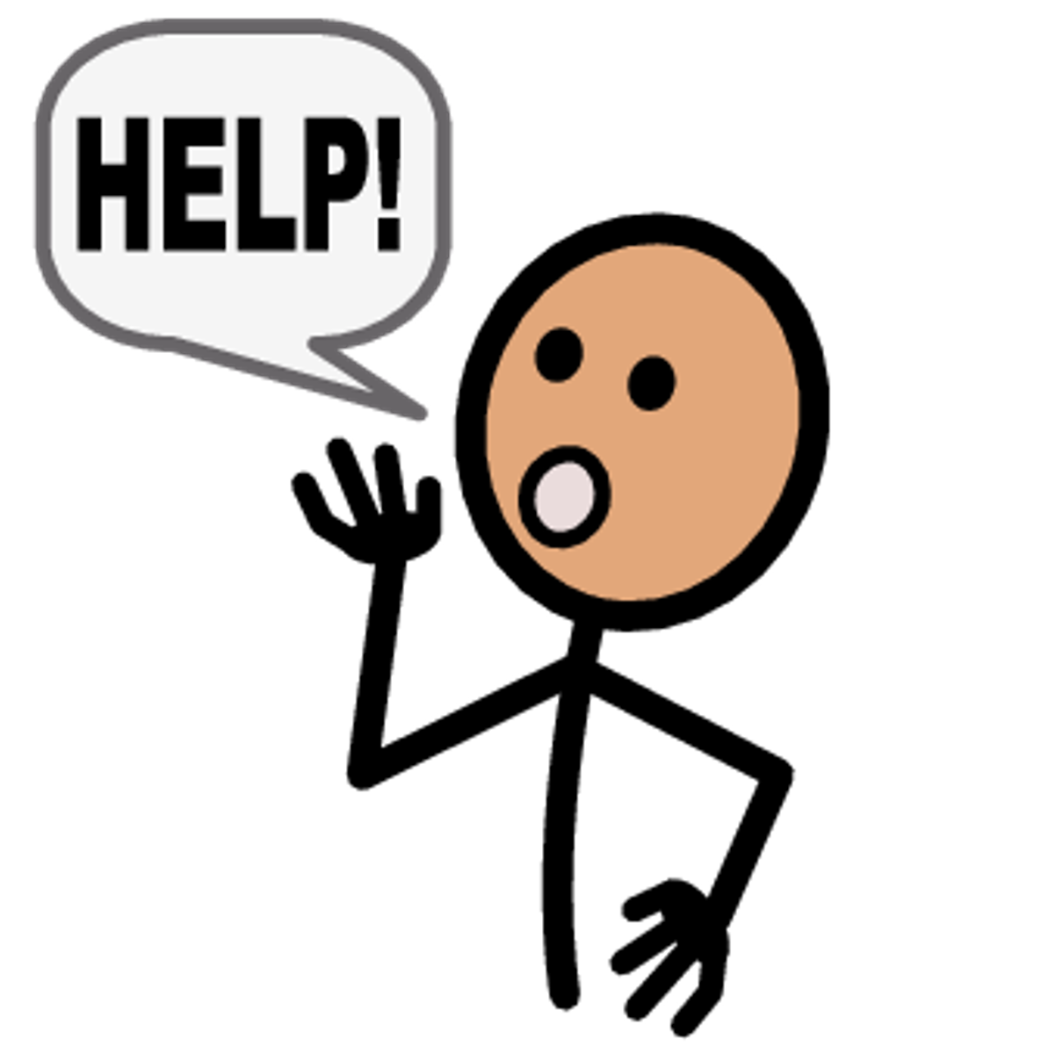
Ask for what you need.

Slide 20
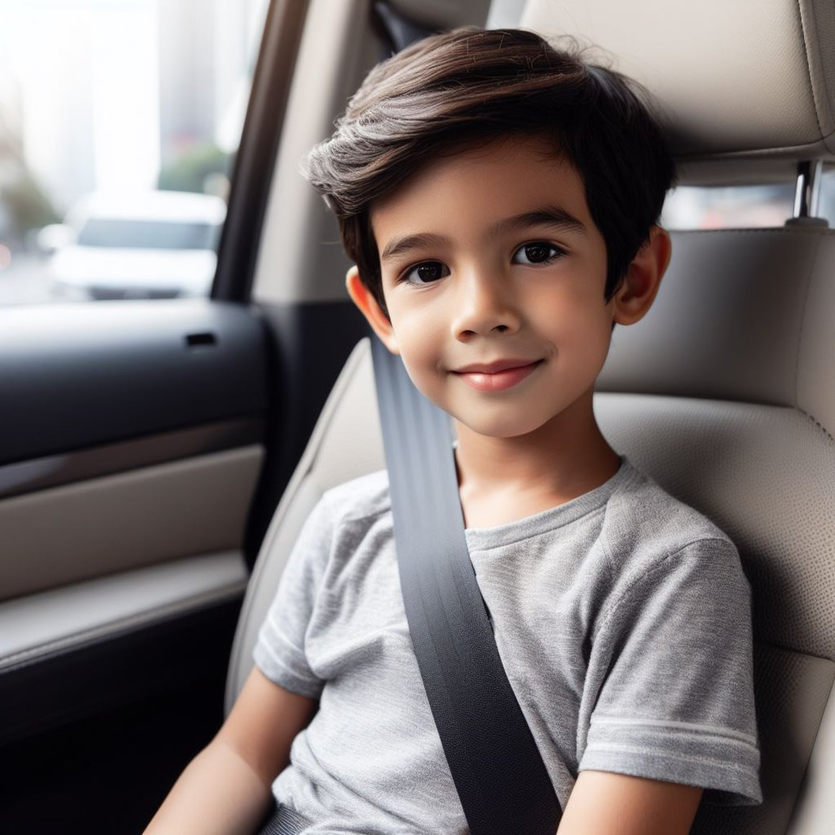
How do we stay safe in a car?

Slide 21
We buckle up.

Slide 22
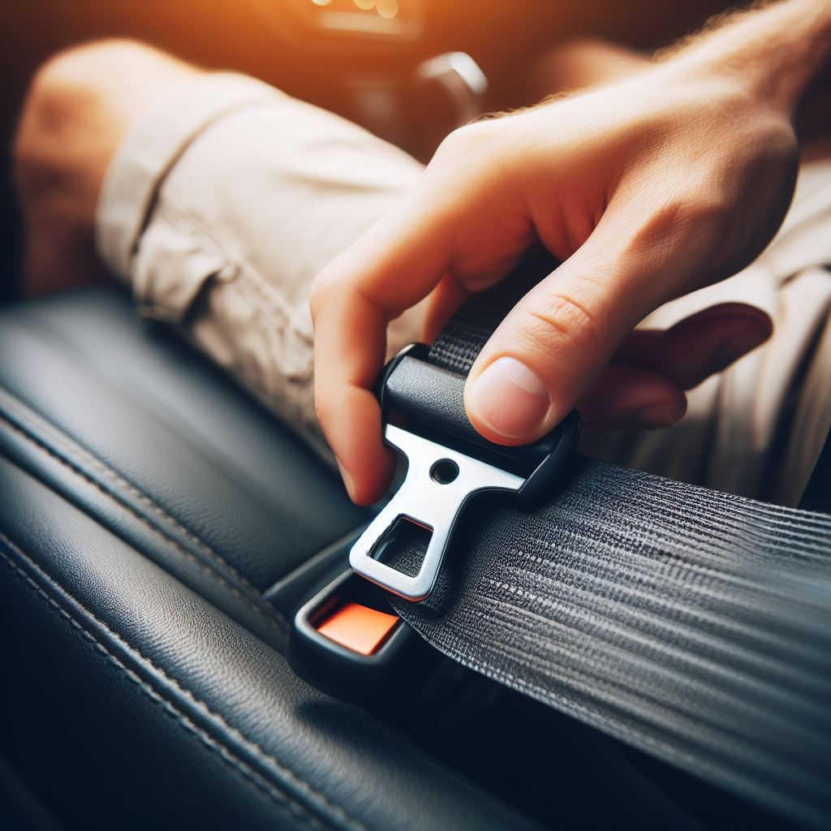
We fasten the seatbelt.

Slide 23
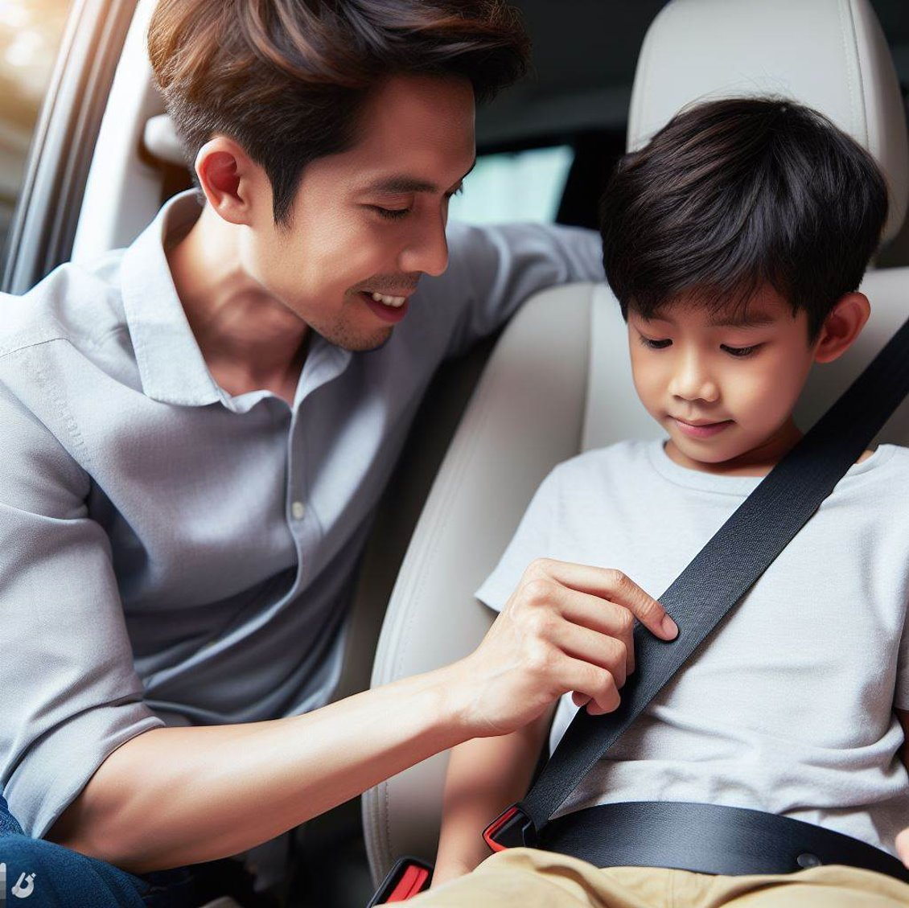
We straighten the straps.

Slide 24
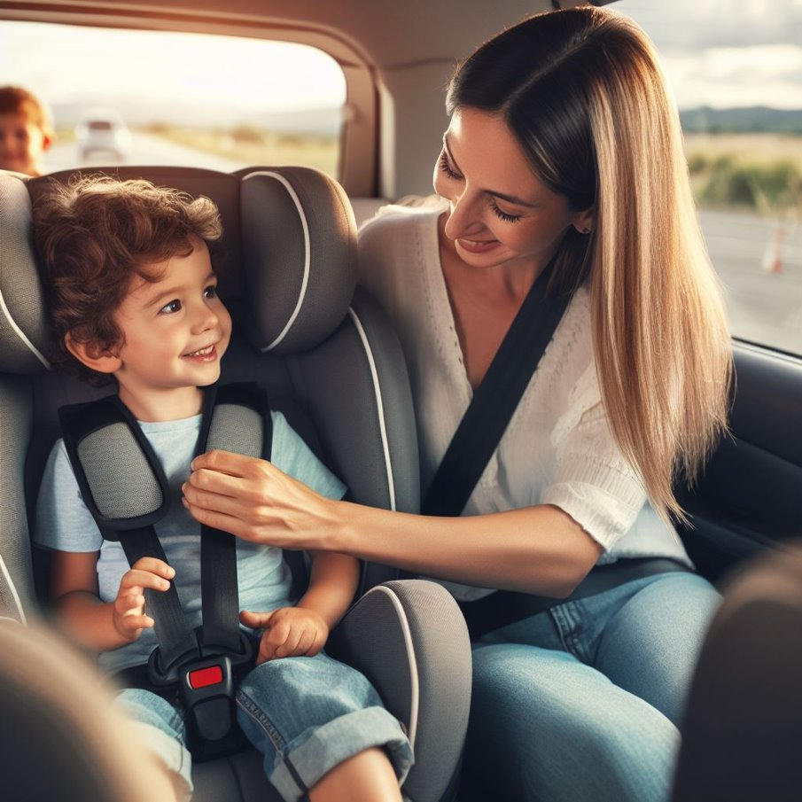
We check the straps and buckle.

Slide 25
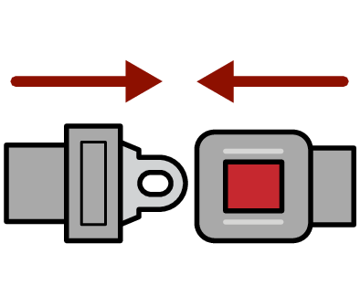

Let's practice
buckling up!

Slide 26

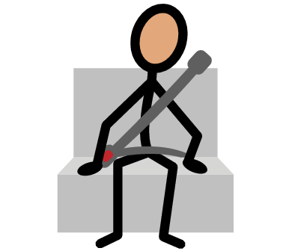
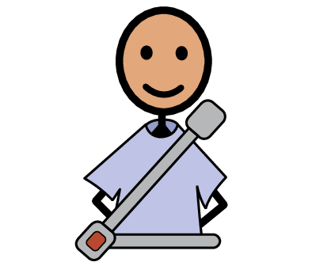
Where's your seatbelt, where's your seatbelt;
Here is mine, here is mine;
Around my hips and chest, around my hips and chest.
Where is yours, where is yours?

Slide 27

Activity

Slide 28


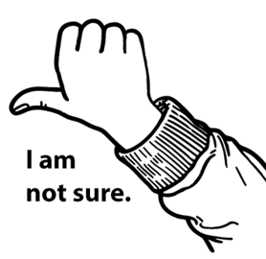

Slide 29
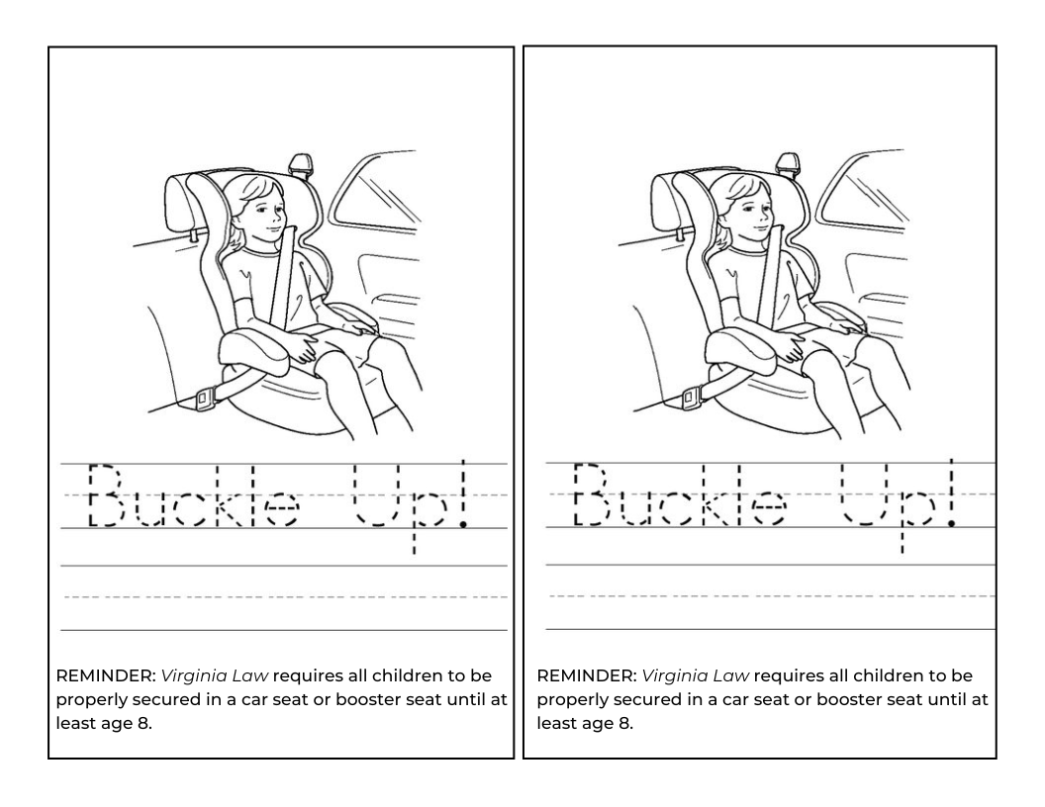
Activity

Slide 30
All done, great job!

