Slide 1

School Rules and Safety
Pre-Kindergarten Lesson 1

Slide 2
When we are learning we will:

Slide 3

Keep our bodies in our own place!

Slide 4

Use our quiet voices!

Slide 5

Keep our ears open!

Slide 6

Have our brains ready to learn!

Slide 7
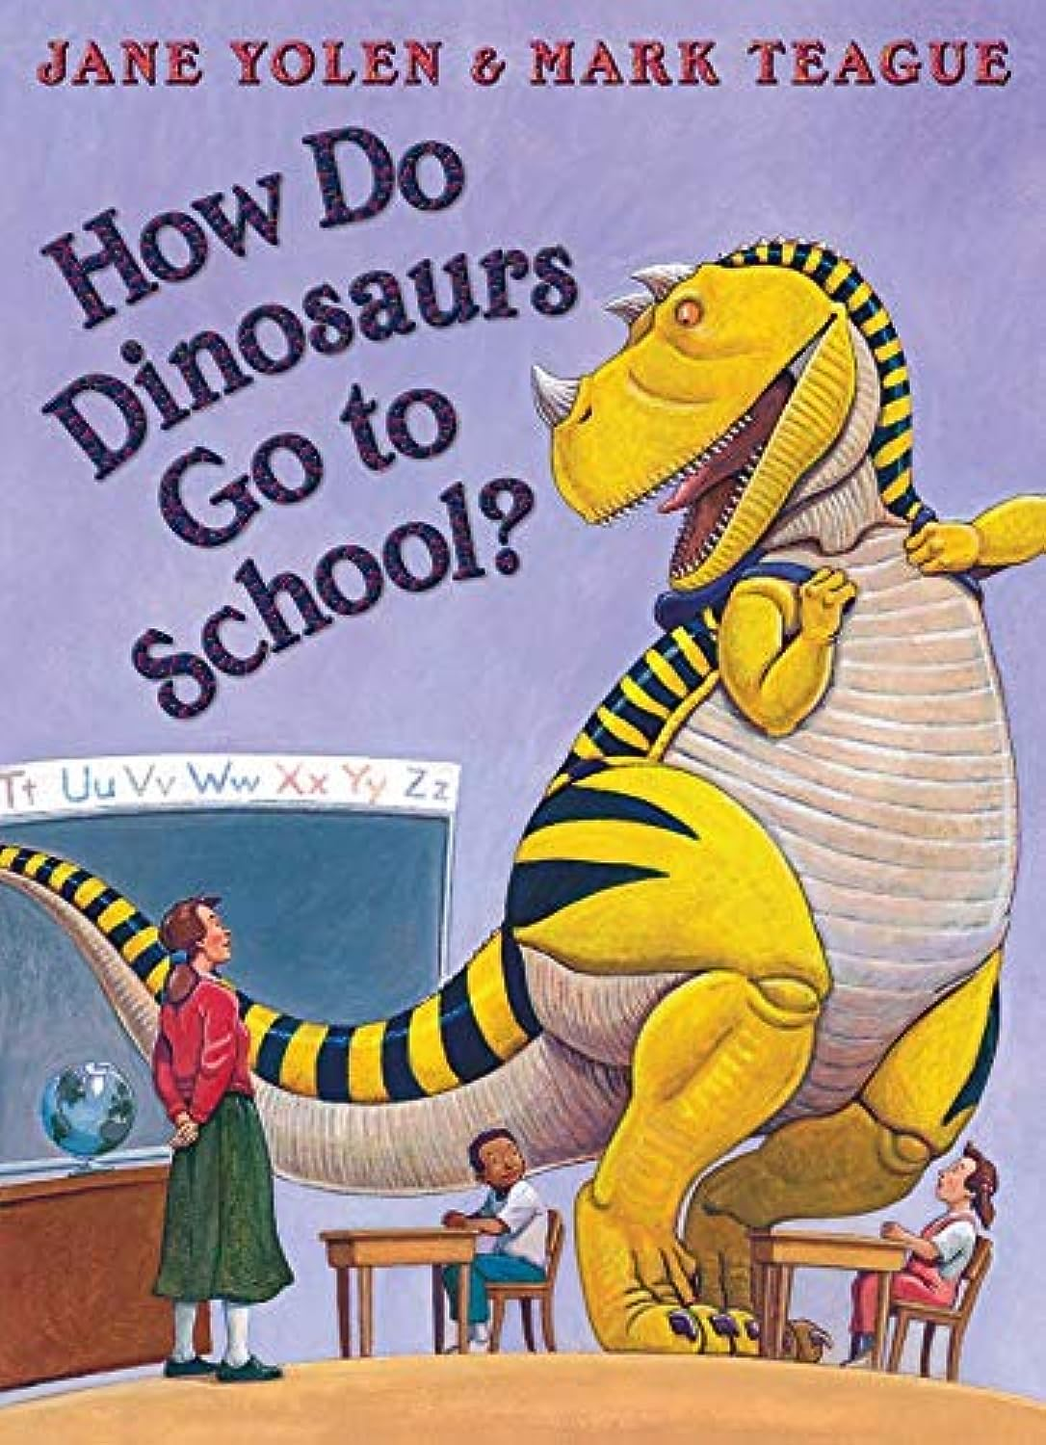
Read:
How Do Dinosaurs Go to School? by Jane Yolen

Slide 8
Why do we have school rules?
Our Classroom Rules
Keep our bodies in our own place
School Rules: Rules to follow at school that help keep us safe and help us learn.
Use our quiet voices
Keep our ears open
Keep our brains ready to learn
Raise our hands

Slide 9

Who enforces the rules?
Teachers
School staff
Principal

Slide 10
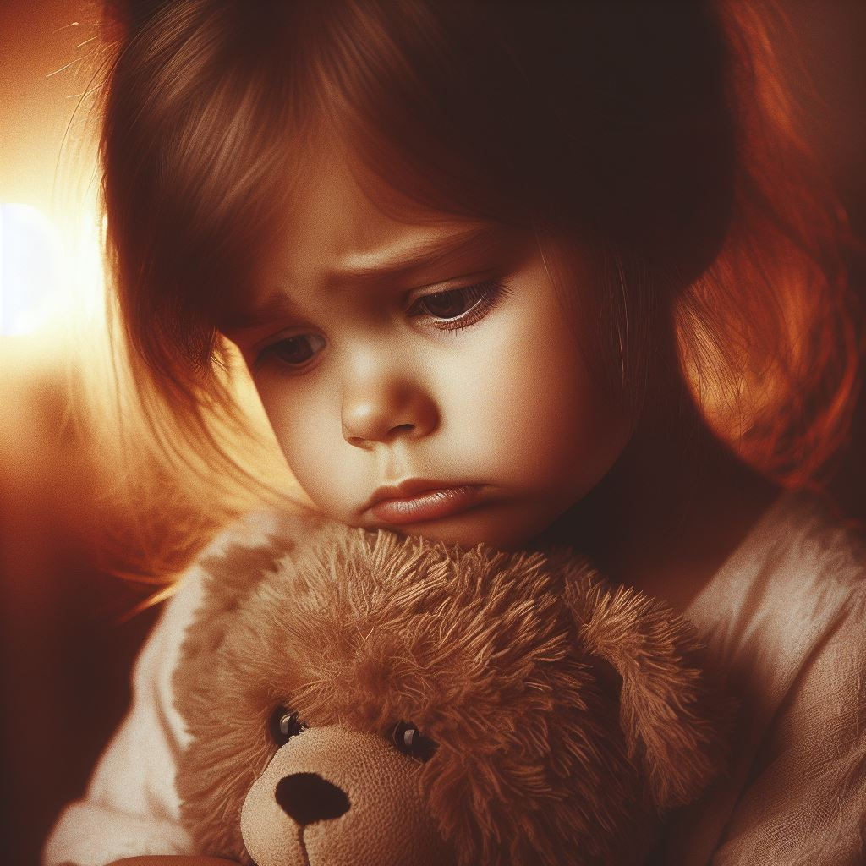
What is a consequence?
A consequence is what happens when we do not follow the rules.

Slide 11



Activity: Rules and Consequences

Slide 12
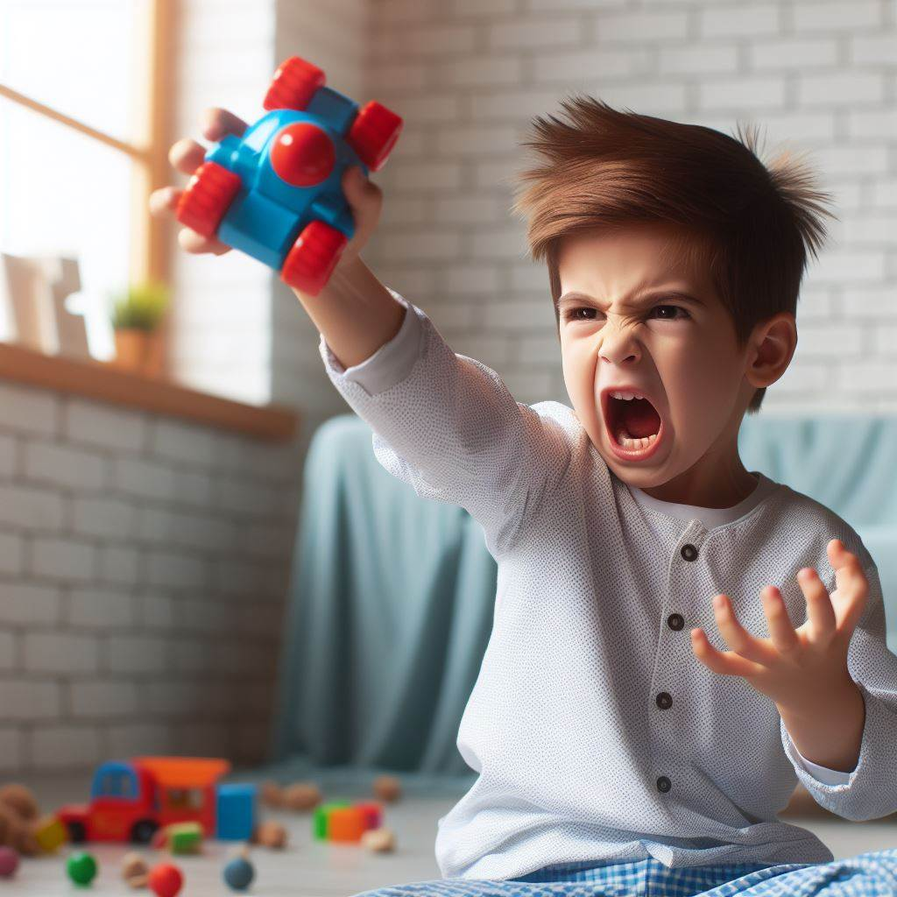
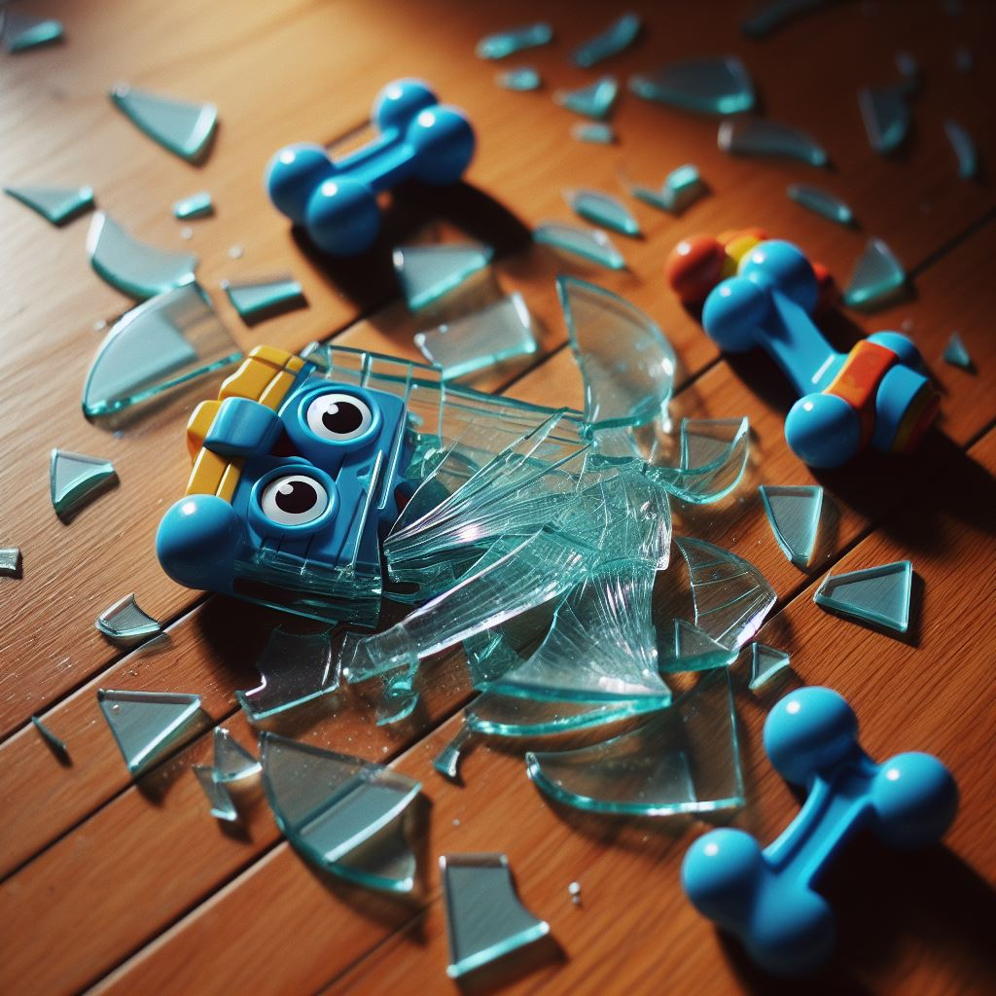
Rules and consequences
If I throw my toy…
my toy could break.
Notes:
Instructor Notes: You can reinforce this rule by stating; “It is important that we use our calm hands with our toys. When we do not have calm hands, then our toys can break.”

Slide 13
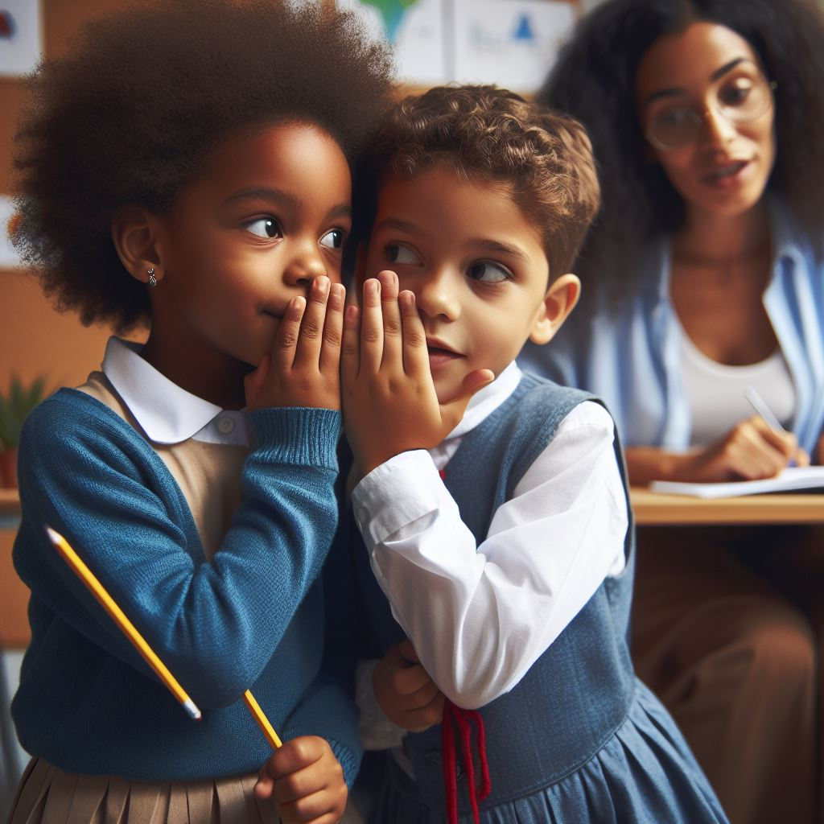
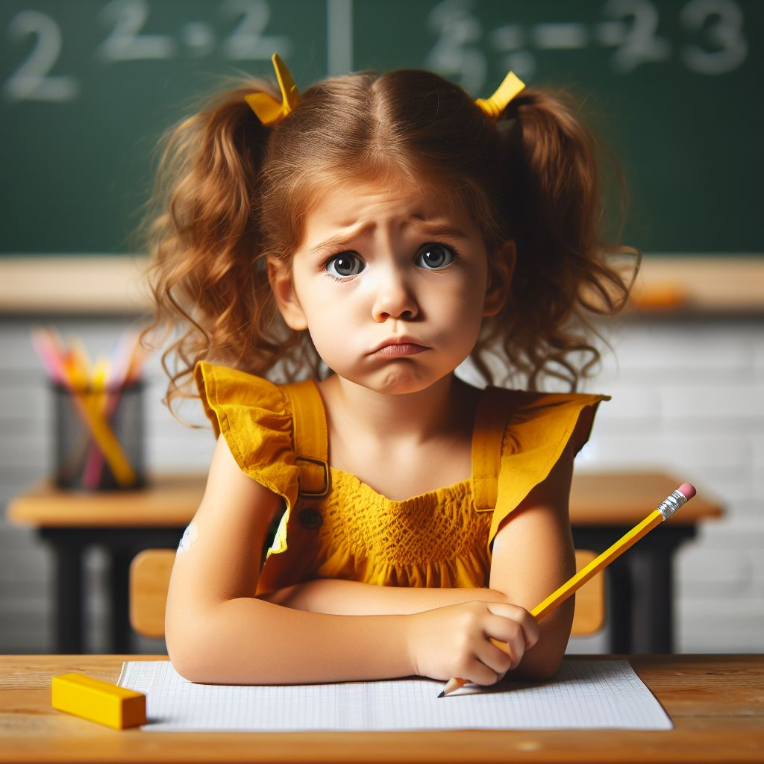
Rules and consequences
When I talk when my teacher is helping me learn…
then I might miss something important my teacher is explaining.

Slide 14
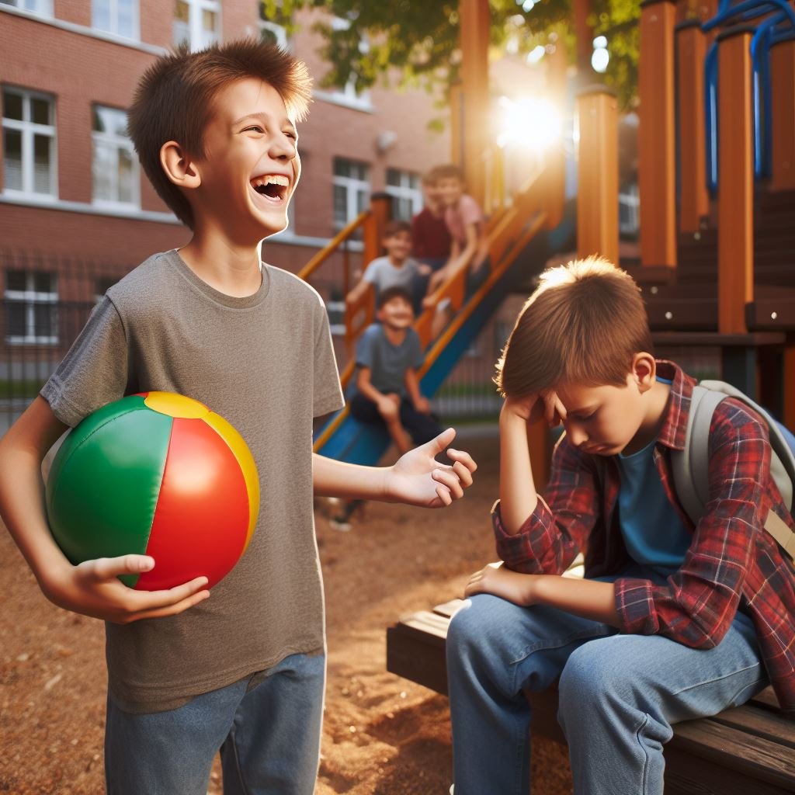
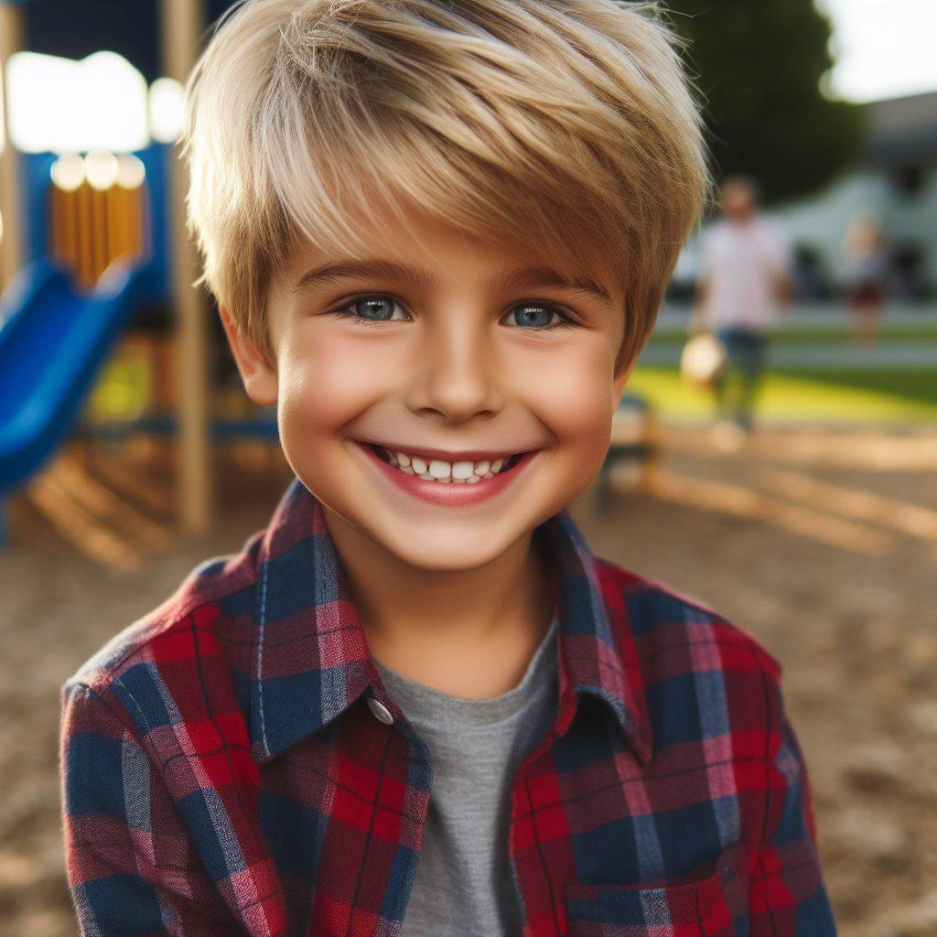
Rules and consequences
When I take a toy away from my friend…
then my friend will be happy.
Notes:
Instructor Notes: You can reinforce this rule by stating; “Oh my! Would your friend be happy when you take away their toy? (Allow wait time for a response) No! They would be sad. Show me what your face would look like if your friend took a toy from you! Let’s review that consequence again”.

Slide 15
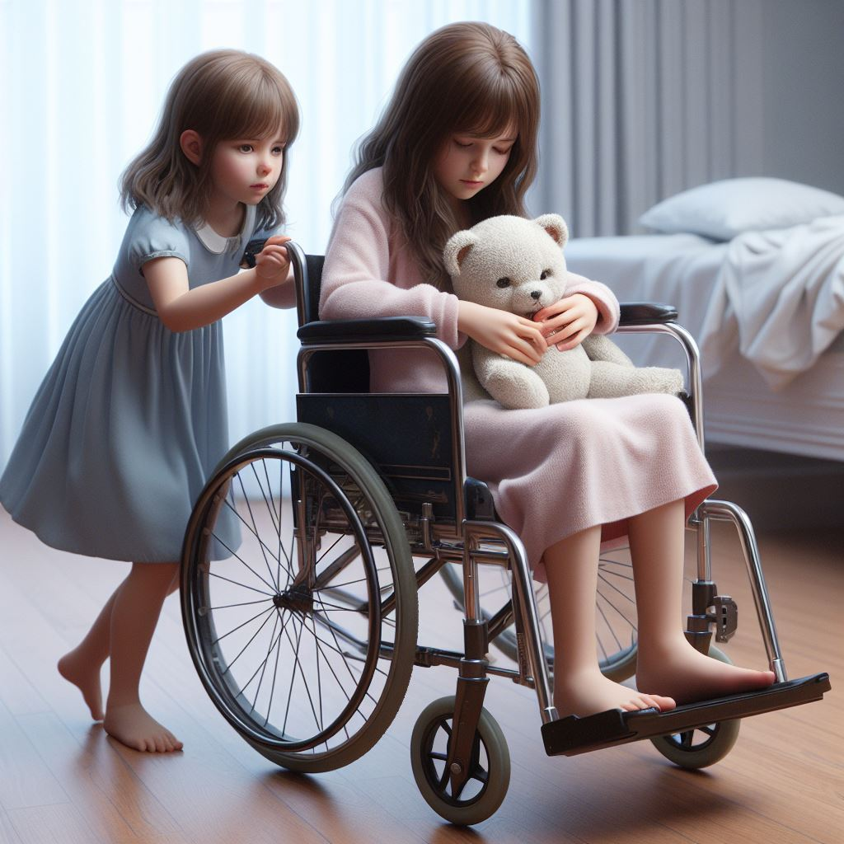
Rule and Consequence
When I take a toy away from my friend…
then my friend will not be happy.
Notes:
Instructor Notes: You can reinforce this rule by stating; “Let’s look at this. This seems like the consequence for this rule. When you take a toy from a friend, then they would be sad”

Slide 16
Activity: Classroom rules and consequences

Slide 17


Our Classroom…
Rules
Consequences
We can stay safe at school!

Slide 18
All done, great job!

