Slide 1

Playground Safety Rules
Pre-Kindergarten Lesson 2

Slide 2
When we are learning we will:

Slide 3

Keep our bodies in our own place!

Slide 4

Use our quiet voices!

Slide 5

Keep our ears open!

Slide 6

Have our brains ready to learn!

Slide 7
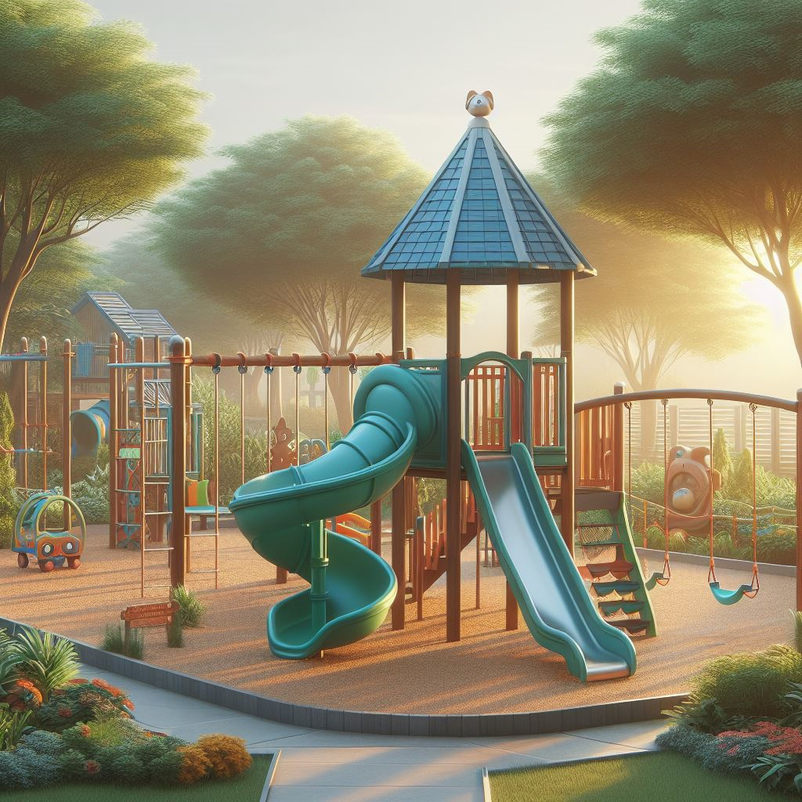
What do we see on the playground?

Slide 8
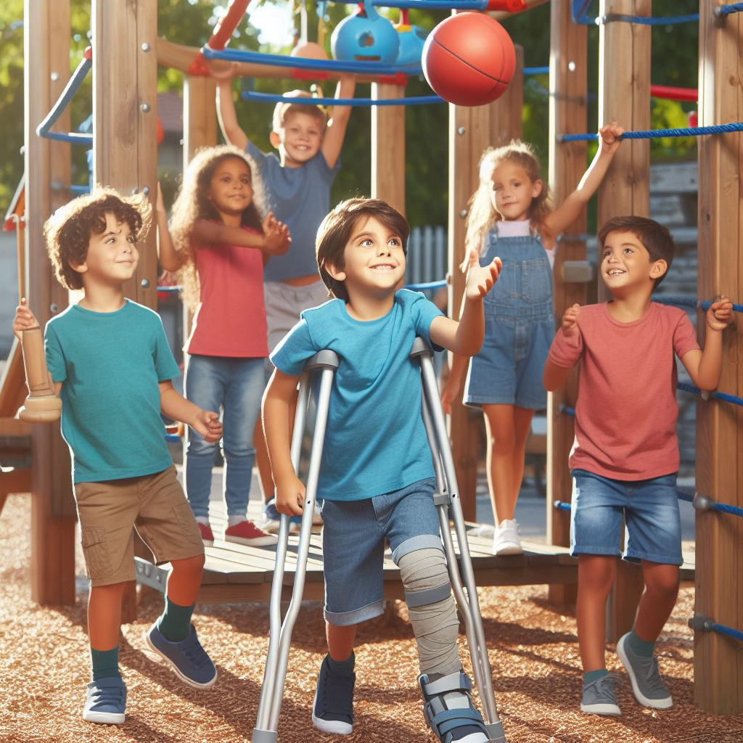
We can be safe on the playground!

Slide 9
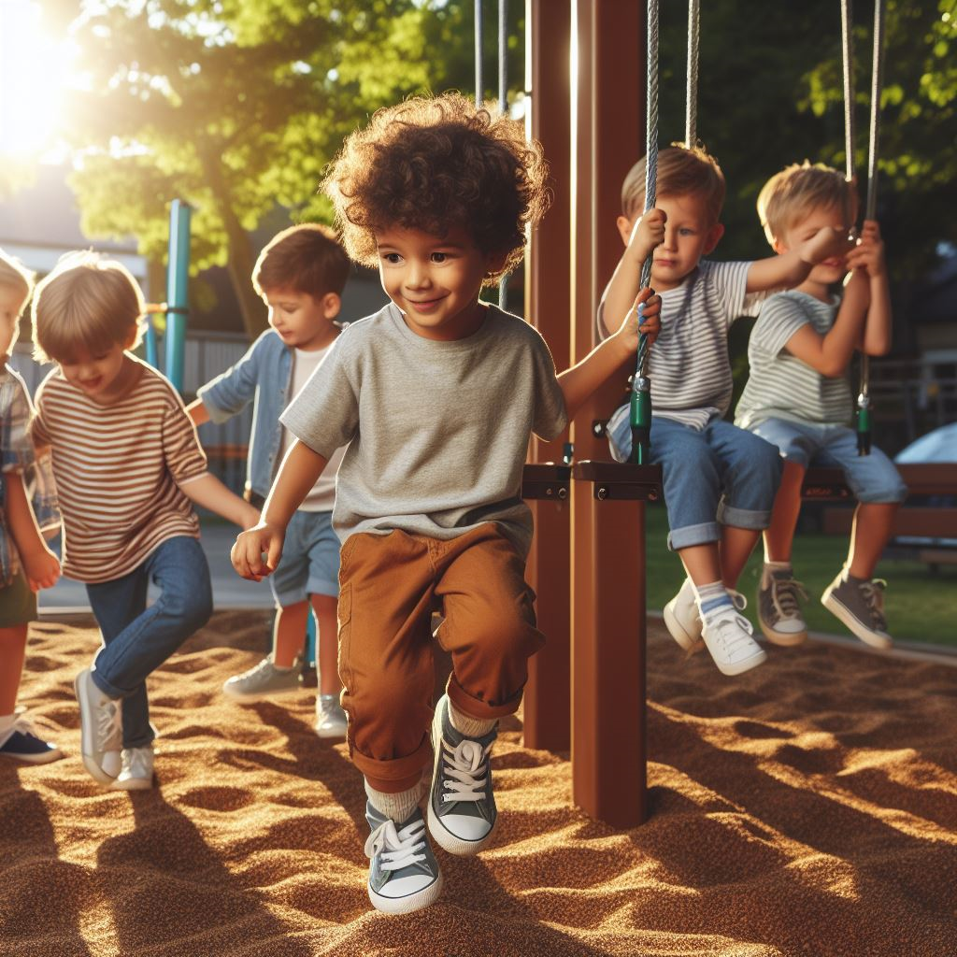
We play and roam on the playground, but first, we make our safety our number one goal!

Slide 10

When we're on swings, we hold on tight and gently push, making sure it's right. When we are running by, we stay clear, making sure our friends can swing all year!

Slide 11
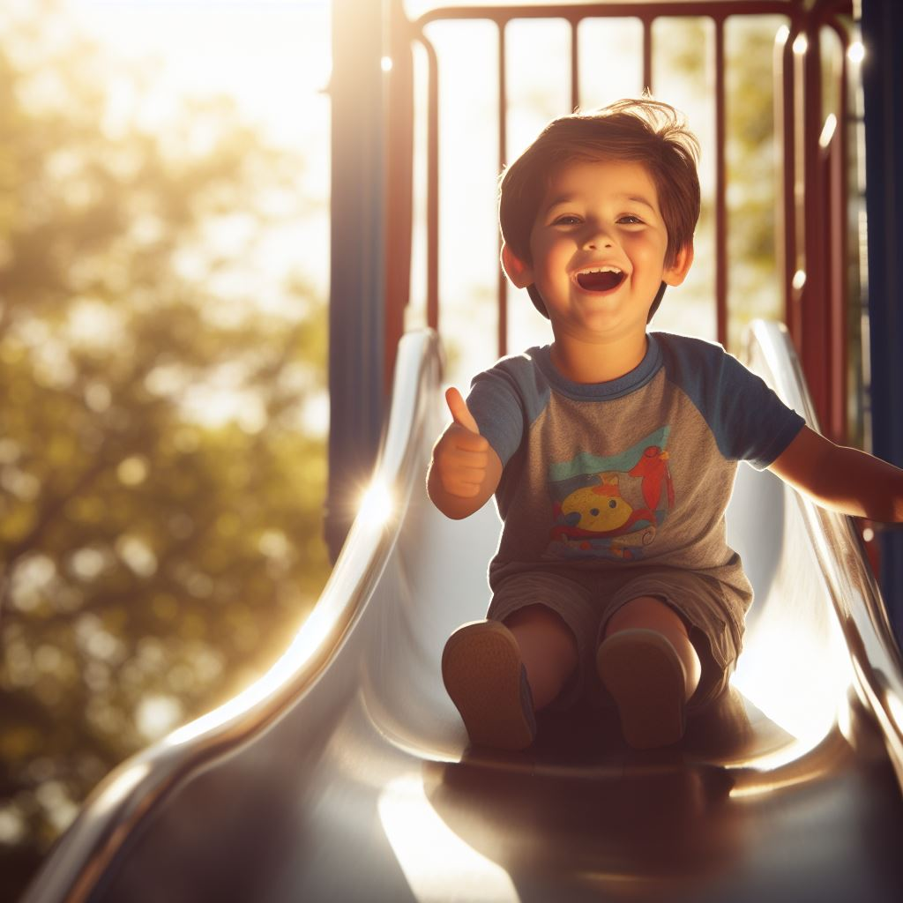
Feet lead the way, sitting is best, we slide down smoothly, passing the test.
Before we go down, we check to see, to make sure that the space is free.

Slide 12

Climbing up, we take it slow, using handrails, up we go! One-by-one we climb tall; safety is for all!

Slide 13
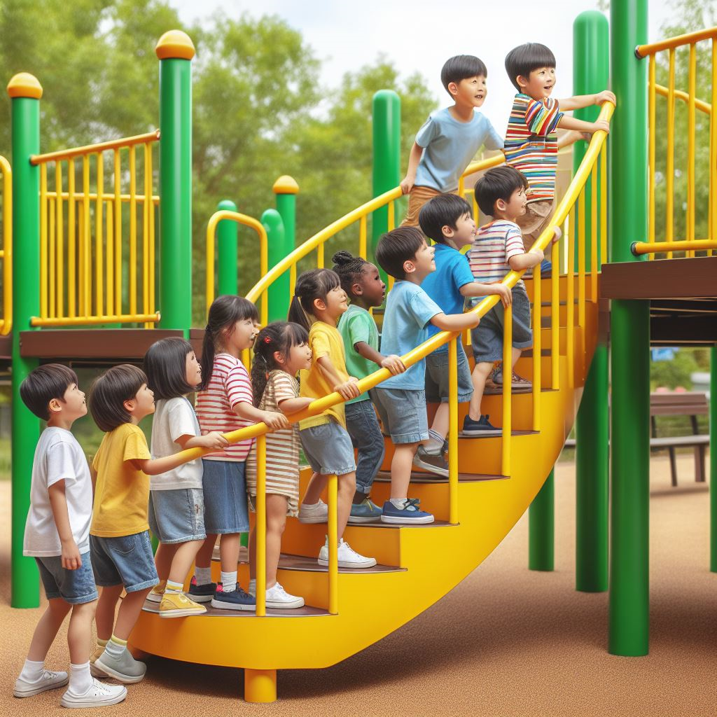
On the playground, fun's our aim, taking turns is just the game! Swings and slides, we all agree, sharing nicely, you and me. So, ‘round we go, we'll all take part, taking turns is where we start!

Slide 14
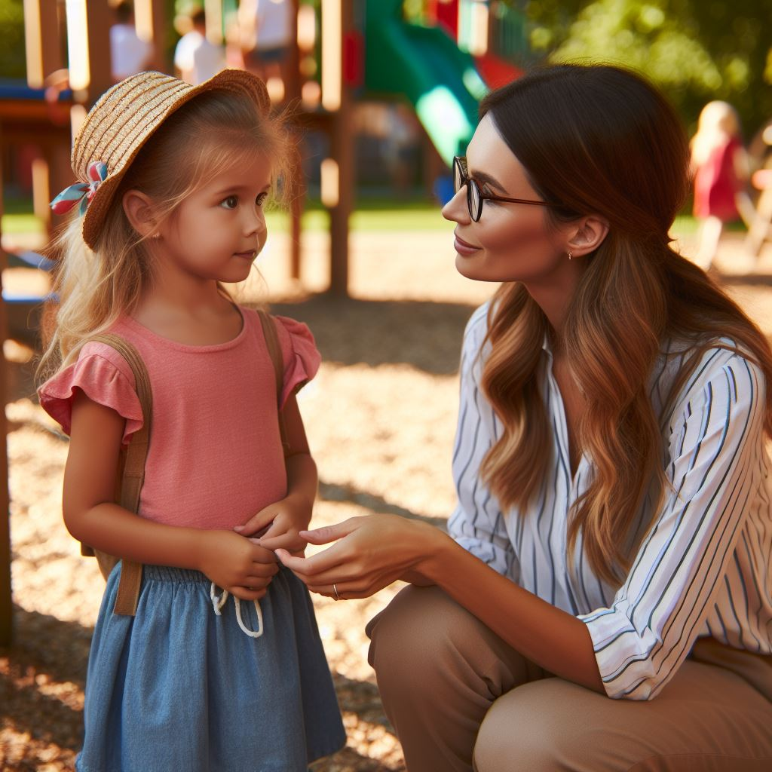
As we play, let's lend a hand, helping friends, a golden plan. If someone's hurt or feeling blue, call the teacher, they'll know what to do!

Slide 15
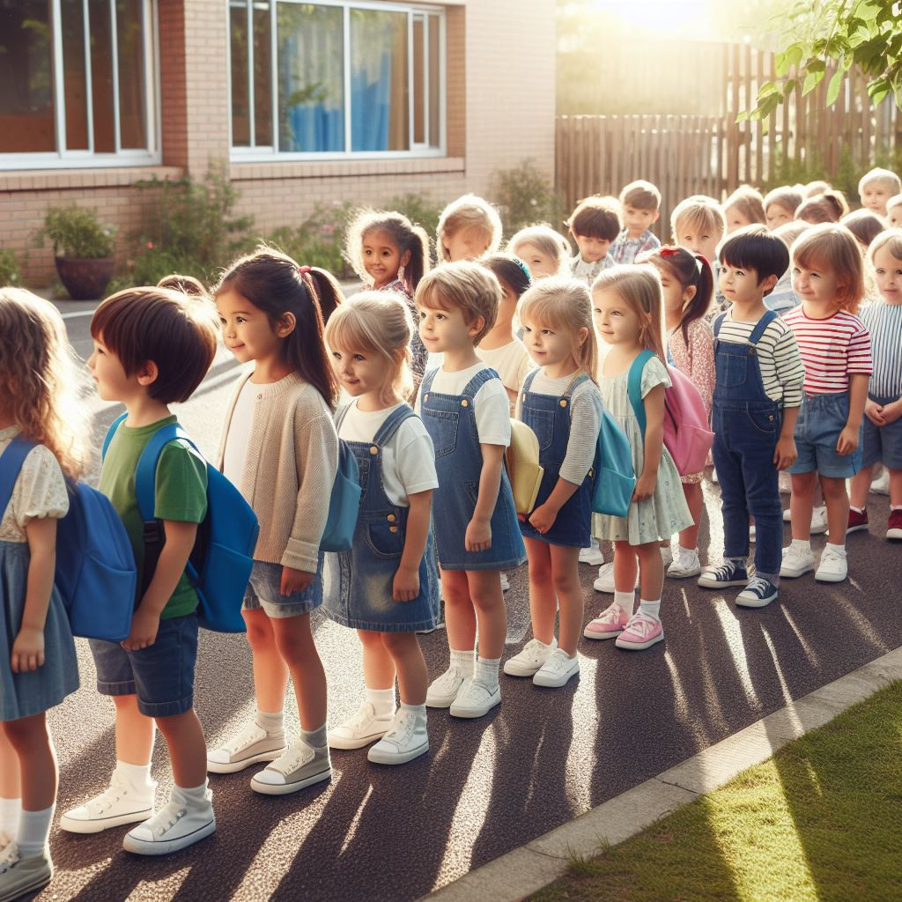
Playtime's fun, but when it ends, we go back inside, with all our friends. When the bell chimes loud, it's time to go! Line up straight, in a neat row, classroom-bound, our smiles glow. Goodbye, playground, we'll be back soon!

Slide 16
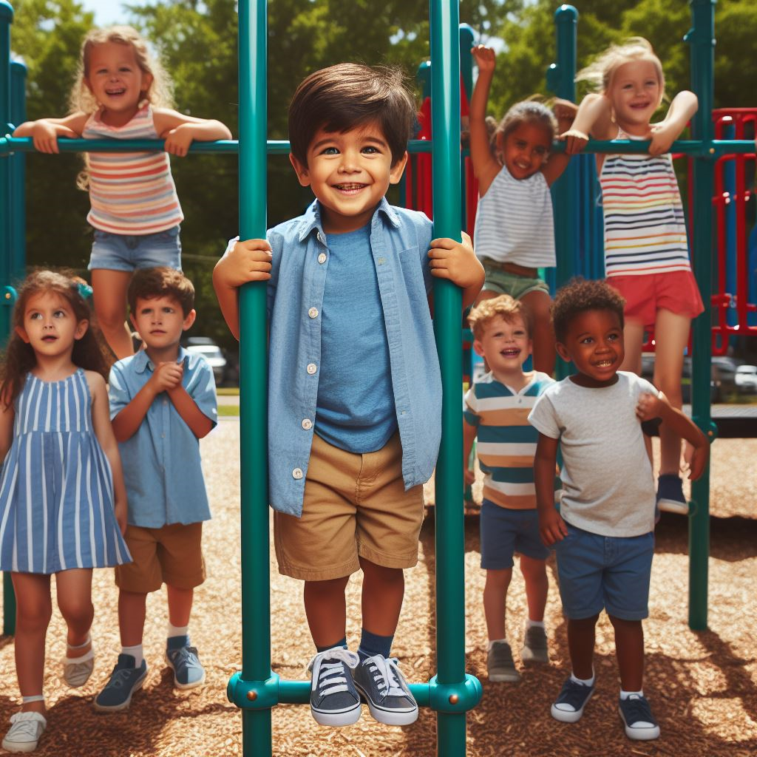
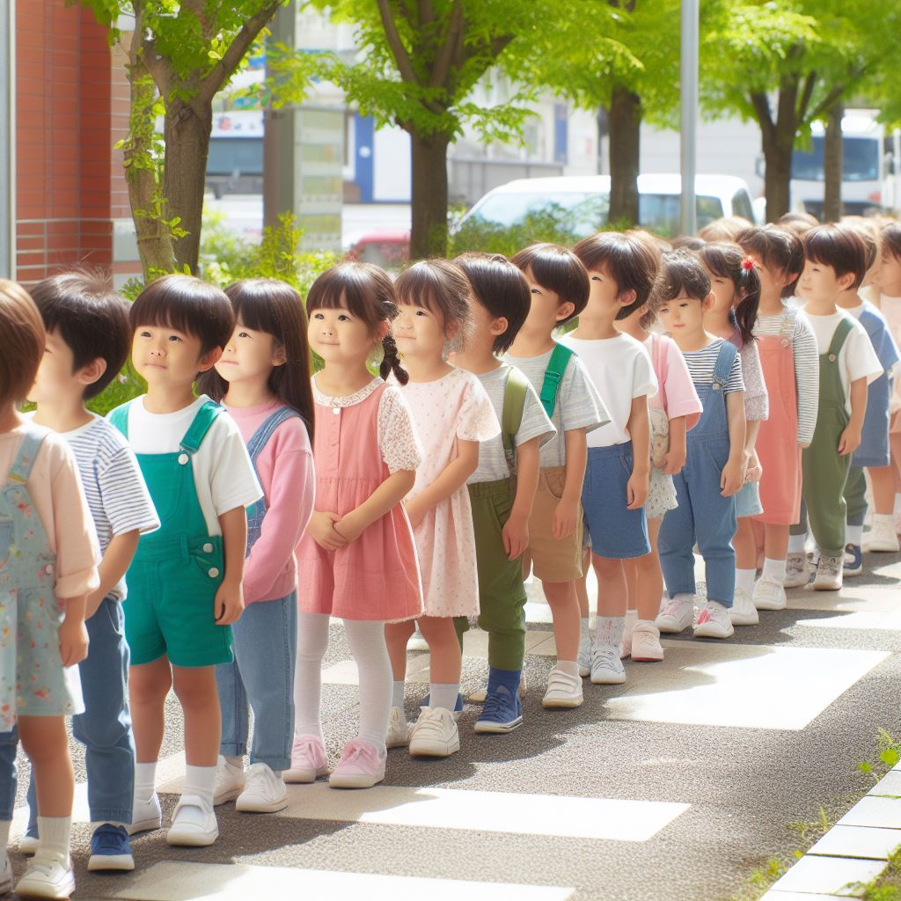
Playground Safety Rules
We use our hands to hold on when climbing and swinging.
We go down the slide with our feet first.
We take turns.
We get a teacher when we need help.
We line up to go back inside.

Slide 17



Game:
Safe or not safe on the playground?

Slide 18
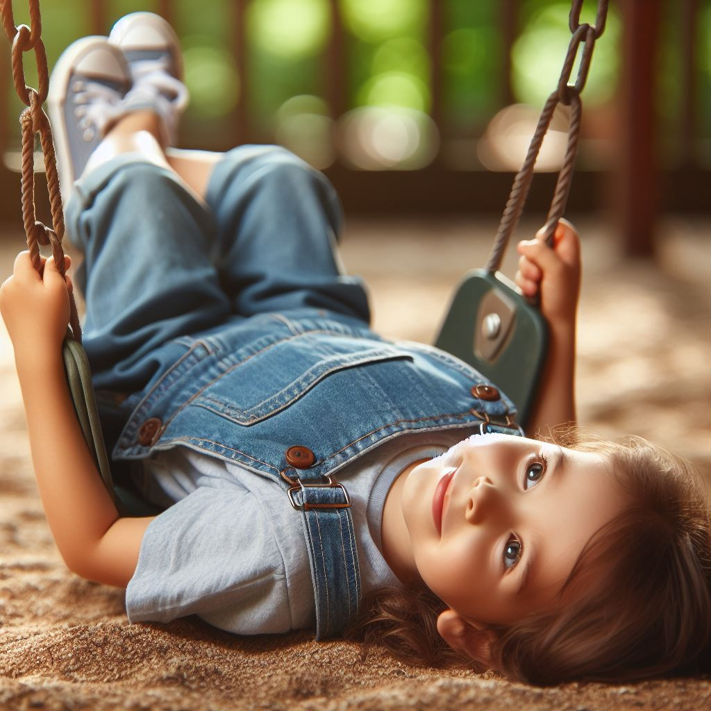
Is this safe?
Laying on a swing

Slide 19
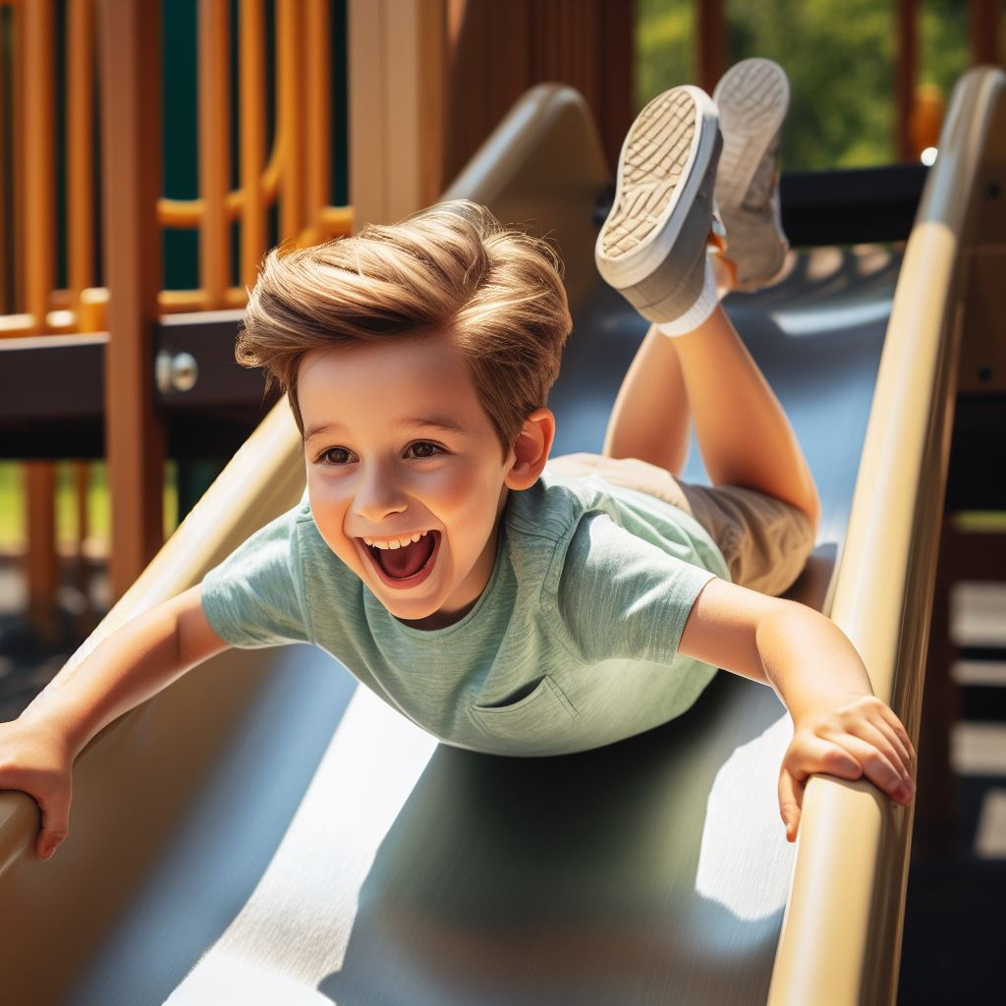
Is this safe?
Going down a slide head-first

Slide 20
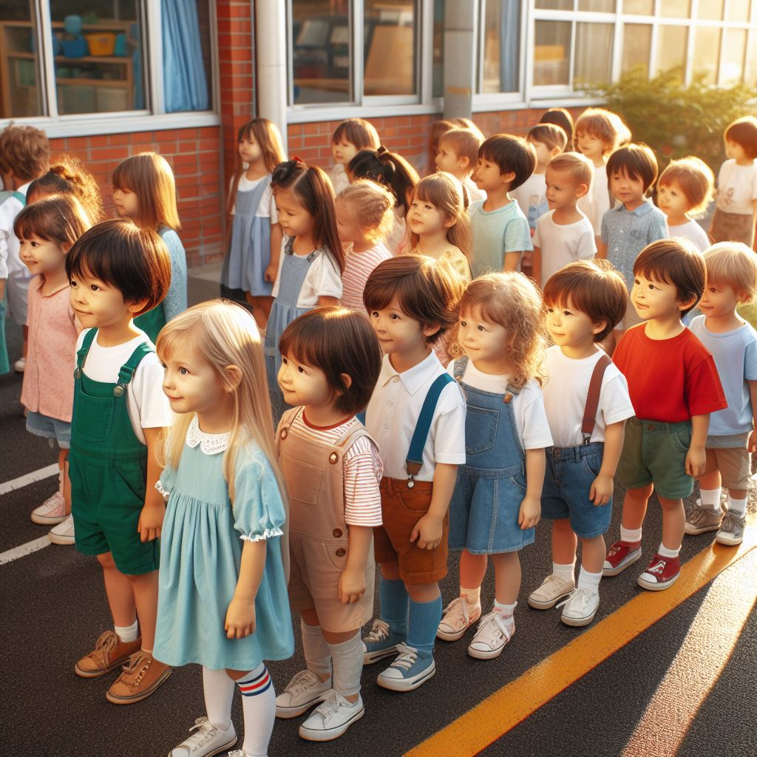
Is this safe?
Waiting in line to go inside

Slide 21
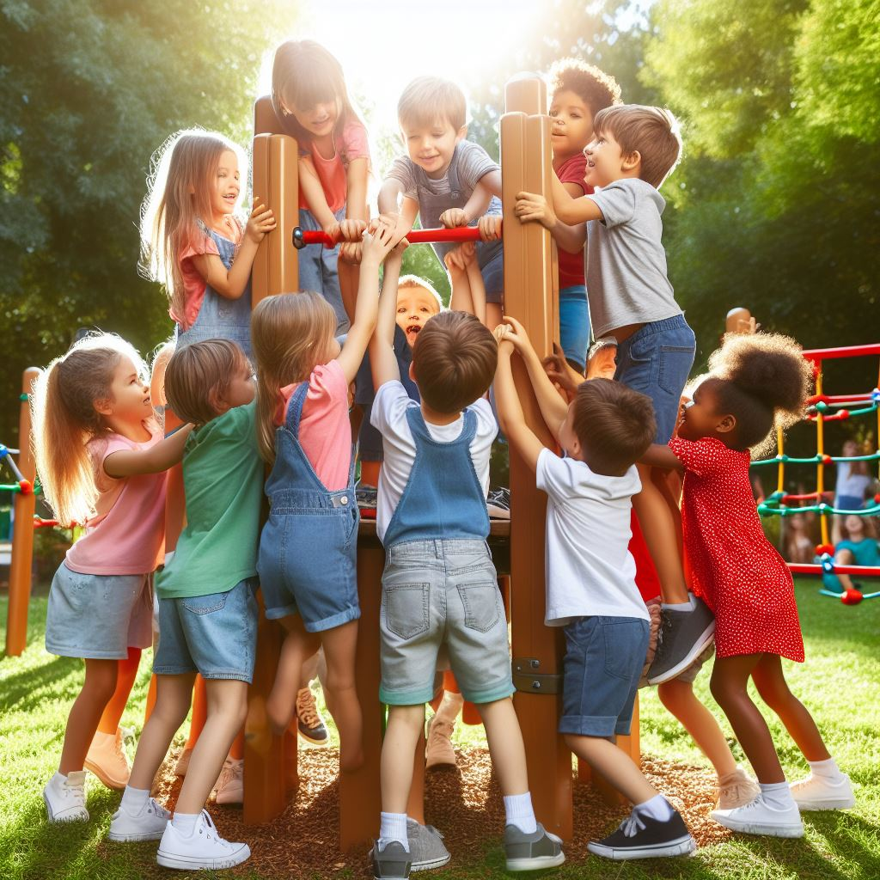
Is this safe?
Pushing while playing

Slide 22
Is this safe?
Waiting in line for your turn

Slide 23
Activity: Playground Safety Pledge

Slide 24
All done, great job!

