Slide 1

Community Helpers
Pre-Kindergarten Lesson 4

Slide 2
When we are learning we will:

Slide 3

Keep our bodies in our own place!

Slide 4

Use our quiet voices!

Slide 5

Keep our ears open!

Slide 6

Have our brains ready to learn!

Slide 7

A community helper is a person whose job is to help us learn, stay healthy, and keep safe.

Slide 8

Helpers in our community:

Slide 9
In our town, there's a lot to see, helpers who care for you and me!

Slide 10
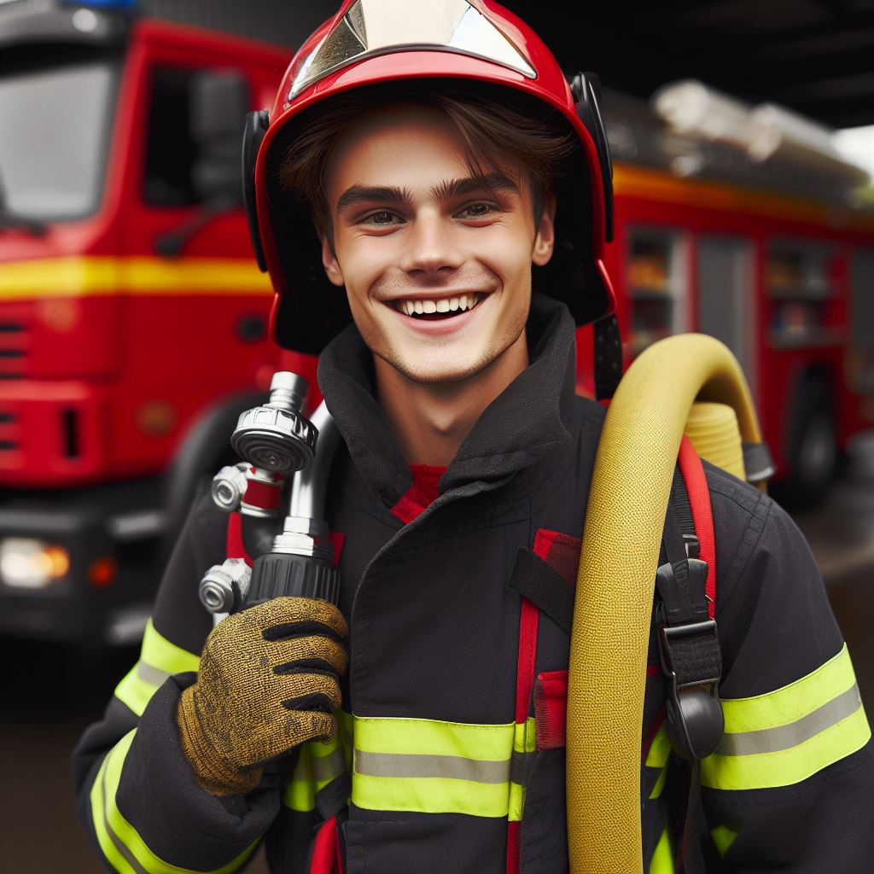
A firefighter brave, with helmet and hose, puts out fires, wherever he goes.

Slide 11
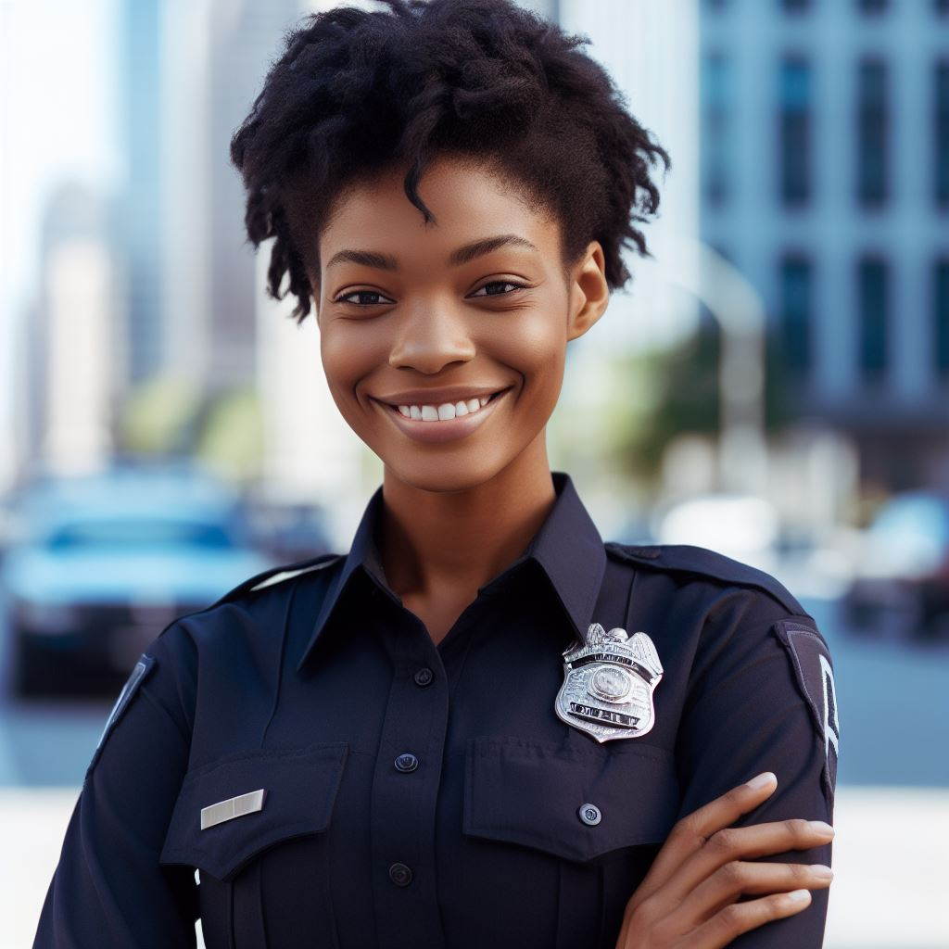
A police officer, standing tall and proud, keeps us safe, in our town and crowd.

Slide 12
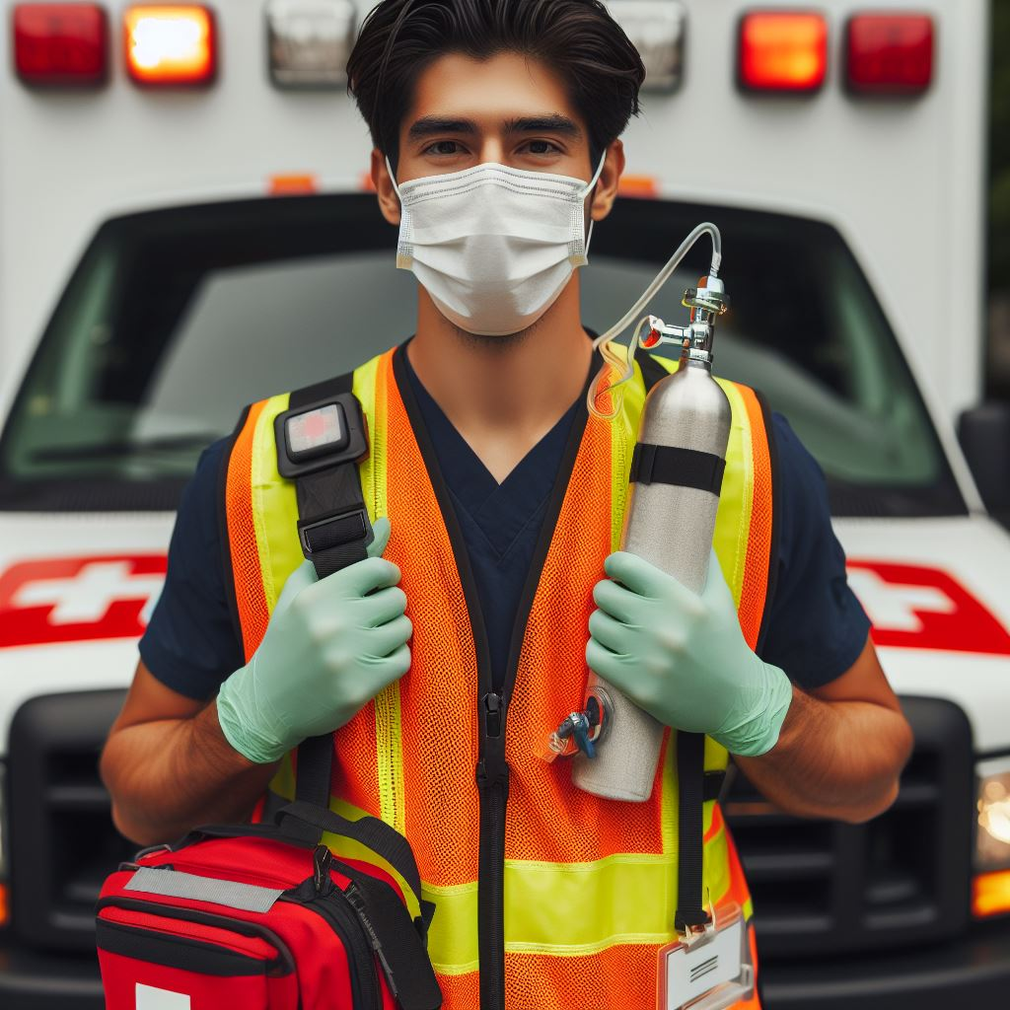
With lights flashing, here comes the Paramedic/EMT! Helping people who are in need.

Slide 13
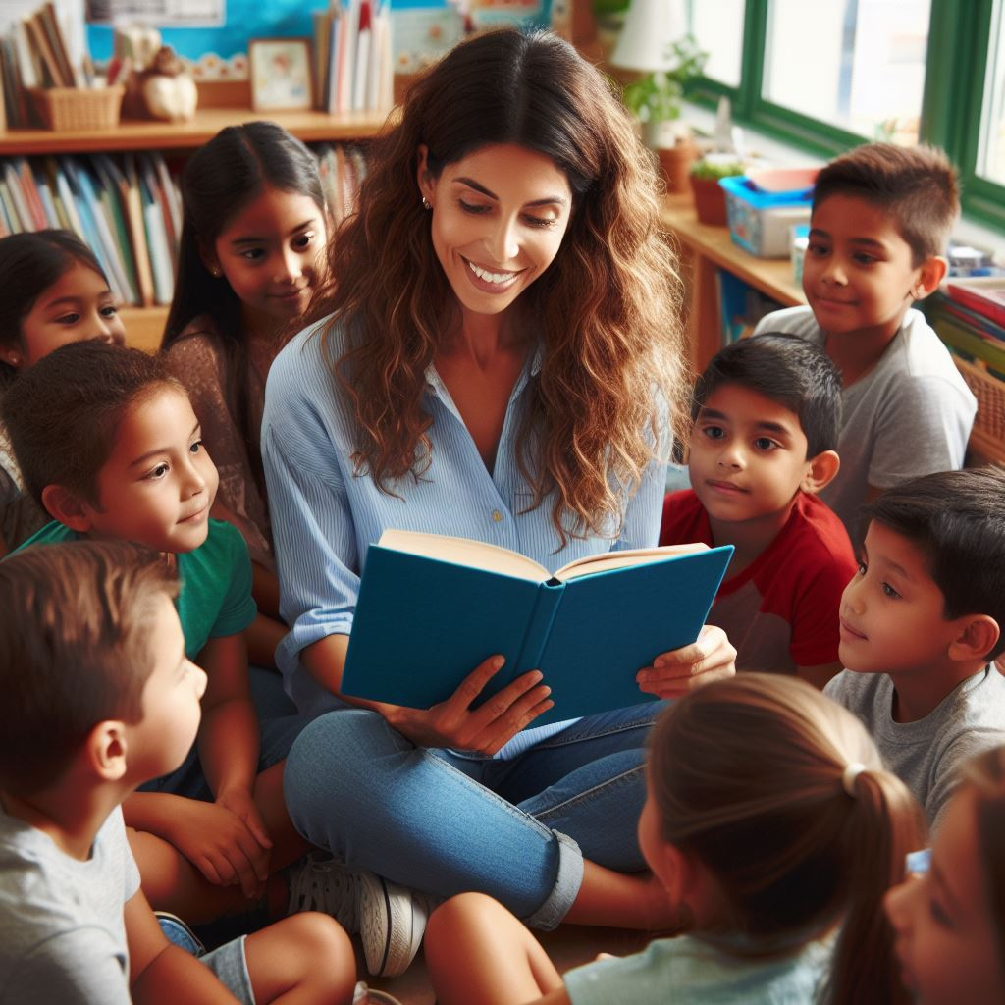
Our teachers at school, with books and a smile, teaches us things that are always worthwhile.

Slide 14
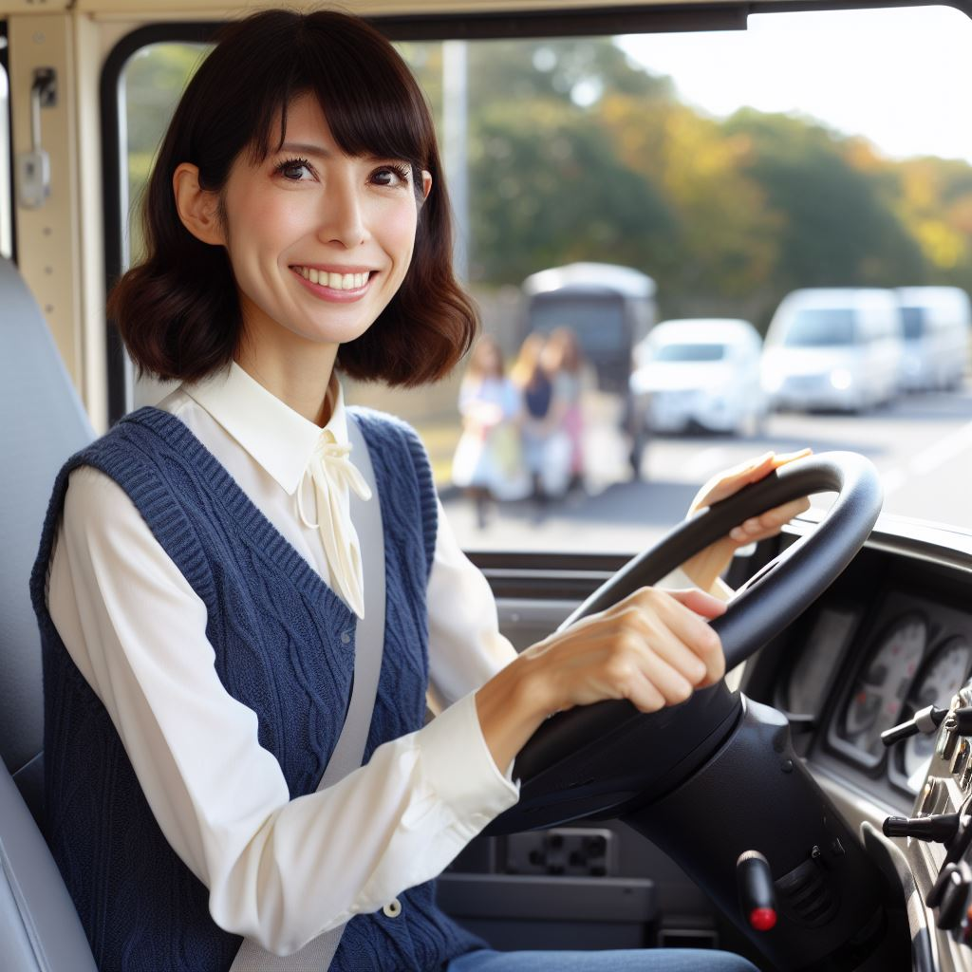
The bus driver waves, a friendly face, takes us around, all over the place.

Slide 15

The doctor and nurse, they heal and mend, making us better from start to end.

Slide 16

The dentist, oh, with tools so neat, keeps our teeth strong, what a treat!

Slide 17
These helpers all around our space, make our community a safer place.

Slide 18


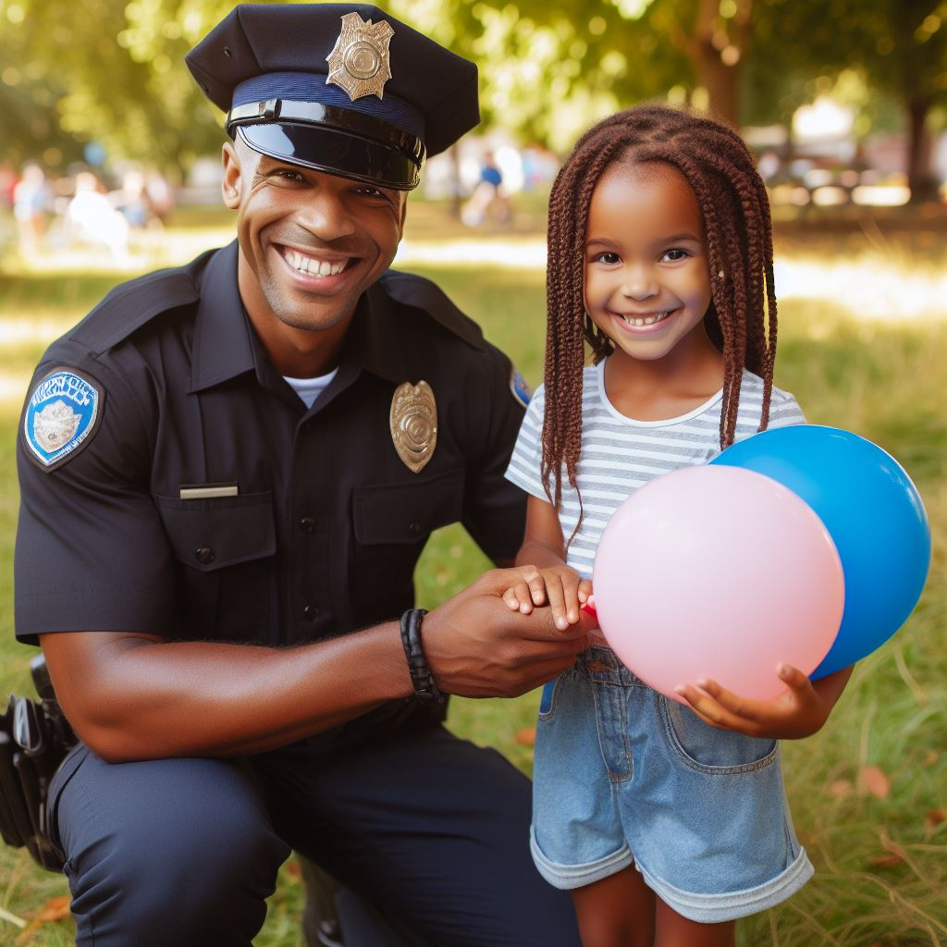
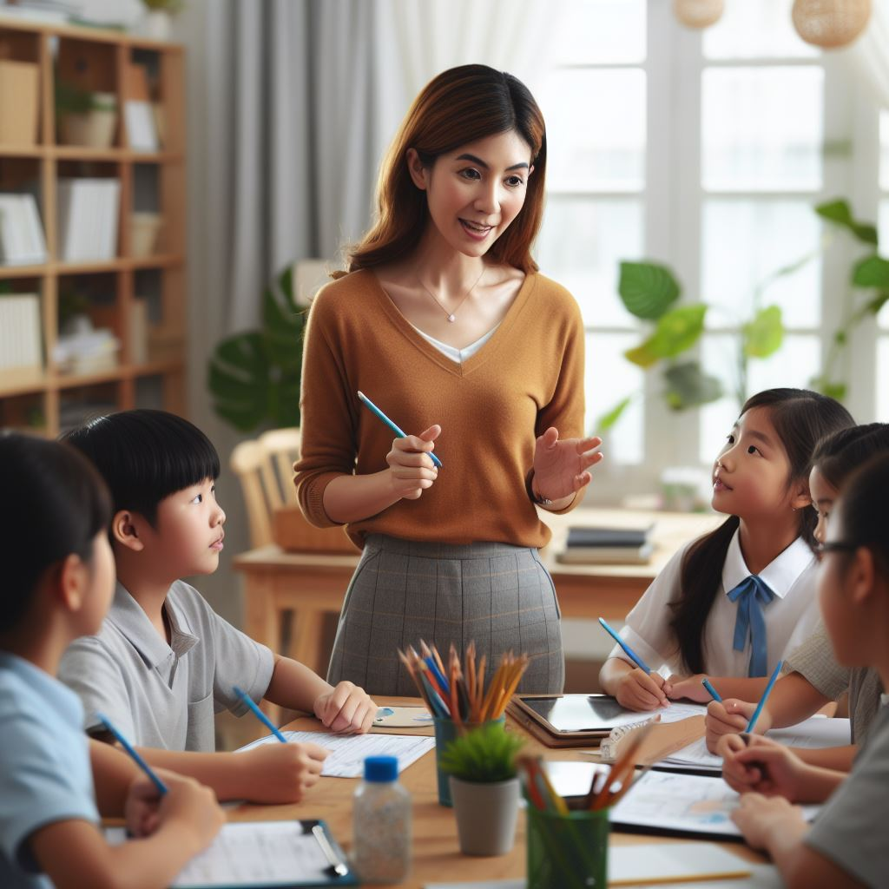
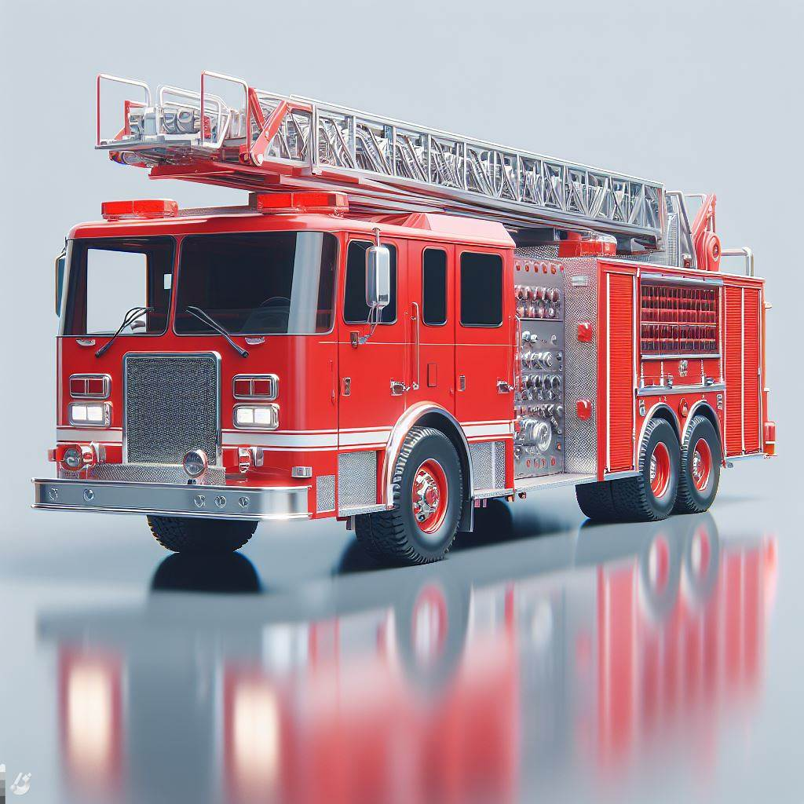

So, let's give a cheer, a hip-hip-hooray, for these amazing helpers in every way!

Slide 19
Activity:
Which community helper?

Slide 20

Who puts out fires?
Firefighter
Dentist
Principal

Slide 21
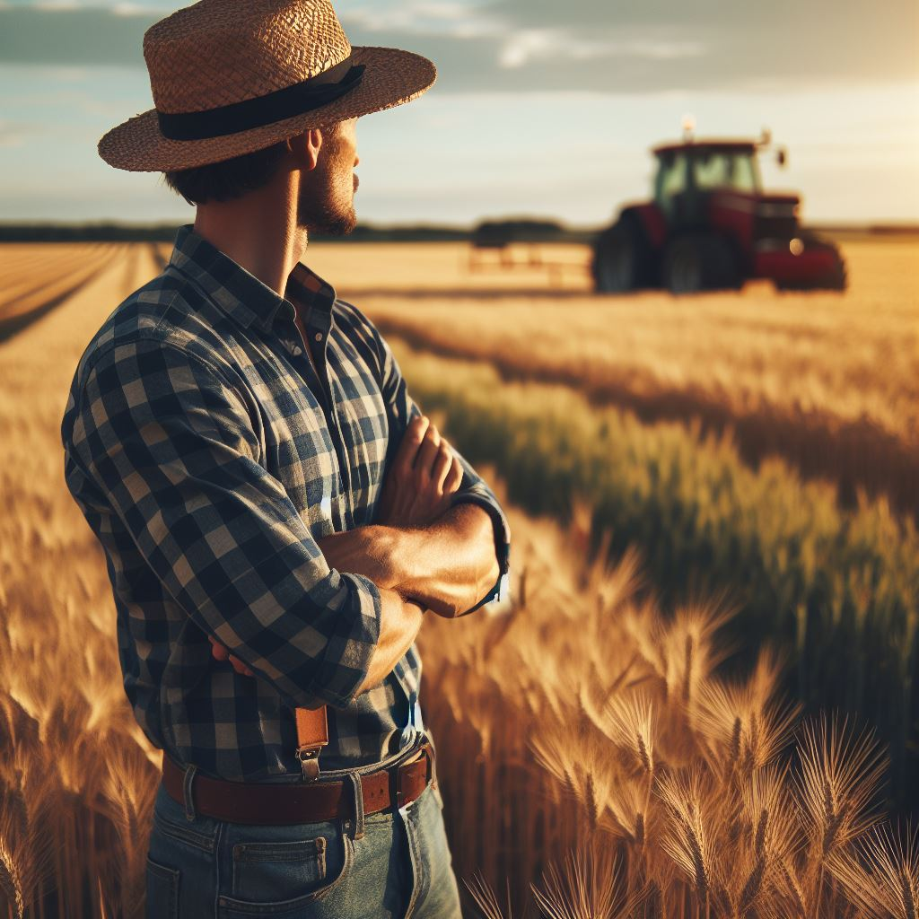
Who do we see when we are sick?
Bus Driver
Doctor/Nurse
Farmer

Slide 22
Who helps us learn?
Paramedic
Police Officer
Teacher

Slide 23
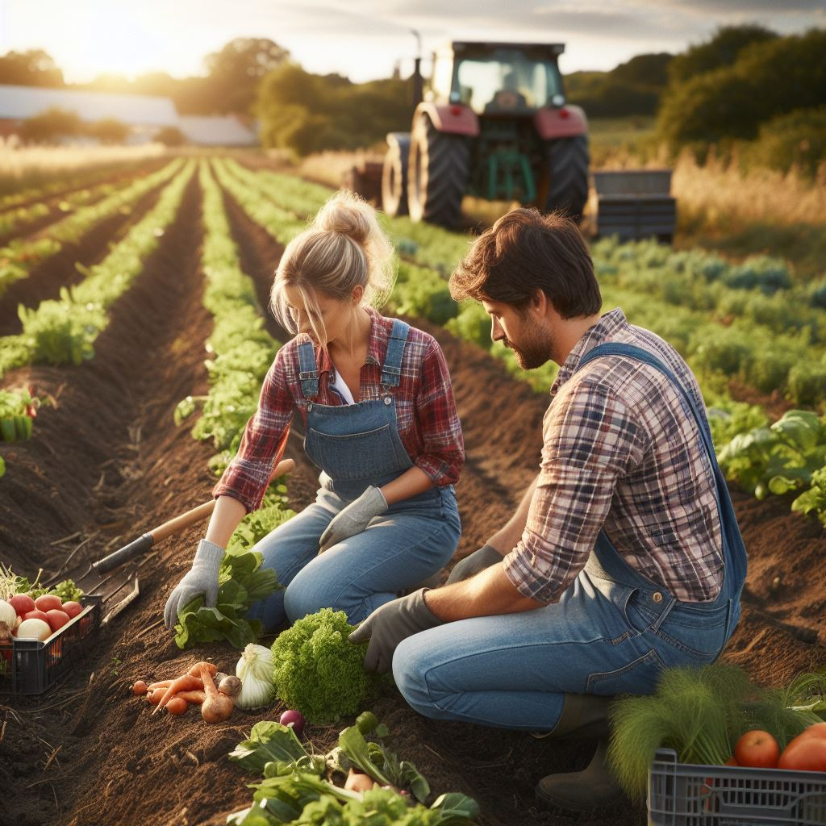
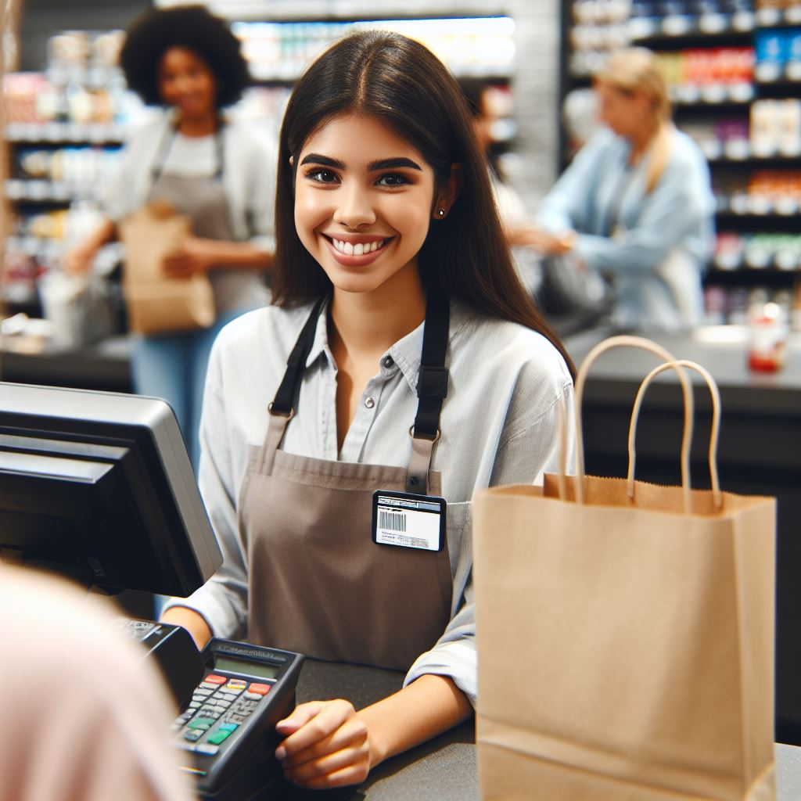
Who keeps us safe?
Farmers
Police Officer
Cashier

Slide 24
Who comes to help us when we are hurt?
Farmer
Paramedic
Bus Driver

Slide 25
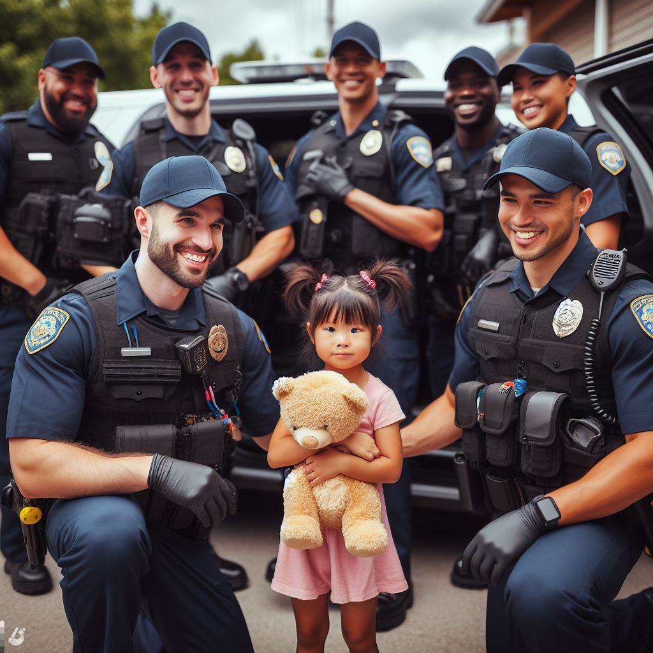
Who keeps our teeth healthy?
Dentist
Police Officer
Firefighter

Slide 26
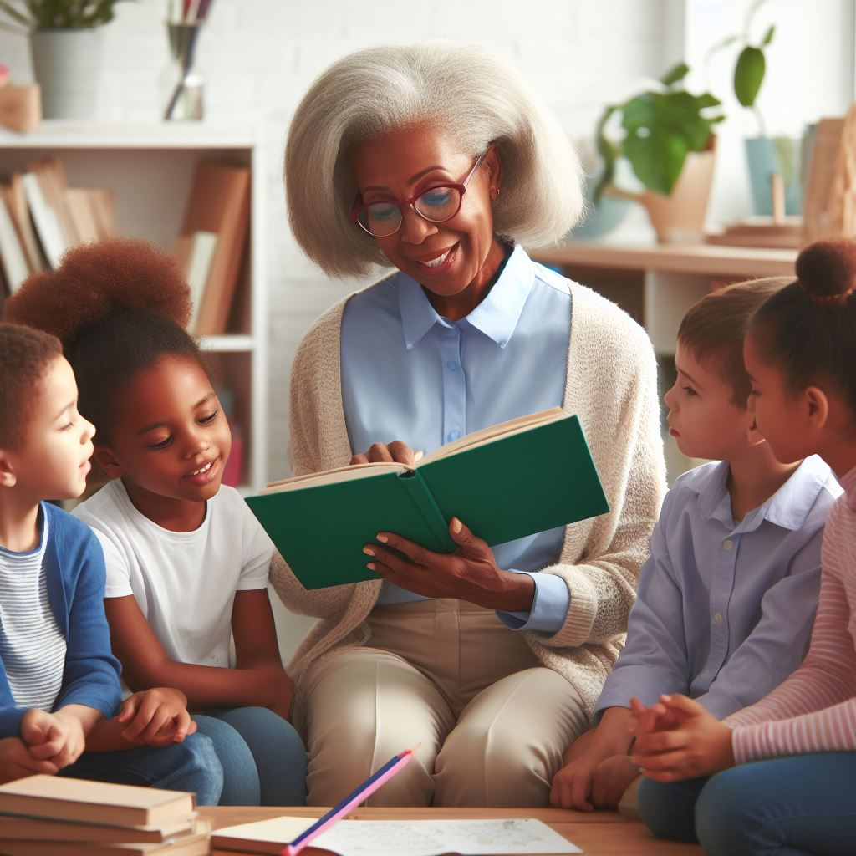
Who drives us to school?
Teacher
Farmer
Bus Driver

Slide 27
Activity:
Community Helper/Tool Matching Game

Slide 28
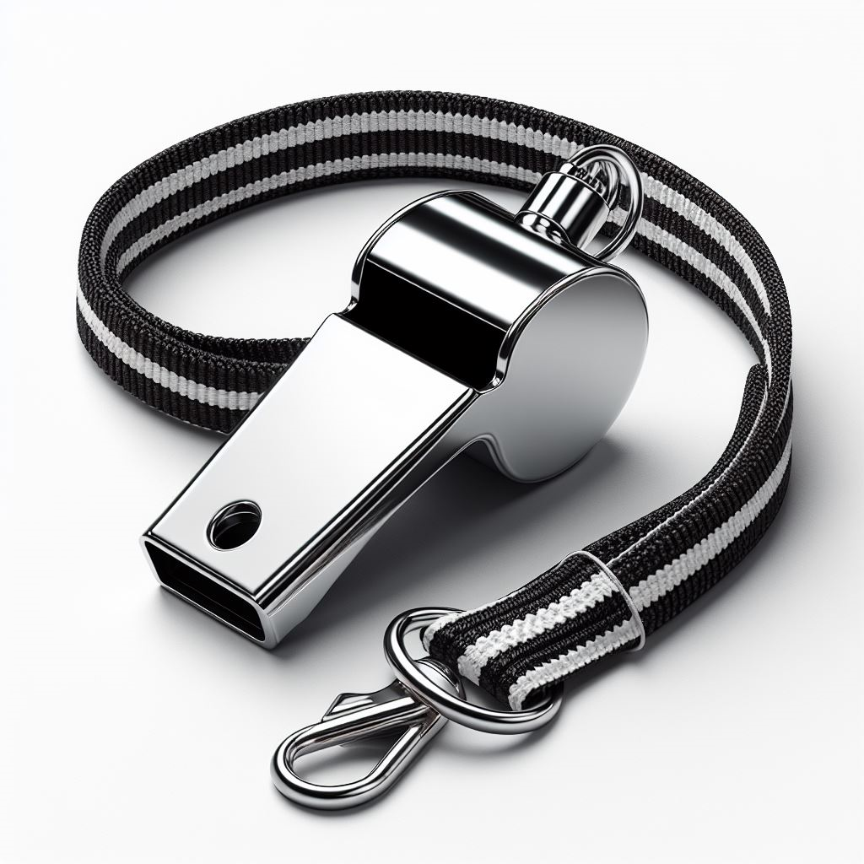
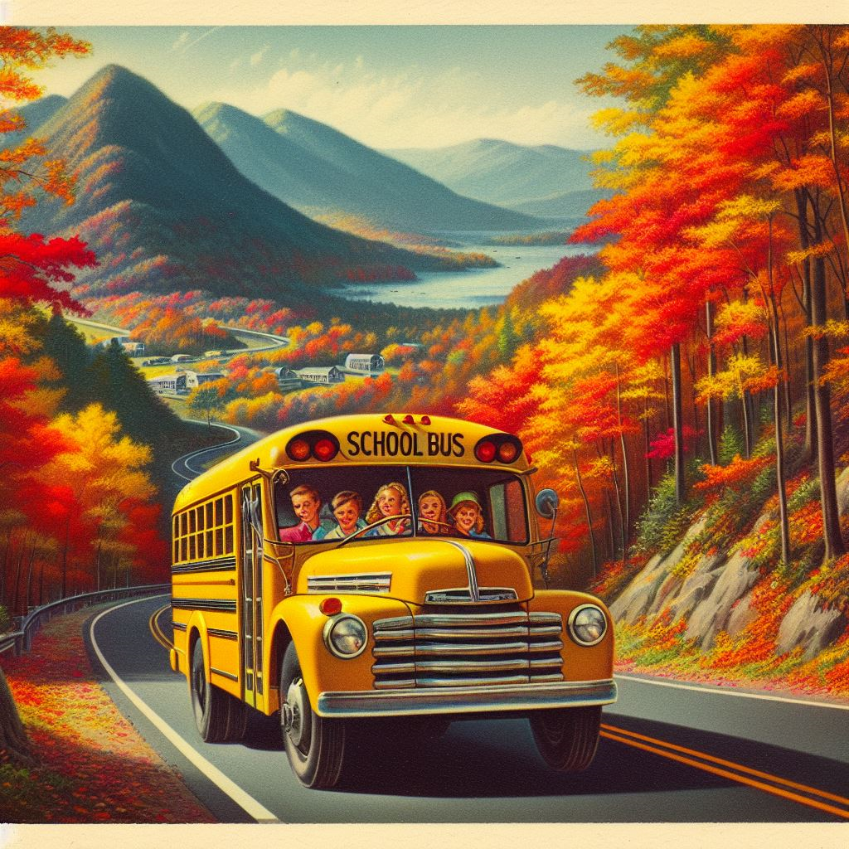
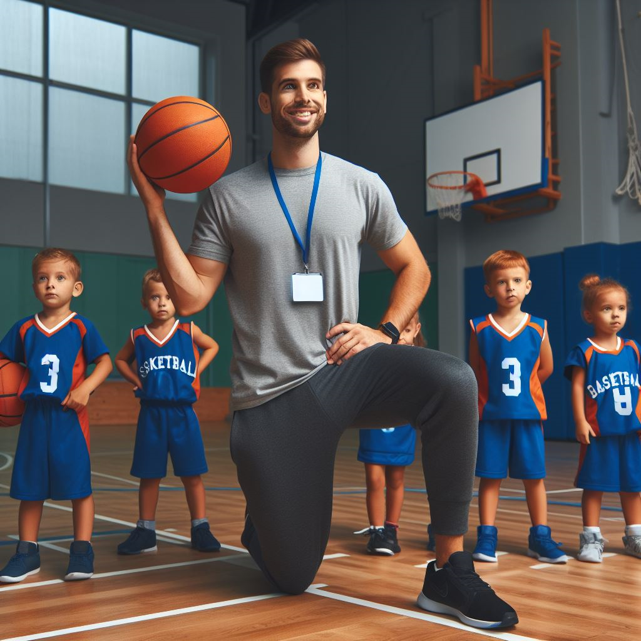
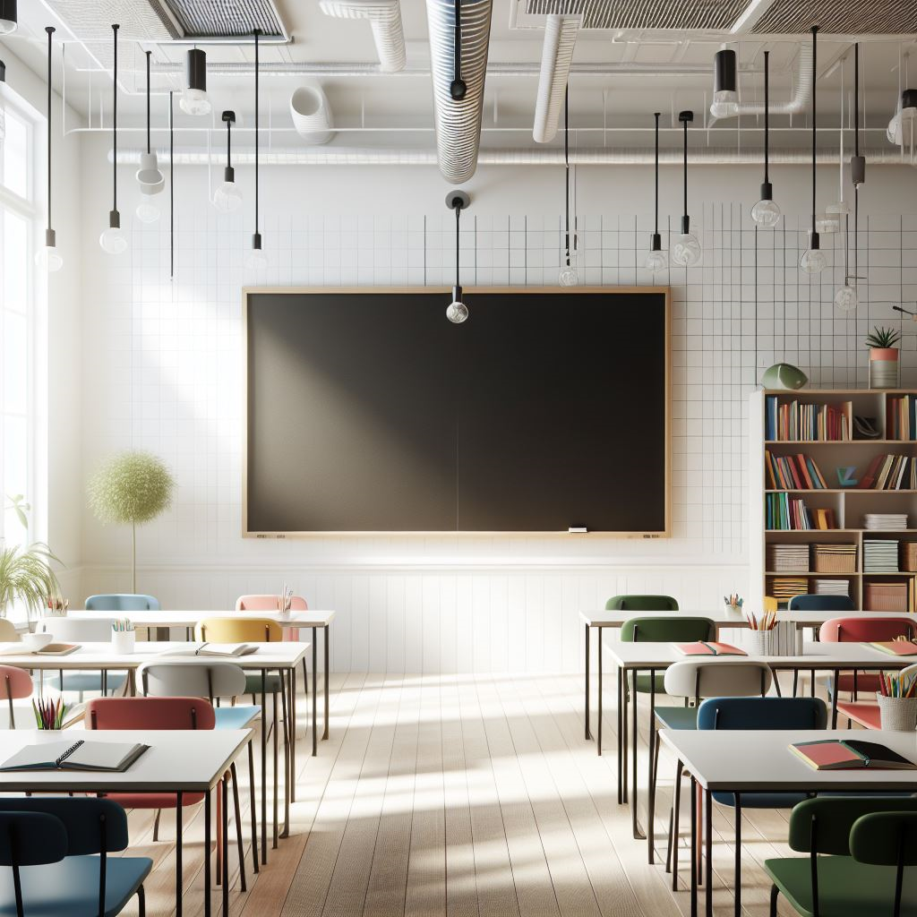
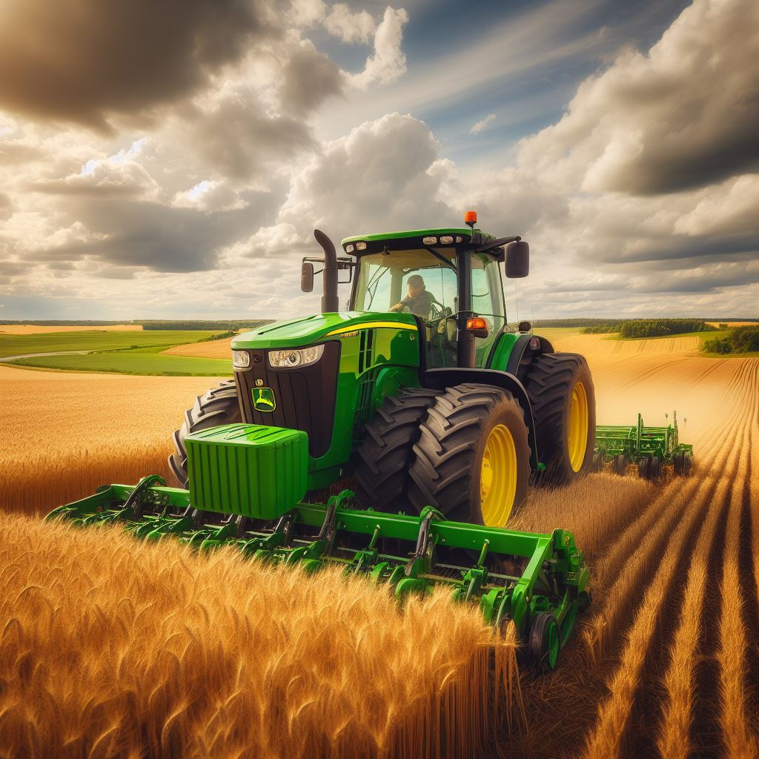

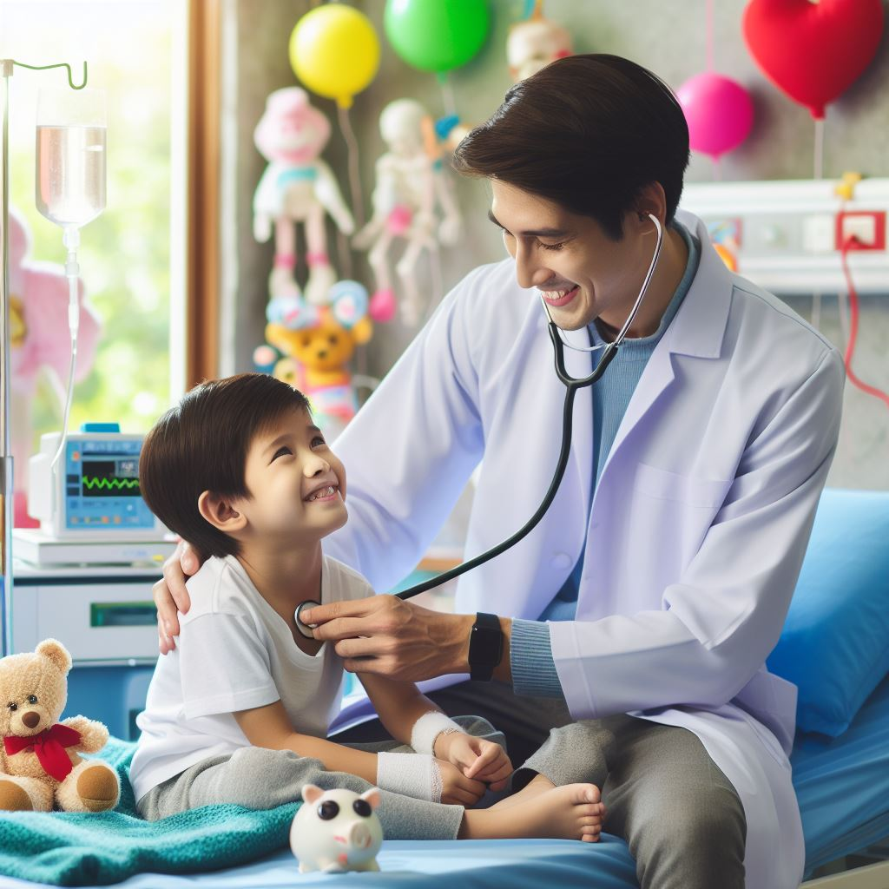
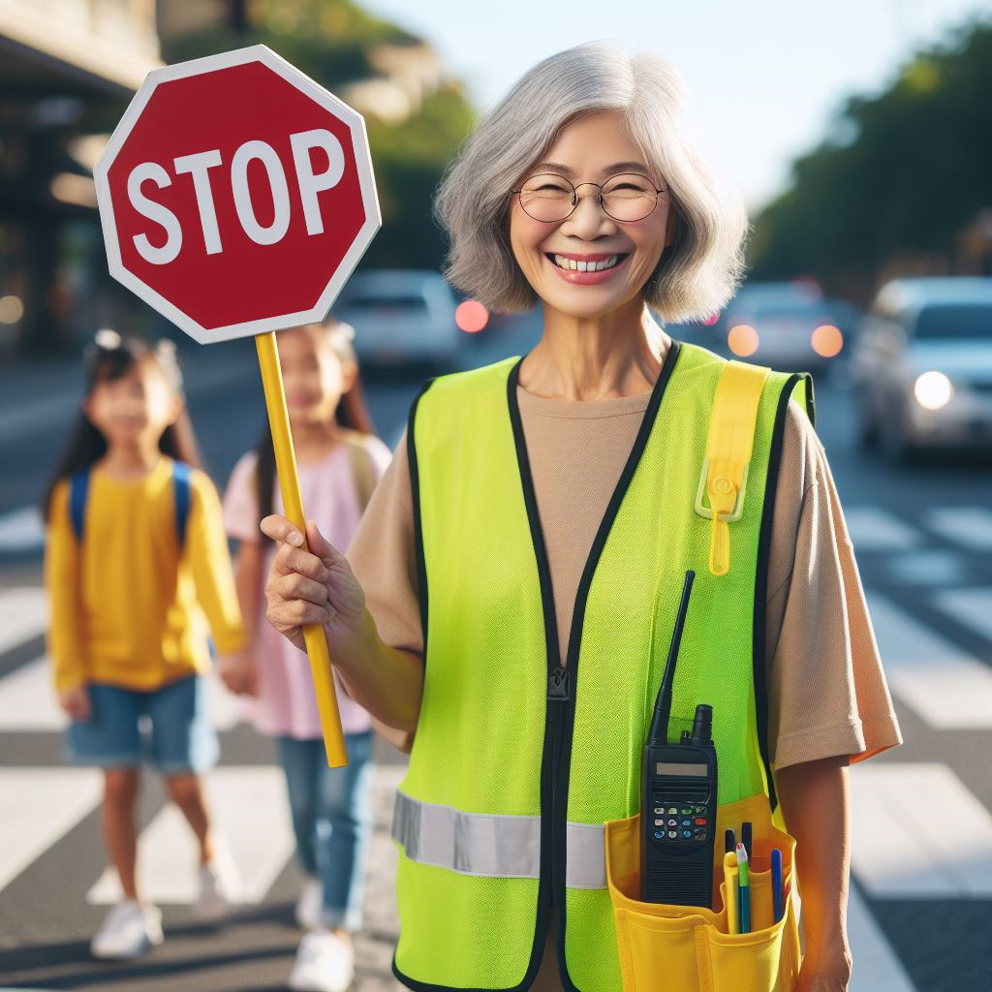
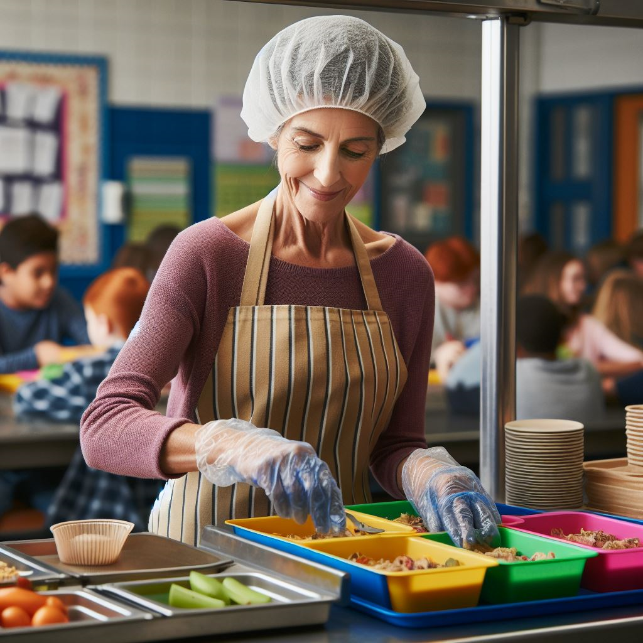
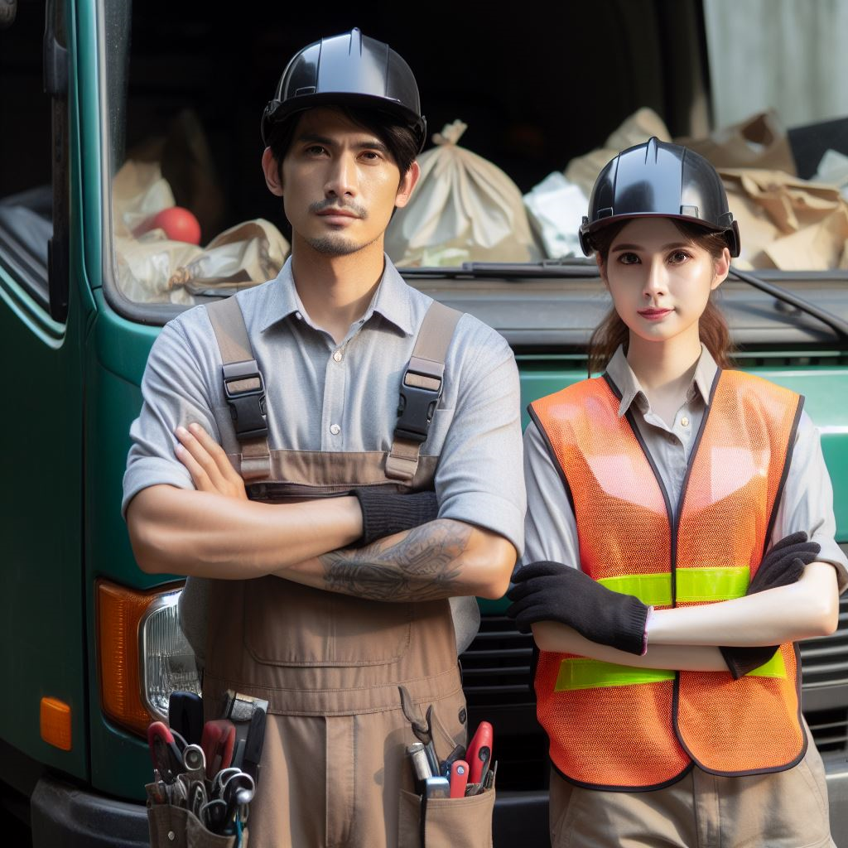
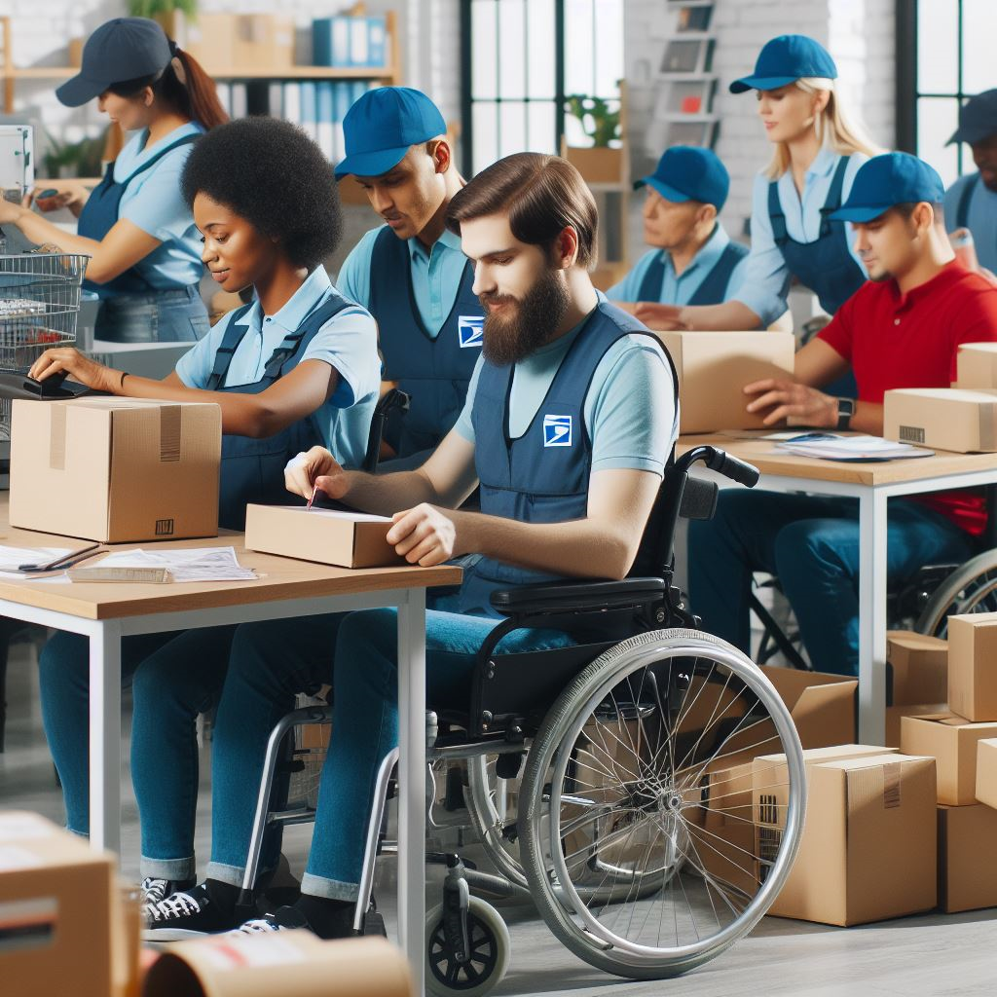
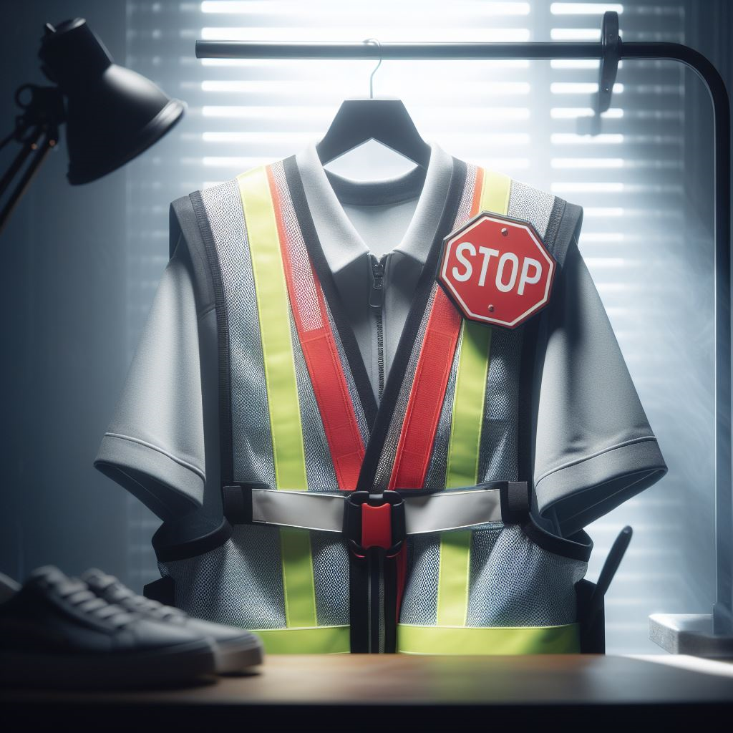
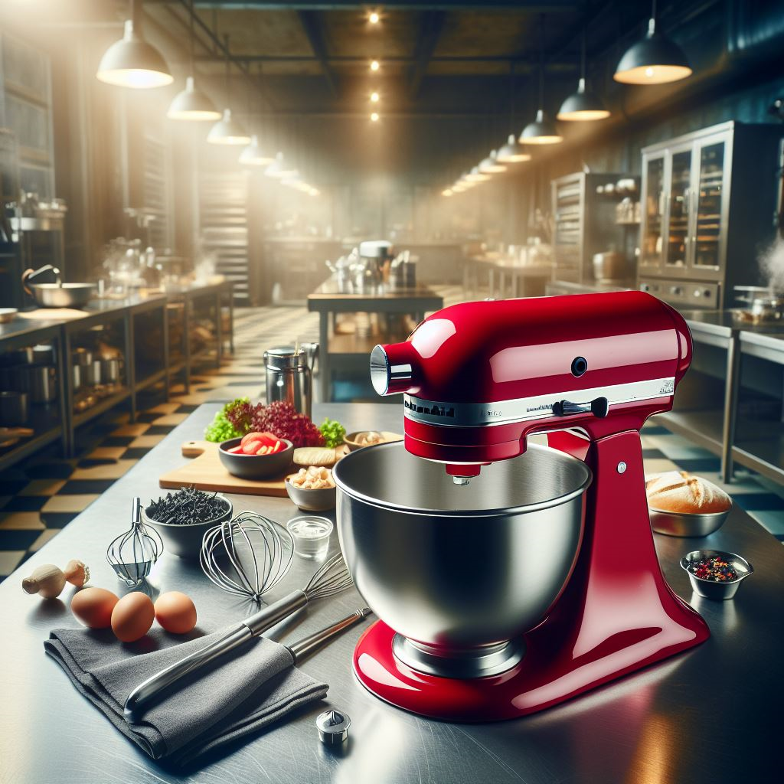
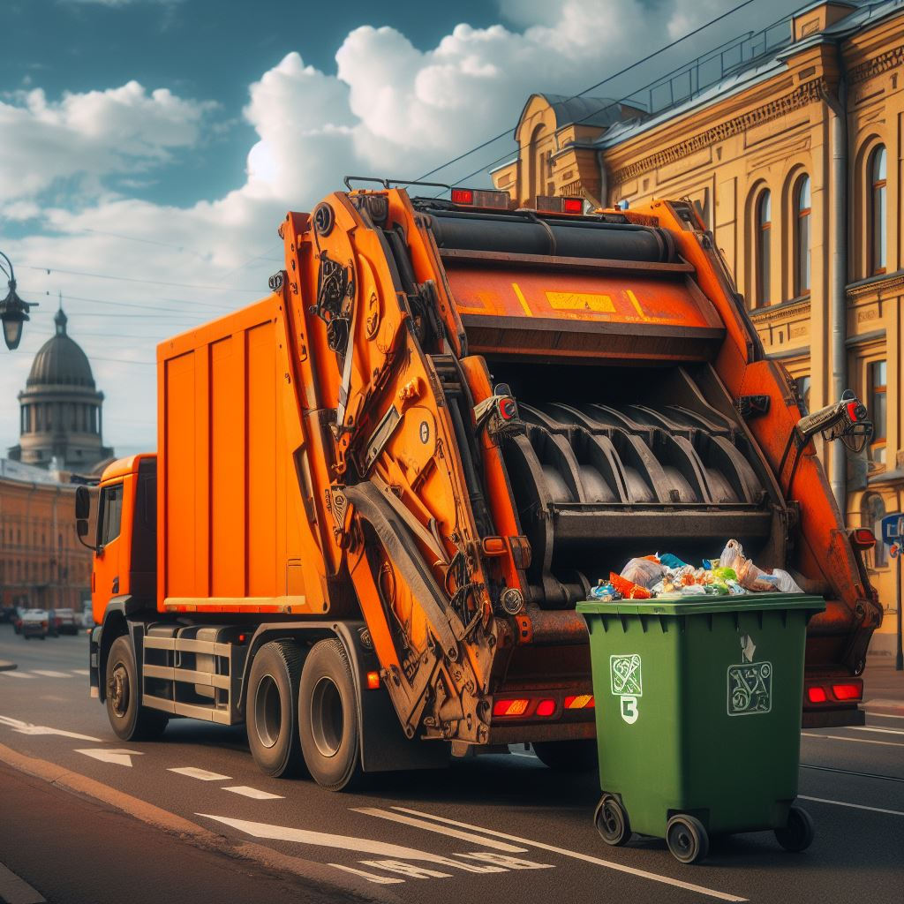
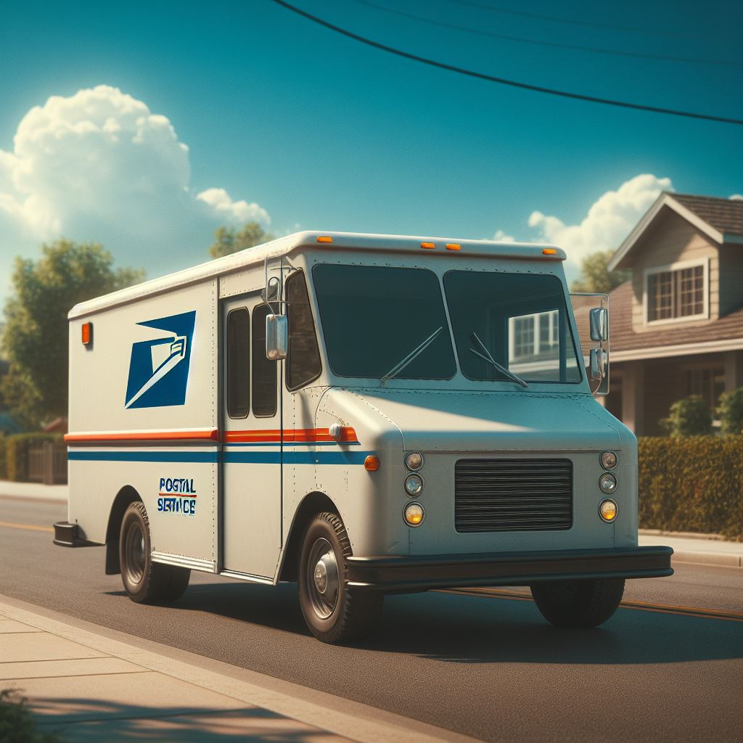
Who uses the tool?
Firefighter
Bus Driver
Coach
EMT
Teacher
Farmer
Doctor
Police
Crossing Guard
Cook
Waste Collector
Postal Worker
Notes:
Click the helper to reveal their tool

Slide 29

Activity: Color a community helper.

Slide 30
Hooray for community helpers!

Slide 31
All done, great job!

