Slide 1

Stealing
Second Grade Lesson 1

Slide 2
When we are learning
we will:

Slide 3

Keep our bodies in our own place!

Slide 4

Use our quiet voices!

Slide 5

Keep our ears open!

Slide 6

Have our brains ready to learn!

Slide 7

Why do we have learning-ready rules?

Slide 8

What is a rule?

Slide 9
A rule is a guide to help keep us safe or do something the right way. Rules can change from place to place.

Slide 10
What is a rule you have at home but not at school?

Slide 11
What is a rule that might be at the movie theaters but not at home?

Slide 12
We also have rules that do not change from place to place. These types of rules are called laws.

Slide 13
A law is an official set of rules. Laws do not change from place to place, and everyone must follow them.

Slide 14


Laws

Slide 15
When we follow the rules and laws, we are obeying them. Why do we obey rules and laws?

Slide 16
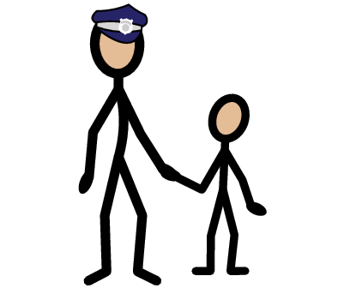
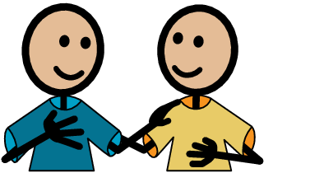
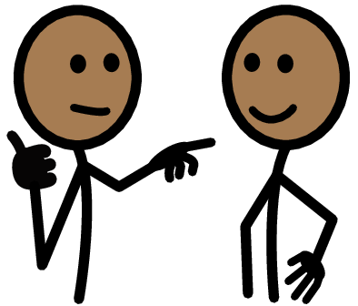
  Laws protect and keep us safe.
  Laws help settle problems and arguments.
  Laws keep order and make things fair.

Slide 17
Crime is an action that violates the law, we call this “breaking” the law.
Today we will learn about a crime called stealing. What is stealing?

Slide 18
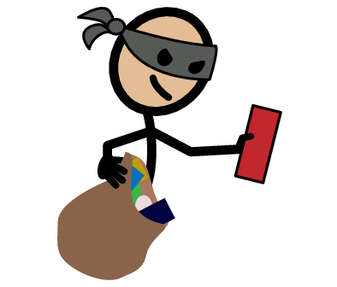
Stealing is taking something that does not belong to you without permission.
There are many laws against stealing, and they do not change, even at school. Remember, stealing is a crime!

Slide 19
How do you know something is yours?

Slide 20
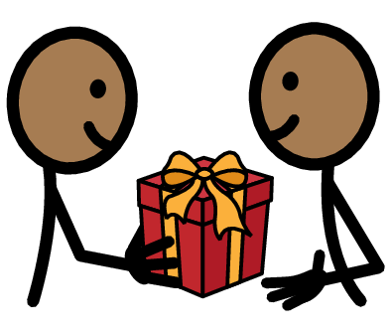

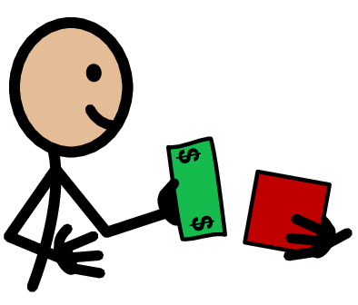
Something you bought with your own money.
Something someone gave to you.
Something you made.

Slide 21


Time for a game!
OR

Slide 22

My parents bought me a bike for my birthday, is it mine?
OR

Slide 24

I saved all my money and bought a video game. Is it mine?
OR

Slide 26

I took a cool pencil from my classmate's crayon box, is it mine?
OR

Slide 27


Slide 28
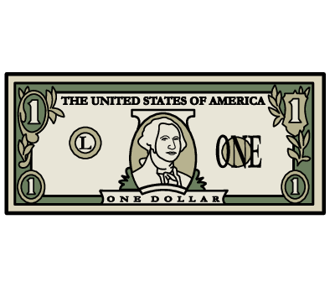
My grandmother gave me a dollar and I put it in my pocket. Is it mine?
OR

Slide 30

I left my golden coin in my pocket and put my pants in the wash - my sister found it in the washing machine. Is it hers to keep?
OR

Slide 32
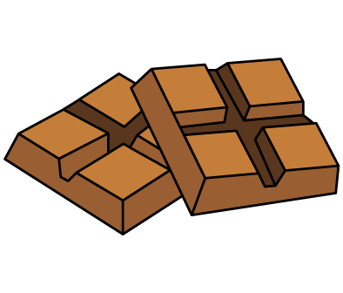
My dad left his chocolate candy on the counter and my brother took it. Was it his to take?
OR

Slide 34

I asked my friend if I could have her hair tie, she said yes. Is it mine?
OR

Slide 36

My cousin has one popsicle left in the freezer and I want it. Is it mine to take?
OR

Slide 38

I gave my abuela a gift for Grandparents Day, is it hers?
OR

Slide 40
How does it feel when you lose something?
How does it feel when you know someone took something that belonged to you?
js

Slide 41
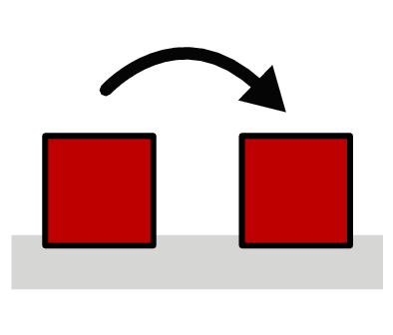
When someone steals there must be results to their actions. This is called a consequence;it is what happens next.

Slide 42
What is something that might happen when someone steals something?

Slide 43
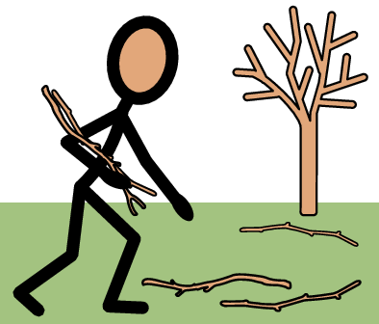
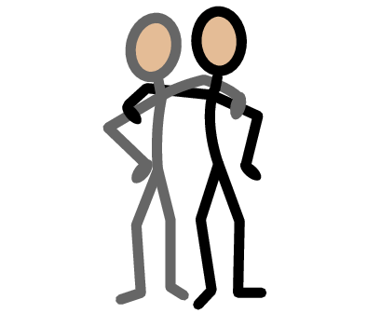
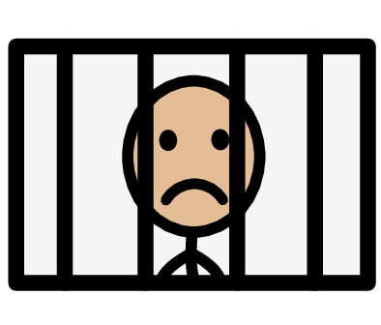
  Go to jail
Community service
Loss of trust
Broken friendships
Everyone pays higher prices in the stores
Low self-esteem
Lose friends

Slide 44
If someone steals something, they should try to make the situation right. What are some ways a person can make the situation right when they steal something?

Slide 45
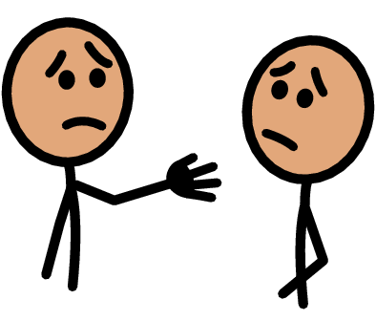

  Return it to the owner.
  Apologize.
  Accept the consequences and learn from their mistakes.

Slide 46
What should you do if you see someone stealing?

Slide 47
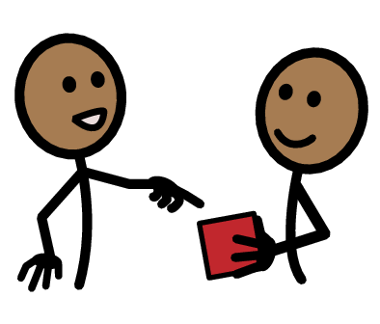

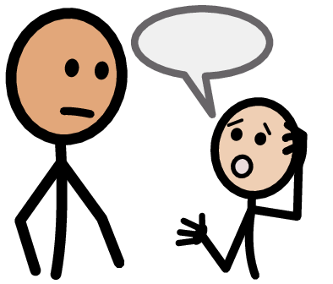
Tell an adult you trust. This does not make you a tattle tale. It makes you a responsible citizen and community helper.
If it is safe to approach the person, tell them they should not do that because it is against the law.

Slide 48
Remember:
Stealing is taking something that does not belong to you. There are many laws against stealing, and they do not change, even at school.
Stealing is a crime!

Slide 49
Positive outcomes for doing something good:
Being a good friend
Feeling proud
Respect from adults
Special rewards

Slide 50
Do you agree stealing is bad?

Slide 51

We are going to make commitments today that we are never going to steal.

Slide 52
I commit to being a good citizen. I commit to never steal and always respect others’ property.
______________________________
(sign name here)

Slide 53
All done, great job!

