Slide 1

Stranger Awareness
Second Grade Lesson 2

Slide 2
When we are learning we will:

Slide 3

Keep our bodies in our own place!

Slide 4

Use our quiet voices!

Slide 5

Keep our ears open!

Slide 6

Have our brains ready to learn!

Slide 7
A stranger is someone you don't know well. They could be a person you've never met, someone you see often but don't know much about, or someone whose name and where they live is a mystery to you.

Slide 8
An acquaintance is a person that you may have seen before, but you do not know them. They are people that you may see on a regular basis or friends of your friends, but you don't know them. You should still consider them as strangers when you are out without a grown-up. An acquaintance should usually be treated like a stranger.

Slide 9
Activity: Stranger or acquaintance?
Notes:
Tell the students to Identify if the person is a stranger or an acquanitance with Yes or No. Thumbs up or down.

Slide 10


The mail carrier who delivers your mail every day
OR

Slide 11
You play on the same soccer team, but you haven't spent much time with them outside of practice
OR

Slide 12
A person you've never met before at the park
OR

Slide 13
You're walking home from school, and a person you don't know offers you a piece of candy.
OR

Slide 14
Your teacher from last year.
OR

Slide 15
You're waiting for your parents to pick you up from school, and someone you've never met before says, "Come with me, I'll take you home.”
OR

Slide 16
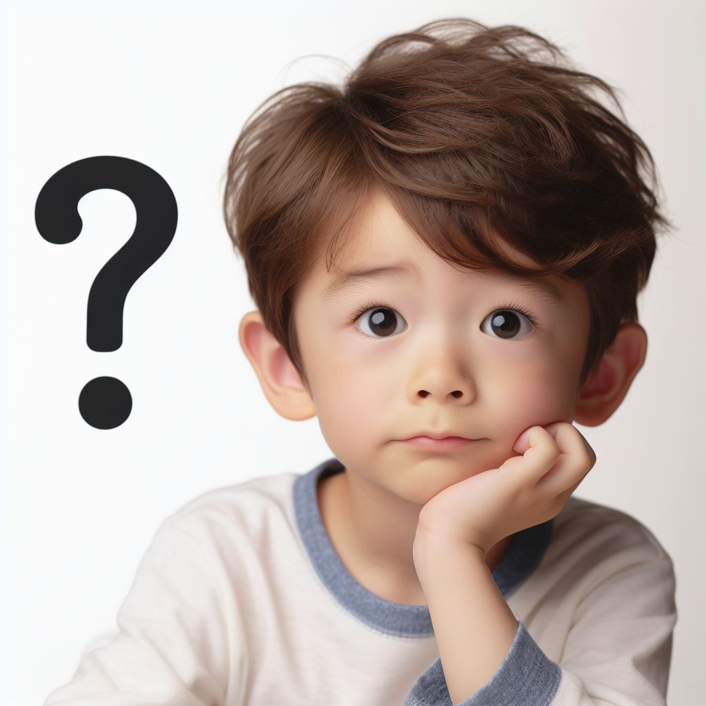
What should we do if we see a stranger?

Slide 17

Don't talk to strangers.

Slide 18

Don't take anything from a stranger.

Slide 19
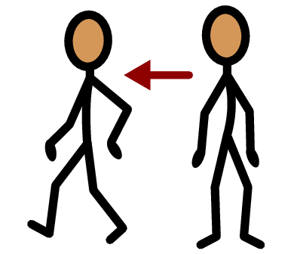
Don't go with a stranger.

Slide 20
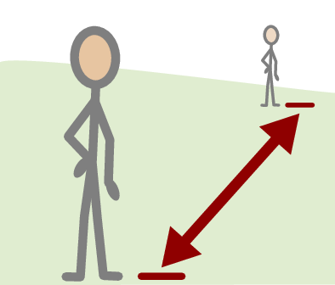
Keep a safe distance from a stranger.

Slide 21
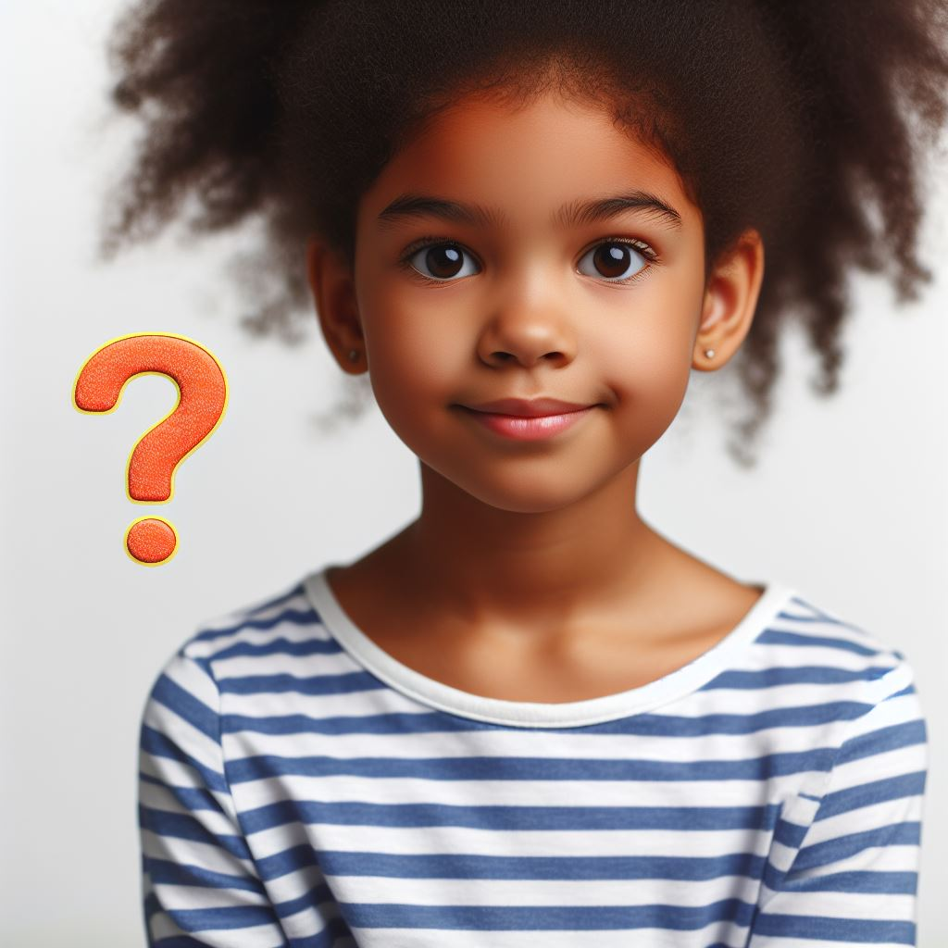
What do we do if we see an acquaintance?

Slide 22
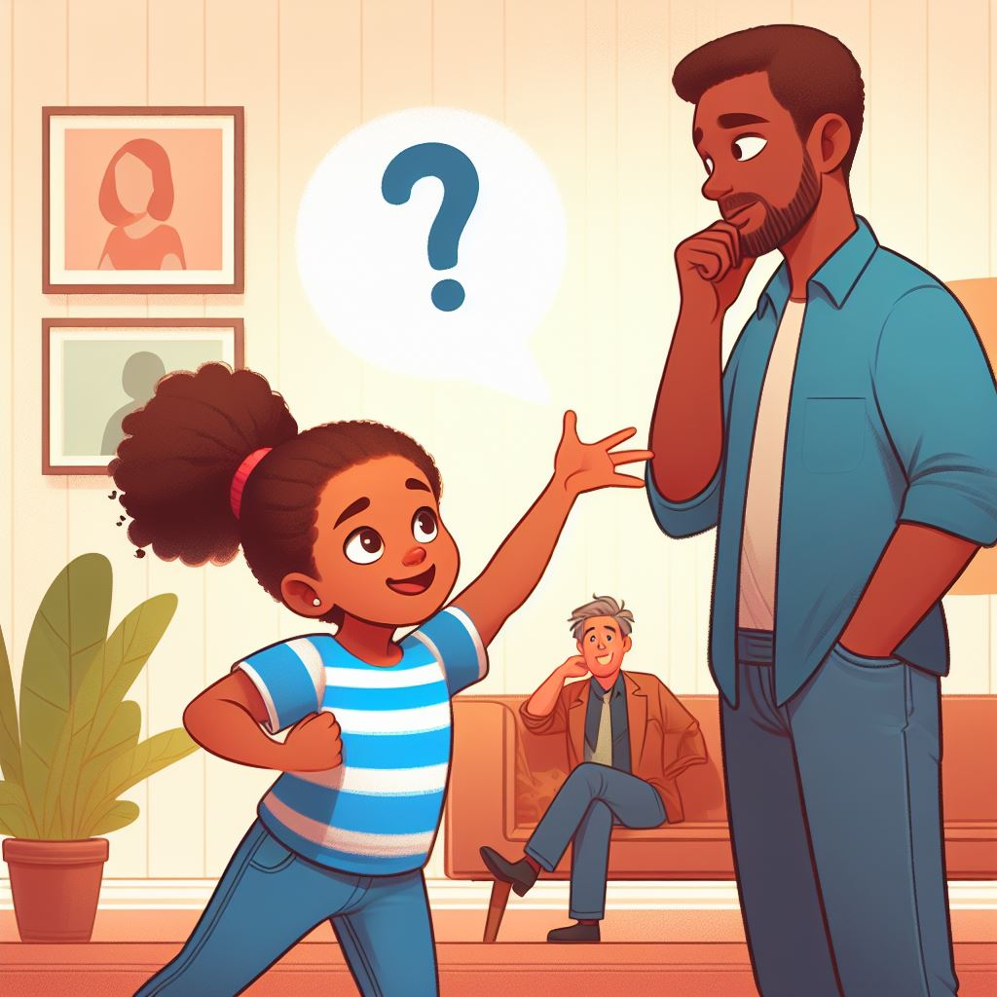
Check with a trusted adult.

Slide 23
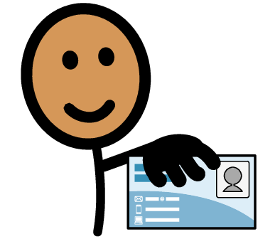
Don’t share personal information.

Slide 24
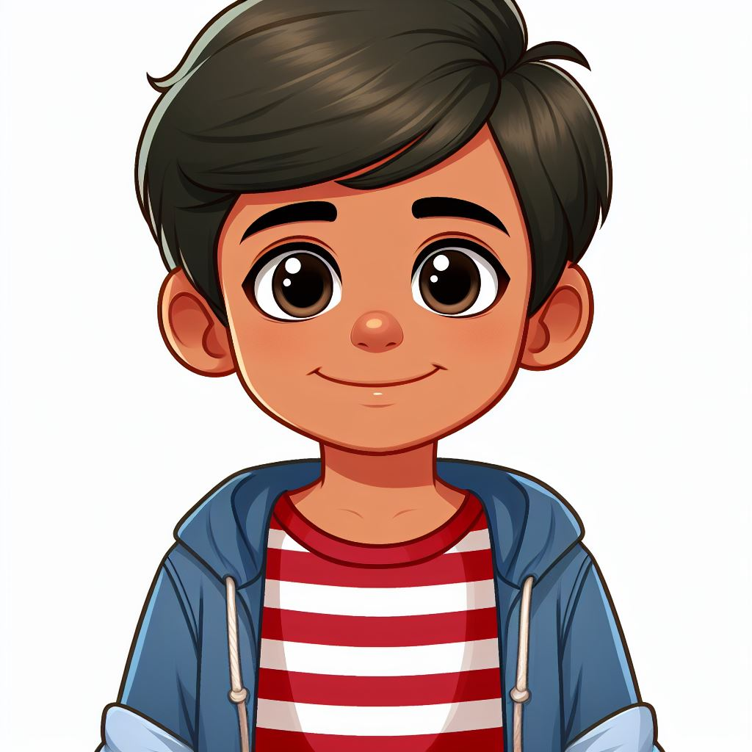
Trust your feelings.

Slide 25
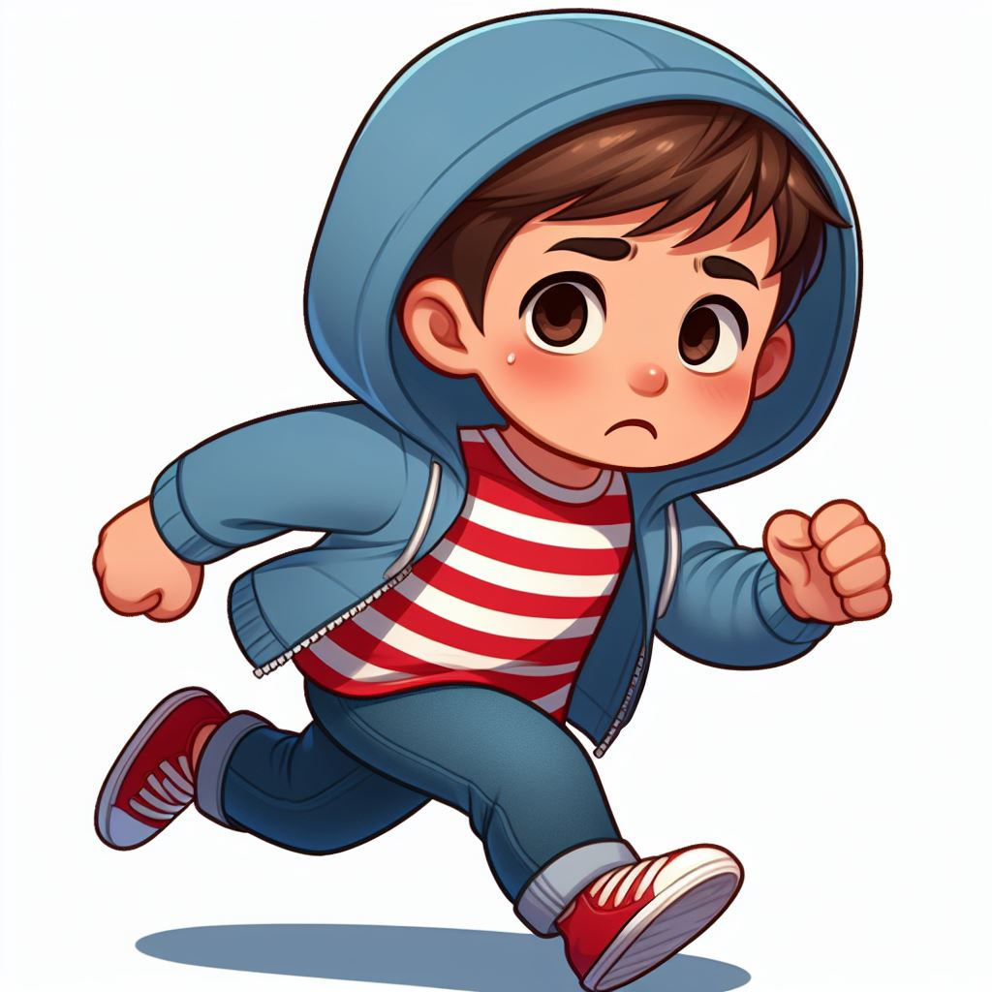
If someone does try to touch you, scream “No!”, yell for help and run away.
Staying Safe in Public

Slide 26
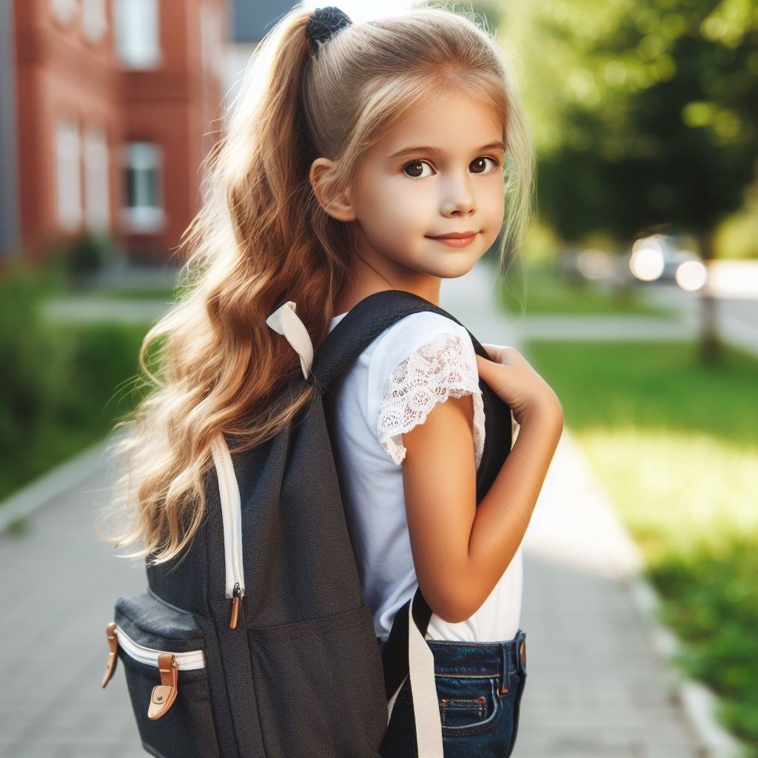
Hold your personal possessions close to you.
Staying Safe in Public

Slide 27


Avoid public restrooms. If you must use the restroom, make sure you take a buddy.
Do not go in alone.
Staying Safe in Public

Slide 28
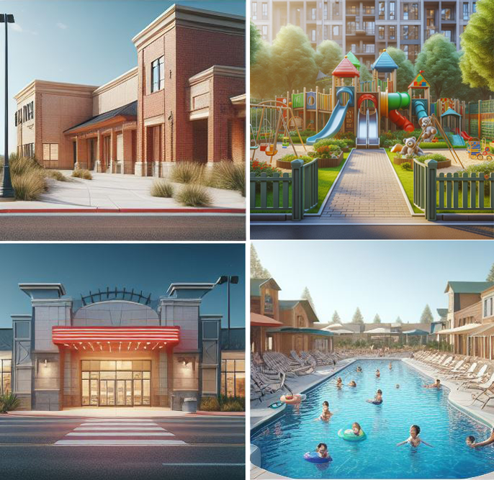
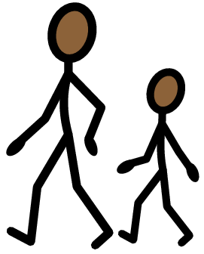
Never go to public places such as malls, movies, parks, or pools alone. Always go with an adult you trust.
Staying Safe in Public

Slide 29
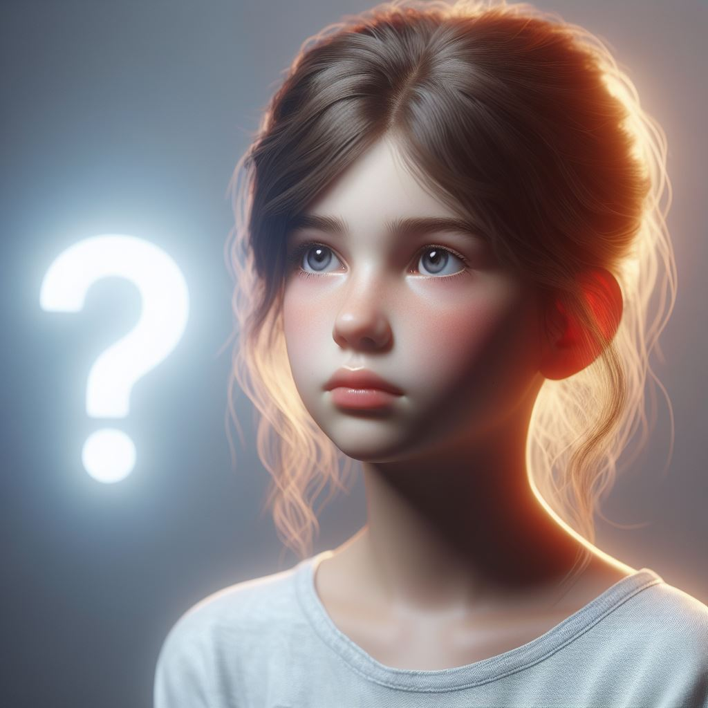
Where can you find strangers?

Slide 30
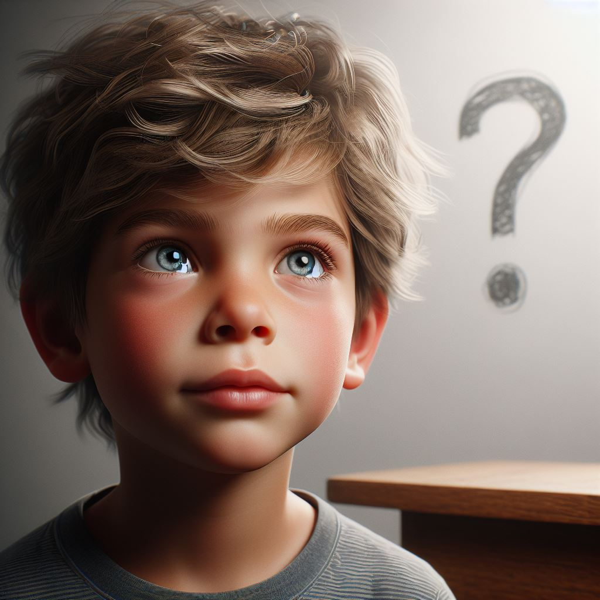
Are all strangers bad people?

Slide 31
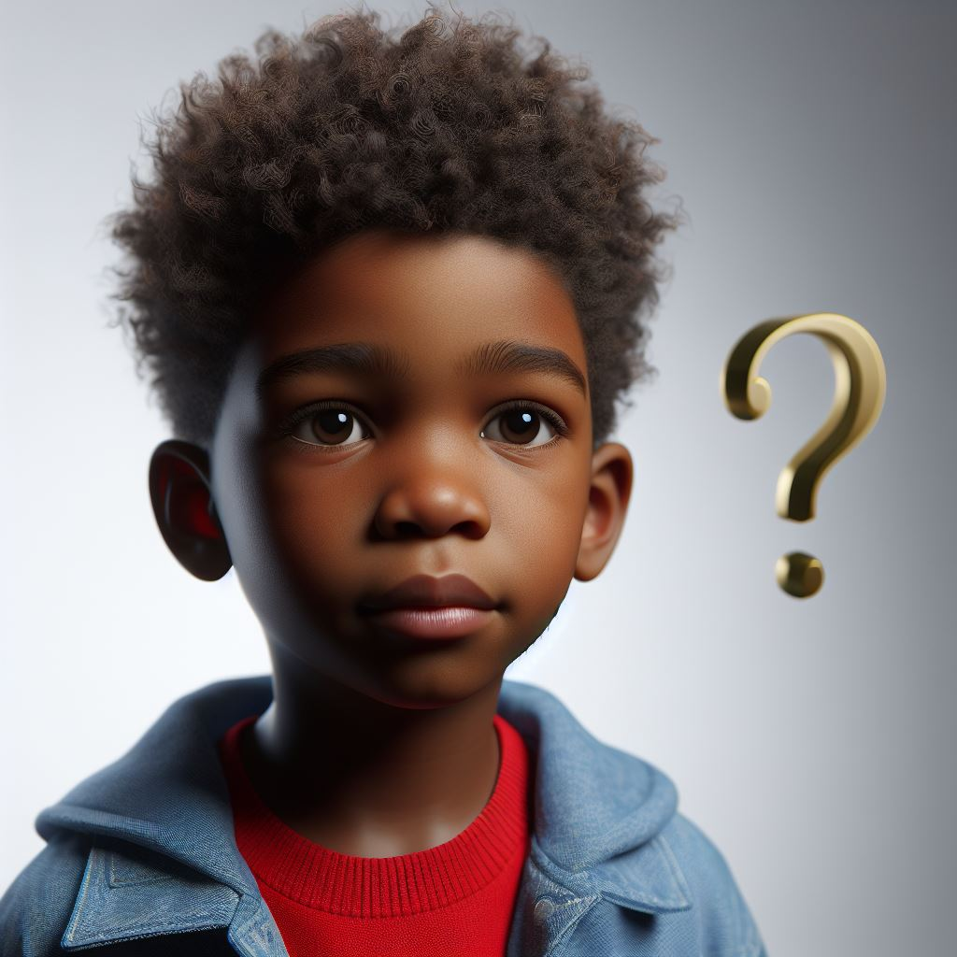
How do you stay safe while in a public place?

Slide 32
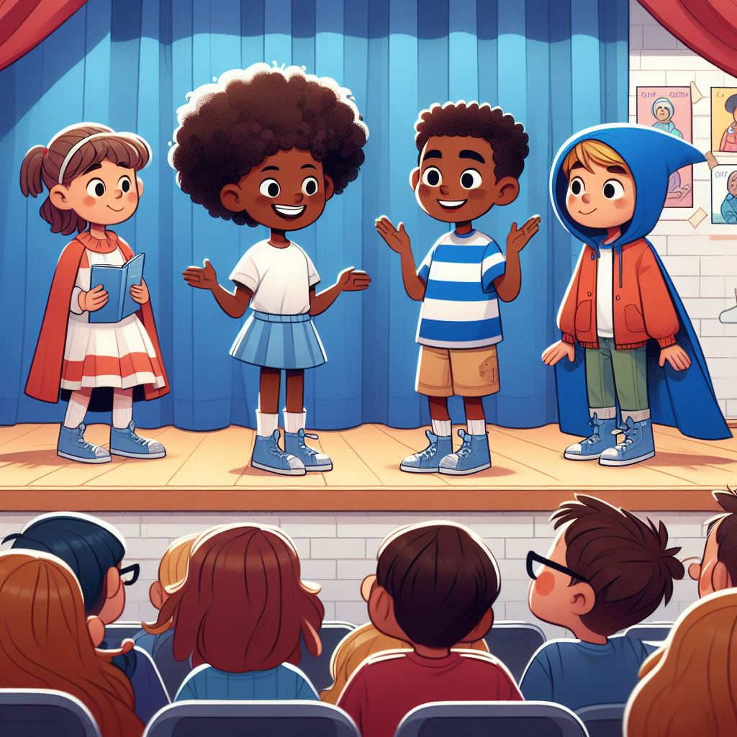
Activity:
Role Play

Slide 33
Activity:
Stranger Awareness Pledge

Slide 34
All done, great job!

