Slide 1

Respect for Rules and Authority
Second Grade Lesson 3

Slide 2
When we are learning we will:

Slide 3

Keep our bodies in our own place!

Slide 4

Use our quiet voices!

Slide 5

Keep our ears open!

Slide 6

Have our brains ready to learn!

Slide 7
Define the word “authority”

Slide 8
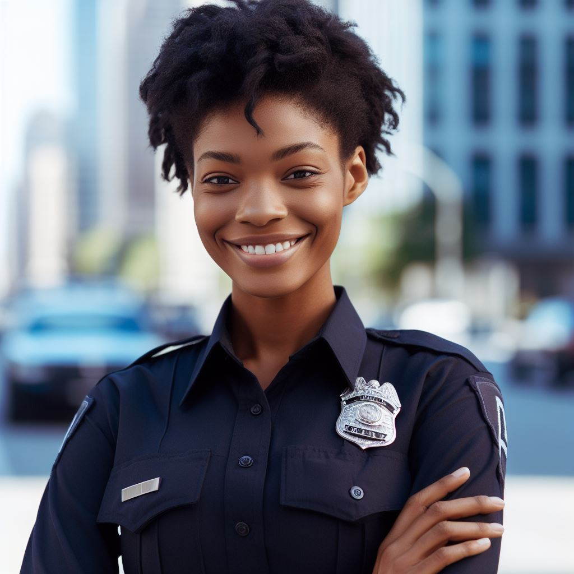

Authority: A person who makes and can enforce rules or laws.
Police Officer
Principal

Slide 9
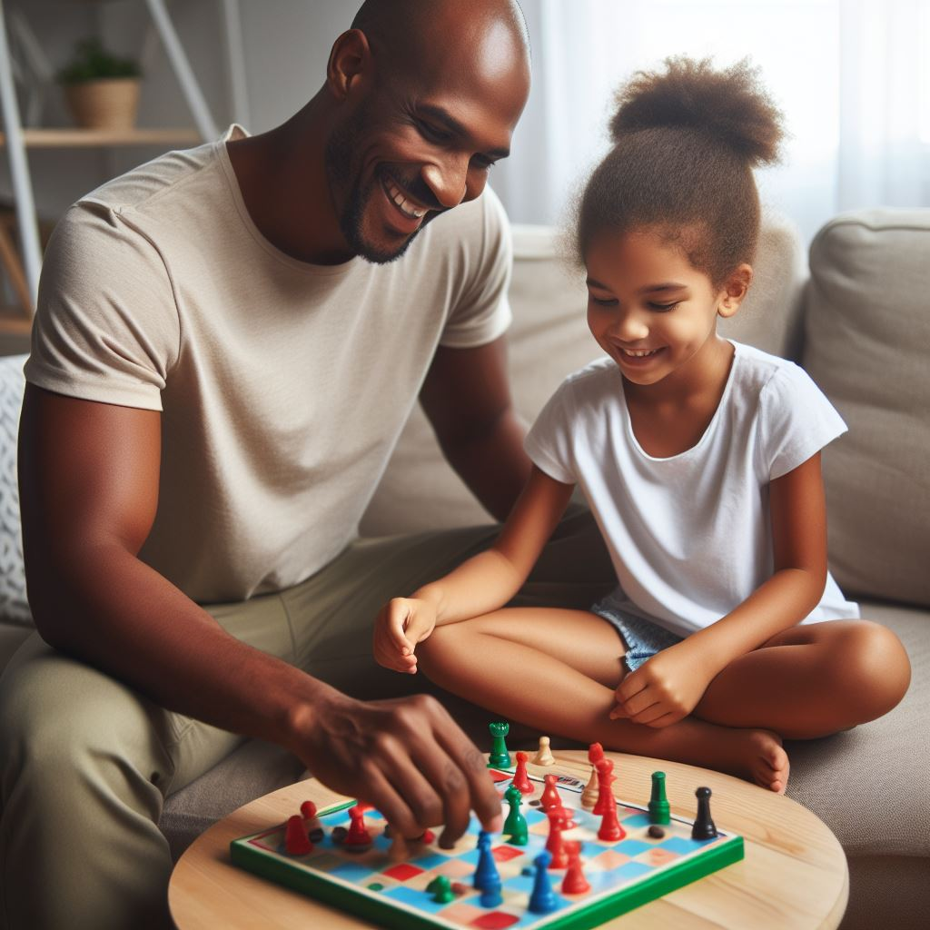
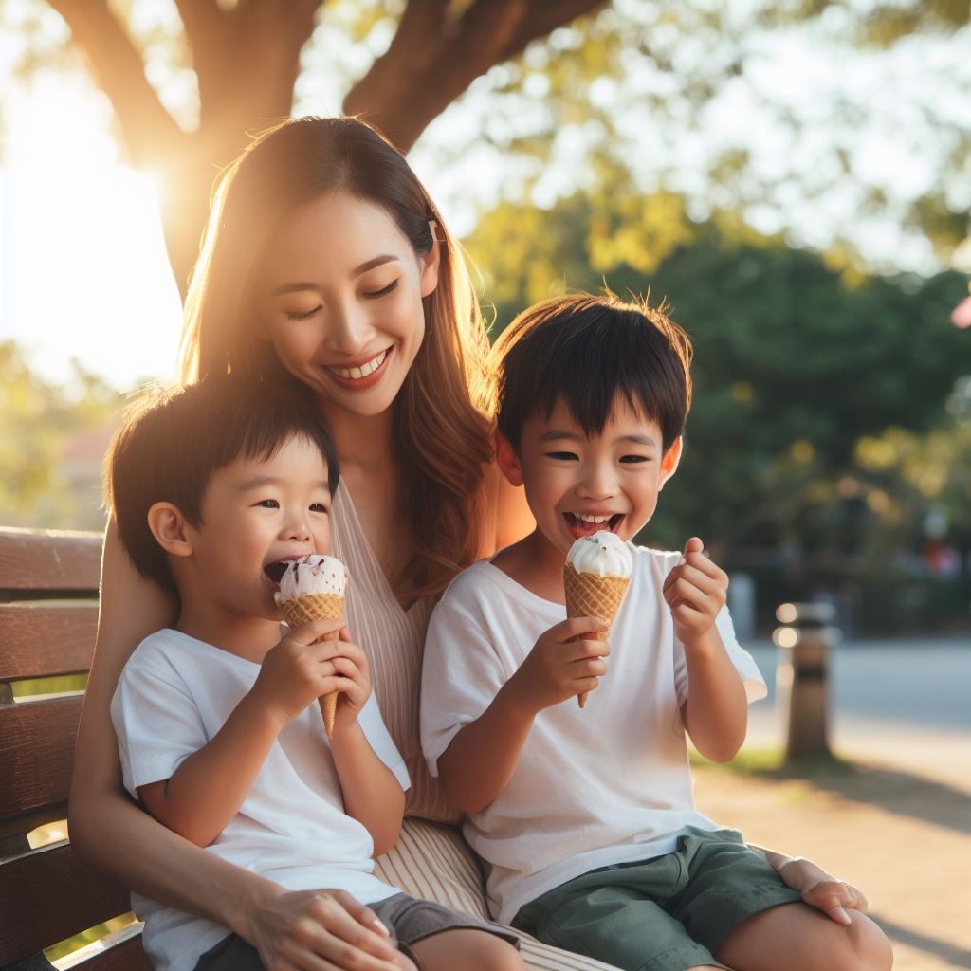
Your parents or guardians have the authority to enforce rules.

Slide 10
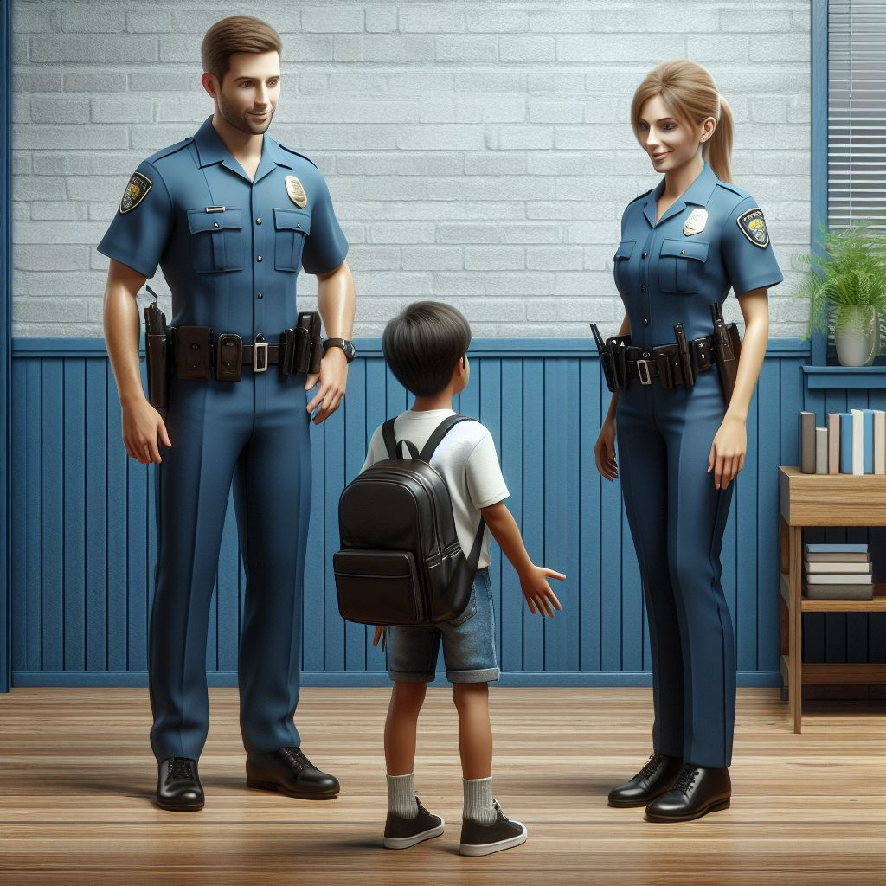
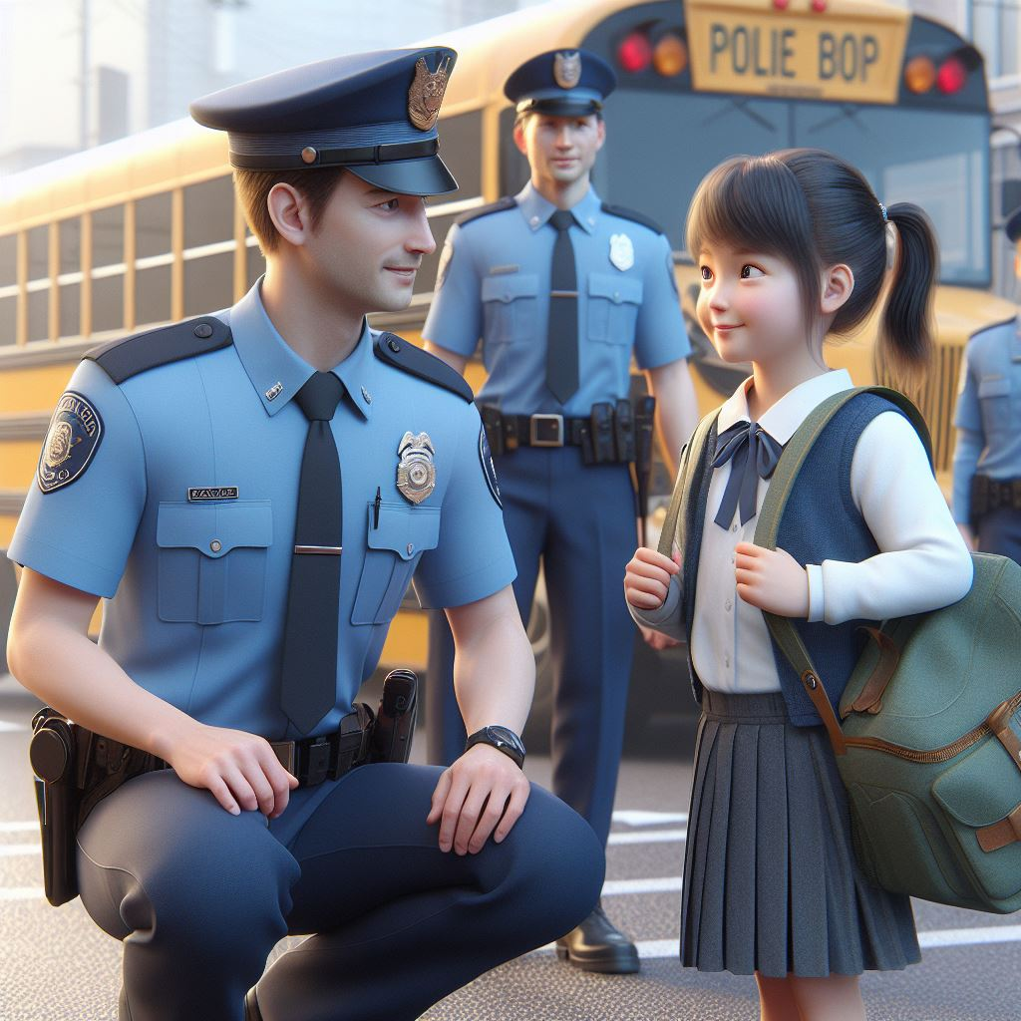
A police officer has the authority to enforce laws.

Slide 11
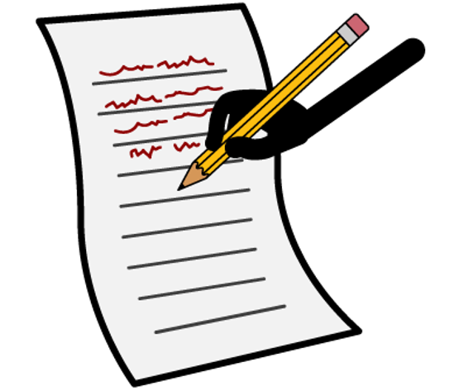
Activity: List the people who have the authority to enforce rules and laws.

Slide 12
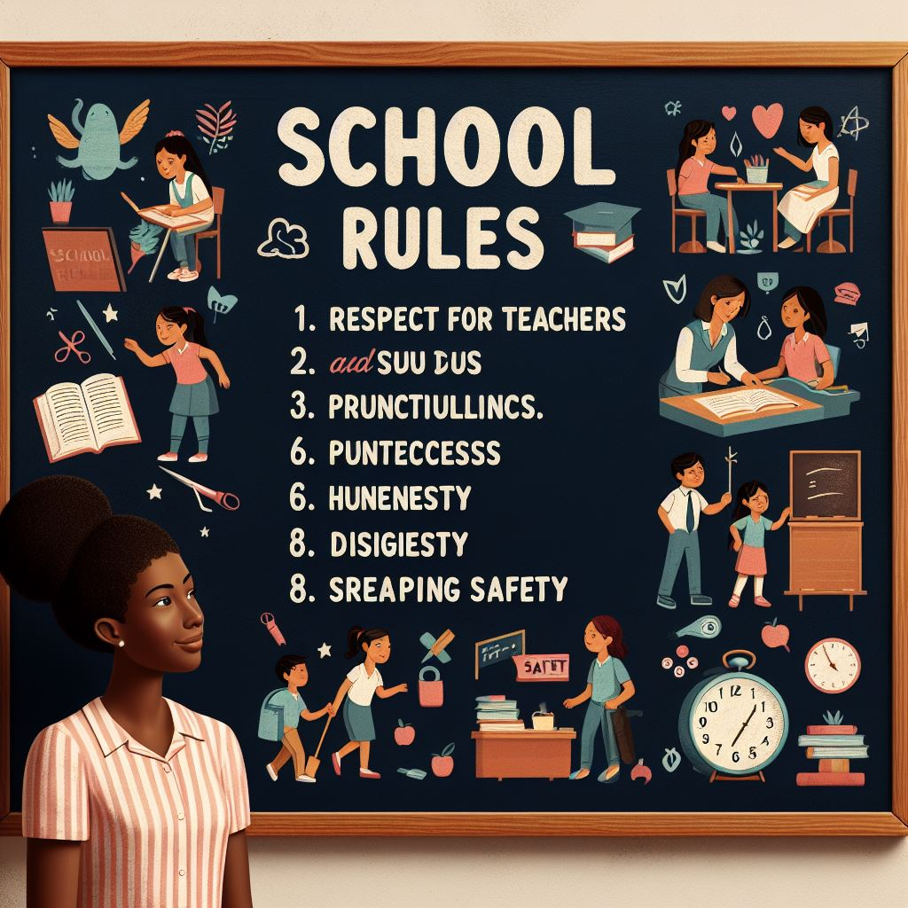
Rule: A guideline set by a specific group or place (like a school rule).
Respect others
Raise your hand
Be kind
Help others
Be on time
Be prepared

Slide 13

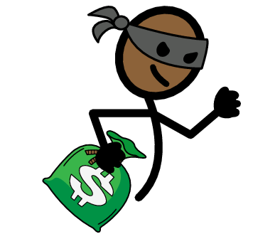


Law: A rule set by the government that everyone in the country must follow.

Slide 14

Read the book:
Rules and Responsibilities by Louise Spilsbury

Slide 15
Activity: Compare and contrast a rule and a law.
Respect others
Raise your hand
Be kind
Help others
Be on time
Be prepared

Slide 16
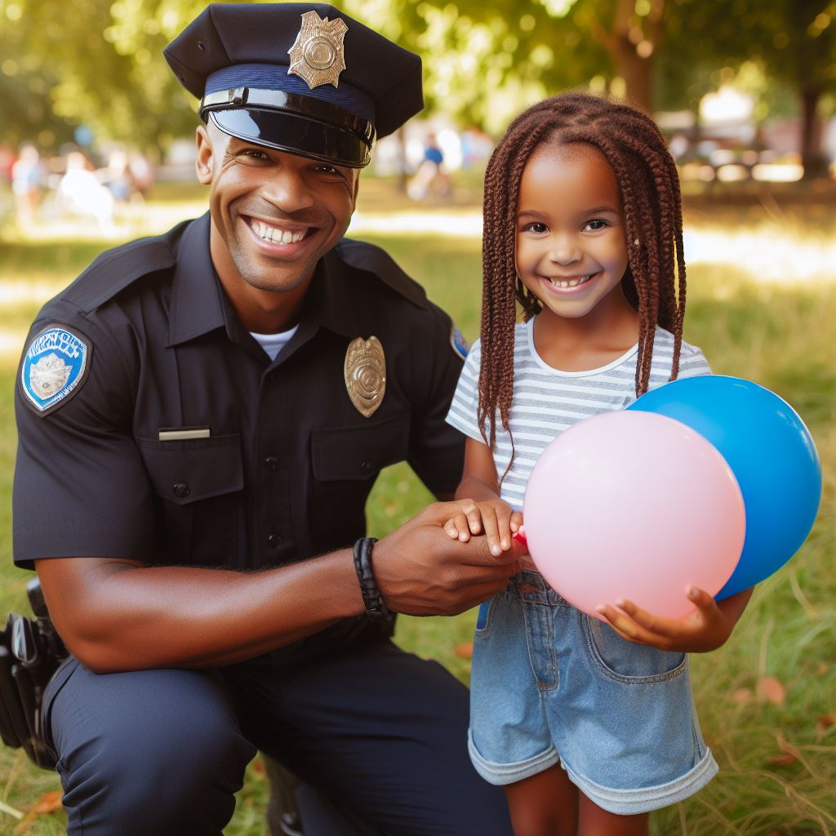
List and practice respectful ways to interact with people and professionals who hold positions of authority.

Slide 17
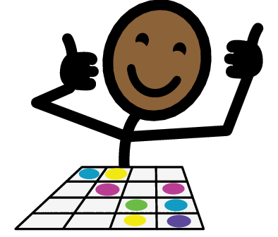
Activity: BINGO

Slide 18
Scenario one:
Your teacher wants you to take something to the office. In the hallway, you are asked to follow the safety rules. What should you do?
BINGO

Slide 19
Scenario two:
It’s dinner time in your house, and you have been asked to help get things ready at the table. What should you do?
BINGO

Slide 20
Scenario three:
The stoplight is not working. The driver of your vehicle sees a police officer at the intersection directing traffic. What should the driver do?
BINGO

Slide 21
Scenario four:
It’s time for lunch! You have been asked to get ready by cleaning up. What should you do?
BINGO

Slide 22
Scenario five:
Your teacher is reading aloud to the class. What should you do to show respect?
BINGO

Slide 23
Scenario six:
You know the answer to a question in the class. What should you do to show the teacher respect?
BINGO

Slide 24
Scenario seven:
You are having a picnic at the park. When you are done with your meal, what should you do?
BINGO

Slide 25
Scenario eight:
It’s time to get into a car and travel to the grocery store. Before you leave, what should you do?
BINGO

Slide 26
Scenario nine:
You are in a car and the driver comes to a stop sign. What does the driver need to do?
BINGO

Slide 27
Scenario ten:
You are riding the bus to school. To stay safe on the bus and show the driver respect, what should you do?
BINGO

Slide 28
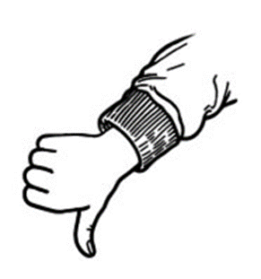
Activity: Is this respectful or disrespectful?
Yes
No

Slide 29
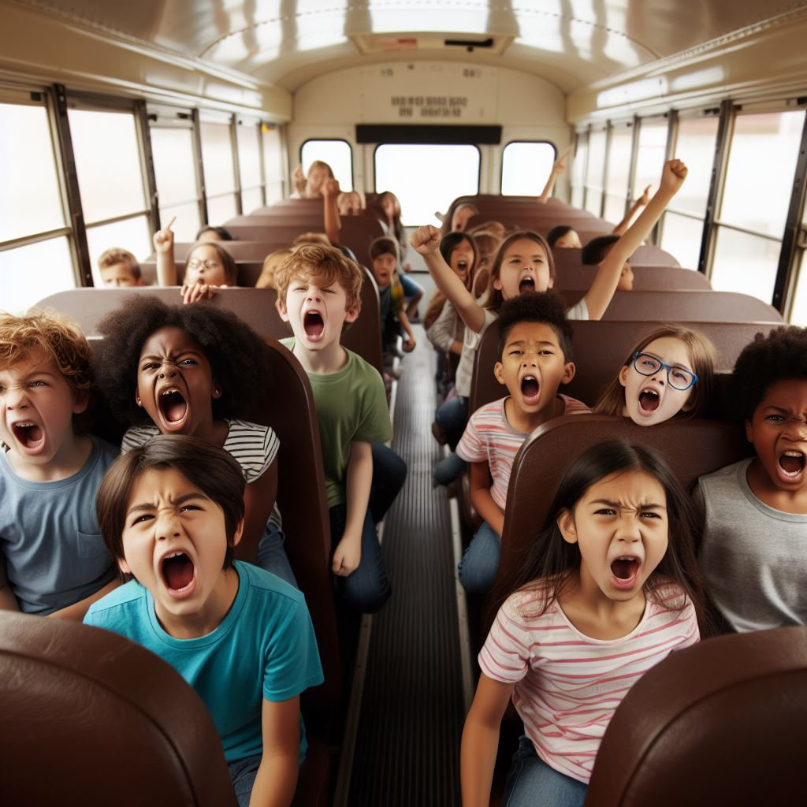
Is this respectful?
Yes
No
You are on the school bus and other students are yelling across the aisle.

Slide 30
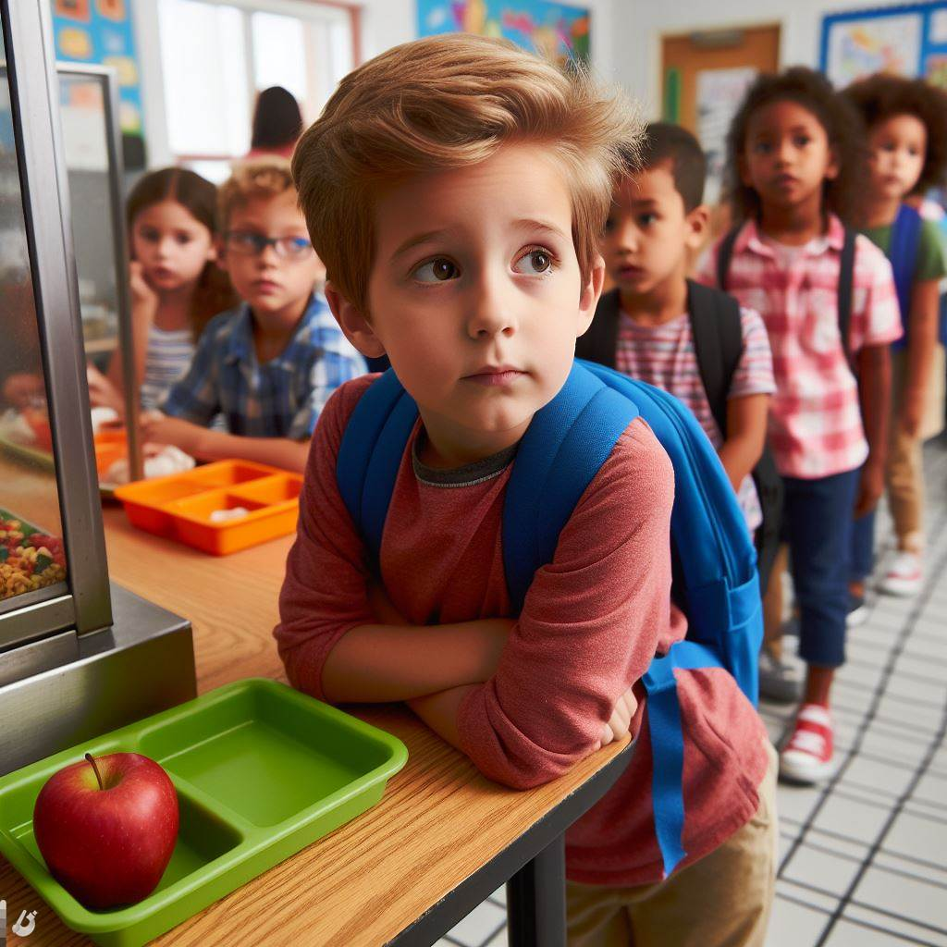
Is this respectful?
Yes
No
It’s lunch time and you are waiting your turn to go through the line, even though you are very hungry!

Slide 31
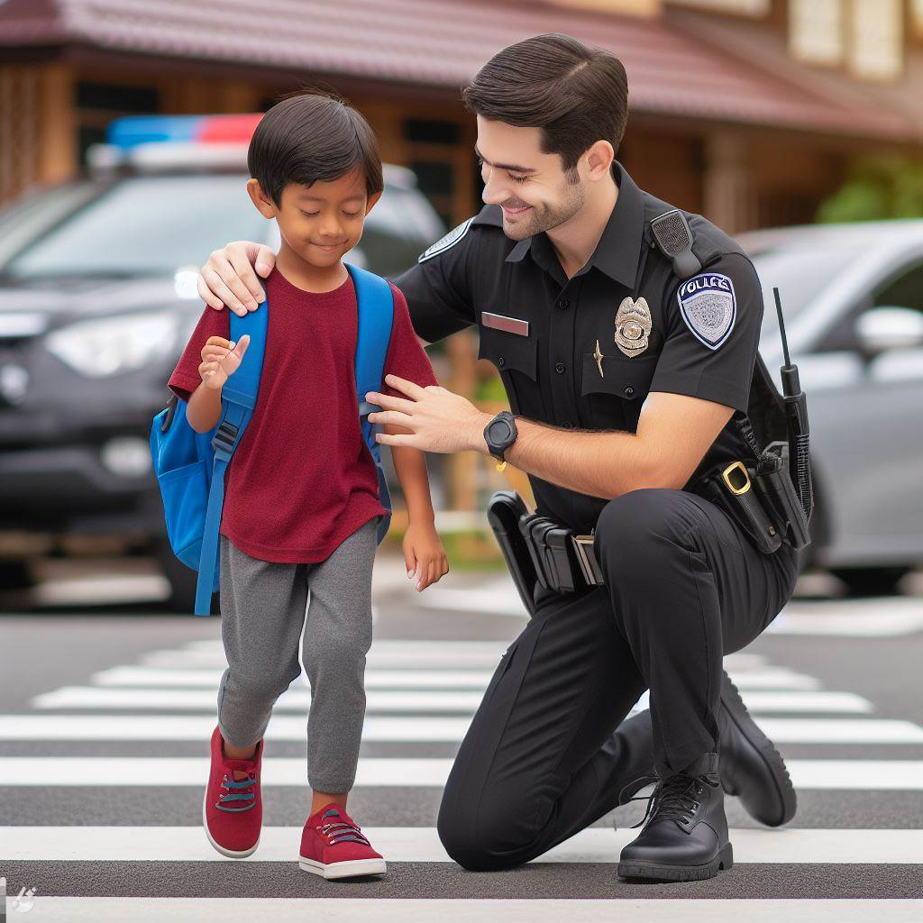
Is this respectful?
Yes
No
A police officer helps you cross a busy street. You turn and tell the officer, ”thank you!”

Slide 32
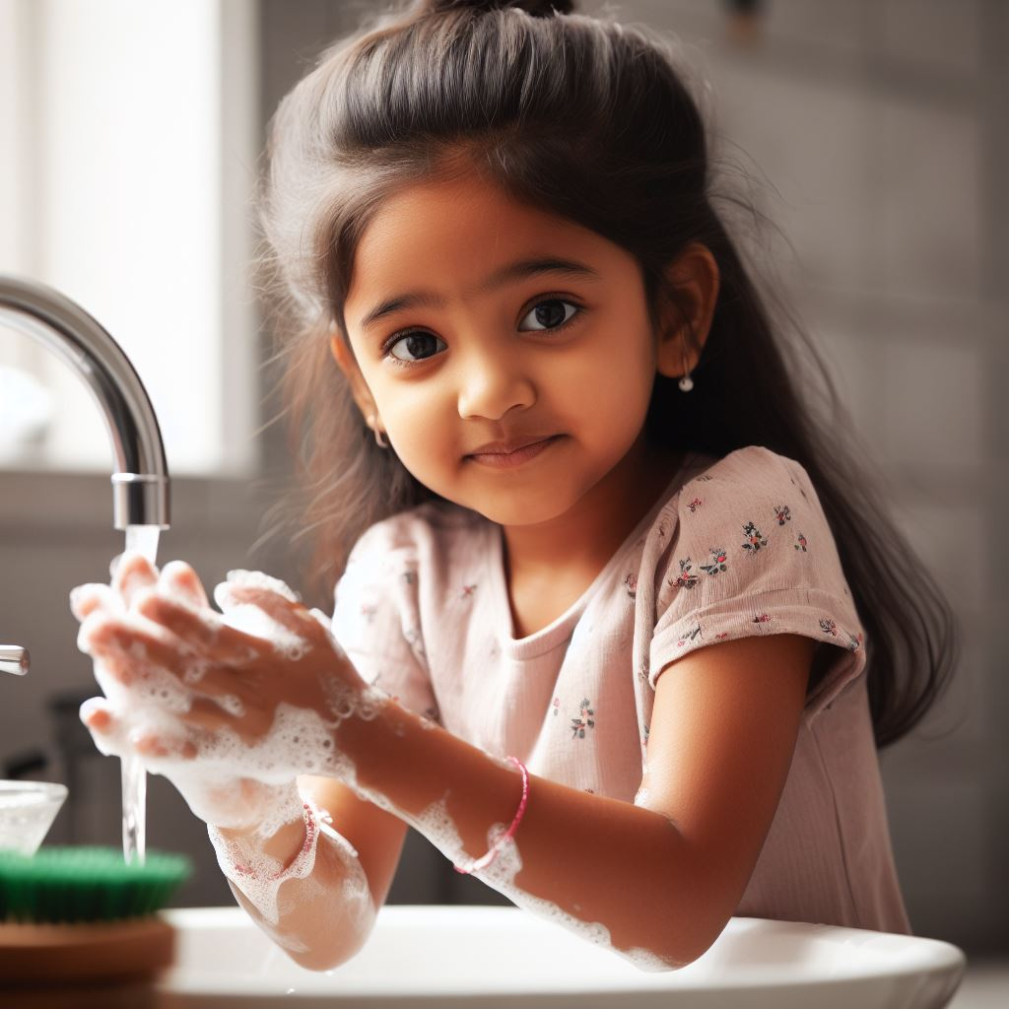
Is this respectful?
Yes
No
You are done washing your hands and you toss your paper towel on the ground.

Slide 33
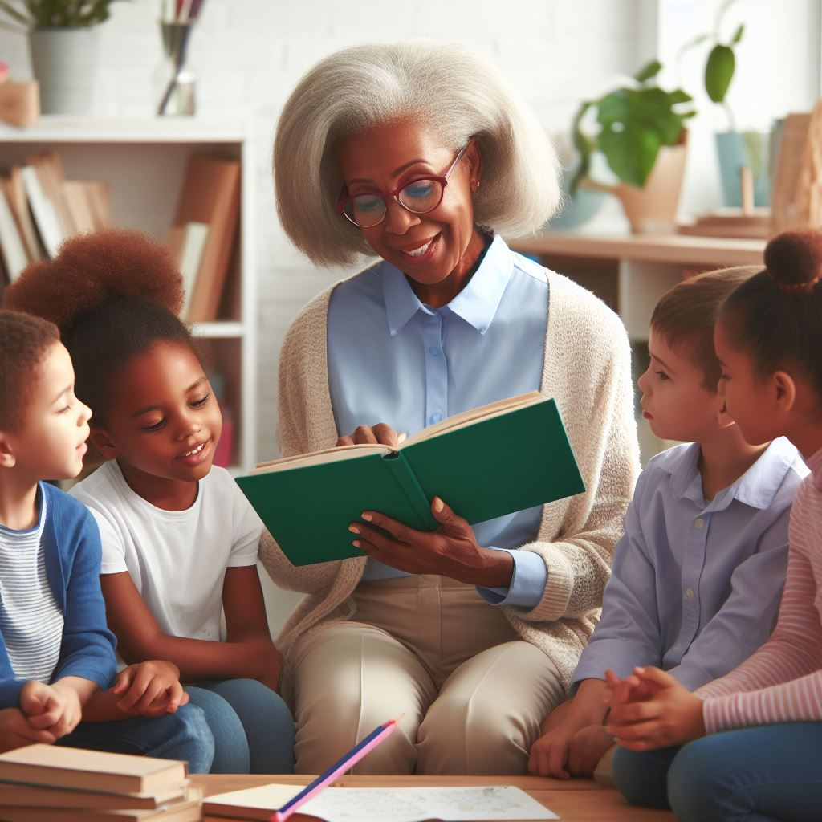
Is this respectful?
Yes
No
Your teacher is out sick. You make sure that you listen and still follow the rules with the substitute teacher there.

Slide 34
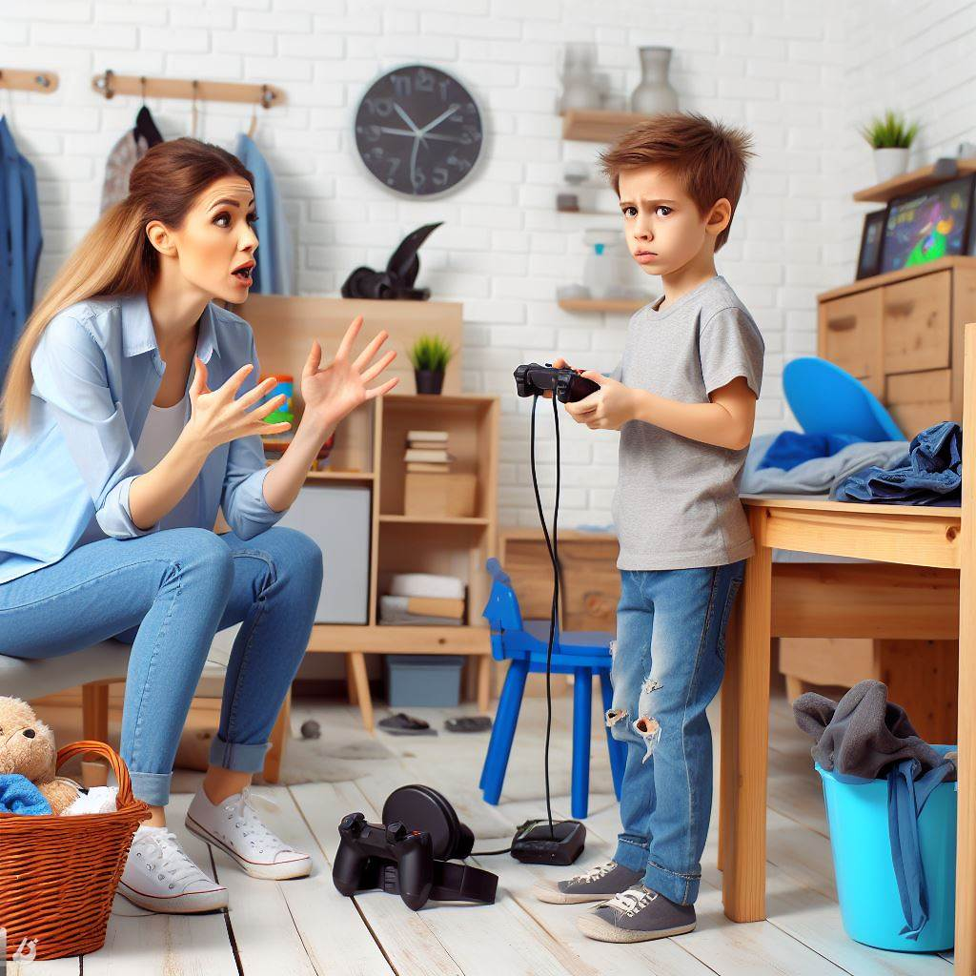
Is this respectful?
Yes
No
Your parent or guardian tell you that it is time to do your homework. You roll your eyes at them and keep playing your game.

Slide 35
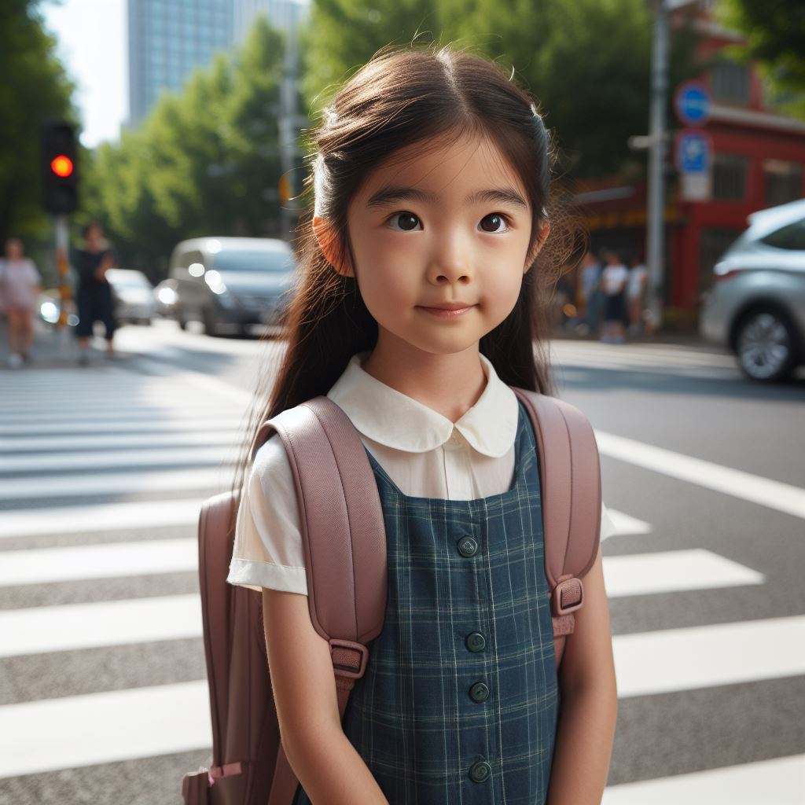
Is this respectful?
Yes
No
You are crossing the street, and you see the crosswalk sign telling you not to cross the street. You stop and wait.

Slide 36
Activity: I can be respectful.

Slide 37
All done, great job!

