Slide 1

Bullying
Second Grade Lesson 4

Slide 2
When we are learning we will:

Slide 3

Keep our bodies in our own place!

Slide 4

Use our quiet voices!

Slide 5

Keep our ears open!

Slide 6

Have our brains ready to learn!

Slide 7


What is a bully?

Slide 8
How do bullies behave?

Slide 9

Bullying means someone is being very unkind, mean, or hurtful to another person again and again. It's when someone is mean on purpose, and it makes the other person feel very sad or scared.

Slide 10
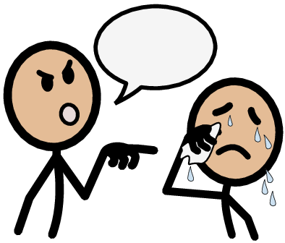
Aggressor: An aggressor is someone who does the bullying. They are the ones being unkind or mean to others. They make others feel bad.

Slide 11


Target: The target is the person who is getting bullied. They are the ones who feel sad or hurt because of the unkind things the aggressor is doing to them.

Slide 12


Bystander: A bystander is someone who sees the bullying happening but doesn't do anything to help. They might watch and not stop it, even though they know it's not right.

Slide 13
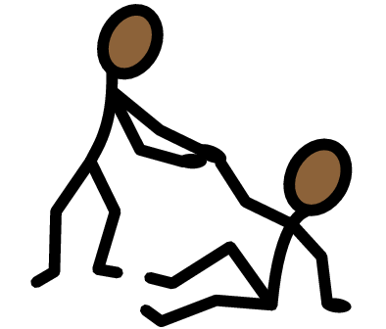
Upstander: An upstander is a person who sees the bullying happening and tries to make it stop. They do something to help the person who is getting bullied, like telling an adult or being kind to them.

Slide 14
What is Bully Behavior?

Slide 15
How does it make you feel when you are the target of bullying?

Slide 16
Sometimes people make mistakes.

Slide 17
Making a mistake is when you do something wrong by accident, like saying something you didn't mean to. But bullying is when you do unkind things on purpose, again and again, to hurt someone's feelings or make them feel scared. So, we should try not to be bullies and always be kind to others.

Slide 18
What is a cyberbully?

Slide 19

Read
Don’t Be a Cyberbully by: Anthony Ardely

Slide 20
What is the difference between cyberbullying and face-to-face bullying?
C
Cyberbullying
Face-to-face bullying

Slide 21

H.A.L.T!

Slide 22

H- Halt
Stop what you're doing if someone is being mean or saying things that hurt your feelings.
Example: If someone is saying unkind things, halt means to stop and not respond.

Slide 23
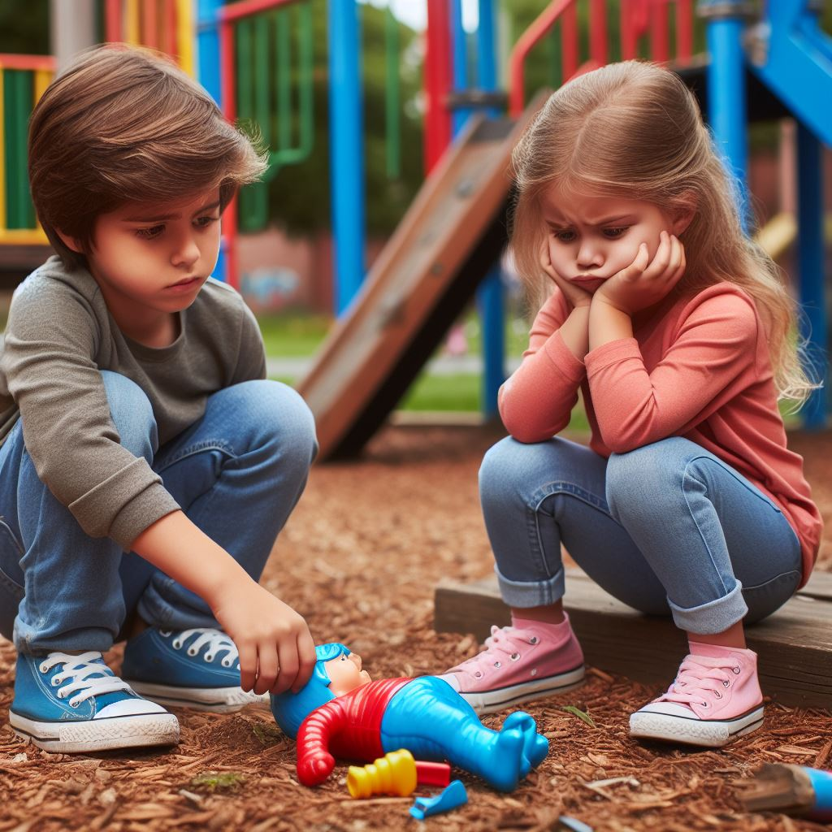
A – Assess
Look at the situation and see if it's making you or someone else feel bad.
Example: If someone is being mean, assess means to think about whether it's a good or bad situation.

Slide 24

L- Listen
Pay attention to your feelings and what the other person is saying.
Example: If your friend feels sad because of mean words, listening means understanding and being a good friend.

Slide 25
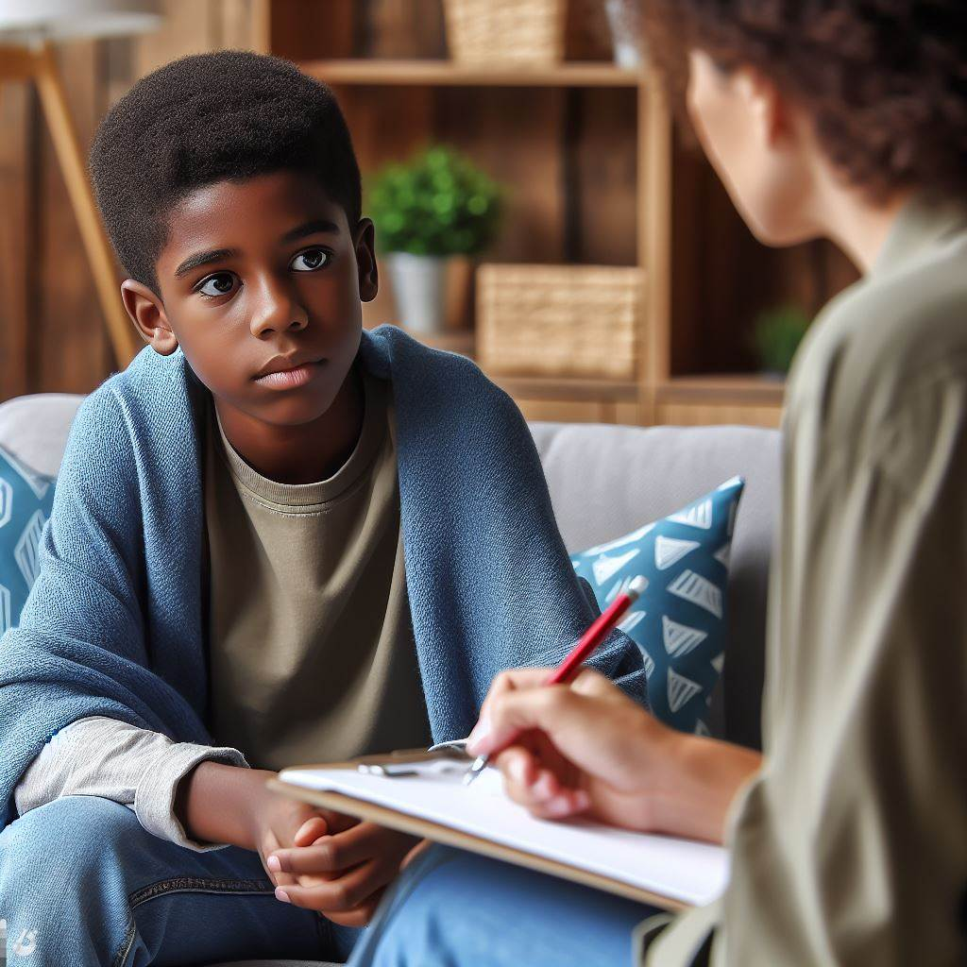
T- Talk
Share what happened with a grown-up you trust.
Example: If something is not right, talk means telling a teacher or parent so they can help you.

Slide 26
Activity: Upstander or bystander?

Slide 27
Activity:
Breathwork
1. Take a breath.
2. Count to ten.
3. Seek help from an adult.

Slide 28
Activity: Role play

Slide 29
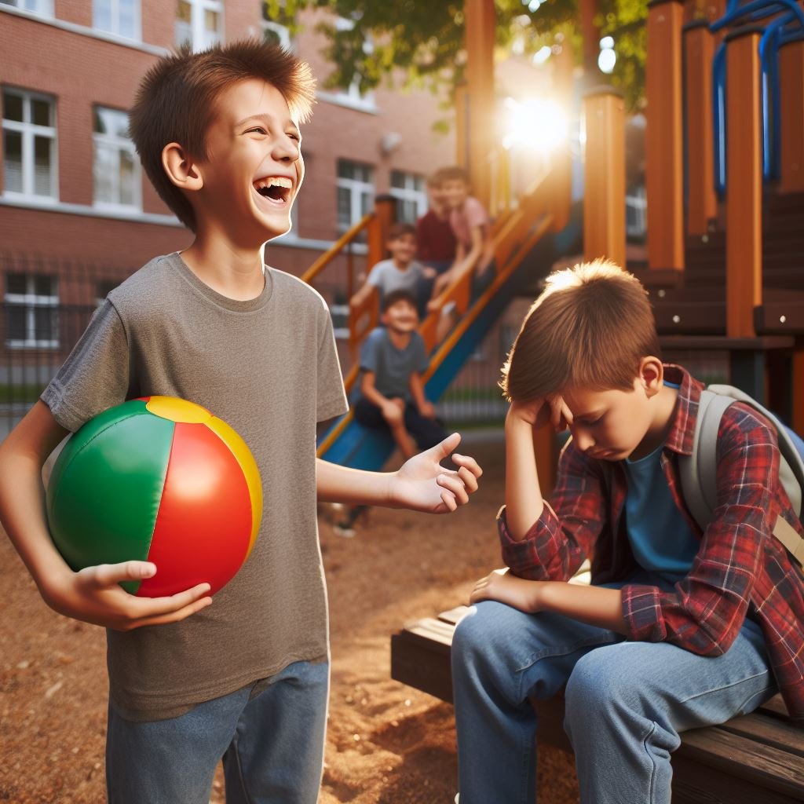
At the playground, Jake keeps taking away Tim's ball and laughing at him, making Tim feel upset and excluded.

Slide 30

During a group project, Emma tells her classmate, Ethan, that his ideas are stupid, and nobody likes working with him.

Slide 31
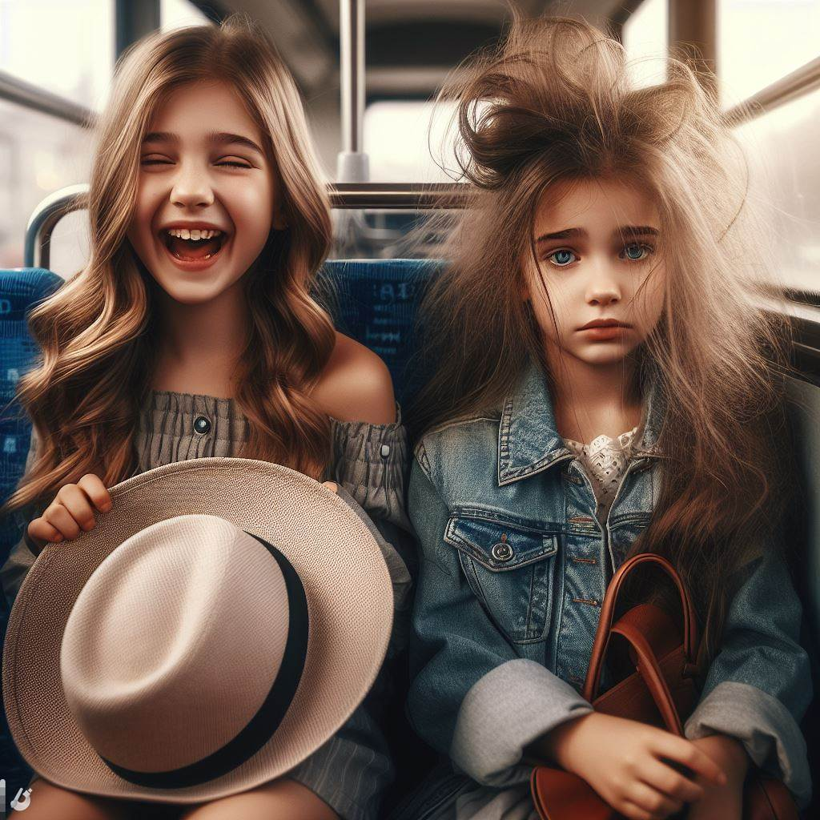
During a school bus ride, Lucy pulls the hat off Sarah's head and teases her about her hairstyle.

Slide 32

In the classroom, Alex writes mean notes about Mark and secretly slips them into Mark's backpack.

Slide 33
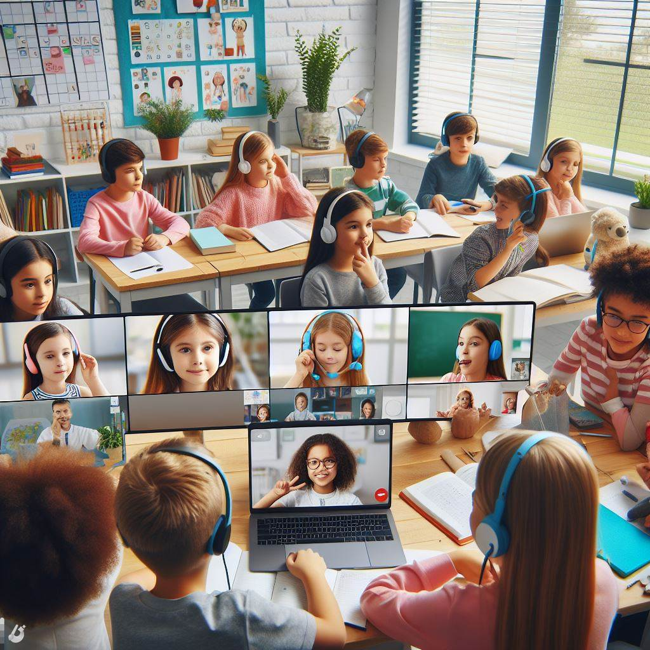
On a virtual classroom platform, Maria constantly interrupts her classmate, David, while he's trying to present his project, causing David to be frustrated.

Slide 34

On a gaming app, Jack joins a game and starts making fun of the other players, including his friend, Sarah.

Slide 35

Lily opens her iPad to find that someone wrote an unkind message on her device.

Slide 36
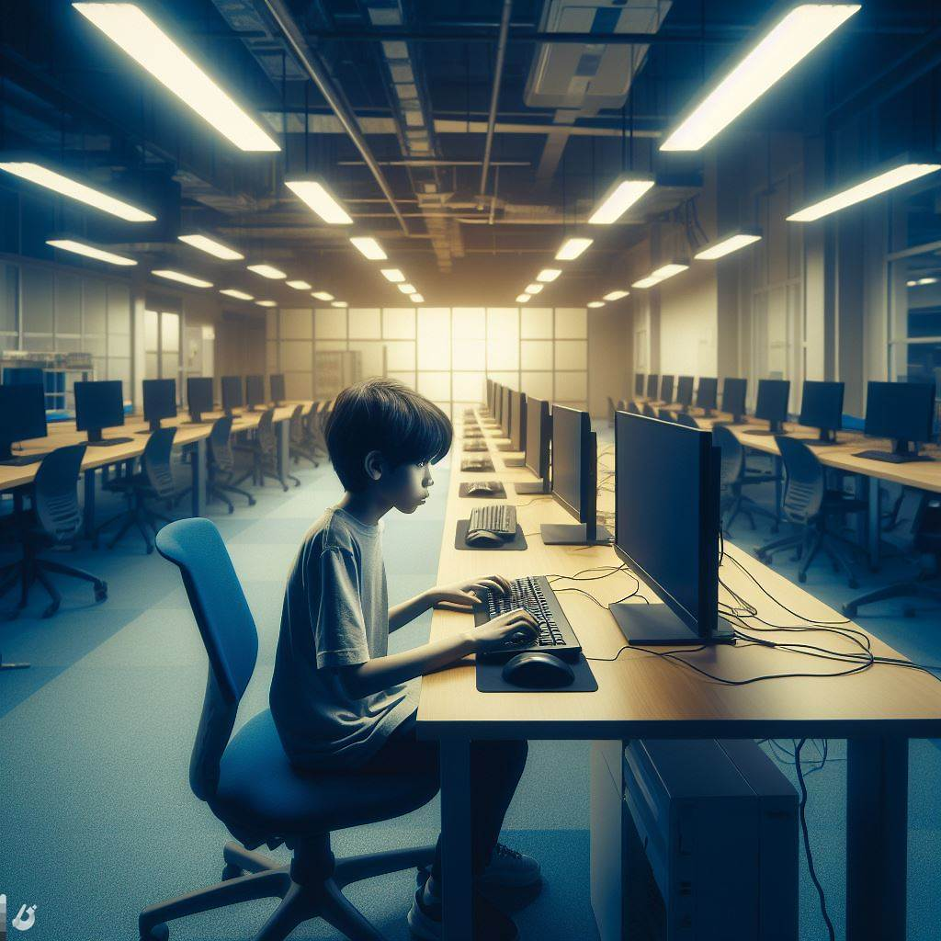
The class is working on a group project on the computer. Samuel decides to delete the group project as a joke on his group.

Slide 37
Activity: Create a bystander and upstander comic strip

Slide 38
What can we do to prevent bullying in both offline and online situations?

Slide 39
How can you be an upstander and help someone who is being bullied?

Slide 40
All done, great job!

