Slide 1

Emergency Preparedness
Third Grade Lesson 1

Slide 2

Be aware of your surroundings, respect others’ space, and stay in your own area.

Slide 3

Use indoor voices, be mindful of noise levels.

Slide 4

Keep our eyes and ears open! And be ready to participate!

Slide 5

Be prepared to problem solve, ask questions, and contribute to the lesson.

Slide 6
What is an emergency?
Notes:
Tell the students “Today we are going to learn about what to do in an emergency. Can someone tell me what an emergency is?”
Let students raise their hands and call on them to respond.

Slide 7
An emergency is when something serious, dangerous, and unexpected has happened and help is needed immediately.
Notes:
Tell the students that “emergency is when something serious, dangerous, and unexpected has happened and help is needed immediately”
Tell the students “You’ve learned about when it is necessary to call 911 when you need someone to come to you to help. Today we are going to talk about weather related emergencies and what you can do to protect yourself during those emergencies.”

Slide 8
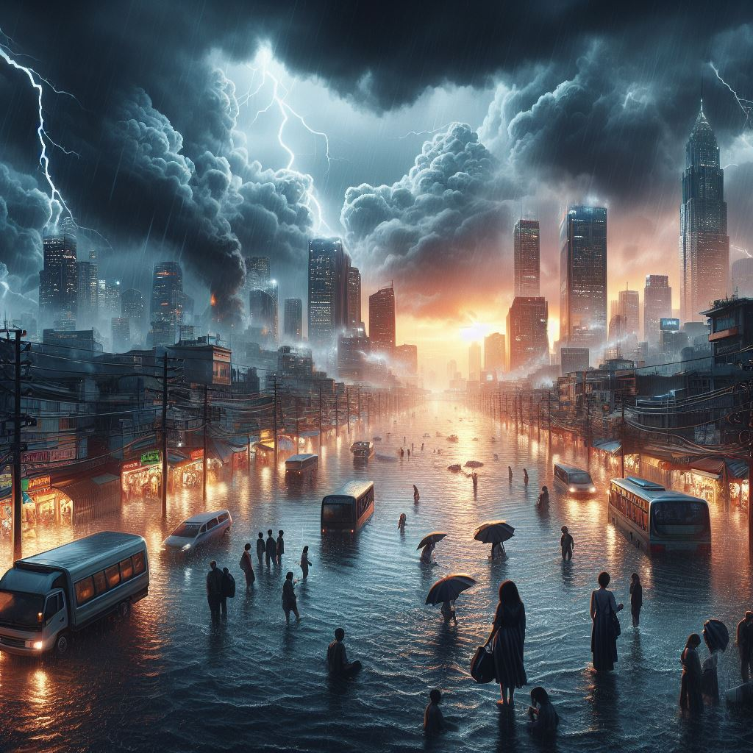
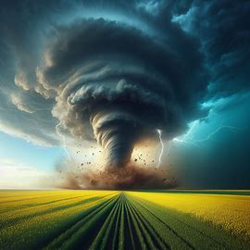
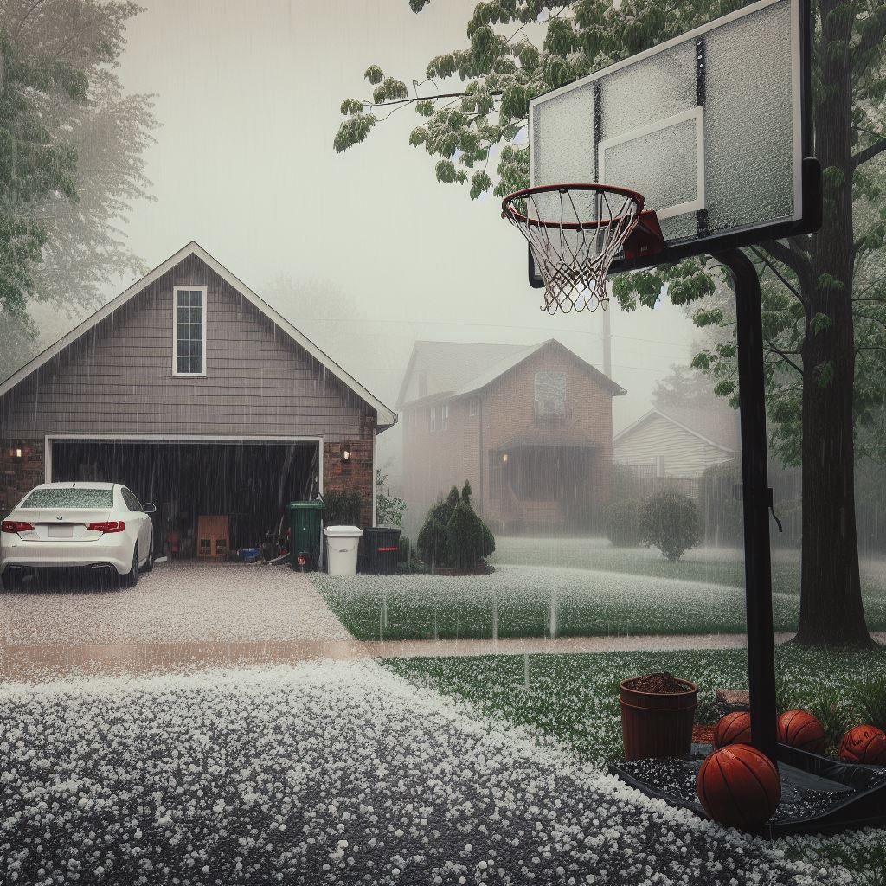
What's the weather?
Notes:
Tell the students “I am going to show you a picture of a weather related emergency and your job is to tell me what it is and what happens during this type of emergency”

Slide 9
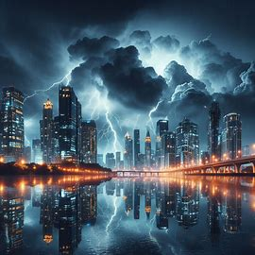

Slide 10
During a thunderstorm there is lots of rain, lightning, wind, and hail.
Notes:
Thunderstorms/lightning
Lots of rain
Thunder, lightning, wind, and hail

Slide 11
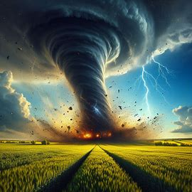

Slide 12
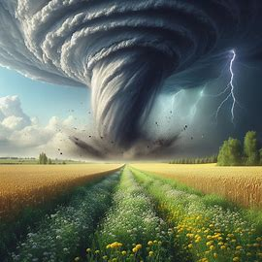
A tornado is a spinning column of air. Tornados can cause lots of damage.
Notes:
Tornado
A tornado is a spinning column of air. Tornadoes have strong winds that can cause a lot of damage to things in their paths

Slide 13
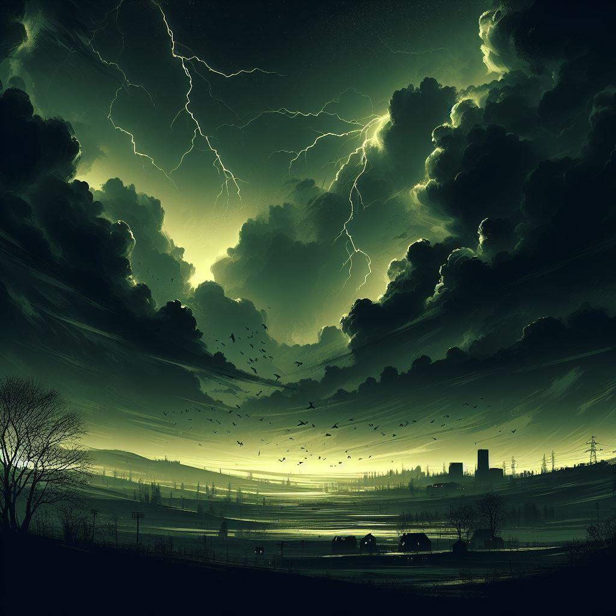
Signs that may help you notice a tornado may be coming:
Dark or green-colored sky
Funnel
cloud
Hail
Notes:
These signs may help you know that a tornado is coming: Dark or green colored sky, funnel cloud, loud train-like sound or hail

Slide 14
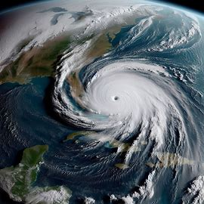

Slide 15
A hurricane is a big storm that forms over the ocean and then comes to land.
Notes:
Hurricane
A hurricane is a big storm that forms over the ocean. It has a spiral shape and can travel a long way before it reaches land.

Slide 16
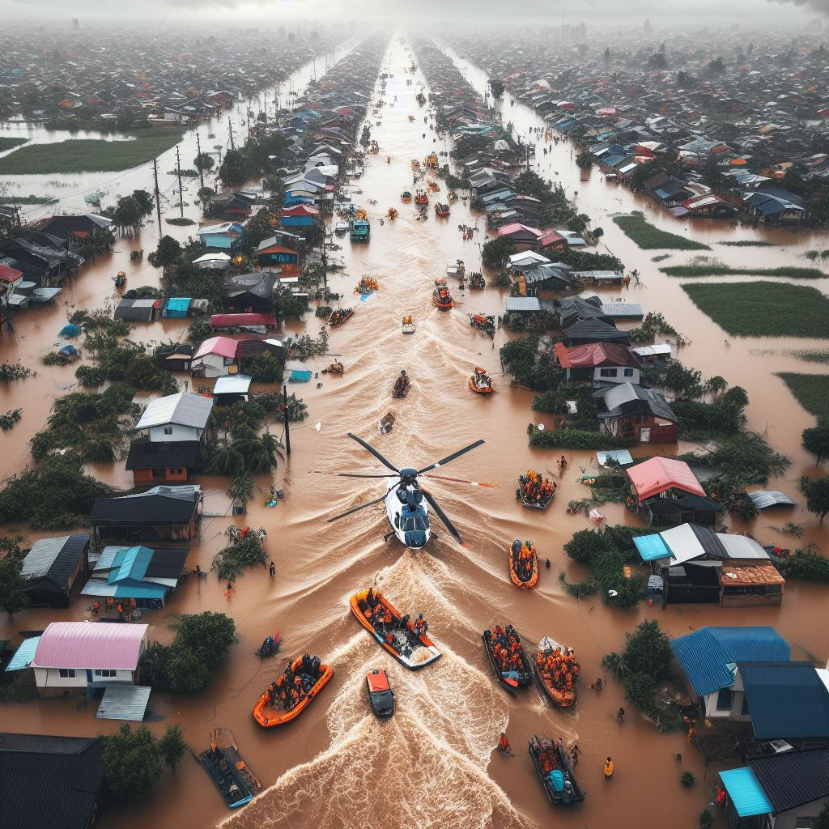
Notes:
A hurricane can cause a lot of damage with strong winds and heavy rain when it hits land. The ocean water can rise with large waves that flood the coast

Slide 17
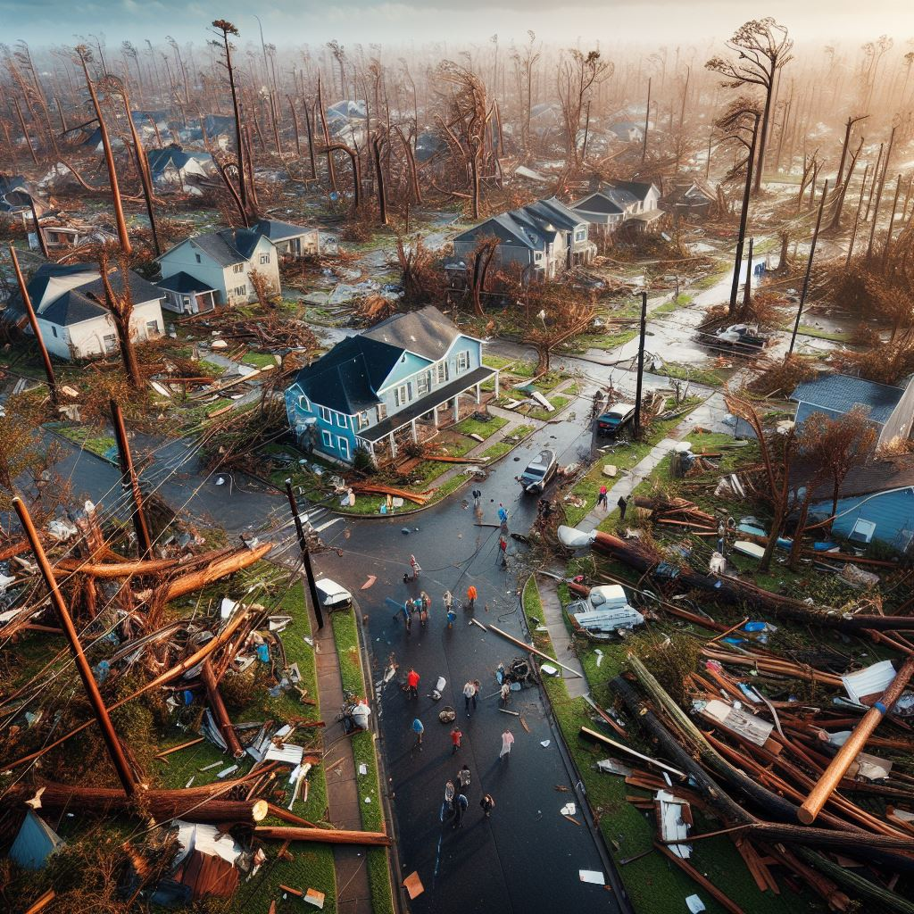
During a flood, water covers land that is normally dry. Waters can be shallow or get very high.
Notes:
Flooding
Water that covers land that is normally dry. They destroy houses and buildings. Floods can also

Slide 18
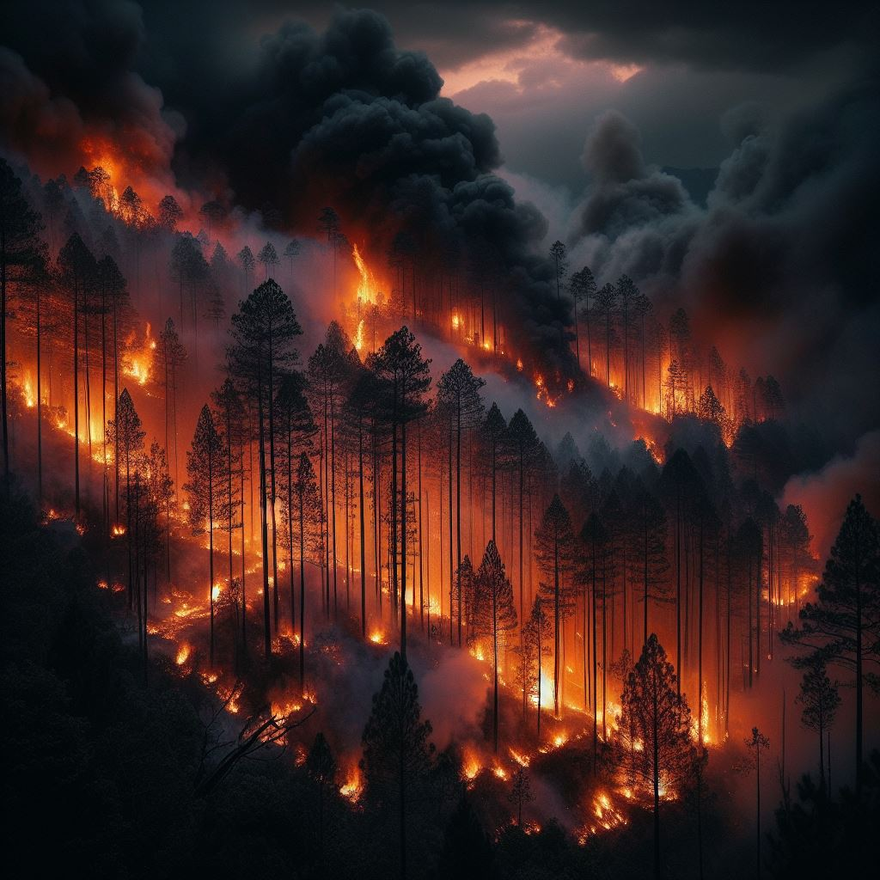

Slide 19
Fires are hot, fast, and dark!
Notes:
Home fires or forest fires
Fire is fast, hot, and dark. Most fires can be prevented

Slide 20
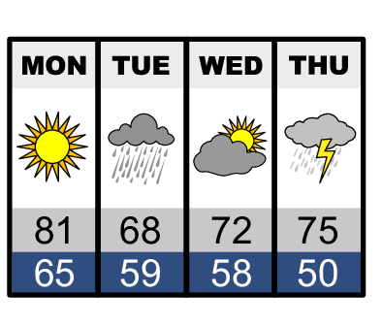

Whose family watches the weather at home on TV?
Notes:
Explain to the students that it is important to be informed and that there are two weather terms that everyone needs to be familiar with.

Slide 21
A weather watch means there is a risk of bad weather happening.
A weather warning means that bad weather is already occurring.
Notes:
Explain to the students that it is important to be informed and that there are two weather terms that everyone needs to be familiar with.
Weather watch - means there is a risk of the bad weather happening.
Weather warning - means the bad weather is already occurring/ happening.
Tell the students “we can know what to expect by watching the weather channel, checking the weather on our phones, or asking an adult”

Slide 22
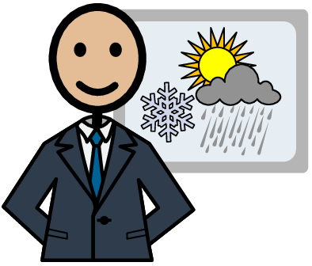
What's the forecast?
Notes:
“Let’s practice understanding the weather channel. I am going to tell you a weather forecast and you will explain to me what it means.”
Show the powerpoint slides or read the scenarios and ask students what the forecast means

Slide 23
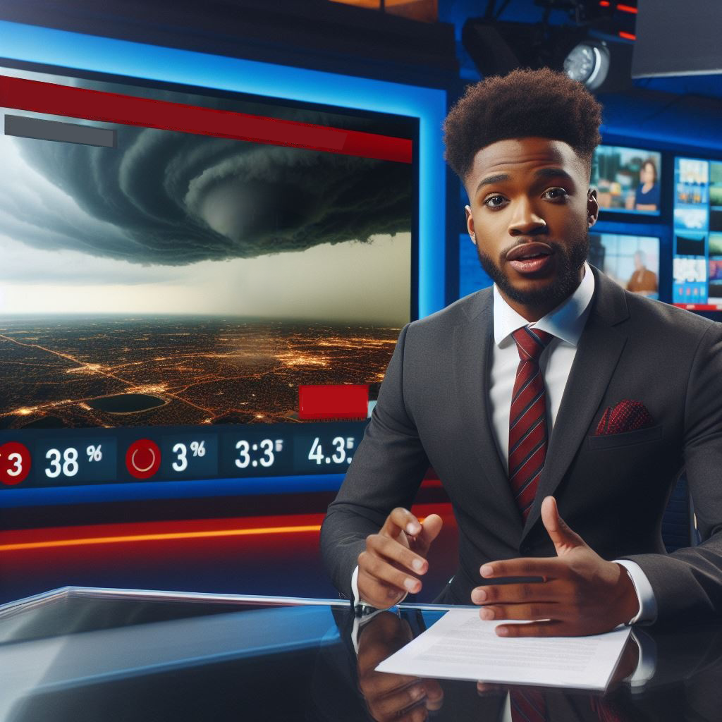
A tornado watch until 3:00 pm.
Notes:
Tornado watch at 3:00

Slide 24
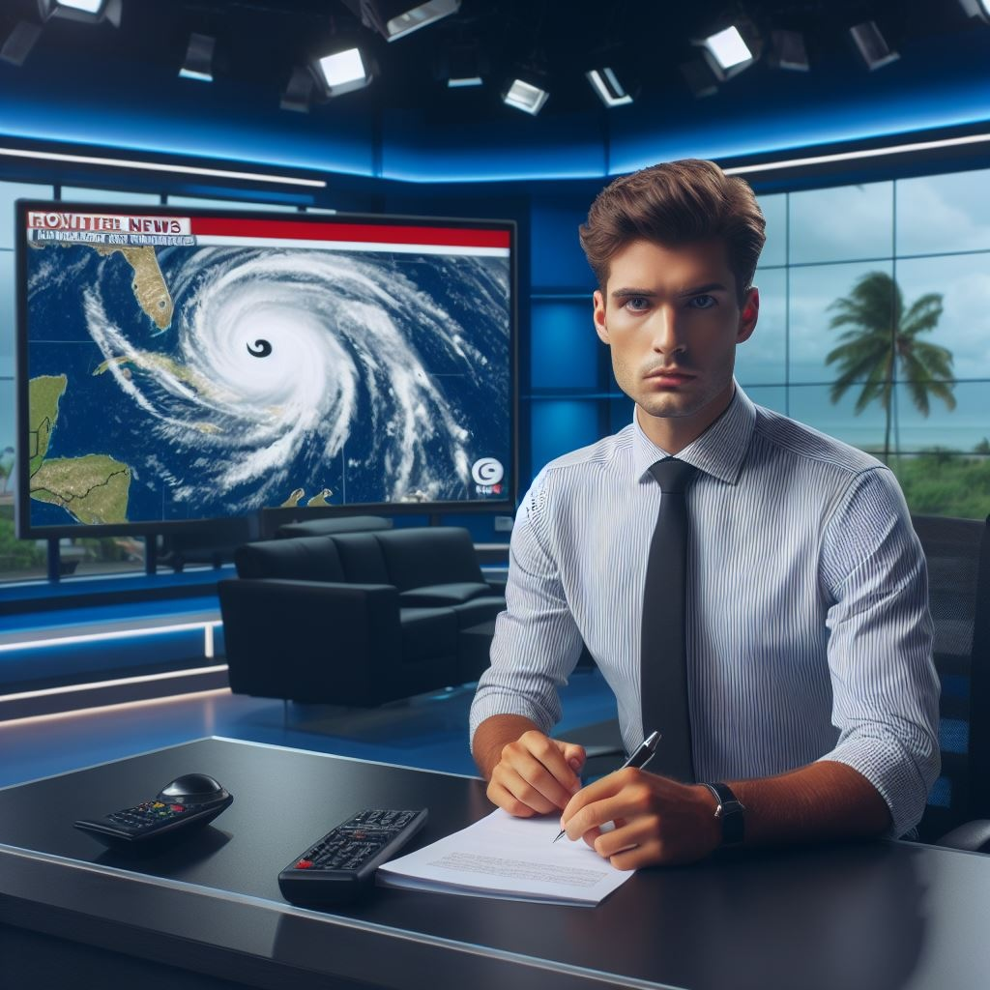
Hurricane warning in Allentown.
you
Notes:
Tornado watch at 3:00

Slide 25

Flood watch in Clifford City tomorrow from 5:00 pm until 2:00 am.
you
Notes:
Flood watch in Clifford City tomorrow at 5:00 pm until 2:00 am

Slide 26
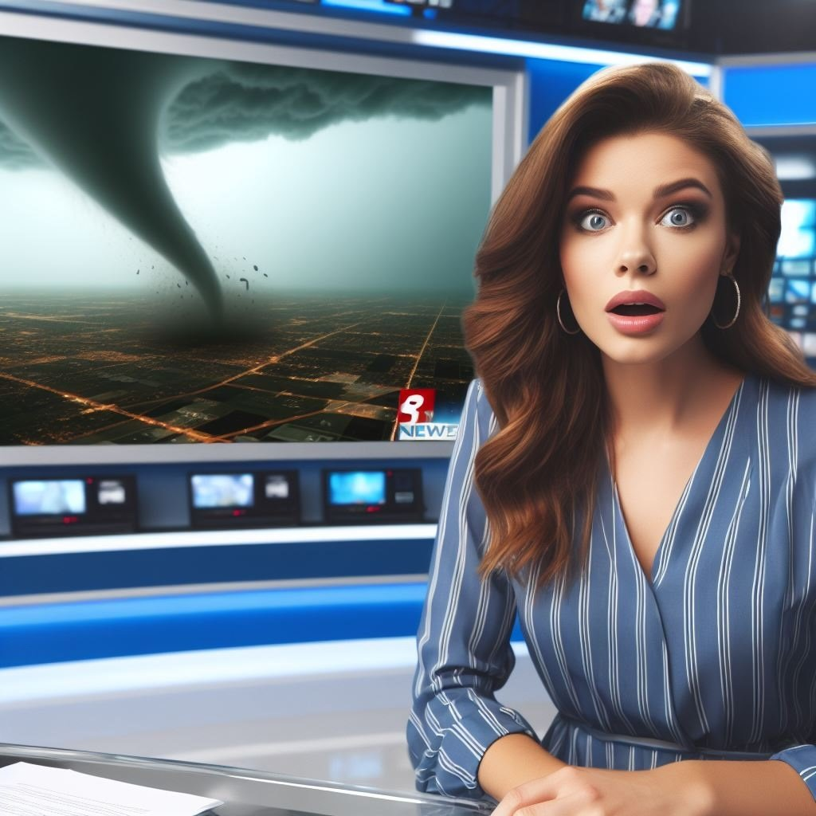
Tornado warning! Take shelter until 7:00 pm.
you
Notes:
Flood watch in Clifford City tomorrow at 5:00 pm until 2:00 am

Slide 27
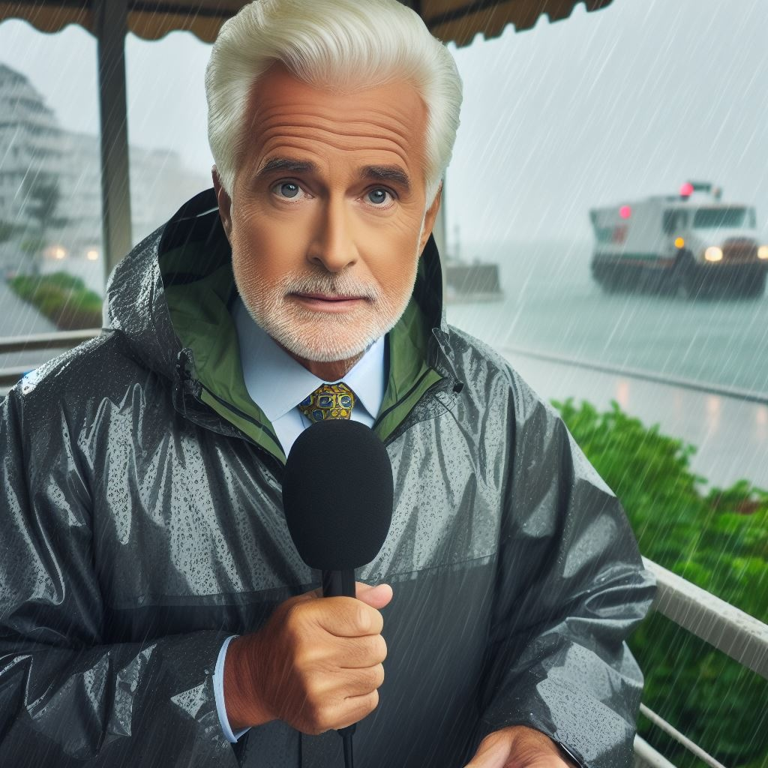
Thunderstorm and hail warnings in Stevens City.
you
Notes:
Thunderstorm and Hail warning in Steven City

Slide 28
Now that you know how to understand the weather we are going to talk about what to do in these situations to keep yourself safe.
Notes:
Tell the students “now that you know how to understand the weather we are going to talk about what to do in these situation to keep yourself safe”

Slide 29
Listen to the adults- it is your teacher's job to keep you safe and know all the safety procedures at school.
At School
Notes:
At school
Listen to the adults- it is your teacher's job to keep you safe and know all the safety procedures at school
Stay calm and follow directions

Slide 30
Stay calm and talk with an adult at home about what to do when there is a weather-related emergency at home.
At Home
Notes:
At home
Listen to adults
Stay calm and follow directions
Talk with an adult at home about what to do when there is a weather related emergency at home - every home is built differently, it is important to have a plan for what to do in your own home
Have a plan with your parents for if you are ever home alone
Change the smoke detector batteries 2x a year and make sure it is working once a month

Slide 31
Know how to respond:
Notes:
Explain to the students that “when we stay calm during these emergencies we can then respond to them with the appropriate safety precautions”
Tell the students “we are going to review each weather related emergency again and this time talk about what we can do to keep ourselves safe”

Slide 32
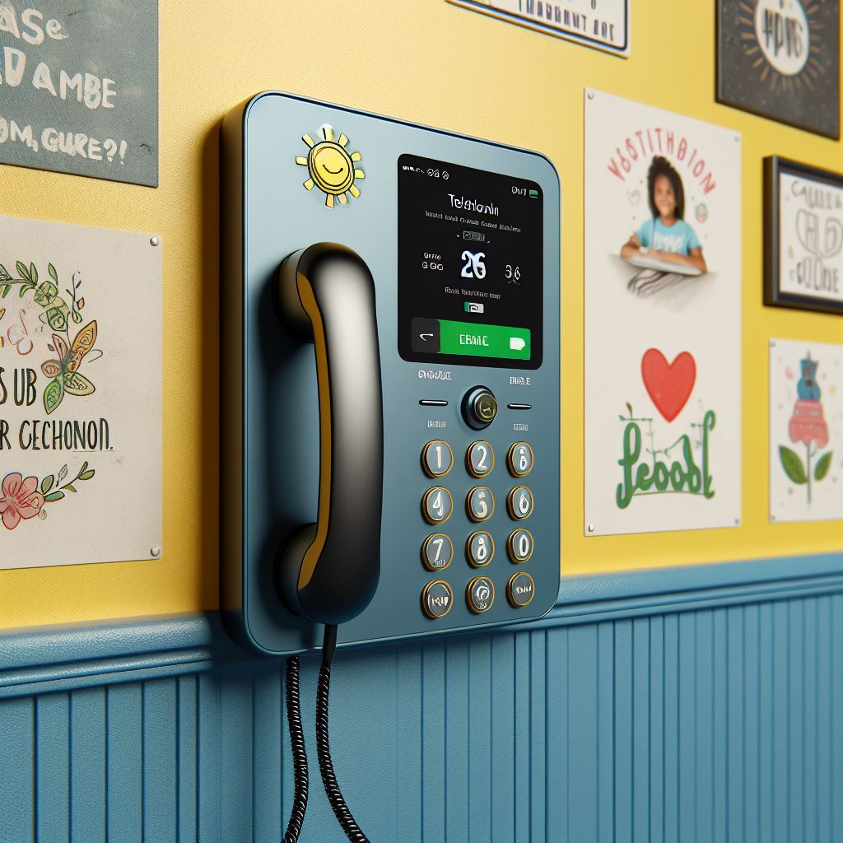
9-1-1 is used for emergencies when we need police or fire and rescue.
Call 911
Notes:
Calling 911:
911 is used for emergencies when we need police, fire and rescue
The dispatcher will answer the phone and ask what is your emergency?
Speak clearly and no head nodding
Know your name, address and phone number
Stay on the phone until the dispatcher tells you to hang up

Slide 33
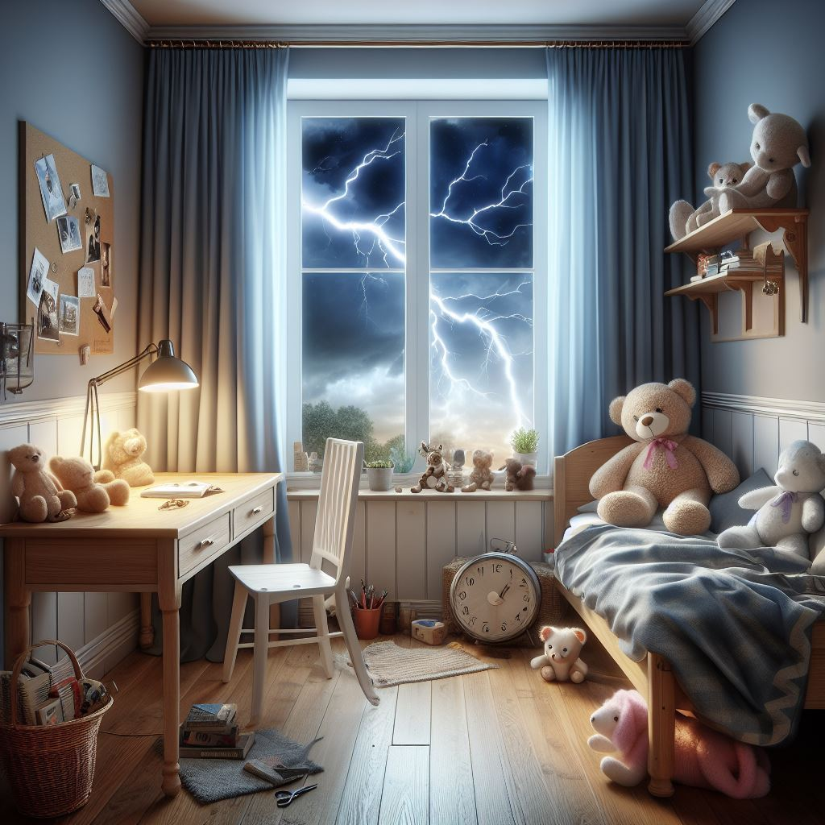
Remember, "When thunder roars, go indoors!"
Thunderstorms
Notes:
Thunderstorms:
Stay inside - It’s not safe to be outside when lightning is near. If you hear thunder, then that means that lightning is close.
Remember, "When thunder roars, go indoors!"
Avoid running water (shower, wash dishes) and anything that plugs into the wall

Slide 34
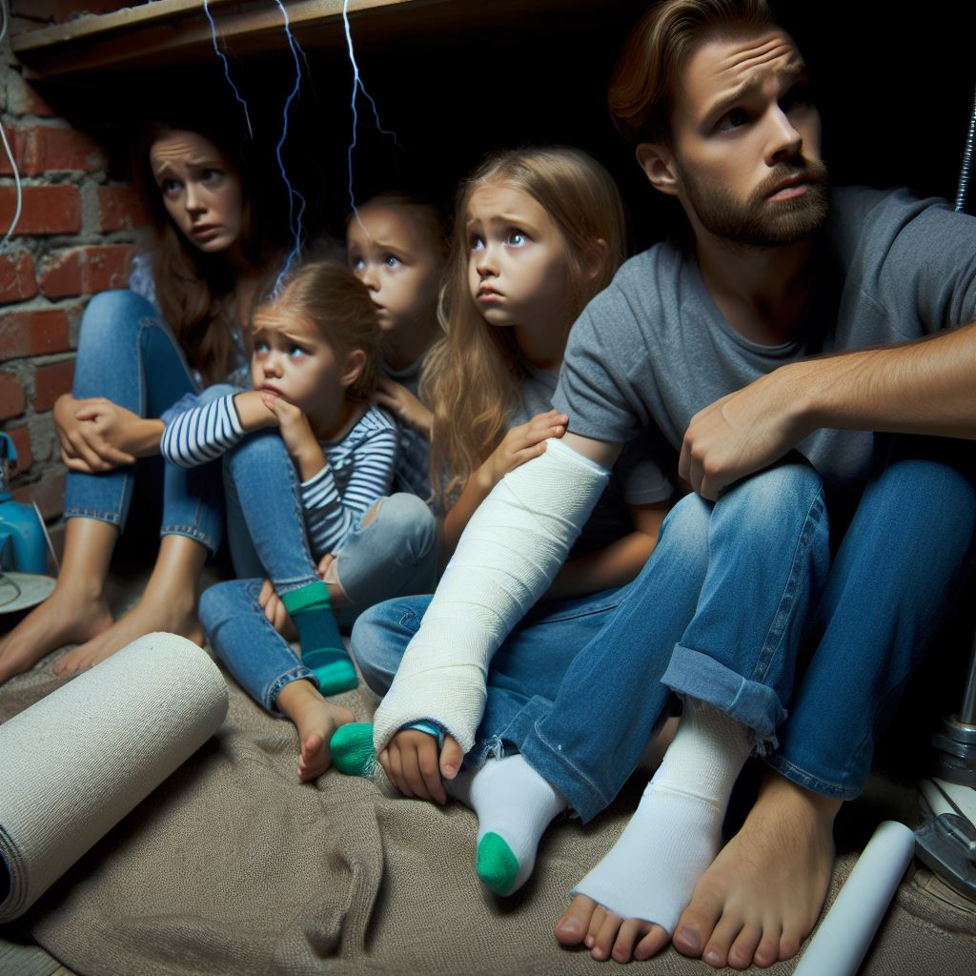
At home: Go to the basement or a small interior room on the lowest floor like a closet or bathroom.
At school: Sit facing the wall. Put your head on the floor and cover it with your hands. Tuck your feet under your body.
Tornados
Notes:
Tornados:
At home: Go to the basement or a small interior room on the lowest floor like a closet or bathroom
At school: sit facing the wall. Put your head on the floor and cover it with your hands. Tuck your feet under your body
Stay away from windows, outside walls and doors
Protect your head and neck from flying debris

Slide 35
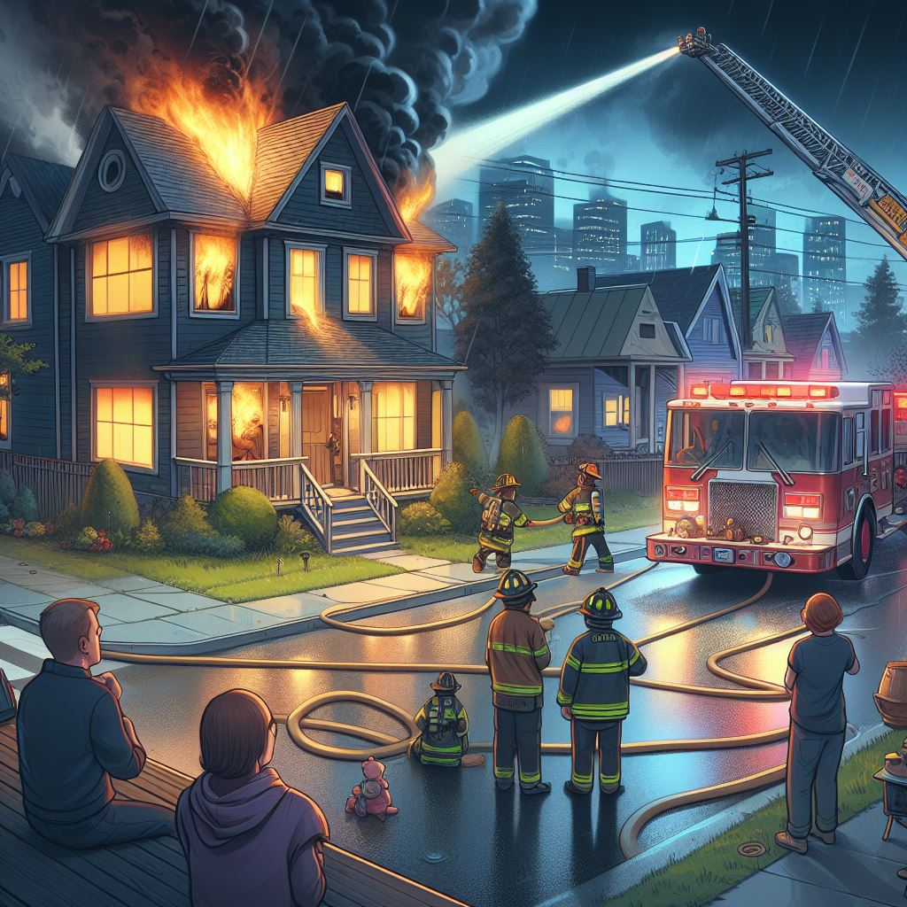
Create a fire escape plan and practice it twice a year.
Fire
Emergencies
Notes:
Fire emergencies:
Fire escape plan: Create a fire escape plan and practice it twice a year. Mark your family’s calendar to remind everyone.
Two ways out: Have two ways to get out of each room. A window might be a second way if the door is blocked by fire or smoke.
Feel your way out: Practice feeling your way out of the house in the dark or with your eyes closed.
Don’t hide: Don’t hide from firefighters! They are there to help you.
Get low and go! Crawl under smoke to an exit. Heavy smoke and deadly gasses rise to the ceiling.
Feel first!: Feel the doorknob and door before opening it. If either is hot, leave the door closed and use the second way out.
Get to your meeting spot: If you are the first one out of a burning building, wait at the emergency meeting spot you and your family decided on and call 911.
Don’t go back into any building unless a firefighter says it is safe
Stop, drop, and roll: If you have fire on your clothes, stop, drop, and roll! Stop where you are: if you run, the fire may spread. Drop to the ground and cover your face with your hands. Then roll over and over, or back and forth, until the fire is out.

Slide 36

Identify two exit points
Notes:
Two ways out: Have two ways to get out of each room. A window might be a second way if the door is blocked by fire or smoke.
Feel your way out: Practice feeling your way out of the house in the dark or with your eyes closed.

Slide 37
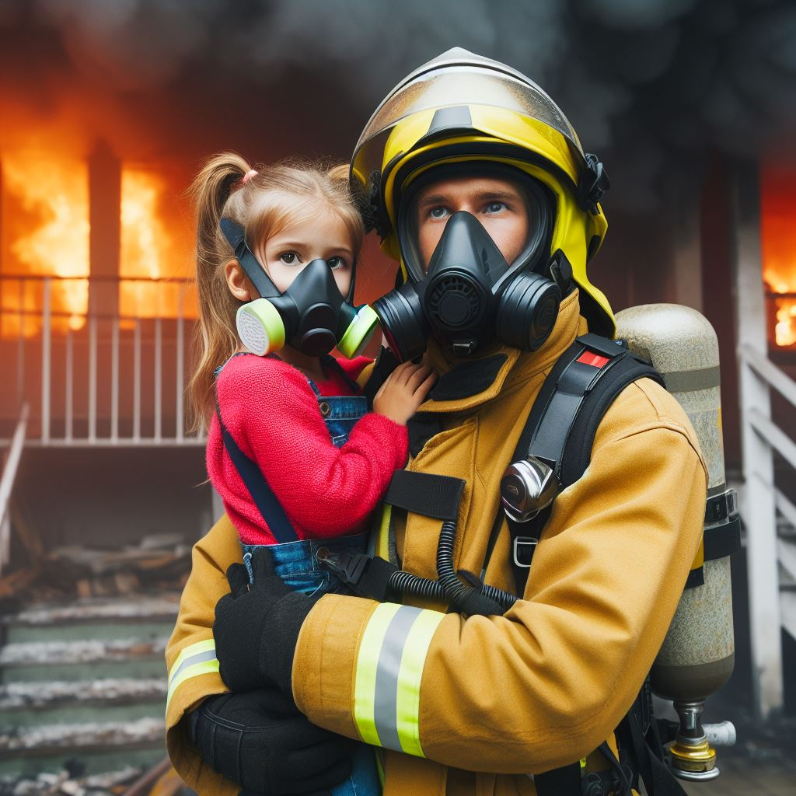
Don’t hide
Notes:
Don’t hide: Don’t hide from firefighters! They are there to help you.

Slide 38
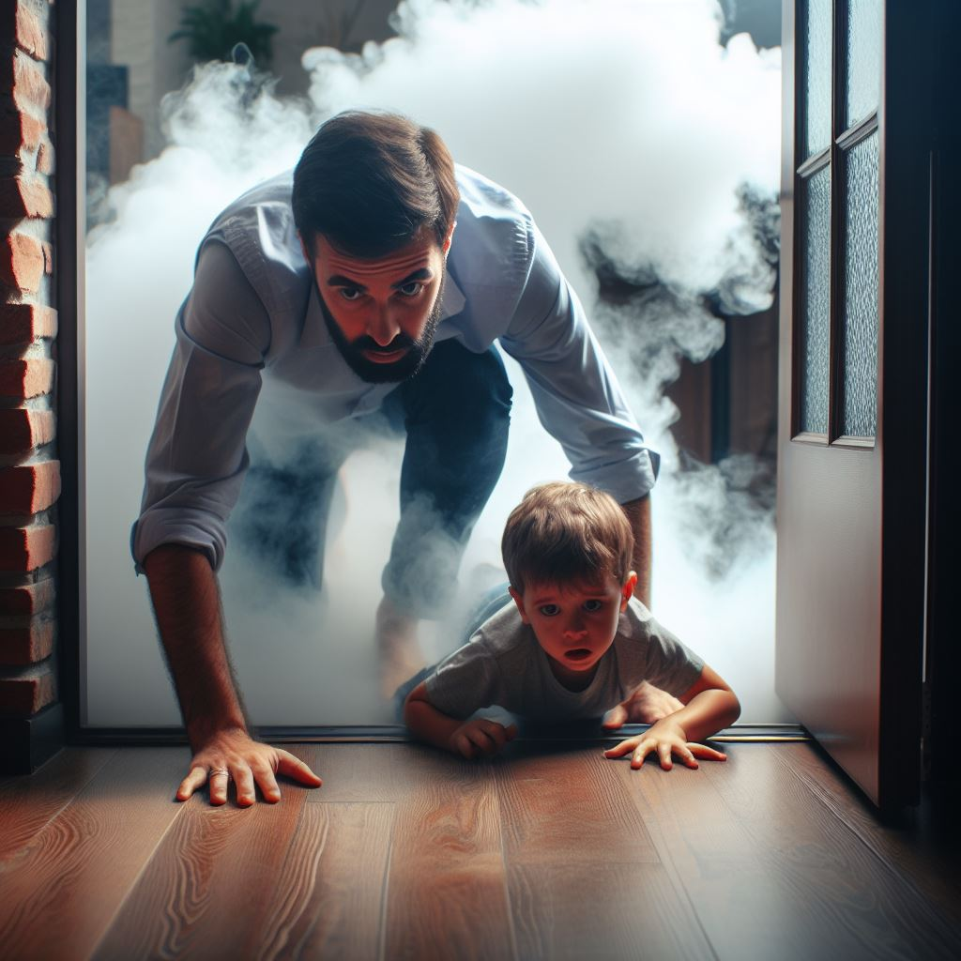
Get low and go!
Notes:
Get low and go! Crawl under smoke to an exit. Heavy smoke and deadly gasses rise to the ceiling.

Slide 39

Feel first
Notes:
Feel first!: Feel the doorknob and door before opening it. If either is hot, leave the door closed and use the second way out.

Slide 40
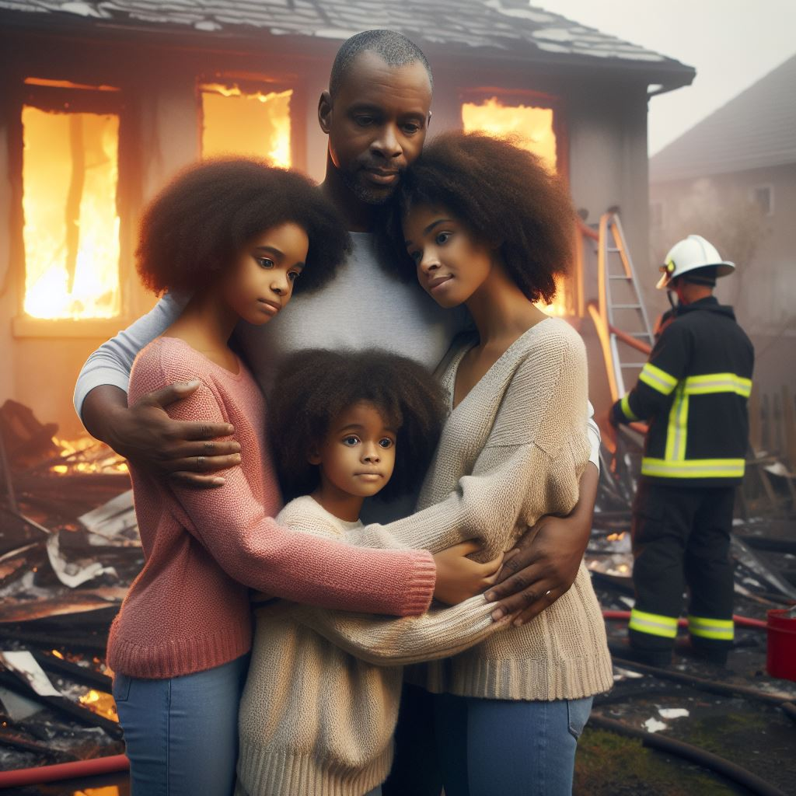
Get to your meeting spot.
Notes:
Get to your meeting spot: If you are the first one out of a burning building, wait at the emergency meeting spot you and your family decided on and call 911.

Slide 41

Don’t go back In.
Notes:
Don’t go back into any building unless a firefighter says it is safe

Slide 42

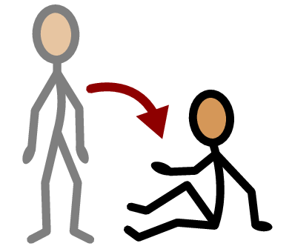
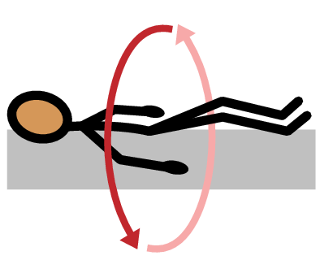
Stop
Drop
& Roll
Notes:
Stop, drop, and roll: If you have fire on your clothes, stop, drop, and roll! Stop where you are: if you run, the fire may spread. Drop to the ground and cover your face with your hands. Then roll over and over, or back and forth, until the fire is out.

Slide 43
Let’s Practice: STOP, DROP, and ROLL
Notes:
Ask the students if they want to practice stop, drop, and roll. The students can make a circle and practice one at a time stop, drop, and roll.

Slide 44
An emergency is when something serious, dangerous, and unexpected has happened and help is needed immediately.
Notes:
Tell the students “remember, emergency is when something serious, dangerous, and unexpected has happened and help is needed immediately”
Explain to the students again that “At school it is important to listen to your teacher and teachers know all the safety plans to keep you safe. At home it is important that everyone has a safety plan that everyone who lives in the home knows.”
Tell the students “I have a job for them to go home and make a plan with their families.” Pass out the make a plan handout for the students to go over with their families (Please see the make a planhandout)

Slide 45
All done, great job!

