Slide 1

Digital Citizenship
Third Grade Lesson 2​

Slide 2


Be aware of your surroundings, respect others’ space, and stay in your own area.

Slide 3

Use indoor voices, be mindful of noise levels.

Slide 4

Keep our eyes and ears open! And be ready to participate!

Slide 5

Be prepared to problem solve, ask questions, and contribute to the lesson.

Slide 6

Becoming a decision-maker:
What did we learn earlier in the year about making
decisions?

Slide 7
Let’s review the decision-making steps.

Slide 8
1. Stop and think

Slide 9

2. Explore the options

Slide 10

3. Gather information

Slide 11

4. Imagine the future

Slide 12
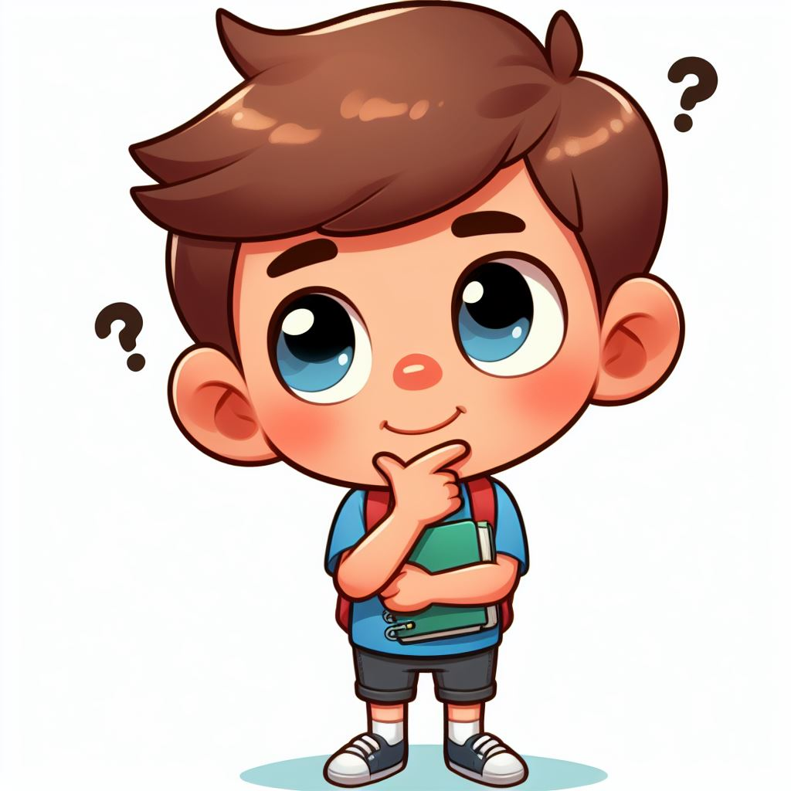
5. Consider the consequences

Slide 13
Stop and think: Avoid impulsive decisions.
Explore the options: Don't settle for the first choice. Brainstorm other possibilities.
Gather information: Seek knowledge from trusted sources to make informed choices.
Imagine the future: Think about how each choice will make you feel in the long run.
Consider the consequences: Analyze the potential outcomes for yourself and others.

Slide 14
Activity:
Becoming a decision-maker online.
Explain to a shoulder buddy what you think it means to “go online.”

Slide 15
Activity:
Becoming a decision-maker online.
What kind of things do you do online?

Slide 16
A consequence is like a natural result of your actions, kind of like an echo! Just like clapping your hands makes a sound, your choices online and offline can also have effects, both good and bad.
Good choices can lead to good consequences: If you're kind online, you might make new friends and feel good about yourself. That's like planting a happy seed and watching it grow into a friendly flower!
Not-so-good choices can lead to not-so-good consequences: If you share too much information online, it might be like leaving your favorite toy outside, it could be hard to get back.

Slide 17
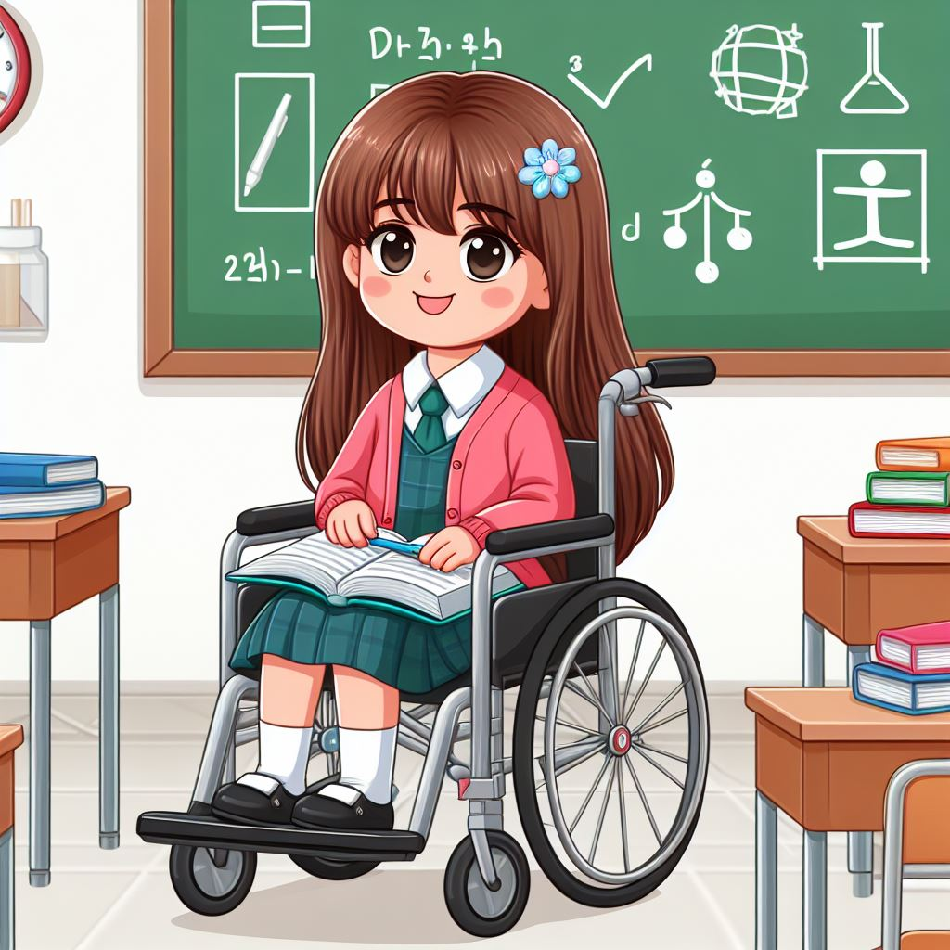
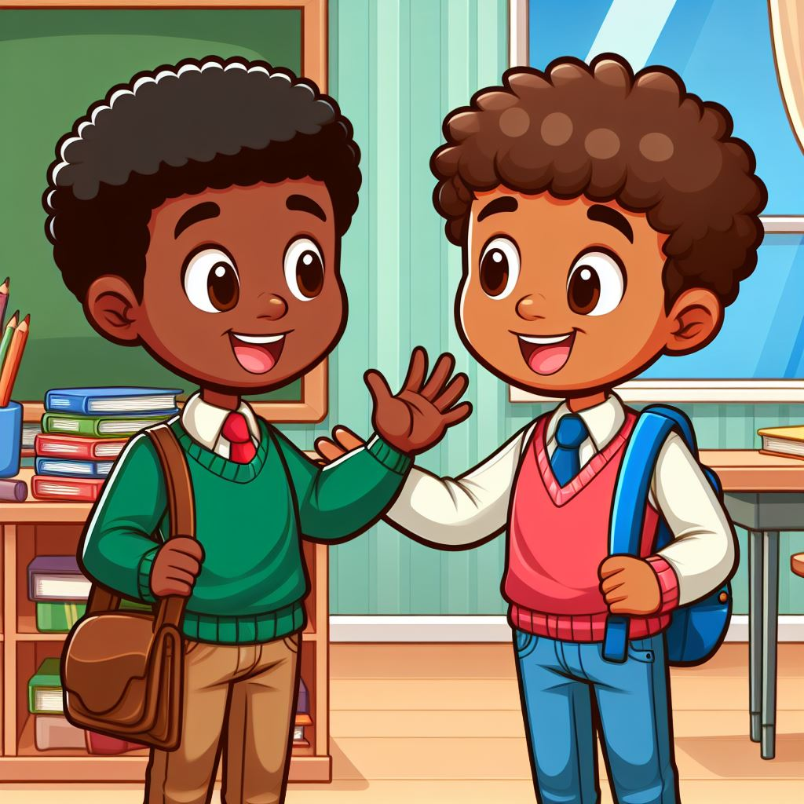
Positive Consequences
Listening in school
Making friends
Notes:
What are the positive consequences of these actions

Slide 18
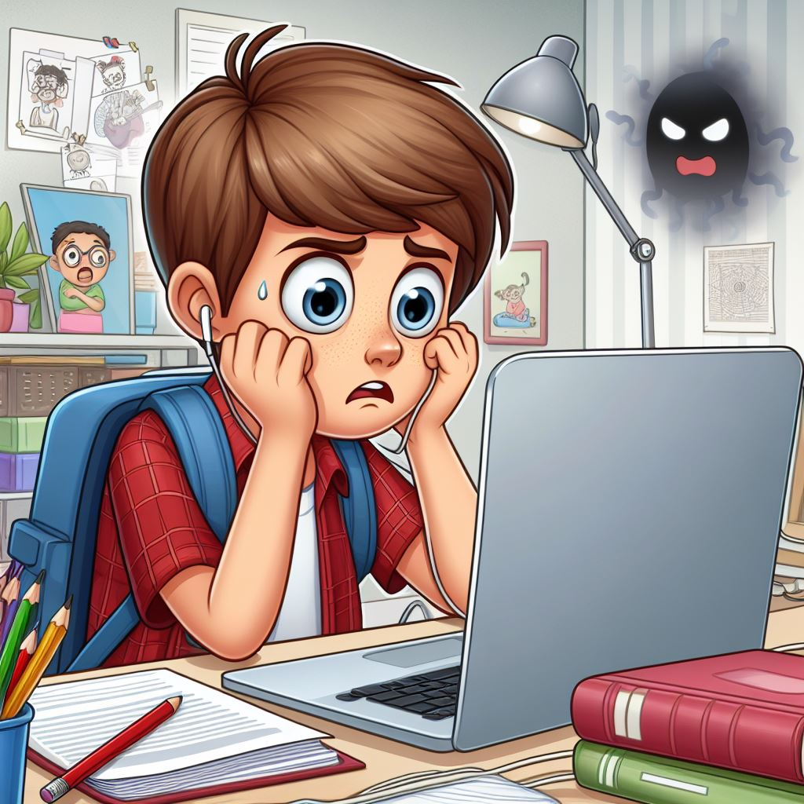
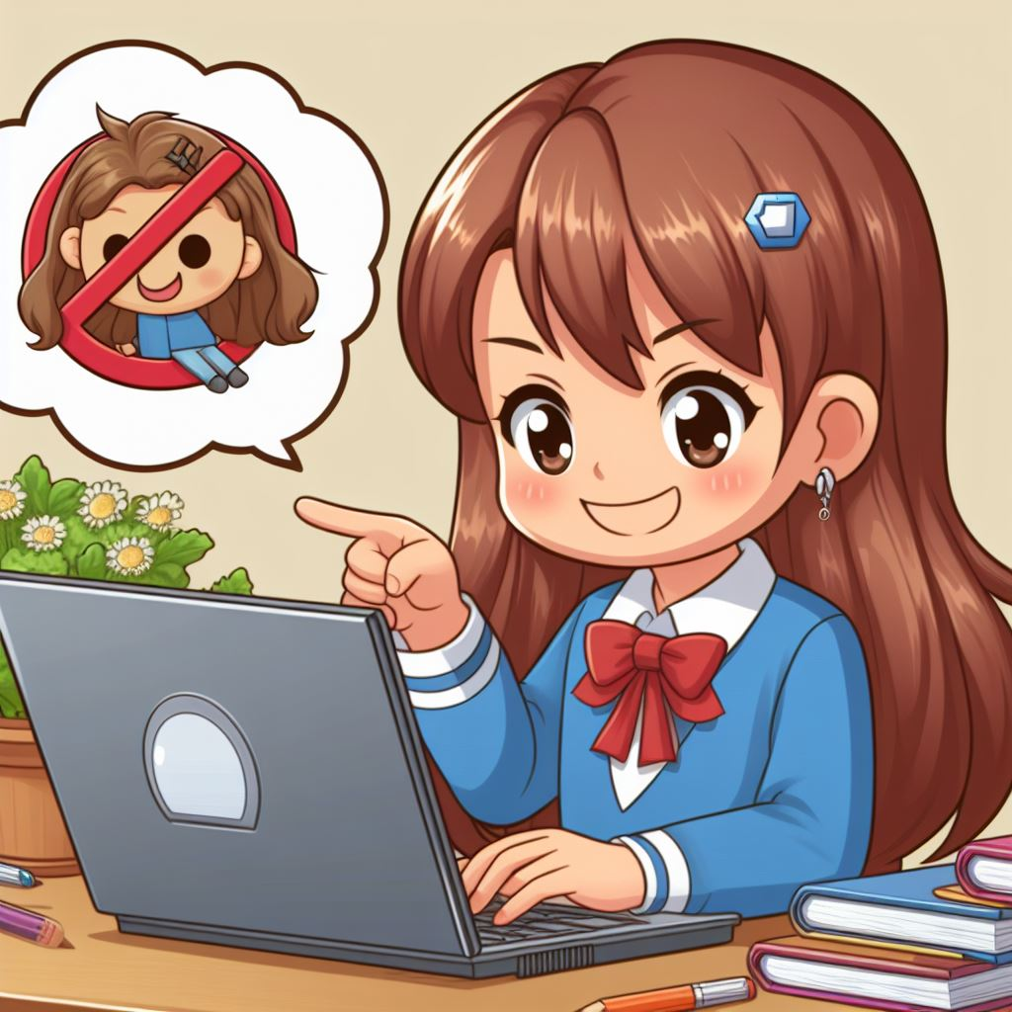
Negative Consequences
Clicking on dangerous links
Making fun of people
Notes:
What are the negative consequences of these actions

Slide 19
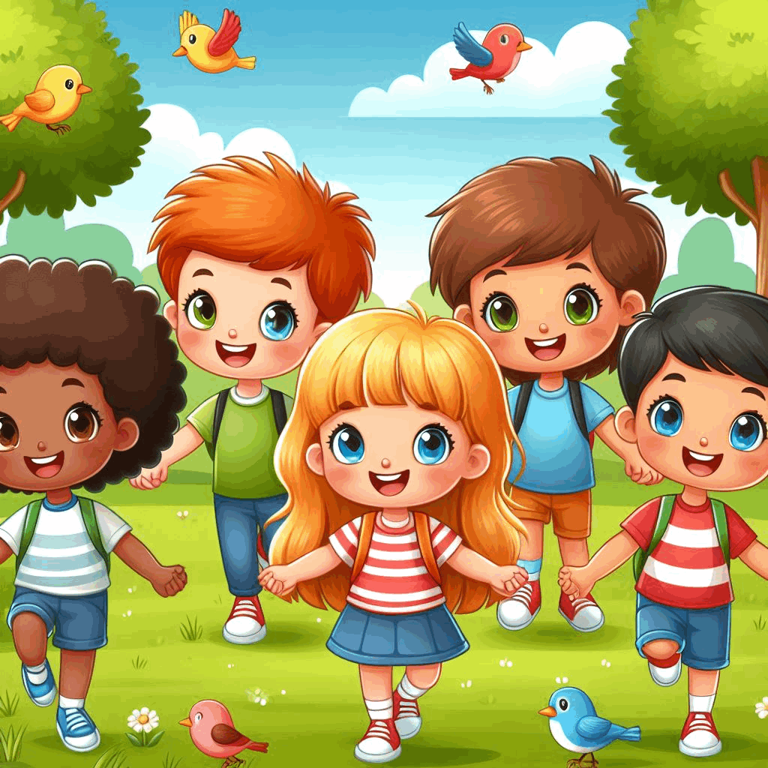
Making Good Decisions Online

Slide 20
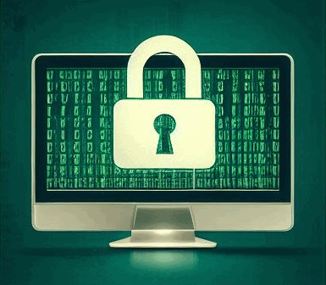
1. Protect personal information

Slide 21
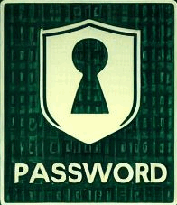
2. Keep passwords safe

Slide 22
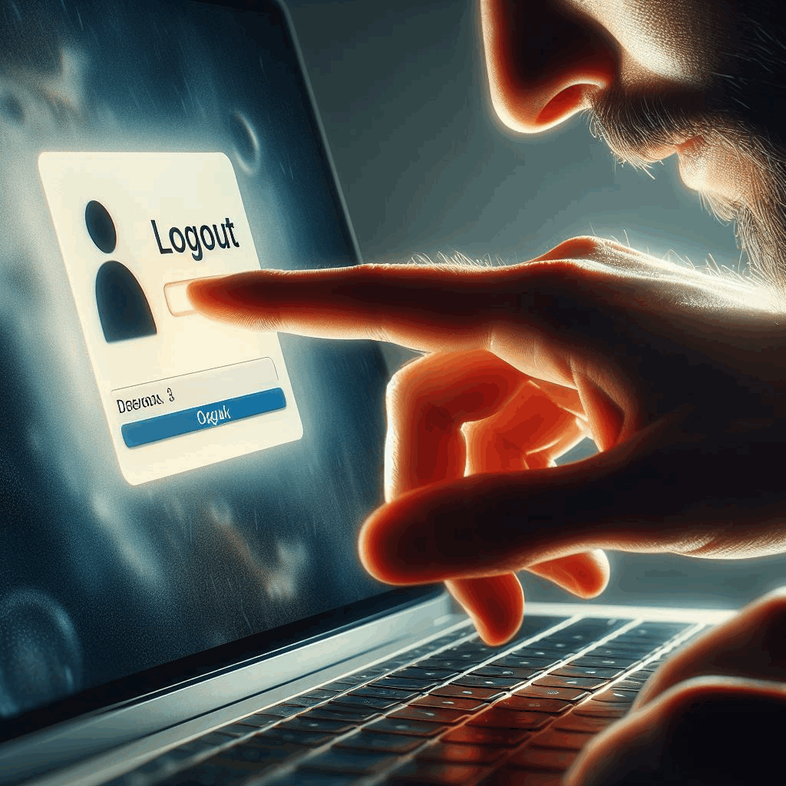
3. Logging off your device after you are finished

Slide 23
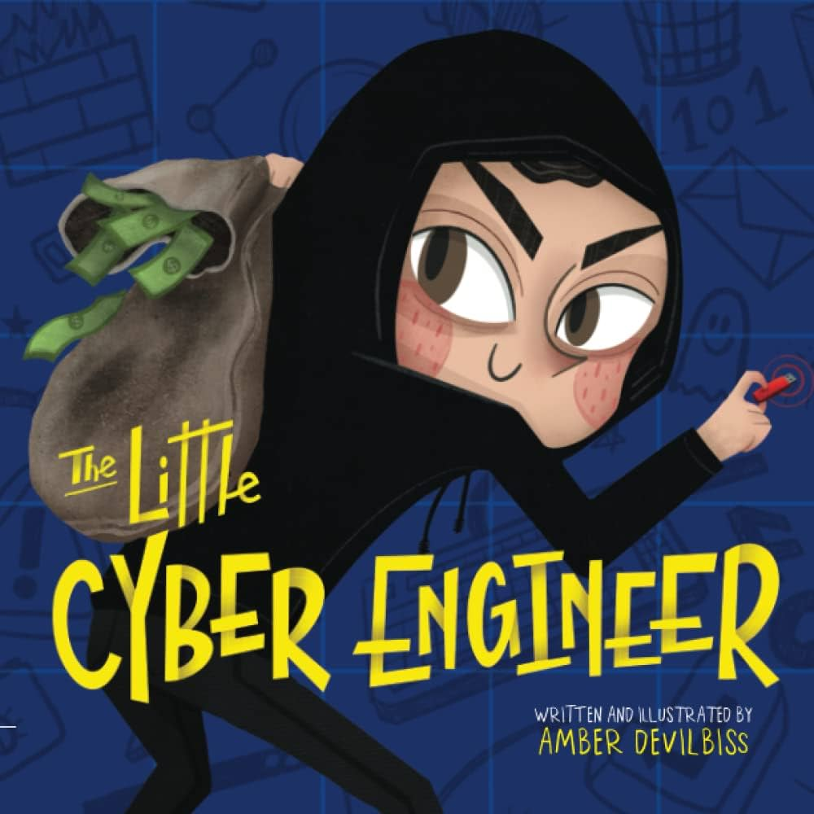
Read the book: The Little Cyber Engineer
By Amber Devilbiss

Slide 24
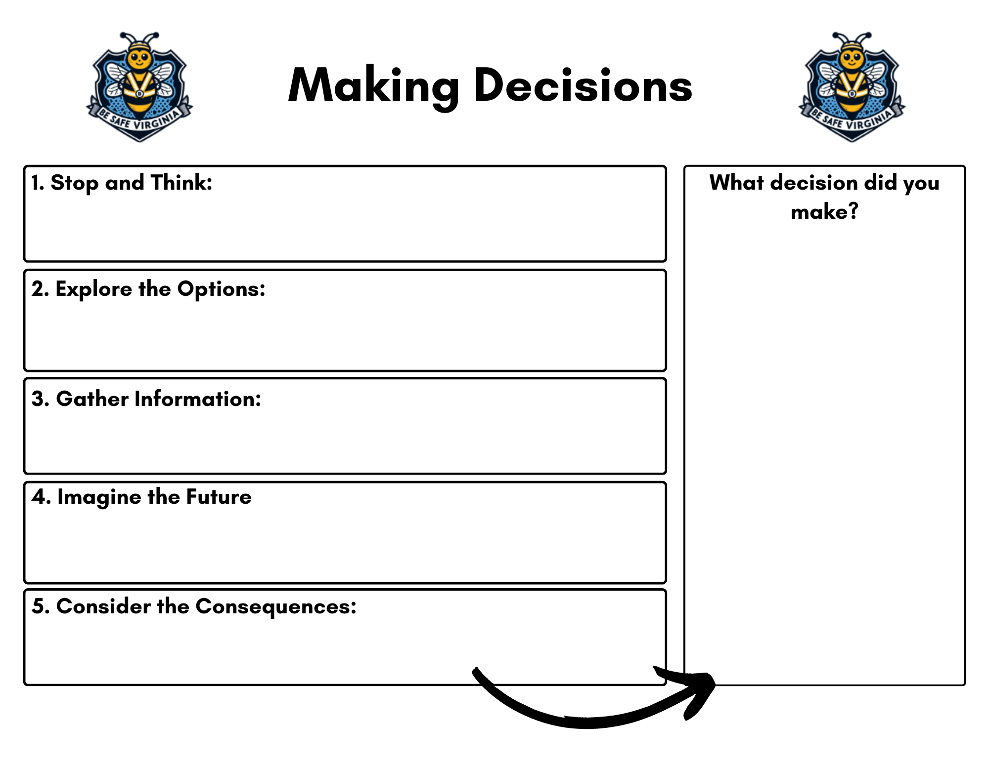
Activity: Role-play
Notes:
Imagine you're playing pretend, but instead of being pirates or superheroes, you get to be decision detectives! This time, you'll use your imagination and what you know about making decisions to act out real-life situations and choose the best course of action.
https://www.canva.com/design/DAF7wtTih4o/n3s6p-pg7ZPtMPdfX1VFWg/edit?utm_content=DAF7wtTih4o&utm_campaign=designshare&utm_medium=link2&utm_source=sharebutton

Slide 25
1. Spot time!
Find a place where you can see the teacher and work with your friends, like superheroes with a secret HQ!
2. Whisper time!
Chat quietly with your team about a time you made a super smart decision online, like choosing the right website for a project.
3. Action time!
Use your graphic organizer to solve the pretend problem the teacher gives you, just like a detective cracking a case!
Activity: Role-play

Slide 26
Your phone dings while hanging out online when you receive a message from someone in your class. It contains an embarrassing picture of another classmate, possibly taken without their consent. What do you do?
Activity
Scenario 1
Notes:
https://www.canva.com/design/DAF7wtTih4o/n3s6p-pg7ZPtMPdfX1VFWg/edit?utm_content=DAF7wtTih4o&utm_campaign=designshare&utm_medium=link2&utm_source=sharebutton

Slide 27
You're playing a cool online game with one of your friends a friend you met on the web. They ask you to send them a picture of yourself so they can see what you look like. What do you do?
Activity
Scenario 2
Notes:
https://www.canva.com/design/DAF7wtTih4o/n3s6p-pg7ZPtMPdfX1VFWg/edit?utm_content=DAF7wtTih4o&utm_campaign=designshare&utm_medium=link2&utm_source=sharebutton

Slide 28
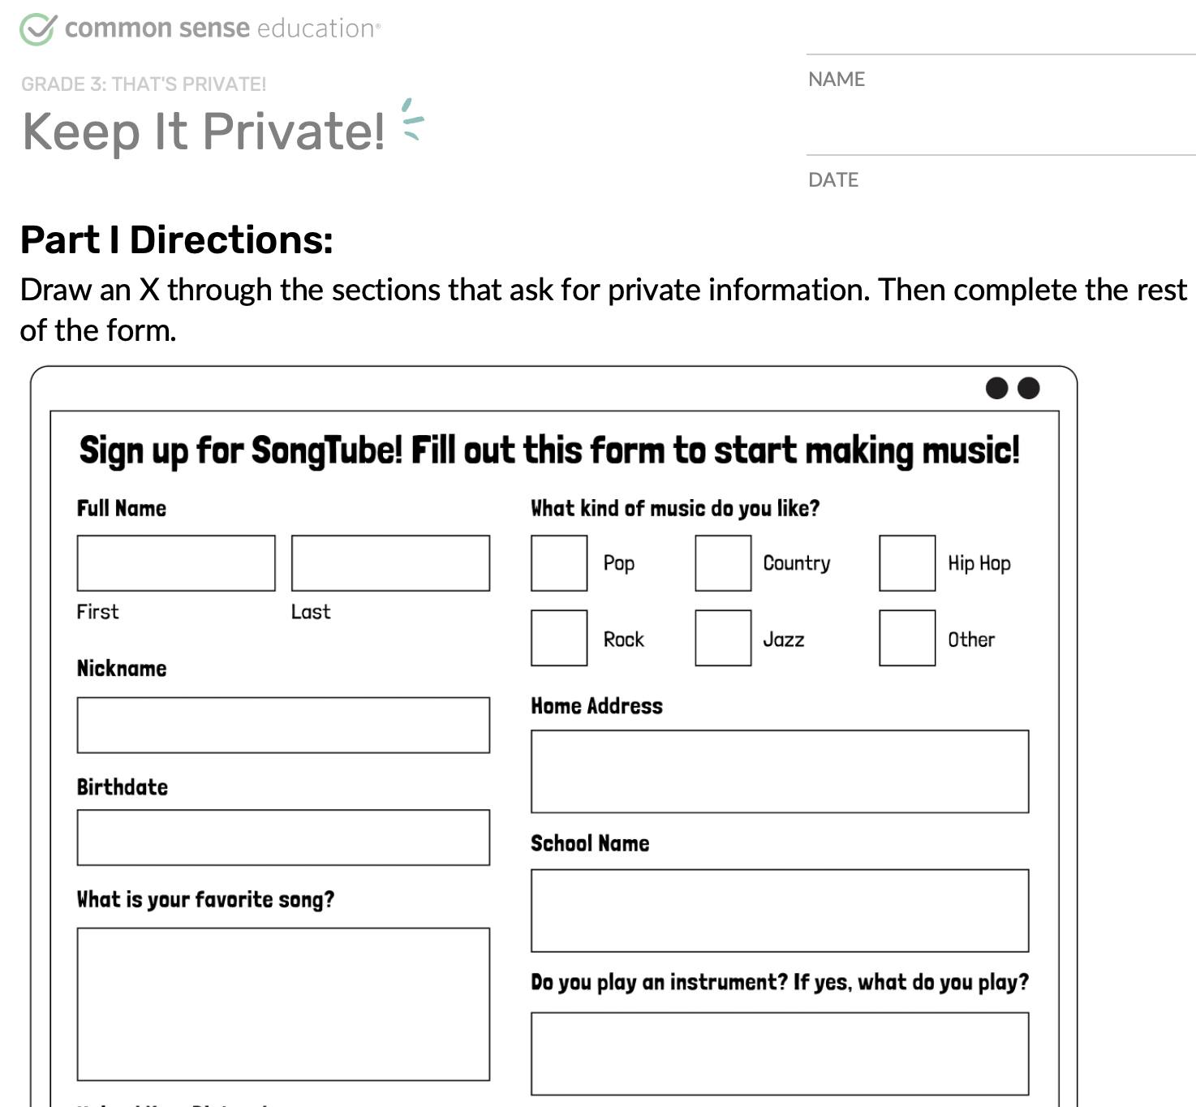
Activity: That’s Private

Slide 29
Activity:
Digital Citizenship Pledge
Notes:
https://www.commonsense.org/education/digital-citizenship/lesson/we-the-digital-citizens

Slide 30
All done, great job!

