Slide 1

Decision-Making
Third Grade Lesson 3​

Slide 2


Be aware of your surroundings, respect others’ space, and stay in your own area.

Slide 3

Use indoor voices, be mindful of noise levels.

Slide 4

Keep our eyes and ears open! And be ready to participate!

Slide 5

Be prepared to problem solve, ask questions, and contribute to the lesson.

Slide 6

Our Decisions
Notes:
Picture of children arguing

Slide 7

The Decision-Making Process

Slide 8

Step 1: Stop and think: Avoid impulsive decisions.

Slide 9

Step 2: Explore the options: Don't settle for the first choice. Brainstorm other possibilities.

Slide 10

Step 3: Gather information: Seek knowledge from trusted sources to make informed choices.

Slide 11

Step 4: Imagine the future: Think about how each choice will make you feel in the long run.

Slide 12

Step 5: Consider the consequences: Analyze the potential outcomes for yourself and others.

Slide 13
The Decision-Making Process
1. Stop and think.
2. Explore the options.
3. Gather information.
4. Imagine the future.
5. Consider the consequences.

Slide 14
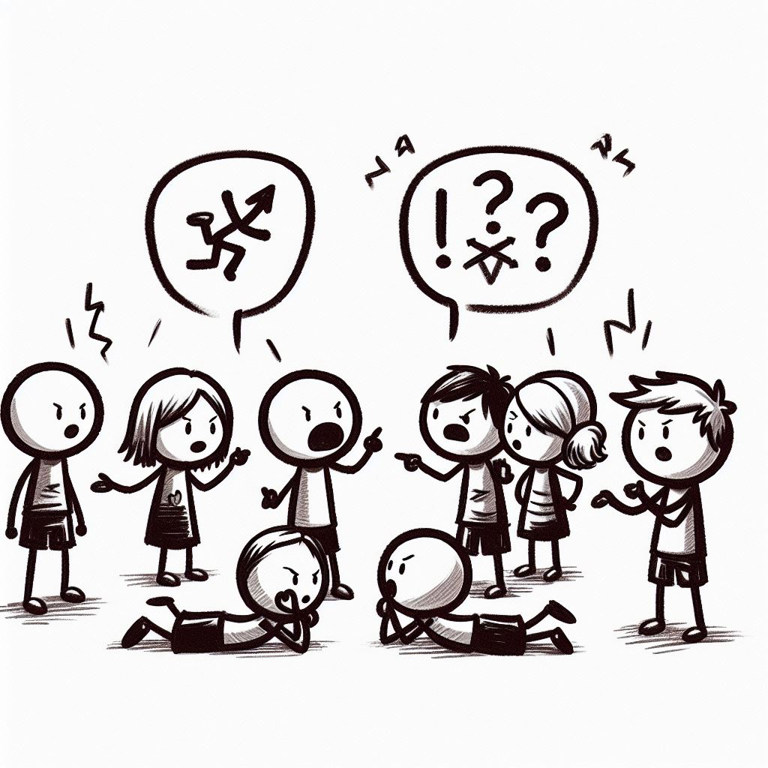
What is conflict?
A conflict is when we have a disagreement or problem with someone.
Notes:
Picture of children arguing

Slide 15
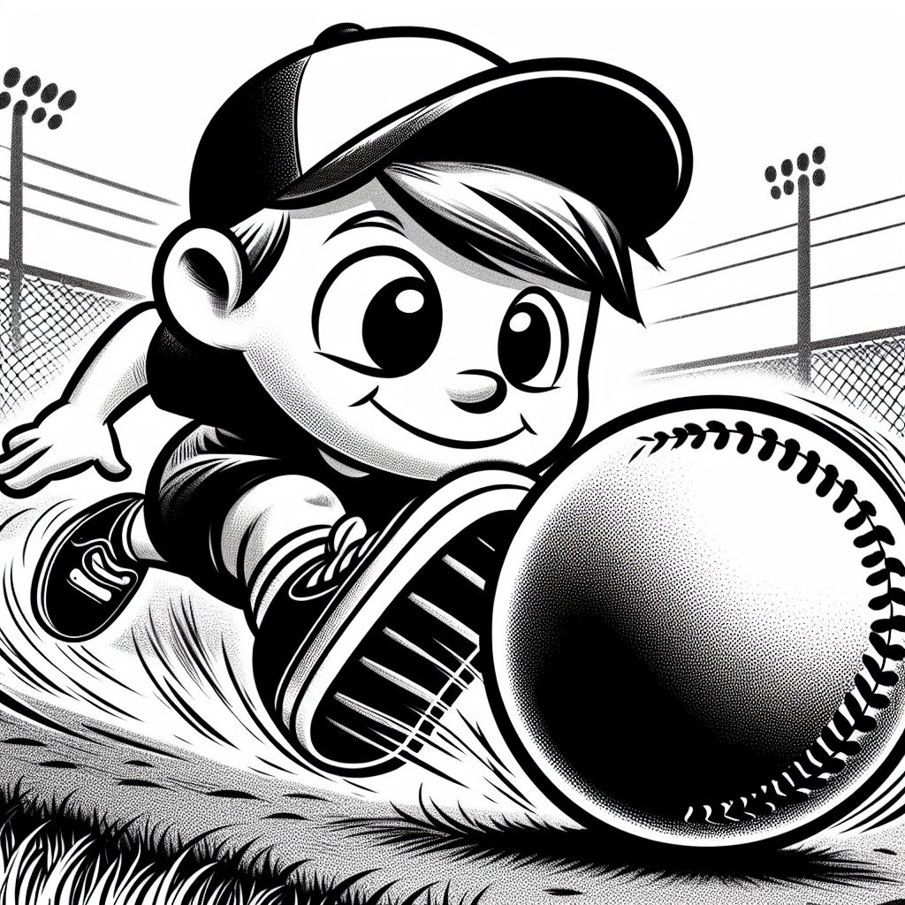
Conflict Scenario 1:
You and your friend both want to be the pitcher in the kickball game but only person can be the pitcher.
What can we do to make a good decision and solve this problem?
Notes:
Picture of children arguing

Slide 16

Conflict Scenario 2:
Elizabeth’s best friend is making an unsafe decision on the playground and invites Elizabeth to play along. What should Elizabeth do?

Slide 17
Activity:
Decision-Making Handout

Slide 18
All done, great job!

