Slide 1

Respect for Authority
Third Grade Lesson 4

Slide 2

Be aware of your surroundings, respect others’ space, and stay in your own area.

Slide 3

Use indoor voices, be mindful of noise levels.

Slide 4

Keep our eyes and ears open! And be ready to participate!

Slide 5

Be prepared to problem solve, ask questions, and contribute to the lesson.

Slide 6
Defining authority figures for children and adults:

Slide 7


Authority refers to a person who has an important role in keeping things fair and safe. They are the ones in charge.

Slide 8
Activity: Brainstorm examples of authority figures in our lives.

Slide 9

Read the book: What if Everybody Did That?
By Ellen Javernick

Slide 10

Activity: List respectful interactions with authority.

Slide 11


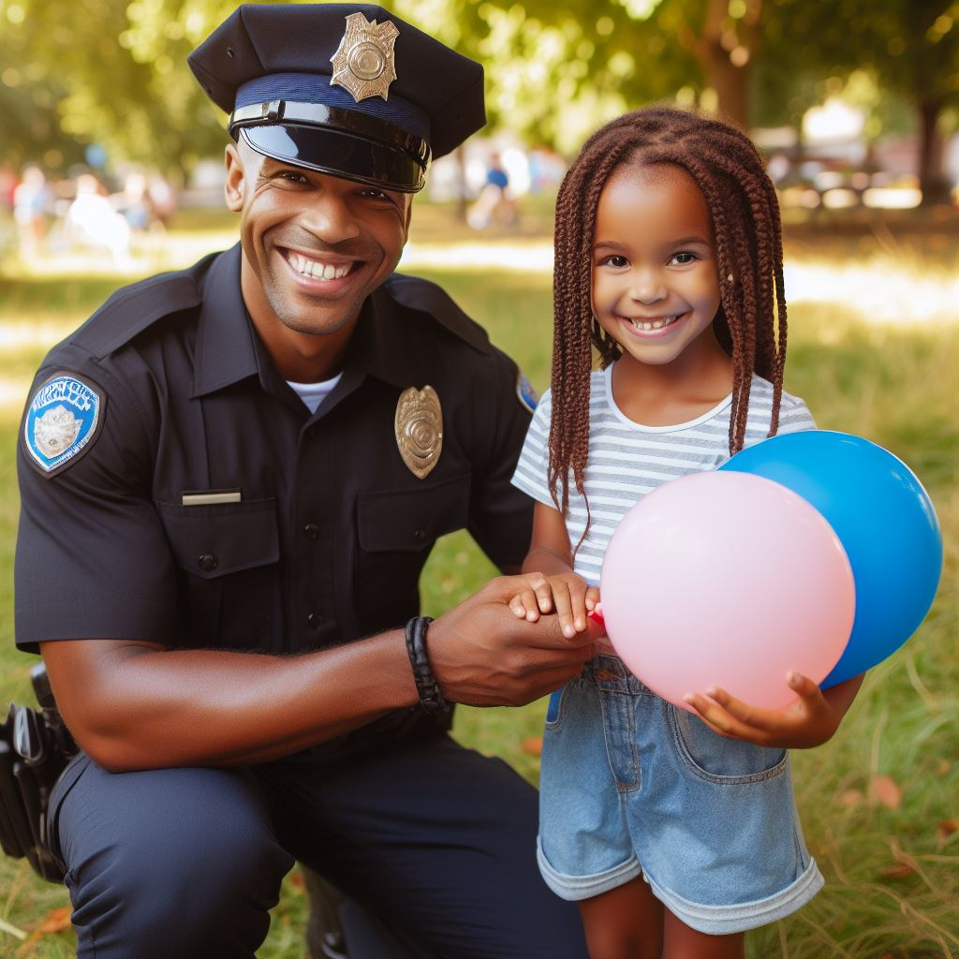

Activity:
List appropriate ways to interact with authority figures.

Slide 12
All done, great job!

