Slide 1

Self-Discipline/ Alternatives to Fighting
Third Grade Lesson 5

Slide 2

Be aware of your surroundings, respect others’ space, and stay in your own area.

Slide 3

Use indoor voices, be mindful of noise levels.

Slide 4

Keep our eyes and ears open! And be ready to participate!

Slide 5

Be prepared to problem solve, ask questions, and contribute to the lesson.

Slide 6
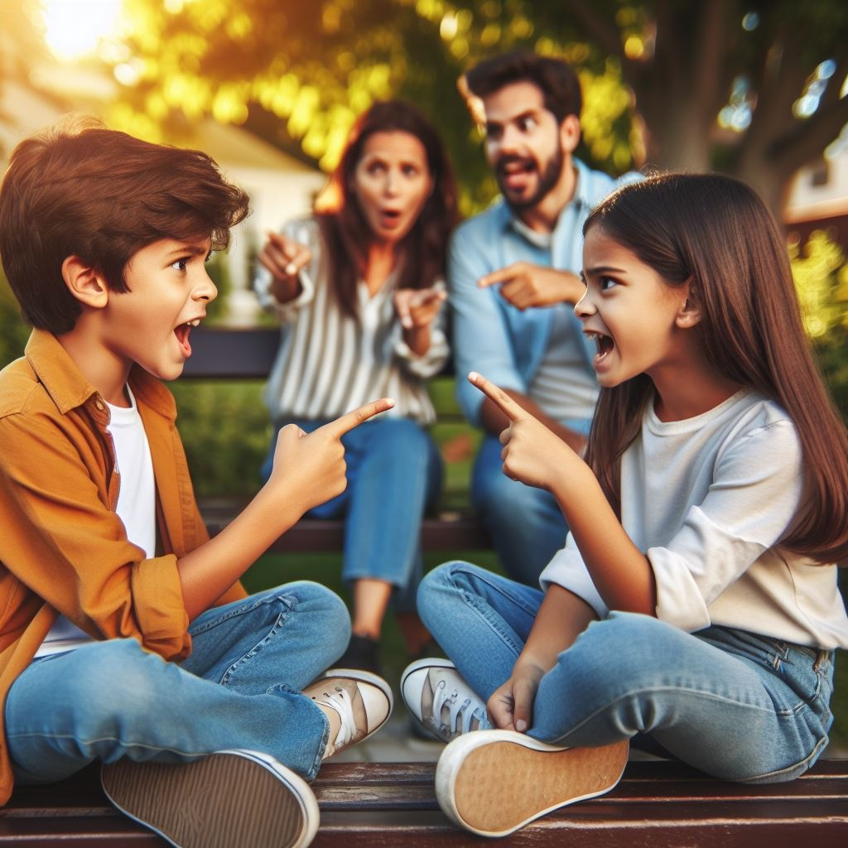
What is a conflict?
Notes:
Picture of children arguing

Slide 7
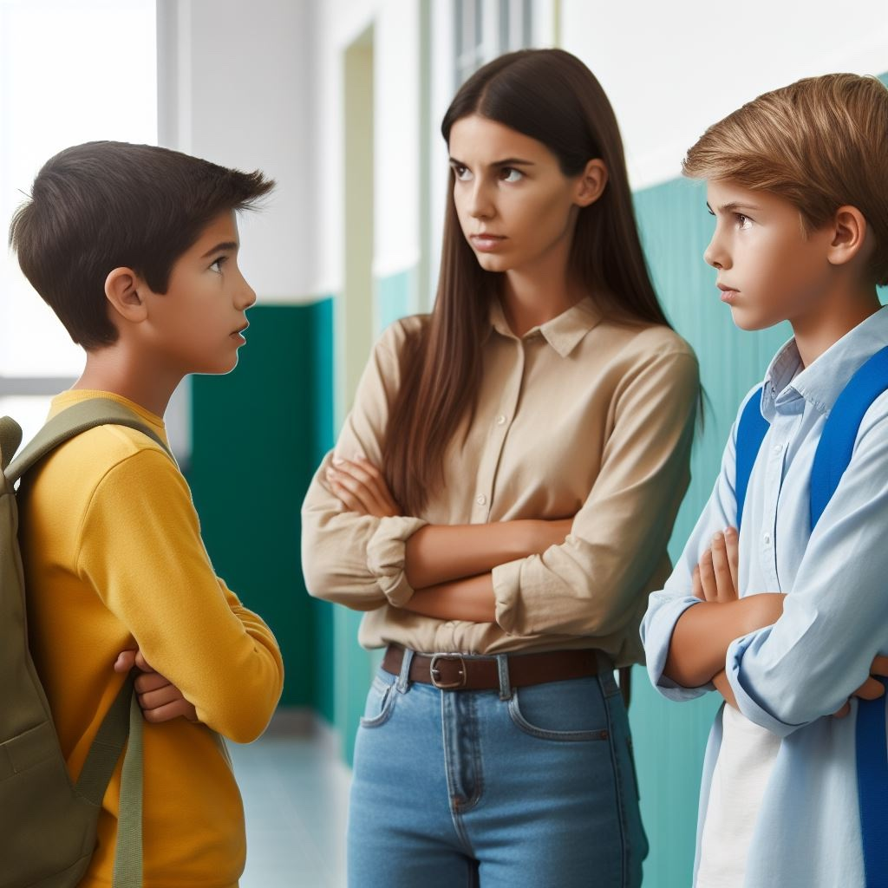
A conflict is like a disagreement or problem between people.

Slide 8
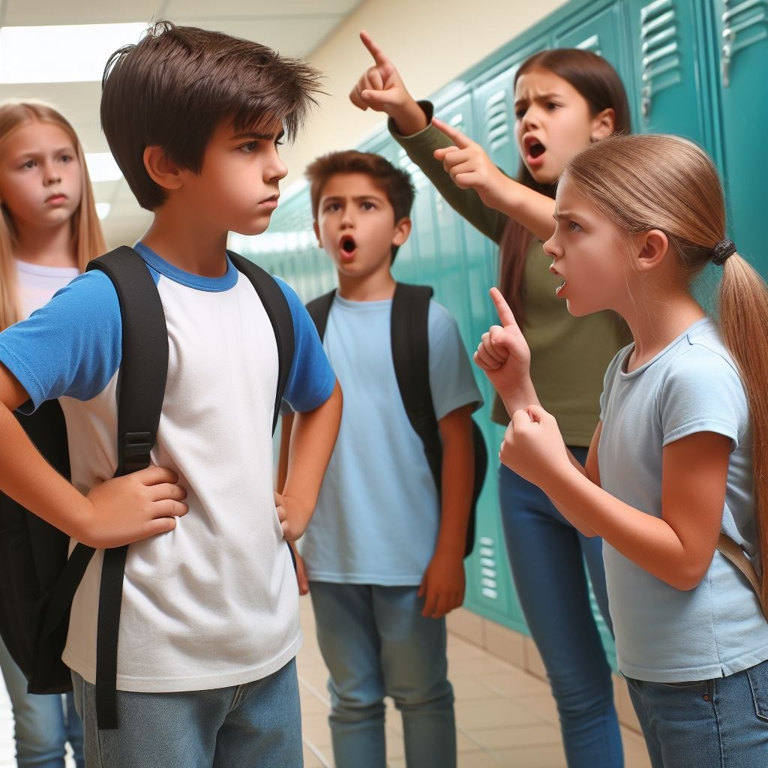
What is self-discipline?

Slide 9
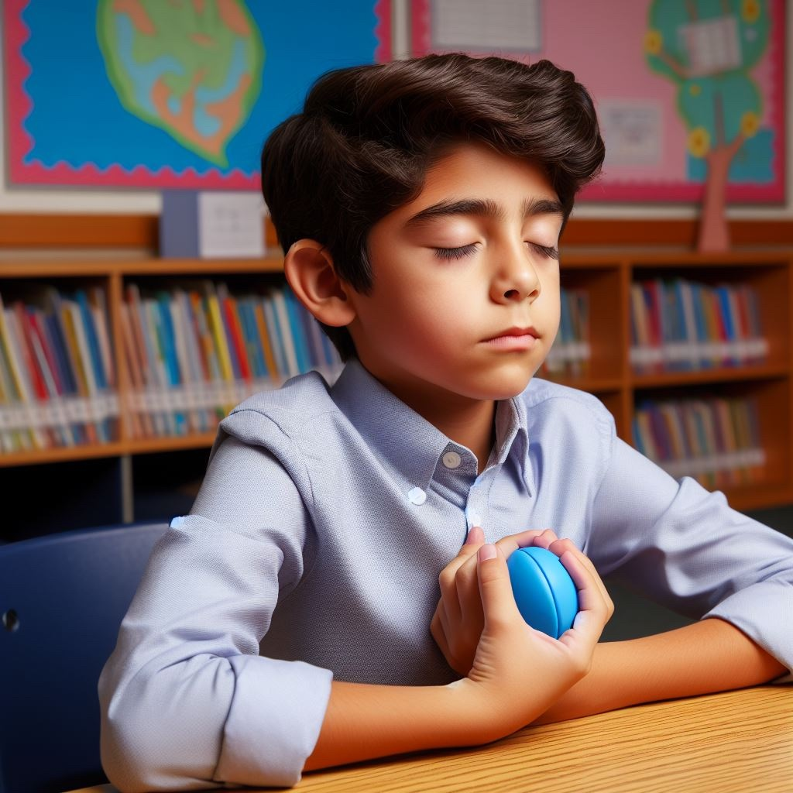
Self-discipline means being in charge of your actions, making good choices, and doing what you need to do, even when it's hard.
Notes:
It's like being the boss of yourself and making positive decisions to reach your goals.

Slide 10
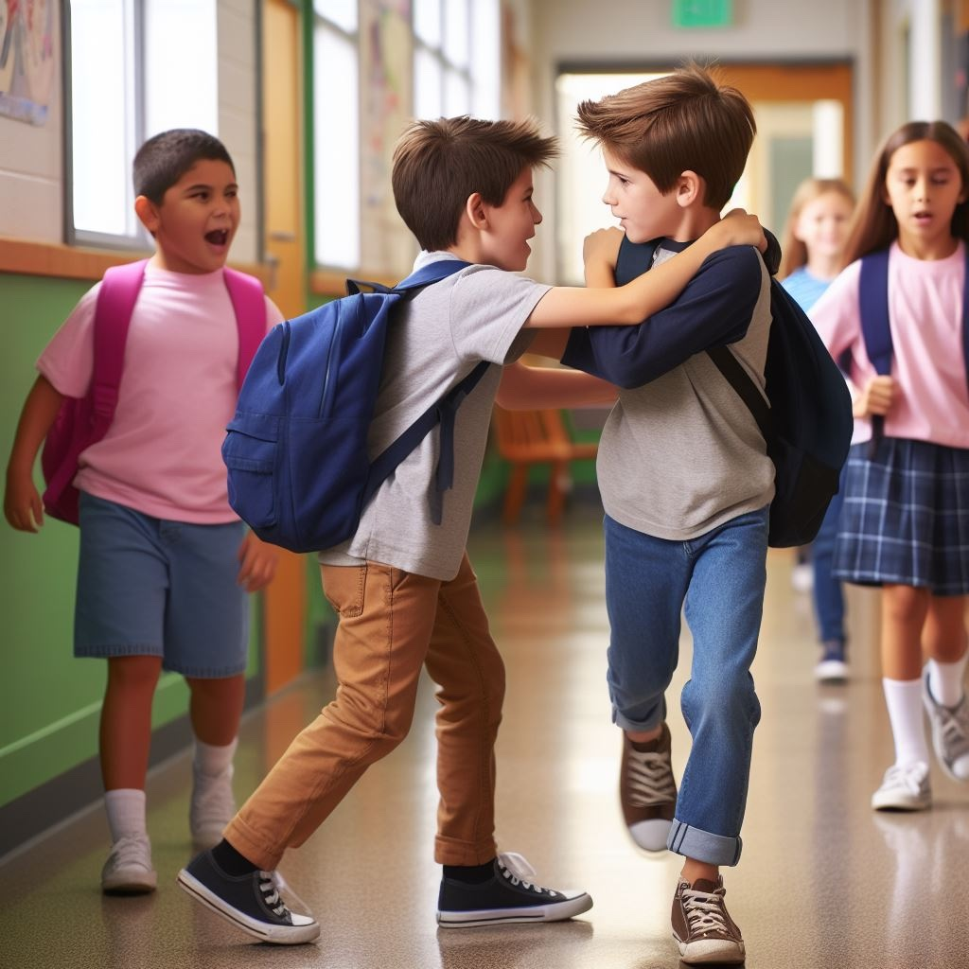
What is a trigger?

Slide 11

A trigger is like a button that starts a conflict. It could be something someone says or does.

Slide 12
Activity: Let’s identify some common triggers that can lead to conflicts.

Slide 13
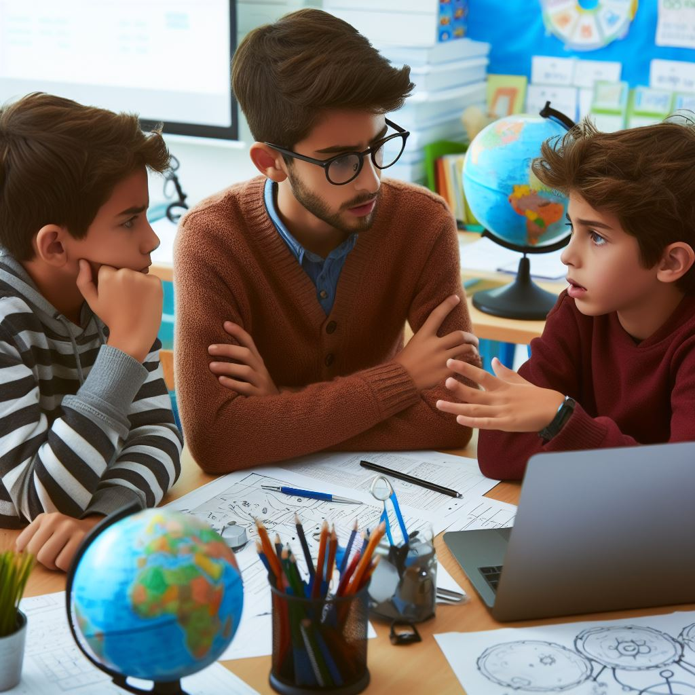
Scenario 1: Miscommunication
Two friends are working on a school project. One thinks they should focus on finding information (research), while the other believes making a big poster is more important.
Notes:
Google image based on this scenario: Two friends are working on a school project. One thinks they should focus on finding information (research), while the other believes making a big poster is more important.

Slide 14
Miscommunication happens when people don't understand each other correctly and it can lead to disagreements or confusion.

Slide 15
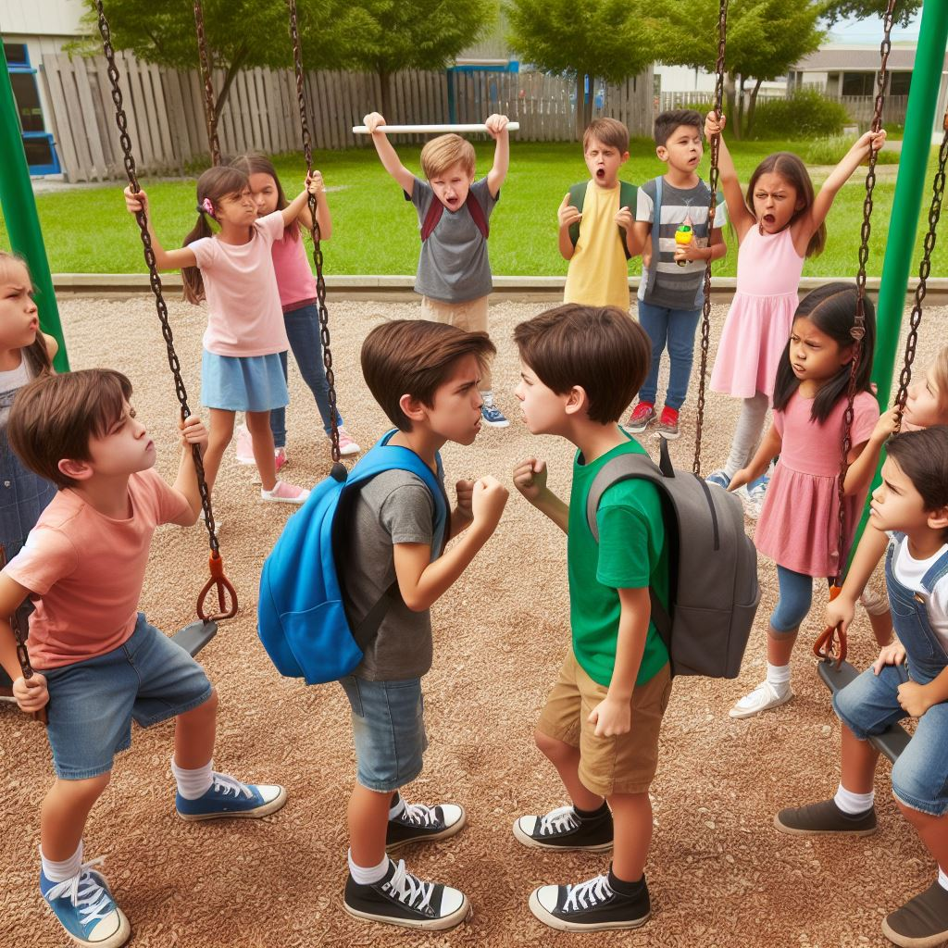
Scenario 2: Competition for resources
Many students want to play on a limited number of swings at recess. They argue about who should get to use the swings first because there aren't enough for everyone.

Slide 16
Competition for resources means people want the same things but there are not enough for everyone, which can cause disagreements.

Slide 17
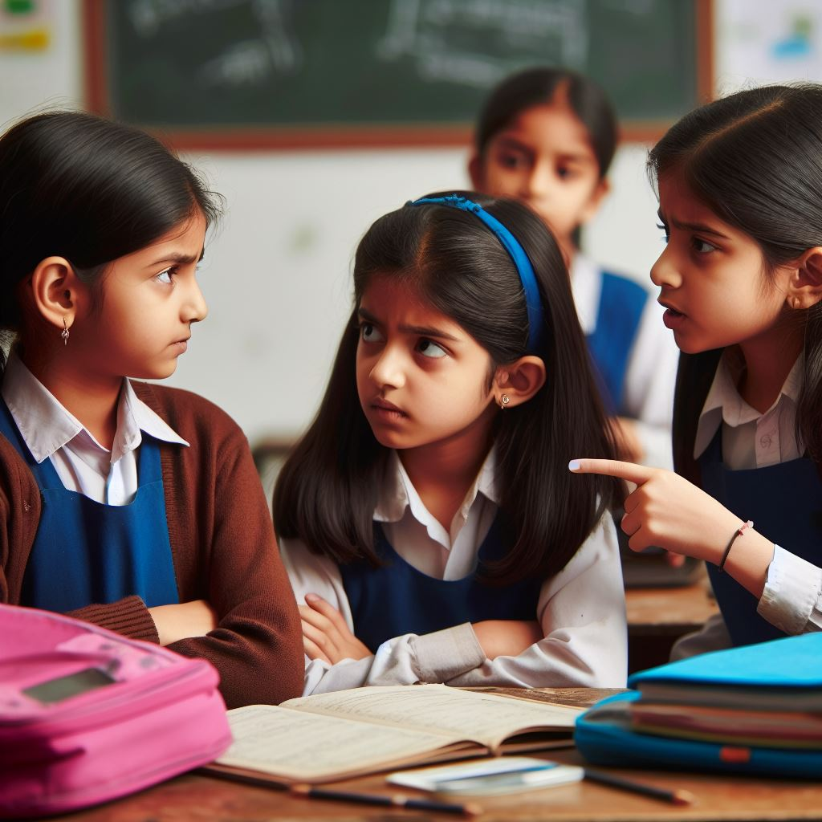
Scenario 3: Different perspectives
Two students have different opinions about a topic they discuss in class. They start arguing because they see things differently and can't agree.

Slide 18
Different perspectives occur when people see things differently or have different opinions.

Slide 19
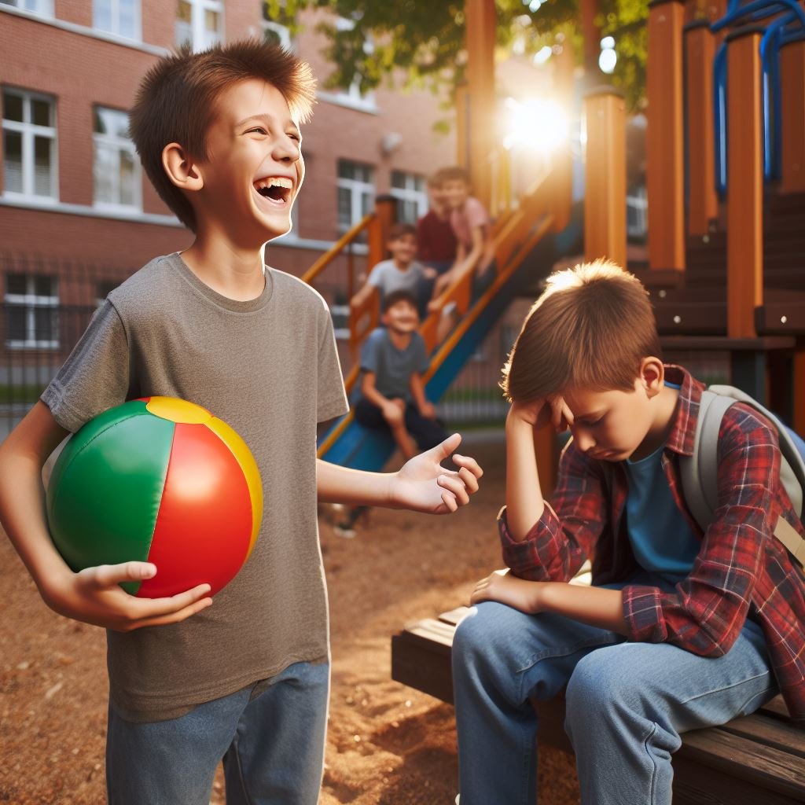
Scenario 4: Unfair treatment
During a game with friends, one person feels sad because others are not including them. They feel left out and treated unfairly, which makes them frustrated.

Slide 20
Unfair treatment means when someone is not treated the same way as others, which can make them feel upset or left out.

Slide 21
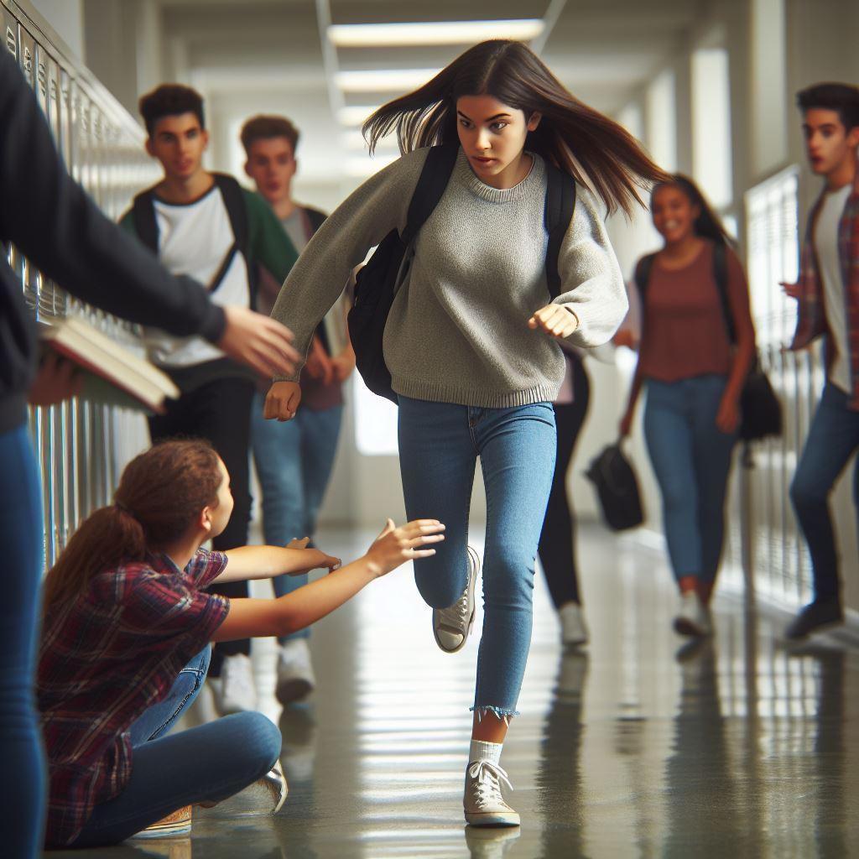
Scenario 5: Violation of personal space
A student accidentally bumps into another in class while rushing to their seat. The student who got bumped feels upset because they think it was done on purpose, invading their personal space.

Slide 22
Personal space is violated when someone gets too close or touches another person when they don't want them to.

Slide 23
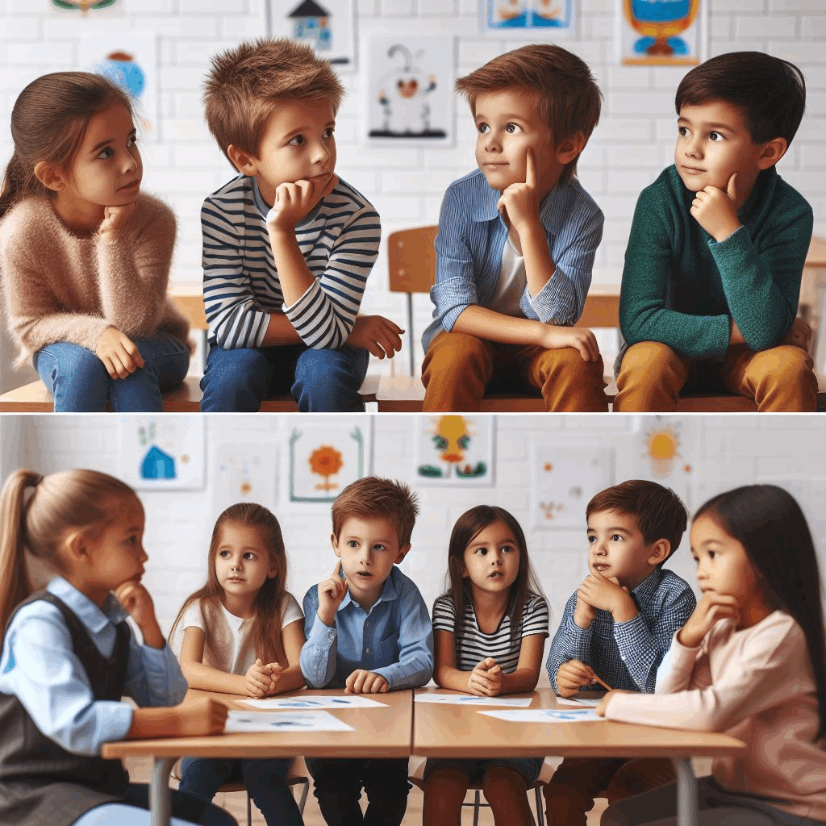
Activity:
Think-Pair-Share

Slide 24
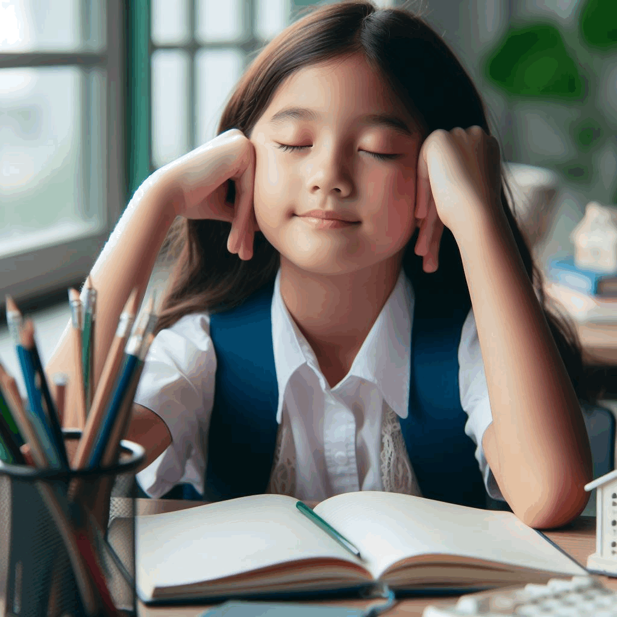
Cool-off techniques

Slide 25

Let’s practice!
Notes:
Deep Breathing:
- Take a deep breath in through your nose.
- Hold it for a few seconds.
- Slowly exhale through your mouth.

Slide 26
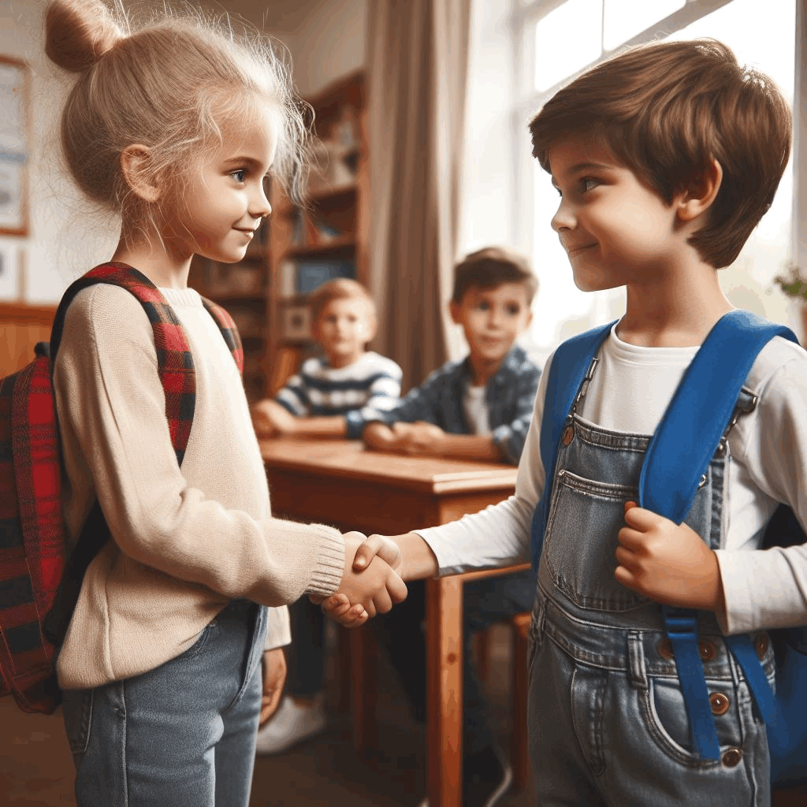
Strategies to avoid conflict

Slide 27
Closing Activity
What was the conflict? | How did you resolve it? | What cool-off technique(s) did you use?

Slide 28
All done, great job!

