Slide 1
Good afternoon. Thank you for joining us today. The Virginia Department of Criminal Justice Services (DCJS) is excited that the launch of the new Online Grant Management System (OGMS) is underway.
DCJS is committed to keeping all constituents informed to ensure a smooth transition for everyone. The VWGP will be one of the first to enter in applications in the OGMS.
The new system provides the ability to manage different aspects of your DCJS grants to include managing users, submitting grant applications, programmatic and financial reports, reimbursement claims, budget amendments and more.

Slide 2
After the training, feel free to contact ogmssupport@dcjs.virginia.gov if you have any additional questions regarding OGMS.
When sending an email to OGMS, please include your grant program and grant # in the subject line so that your question(s) can be answered by the appropriate DCJS staff.
For this training, we will be using a sample funding opportunity (formerly known as a grant solicitation). This is not an official funding opportunity but contains the same components as your application.
At the end of the training, we will have a live Q&A session devoted to VWGP specific questions and OGMS.

Slide 3
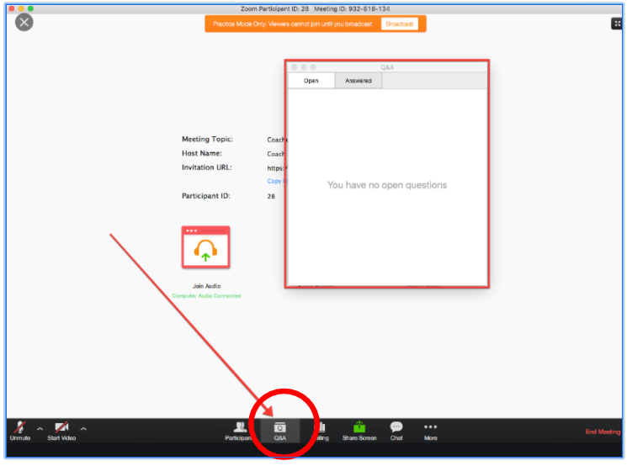
Q and A Button: During the training, please type your questions in the Q&A feature and we’ll answer them as we go along.

Slide 4
This session is being recorded and will be available on the DCJS website.
Again, thank you for joining us.

Slide 5
Virginia Victim Witness Grant Program (VWGP) For Continuation Applicants Only
Application Due Date:
Monday, March 29, 2021, 5:00 pm
To the Online Grant Management System (OGMS)
Late applications will not be accepted.

Slide 6
Training Agenda
Anya Shaffer, VOCA Administrator: Provide an overview of VOCA Administration in Virginia funding outlook as it relates to the Crime Victims Fund.
Patricia Foster, Victim/Witness Grant Program Coordinator: Provide a review of the grant guidelines and the application process for the upcoming FY22-23 funding cycle.
Amia Barrows, Grant Monitor Supervisor: Provide an overview of the Online Grants Management System (OGMS) application process.

Slide 7
VOCA Overview
Crime Victims Fund (CVF) & Congressional Cap
Deposits to & obligations/allocations from the CVF
Fund sustainability
Notes:
VOCA, Victims of Crime Act funding supports a large portion of the Victim Witness grant program. In the interest of transparency, we wanted to give you an overview and update of the status of VOCA Funding.
VOCA funded out of the federal Crime Victims Fund, which is supported by fines and penalties from federal criminal convictions.
The amount of funding from the CVF allocated to the states is set by congress in the Appropriations Act and referred to as the “VOCA Cap”
VOCA finding has swung up and down wildly in the last 5 years or so. We’re now at a point where obligations on the crime victims fund outweigh deposits and there are sustainability concerns.

Slide 8
Virginia’s VOCA Allocations
Declining since Federal (FY) 2018
Approximately 32% reduction from FY2018 to FY2019
Approximately 26% reduction from FY2019 to FY2020

Slide 9
Recent Congressional Actions
Congress reached a deal with the appropriations and COVID relief packages
For FY2021, overall VOCA Cap had a $600 million decrease or about a 23% decrease
Language to address the sustainability of the Crime Victims Fund was not included
Notes:
Work is being done to estimate what the new Cap amount means for individual state awards. There’s not a direct correlation, but it’s enough information to make an estimate.

Slide 10
VOCA Funding Outlook
Due to the instability of the CVF, there is still uncertainty with future VOCA funding levels
Goals of sustainability & best meeting victims’ needs
Anticipate decrease in amount of grant funding available
Notes:
Current open VSGP solicitation had decreased available funding but we were able to have level funding for non-competitive grants programs. Anticipate future decreases in the years coming. The current amount of funds allocated is not sustainable.

Slide 11
VWGP Application Introduction
Applications must be submitted in the DCJS Online Grants Management System (OGMS) no later than 5:00 p.m. on, March 29, 2021.
The system will not allow you to submit an application after the deadline and, therefore it will not be considered. Plan time for any possible technical difficulties you may experience since the application will not be accepted after the deadline.
Each application form in OGMS must be marked as complete before you can submit the application. If you receive an alert, you will need to review the form for any missing required information.

Slide 12
VWGP Application in OGMS
Terminology Changes
Requirements to Use OGMS
Funding Opportunity
Application Details (checklist)

Slide 13
Terminology: change

Slide 14
Requirement to Use OGMS
Approved Registration of all users (Project Director, Project Administrator, and Finance Officer) within your agency that are responsible for submitting applications, uploading progress reports, entering financial reports, and requesting funds must also register in OGMS.
This includes authorized personnel (City Manager or County Administrator or their designee) who can formally commit the agency/locality to submit the grant application.

Slide 15
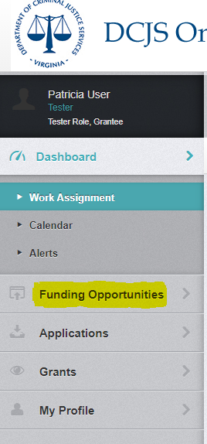
Funding Opportunity
To begin completing your application in OGMS, you will need to locate your Funding Opportunity (26-Victim Witness Grant Program FY22-23)

Slide 16
Application Details

Slide 17
Attachments
Cooperative Agreements
NEW State and Local Cooperative Agreement Sample
Job Descriptions
Grant Development Resources: VOCA Rule, Vocapedia, and Prorating Information Form
Additional Information to support your application
Notes:
Upload additional documentation required by the grant program. The description should explain the information provided in the file. Use the attachments tab to access uploading feature for documents related to your application completion.

Slide 18
Project Narrative
Demonstration of Need (Equivalent to Need Justification): The purpose of the need justification is to demonstrate to the Criminal Justice Services Board that the requested funding level is reasonable, appropriate, and cost effective. As necessary, applicants should also describe plans to improve or amplify specific service delivery in this section.
Project Description: Provide the program’s mission statement and how many years the program has been providing victim services.
Notes:
Demographics can be summarized as this is a projection.

Slide 19
Project Narrative Continued:
Service Area Demographic/Target Population: Identify the demographics of the program service area. Applicants must identify the percent of requested funding dedicated to each Priority Area (see previous descriptions of the VOCA Priority Areas).
Notes:
This can include summary demographic information.

Slide 20
Project Narrative Continued
Sustainment Plan: (Describe your state or local program for sustainment of direct victim services using VOCA, State Special, and or State General Funding).
Due to uncertainty regarding future funding amounts, programs are encouraged to develop short and long-term sustainability plans.
Under the Sustainment Plan section, describe how the program will achieve financial sustainability to ensure the continuation of services with level funding. Be specific in identifying short-term and long-term budgeting strategies for your program.
Notes:
Continued sustainability of project funding is provided through VOCA and the Virginia Crime Victim Fund.

Slide 21
Priority Areas
Services to Victims of Child Abuse (Includes child physical abuse, neglect, and child sexual abuse) Projects that provide services to children and youth (under 21) who have been victims of crime, or have been secondary victims (for example, children/youth who have witnessed violent crime in their neighborhoods or domestic violence in their homes).
Services for Traditionally Underserved Populations Projects that provide services to traditionally underserved or unserved populations. For the purposes of these guidelines, underserved/unserved populations can be any victim population that lacks adequate access to victim services in the applicant’s service area.
Services to Victims of Domestic Violence Projects that provide services to victims of domestic violence. Domestic violence is defined as a crime in which there is a past or present familial, household, or other intimate relationship between the victim and the offender. Domestic violence can be physical, sexual, emotional, economic, or psychological actions or threats of actions that influence another person.
Services to Victims of Sexual Assault Projects that provide services to victims of sexual assault, including adults sexually abused as children. Sexual assault includes a wide range of victimizations involving unwanted sexual contact between victim and offender.
Include the percentage of services your program anticipates serving each of the four priority areas as part of your Service Area Demograhpic/Target Population Project Narrative.
Notes:
The Office for Victims of Crime (OVC) has identified the following priority areas for VOCA funding. Applicants are encouraged to maintain, develop, or expand initiatives addressing the following priority areas.

Slide 22
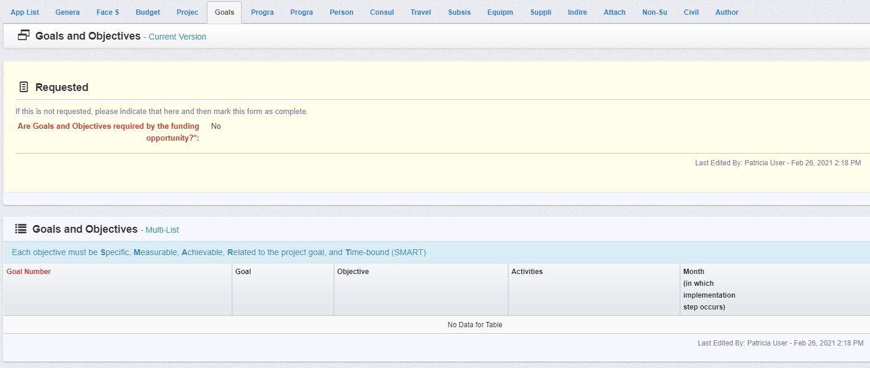
Goals and Objectives (Targets)
The Goals and Objectives tab is available for possible future use.

Slide 23
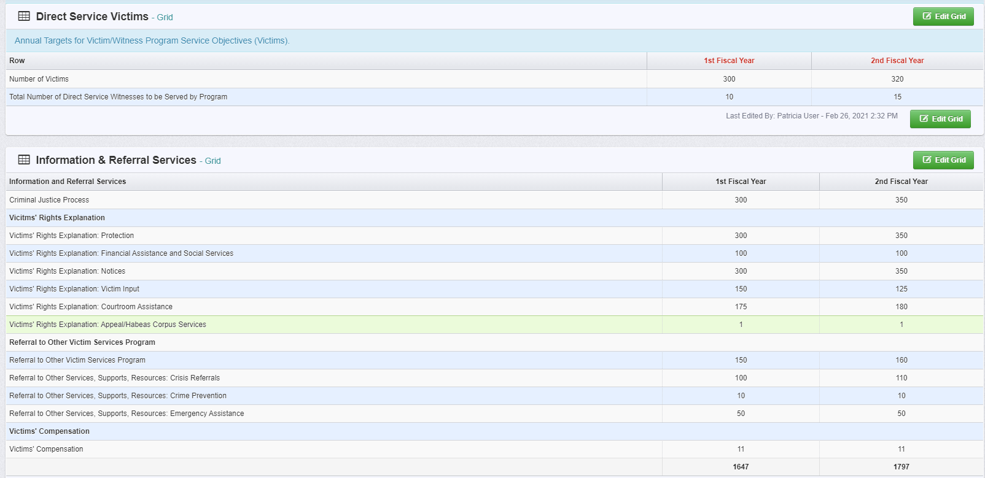
Goals and Objectives (Targets) continued
Indicate the number of victims and witnesses your program proposes to serve. This section reflects your Annual Target Service Objectives.
Notes:
Not every victim will receive every services. There are (5) service objective sections with multiple services under each service objective for direct service victims. Eight services for witnesses.

Slide 24
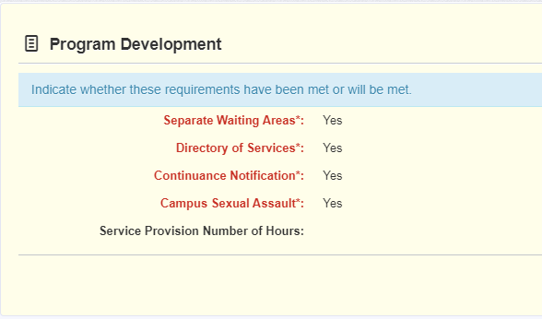
Program Development
Complete each section with a Yes or No response. Enter a numerical value (including zero) for Service Provision Number of Hours.

Slide 25
Other Required Certifications
Notes:
Indicate with a Yes or No.

Slide 26
Certifications
The following certifications are completed in OGMS:
Non-Supplantation
Civil Rights Certification of Compliance
Authority Certification
Notes:
3 sections of CRC: Project Information, Director Certification, and Project Administrator Certification. Ensure that state or local policies and procedures are followed or developed in providing the authorized individual is listed in the section.

Slide 27
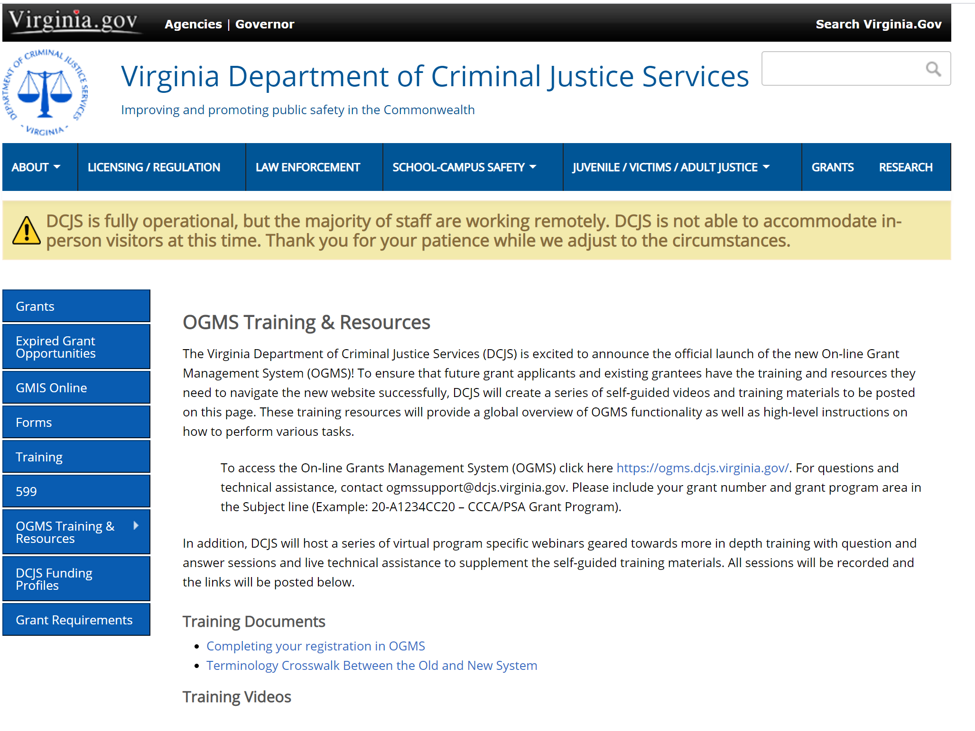
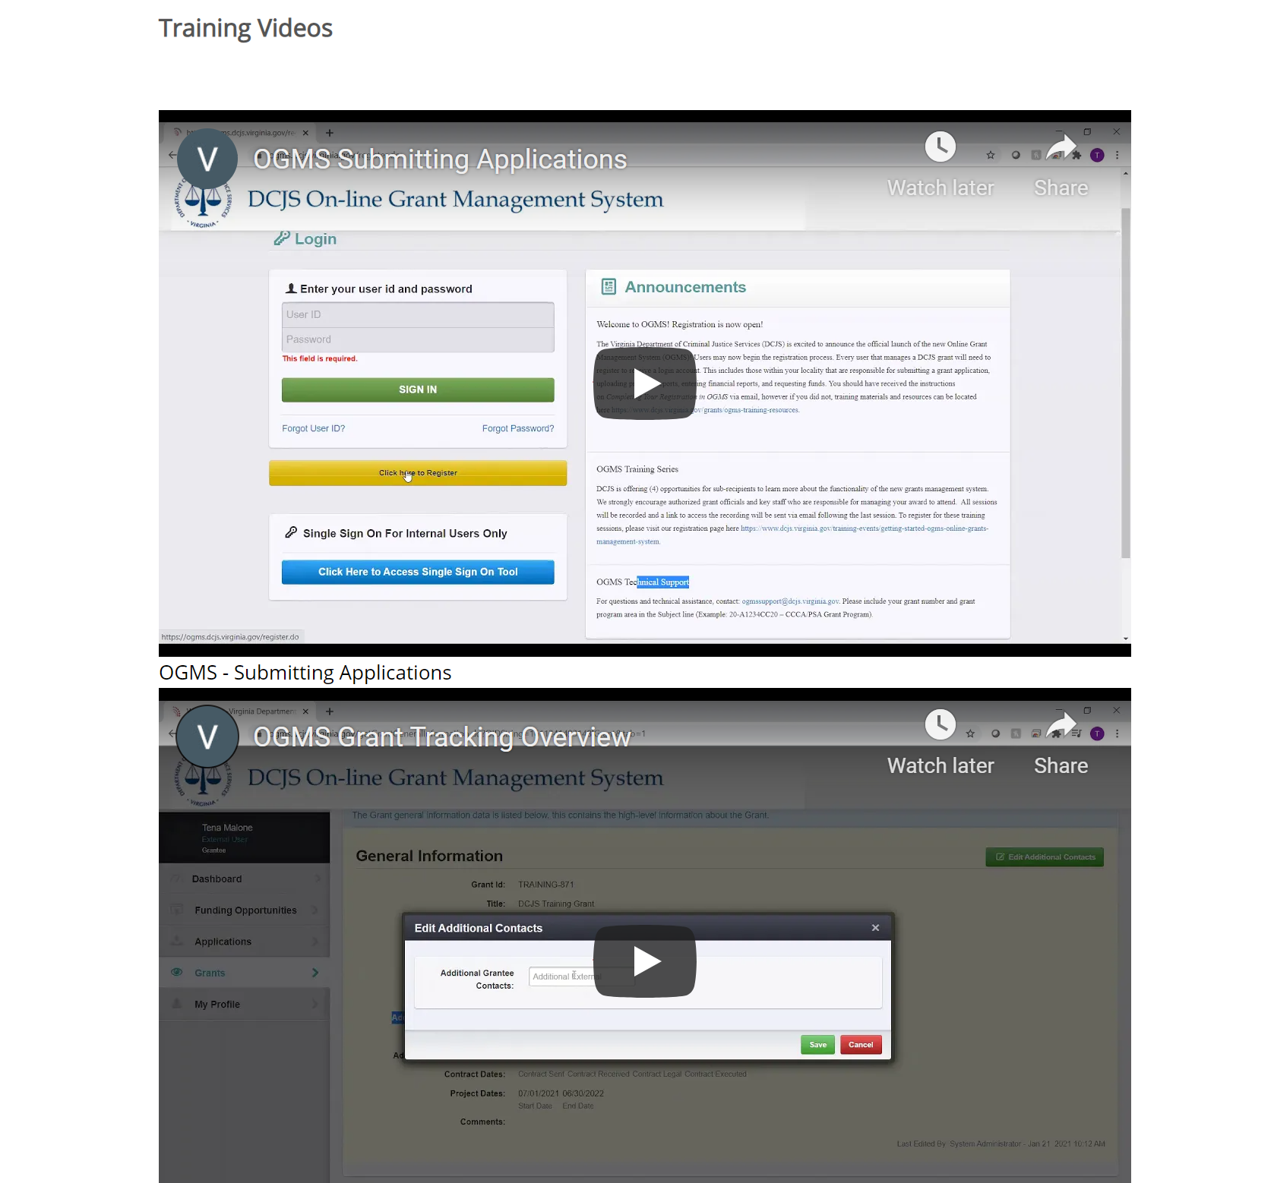
On-line Grant Management System (OGMS) Training & Resources Page: https://www.dcjs.virginia.gov/grants/ogms-training-resources

Slide 28
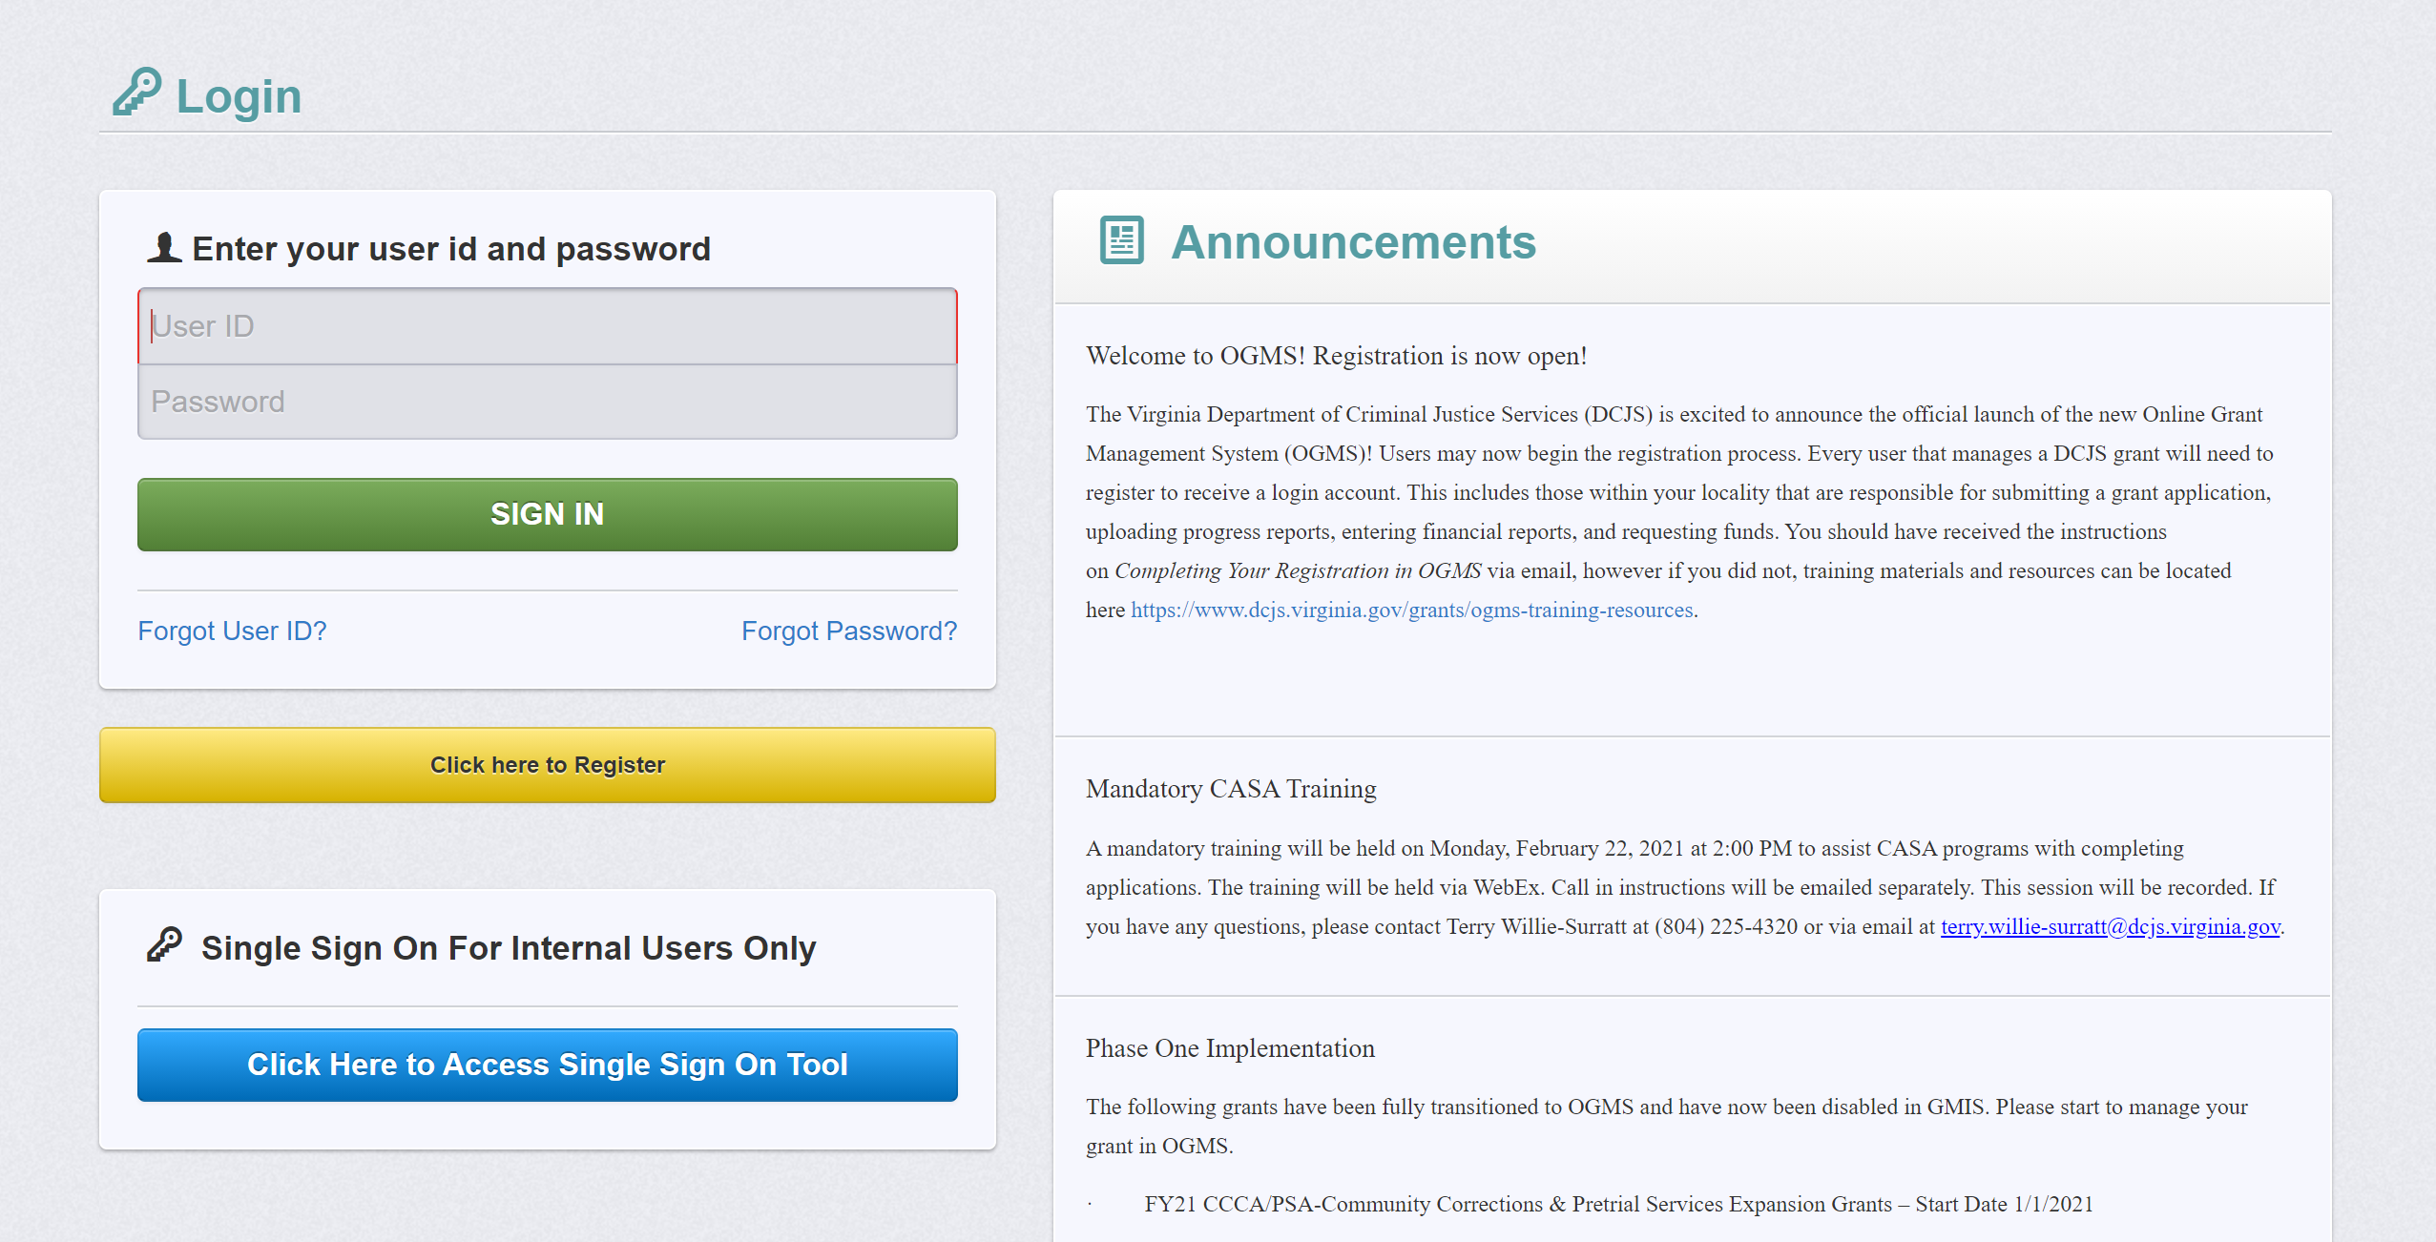
On-line Grant Management System (OGMS) https://ogms.dcjs.virginia.gov/

Slide 29
Registration

Slide 30
Registration
As a reminder, every user that manages a DCJS grant will need to register to receive a login account.
When registering, the Program Area of Interest is only used to process registration and it doesn’t restrict your ability to apply for other funding opportunities
Registration approval takes approximately 3-5 business days.
You will receive a confirmation email from: VAgrantsDCJS@webgrantsmail.com with your user id and temporary password to login to OGMS.
To update your personal contact information, select My Profile, update the information and select save.
For technical assistance contact: ogmssupport@dcjs.virginia.gov

Slide 31
Navigating the System

Slide 32
Navigating the System
Use the system buttons within the window or the menu on the left side panel to navigate to different areas and forms

Slide 33
Funding Opportunities

Slide 34
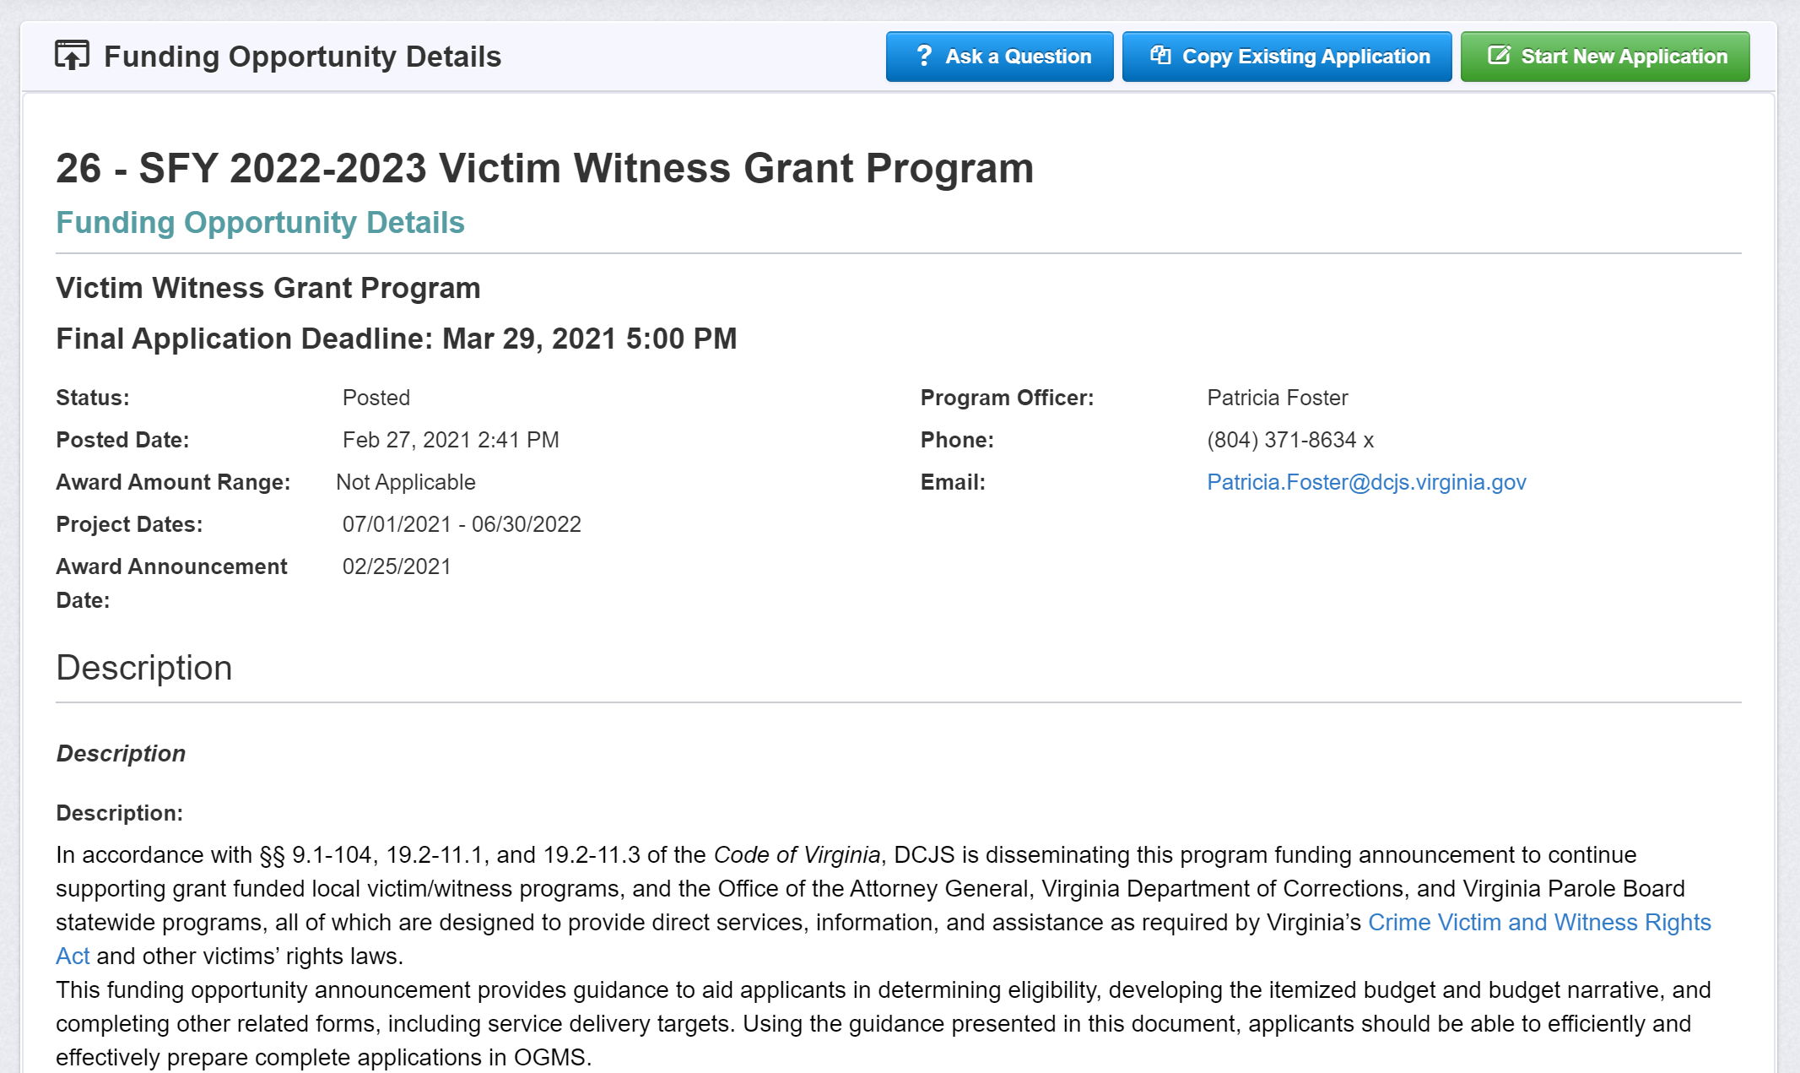
Starting a Grant Application

Slide 35
FAQ Feature in OGMS
The answers to your questions will be posted to the bottom of the Funding Opportunity Details

Slide 36
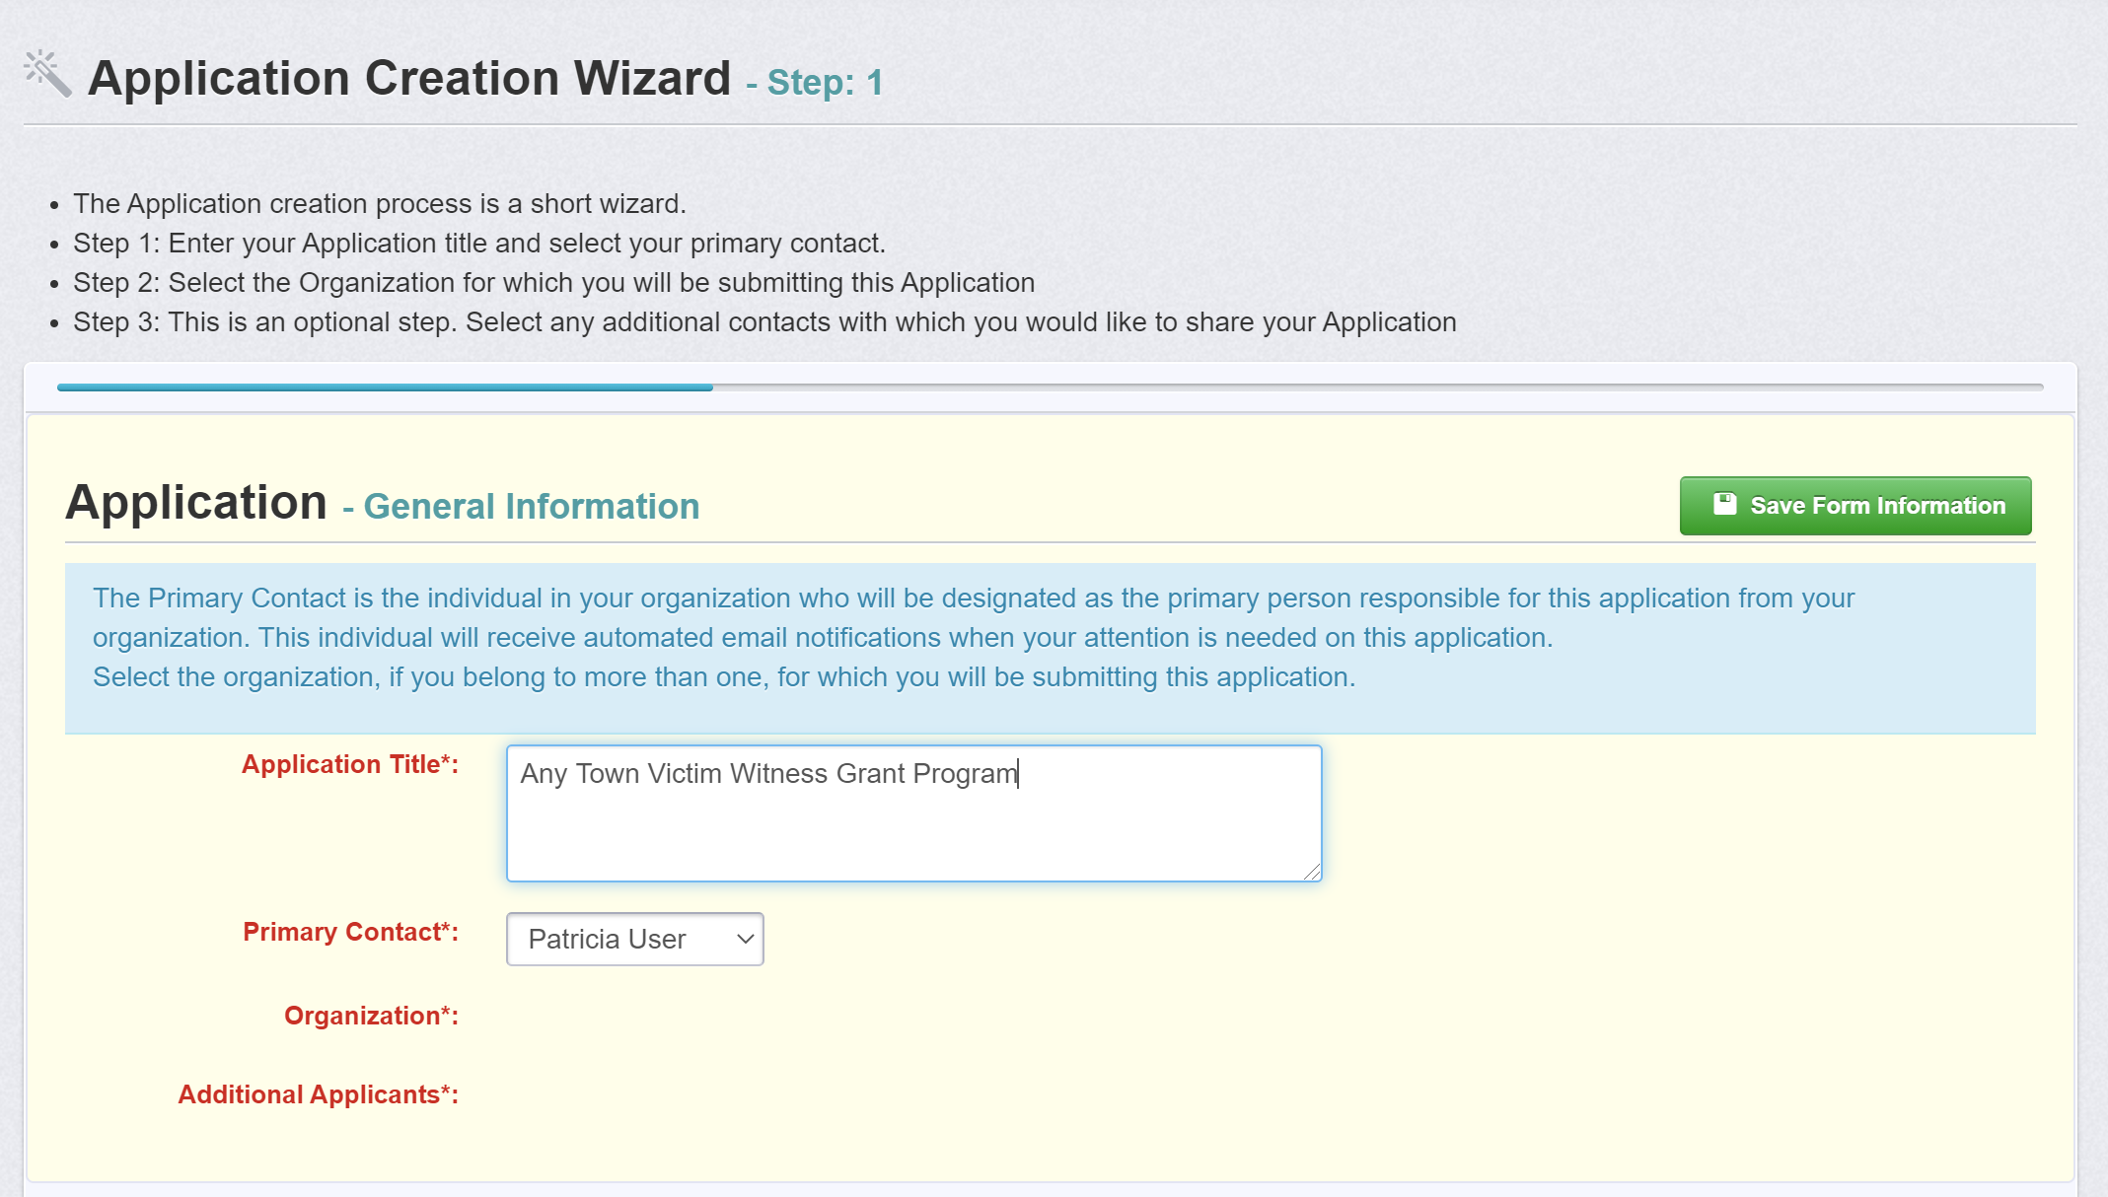
Starting a Grant Application

Slide 37
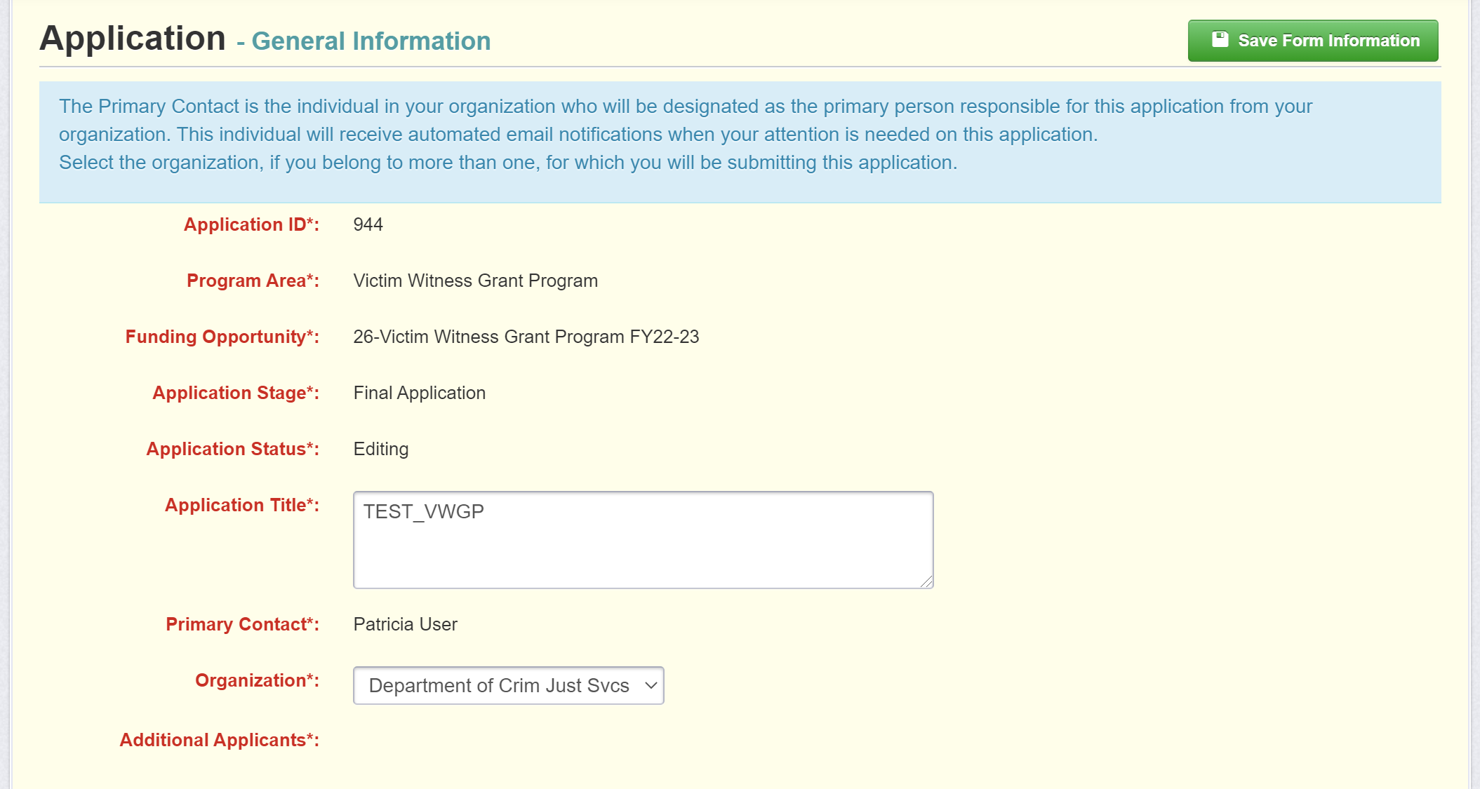
Starting a Grant Application

Slide 38
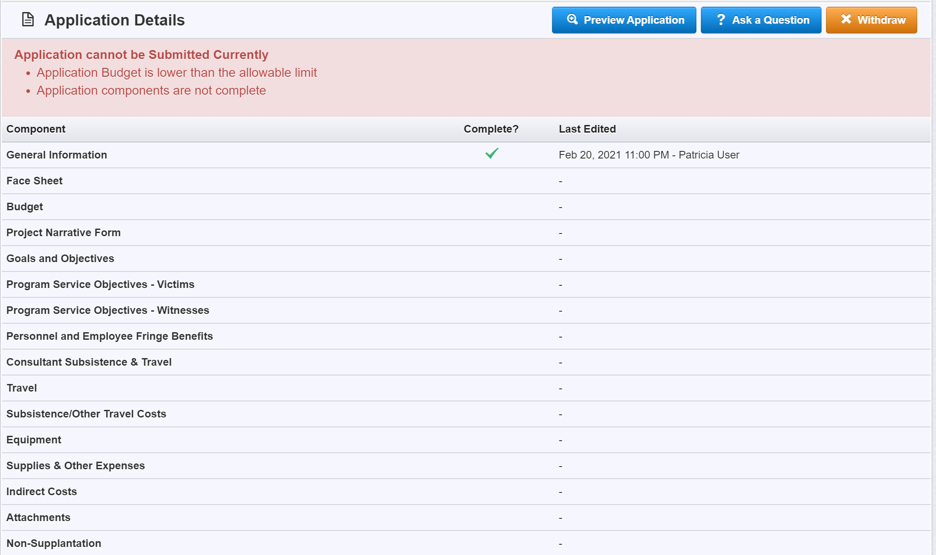
Application List

Slide 39
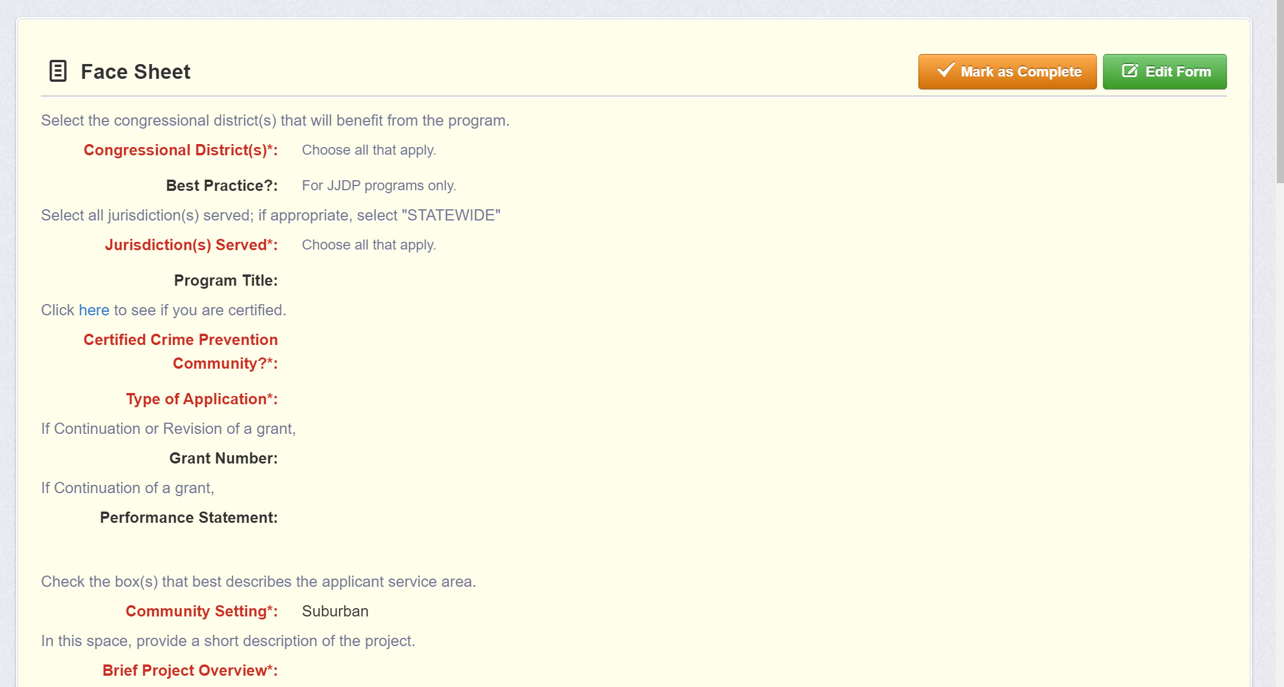
Editing the Application – Face Sheet

Slide 40
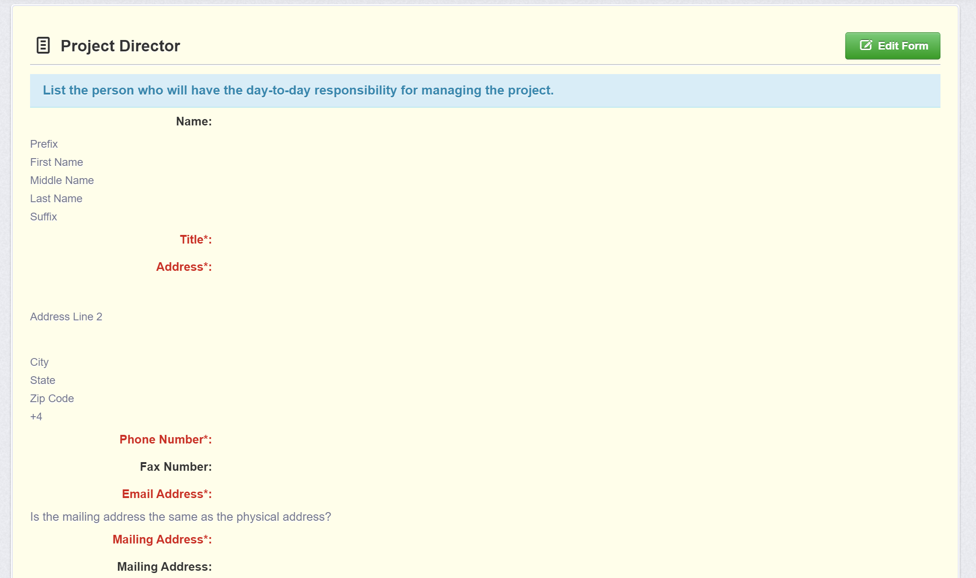
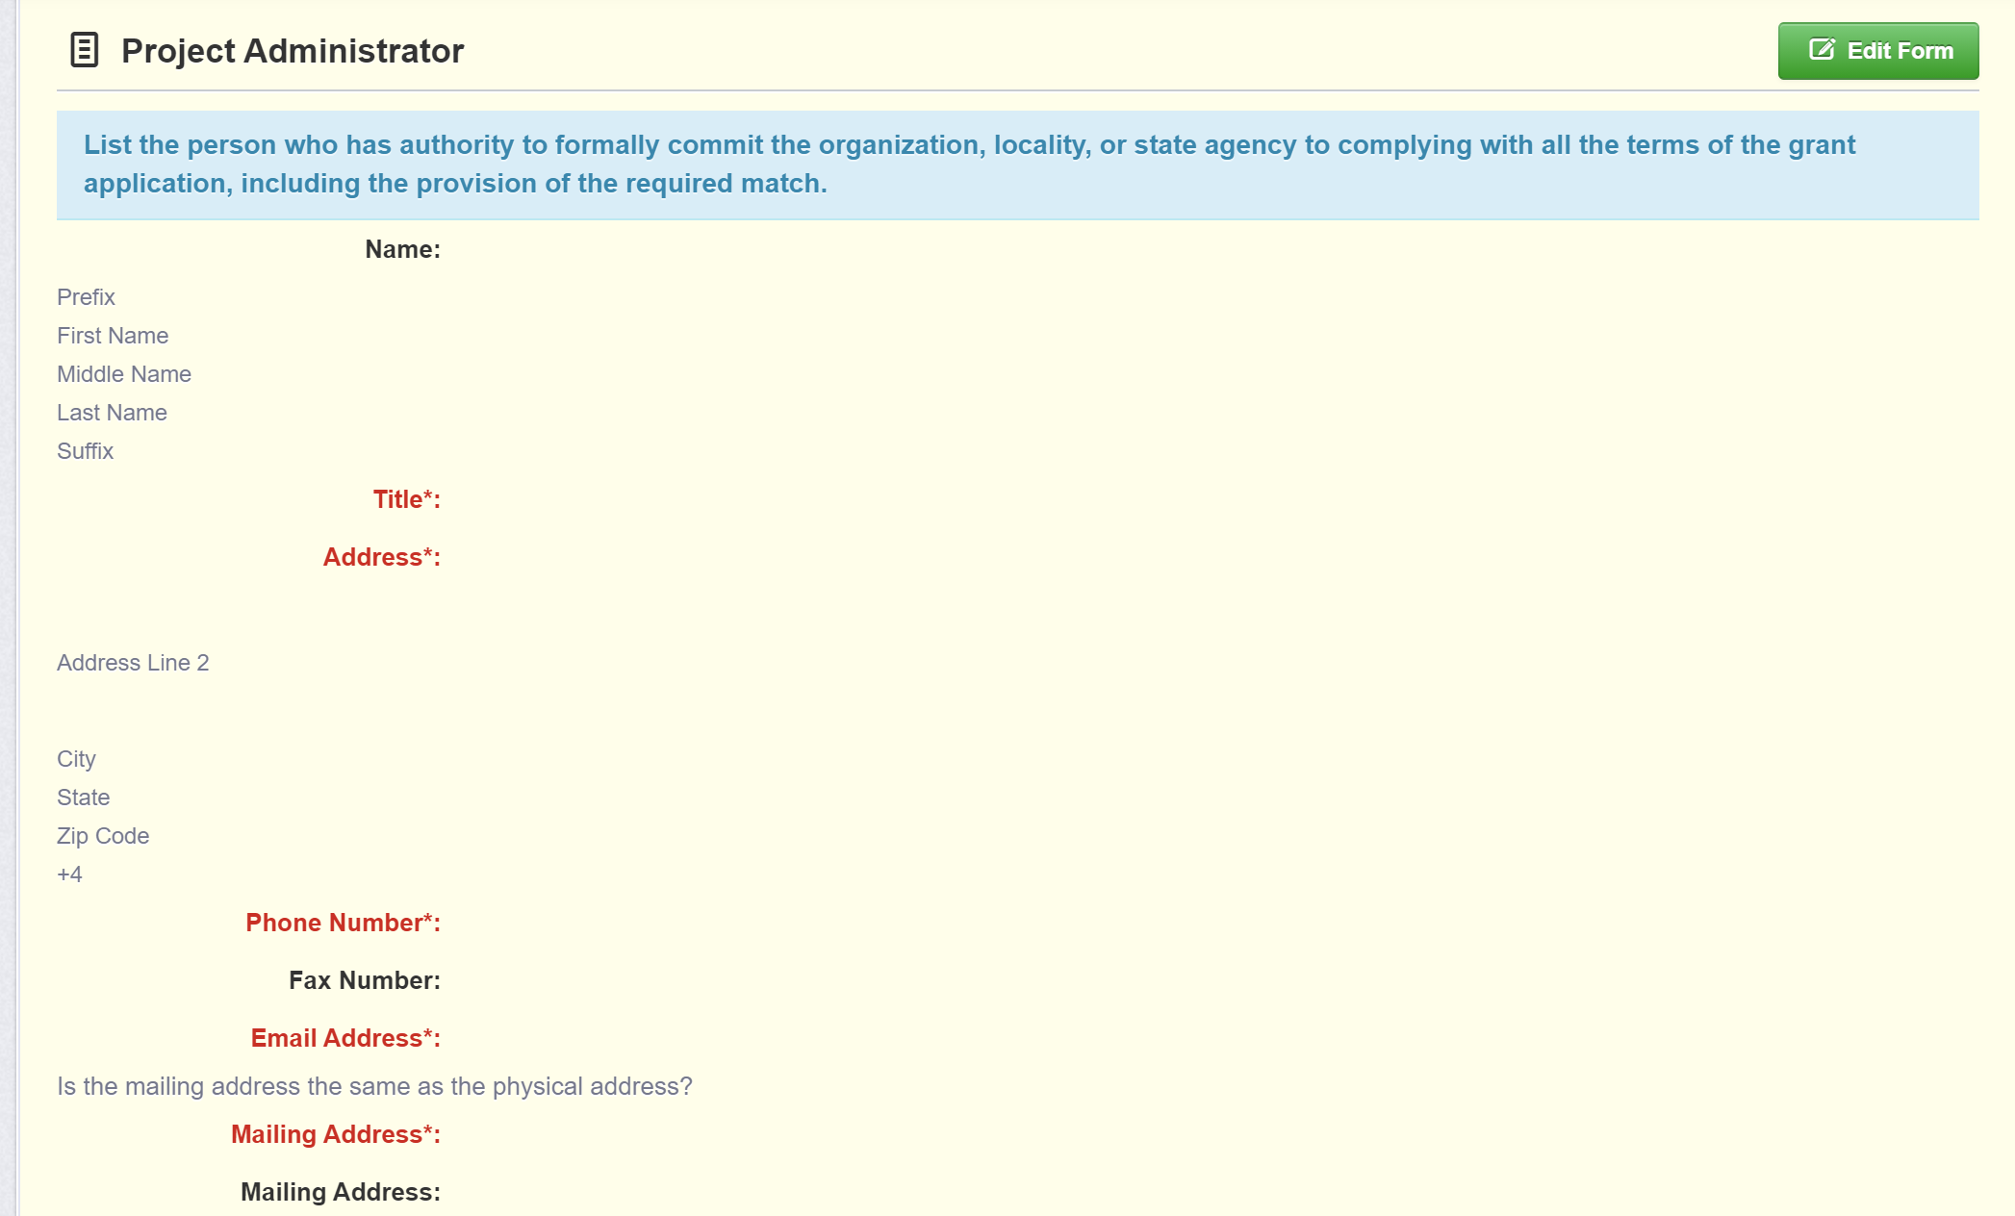
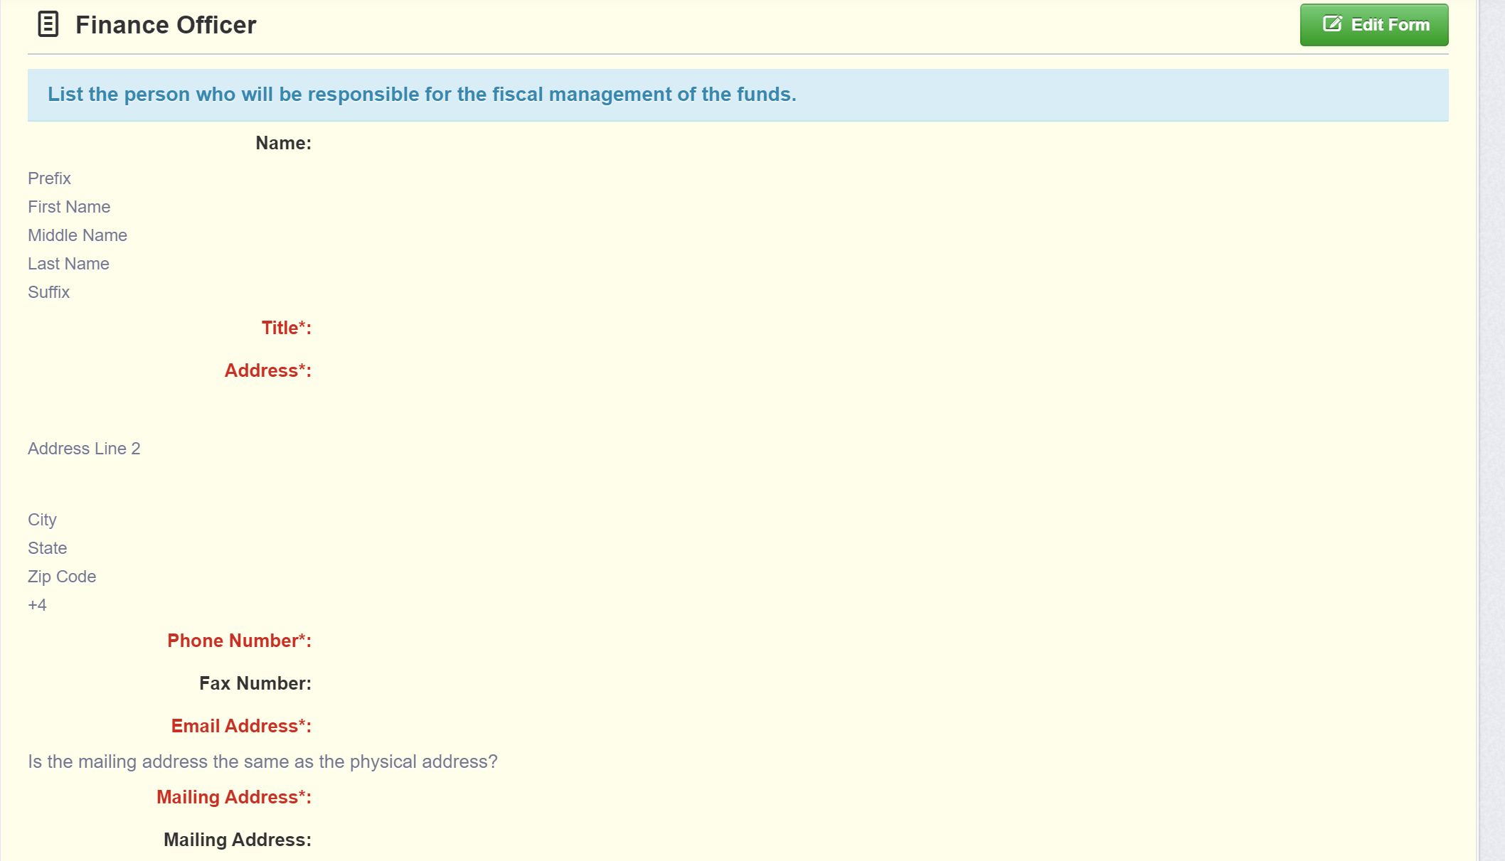
Editing the Application – Face Sheet (cont’d.)

Slide 41
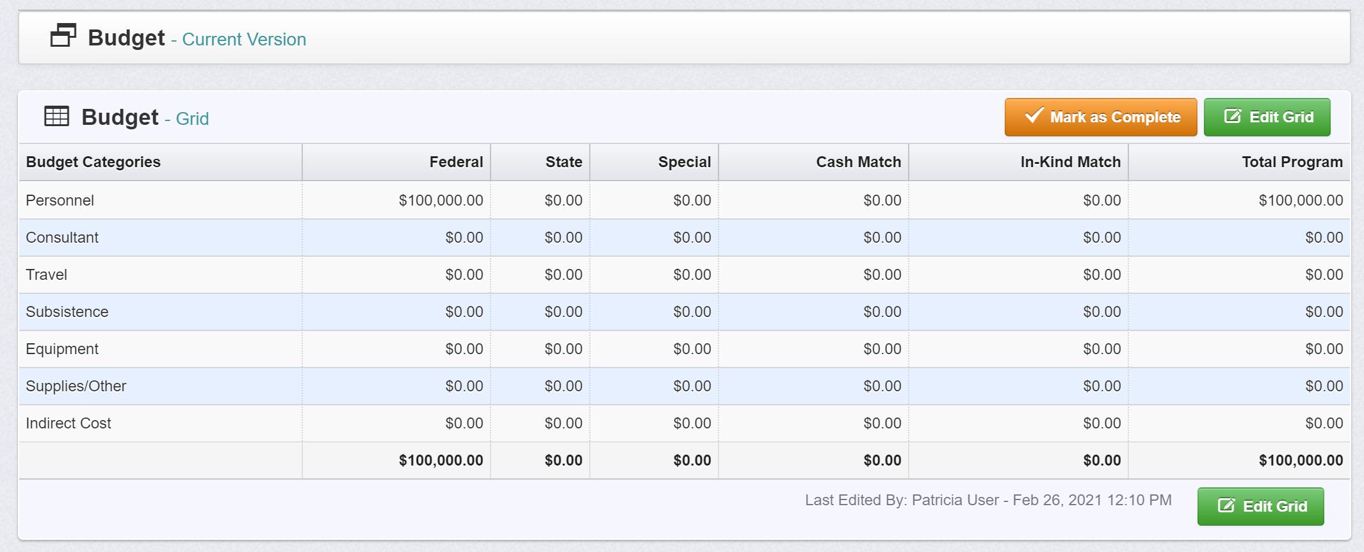
Editing the Application – Budget (Federal)

Slide 42
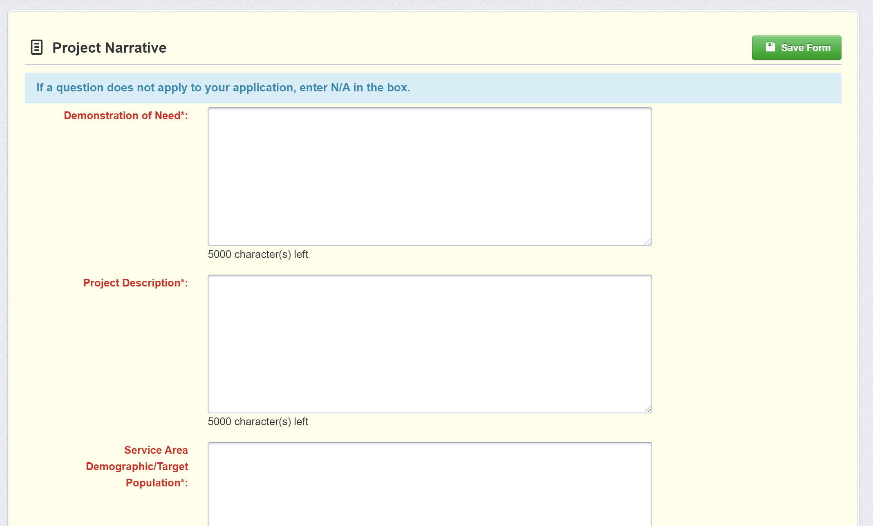
Editing the Application – Project Narrative Form

Slide 43
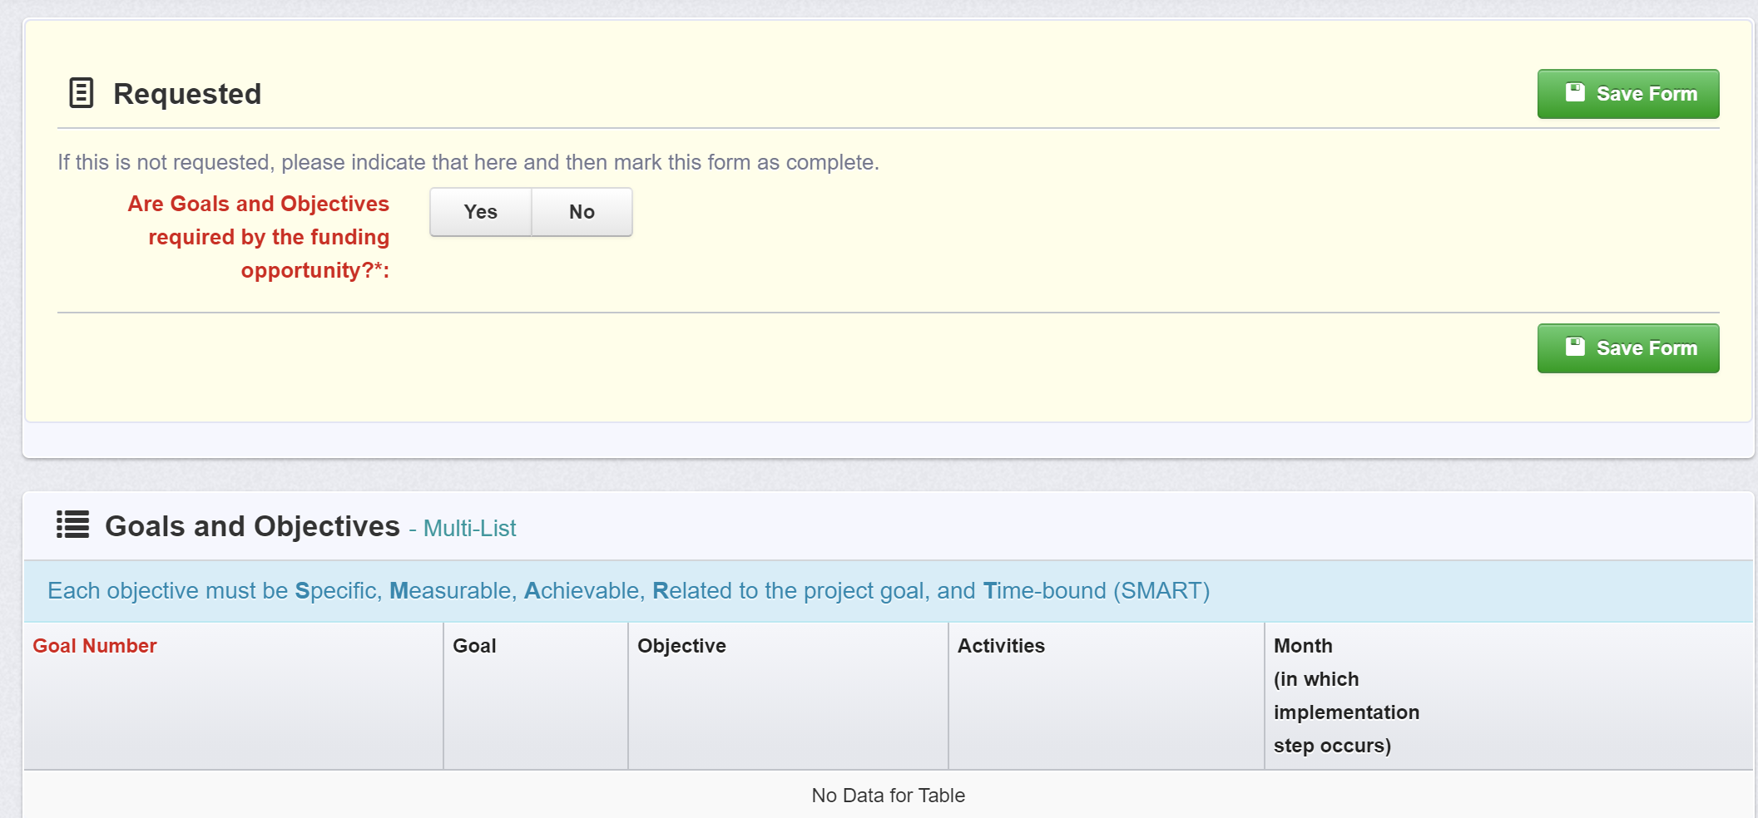
Editing the Application – Goals & Objectives (Not Required for VWGP)

Slide 44
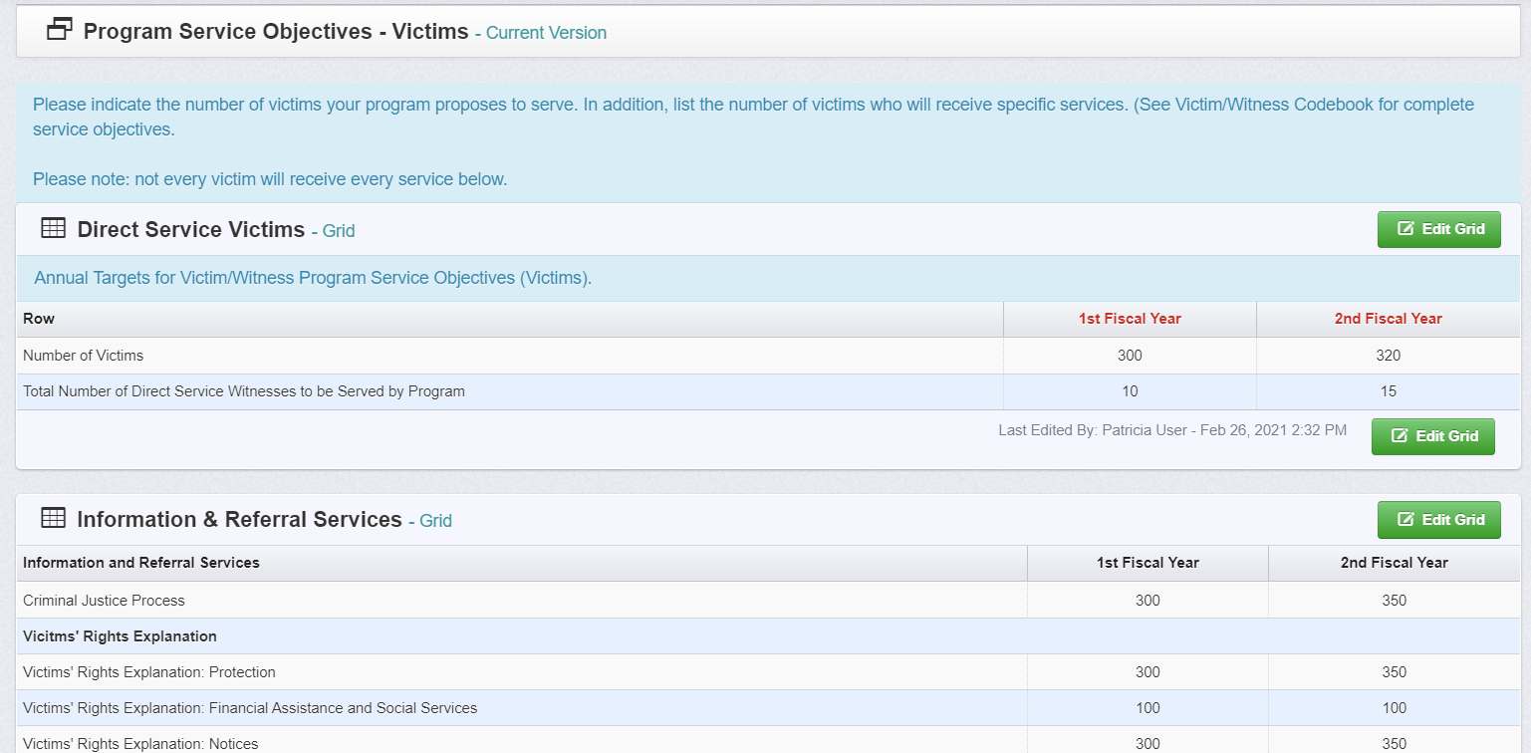
Editing the Application – Program Service Objectives (Victims)

Slide 45
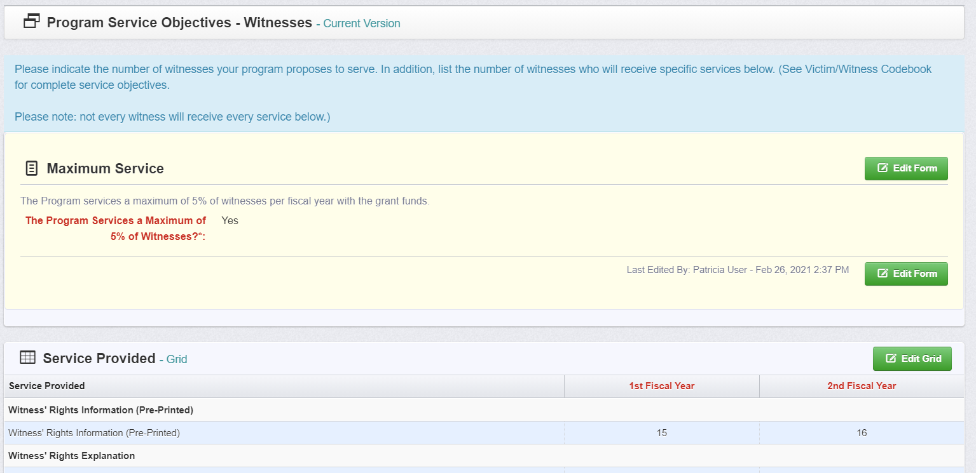
Editing the Application – Program Service Objectives (Witnesses)

Slide 46
Editing the Application

Slide 47
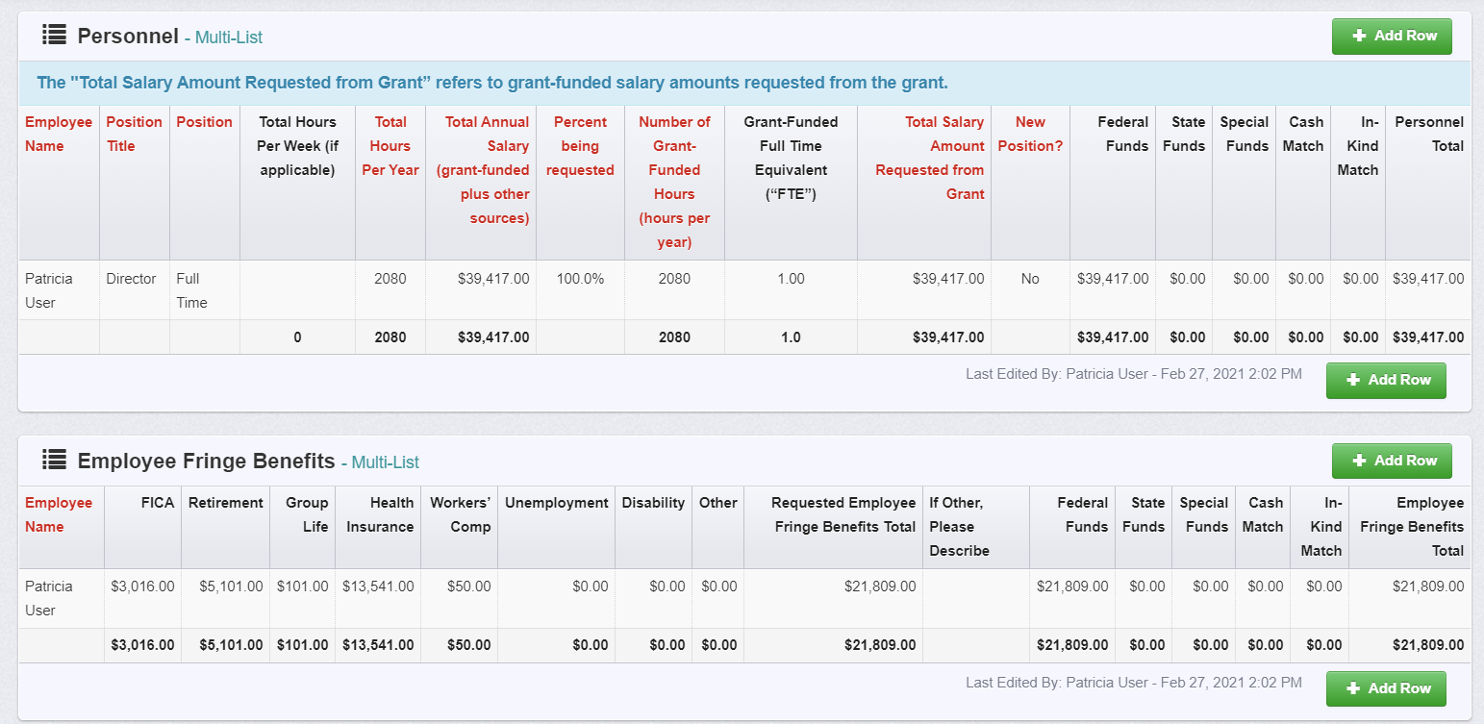
Editing the Application – Personnel

Slide 48
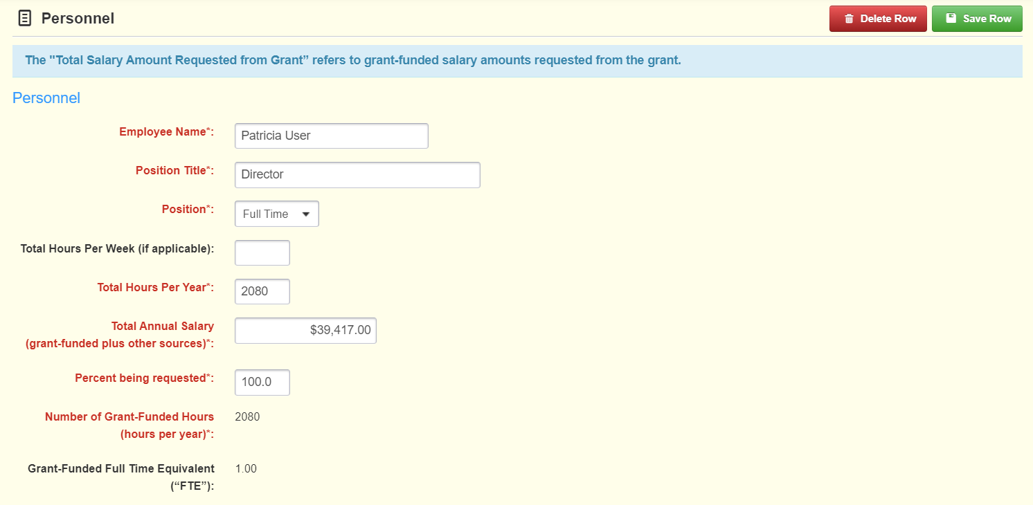
Editing the Application – Personnel (Cont’d)

Slide 49
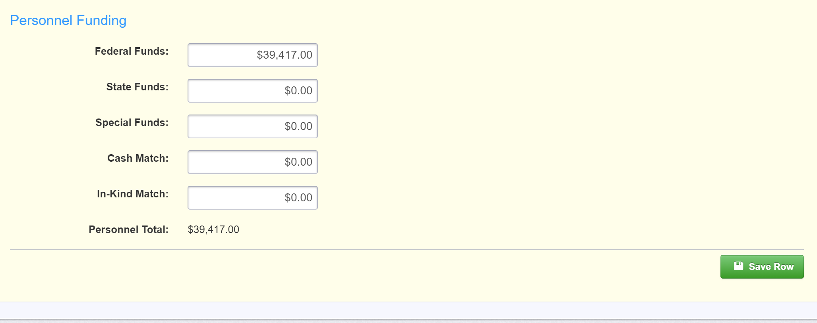
Editing the Application – Personnel (Cont’d)

Slide 50
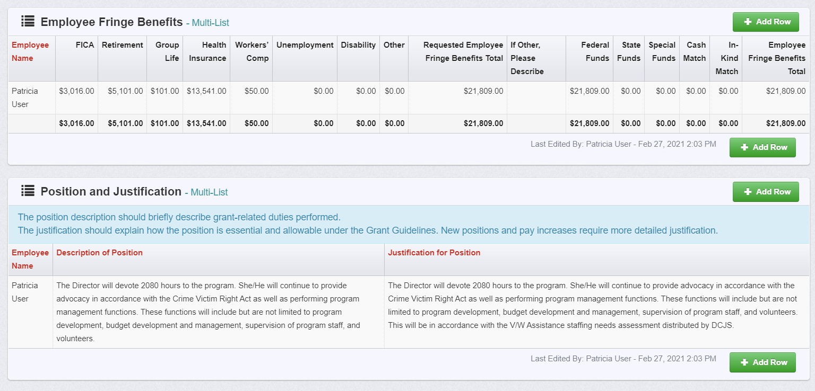
Editing the Application – Fringe Benefits, Position Description & Justification

Slide 51
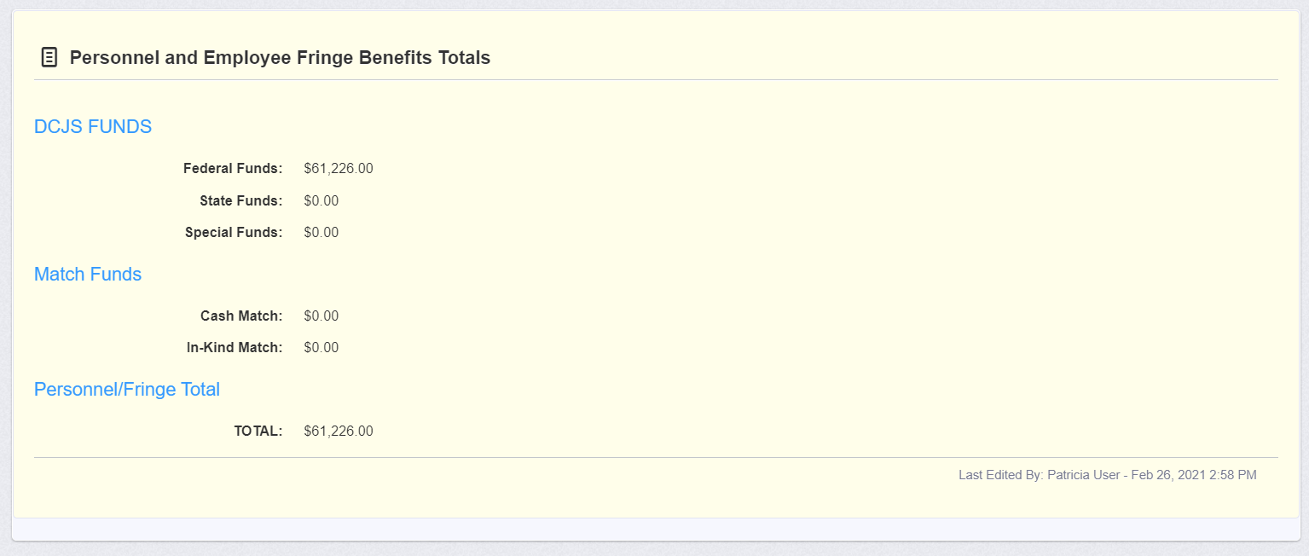
Editing the Application – Total Requested

Slide 52
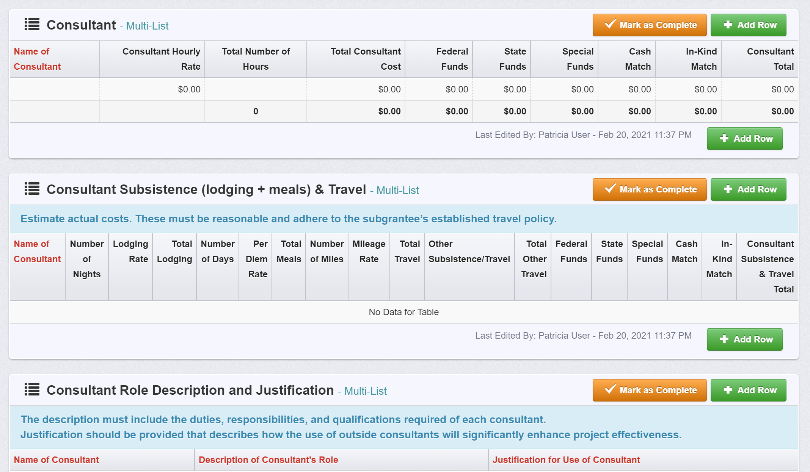
Editing the Application – Consultants, Consultants Subsistence & Travel

Slide 53
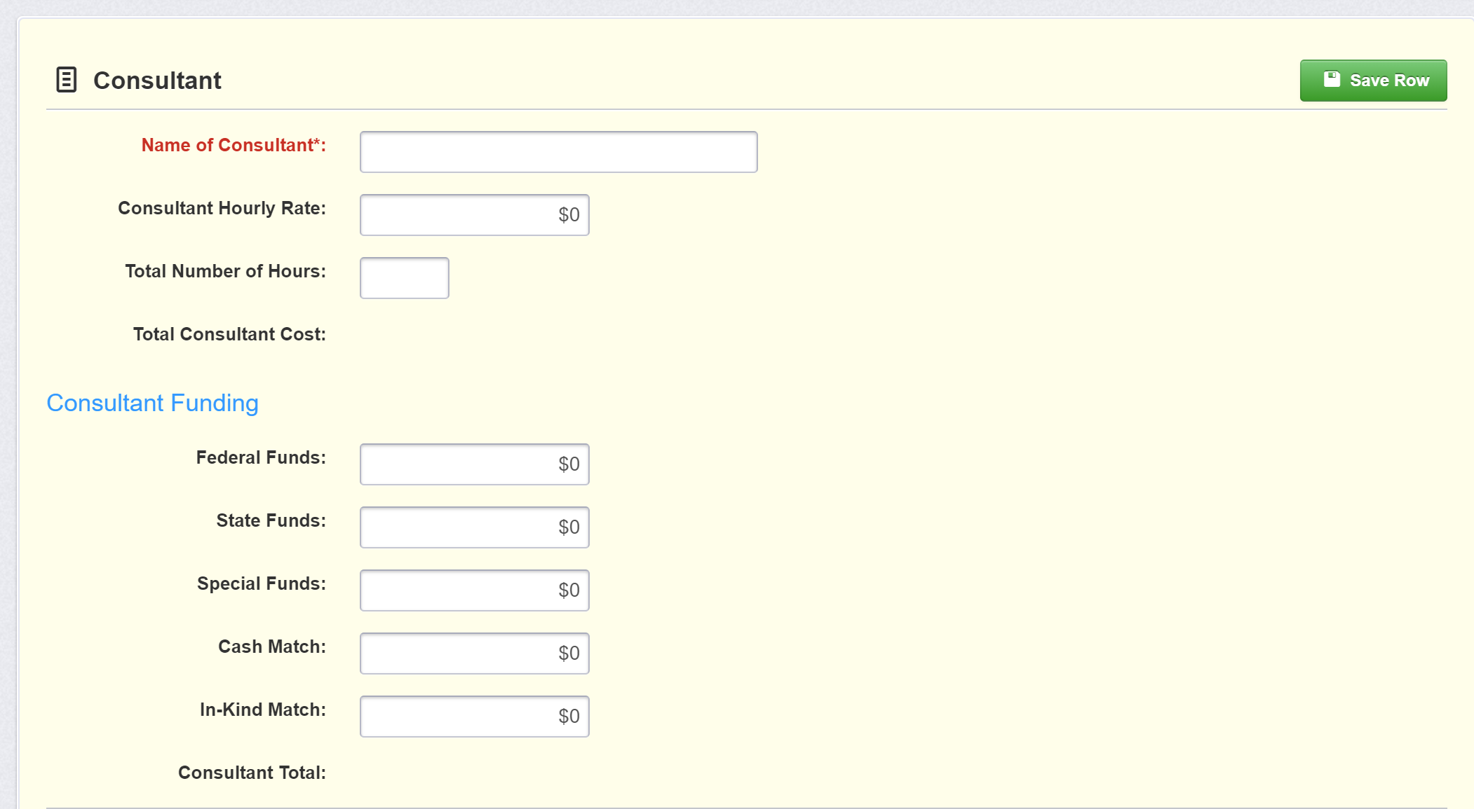
Editing the Application – Consultants

Slide 54
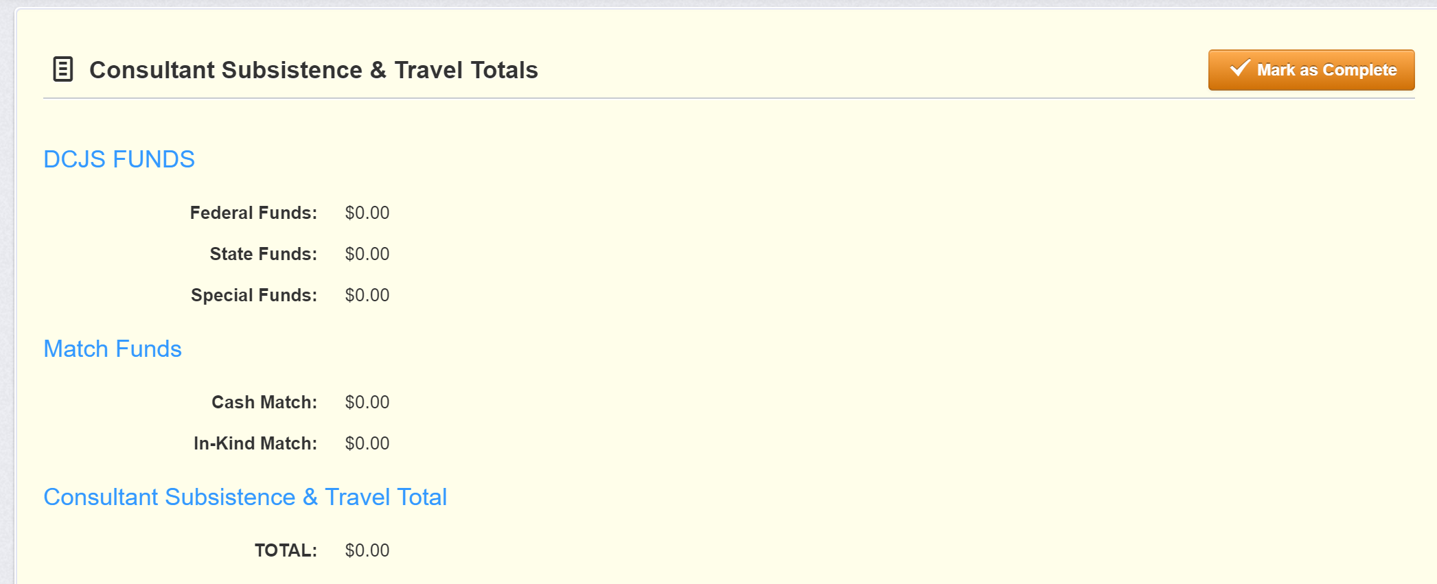
Editing the Application – Total Requested

Slide 55
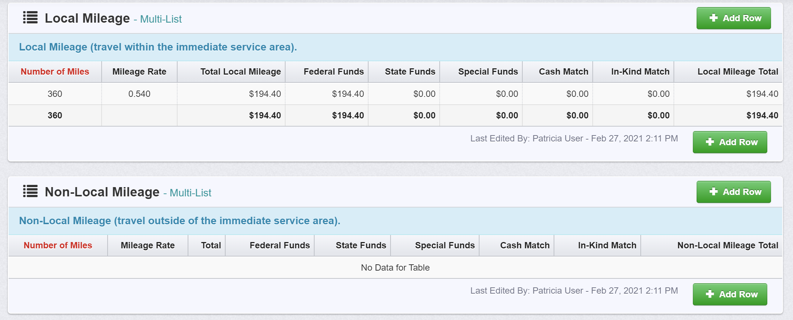
Editing the Application – Travel (Mileage)

Slide 56
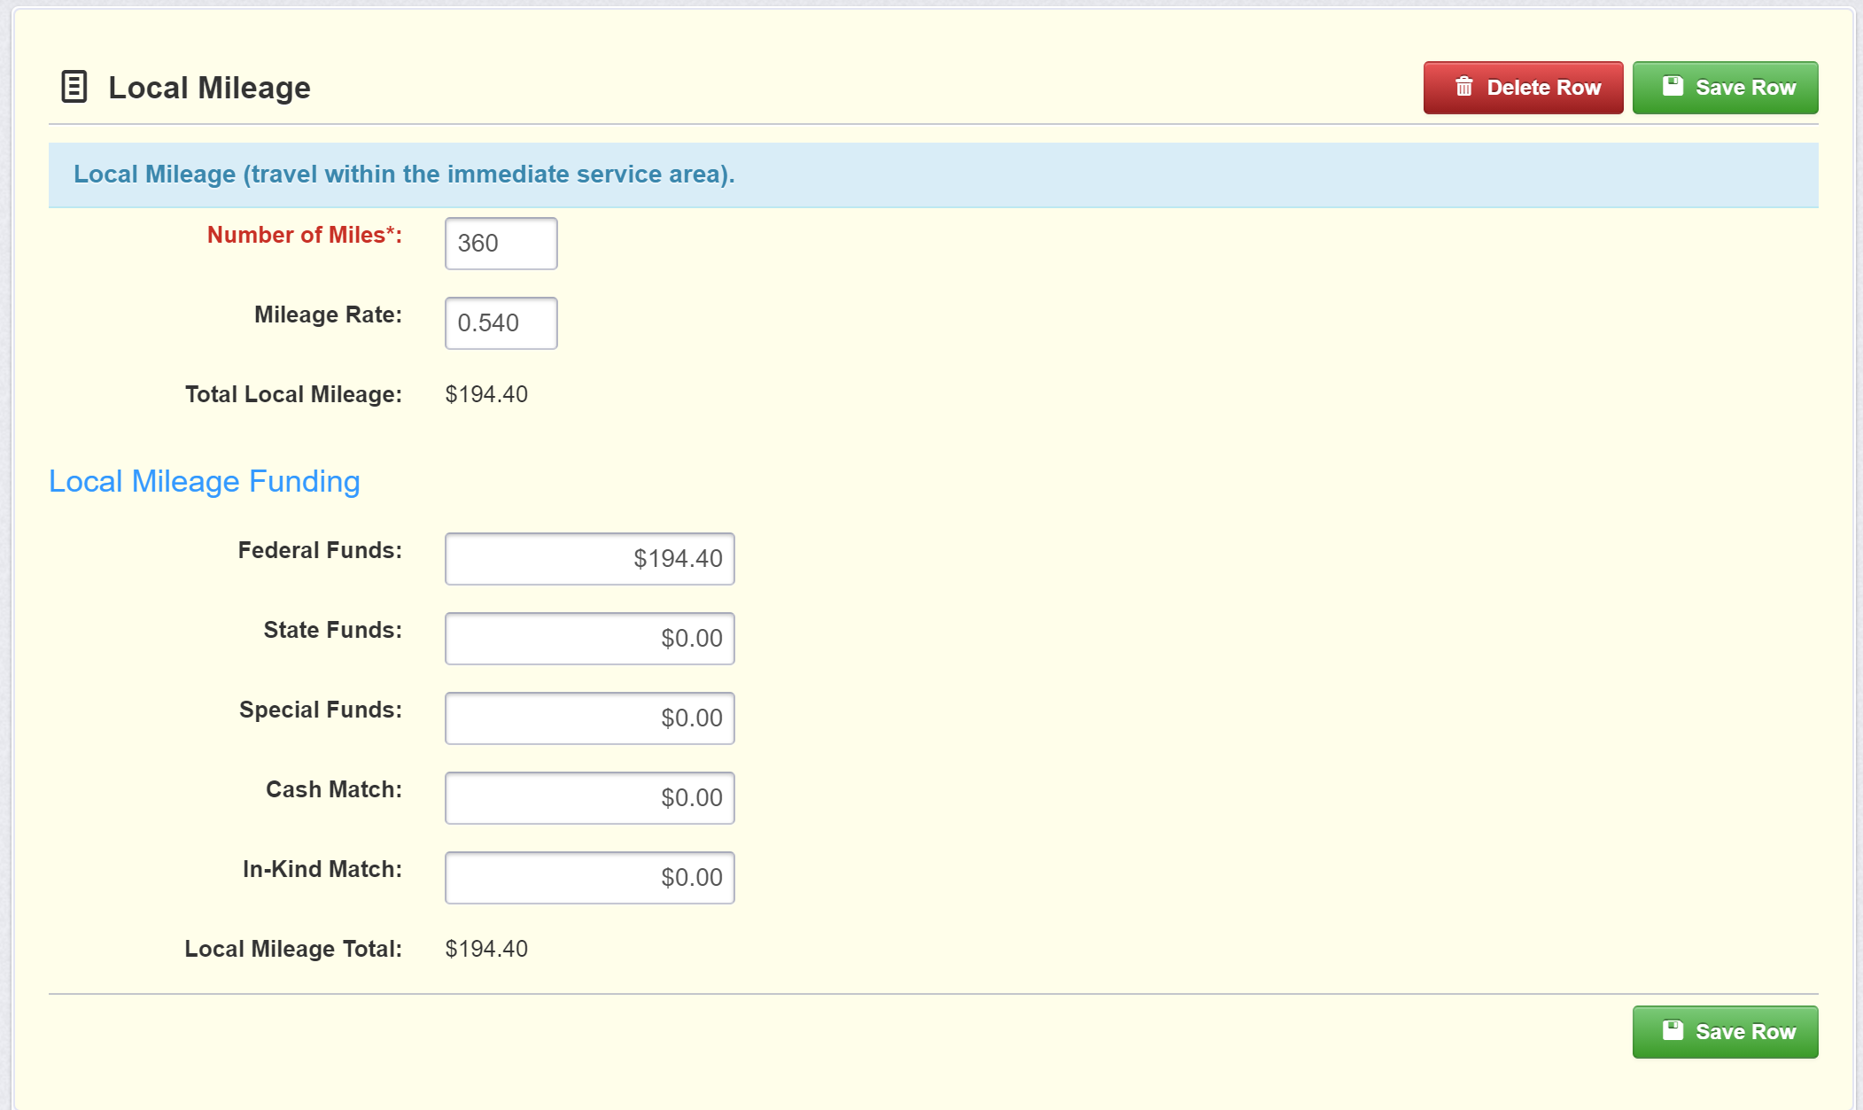
Editing the Application – Travel (Mileage)

Slide 57
Editing the Application – Travel (Mileage)

Slide 58
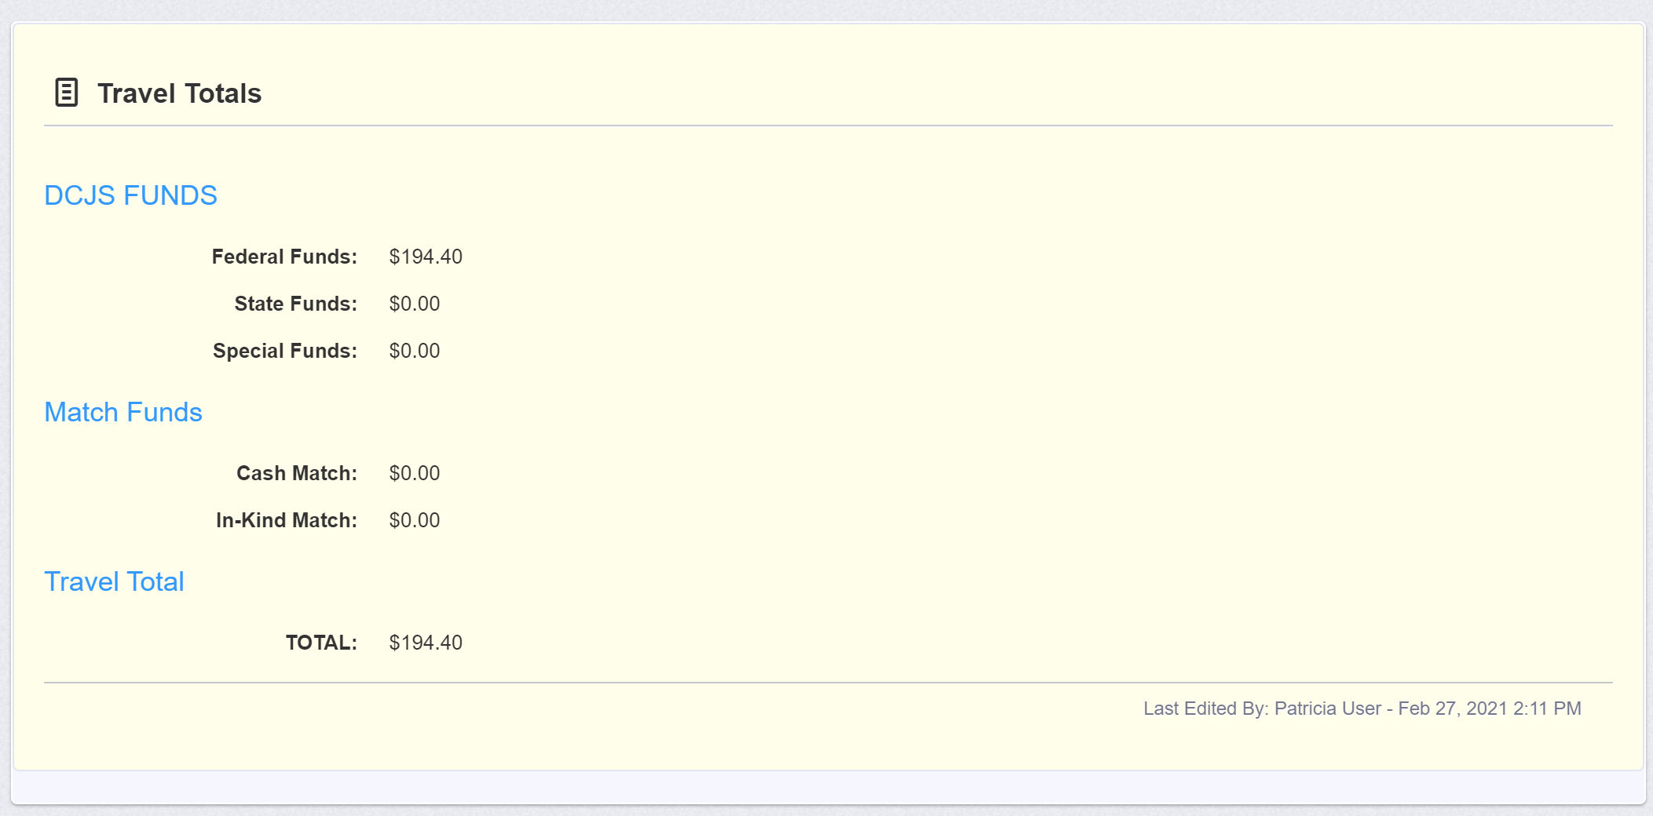
Editing the Application – Travel Total (Mileage)

Slide 59
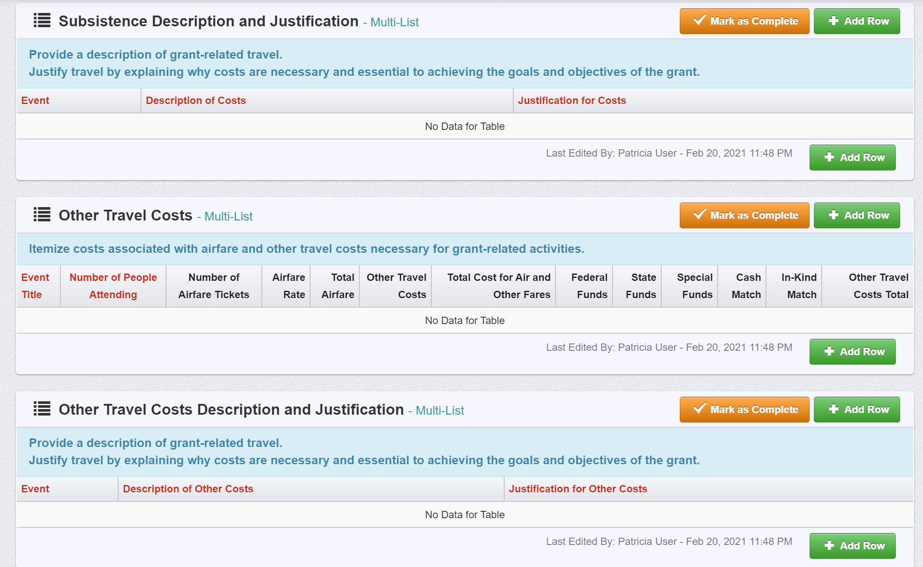
Editing the Application – Subsistence (Lodging & Meals)

Slide 60
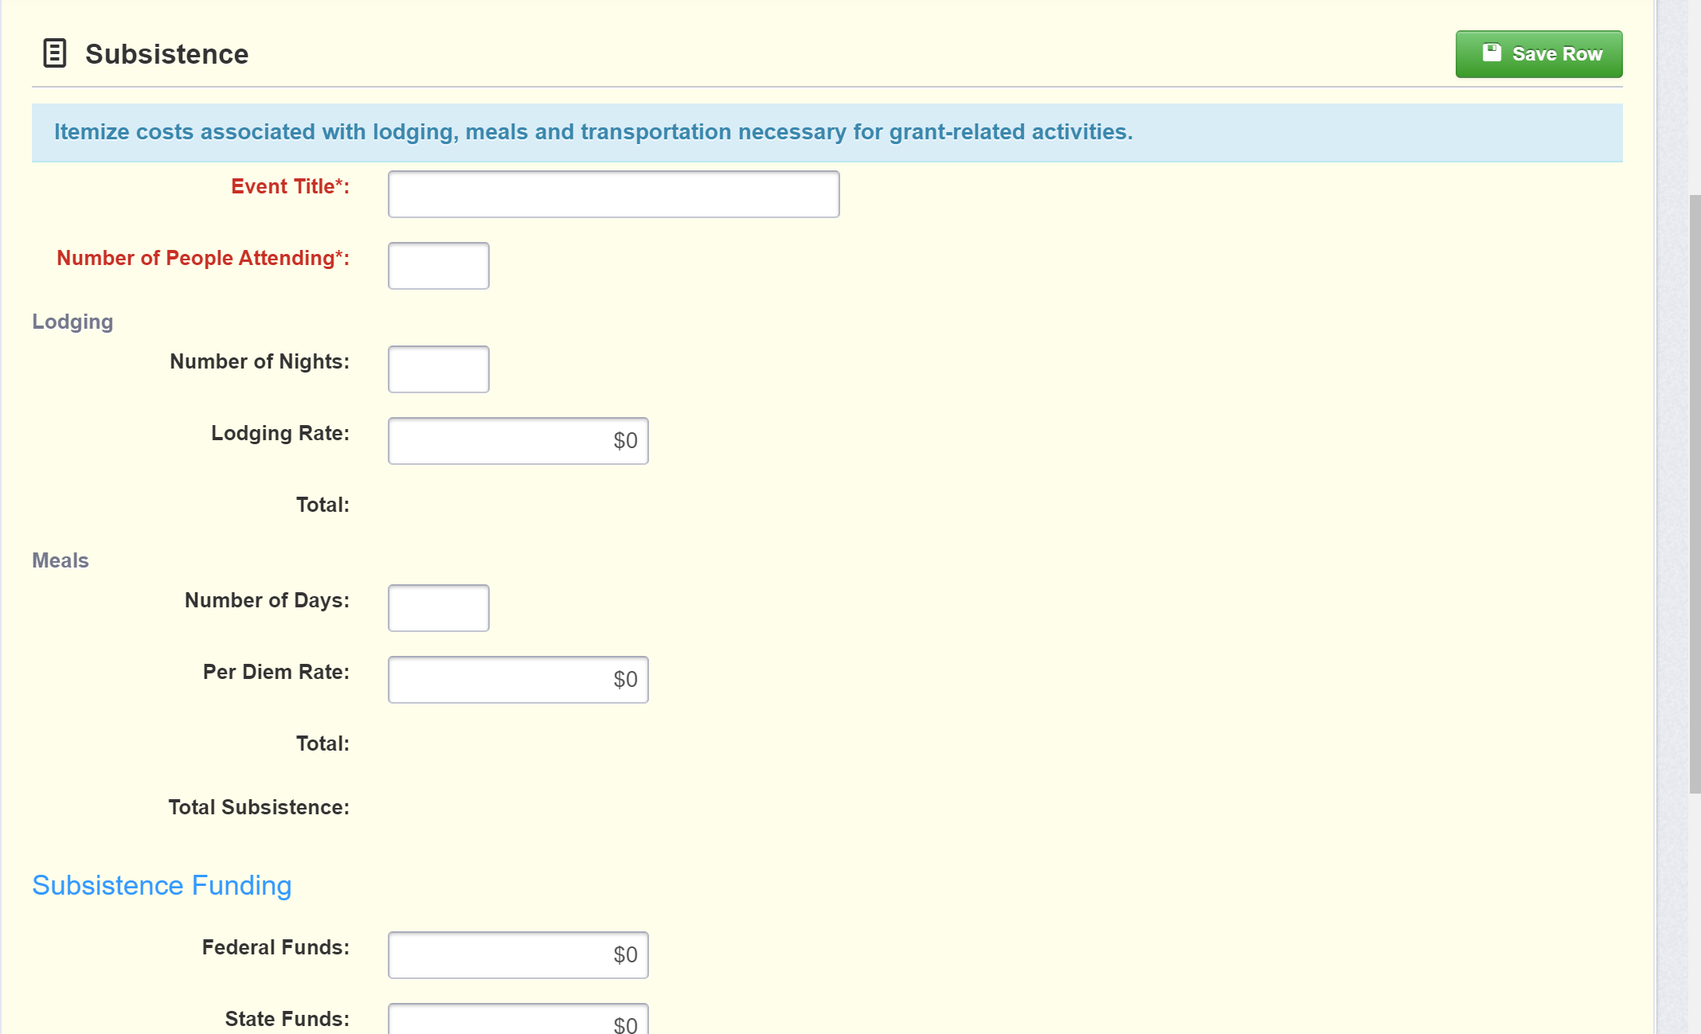
Editing the Application – Subsistence (Lodging & Meals)

Slide 61
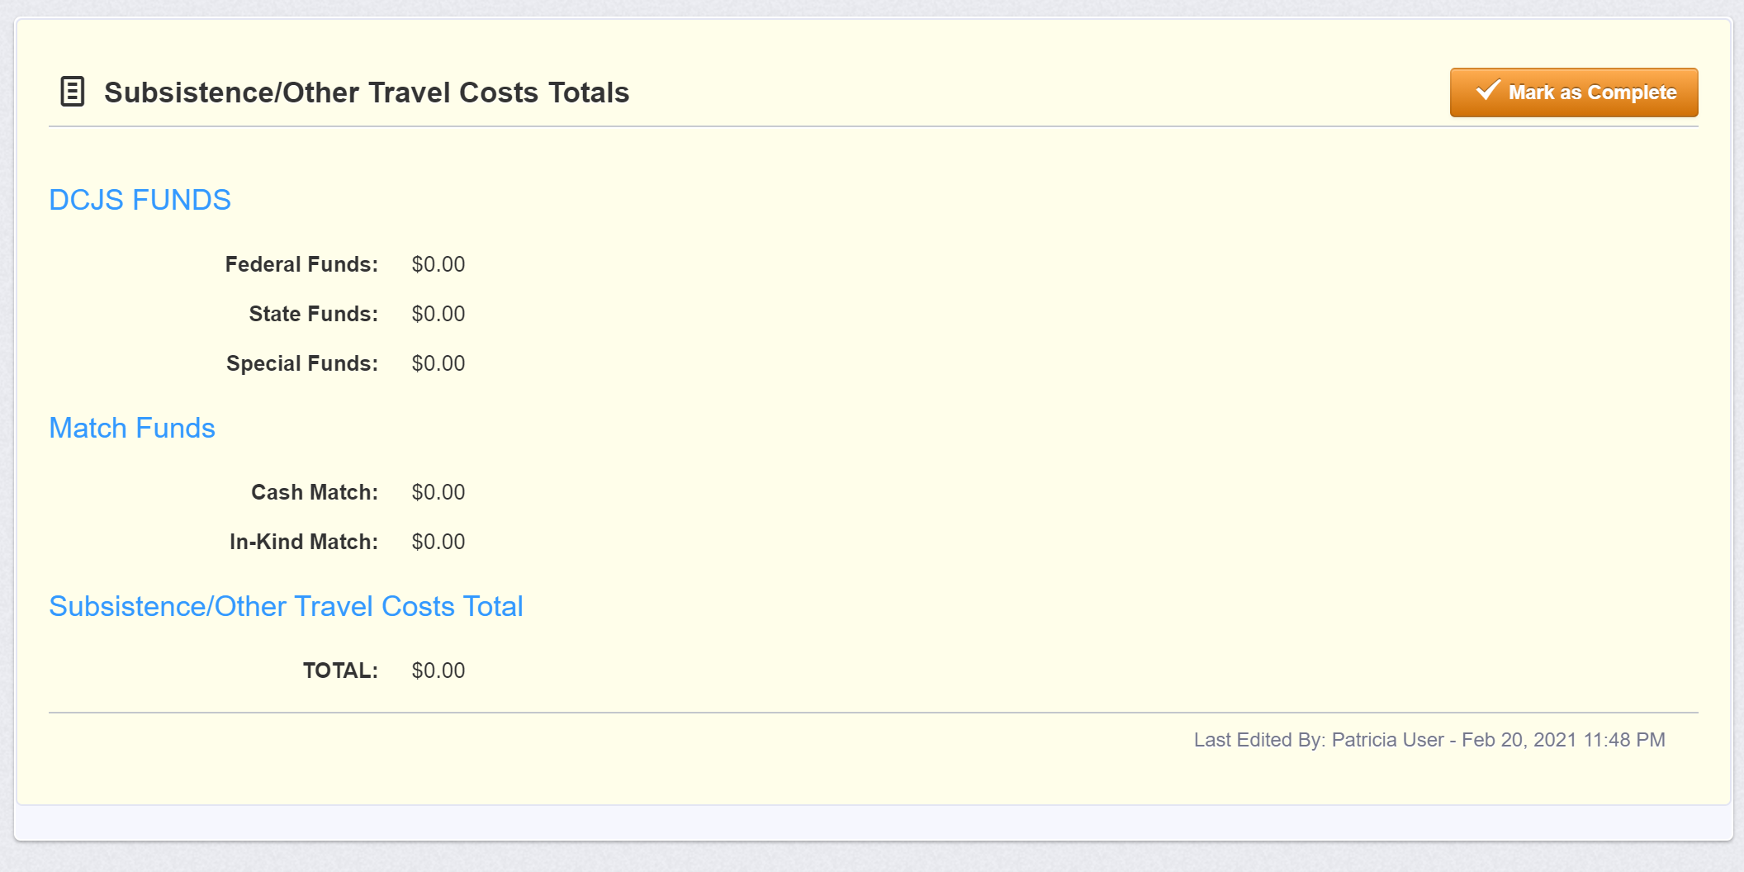
Editing the Application – Subsistence Totals

Slide 62
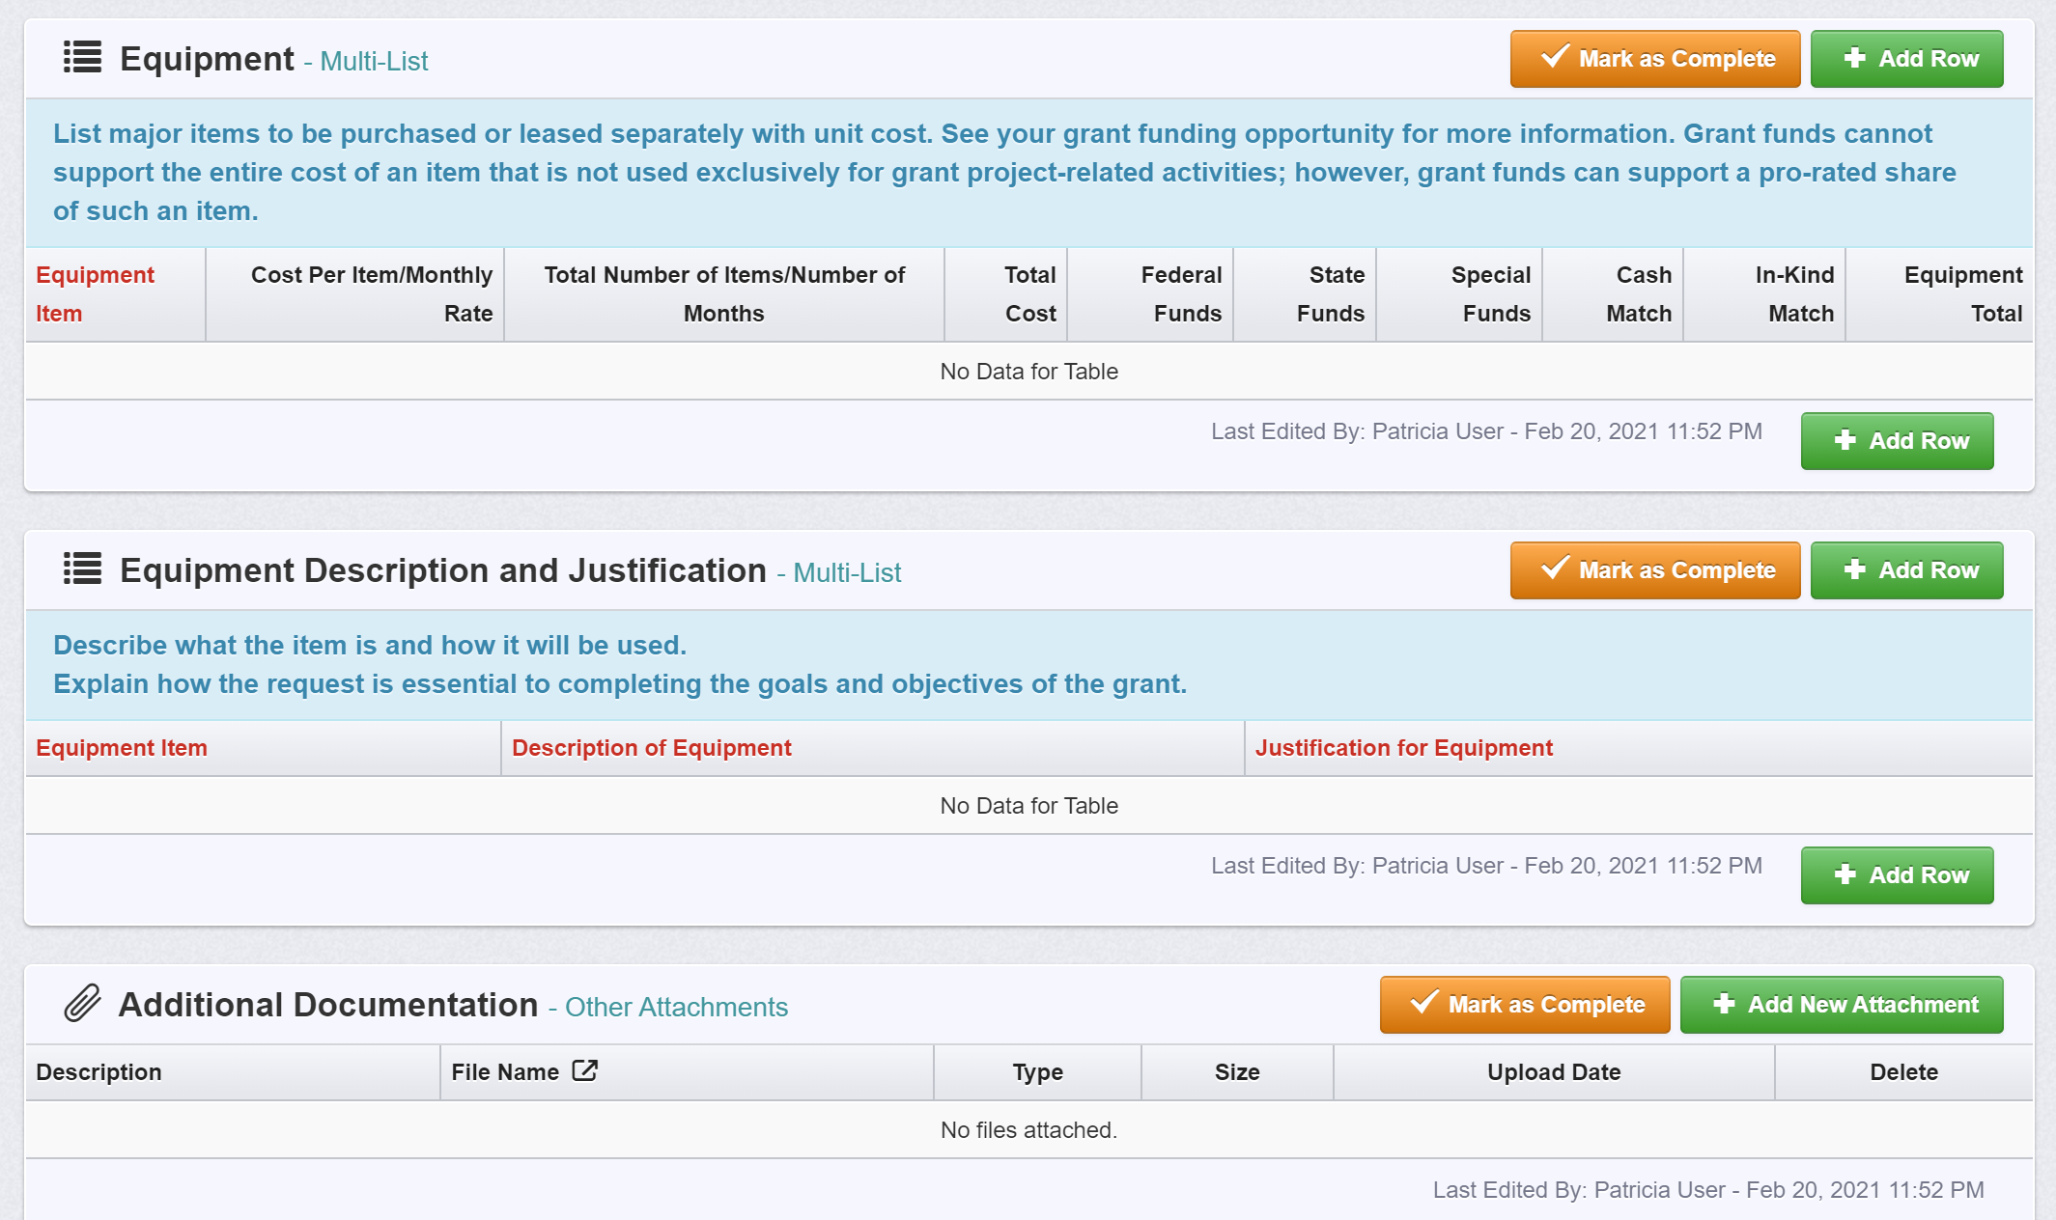
Editing the Application – Equipment

Slide 63
Editing the Application – Equipment

Slide 64
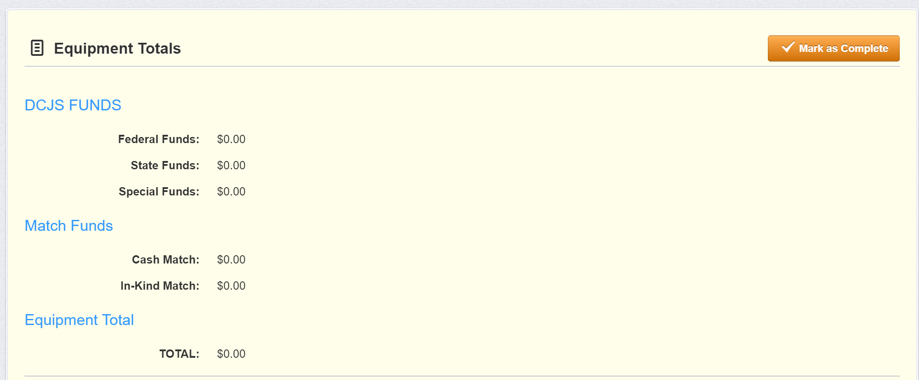
Editing the Application – Equipment Totals

Slide 65
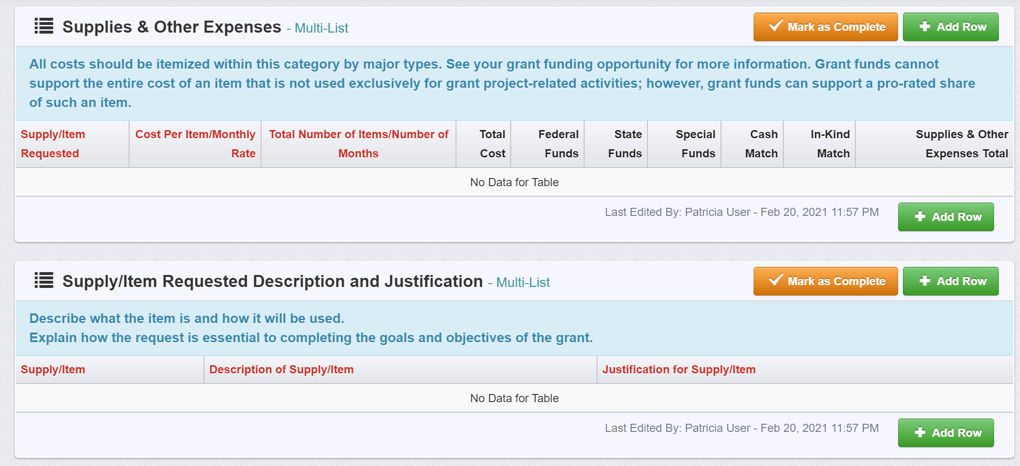
Editing the Application – Supplies & Other

Slide 66
Editing the Application – Supplies & Other

Slide 67
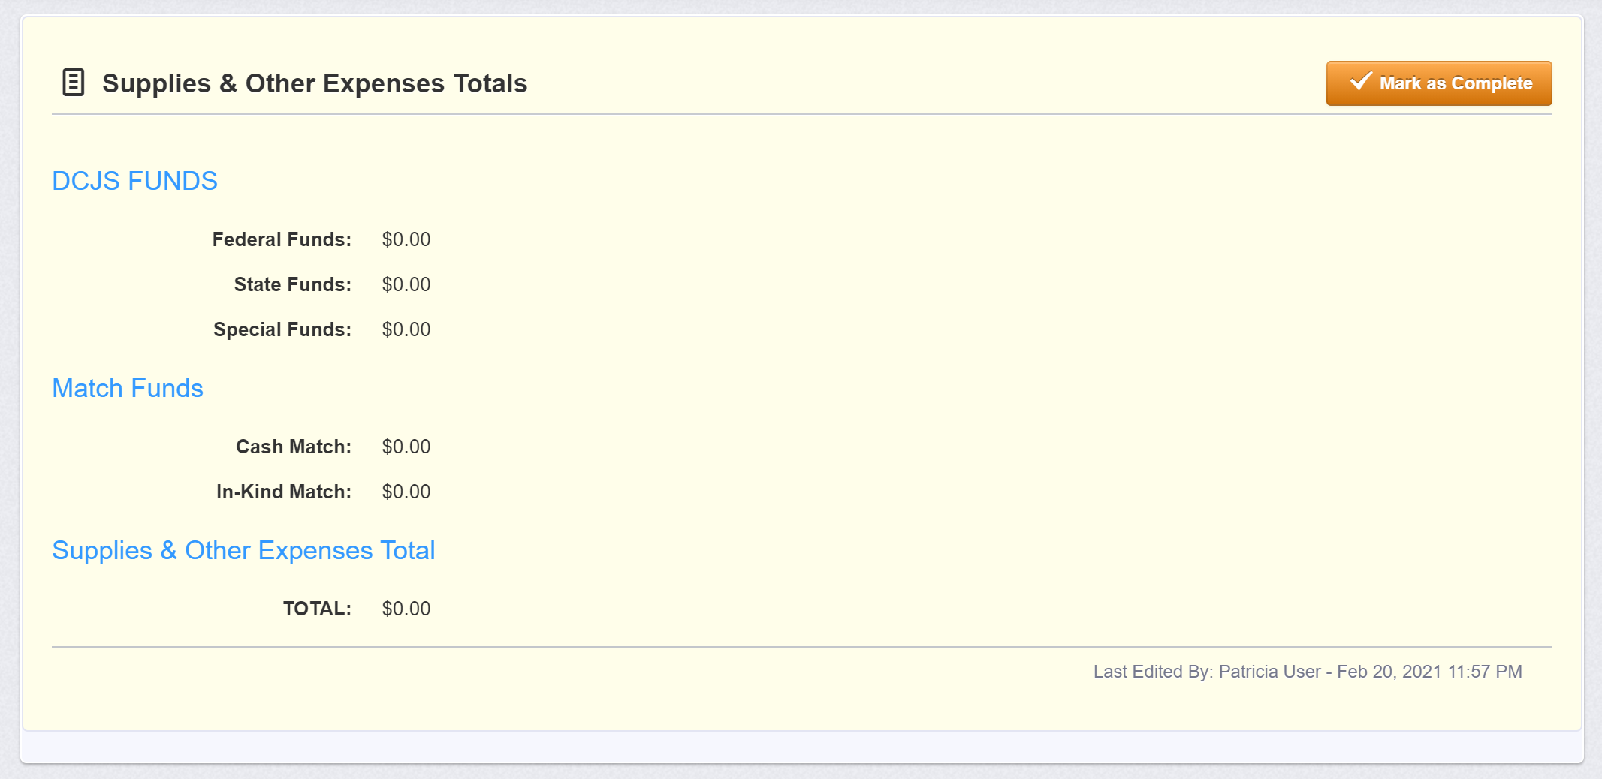
Editing the Application – Supplies Total

Slide 68
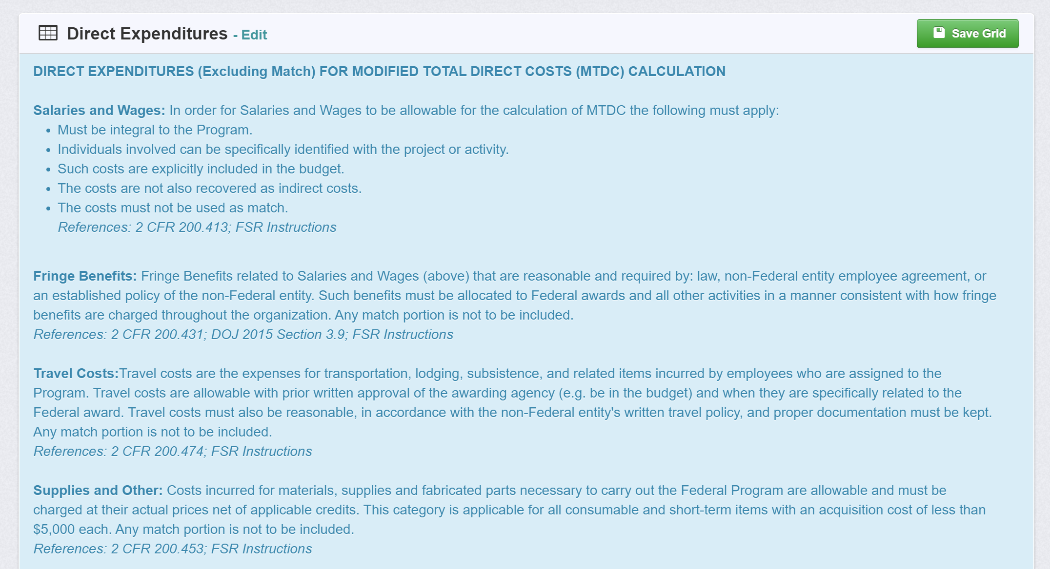
Editing the Application – Indirect Costs

Slide 69
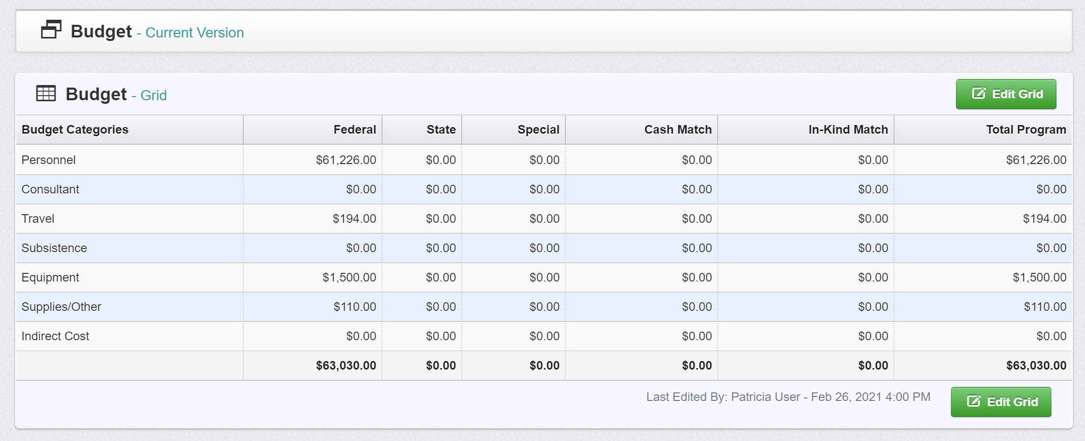
Editing the Application – Budget (Federal)

Slide 70
Editing the Application – Attachments

Slide 71
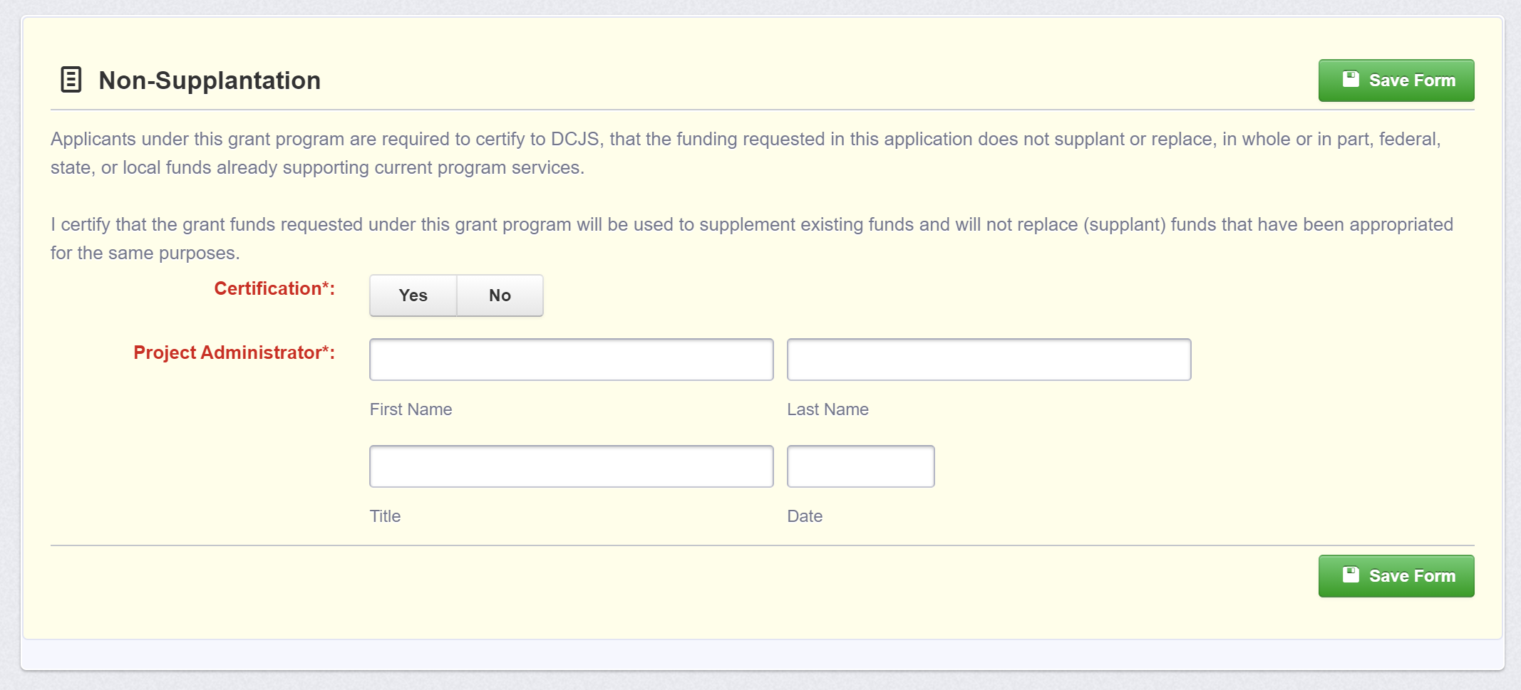
Editing the Application – Non Supplantation

Slide 72
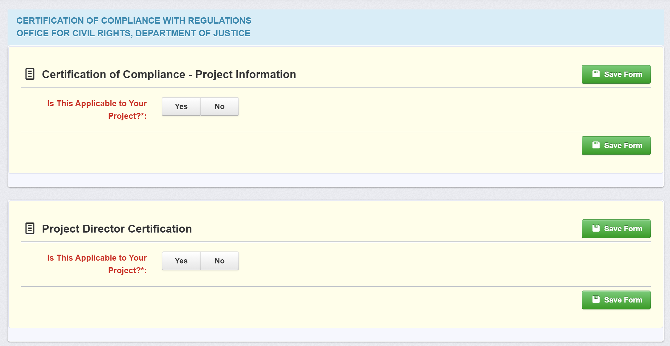
Editing the Application – Certification of Compliance with Civil Rights

Slide 73
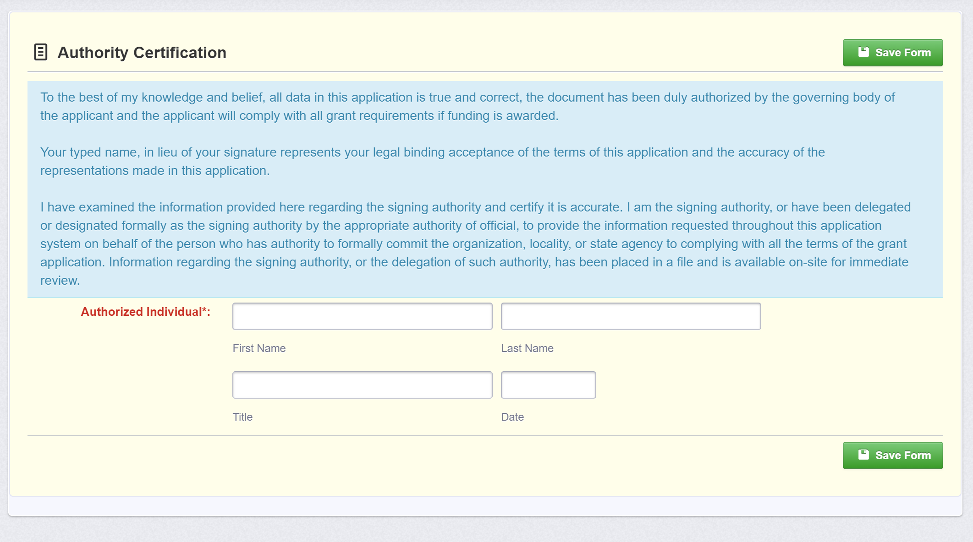
Editing the Application – Authority Certification

Slide 74
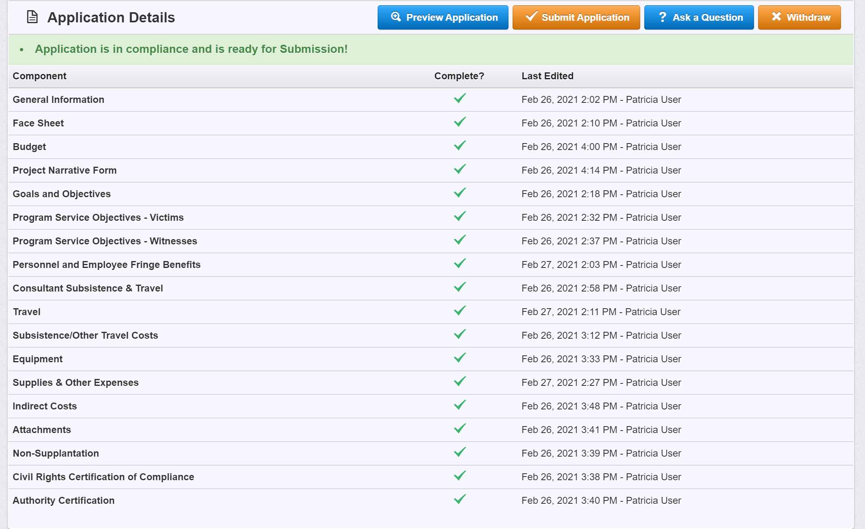
Editing the Application – Application List

Slide 75
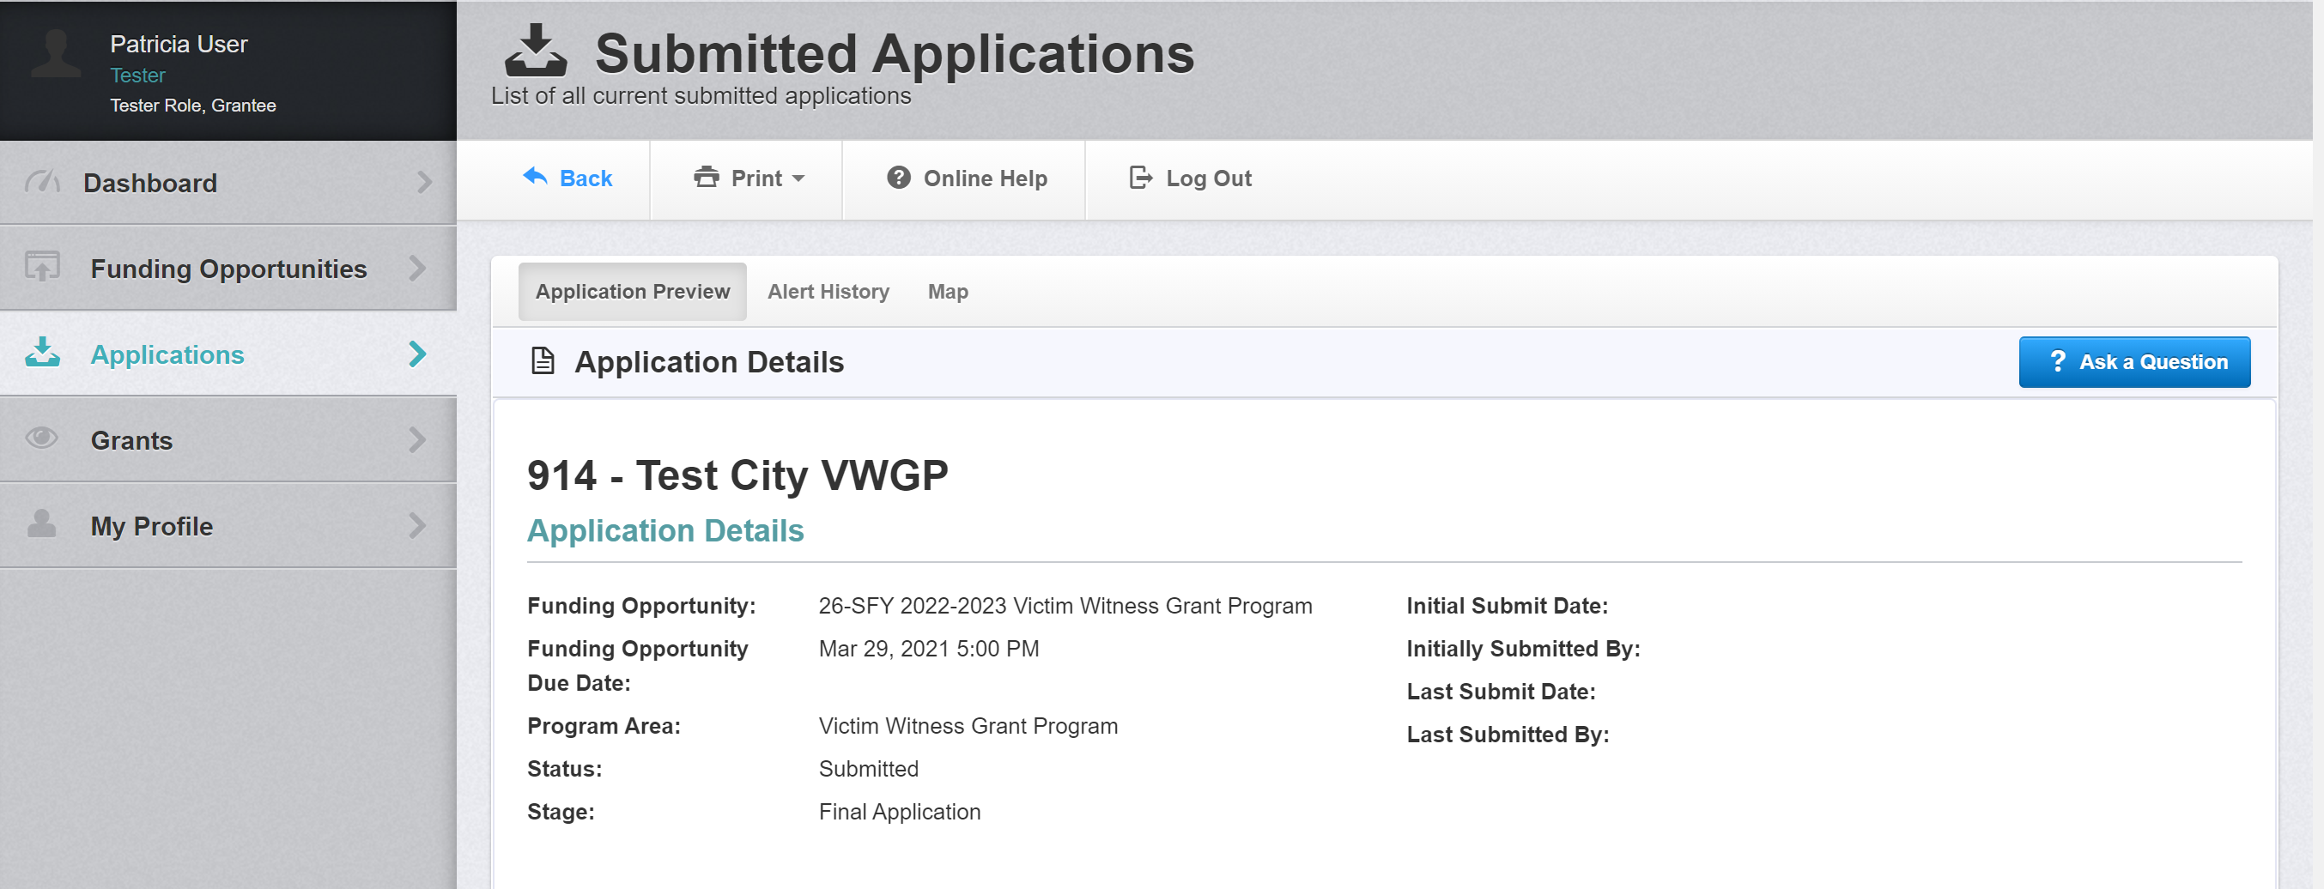
Editing the Application – Application Preview

Slide 76
Reminders
As you edit the application, save your work!
Once you complete a form select ‘Mark As Complete’
Applications cannot exceed the maximum award amount. Refer to the VWGP Guidelines for more information.
Enter the total amount requested from each of the itemized budget forms to the main Budget Form in the Federal column.
An application cannot be submitted until all forms are completed.
Once submitted, you cannot edit an application.
An application cannot be submitted after the deadline.
The VWGP application is due by 5:00 p.m. Monday, March 29, 2021.

Slide 77
Technical Assistance
For assistance with the OGMS system, email ogmssupport@dcjs.virginia.gov and include the grant program, application ID number, and the current grant number in the subject line. This should be used for general system questions and not grant application-specific inquiries.
Please contact the following DCJS staff for questions regarding VWGP specific inquiries: Patricia Foster at Patricia.Foster@dcjs.Virginia.gov or telephone (804) 972-3103.
For specific questions regarding VOCA allowable costs, please contact Anya Shaffer at Anya.Shaffer@dcjs.Virginia.gov or (804) 786-2059.
A copy of this solicitation is available on OGMS and the DCJS website. For additional resources, refer to the Attachments and Website Links under the Funding Opportunity at www.dcjs.Virginia.gov/victims-services

