Slide 1
SRO/SSO Incentive Grant Program Grant Management
Michelle Miles, SRO/SSO Grant Monitor
Virginia Center for School and Campus Safety
Notes:
Hello! This presentation is for the basic grant management for the SRO/SSO Incentive Grant Program. The information is specific to this grant program and may be different from other DCJS grants.
If you have any questions about the information provided in the slides, please contact Michelle Miles at michelle.miles@dcjs.Virginia.gov or 804-225-1846.

Slide 2
What to expect?
Statement of Grant Award Package
Grant Requirements
Reporting Requirements
Documentation Retention
On-line Grants Management System (OGMS)
Claims
Encumbrances
Contract Amendments
DCJS Contacts
Notes:
This presentation will go over:
The Statement of Grant Award
Grant Requirements
Reporting Requirements
Documentation Retention
On-line Grants Management System (OGMS)
Claims
Encumbrances
Contract Amendments
And provide you with contact information for DCJS staff.

Slide 3
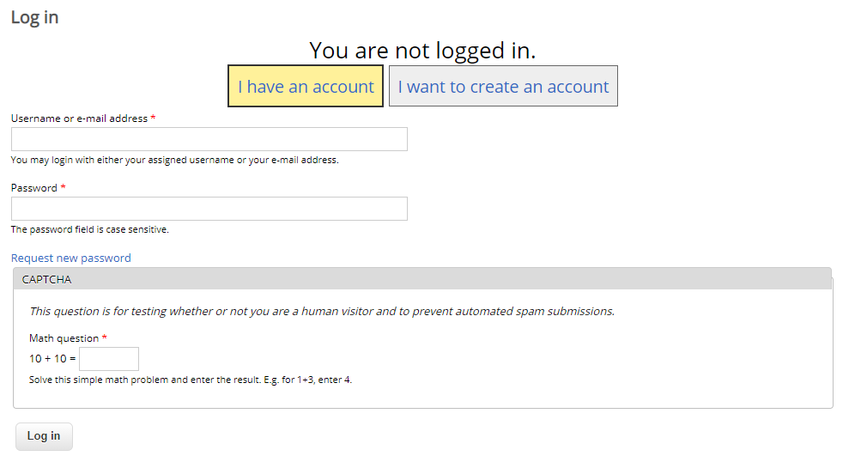
DCJS Resources
OGMS Training & Resources
Visit https://www.dcjs.virginia.gov/grants/ogms-training-resources for training documents and videos.
All Project Directors are required to watch the OGMS Grant Tracking Overview video.
Notifications
Sign up to receive notification for upcoming trainings and other events.
Notes:
On the DCJS website there are additional resources on how to navigate OGMS. We are requiring Project Directors to watch the OGMS Grant Tracking Overview video but we encourage anyone who will be working with the grant to watch it as well. These resources can be found on the OGMS Training and Resources page at https://www.dcjs.virginia.gov/grants/ogms-training-resources.
We also strongly recommend that you sign up for DCJS Updates via our website. To register, go to dcjs.Virginia.gov and click in the yellow box that says ‘DCJS Updates’. You will be brought to the login screen where you can create an account. After your registration is complete you can sign up to receive various updates on trainings, announcements, and grant opportunities.

Slide 4
Terminology
DCJS/GMIS
OGMS
Solicitation
Progress Reports
Financial Reports
Voucher
Statement of Grant Award
Budget Amendment
Program Update Form
Special Conditions
Grant Program
Email Notification
Solicitation Posting
Email to DCJS
Funding Opportunity
Status Reports
Claims/Detail of Expenditures
Claim/Reimbursement
Contract
Contract Amendment
Contract Amendment
Negotiations/Encumbrances
Program Area
Alert
Announcement
Correspondence
Notes:
Those of you who have grants with DCJS will notice that some of the terminology with the new system has changed.
A big one to point out is a solicitation is now referred to as a ‘funding opportunity’.
There are a few other changes such as; a progress report is now a status report. A ‘Claim’ will include reimbursement requests and detail of expenditures what we currently refer to as the financial report and voucher.
I would like to point out that this presentation focuses on the SRO/SSO Incentive Grant Program in detail and some information might not be applicable to other DCJS grants. Please contact your grant monitor for the other program for additional guidance.

Slide 5
Award Package
Acceptance of the grant award constitutes its agreement that the grantee assumes full responsibility for the management of all aspects of the grant and the activities funded by the grant.
By signing the Statement of Grant Award/Acceptance, the grantee agrees to comply with all 23 requirements.
It includes:
The Award Letter
Statement of Grant Award (SOGA)
Special Conditions
Reporting Requirements (found here)
Reporting Schedule
Notes:
Now we are going to discuss the Award Package, which notifies you that you have been awarded the grant and provides important information to maintain compliance.
By accepting the grant and signing the Statement of Grant Award, the locality agrees that they assume full responsibility for the management of the grant and agrees to comply with all 23 requirements.
The Award Package includes the Award Letter, the Statement of Grant Award or SOGA, Special Conditions, Reporting Requirements, and the Reporting Schedule.
You will receive the Award Letter and Statement of Grant Award by email but the other documents are located on the DCJS website. (https://www.dcjs.virginia.gov/grants/programs/fy2022-school-resource-officerschool-security-officer)

Slide 6
Notes:
The Statement of Grant Award (SOGA) contains the grant number, grant start and end dates, and the budget broken down by state special funds and the required local match.
When reviewing the SOGA, verify that all information is correct. If contact information has changed, at this point, you can cross it out and enter the new information before it is signed. Any changes after the SOGA has been submitted to DCJS, will need to be done through a Contract Amendment which we will discuss later on.
The Project Administrator must sign the SOGA, which must be the person who has the authority to commit the locality to comply with the terms of the grant. This would be the County Administrator, City or Town Manager, or Mayor. The exception would be if another individual were given signing authority. In that case, we must have a letter or memo from the Project Administrator stating this.

Slide 7
Award Package (continued) General Conditions for all DCJS state funded awards
Performance and obligation periods
Financial management systems
Access to grant records
Documentation requirements
Additional monitoring requirements
Record retention and access
Non-Supplanting requirement
Travel policy
Project initiation
Contract amendments
Financial audits
Project income
Required reports
Delegation of responsibility
Procurement
Nondiscrimination under state grants and programs
Notes:
There are 16 general special conditions for all DCJS state funded awards and we will highlight some of them next.
It is very important that you read all of them because there might be some action, on your part, needed to remain in compliance.
By signing the SOGA, you agree to comply with all of the special conditions, if you fall out of compliance, it could affect future funding opportunities.

Slide 8
Generic Requirements – Spotlight
2. Financial management systems
Must have a system in place that is able to record and report on the receipt, obligation, and expenditure of grant funds.
4. Documentation requirements
Upon request, must provide financial or programmatic-related documentation, including expenditures and achievements.
5. Additional monitoring requirements
May be subject to financial and programmatic on-site monitoring.
6. Record retention and access
Records pertinent to the award must be retained for a period of three (3) years from the date of the submission of the final expenditures report. (Current grant year, plus 3)
10. Contract amendments
No changes to the approved budget may be made without the prior approval of DCJS.
Notes:
Now I am going to discuss, briefly, five of the generic requirements. Please make sure to read all of them in their entirety in the award package so you understand the requirements of each one.
Special condition #2, Financial Management Systems, says that Grantees must properly track the use of grant funds and maintain adequate supporting documentation including proper records for all paid grant and match staff.
Number 4, Documentation Requirements, requires grantees to provide documentation upon request; this will be discussed in more detail later in the presentation.
Number 5, Additional Monitoring Requirements, says that the grantee agrees to comply with requests for financial and programmatic grant monitoring. This can include an in-person site visit, an enhanced desk review, or a virtual monitoring visit.
Number 6, Record Retention and Access, includes performance measure data in addition to financial records, supporting documents, statistical records, and other pertinent papers. It is important to note you must keep grant records for the current and past three grant years. For example, at this time you should have available grant records for FY22, FY21, FY20, and FY19, if you have had the grant that long.
Number 10 addresses contract amendments. All changes to the budget must be approved before those funds can be expended. There are two ways to complete a budget amendment. If you are moving money between line items, such as Personnel and Equipment, then you must submit a Budget Revision-Amendment through OGMS. No more than two are permitted and the deadline is 45 days prior to the end of the grant year. If you are moving money within a line item, such as Personnel, then you need to complete a Budget Revision- In Line Adjustment with the reason and justification for the change and the basis of computation of the new amounts. Contract Amendments will be discussed in further detail later in the presentation.

Slide 9
SRO/SSO Specific Conditions
17. School Resource Officer (SRO) position requirements
Positions must be based on the DCJS Virginia School-Law Enforcement Partnership Guide (SLEP) and must be a certified, sworn law enforcement officer as defined in Virginia Code § 9.01-101. SRO must be 21 years of age or older and have no less than three (3) years of certified law enforcement experience.
18. SRO Basic Training Course
Must have attended a DCJS SRO Basic Training course or attend one within the first four months of the grant period, or as required by the SRO certification standards, whichever is shorter. Must send a copy of the training certificate to your DCJS grant monitor.
19. Compliance with minimum training standards
As required by § 9.1-114.1, every full-time or part-time SRO, shall comply with the compulsory minimum training standards for SROs.
Notes:
There are six specific SRO/SSO Incentive Grant Program Special Conditions. Again, please read them in their entirety in the award package.
Number 17 is the position requirements for SROs. Included in the condition is that the SRO must be 21 years of age or older and have no less than 3 years of certified law enforcement experience.
Number 18 references the SRO Basic Training Course stating that you must notify your grant monitor if you are unable to complete the training within a specified time.
Number 19 says anyone employed, as an SRO after July 1, 2020, must comply with the minimum training standards for SROs.

Slide 10
SRO/SSO Specific Conditions (continued)
20. Memorandum of Understanding
As required by § 22.1-280.2:3, a grantee receiving funds for one or more SRO positions shall enter into a MOU between local law enforcement and the school division, to be reviewed every two (2) years.
21. Additional reporting requirements
Agrees to provide additional information to DCJS, as requested, to support reporting requirements to the General Assembly.
22. School Security Officer Requirements
SSOs must meet eligibility and training requirements for certification as a SSO as outlined in 6VAC20-240.
Notes:
Number 20 is the requirement for law enforcement and school divisions to enter into a MOU that must be renewed every 2 years if they are receiving funding for a SRO position.
Number 21 says you agree to provide additional information upon request.
In addition, number 22 says the SSO must meet eligibility and training requirements for certification outlined in the Virginia Administrative Code.

Slide 11
SRO/SSO Specific Conditions (continued)
23. Any additional “action item” encumbrances related to your award will be shown online via OGMS.
Actions must be taken, and approved by the Grant Monitor and/or Grants Management, before funds can be requested. Action item encumbrances are due August 31st of the grant fiscal year.
Encumbrances can be sent to your Grant Monitor, through Correspondences, unless otherwise instructed.
Notes:
Number 23 includes any actions that must be approved before you can receive funding. It means corrections need to be made so please contact your grant monitor if you have questions about what needs to be corrected.
They are due August 31st , unless otherwise noted, to your grant monitor using the Correspondence component in OGMS. These encumbrances can take up to 30 days to process depending on any back and forth to make sure they are right.

Slide 12
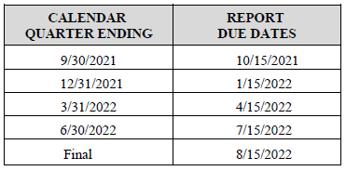
Reporting Requirements
FINANCIAL REPORTS & REIMBURSEMENTS (CLAIMS) are due within 15 days after the end of each calendar quarter. Reports are required even if no expenditures occurred during the quarter. If the due date falls on a weekend or non-business day, the report is due on the next business day.
PROGRESS/STATUS REPORTS for most grant programs are due within 15 days after the end of each calendar quarter and must be approved by your DCJS Grant Monitor.
Reporting Schedule
Notes:
It is very important to know that both status reports and claims are due quarterly. There is a schedule at the end of the grant requirements, but they are due 15 days after the end of the quarter. For example, as you can see on the slide, your first quarter progress report and financial report for this fiscal year are due October 15th. Failure to submit reports by the deadline dates may result in delay for reimbursement requests and/or cancellation of the award.
There is a financial review component to a monitoring visit, your expenditure reports should align with the reports in OGMS. It is advised not to split the grant in four even parts. Your locality’s financial system needs to match what you enter on your financial reports/claims.
You are still required to submit both reports even if no funds were expended and no activities were performed. You would simply enter 0’s in the financial report and note on the progress report the reason why no activities were performed, such as a vacancy in the position.

Slide 13
Reporting Requirements (continued)
BUDGET AMENDMENTS may be submitted for consideration through OGMS. Please review your Special Conditions carefully to determine the requirements and procedures for amending budgets.
GRANT CLOSEOUT: The grantee has up to 45 days from the end of the award period to liquidate any unpaid obligations and submit a final financial report. The liquidation period exists to allow projects time to receive final invoices and make final payments – no new obligations may be incurred during this period.
STATUS REPORTS: Additional guidance on how to complete the status reports for SROs and SSOs are available online on our DCJS SRO/SSO Incentive Grant Program page under Resources. Failure to submit reports by the deadline dates may result in delay for reimbursement requests and/or cancellation of the award.
Notes:
Budget amendments should be submitted through OGMS for consideration. We will discuss amendment types in more detail when we discuss Contract Amendments.
For information on how to complete the status reports, please go to https://www.dcjs.virginia.gov/virginia-center-school-and-campus-safety/public-safety/grants/srosso-incentive-grant-program. Under ‘Resources’ there is a status report presentation and report examples.

Slide 14
Documentation Retention
Records pertinent to the award must be retained for a period of three (3) years from the date of submission of the final expenditure report.
Grantee must provide access, including performance measurement information, in addition to the financial records, supporting documents, statistical records, and other pertinent records
Notes:
Next, we will discuss documentation retention and provide you with a list of records you will be required to show during a monitoring visit.
You must keep grant records for 3 years after the end of the final financial report. This means you should have documents available on the current year and the three previous years, if you have had the grant that long.
We do recommend that you check with your locality to see if they have any additional policies for record retention and if they must be available beyond what the grant requires.

Slide 15
Documentation Retention (continued)
For the current grant year and the past three grant years (e.g., FY22, FY21, FY20, FY19):
Signed Statement of Award Packages
Signed grant applications
Approved progress/status reports
Approved financial reports/claims
Approved special conditions/encumbrances
Grant adjustment documentation (amendments, project scope changes, etc.)
Notes:
When you are contacted for a monitoring visit, and after a date has been scheduled, you will receive a list of documents that need to be accessible upon request.
These include signed grant award documents, such as the SOGA and application and includes approved reports and special conditions/encumbrances.
We recommend that you keep the award packages together, or have all parts easily accessible so you can refer back to make sure you are in compliance with the grant.

Slide 16
Documentation Retention (continued)
For the current grant year:
Signed Memorandum of Understanding
General Orders or Standard Operating Procedures
Training and certification documents
Evidence that supports the information reported on progress reports (e.g. outlook calendar, calls for service, check lists, Power School reports)
Evidence of the financial system accurately recording the receipt, obligation, and expenditure of grant funds
Personnel time sheets for grant funded employees
Notes:
During the site visit, you will also be required to provide some documentation on current or recent activities.
You will need to provide evidence that supports the information reported on your progress reports.
For example, if you reported that you provided training or instructions to students or staff, your supporting documentation could include your outlook calendar.
When reporting on the number of incidents, you might have calls of service logs or Power School reports.
The supporting documentation can be in any form that works for you as long as it can back up what you entered on a status report or goals and objectives.
For the financial review, you will need to show how your financial system records grant expenditures, obligations, and receipt of grant funds. This is commonly done by using a coding system where grant funds are assigned a certain code to track those monies. Grantees must properly track and maintain adequate supporting documentation for local match provided.

Slide 17
Register in OGMS
Every user that manages a DCJS grant will need to register for an account.
This includes those within your locality that are responsible for submitting a grant application, uploading status reports, entering financial reports, and reimbursements.
Project Directors, Project Administrators, and Finance Officers should register.
Notes:
For the next few sections of the presentation, I’m going to discuss how to navigate registering and completing contract amendments and claims in OGMS.
It’s important that anyone in your locality that will work on the application or the grant must register in the system. This would include Project Directors, Project Administrators, Finance Officers, and anyone who will be submitting reports and completing the application.
It’s important to note that OGMS is compatible with many different browsers but when you are in the system, it’s recommended that you use the OGMS menu and not the browser menu.

Slide 18
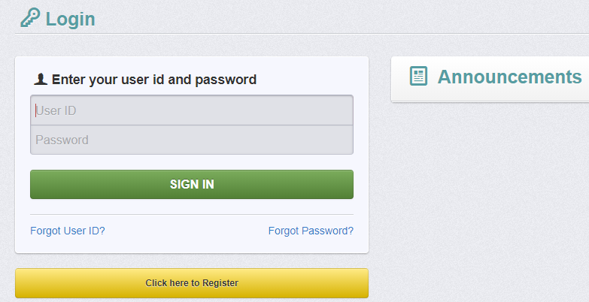
Register as a New User
URL: Ogms.dcjs.Virginia.gov
Click on ‘Click here to Register’
Notes:
The URL for OGMS is ogms.dcjs.virginia.gov
Once you enter the URL in your browser, it will take you to the Login page.
From there you will choose ‘Click here to Register’

Slide 19
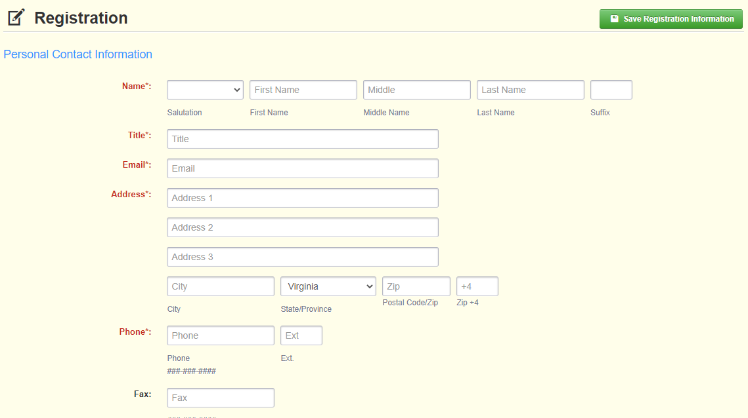
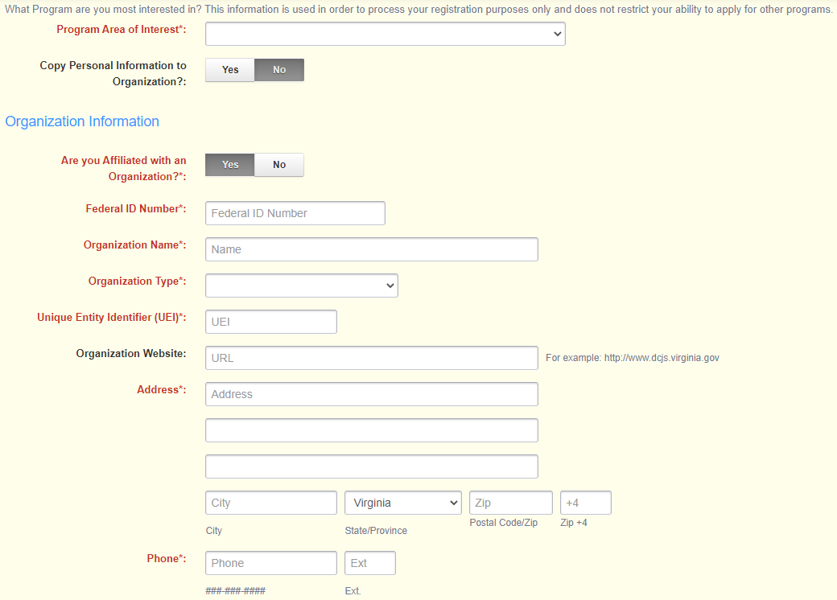
Register as a New User (continued)
All required fields are shown with a Red Asterisk *
Program Area of Interest will be ‘FREE’
Your Unique Entity Identifier (UEI) would be your 9 digit DUNS number.
Notes:
On the Registration page, enter the personal contact and organization information requested.
All required fields will have a Red Asterisk or the box will be outlined in red.
Under Program Area of Interest, you will choose ‘FREE’. This will not prevent you from seeing or applying for opportunities in other program areas, it’s used only for registration purposes.
For the UEI, or unique entity identifier, you will enter your 9-digit DUNS number.
And under FIPS code, you will choose your locality from the drop down list. If you do not see your locality in the list, please contact the OGMS support email and copy me. The email address will be on a slide at the end of the presentation.

Slide 20
Register as a New User (continued)
You will receive a confirmation of your registration with the message that an alert notification has been sent to your email address.
Notes:
After completing the required fields and clicking ‘Save Registration Information,’ you will receive a message letting you know that a confirmation email was sent to the email address you entered.
This is not approving your registration but confirming we received your information.

Slide 21
Register as a New User (continued)
You will receive an email alert notifying you that your registration is under review.
After your registration is approved, you will receive two separate email notifications with your assigned User ID and temporary password.
Alerts and Emails will be sent from VAgrantsDCJS@webgrantsmail.com
Each email provides the URL for logging into OGMS.
Once both emails are received you may log into DCJS OGMS.
Notes:
You will receive three separate email alerts; the first one will say your registration is under review and once it’s been approved you will receive an email with your username and the third one will have your temporary password.
Alerts will be sent from VAgrantsDCJS@webgrantsmail.com. It’s beneficial to add this address to your email contact lists so the alerts aren’t filtered incorrectly.
Once you’ve received your username and password you can log into DCJS OGMS.
The individual will not automatically have access to the grant and must be added as an additional contact. Additional information on how to add someone is discussed later in the presentation.

Slide 22
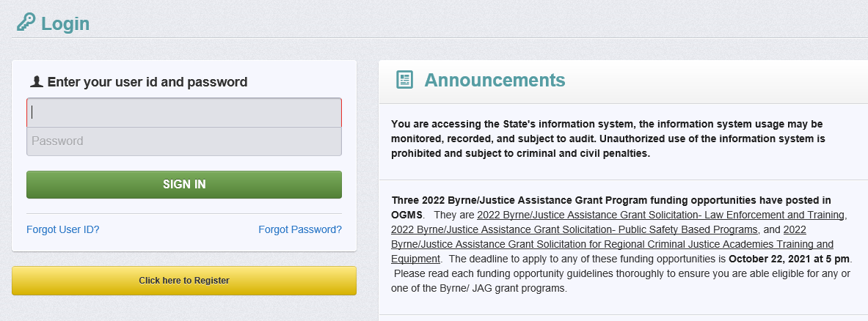
Login and Announcements
You will be able to view open funding opportunities and notifications under ‘Announcements’
Sign in by entering your User ID and password
Notes:
When you go to the login page, you will find announcements on the right hand side of the screen.
This area will include any open funding opportunities, system maintenance alerts, and other information that will be helpful with managing your grants in OGMS.
Under the area where you log in will be the single sign on tool but it is for DCJS users only.
To login, you will use your username and temporary password from your emails.
It will then ask you to change your password when you sign in for the first time.

Slide 23
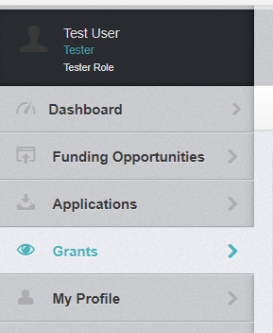
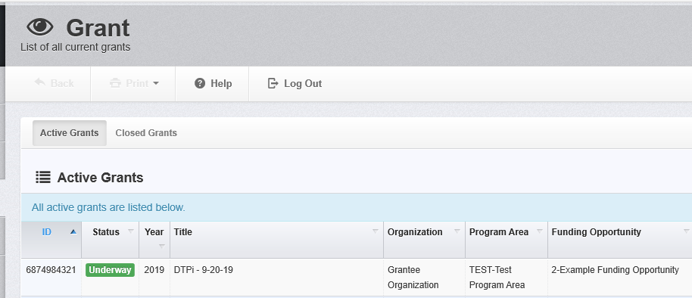
Accessing your Grant
From the Side Menu:
Click on ‘Grants’
Select the Grant you would like to access in the ‘Active Grants’ listing.
If you need to access a closed grant, click on the ‘Closed Grants’ tab.
Notes:
To access your grant, click on ‘Grants’ in the vertical tool bar on the left hand side of the screen.
This will bring you to the list of ‘Active Grant’s where you can select the grant you would like to access. If you don’t see the grant in this list, contact your Project Director to add you as an additional contact on the grant.
If your grant is listed as ‘Awarded’ and not ‘Underway’ that means DCJS has not received the signed SOGA. You will not have access to all grant components until it has been received and reviewed.

Slide 24
Accessing your Grant (continued)
Once you have selected the Grant, you will be directed to the ‘Grant Components’.
Components may not be the same for all grant programs.
‘General Information’ is where the Project Director can add additional contacts
Notes:
After you click on the grant you will see the list of grant components. The grant components may be different for each grant program.
Under ‘General Information’ is where the Project Director can add additional contacts.

Slide 25
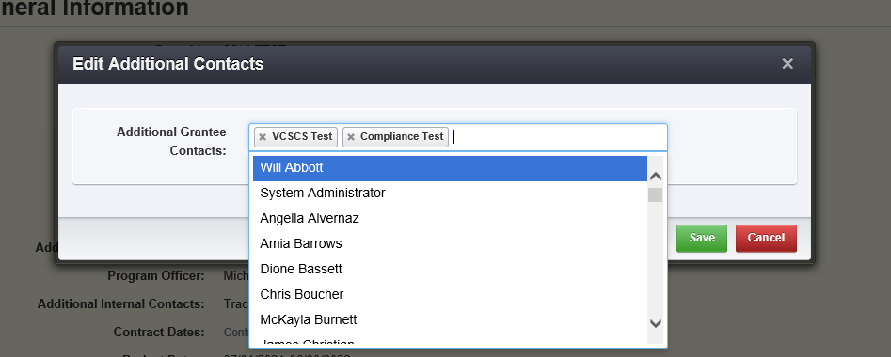
Accessing your Grant (continued)
* Individuals listed as a contact have full access to all grant components.
To add or remove someone from the grant click ‘Edit Additional Contacts’
Click in the box and choose the individual you want to add
To remove, click the ‘x’ next to the name in the box
Notes:
It is important to notes that individuals listed as contacts on the grant have full access to all grant components so it’s important for the grantee to discuss roles and responsibilities in OGMS.
To add someone to the grant, or remove them, click ‘Edit Additional Contacts’.
Click in the ‘Additional Grantee Contacts’ box and a drop down box will appear with all the individuals associated with the same organization. Choose the person you want to add and click ‘Save’.
To remove someone, click the ‘x’ beside their name in the box and select ‘Save’.

Slide 26
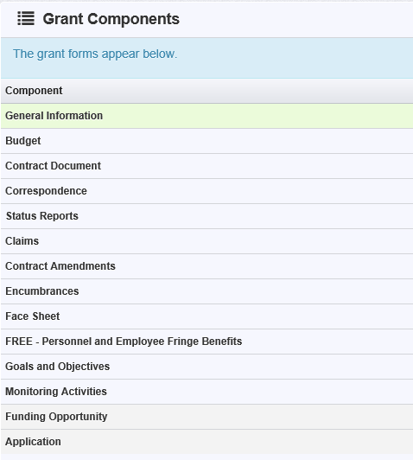
Starting a Claim
Choose ‘Claims’ from the components list.
Click ‘Add Claim’ on the right side of the screen.
Notes:
At this point in this presentation we will choose the ‘Claims’ component.
When you click on ‘Claims’ it will bring you to a screen that lists claims that are in editing status, have been submitted, or were withdrawn.
To start a claim, click the ‘Add Claim’ button.

Slide 27
Starting a Claim (continued)
The status will be auto populated.
Type: Reimbursement
Report Period: the beginning and end of the quarter
Final Request: Do not select ‘Yes’ unless this is your final quarterly Claim submission
Click ‘Save Form’
Notes:
OGMS will ask you to complete the General Information portion of the claim before you can save it.
The status will be auto populated
Under Type, choose ‘Reimbursement’
The report dates are the beginning and end of the quarter. Those are:
1st Quarter- July 1 through September 30
2nd Quarter- October 1 through December 31
3Rd Quarter- January 1 through March 31
4th Quarter- April 1 through June 30

Slide 28
Starting a Claim (continued)
Claim number is auto populated
Reimbursement – enter quarterly expenses to be reimbursed and report local match
Detail of Expenditures – describe the funds expended during the quarter
Notes:
Once the ‘General Information’ has been completed, you will see the ‘Claim Details’ page. A claim cannot be submitted until all components have been marked as complete.
Note: the system has created a claim number as soon as you clicked ‘Save Form’. If you log out of the system at this point or any future point, you will click on the existing claim until it has been submitted
The ‘Reimbursement’ form is where you will enter the quarter’s expenses and local match.
The ‘Detail of Expenditures’ is where you will describe the funds that were expended during the quarter and break it down between Special funds and Match.

Slide 29
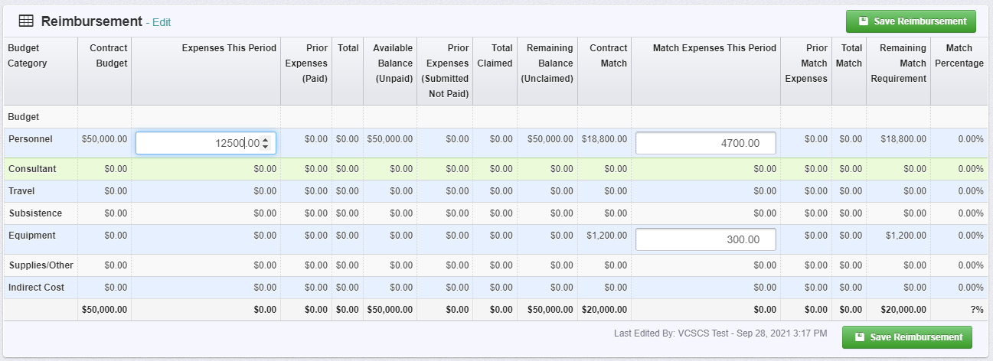
Reimbursement
Click ‘Edit Reimbursement’
Enter line item totals
Click ‘Save Reimbursement’
Notes:
Click on ‘Edit Reimbursement’
The grid will only allow you to enter amounts in the categories where there is an approved budget.
Enter line item totals for all state funding under the ‘Expenses This Period’ column.
All local match should be reported under the ‘Match Expenses This Period’ column.
When complete, click ‘Save Reimbursement’. If you do not save the form and you either back out of the form or section of the form, your information will be lost.

Slide 30
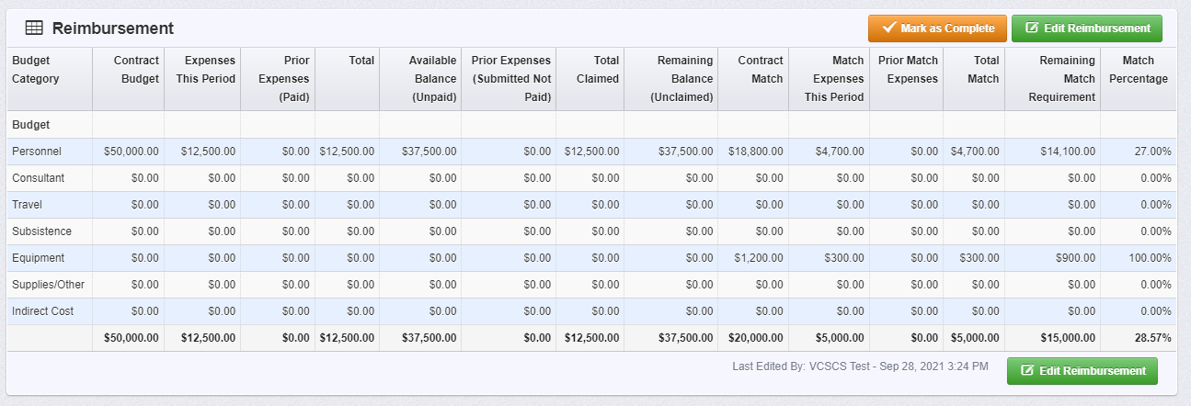
Reimbursement (continued)
‘Match Percentage’ will be calculated after the form has been saved
Match can be met anytime through the grant year
Notes:
After you’ve saved the form, you will see the ‘Match Percentage’ in the far right column.
Match can be met anytime through the grant year as long as you’ve met the total match by the end of the fiscal year. Grantees must properly track and maintain adequate supporting documentation for local match provided.

Slide 31
Detail of Expenditures
Must correspond with the expenditures reported in the reimbursement section
Notes:
Now we will discuss how to complete the ‘Detail of Expenditures’ component.
This section must correspond with the expenditures reported in the reimbursement component but this is where the expenditures are broken down.
To enter your detailed expenditures, click on the ‘Detail of Expenditures’ form and then the green ‘Add Row’ button on the right hand side.

Slide 32
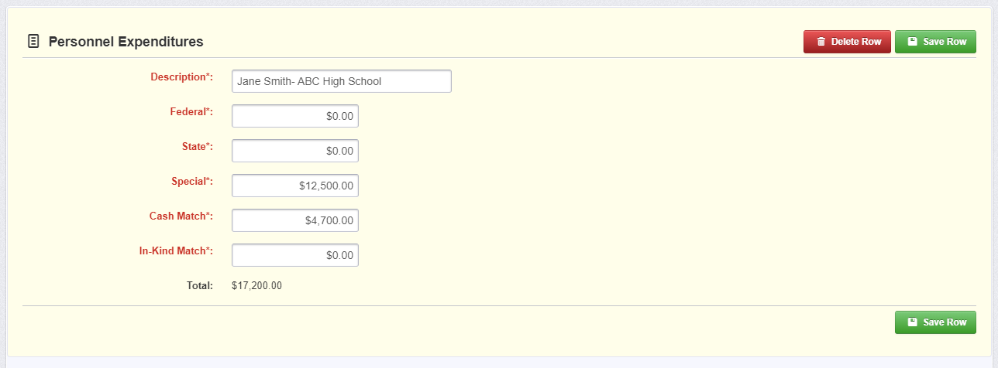
Detail of Expenditures (continued)
‘Personnel Expenditures’ should include salary and fringe benefits
‘Description’: Employee’s name
If more than one employee on a grant, include the school
Expenses should be broken down between Special and local match, if applicable.
Notes:
For the purpose of this presentation we will only go over the ‘Personnel Expenditures’ section since the majority of SRO/SSO grants are personnel expenses only.
Under the ‘Personnel Expenditures’ section you will include expenditures for salary and fringe benefits.
For the description you need to enter the employee’s name and the school they are assigned to if you have more than one individual on the grant.
After you’ve entered the personnel expenses click ‘Save Row’.
Once you’ve completed all sections you can click ‘Mark as Complete’.

Slide 33
Submitting the Claim
‘Preview Claim’ to verify the amounts in both sections are inline
Submit Claim
You are not able to delete a claim but can withdraw
Notes:
Before you submit the claim, it is encouraged to preview the claim to make sure the ‘Detail of Expenditures’ and ‘Reimbursement’ sections are inline. In preview form you will need to click ‘Edit Claim’ to return to the claim you were working on.
All sections must be marked as complete before you can submit the claim. After you’ve reviewed the information, and it’s accurate according to your approved budget, click ‘Submit Claim’
You are not able to delete a claim but you can withdraw the claim before it has been submitted. It will remain in your list of all the claims associated with your grant.

Slide 34
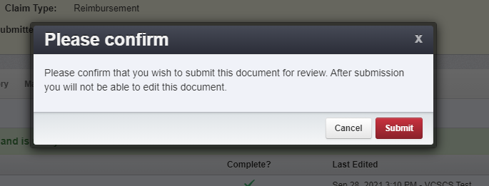
Submitting the Claim (continued)
Verify you wish to submit the claim
Claim has been submitted
Notes:
The last step is to verify that you are ready to submit the claim. Remember that once it’s submitted you are not able to edit the forms.
After you’ve submitted the claim you can return to the ‘Claims’ component to see that it’s been submitted.

Slide 35
Encumbrances
Encumbrances are actions that need to be taken before you can implement the project or submit a claim.
Notes:
Now we will discuss ‘Encumbrances’ which are actions that need to be taken before you can implement the project or submit a claim.
Encumbrances can be viewed while the grant is in ‘Awarded’ and ‘Underway’ status and it is the grantees responsibility to check this component for any actions they need to take.
An encumbrance, with a hold on payments, can be entered if status reports and other requested documentation are not provided on time.

Slide 36
Encumbrances (continued)
Status will let you know if it’s been completed
Compliance Date will tell you when it was approved
Description will tell you what needs to be done
Due Date will tell you when you must complete the action by
Hold Payment, when yes, indicates you will not be able to submit a claim until it has been met
Notes:
The status will let you know if the encumbrance has been completed. The box will either say Pending, Compliant, or Cancelled. ‘Pending’ status means you still need to complete the action. ‘Compliant’ means the action has been taken and the Grant Monitor and/or Grants Management have approved. If it says ‘Cancelled’ then the encumbrance is not longer needed.
‘Compliance Date’ will let you know when the action was completed and approved by the Grant Monitor and/or Grants Management.
‘Description’ will explain what action you need to take to be in compliance. If the description is not clear, contact your Grant Monitor for additional guidance. It is preferable to submit any information via the ‘Correspondence’ component in OGMS unless it says otherwise.
Due date is the date when the action must be completed by and submitted to DCJS.
If there is a ‘Yes’ under ‘Hold Payment’ then you will not be able to submit a claim for reimbursement until you are in compliance with the encumbrance.

Slide 37
Contract Amendments
Contract Amendments is a request to change the grant
Any changes must be approved by DCJS before it can take effect
Types:
Budget Revision – Amendment
Budget Revision – In Line Adjustment
Change Grant Funded Staff
Change in Authorized Official
Change in Award Sponsorship
Grant Award Period Extension
Project Scope of Work Revision
Reporting Extension
Other
Notes:
Moving on, a ‘Contract Amendment’ is the request to make a change to your grant.
There are several types but this presentation will go through a few since some would rarely apply to this grant program.

Slide 38
Contract Amendments (continued)
Choose ‘Contract Amendment’ from the components list
Click ‘Add Amendment’
Notes:
To start a ‘Contract Amendment’ choose it from the components list under your grant.
If you’ve previously started a contract amendment it will show up in the amendments list and include the type of amendment and status.

Slide 39
Contract Amendments (continued)
General Information will be the same for all amendments
The status will be auto populated
Choose the amendment type from the drop down box
The title should include a brief description of the amendment (e.g., Salary Adjustment for SRO or 2nd Quarter Status Report Extension Request)
Notes:
You will be asked to complete the general information which is the same for all contract amendment types.
The status is auto populated and the type is chosen from the drop down box.
For the title, you want to briefly describe the request you are submitting. For a ‘Budget Revision-In Lind Adjustment’ it could be something like, “Salary Adjustment for SRO.” For an extension request for a status report the title should include the quarter such as, “2nd Quarter Status Report Extension Request.”

Slide 40
Budget Revision – In Line Adjustment
Click ‘Budget Revision (In Line Adjustment)’ from the ‘Amendment Details’ screen
Enter the justification for the change
Click ‘Save Form’
Mark as complete and submit for review
Notes:
An in-Line budget adjustment allows you to move funds within the same budget category. In addition to indicating the changes within the budget category, you are asked to submit justification for the change in the space provided.
The purpose of the justification is to explain the reason for the change and to itemize the proposed costs. In the justification, please indicate the following:
Why the change is being requested;
Where the funds are being moved to;
Where the funds are being moved from.
Then itemize all new requests or changes.
In line adjustments can be submitted anytime during the year, but must be approved by DCJS prior to funds being expended.

Slide 41
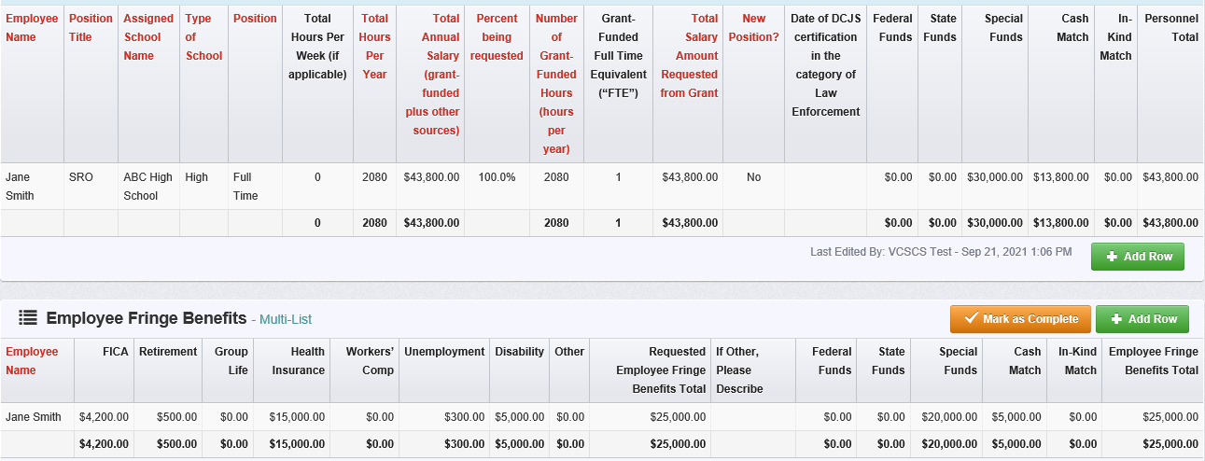
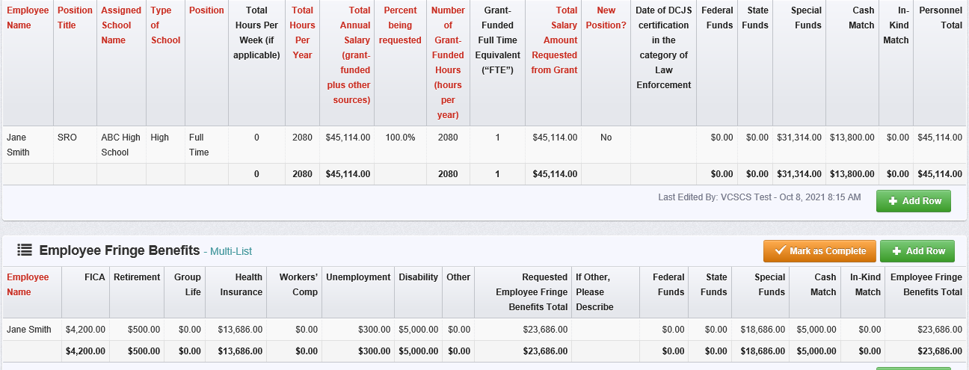
Budget Revision – In Line Adjustment (continued)
Notes:
Once the in line budget adjustment has been reviewed and approved by DCJS, you may be asked to revise the component form. The component will have ‘Pending Version’ in red font to the right of the component title.
The appropriate form will be unlocked so you are able to make the approved changes from your contract amendment. Make sure to change all applicable fields as demonstrated in the example on this slide.
You are not able to ask for more than what was awarded so make sure the totals match those amounts.
You will need to mark it as complete and submit the corrected version. The form will be reviewed for accuracy and then marked as the current version by the Grant Monitor.

Slide 42
Change Grant Funded Staff
This type is to notify DCJS of a change in grant funded staff
General information process is the same for all amendments
After general information is complete click on ‘Program Update’
Notes:
A change in grant funded staff is used when the SRO or SSO filling the position on the grant changes or goes out on extended leave.
This form should not be used for changes in authorized officials (Project Director, Project Administrator, Finance Officer).
After completing the general information you will be taken to the ‘Amendment Details’ page where you will click on ‘Program Update’.

Slide 43
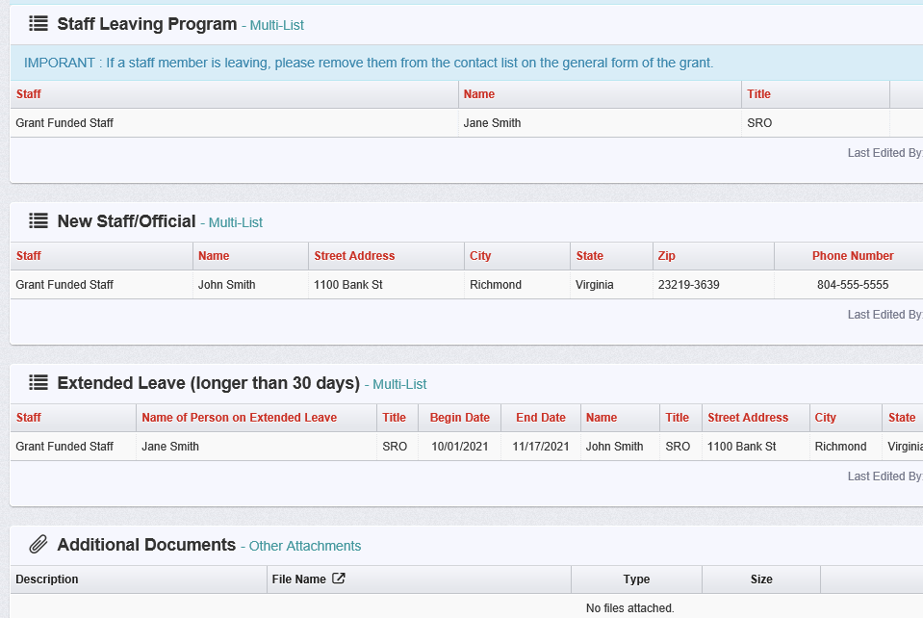
Change Grant Funded Staff (continued)
Notify DCJS within 30 days of personnel changes
Four sections:
Staff Leaving Program
New Staff/Official
Extended Leave
Attachments
Notes:
All grant-funded programs are required to notify DCJS within 30 days of any personnel changes in the grant funded program.
Compete the appropriate section for the change you are requesting.
The attachments section is an opportunity to include additional documentation such as the SRO Basic training records and DCJS certification. This information is required before the amendment can be approved. .

Slide 44
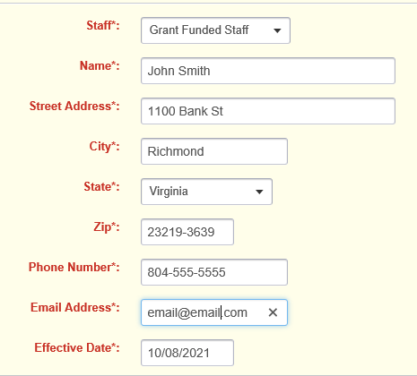
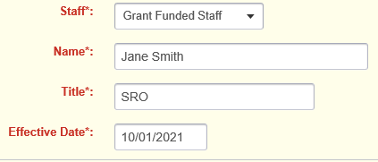
Change Grant Funded Staff (continued)
Staff Leaving Program
If a staff member is leaving, please remove them from the contact list on the general form of the grant
New Staff
Enter information for new staff
Notes:
If staff is no longer involved with the grant you will want to remove them as an additional contact. The Project Director can do this by going to the ‘General Information’ component under Grant Components. If they are leaving the organization/agency you can send an email to ogmssupport@dcjs.Virginia.gov to request that the person be removed from your organization’s profile.
If the new staff should have access to the grant in OGMS, they will need to register in the system and the Project Director can add them as an additional contact on the grant.

Slide 45
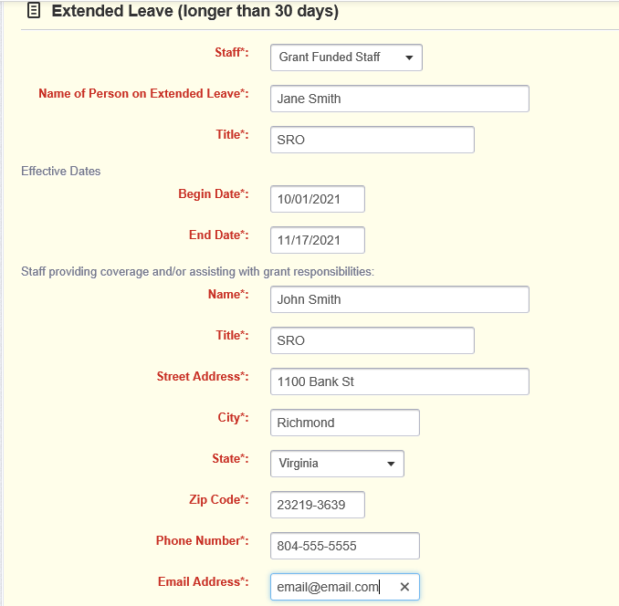
Change Grant Funded Staff (continued)
Extended Leave
If the leave is longer than 30 days
Enter information for staff going out on leave
Enter information if staff is providing coverage
Notes:
If the staff member is going to be out on leave for more than 30 days then complete the ‘Extended Leave’ section.
If another staff will be temporarily providing coverage you should provide their information as well.

Slide 46
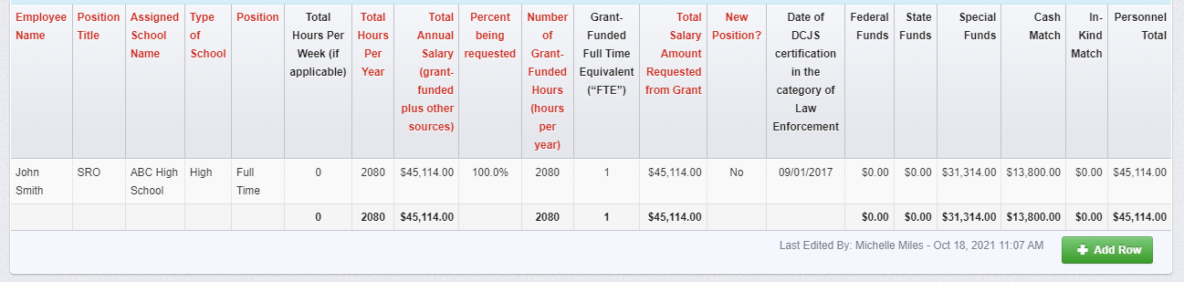
Change Grant Funded Staff (continued)
Change name in all sections
Revise salary, if applicable, not to exceed total awarded amount
Include date of DCJS certification
Notes:
When new grant funded staff is added to the grant, just like with the in line budget adjustment, you will be asked to revise the ‘Free-Personnel and Employee Fringe Benefits’ component.
You will need to change the name on the ‘Personnel’, ‘Employee Fringe Benefits’, and ‘Position and Justification’ sections. The date of DCJS certification in the category of Law Enforcement should be provided and should demonstrate no less than 3 years of certified law enforcement experience.
Any changes to the salary or fringe benefits should also be recorded. Remember, you are not able to ask for more than what was awarded and the totals should remain the same. If you need assistance or have any questions, contact Michelle Miles.

Slide 47
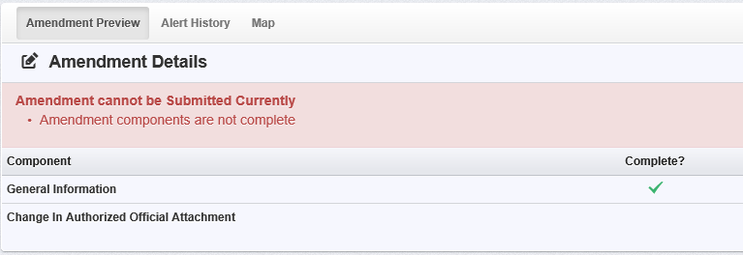
Change in Authorized Official
This type is to notify DCJS of a change in Project Director, Project Administrator, or Finance Officer
Required to notify DCJS within 30 days of the change
After general information is complete click on ‘Change in Authorized Official Attachment’
Notes:
For any changes to the Project Director, Project Administrator, or Finance Officer a ‘Change in Authorized Official’ should be submitted.
Again, the general information is the same for all amendment types but you would choose ‘Change in Authorized Official’ from the drop down box. An example for a title could be, “Change in Project Director.”

Slide 48
Change in Authorized Official (continued)
Program Update Form is located on the DCJS website here
Should be signed by the Project Administrator
Upload as an attachment under ‘Contract Amendment-Change in Authorized Official’
Notes:
You should notify your grant monitor within 30 days of any changes in grant related personnel.
The Project Administrator must sign the form if there is a change to the Project Director, Project Administrator, or Finance Officer. The Program Update Form can be found on the DCJS website under ‘Forms’ at https://www.dcjs.virginia.gov/virginia-center-school-and-campus-safety/public-safety/grants/srosso-incentive-grant-program.

Slide 49
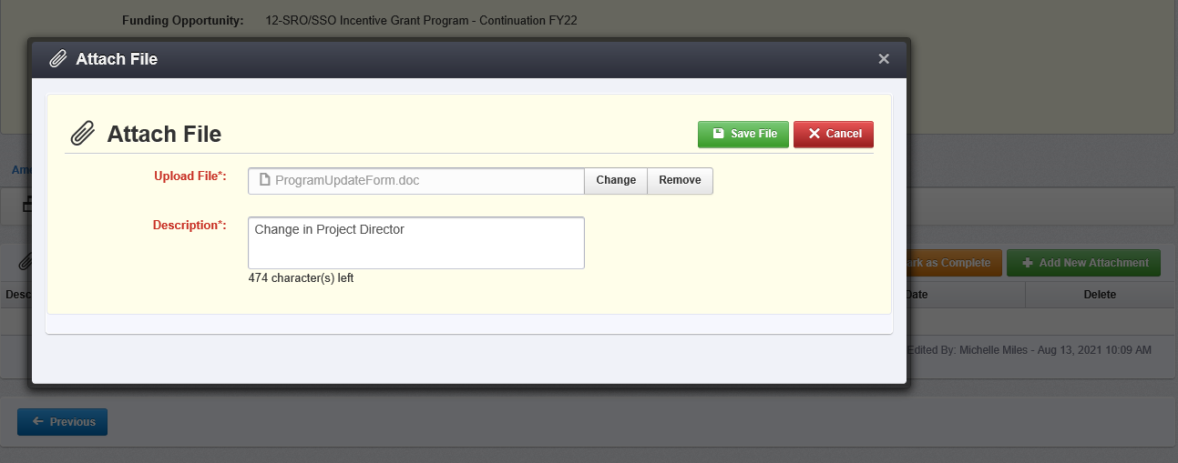
Change in Authorized Official (continued)
Click ‘Add New Attachment’
Upload completed Program Update Form signed by the Project Administrator
Description should briefly explain the change
Click ‘Save Form’
Mark as Complete
Submit Amendment
Notes:
A program update form must be completed and signed by the Project Administrator.
The description should briefly explain the change you are requesting, such as, “Change Project Director from Jane Smith to Susan Doe”
The form must be uploaded as an attachment and will be reviewed by DCJS. Once it’s been approved Grants Management will update the ‘Face Sheet’ component in OGMS.

Slide 50
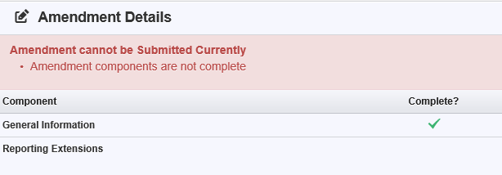
Reporting Extensions
Choose Reporting Extensions
Complete the form
Save Form
Mark as complete
Submit Amendment
Notes:
You will need to submit a reporting extension contract amendment if you know your status report or claim will be late.
Award recipients must submit the required financial and programmatic reports, unless otherwise specified in the terms and conditions of the award, 15 calendar days following the end of the calendar quarter.
Failure to submit complete and accurate reports in a timely manner can potentially result in delayed funding and impact future funding.
To submit a report extension, indicate the current reporting period, explain the reason for the delay, and provide the date in which the report will be submitted.
All requests will be reviewed and approval is contingent upon adequate justification of the request.
No more than two report extensions will be approved per award period.
The request for an extension must be submitted prior to the reporting deadline.

Slide 51
Project Scope of Work Revision
Choose ‘Project Scope of Work Revision’
Briefly describe the change you are requesting
Provide a justification for the change.
Indicate if the change will impact another aspect of the grant (e.g., Goals and Objectives)
Save form
Mark as complete
Submit Amendment
Notes:
To change the scope or objectives for grant-funded projects, you must submit an amendment request and receive approval prior to implementing the change.
The ‘Project Scope of Work Revision’ can be used to request a change in your grant objectives or activities, a change to the school where the grant funded staff is assigned, or other revisions that cause a project to change substantially from what was approved.
The request should describe the scope change needed and the impact the change will have on the timeline and budget. Discuss and document any unique circumstances that will impact the ability to meet the expectations of the funded project.
Prior to submitting the amendment request, consult with your DCJS grant monitor with questions to ensure that the potential changes are in line with the purpose of the funding.
All project scope requests must be submitted no later than 45 days prior to end of the award period.

Slide 52
Contacting DCJS
Status reports: Grant Monitor
Goals and Objectives: Grant Monitor
Budget Amendment: Grant Monitor
Financial Reporting/Claims: Will Abbott or Mark Fero
Grant Closeout: Andrew Wooldridge or Mark Fero
OGMS technical support: ogmssupport@dcjs.virginia.gov
For financial questions, contact:
Will Abbott at (804) 997-5195 or will.abbott@dcjs.virginia.gov
Mark Fero at (804) 225-2782 or mark.fero@dcjs.virginia.gov.
Andrew Wooldridge at (804) 225-1863 or andrew.wooldridge@dcjs.virginia.gov
Notes:
Here is some guidance for who to contact and when.
If you have questions about your grant’s status reports, goals and objectives, budget amendments or other programmatic issues, you will need to contact your grant monitor.
For questions on claims and reimbursements, please contact Will Abbott. You can find their contact information on the bottom of this slide or in the award package.
Contact Andrew Wooldridge or Mark Fero if you have any questions about the grant closeout.
When contacting various staff at DCJS about your grant, feel free to copy your grant monitor.

Slide 53
Virginia Center for School and Campus Safety K-12 Staff
Michelle Miles, SRO/SSO Grant Monitor
804-225-1846
michelle.miles@dcjs.virginia.gov
Monday through Friday, 7 a.m. to 3:30 p.m.
Kim Simon, SRO/SSO Training and Program Coordinator
kim.simon@dcjs.virginia.gov
James Christian, K-12 School Safety and Threat Assessment Manager
james.christian@dcjs.virginia.gov
Carol Miller, Administrative Training Specialist (SSO Certification Database)
schoolsecurity@dcjs.virginia.gov
Notes:
Here is the contact information for the Virginia Center for School and Campus Safety K-12 Staff
Michelle Miles is the grant monitor for all SRO/SSO grants. Her normal business hours are Monday through Friday, 7 am to 3:30 pm.
If I she is not available and you need immediate assistance, you can contact Kim Simons or James Christian and they will try to help you in her absence.
Kim Simon is the SRO/SSO Training and Program Coordinator. You can contact her with any questions or needed guidance relating to the role, duties, training or certification of SROs and SSOs.
For questions about the SSO certification database, you can contact Carol Miller at schoolsecurity@dcjs.virginia.gov.

Slide 54
Questions?
Notes:
Thank you for viewing this presentation. Again, if you have any questions about the material presented, please contact Michelle Miles through the Correspondence component or at michelle.miles@dcjs.Virginia.gov or 804-225-1846.

