Slide 1
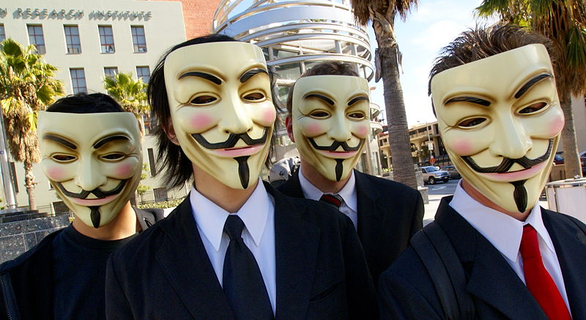
Domestic Terrorism and Extremist Groups

Slide 2
Disclaimer
The following material is Law Enforcement Sensitive and should not be disseminated outside LEO circles. The purpose of this PowerPoint is for law enforcement safety and situational awareness of groups or movements that MAY display extremist behavior.
Be mindful of First Amendment protections afforded to these groups and individuals and do not conduct law enforcement actions that are not predicated on criminal behavior

Slide 3
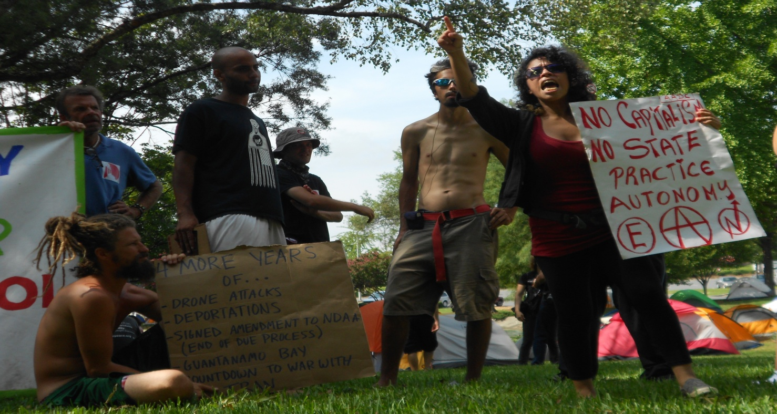
Subversive?
Seeking to change an established system
Troublemaker, Dissident, Agitator, Revolutionary, Renegade, Rebel

Slide 4
Animal Rights Extremists
Consider animals of the same value as humans, therefore view lab animals as “prisoners”
“A rat is a pig is a dog is a boy”
Main target is Huntingdon Life Sciences (HLS), based in England and New Jersey

Slide 5
Animal Rights Extremists
Protest “vivisection”, or the experimental cutting of, or surgery on, a live animal for scientific purposes
Certain violent acts considered domestic terrorism by FBI

Slide 6
Animal Rights Extremists
Literature and propaganda generally depicts puppies or rabbits
Can be printed and copied directly from groups’ websites

Slide 7
Animal Rights Extremists
M.O. normally resembles anti-abortion activity
Ranges from picketing with bullhorns and picketing with flyers to firebombing and B&E on U.S. west coast
“Flash Raids”
Infiltration of labs
Vandalisms

Slide 8
Animal Rights Extremists
Main Groups:
Close HLS www.closehls.net
www.Animalliberationfrontline.com
ALF www.animalliberationfront.com
PETA www.peta.org (Not an extremist group, but a good website for situational awareness)

Slide 9
Animal Rights Extremists Investigation Techniques
Detain and identify
Collect literature/flyers as evidence
Document vehicles
Complete Investigative Report
Contact Intelligence Apparatus
Remember to Smile ☺: they will always record activities

Slide 10
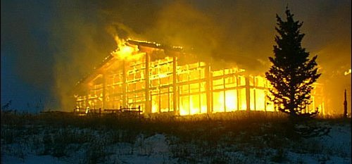
Earth Rights Extremists
Land cannot be owned
Economic sabotage to stop the destruction of the environment
Arson
Property damage
Tree staking
Subdivisions and multi-million dollar houses

Slide 11
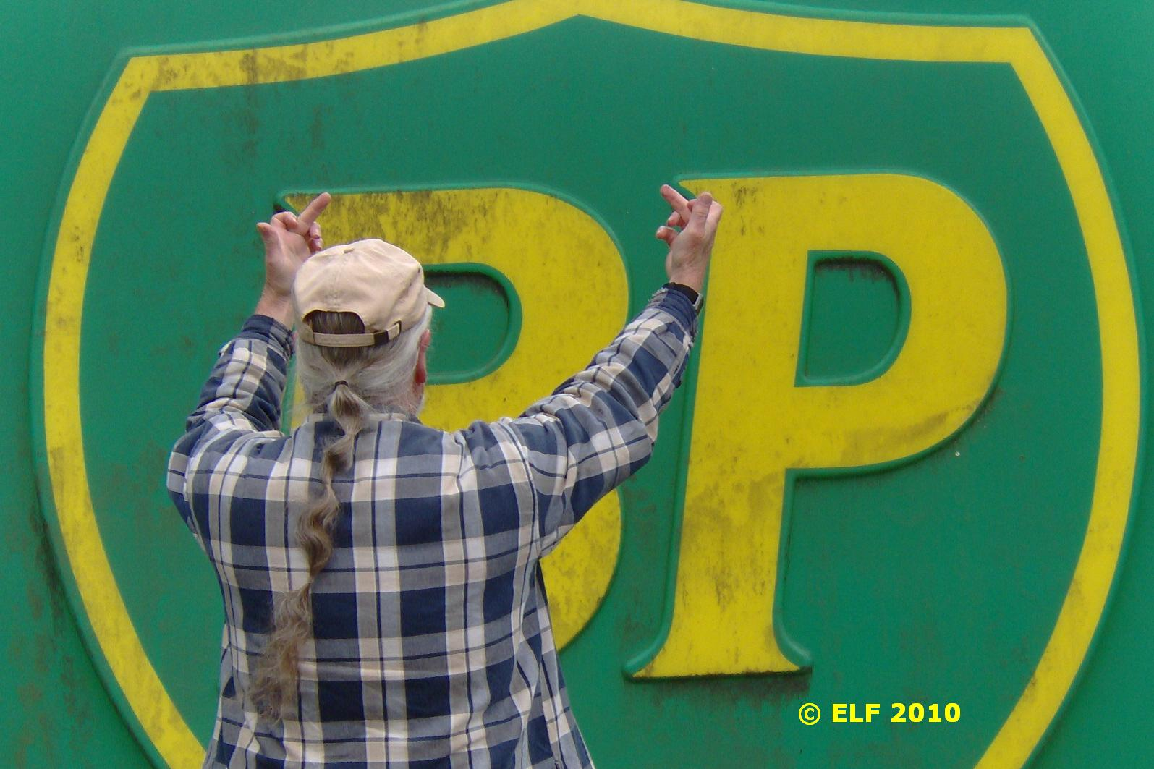
ELF
Leaderless (biggest problem)
Believe in direct action
Utilize open source communiqués to spread propaganda

Slide 12
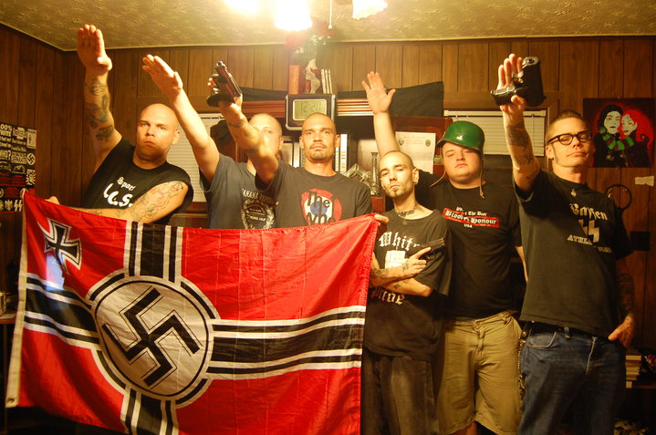
White Supremacists
Young
Well Organized
Violent
Secretive
Technologically savvy with internet

Slide 13
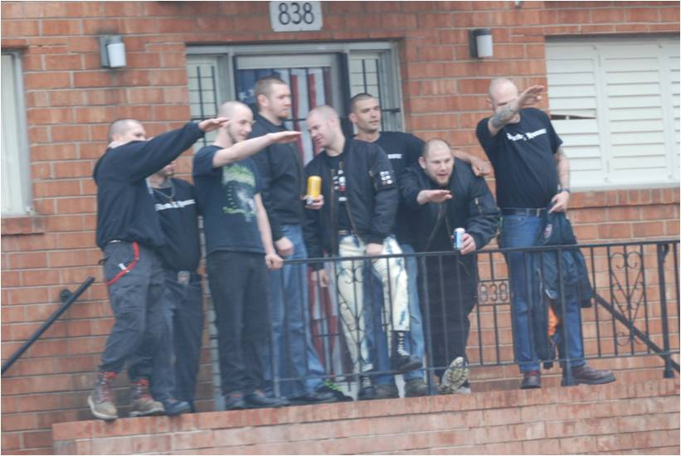
White Supremacists
Growing in the US, primarily due to Obama’s presidency and the illegal immigration issue
Younger, more violent individuals with more radical views

Slide 14
White Supremacists
Militant look, to include Ma-1 bomber jackets and boots
Close-cut hairstyles
Short or bloused pants legs to accentuate boots
Prefer ‘Dr. Marten’ brand black boots
Fred Perry or Ben Sherman clothing

Slide 15
White Supremacists

Slide 16
Websites
www.nsm88.org
www.newsaxon.org
www.resist.com
www.rebware.com
www.hammerskins.net
www.vinlanders.com
www.swa43.com
***Never ever visit sites from your home computer***

Slide 17
White Supremacists Investigation Techniques
Separate/Isolate – Treat as street gang member for officer safety
Photograph
Document and photograph tattoos at every encounter
Record vehicle info
Determine group affiliation

Slide 18
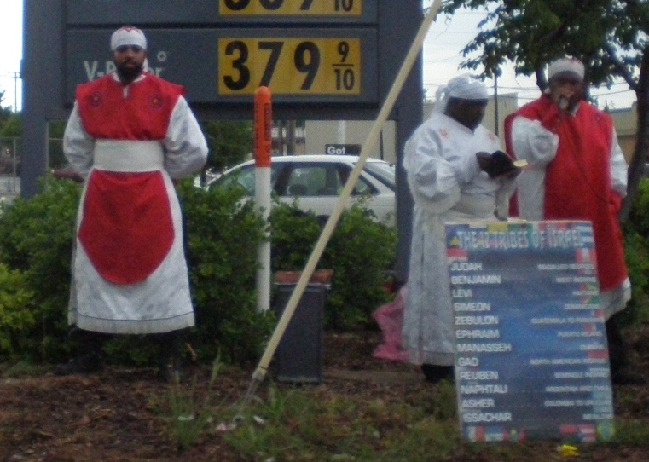
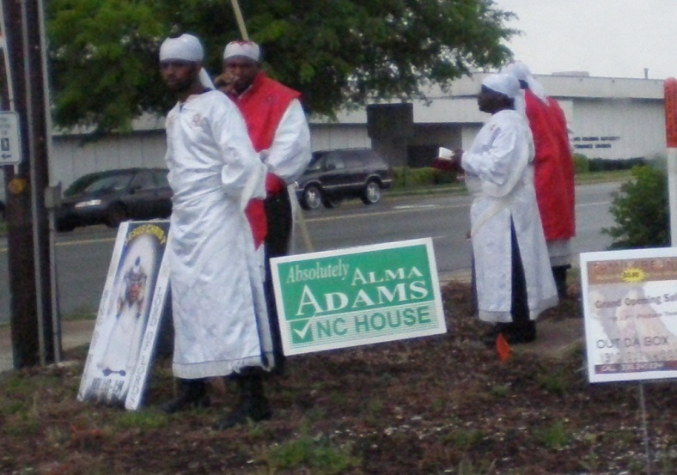
Black Hebrew Israelites
Also known as the Nation of Yahweh and Israelite Church of God and Jesus Christ
Black Separatists
Believe they are the lost nation of Israel and were robbed of their culture and heritage by centuries of white domination

Slide 19
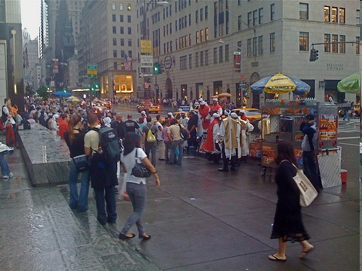
Black Hebrew Israelites
Believe that Yahweh Ben Yahweh is the son of God and his mission is to gather the lost sheep of Israel (the black race) and establish a society and government based on the laws of God
Blacks are the true Jews
God and Jesus are black
New York City

Slide 20
Black Hebrew Israelites
They assert that Negroes, and Indians of North America, Central America, South America, and the Caribbean are all descended from the twelve tribes of Israel
Most reject Judaism and tend to reject Jewish conversion
Most Black Hebrew Israelites are neither overtly racist or anti-Semitic,
but there are militant
groups that are very
vocal

Slide 21
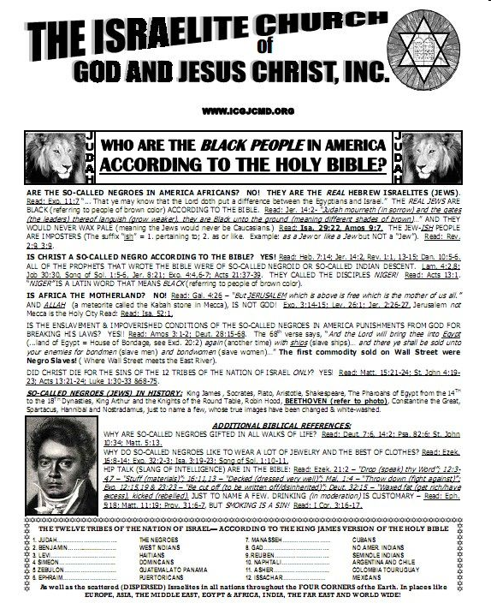
Black Hebrew Israelites
Israelite Church of God and Jesus Christ
Street Preachers/Incite
Black supremacy/Racist
Whites and Jews are forbidden from joining their congregation

Slide 22
Black Hebrew Israelites
Believe whites and Jews are descendants of Satan
Members of the Israelite Church of God and Jesus Christ are the most visible
Preach on the streets to get response
Produce television programs called “The Hidden Truth of the Bible”, which airs on public access TV

Slide 23
Black Hebrew Israelites
BHI members often recruit at military installations and penitentiaries
Recruitment efforts rely on the emphasis of racial divide
Some members are anti-law enforcement
“Street preaching” around US has become increasingly hostile
Racial
Anti-government
May incite confrontation and violence

Slide 24
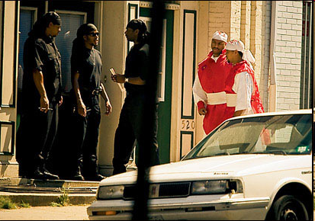
Black Hebrew Israelites
“Street preachers” may have security guards with them
Black headscarves, black t-shirts, black military style pants tucked into combat boots
Often armed with
billy clubs, knives
and guns
SPLC Issue 131

Slide 25
Black Hebrew Israelites
Israelite Church of God and Jesus Christ
http://www.theholyconceptionunit.org/
Religious Tolerance
http://www.religioustolerance.org/bhi.htm
Israelite Heritage
http://www.hebrewisraelites.org/

Slide 26
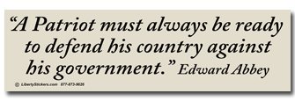
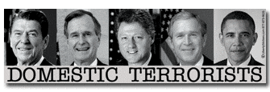
Anti-Government Extremists

Slide 27
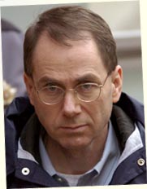
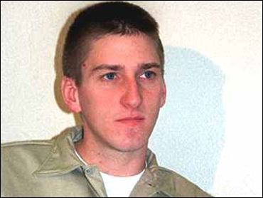
Anti-Government Extremists
“Patriot” Movement
Extreme right-wing beliefs
Some groups considered domestic terrorists

Slide 28
Anti-Government Extremists
Extremists fond of William Pierce’s writings: The Turner Diaries and Hunter
The Turner Diaries is a playbook/recipe book for homegrown extremists
April 19 and 20 are significant dates for U.S. law enforcement:
4/19/93 – Waco
4/19/95 – OK City
4/20/99 – Columbine
4/20 – Hitler’s birthday
Literature to be aware of

Slide 29
Anti-Government Extremists
Close association with
militia groups but not an exclusive connection
Tax Protesters
May be more likely to possess/sell firearms
Anti-Government beliefs may lead to Violence

Slide 30
Anti-Government Extremists
Triggers:
Money
Health Care Legislation
Social Welfare
Taxes/IRS
Gun Control*
Land Rights Issues*

Slide 31
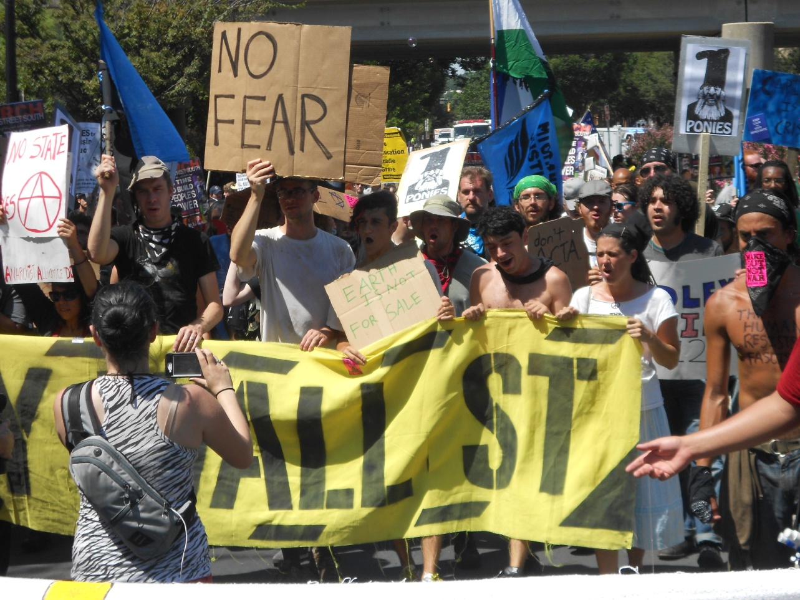
Anarchists
Mostly young, college-aged
Believe in the absence of government and are often anti-capitalist and “anti-corporate”
Some tied to the Occupy Movement which spread
nationwide in late 2011
and 2012
College campuses and liberal enclaves

Slide 32
ANARCHY
The absence of government, authority or order
The desire to live in a “utopian” society of individuals who want freedom without restriction
Proponents of this theory are called “anarchists”
Anarchism: can be viewed as a
political philosophy

Slide 33
HISTORY IN THE U.S.
Organized labor and the demand for an 8 hour workday
Haymarket Affair (Chicago, IL)
The Federation of Organized Trades and Labor Unions sets May 1, 1886 as the beginning of the 8 hour workday standard
Unions across the U.S. begin to strike to show support
Anarchists stage a rally in Haymarket Square

Slide 34
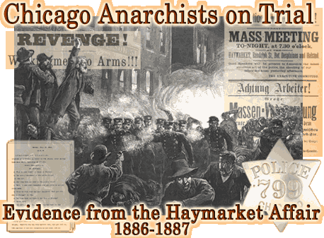
HAYMARKET AFFAIR
7 police officers, 4 civilians killed
Over 100 civilians injured
8 anarchist leaders tried for inciting the riots
4 executed
3 jailed
1 suicide
What does any of this have to do with today?

Slide 35
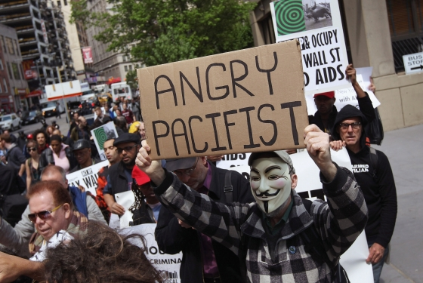
MAY DAY
May 1st
Also called International Workers’ Day
What is it really?
A set day every year to meet as a group and destroy property
Violent protests in
Seattle, Oakland,
San Francisco, NYC
V

Slide 36
ANARCHIST IDENTIFICATION
Anarchy is order
Anarchy and solidarity
Typically spray painted or written in marker

Slide 37
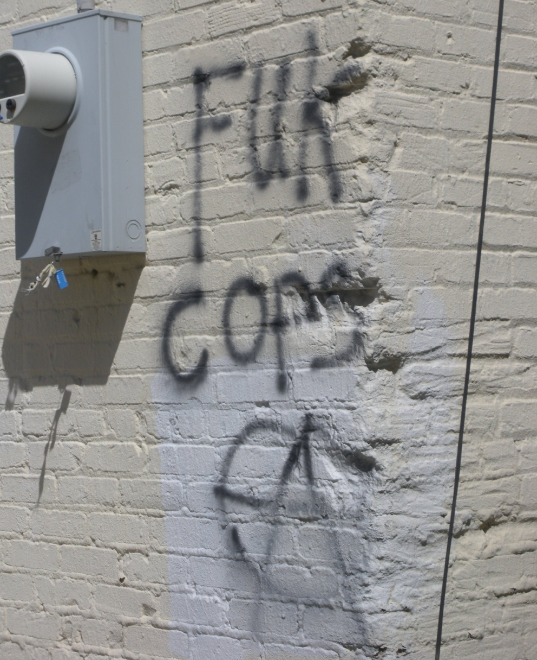
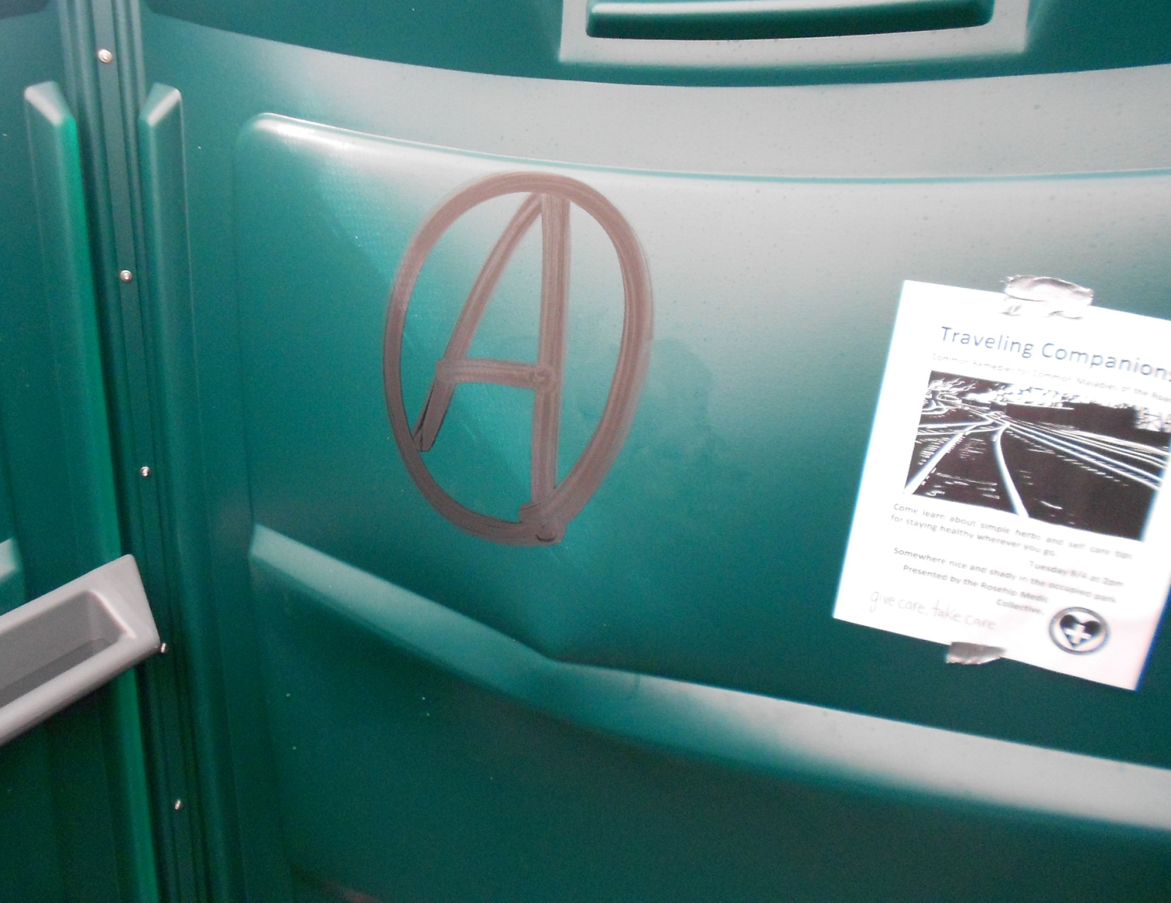
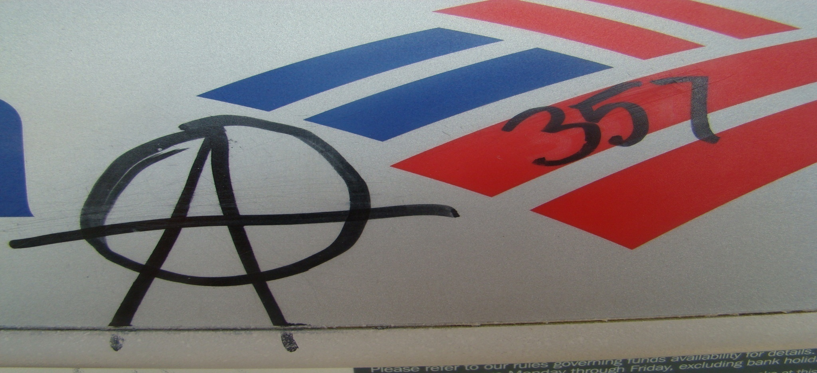
Anarchy Symbology
Anarchist graffiti found downtown Greensboro August 2009 during protest against NSM

Slide 38
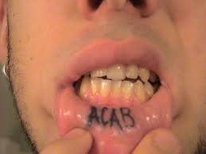
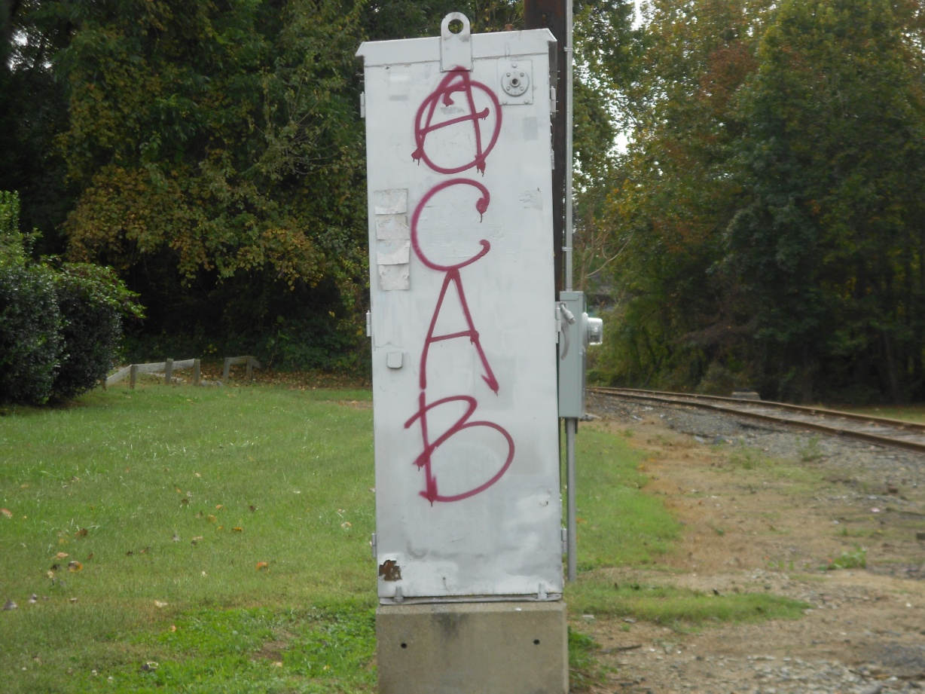
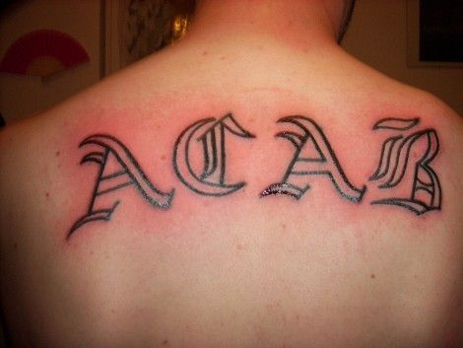
ACAB
All Cops Are Bastards

Slide 39
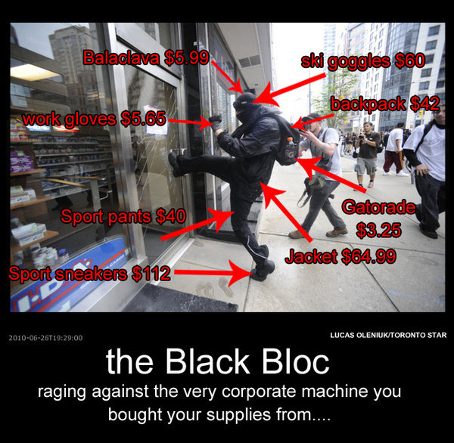
BLACK BLOC
It isn’t a group or movement, it’s a tactic-
the wearing of
all black-to include
face masks,
bandanas, hats,
gloves-with the
hope of appearing
as one unified mass

Slide 40
Goal is to monitor police activity while looking for police misconduct and police brutality
Very aggressive and confrontational
Team with the October 22nd Coalition
V

Slide 41
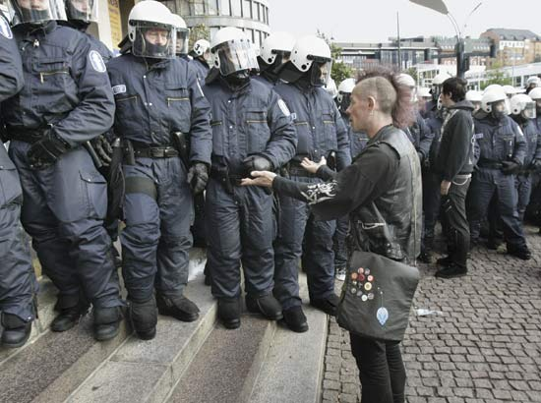
DEALING WITH ANARCHISTS
YOU WILL BE RECORDED!
They will be very vocal/confrontational
They are often very articulate
They will know the law, especially search and seizure
They will try to bait you
YOU WILL BE RECORDED!

