Slide 1
Sovereign Citizens Overview
A Quick-Reference Resource for Law Enforcement

Slide 2
Sovereign Ideology
Anarchist ideology
Adherents differentiate between a “State Citizen” and a “14th Amendment Corporate Citizen”
Believe that they were fraudulently incorporated into the “Corporation” with passage of the 14th Amendment
Do not recognize law enforcement authority or jurisdiction

Slide 3
Sovereign Citizen Buzzwords/Phrases
“Indigenous”
“El-Bey”
“Sovereign”
“De Facto Government”
“Where is your oath of office?”
“Domicile”
Uniform Commercial Code (UCC)
“Without Prejudice”
“Travelling in a commercial/Private capacity”
“Who is the victim?”
“Non-resident alien”
“Aboriginal”
“Conveyance”
“Strawman”
“Vessel”

Slide 4
Moorish Nation
Moorish Science Temple of America was founded in Newark, NJ in 1913 by B. Timothy Drew (Noble Ali)
Uses Religion to mask illegal activity
Ideology based on the “five pillars”
Love
Truth
Peace
Freedom
Justice
Beauty (Just added as a 6th Pillar) — assists with recruiting in correctional institutions based on street gang allegiance

Slide 5
Moorish Nation
Element of Islamic beliefs
Similar sovereign criminal tactics
Mortgage Schemes, False Liens, False Documentation
Mu’ur, Moorish Nation, United Mawshakh Nation of Nuurs, The United Nuwaubian Nation of Moors (U.N.N.M.), and the Washitaw Nation
www.moorishrepublic.com
www.themoorishsciencetempleofamerica.org

Slide 6
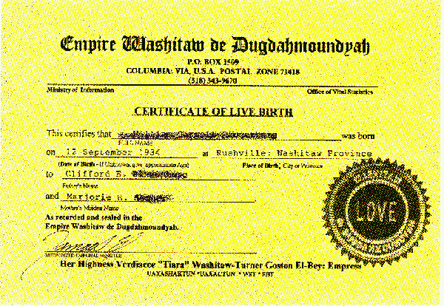
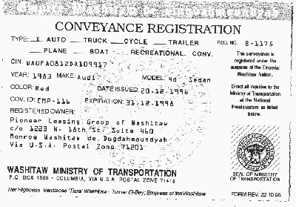
Washitaw Nation
Predominantly black members, but not exclusively
Claim to occupy United Nations Indigenous Peoples Seat #215
Create and utilize fraudulent birth certificates, IDs, vehicle registrations
Heavily involved in fraud schemes
Will initiate lawsuits and liens against Government Officials as form of “Paper Terrorism”

Slide 7
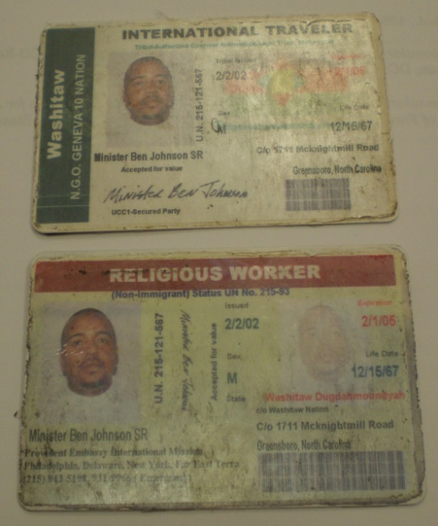
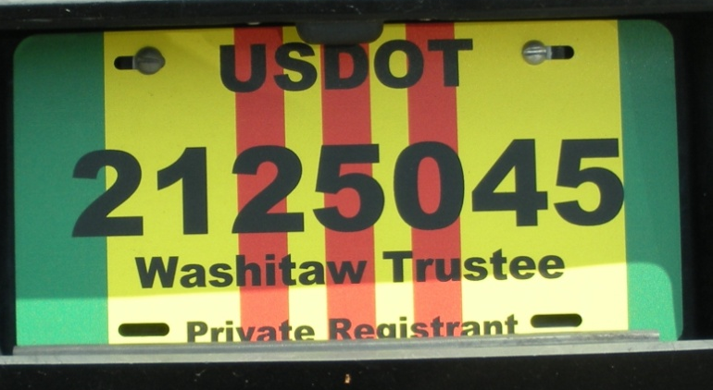
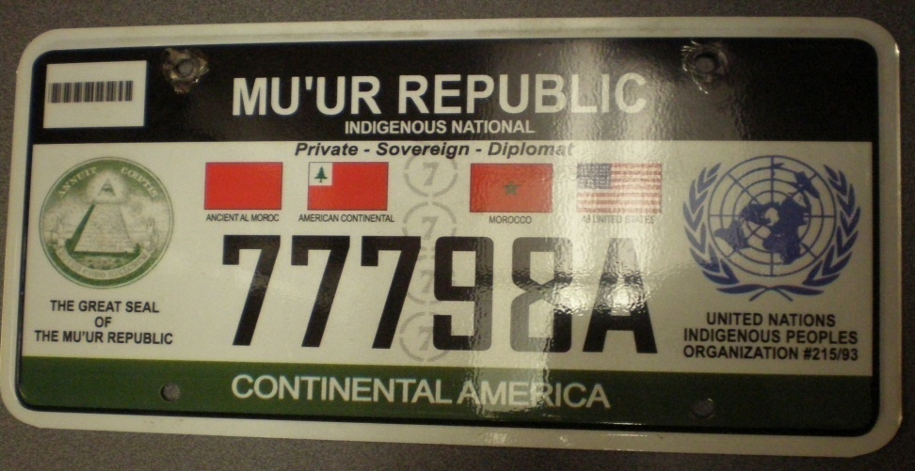
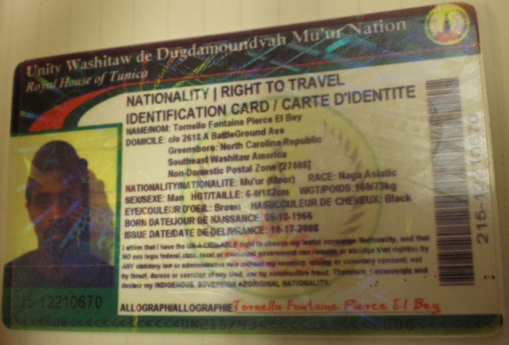
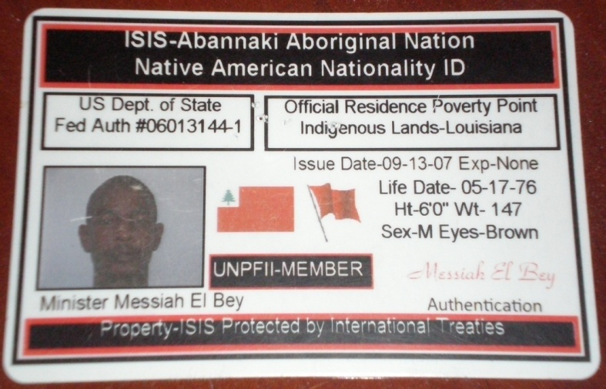
Washitaw Nation

Slide 8
County Rangers
Loosely organized in all 50 states, with a few highly organized exceptions
Predominately white members
Groups and Individuals will challenge legitimate government and LEO authority
Believe that they are the “True Law Enforcement Authority”
Organized groups often announce members court dates online in efforts to bully or overwhelm court officials
Will attempt to overwhelm and confuse officers during stops

Slide 9
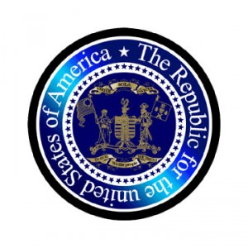
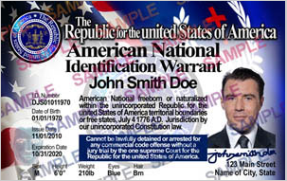
Republic For the united States of America (RuSA)
True “De Jure” government based on the “original” Constitution
United States became an illegal corporation in 1871
14th Amendment was government trickery
Representation in all 50 States and works closely with National Liberty Alliance
Initiates “Common Law Grand Juries” to target government officials and law enforcement
www.republicoftheunitedstates.org/

Slide 10
Traffic Stops
Will roll down the window an inch, if at all
Will ask for “Oath of Office”
Will require you to fill out a “Public Servant Questionnaire”
Will ask “Who was harmed?” or “Who’s the victim?”
Will claim they are “under duress”
Overall non-compliance and intimidation

Slide 11
Police Encounters
Utilize extreme officer safety
Do not engage in debate; you will be recorded
Verify identity
Prohibit cell phone use during encounter (History of calling for County Ranger Assistance)
Seize and document any false I.D. cards or Registration plates
Book under ‘John/Jane Doe’ if no valid I.D.
Notify Intelligence Unit or Equivalent
Don’t be intimidated

Slide 12
Videos
http://www.youtube.com/watch?v=yzjv20sC5CY
http://www.youtube.com/watch?v=d_y-gLm9Hrw
http://www.youtube.com/watch?v=2F_pY47hE5U
http://www.youtube.com/watch?v=RfVbiefMdNU

