Slide 1
Developing Your CMP
School Crisis, Emergency Management and Medical Emergency Response Plan
Notes:
This training is intended to assist school and division leadership as they complete the DCJS School Crisis, Emergency Management and Medical Emergency Response Plan template, also known as the CMP Template.
This template was developed as a resource by the Virginia Center for School and Campus Safety in alignment with Code of Virginia § 9.1-184.D to serve as recommended effective processes and procedures that align with state code and industry best practices. Unless otherwise noted as a requirement under the Code of Virginia, suggested actions should be tailored to align with local and regional emergency management plans and customized to fit school-specific needs.

Slide 2

Unit 3: AFTER
Important Considerations After a Crisis
Notes:
This section of the CMP template training covers the federally recognized phase of emergency management that take place after an emergency occurs: recovery.
Throughout the training there will be items covered that are specific to the division-level plan only. Those slides are indicated by the DCJS seal in the bottom right-hand corner as seen above. While different information is needed to complete each plan, it is important that individuals responsible for plan completion understand the vertical alignment that exists between the school and division-level plans.
Unit 3 Handouts:
3.70 Reunification Site Staffing Chart
3.80 Essential Department Functions list

Slide 3
Module 7
Reunification
Notes:
The After module of this training covers items that take place in the immediate aftermath of a crisis or emergency as the school or division works to return to normal daily operations as quickly as possible.

Slide 4
Planning for Reunification
Can occur on-site or off-site
May serve as host school for Reunification
Information will be provided to parents/guardians as available
Notes:
Reunification can occur on-site if the emergency allows. In that case, you may just need to alter your regular pick-up process by identifying alternate locations that can serve as part of the reunification process. Regular dismissal processes should not be used in these situations as maintaining student accountability is crucial in an emergency.
There may be times that your school is called upon to host a reunification site for another school. In these instances, normal dismissal processes may be adjusted to accommodate the influx of parents and students, or an early dismissal may be appropriate to clear the site before the impacted school arrives. In those instances, we want to have mapped out where arriving students and parents will be reunified so as not to conflict with your own process.
If an off-site reunification is needed, information should be posted at the entry point to the school property and/or a staff member assigned to distribute information about where students have been transported. Information will also be sent out by the Division-level communications team giving instructions to parents/guardians about where to go.

Slide 5




In an emergency…
Notes:
Before we jump into planning for reunification, we want to pause for a quick review of the process. There are a lot of moving parts immediately following an emergency but with the occasional exception:
Cops own the crime
Fire owns the flame
Paramedics own the patient
Schools own the kids

Slide 6
Objectives:
Every student is accounted for
Every staff member is accounted for
Every visitor is accounted for
Every student is reunited with their parent / guardian
Notes:
During the reunification process, our objectives are:
Every student is accounted for
Every staff member is accounted for
Every visitor is accounted for
Every student is reunited with their parent / guardian
Sometimes this will happen on the impacted site if it possible to safely facilitate without being in the way of first responders. If the site is unsafe in any way, or there are still ongoing rescue or recovery operations, we will transport students and staff to a different school or a non-division facility. As we discussed in the During section, MOUs should be in place with any non-division owned property that clearly outlines what each team will provide to make the reunification process run smoothly.

Slide 7
Reunification Process
Division
Students / Staff
Parents
Notes:
Let’s walk through each portion of the process. We’re going to bounce between the Emergency Operations Center, the Impacted Site, and the Reunification Site to demonstrate the moving parts of the reunification process.
First, let’s clarify what each site is.

Slide 8
Division-Level ICS Team
Location: Emergency Operations Center
Directing response actions
Coordinate Reunification site
Communicate with Transportation
Notes:
The EOC will serve as the Central Hub for the incident as it transitions into the reunification process. There will still be activities going on at the impacted site that require oversite and direction, but the bulk of staff attention will shift to setting up and preparing the reunification site before information is sent out to parents about the location. Ideally, division level staff will be responsible for the bulk of the set up and operations of the reunification process, allowing school-level staff to focus on their students.
The EOC will facilitate all information flow – from coordinating transportation, to sending information out to parents or guardians; everything goes through the EOC first. Timing is crucial for controlling traffic flow, protecting information, and providing for a quick process.

Slide 9
School-Level ICS Team
Location: Impacted Site
School where the incident occurred
School Staff fill most of the roles initially
Small team from Division
First Responder presence
Notes:
Depending on the situation, if there was an active attack, high number of injuries, or a lot of damage to the building, the impacted site may be a hard place to be at. There will be a variety of first responders, public officials, and other moving parts. The building ICS team will fill critical roles initially but may be relieved of their duties as first responders or division staff members arrive. There will be: security needs to address; facility needs to address; staff needs to address; student needs to address; and a host of phone calls from parents trying to get any information that they can.
Remember:
Fire owns the Fire
EMS owns the injured
Police owns the crime
School owns the people
Our primary focus is on our staff, students, and visitors.

Slide 10
Select Reunification Site
Division-Level lead; School-Level support
Division controlled facilities when possible
Agreements with outside facilities
Set up is critical
Notes:
The Reunification Site is where the process actually takes place. As soon as the school division knows that the reunification process will be needed a site will be selected depending on the situation and the reunification team will be sent to start setting up and preparing for student arrival and eventually parent arrival.
School staff will play a supporting role in the Reunification process because they are the ones who know their students and their families as they have daily interactions with them. It will be a long process; but we want the system to be set up correctly so that it’s done right, and the process can run smoothly

Slide 11
Immediate Response
Location: Impacted Site
Activate the response protocol needed
Contact Division
Gather at on-site meeting location
Notes:
When an emergency occurs, response protocols are initiated to address the immediate situation. Once the emergency has been addressed or it is safe to do so, the person designated on the building ICS chart as incident commander should be in communication with the Division level staff to pass along details about the situation so that the EOC can determine the best course of action regarding reunification.
Depending on the situation, there are multiple gathering places identified at each building that students, staff and visitors can gather at to wait for transportation to arrive.

Slide 12
Preparing for Reunification
Location: Emergency Operations Center
On-site or off-site reunification
Dispatch transportation
Activate Reunification Team
Notes:
At the EOC, a decision will be made about reunification, including the location that will be used for the process.
If needed, transportation will be dispatched from the EOC and communicated to the impacted site team to prepare for loading.
The reunification team will be activated to begin setting up the reunification site.

Slide 13
Preparing for Transport
Location: Impacted Site
Account for students, staff, visitors
Transportation arrives
Reunification process begins
Notes:
At the impacted site, once everyone has moved to the meeting location students, staff and visitors should be accounted for to ensure no one got misplaced when preparing for transportation. As buses are loaded, a copy of the full list of students, staff and visitors should be sent on the first bus so that it arrives at the reunification site with the first wave of people. Once there, a Student Accountant will be responsible for making sure everyone on that list arrives at the reunification location.

Slide 14
Setup and Preparation
Location: Reunification Site
Drive through or walk-up process
Determine student holding location
Determine family support location
Set up check-in / ID check stations
Establish traffic flow with cones / signs
Station officers around site for security / traffic assistance
Notes:
As the process gets going, the reunification team decide whether the reunification site and the situation are better suited for a drive through process or a walk-up process. For instance, if there is sufficient parking available, but not a lot of space for a vehicle line to form, it would be better to have parents park and come inside the building to pick up their student. However, if there is not room inside to allow for potential medical treatment and privacy for counseling services to take place separate from where are students are being kept, parents should not be allowed in the building. Additionally, a drive through process might be more appropriate for older students who are able to recognize vehicles.
Once that determination is made, set up can begin. Every adult who arrives to pick up a student will need to have their identification verified to ensure that they are legally allowed to pick up the student. Student safety is the priority in this process and ensuring that they go home with the right adult. A traffic pattern should be established with clear signs and cones to direct drivers, especially if a drive through process is being used. Whenever possible, additional officers or security guards should be stationed around the main entrance and exit to help control traffic flow in and out, with students as they arrive and, in the student, holding area, and around the check-in stations. Emotions will be running high and there will be a lot of stress throughout the process; people do not always handle that well.

Slide 15
Reunification Team Assignments
Checkers
Reunifiers
Accountants
Class Leaders
Greeters, Interpreters, Floaters
Notes:
The reunification team is primarily made of division level staff directing the process with school level staff providing support as they are available to do so.
Checkers are there to verify ID and custody – these staff members should be someone who is familiar with students/parents, has training in the visitor management system the division uses or has access to student record information. Your front office staff members are ideal candidates to assist with this part of the process.
Reunifiers are runners to help locate students and bring them to their parent or guardian. A critical part of the Reunifiers job is asking each student “Do you feel safe leaving with this person?” before bringing them to the adult.
Accountants: There should be at least 2 accountants – one is to verify that each student is accounted for and has arrived at the reunification site; the second is to verify when each student leaves, who they left with, and document it on their student check-out card. These individuals need to be very detail-oriented and able to multi-task as getting families out the door is the last step in the process. More than one individual can be used at each point, but communication will be critical to ensure all students are accounted for the entire time; sometimes too many people in this role muddies the water.
Class Leaders: teachers should be assigned to stay with their class during the entire process. If a teacher is injured, asked to remain at the impacted site as a witness or needed in another role, buddy teachers or available classroom aides can step to assist with that class.
Without overcrowding the area, you can also assign division-level staff members to serve as greeters, interpreters or floaters to direct people through the process, pass out reunification cards, answer questions, etc.
One note is to refrain from assigning administrators to a position – if they are not asked to stay at the impacted site, we want them to be flexible and able to move around. They are the face of the campus and students and parents will want to see them.
Handout:
3.70 Reunification Staffing Chart

Slide 16
Parents
Notification from Communication Department
  Incident Information
  Next Steps
Reunification Instructions
  When and Where
  Bring ID
Notes:
By the time we are ready to move students, parents will have been notified of the situation and given instructions on where to go, what to bring, and what to expect during the process. If possible, a school staff member should remain at the impacted site, near the main entrance, to pass along printed copies of the same information for any parents who show up on site.

Slide 17
Notes:
When parents arrive, at the reunification site, they will be given a card to fill out. The above picture is what the Standard Reunification Method card looks like; your division may have their own way of gathering the same information. There are also digital platforms to help facilitate the process.
There should be on card per student completed to provide for complete accountability of every student during the process. At the end of the day, these will serve as the record of who picked up each student, at what time, and what staff member verified the pickup.

Slide 18
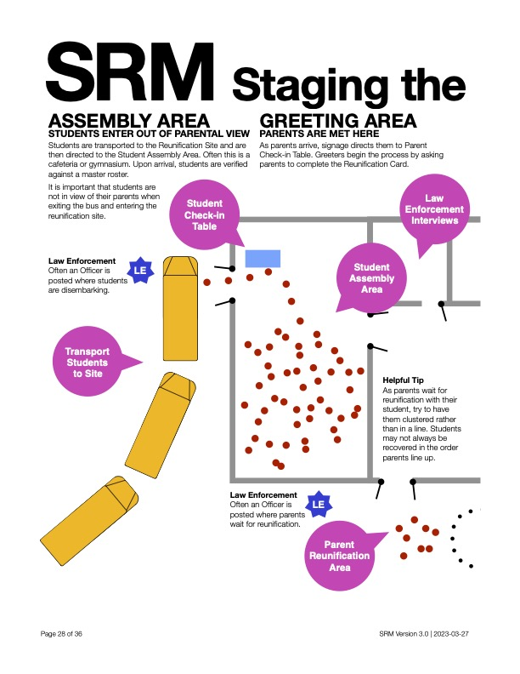
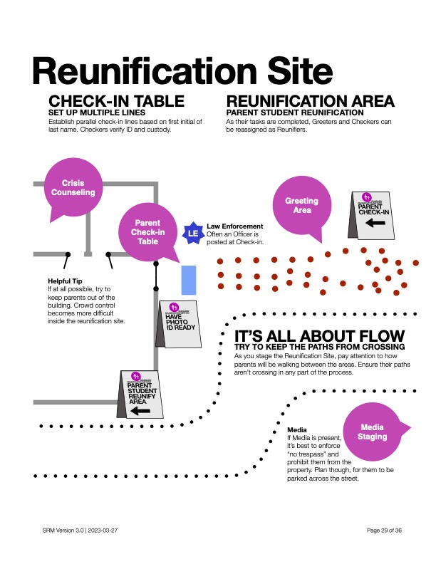
Notes:
Using these images from the I Love U Guys Foundation: SRM Operational Guidance v3 manual, here is an overview of the setup and process.
Students and parents should arrive on opposite sides of the building whenever possible; if that is not an option, parents should be held off-property until all students arrive and are safely inside.
Students are moved to the assembly area and parents enter the check-in area to begin their side of the process.
Separate spaces should be allocated for law enforcement interviews and crisis counseling teams to meet with families when needed.

Slide 19
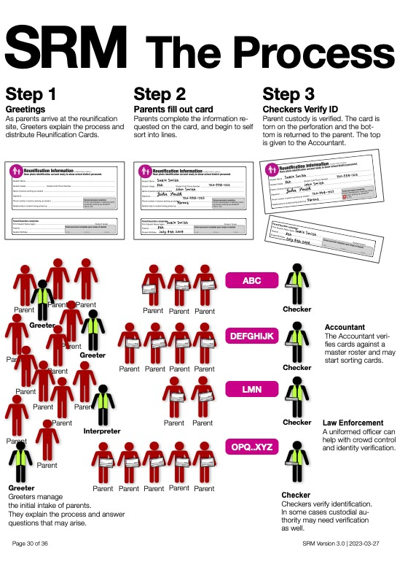
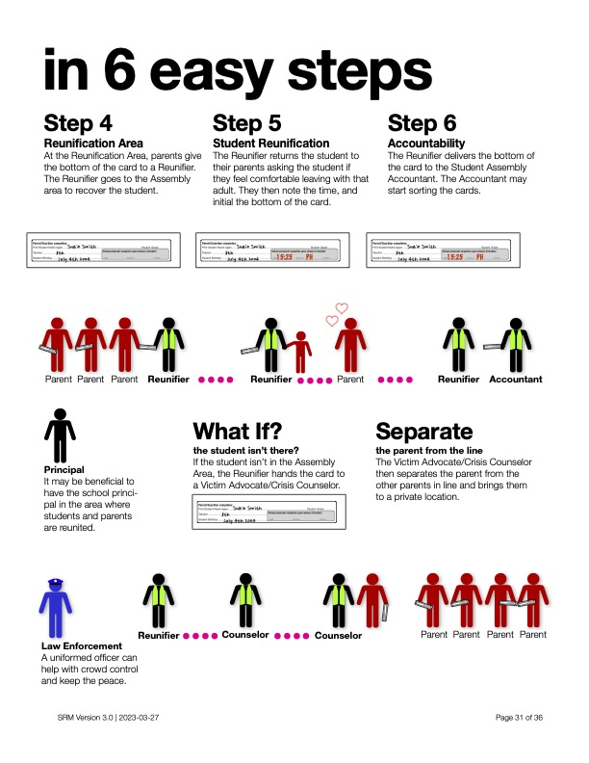
Notes:
Once everything is set up and ready, parents arrive and complete the card for each student. Their ID is verified and the accountant confirms that the student(s) are onsite.
If the student is not onsite, the parent/guardian is taken to the side to speak with law enforcement or a member of the crisis counseling team to provide information about where their student is (transported to local hospital, etc.).
If the student is onsite, the Reunifier locates the student, asks them if they feel safe leaving with the adult, and then makes the connection. The adult and student student leave and the second student accountant marks that student as having completed the process.

Slide 20
Reunification Planning
Division Level:
  Set up team
  Reunification team supervisors
  Transportation needs
  Locations
School Level:
  Reunification team support
Notes:
Now that we’ve walked through the process and site needs, here are the things that need to be planned for in the CMP template.
We would encourage you to take the full SRM training through the I Love U Guys Foundation and make use of the detailed job aides and checklists that they have on their website.

Slide 21
Module 8
Recovery
Notes:
The last section of the After unit covers items that will need to be addressed in order to move the division or school back toward normal daily operations.
A lot of these actions are primarily conducted at the school-level but developing the process and procedures may require input or feedback from division-level staff members.

Slide 22
Purpose, Goals, Focus
Short Term
Long Term
Incident Reporting
Memorial / Anniversary Remembrance
Notes:
As your team begins moving toward resuming daily operations, you will need to divide your attention between short term actions, long term goals, incident reporting, and preparing for any memorials as well as anniversary or remembrance events that will come down the line.
Short term actions include identifying facility needs, identifying academic priorities to resume learning, providing for student and staff emotional support, and taking account of inventory needs.
Long term include items such as building repairs, financial reimbursement, state reporting, and replacement of lost or damaged items.
Reports may need to be submitted to varying agencies and the local, state and national level depending on the situation and needs identified after the incident concludes.
Additionally, the school or division will need to make decisions on what level of support and resources they allocate toward memorial events, remembrance plaques, etc.

Slide 23
Counseling / Support
Trauma-Informed strategies
General or Group counseling
Referrals to outside resources
Supporting students experiencing homelessness or DSS placement
Standardized process to ensure continuity of services
Notes:
When considering counseling and staff or student support needs, schools should have a triage process in place for determining who would benefit from group services versus the need for individual services or even referral to outside resources if the need is beyond the scope of what school staff can provide. Care and attention should also be provided to any students who require extra services if the campus is displaced for any length of time, including students experiencing homelessness or those in DSS care. A process should be established to ensure that students who were receiving services prior to the incident continue to receive that care.

Slide 24
Facilities and Transportation
Building needs
  Repair
  Replacement
  System records
Transportation needs
  Status of bus fleet and reserves
  Road issues in the area
  Alternate pick up/drop off points
Notes:
When looking at the physical needs of the school or division, consideration should be given to what can be repaired versus what would require a complete replacement to prioritize short- and long-term objectives for recovery. It is also imperative that all system records (fire suppression, burglary alarm, kitchen equipment, etc.) be maintained throughout the entire process to ensure that all systems are functioning properly before they are returned to service.
Transportation staff will need to maintain inventory of all vehicles, what is available for use and what may need to be taken out of services for repair or replacement due to the incident. If the emergency was a natural disaster, they will need to maintain daily road reports to identify potential route changes, or alternate pick up and drop off points until roads are repaired.

Slide 25
Contracts and Agreements
Off-site reunification
Transportation backups
Agency MOUs
  SROs and/or other law enforcement services
  Counseling services
Notes:
When looking at the physical needs of the school or division, consideration should be given to what can be repaired versus what would require a complete replacement to prioritize short- and long-term objectives for recovery. It is also imperative that all system records (fire suppression, burglary alarm, kitchen equipment, etc.) be maintained throughout the entire process to ensure that all systems are functioning properly before they are returned to service.
Transportation staff will need to maintain inventory of all vehicles, what is available for use and what may need to be taken out of services for repair or replacement due to the incident. If the emergency was a natural disaster, they will need to maintain daily road reports to identify potential route changes, or alternate pick up and drop off points until roads are repaired.

Slide 26
Academic Recovery
Accounting for missed days/minutes of instruction
Verify and validate grades/transcripts
Coordinate with state testing agencies
Coordinate with college board testing centers
Secure educational materials or substitutions
Notes:
In addition to physical recovery, academic recovery should begin as soon as possible with teams accounting for missed days or minutes of instruction, verifying the impact on grades and transcripts (especially for graduating seniors), any upcoming state or college testing days that may need to be rescheduled and securing materials that can be utilized as needed until classroom instruction resumes.

Slide 27
Essential Departments and Functions
Human Resources
Business Office
Purchasing Department
Child Nutrition
Health Services
Special Education
Communications
Safety and Security
Technology
Notes:
In addition to physical recovery, academic recovery should begin as soon as possible with teams accounting for missed days or minutes of instruction, verifying the impact on grades and transcripts (especially for graduating seniors), any upcoming state or college testing days that may need to be rescheduled and securing materials that can be utilized as needed until classroom instruction resumes.

Slide 28
Training Opportunities
Online ICS Trainings
Standard Response Protocol
Standard Reunification Method
Notes:
There are also a host of daily operations that exist at the division level that will need to be addressed. If you look at the handout for this module, you will see a checklist of essential departments and functions. This can be modified to fit your specific division needs, but the goal is that each department creates a timeline of essential functions and how quickly those can/should be restored following any major incident. Once each department has completed their section, the division administration team should meet to discuss allocation of resources to ensuring these needs can be met and establishing a division-wide timeline of priorities.
Handout:
3.80 Essential Department Functions list

