Slide 1
Developmental Discipline
Creating Positive Change

Slide 2
Misbehavior
A behavior considered inappropriate for the setting, context, environment
Why do children misbehave?

Slide 3
Purpose of Discipline
Punish, penalize for the sake of enforcing obedience Merriam-Webster
Training a person to obey, abide by rules and standards of behavior Oxford Languages
To fix incorrect behavior Yourdictionary.com

Slide 4
Prevention - Social Emotional Learning
Maurice Elias, a psychology professor at Rutgers University and director of the university’s Social Emotional Learning Lab, describes SEL as the process through which we learn to
recognize and manage emotions
care about others
make good decisions
behave ethically and responsibly
develop positive relationships
avoid negative behaviors.

Slide 5
Prevention – Positive Behavior Supports
To improve quality of life
Exchange maladaptive behavior for more socially acceptable behavior
Non-punitive, systemic

Slide 6
When we discipline, we assume a child . . . . . .
Thinks before acting
Able to plan and organize
Able to understand another person’s point of view
Sees the world as larger than him or herself
Experiences guilt
Believes he or she is competent and capable
Able to manage emotions

Slide 7
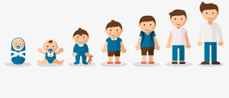
What is missing in social emotional learning and PBS?
Difference between child development and learning
Difference between behavior and volitional choices
Difference between effective functioning versus compliance

Slide 8
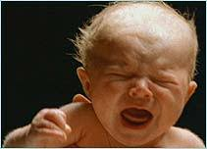
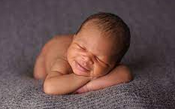
Human Needs Human Drives

Slide 9
Brain Development
Brain stem
Oxygen, nutrition, warmth, comfort, survival

Slide 10
Brain Development
Limbic system
view of the world and of self, memories, hormones
Brain stem

Slide 11
Brain Development
Piaget and Erikson
Sensorimotor /Trust (0 to 2 years old)
Learning to use senses and body
Develops cause and effect and object permanence
Motivation is to avoid punishment – no awareness of right vs. wrong
1
Limbic system
Brain stem

Slide 12
Brain Development
Piaget and Erikson
Pre operational / Initiative (2 to 7 years old)
Egocentric – he or she is the cause of all things that occur, good or bad
Sees only one aspect of a situation (black or white thinking, all or none)
Motivation is to be independent and to seek rewards
No understanding of right or wrong
2
1
Sensorimotor / Trust
Limbic system
Brain stem

Slide 13
Brain Development
Piaget and Erikson
3
Concrete operational / Industry (7 to 11 years old)
Perspective taking, starts to see other people’s views
Motivation is to plan and execute and to be independent
2
1
Pre operational / Initiative
Sensorimotor / Trust
Limbic system
Brain stem

Slide 14
Brain Development
Piaget and Erikson
4
3
Formal operational / Identity and Intimacy (12 years old +)
Problem solving is creative, imaginative and no longer just based on past experiences
Develops metacognition – thinking about one’s own thinking
Leads to the development of morality
2
1
Concrete operational / Industry
Pre operational / Initiative
Sensorimotor / Trust
Limbic system
Brain stem

Slide 15
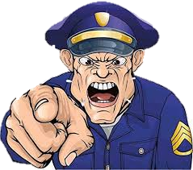
Brain Development
NEEDS MUST BE MET!!

Slide 16
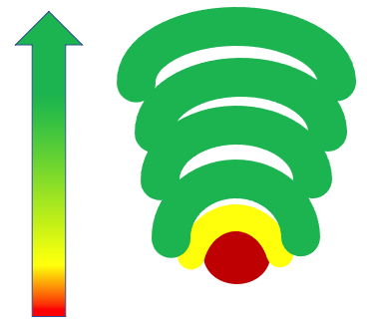
Neurological Needs and Drives
Hopeful
Goal oriented
Empathetic, compassionate
Social and appropriate
Sees self as competent and capable
Experiences belonging
Manageable stress response

Slide 17
Neurological Needs and Drives
Hopeless
Unmotivated
Need to be superior
Protective
SEES SELF AS INCOMPETENET
ISOLATED AND INAPPROPRIATE
UNMANAGEABLE STRESS RESPONSE

Slide 18
Misbehavior
A behavior considered inappropriate for the setting, context, environment
Why do children misbehave?
Unmet neurological needs and developmental delays

Slide 19
Neurological Needs and Drives
Understand the biological imperatives and the intensity of human needs and the power of human drives
Changing the brain is uncomfortable and scary, and at the same time necessary

Slide 20
Understand and Support
Sequential development
Cortical behaviors
Effective functioning

Slide 21
Purpose of Discipline
Punish, penalize for the sake of enforcing obedience Merriam-Webster
Training a person to obey, abide by rules and standards of behavior Oxford Languages
To fix incorrect behavior Yourdictionary.com

Slide 22
Purpose of Discipline
To build within the child the courage to function effectively
To build within the child the courage to be imperfect
Alfred Adler
Rudolph Dreikurs

Slide 23
Purpose of Discipline
Develop motivation to seek the joy inherent in ethical behavior – not
rewards and punishments – Child Development Project
Organize themselves – Canadian Paediatric Society

Slide 24
What bucket am I filling?
Rosie Mann, RN CCTP
drmann1@comcast.net
717-419-4580

