Slide 1
The Path to Domestic Extremism – and the Road Back to Peer Support and Trauma Recovery
Christopher Buckley, Peer Support Mentor
Certified Peer Specialist in Mental Health (CPS-MH), Forensic Peer Mentor (FPM)

Slide 2
Introduction
Peer Support Mentor, Parents for Peace
Father, Husband, and Veteran

Slide 3
Recipe for Disaster
Childhood Trauma
Terrorist Attacks on 9/11
Military Service
Substance Abuse

Slide 4
How did I get recruited into the KKK?

Slide 5
How did I recruit others?

Slide 6
With the help of people I consider family and friends, I successfully left the KKK in 2016.

Slide 7
Parents for Peace
Founded in 2015 by Melvin Bledsoe and Monica Holley
Parents for Peace (P4P) is a public health 501(C)(3) non-profit empowering intimate bystanders (i.e., families and friends) and communities to prevent and manage radicalization, violence, and extremism.

Slide 8
What does Parents for Peace do?

Slide 9
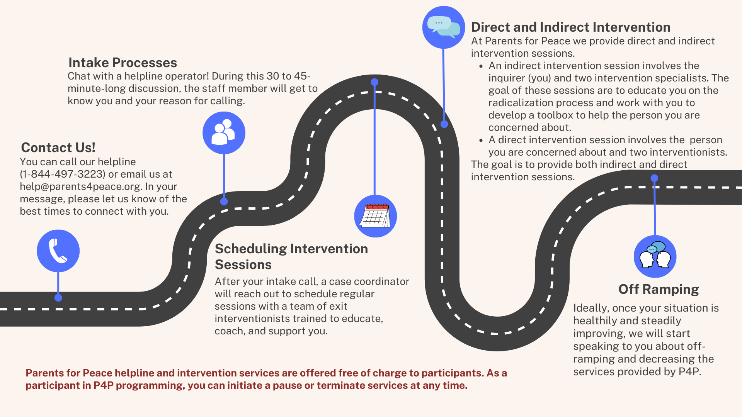

Slide 10
What do I do at Parents for Peace?
Started by consulting on cases where white supremacy ideology was present, giving feedback to the interventionist
Now I work with our intervention teams to support individuals of concern and their families. I am also developing our Trauma Recovery Program (TRP)

Slide 11
Certifications and Continuing Education
Peer Support Training
Certified Peer Specialist in Mental Health (CPS-MH)
Forensic Peer Mentor (FPM)
Working toward National Peer Support Certification
Certificate in Traumatic Stress Studies from the Trauma Research Foundation developed and administered by Dr. Bessel van der Kolk
Topics included: type of trauma, how trauma affects the brain, types of treatment available
UPCOMING: Peer Support Specialist Training. In coordination with a team at Georgia State, we are developing a peer support curriculum for former extremists with lived recovery experience.

Slide 12
Trauma Recovery Program (TRP)
Deradicalization felt like a detox.
List of risk factors for substance abuse and extremist recruitment were essentially the same
Research shows that extremist groups target individuals with trauma and veterans.
Dr. James Kimmel (Yale) finds that revenge cravings that arise out of grievances and perceived victimization can be addicting. In other words, hate and revenge can be addicting.
Could we build resilience to extremism by addressing veteran's trauma? Could we do this using substance abuse recovery models (i.e. 12 steps)?

Slide 13
Trauma Recovery Program (TRP)
Trauma recovery program helps returning veterans deal with the trauma from their military service, making them more resilient to issues with substance abuse, domestic abuse, extremism, etc.
Law Enforcement adaptation made to assist with job related trauma. This adaptation was run as a pilot in Aurora, CO, in collaboration with Sammie Wicks
"The piloted program fostered community between the participants, facilitated introspection, and through conversation, created an environment where participants were introduced to new stress management and coping techniques. We’re excited about the continued development of the program and look forward to seeing the final product." - Aurora Police Department

Slide 14
Trauma Recovery Program (TRP)
Currently, TRP is undergoing further development in collaboration with Dr. Colby Rogers, Clinical Manager at Sturm Center (Denver University).
Learning from the pilot in Aurora, we are building this out and developing relationships with different law enforcement agencies to schedule future pilots.

Slide 15
Thank you!
If you or someone you know is struggling with extremism, please call us at (844) 497-3223 or email us at help@parents4peace.org

Slide 16
What does an intervention look like?
Getting to know the caller (intimate bystander or individual of concern)
Educate the caller about extremism and why people look to join extremism movements
Provide practical advice and support to help with behavioral and social disengagement of either themselves or a loved one

